Slide 1



ESSC Guided Pathway Advisors
Smita Duorah
Lower division pathways for BME/ChE/MatE
Ahmed Banafa
Lower division pathways for EE/CMPE/SE/GE
Jack Warecki
Lower division pathways for ME/CEE/AE/IDE

Slide 2
What are some major factors that influence the development of 18 to 24 year olds?
What affects their well-being, their happiness and health?
(Don’t just think of yourself)

Slide 3
Area E and ENGR 10 Assignments
Factors in College Student Development

Slide 4
SJSU General Education
Area A – Basic Skills (9 units)
Area B – Science & Math (9 units)
Area C – Humanities & Arts (9 units)
Area D – Social Sciences (9 units)
Area E – Human Understanding & Development
(3 units)
SJSU Studies (12 units)

Slide 5
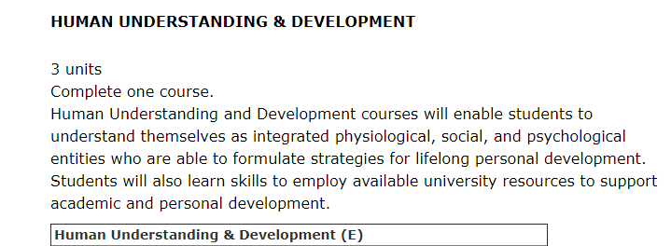
Area E – SJSU General Education
http://info.sjsu.edu/web-dbgen/narr/static/schedules/general-education-corege.html

Slide 6
Course Goals – GE Area E
At the end of this course students will be able to identify the:
factors and their interrelation on human development
and recognize how:
Those factors and their interrelation influence a student’s well-being
A student’s well-being is affected by the university’s academic and social systems
To use appropriate social skills to enhance learning and develop positive interpersonal relationships
Psychological | (Cognitive/Emotional)
Social | Physiological

Slide 7
Area E - Student Learning Objectives
SLO | How Achieved
Recognize the psychological, social, and physiological factors that influence emerging adults’ well-being Recognize the interrelation of the psychological, social, and physiological factors on emerging adults’ development across the lifespan Use appropriate social skills to enhance learning and develop positive interpersonal relationships with diverse groups and individuals | Research Paper Research Paper and Design Across Life Span Paper Teamwork in Lab

Slide 8
Area E - Student Learning Objectives
SLO | How Achieved
Recognize how emerging adults’ well-being is affected by the university’s academic and social systems, and how they can facilitate their development within the University environment | Personal Reflections

Slide 9
How Area E is Achieved .....
Research Paper
  1000-1500 word research paper
  Factors influencing Emerging Adults
Teamwork
  Work with diverse groups and individuals in Labs
Reflections
  Develop strategies for one’s well-being
  Explore university resources
Robot
Paper
  Paper recognizing factors on development across the lifespan from the perspective of designing a robot

Slide 10
How Old Are You?
A) Younger than 18
B) 18-20
C) 21-25
D) 25-30
E) Older than 30

Slide 11
Are you an adult?
Do you feel you have reached adulthood?
Yes
No
In some ways yes, in some ways no

Slide 12
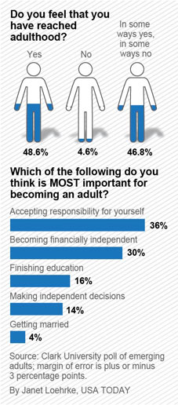
What 18 to 25 year olds think…

Slide 13
What makes you an adult?
Which of the following do you think is most important for becoming an adult?
Making independent decisions
Accepting responsibility for yourself
Getting Married
Becoming financially independent
Finishing your education
Arnett
Arnett
Arnett

Slide 14
What 18 to 25 year olds think …

Slide 15


Slide 16
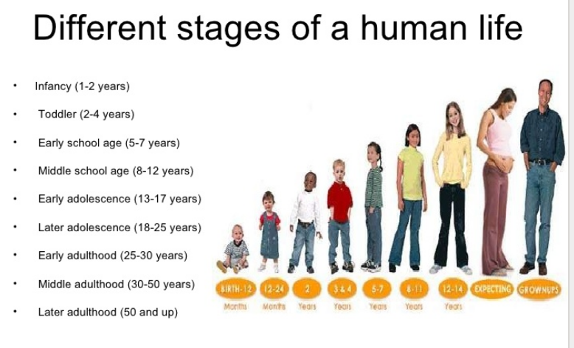
Stages of Human Development

Slide 17
Developmental Periods
Today,
- Live with parents or
- Cohabitate
Children later, and less
Education prolonged
Changing jobs
Peers role model
infancy
In 1970, 21 year old
- Married
New born
Education complete
In long term job
Parents role model
early childhood
middle childhood
adolescence
emerging
adulthood
young adulthood
18-25 years old
adulthood
late adulthood
Arnett’s Model
Adolescence
Emerging
Adulthood
Young
Adulthood
Middle
Adulthood
Late
Adulthood

Slide 18
What are the Characteristics of Emerging Adults?
Exploring identities
Instability (work, romance, residence)
Focusing on self as independent
Believe themselves “between” adolescent & adult
Believe life holds many possibilities
NOT Universal – LOTS of variation

Slide 19
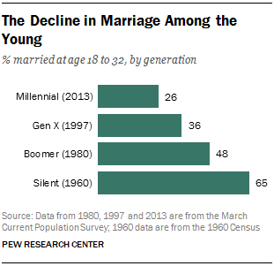

Slide 20
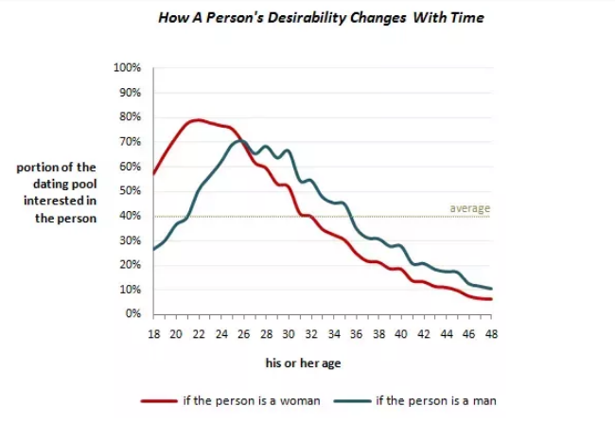
Peak Attractiveness
https://www.quora.com/At-what-age-is-peak-physical-attractiveness-for-women

Slide 21
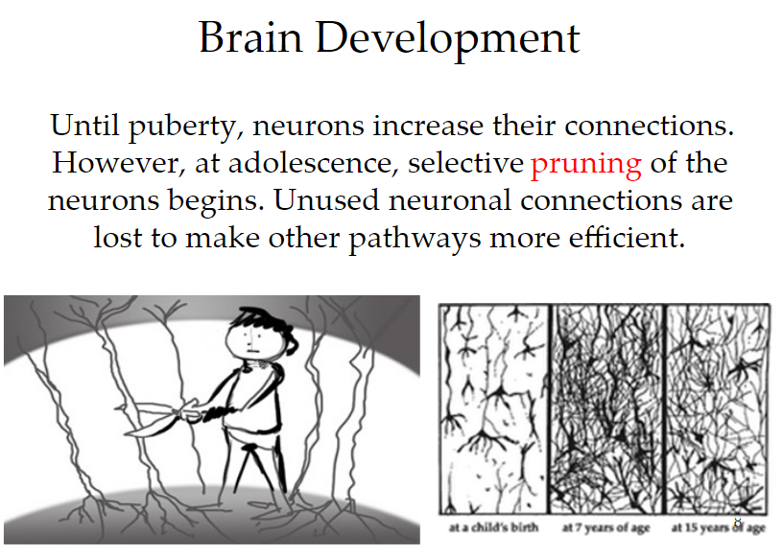

Slide 22
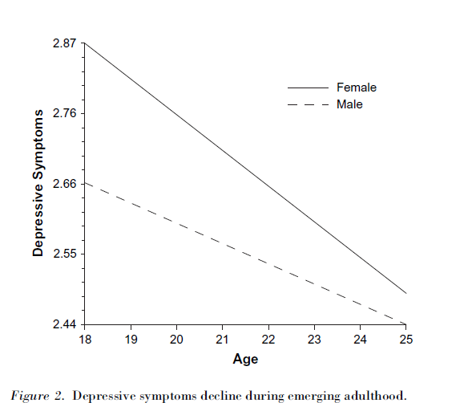
Believe life holds many possibilities
Depressive Symptons Decline
Arnett, J. J. (2007). Emerging adulthood: What is it, and what is it good for?.Child development perspectives, 1(2), 68-73.

Slide 23
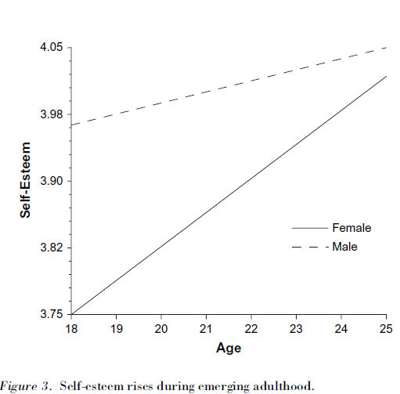
Believe life holds many possibilities
Self-Esteem Rises
Arnett, J. J. (2007). Emerging adulthood: What is it, and what is it good for?.Child development perspectives, 1(2), 68-73.

Slide 24
Area E
Is a General Education Requirement for students in:?
The College of Engineering only
All Colleges at SJSU
Only for Engr 10 students

Slide 25
Key Areas of Human Development
  The Mind
  Emotions
  Social
  Physical
Across All Stages of Human Development
Notes:
Morality is another one.

Slide 26
Key Areas of Human Development
  Cognitive
  Emotions
  Social
  Physical
Across All Stages of Human Development
Notes:
Morality is another one.

Slide 27
Key Areas of Human Development
  Cognitive
Psychological
  Emotions
  Social
  Physical
Across All Stages of Human Development
Notes:
Morality is another one.

Slide 28
Major Areas of Development
Psychological
(Cognitive)
  Thinking, learning, understanding, gaining knowledge, memory, language, perceiving; ideas; beliefs; attitudes; identity formation; etc.
Psychological
(Emotional)
  Self-esteem; pride; shame; sympathy; empathy; mental health; stress; anxiety; happiness; anger; hopelessness; etc.
Social
  Relationships with family; significant others; peers; classmates; professors; interactions with others; group memberships and activities; cultural relationships; etc.
Physiological
  Health (such as: high blood pressure, high cholesterol, STDs/HIV/AIDS); fitness; nutrition; physical activities; etc.

Slide 29
Key Areas of Human Development
“Domains”
  Psychological
  Social
  Physical
Notes:
Morality is another one. Domains refer to specific aspects of human development in terms of growth and change as it relates to the human lifespan.

Slide 30
Factors That Affect Development
Nature or Nurture
  Psychological
Nature or Nurture
  Social
Nature or Nurture
  Physical

Slide 31
Student Development Paper
Your paper will examine how a specific topic affects 18 to 25 year olds in their psychological, social and physiological development
You must cover the same topic in all three domains
1000-1500 word research paper not including reference list

Slide 32
Factors That Affect Development in
Emerging Adults
Topic
Domain
Depression
  Psychological
What does the research say?
Depression
  Social
What does the research say?
Depression
  Physiological
What does the research say?

Slide 33
Factors That Affect Development in
Emerging Adults
Topic
Domain
Drugs
  Psychological
What does the research say?
Drugs
  Social
What does the research say?
Drugs
  Physiological
What does the research say?

Slide 34
Factors That Affect Development in
Emerging Adults
Topic
Domain
Hooking Up
  Psychological
What does the research say?
Hooking Up
  Social
What does the research say?
Hooking Up
  Physiological
What does the research say?

Slide 35
Factors That Affect Development in
Emerging Adults
Topic
Domain
Anxiety
  Psychological
What does the research say?
Anxiety
  Social
What does the research say?
Anxiety
  Physiological
What does the research say?

Slide 36
Student Development Paper
Assignment Preparation
Watch video by Dr. Maureen Smith
Review Paper Guidelines and Rubric
Review Audio Lectures and Videos
Choose Topic (Examples in Canvas)
Read and Find Peer-Reviewed Articles
Write Outline, Prepare to Review in Lecture
Write Paper and Upload to Canvas
Notes:
Choose

Slide 37
Materials in Canvas
Paper Guidelines
Suggested Topics for the paper
Rubric for Grading Paper
Audio Lectures
Lifespan Development and Area E (21 minutes)
Emerging Adulthood (29 minutes)
General Issues in College Student Development (20 minutes)
College Student Developmental in the Context of Developmental Domains (40 minutes)
Paper-overview and how to find the references (15 minutes)
Quizzes
Emerging Adulthood quiz (due last night)
Take Lifespan Development quiz.
Take the College Student Development quiz

Slide 38
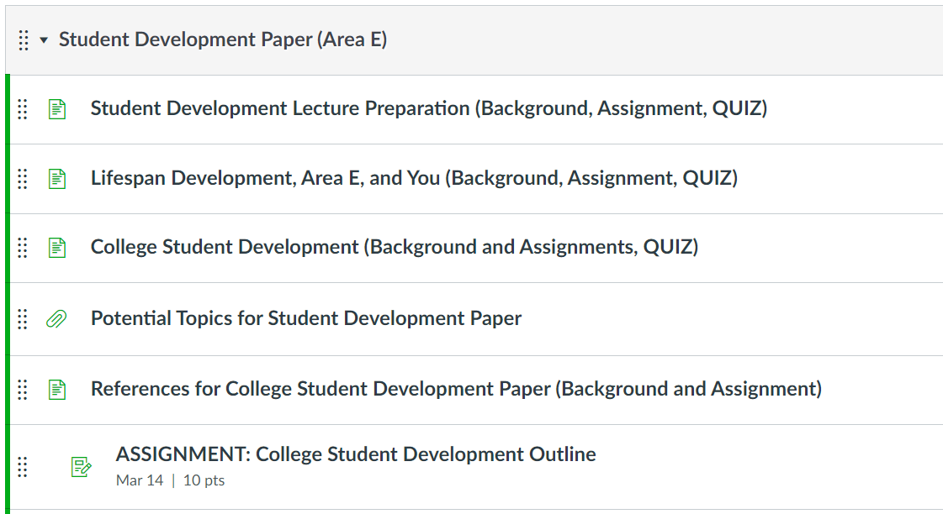
Materials in Canvas - Modules

Slide 39
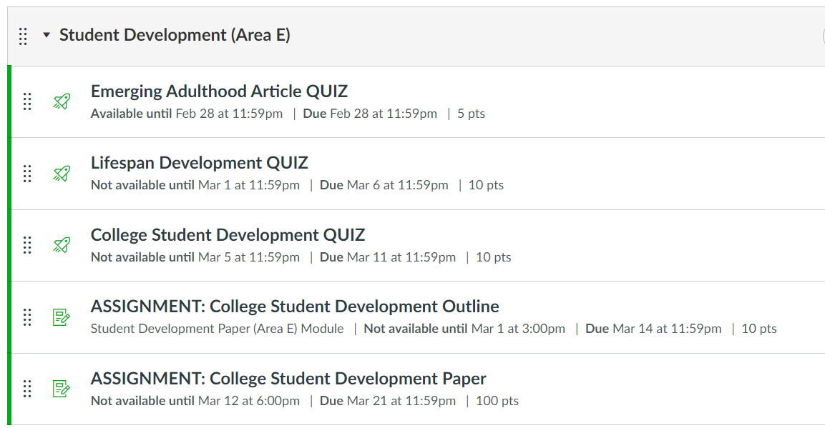
Materials in Canvas - Assignments

Slide 40
Important Dates
Learn about Lifespan Development and Emerging Adulthood
Watch: Lifespan Development and Area E (video 21 minutes)
Watch: Emerging Adulthood (video 29 minutes)
Watch: Interview with Jeffrey Arnett (video 15 minutes)
Take Lifespan Development quiz. Mar 6
Learn about College Student Development
Read the four research articles* (see 2nd slide from this one)
Watch: General Issues in College Student Development (video 20 minutes)
Watch: College Student Developmental in the Context of Developmental Domains (video 40 minutes)
Take the College Student Development quiz Mar 11

Slide 41
Important Dates (cont)
College Student Development Paper Outline and References
Watch: How to Find References that explains how to find the references (video 22 minutes)
Upload outline (including references) in Canvas Mar 14
Prepare to review in Lecture Mar 15
College Student Development Paper Due Mar 21
(NO LATE PAPERS)
Use Emerging Adulthood Paper Template
Upload file to Canvas, Mac users upload .pdf

Slide 42
*College Student Development Research Articles
Read the following articles –
  Burgess, S. R., Stermer, S., & Burgess, M. R. (2012). Video game playing and academic performance in college students. College Student Journal, 46(2), 376-387 PDF Link
  Conley, K. M., & Lehman, B. J. (2012). Test anxiety and cardiovascular responses to daily academic stressors. Stress And Health: Journal Of The International Society For The Investigation Of Stress, 28(1), 41-50. doi:10.1002/smi.1399 PDF Link
  Holman, A., & Sillars, A. (2012). Talk about 'hooking up': The influence of college student social networks on nonrelationship sex. Health Communication, 27(2), 205-216. doi:10.1080/10410236.2011.575540 PDF Link
  Zawadzki, M. J., Graham, J. E., & Gerin, W. (2013). Rumination and anxiety mediate the effect of loneliness on depressed mood and sleep quality in college students. Health Psychology, 32(2), 212-222. doi:10.1037/a0029007 PDF Link

Slide 43
Components and Order of Paper
Sections must be clearly labeled (use template)
Introduction/Topic
Psychological Domain
Social Domain
Physiological Domain
Conclusion
References
Domain sections should be 2 to 3 paragraphs

Slide 44
Name: ID: | Topic
Introduction
Psychological Domain
Social Domain
Physiology Domain
Conclusion
Reference List
Template (in Canvas)

Slide 45
Components of Paper
Introduction
Defines emerging adulthood
Clearly identifies the topic (see examples)
States a position about the topic (neutral, positive or negative)
Provides background information about how the topic impacts emerging adulthood
Indicates why the topic and your focus is important to understand
Provides an overview of what the paper will do and cover

Slide 46
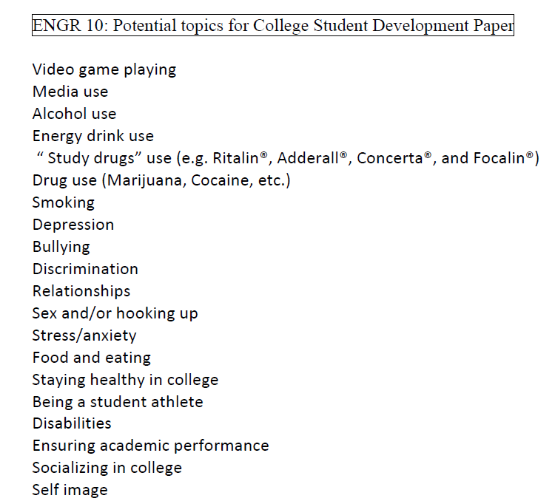
Sample Topics (in Modules)
Choose ONE
One that you can find references for

Slide 47
Components of Paper
For Each Domain
Provides information about the domain in the context of the topic
Introduces and cites the article (in APA format) related to the topic for that domain
Describes the subjects of the study
Provides relevant results of the study
Sums up key points, integrates the key findings, transitions to next domain

Slide 48
Components of Paper
Conclusion
Provides overview of the key points of the paper
Provides insights about the topic w/respect to the domains; what did YOU learn, if anything
Discusses implications for current development and the transition to later development for the ways the four developmental domains inter-relate.

Slide 49
Peer-Reviewed Articles
Sometimes called “refereed” or “scholarly” articles
Written by experts and reviewed by other experts in the field
Limit database search to peer-reviewed journals only
Google: “how to check if an article is peer reviewed”
Visit Google Scholar
Visit PsychInfo (database in MLK Library); LibGuide for Child and Adolescent Development
https://library.sjsu.edu/video/finding-scholarly-peer-reviewed-articles

Slide 50
Components of Paper
Reference List
List of all the articles cited in paper
Must be in APA style format

Slide 51
APA Style for References
Journal article
  Burgess, S. R., Stermer, S., & Burgess, M. R. (2012). Video game playing and academic performance in college students. College Student Journal, 46(2), 376-387.
Conference Paper
  Smith, M. E., Nguyen, D. T., Lai, C., Leshed, G., & Baumer, E. P. (2012, February). Going to college and staying connected: Communication between college freshmen and their parents. In Proceedings of the ACM 2012 conference on Computer Supported Cooperative Work (pp. 789-798). ACM.
Book
  Arnett, J. J. (2004). Emerging adulthood: The winding road from the late teens through the twenties. Oxford University Press.

Slide 52
References must be alphabetized
Conley, K. M., & Lehman, B. J. (2012). Test anxiety and cardiovascular responses to daily academic stressors. Stress And Health: Journal Of The International Society For The Investigation Of Stress, 28(1), 41-50. doi:10.1002/smi.1399
Emerging adulthood and early adulthood. (2013, December 23). In Wikipedia, The Free Encyclopedia. Retrieved April 14, 2014, from http://en.wikipedia.org/w/index.php?title= Emerging_adulthood_and_early_adulthood&oldid=587320746
Holman, A., & Sillars, A. (2012). Talk about 'hooking up': The influence of college student social networks on nonrelationship sex. Health Communication, 27(2), 205-216. doi:10.1080/10410236.2011.575540
Jayson, S. (2012, July 30). Many 'emerging adults' 18-29 are not there yet. USA Today. Retrieved from http://usatoday30.usatoday.com/

Slide 53
Example
Topic: Anxiety
Introduction
High anxiety in emerging adults negatively affects a student’s overall well-being … Emerging adulthood is…. This paper will examine the effects of high anxiety on emerging adults….
Domains: What does the research say for each domain?
Psychological: Impact to memory? Affect short or long term learning? Depression? Distress? Mental health issues?
Social: Lack relationships? Create dependencies?
Physical: High blood pressure? Headaches? Fatigue? Impact to overall fitness?

Slide 54
Example
Reference
Topic
Psychological Domain
Too much anxiety can negatively affect students test scores. (Warecki, 2012) studied 500 freshmen students, 400 males and 100 females, at a leading college in the Western United States. The study found that those students who identified themselves as generally anxious to very anxious had test scores 10% to 15% lower than those students who reported they had no anxiety or minimal anxiety when taking a test. Those that did report having higher anxiety cited short term memory problems as a major reason. More…
The study also points out that this may lead to an increase in anxiety which can possibly lead to possible anti-social issues.
Results of Study
The last sentence is a transition to the next domain - Social

Slide 55
Example
  References
  Warecki, J. J. (2012). Student anxiety – good or bad?. College Professor Journal, 24(7), 176-229.

Slide 56
Topic for Paper
Which would not be considered a valid topic?
Video Games
Depression
Shoe Horns
Weight
They’re all good topics

Slide 57
Sections must be labeled: Which sections must be clearly identified?
A.
Introduction
Conclusion
References
B.
Introduction
Psychological Domain
Social Domain
Physiological Domain
Conclusion
References
C.
Psychological Domain
Social Domain
Physiological Domain
Conclusion

Slide 58
Do Not Quote or Plagiarize!
Do not quote a writer
  Do not just cut and paste and attach quotes
Plagiarizing is copying someone else’s work and claiming it as your own
  Turnitin.com will be used to check your entire paper
  Automatic 0 and reported to Academic Affairs
Paraphrase what you read, don’t just change a few of the author’s words
  Write in your own words what the author is saying

Slide 59
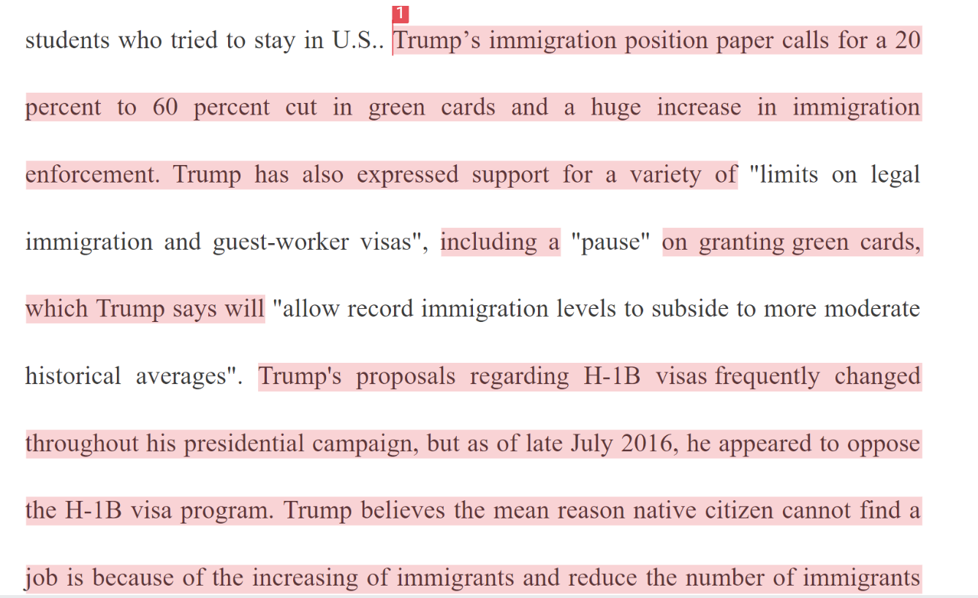
Plagiarism
Turnitin uses certain colors to represent similarity percentages.
Blue: 0%
Green: 1-24%
Yellow: 25-49%
Orange: 50-74%
Red: 75-100%
Example: Turnitin similarity index 78%

Slide 60
Outline (due Mar 14)
Introduction
  Clearly define your topic (one topic)
  Answer the question: What is your position on how the topic impacts, influences or affects students (18 to 25 year olds) in emerging adulthood? Positive, Negative or Neutral (maybe you don’t know, not sure)?

Slide 61
Outline (cont)
For Each Domain*
  Indicate the reference to be used (cite using APA format)
  Describe results of study
  Briefly write about how topic influences development
*
Psychological Domain
Social Domain
Physiological (Physical) Domain

Slide 62
Outline (cont)
Conclusion
  Summarize key points
  Answer question: What insights gained? Does research support (or contradict) your position identified in Introduction?

Slide 63
Outline (cont)
Reference List (APA format)
Conley, K. M., & Lehman, B. J. (2012). Test anxiety and cardiovascular responses to daily academic stressors. Stress And Health: Journal Of The International Society For The Investigation Of Stress, 28(1), 41-50. doi:10.1002/smi.1399
Emerging adulthood and early adulthood. (2013, December 23). In Wikipedia, The Free Encyclopedia. Retrieved April 14, 2014, from http://en.wikipedia.org/w/index.php?title= Emerging_adulthood_and_early_adulthood&oldid=587320746
Holman, A., & Sillars, A. (2012). Talk about 'hooking up': The influence of college student social networks on nonrelationship sex. Health Communication, 27(2), 205-216. doi:10.1080/10410236.2011.575540
Jayson, S. (2012, July 30). Many 'emerging adults' 18-29 are not there yet. USA Today. Retrieved from http://usatoday30.usatoday.com/

Slide 64
Tips for a Good Score
Clearly Defined Topic
  Choose another one if you cannot find references
Quality References Related to the Topic and Domain
References Cited in Paper and Listed on Last Page (APA style)
Each Section Labeled (use template)
Complete the Outline
Review the Guidelines and Rubric
Visit SJSU Writing Center
Not a Self-Reflection but a Research Report
Do Not Quote and Do NOT Plagiarize!
No Late Papers Accepted

Slide 65
College Student Development Outline Due
Upload to Canvas* – Mar 14
Prepare to Review in Lecture – Mar 15
College Student Development Paper Due – Mar 21
* For both outline and final paper
If you are PC/MS Word user, upload as .doc or .docx
If you are a Mac/Pages user, upload as .pdf

Slide 66
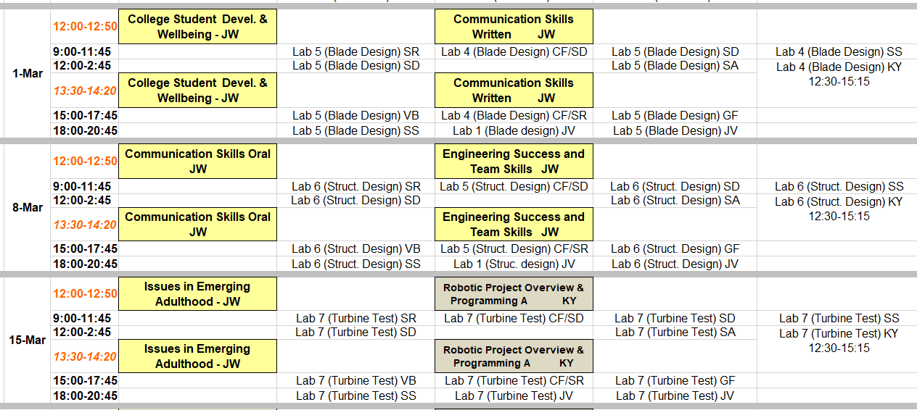
Upload Outline in Canvas, Sunday, Mar 14, 11:59pm
Prepare to Review in Lecture, Monday, Mar 15
Paper Due Sunday, Mar 21, 11:59pm

Slide 67
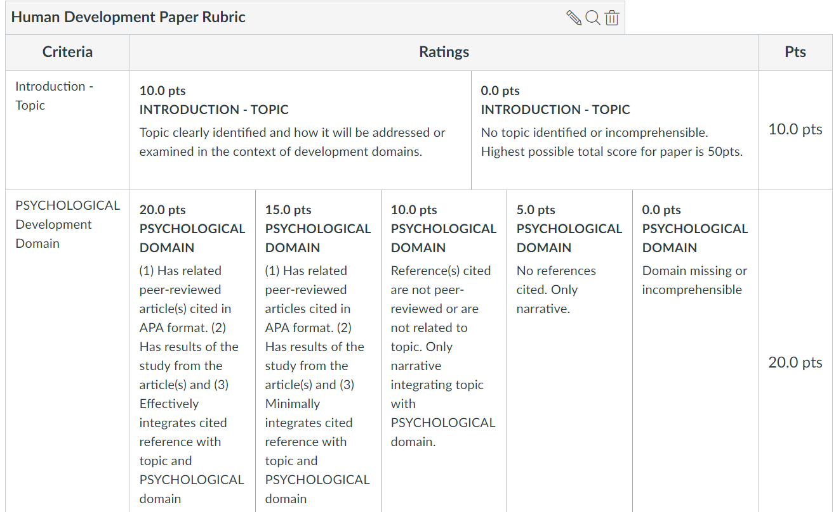
Rubric

Slide 68
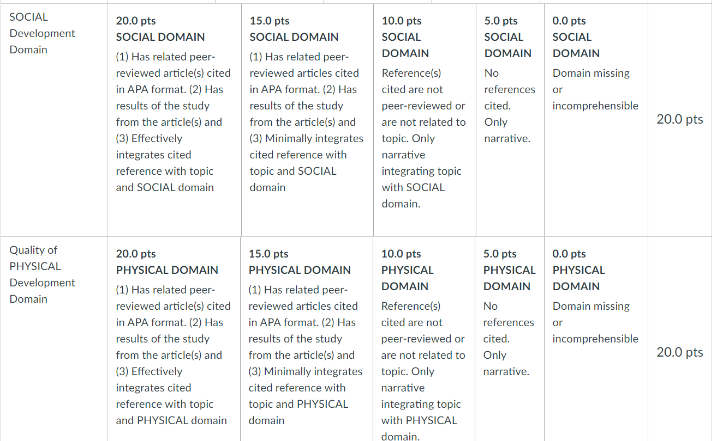
Rubric (cont)

Slide 69
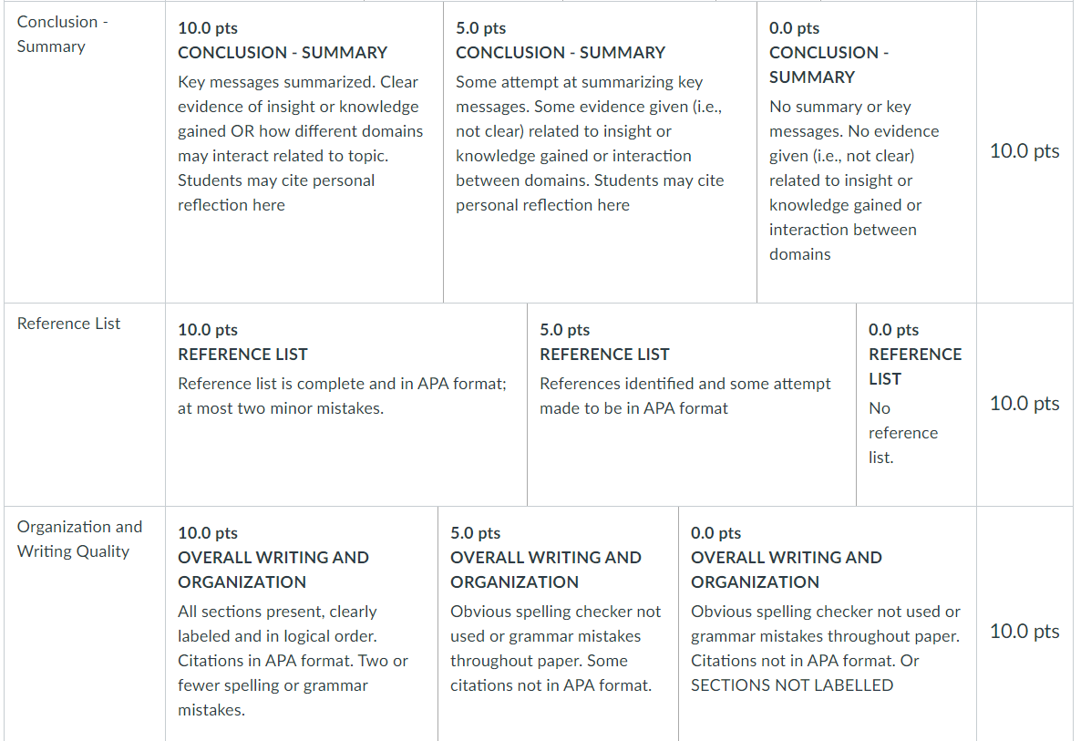
Rubric (cont)

