Slide 1
What are some major factors that influence 18 – 24 year olds’ development that affect their well-being, that is, their happiness and health?

Slide 2
Area E and ENGR 10 Assignments
Factors in College Student Development

Slide 3
SJSU General Education
Area A – Basic Skills (9 units)
Area B – Science & Math (9 units)
Area C – Humanities & Arts (9 units)
Area D – Social Sciences (9 units)
Area E – Human Understanding & Development
(3 units)
SJSU Studies (12 units)

Slide 4
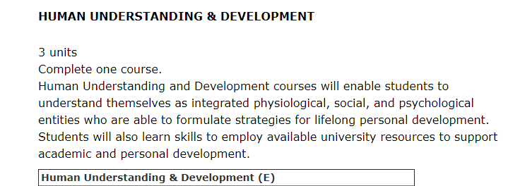
Area E – SJSU General Education
http://info.sjsu.edu/web-dbgen/narr/static/schedules/general-education-corege.html

Slide 5
Course Goals – GE Area E
At the end of this course students will be able to identify the:
factors and their interrelation on human development
and recognize how:
Those factors and their interrelation influence a student’s well-being
A student’s well-being is affected by the university’s academic and social systems
To use appropriate social skills to enhance learning and develop positive interpersonal relationships
Psychological | (Cognitive/Emotional)
Social | Physiological

Slide 6
Area E - Student Learning Objectives
SLO | How Achieved
Recognize the psychological, social, and physiological factors that influence your well-being Recognize the interrelation of the psychological, social, and physiological factors on your development across the lifespan Use appropriate social skills to enhance learning and develop positive interpersonal relationships with diverse groups and individuals | Research Paper Research Paper and Design Across Life Span Paper Teamwork in Lab

Slide 7
Area E - Student Learning Objectives
SLO | How Achieved
Recognize how your well-being is affected by the university’s academic and social systems, and how you can facilitate your development within the University environment | Personal Reflections

Slide 8
How Area E is Achieved .....
Research Paper
  1000-1500 word research paper
  Factors influencing Emerging Adults
Teamwork
  Work with diverse groups and individuals in Labs
Reflections
  Develop strategies for one’s well-being
  Explore university resources
Robot
Paper
  Paper recognizing factors on development across the lifespan from the perspective of designing a robot

Slide 9
How Old Are You?
A) Younger than 18
B) 18-20
C) 21-25
D) 25-30
E) Older than 30

Slide 10
Are you an adult?
Do you feel you have reached adulthood?
Yes
No
In some ways yes, in some ways no

Slide 11
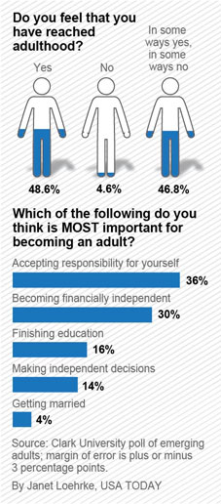
What the public thinks…

Slide 12
What makes you an adult?
Which of the following do you think is most important for becoming an adult?
Making independent decisions
Accepting responsibility for yourself
Getting Married
Becoming financially independent
Finishing your education
Arnett
Arnett
Arnett

Slide 13
What the public thinks …

Slide 14
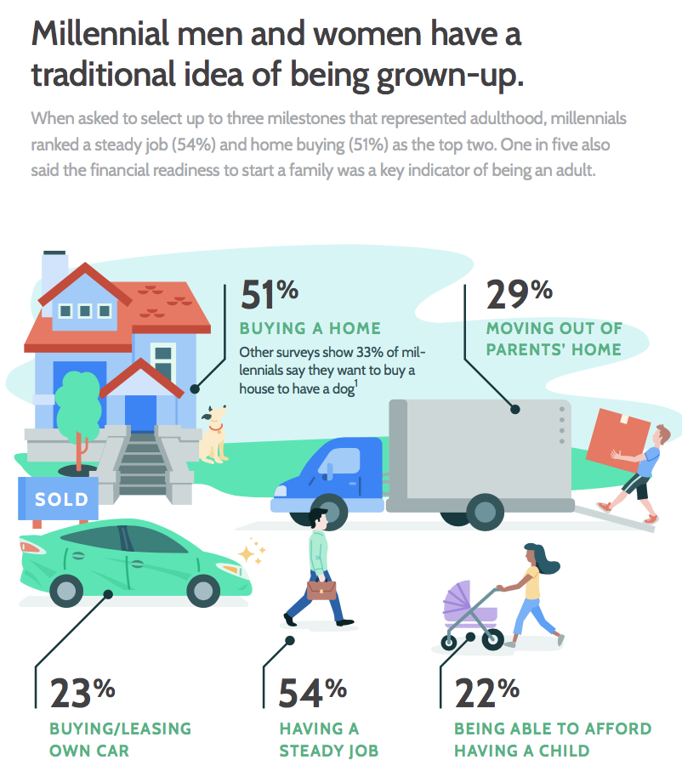

Slide 15
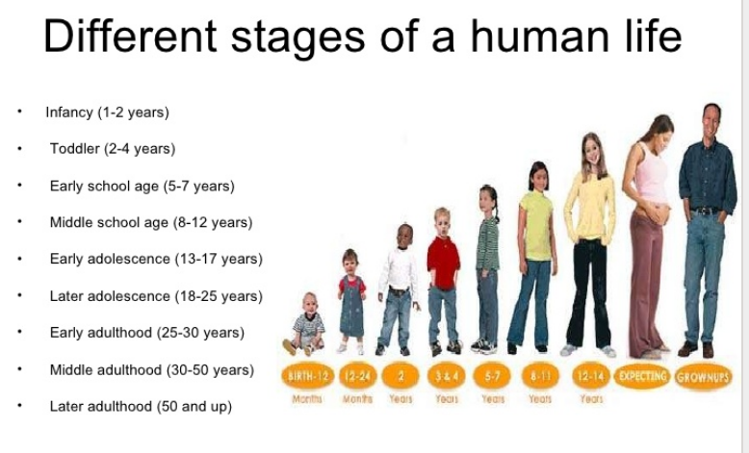
Stages of Human Development

Slide 16
Developmental Periods
Today,
- Live with parents or
- Cohabitate
Children later, and less
Education prolonged
Changing jobs
Peers role model
infancy
In 1970, 21 year old
- Married
New born
Education complete
In long term job
Parents role model
early childhood
middle childhood
adolescence
emerging
adulthood
young adulthood
18-25 years old
adulthood
late adulthood
Arnett’s Model
Adolescence
Emerging
Adulthood
Young
Adulthood
Middle
Adulthood
Late
Adulthood

Slide 17
What are the Characteristics of Emerging Adults?
Exploring identities
Instability (work, romance, residence)
Focusing on self as independent
Believe themselves “between” adolescent & adult
Believe life holds many possibilities
NOT Universal – LOTS of variation

Slide 18
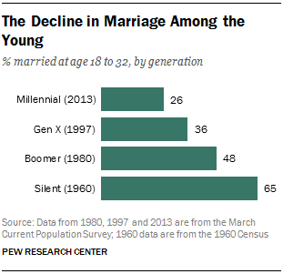

Slide 19
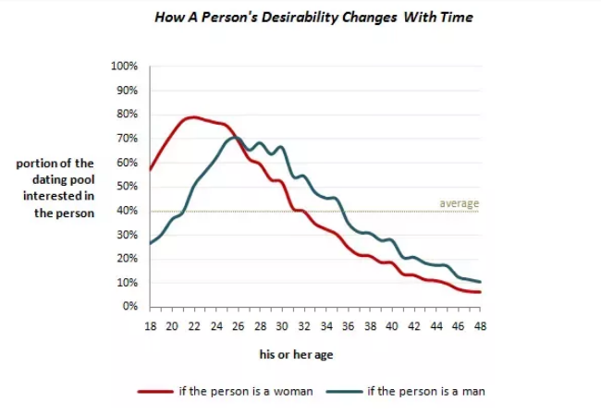
Peak Attractiveness
https://www.quora.com/At-what-age-is-peak-physical-attractiveness-for-women

Slide 20
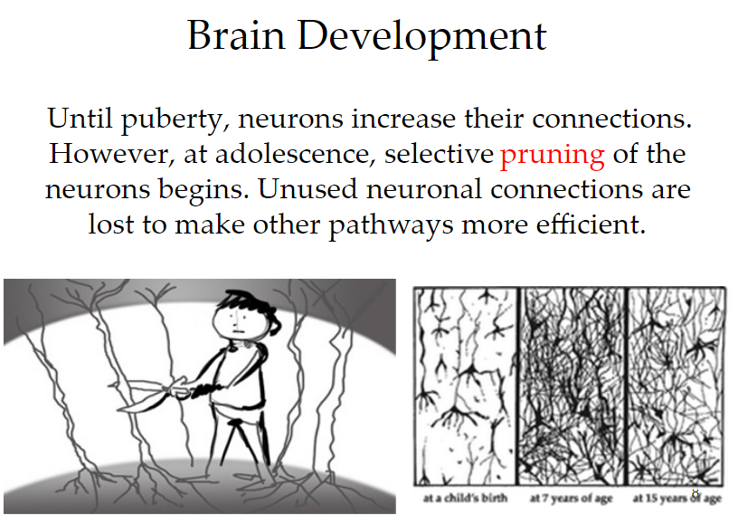

Slide 21
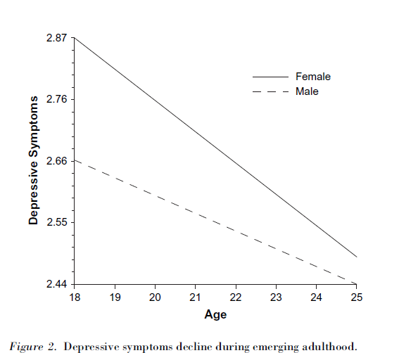
Believe life holds many possibilities
Depressive Symptons Decline
Arnett, J. J. (2007). Emerging adulthood: What is it, and what is it good for?.Child development perspectives, 1(2), 68-73.

Slide 22
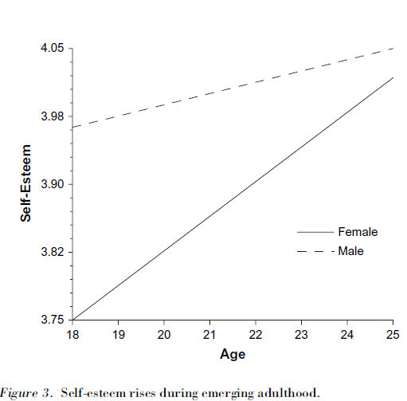
Believe life holds many possibilities
Self-Esteem Rises
Arnett, J. J. (2007). Emerging adulthood: What is it, and what is it good for?.Child development perspectives, 1(2), 68-73.

Slide 23
Key Areas of Human Development
  The Mind
  Emotions
  Social
  Physical
Across All Stages of Human Development
Notes:
Morality is another one.

Slide 24
Key Areas of Human Development
  Cognitive
  Emotions
  Social
  Physical
Across All Stages of Human Development
Notes:
Morality is another one.

Slide 25
Key Areas of Human Development
  Cognitive
Psychological
  Emotions
  Social
  Physical
Across All Stages of Human Development
Notes:
Morality is another one.

Slide 26
Major Areas of Development
Psychological
(Cognitive)
  Thinking, learning, understanding, gaining knowledge, memory, language, perceiving; ideas; beliefs; attitudes; identity formation; etc.
Psychological
(Emotional)
  Self-esteem; pride; shame; sympathy; empathy; mental health; stress; anxiety; happiness; anger; hopelessness; etc.
Social
  Relationships with family; significant others; peers; classmates; professors; interactions with others; group memberships and activities; cultural relationships; etc.
Physiological
  Health (such as: high blood pressure, high cholesterol, STDs/HIV/AIDS); fitness; nutrition; physical activities; etc.

Slide 27
Key Areas of Human Development
“Domains”
  Psychological
  Social
  Physical
Notes:
Morality is another one. Domains refer to specific aspects of human development in terms of growth and change as it relates to the human lifespan.

Slide 28
Factors That Affect Development
Nature or Nurture
  Psychological
Nature or Nurture
  Social
Nature or Nurture
  Physical

Slide 29
Student Development Paper
Your paper will examine development in all three development domains (psychological, social, physiological) during emerging adulthood for a specific topic of your choosing (see examples).
You must cover the same topic in all three domains
1000-1500 word research paper not including reference list

Slide 30
Factors That Affect Development in
Emerging Adults
Topic
Domain
Depression
  Psychological
What does the research say?
Depression
  Social
What does the research say?
Depression
  Physiological
What does the research say?

Slide 31
Factors That Affect Development in
Emerging Adults
Topic
Domain
Drugs
  Psychological
What does the research say?
Drugs
  Social
What does the research say?
Drugs
  Physiological
What does the research say?

Slide 32
Factors That Affect Development in
Emerging Adults
Topic
Domain
Hooking Up
  Psychological
What does the research say?
Hooking Up
  Social
What does the research say?
Hooking Up
  Physiological
What does the research say?

Slide 33
Factors That Affect Development in
Emerging Adults
Topic
Domain
Anxiety
  Psychological
What does the research say?
Anxiety
  Social
What does the research say?
Anxiety
  Physiological
What does the research say?

Slide 34
Student Development Paper
Assignment Preparation
Watch video by Dr. Maureen Smith
Review Paper Guidelines and Rubric
Review Audio Lectures and Videos
Choose Topic (Examples in Canvas)
Read and Find Peer-Reviewed Articles
Write Outline, Bring to Class for Review
Write Paper and Upload to Canvas
Notes:
Choose

Slide 35
Materials in Canvas
Paper Guidelines
Suggested Topics for the paper
Rubric for Grading Paper
Audio Lectures
Lifespan Development and Area E (21 minutes)
Emerging Adulthood (29 minutes)
General Issues in College Student Development (20 minutes)
College Student Developmental in the Context of Developmental Domains (40 minutes)
Paper-overview and how to find the references (15 minutes)
Quizzes
Emerging Adulthood quiz (due last night)
Take Lifespan Development quiz.
Take the College Student Development quiz

Slide 36
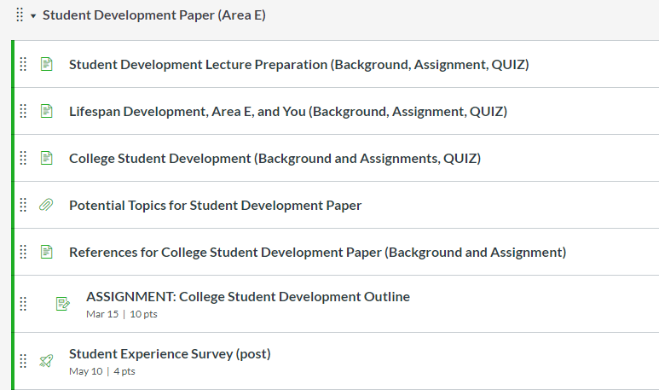
Materials in Canvas - Modules

Slide 37
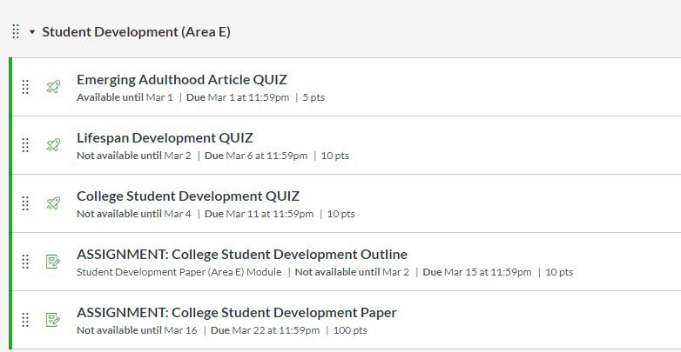
Materials in Canvas - Assignments

Slide 38
Important Dates
Learn about Lifespan Development and Emerging Adulthood
Watch: Lifespan Development and Area E (video 21 minutes)
Watch: Emerging Adulthood (video 29 minutes)
Watch: Interview with Jeffrey Arnett (video 15 minutes)
Take Lifespan Development quiz. Mar 6
Learn about College Student Development
Read the four research articles* (see 2nd slide from this one)
Watch: General Issues in College Student Development (video 20 minutes)
Watch: College Student Developmental in the Context of Developmental Domains (video 40 minutes)
Take the College Student Development quiz Mar 11

Slide 39
Important Dates (cont)
College Student Development Paper Outline and References
Watch: How to Find References that explains how to find the references (video 22 minutes)
Upload outline (including references) in Canvas Mar 15
Bring paper copy of outline to class Mar 16
College Student Development Paper Due Mar 22
(NO LATE PAPERS)
Use Emerging Adulthood Paper Template
Upload file to Canvas, Mac users upload .pdf

Slide 40
*College Student Development Research Articles
Read the following articles –
  Burgess, S. R., Stermer, S., & Burgess, M. R. (2012). Video game playing and academic performance in college students. College Student Journal, 46(2), 376-387 PDF Link
  Conley, K. M., & Lehman, B. J. (2012). Test anxiety and cardiovascular responses to daily academic stressors. Stress And Health: Journal Of The International Society For The Investigation Of Stress, 28(1), 41-50. doi:10.1002/smi.1399 PDF Link
  Holman, A., & Sillars, A. (2012). Talk about 'hooking up': The influence of college student social networks on nonrelationship sex. Health Communication, 27(2), 205-216. doi:10.1080/10410236.2011.575540 PDF Link
  Zawadzki, M. J., Graham, J. E., & Gerin, W. (2013). Rumination and anxiety mediate the effect of loneliness on depressed mood and sleep quality in college students. Health Psychology, 32(2), 212-222. doi:10.1037/a0029007 PDF Link

Slide 41
*College Student Development Research Articles
Read the following four articles:
  Burgess, S. R., Stermer, S., & Burgess, M. R. (2012). Video game playing and academic performance in college students. College Student Journal, 46(2), 376-387 (PDF Link )
  Conley, K. M., & Lehman, B. J. (2012). Test anxiety and cardiovascular responses to daily academic stressors. Stress and Health: Journal of the International Society for the Investigation of Stress, 28(1), 41-50. doi:10.1002/smi.1399 (PDF Link )
  Holman, A., & Sillars, A. (2012). Talk about 'hooking up': The influence of college student social networks on nonrelationship sex. Health Communication, 27(2), 205-216. doi:10.1080/10410236.2011.575540 (PDF Link )
  Zawadzki, M. J., Graham, J. E., & Gerin, W. (2013). Rumination and anxiety mediate the effect of loneliness on depressed mood and sleep quality in college students. Health Psychology, 32(2), 212-222. doi:10.1037/a0029007 (PDF Link )

Slide 42
Components and Order of Paper
Sections must be clearly labeled (use template)
Introduction/Topic
Psychological Domain
Social Domain
Physiological Domain
Conclusion
References
Domain sections should be 2 to 3 paragraphs

Slide 43
Paper Template (find in Canvas)
Name: | ID Number:
Introduction and Topic
Psychological Domain
Social Domain
Physiology Domain
Conclusion
Reference List

Slide 44
Components of Paper
Introduction
Defines emerging adulthood
Clearly identifies the topic (see examples)
States a position about the topic (neutral, positive or negative)
Provides background information about how the topic impacts emerging adulthood
Provides an overview of what the paper will do and cover

Slide 45
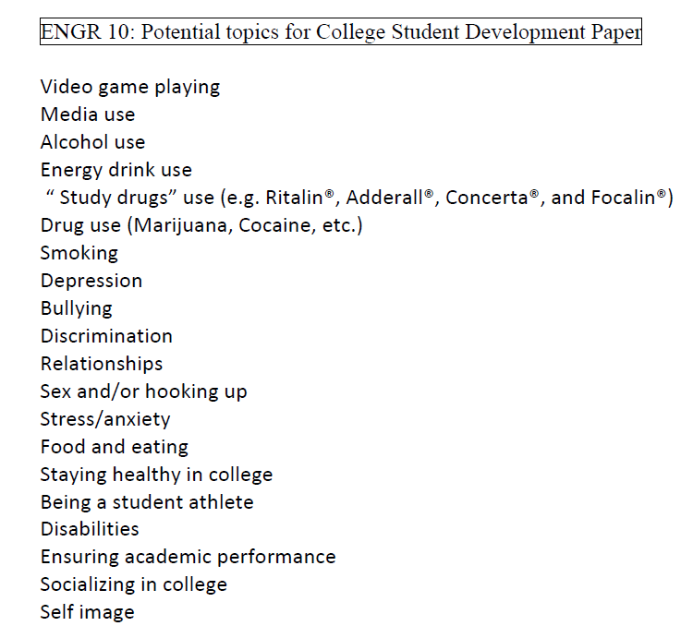
Sample Topics (in Modules)
Choose ONE
One that you can find references for

Slide 46
Components of Paper
For Each Domain
Provides information about the domain in the context of the topic
Introduces and cites study (in APA format) related to the domain
Provides relevant results of the study
Sums up key points, integrates the key findings, transitions to next domain

Slide 47
Components of Paper
Conclusion
Provides overview of the key points of the paper
Provides insights about the topic w/respect to the position taken or what did YOU learn, if anything
Discusses implications for current development and the transition to later development for the ways the four developmental domains inter-relate.

Slide 48
Peer-Reviewed Articles
Sometimes called “refereed” or “scholarly” articles
Written by experts and reviewed by other experts in the field
Limit database search to peer-reviewed journals only
Check database Ulrichsweb.com to determine if journal is peer-reviewed
Check actual journal (the physical version)
Visit PsychInfo (database in MLK Library); LibGuide for Child and Adolescent Development
Google Scholar
https://library.sjsu.edu/video/finding-scholarly-peer-reviewed-articles

Slide 49
Components of Paper
Reference List
List of all the articles cited in paper
Must be in APA style format

Slide 50
APA Style for References
Journal article
  Burgess, S. R., Stermer, S., & Burgess, M. R. (2012). Video game playing and academic performance in college students. College Student Journal, 46(2), 376-387.
Conference Paper
  Smith, M. E., Nguyen, D. T., Lai, C., Leshed, G., & Baumer, E. P. (2012, February). Going to college and staying connected: Communication between college freshmen and their parents. In Proceedings of the ACM 2012 conference on Computer Supported Cooperative Work (pp. 789-798). ACM.
Book
  Arnett, J. J. (2004). Emerging adulthood: The winding road from the late teens through the twenties. Oxford University Press.

Slide 51
References must be alphabetized
Conley, K. M., & Lehman, B. J. (2012). Test anxiety and cardiovascular responses to daily academic stressors. Stress And Health: Journal Of The International Society For The Investigation Of Stress, 28(1), 41-50. doi:10.1002/smi.1399
Emerging adulthood and early adulthood. (2013, December 23). In Wikipedia, The Free Encyclopedia. Retrieved April 14, 2014, from http://en.wikipedia.org/w/index.php?title= Emerging_adulthood_and_early_adulthood&oldid=587320746
Holman, A., & Sillars, A. (2012). Talk about 'hooking up': The influence of college student social networks on nonrelationship sex. Health Communication, 27(2), 205-216. doi:10.1080/10410236.2011.575540
Jayson, S. (2012, July 30). Many 'emerging adults' 18-29 are not there yet. USA Today. Retrieved from http://usatoday30.usatoday.com/

Slide 52
Example
Topic: Anxiety
Introduction
Emerging adulthood is…. High anxiety in emerging adults negatively affects a student’s overall well-being … This paper will examine the effects of high anxiety on emerging adults….
Domains: What does the research say for each domain?
Psychological: Impact to memory? Affect short or long term learning? Depression? Distress? Mental health issues?
Social: Lack relationships? Create dependencies?
Physical: High blood pressure? Headaches? Fatigue? Impact to overall fitness?

Slide 53
Example
Reference
Topic
Psychological Domain
Too much anxiety can negatively affect students test scores (Warecki, 2012). The study found that those students who identified themselves as generally anxious to very anxious had test scores 10% to 15% lower than those students who reported they had no anxiety or minimal anxiety when taking a test. Those that did report having higher anxiety cited short term memory problems as a major reason. …
[Another paragraph]
The study also points out that this may lead to an increase in anxiety which can possibly lead to possible anti-social issues.
Results of Study
The last sentence is a transition to the next domain - Social

Slide 54
Example
  References
  Warecki, J. J. (2012). Student anxiety – good or bad?. College Professor Journal, 24(7), 176-229.

Slide 55
Tips for a Good Score
Clearly Defined Topic
Quality References Related to the Topic and Domain
References Cited in Paper and Listed on Last Page (APA style)
Complete the Outline and Bring to Class
Visit SJSU Writing Center (Clark Hall or MLK)
Each Section Labeled
Review the Guidelines and Rubric
Not a Self-Reflection but a Research Report
No Late Papers Accepted
Do Not Quote and Do NOT Plagiarize!
Notes:
Any turnitin score > 15% will be reviewed for plagiarism

Slide 56
Do Not Quote or Plagiarize!
Do not quote a writer
  Do not just cut and paste and attach quotes
Plagiarizing is copying someone else’s work and claiming it as your own
  Turnitin.com will be used to check your entire paper
  Automatic 0 and reported to Academic Affairs
Paraphrase what you read, don’t just change a few of the author’s words
  Write in your own words what the author is saying

Slide 57
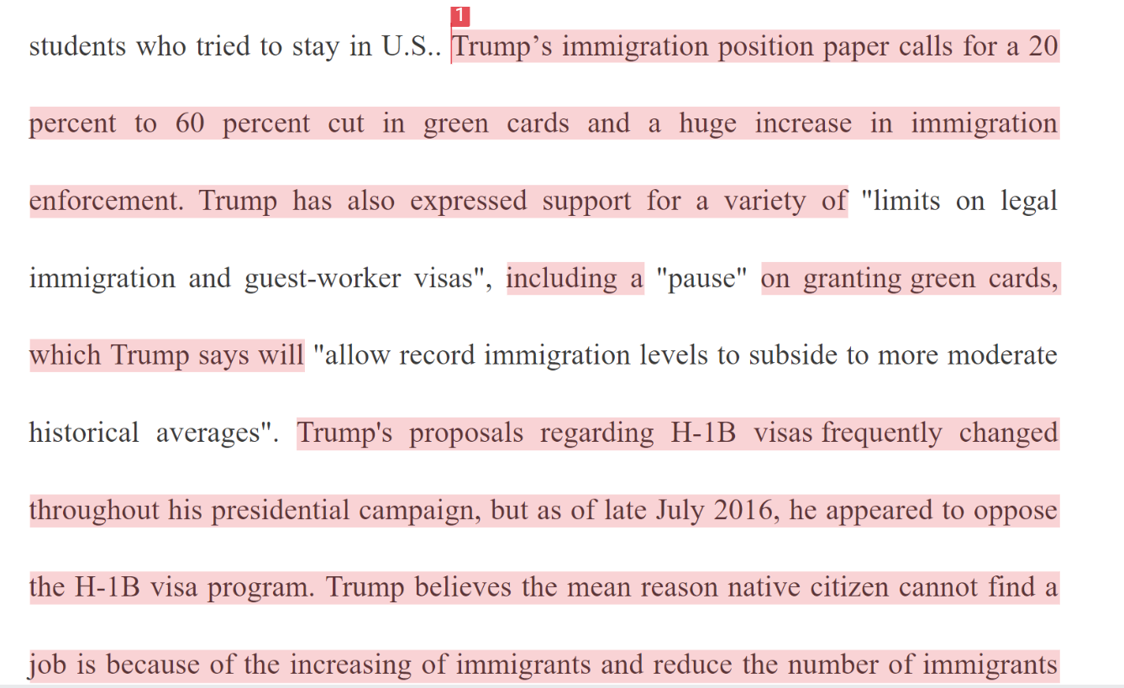
Plagiarism
Turnitin uses certain colors to represent similarity percentages.
Blue: 0%
Green: 1-24%
Yellow: 25-49%
Orange: 50-74%
Red: 75-100%
Example: Turnitin similarity index 78%

Slide 58
Outline
Introduction
  Clearly define your topic (one topic)
  Answer the question: What is your position on how the topic impacts, influences or affects students (18 to 25 year olds) in emerging adulthood? Positive, Negative or Neutral (maybe you don’t know, not sure)?

Slide 59
Outline (cont)
For Each Domain*
  Indicate the reference to be used (cite using APA format)
  Describe study subjects and results of study
  Be prepared to discuss (if not written) how the study integrates with your topic
*
Psychological Domain
Social Domain
Physiological (Physical) Domain

Slide 60
Outline (cont)
Conclusion
  Summarize key points
  Answer question: What insights gained? What did you learn? Does research support (or contradict) your position identified in Introduction?

Slide 61
Outline (cont)
Reference List (APA format)
Conley, K. M., & Lehman, B. J. (2012). Test anxiety and cardiovascular responses to daily academic stressors. Stress And Health: Journal Of The International Society For The Investigation Of Stress, 28(1), 41-50. doi:10.1002/smi.1399
Emerging adulthood and early adulthood. (2013, December 23). In Wikipedia, The Free Encyclopedia. Retrieved April 14, 2014, from http://en.wikipedia.org/w/index.php?title= Emerging_adulthood_and_early_adulthood&oldid=587320746
Holman, A., & Sillars, A. (2012). Talk about 'hooking up': The influence of college student social networks on nonrelationship sex. Health Communication, 27(2), 205-216. doi:10.1080/10410236.2011.575540
Jayson, S. (2012, July 30). Many 'emerging adults' 18-29 are not there yet. USA Today. Retrieved from http://usatoday30.usatoday.com/

Slide 62
College Student Development Outline Due – Mar 17
Upload to Canvas*
Bring hard copy to class – Mar 18
* For both outline and final paper
If you are PC/MS Word user upload as .doc or .docx
If you are a Mac/Pages user upload as .pdf

Slide 63
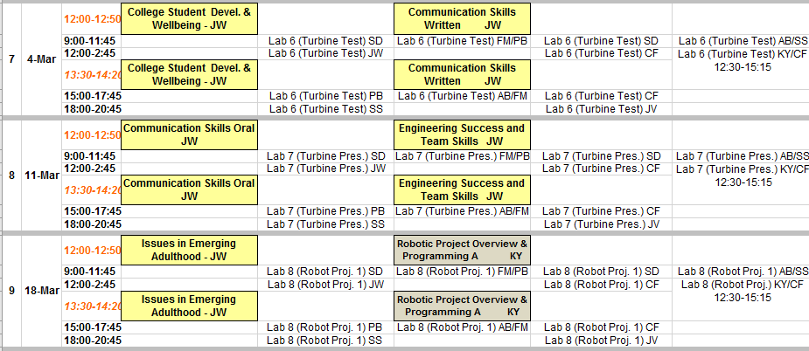
Upload Outline in Canvas Mar 17, 11:59pm
Bring Outline (Hard Copy) to Lecture Mar 18
Paper Due Mar 24, 11:59pm

Slide 64
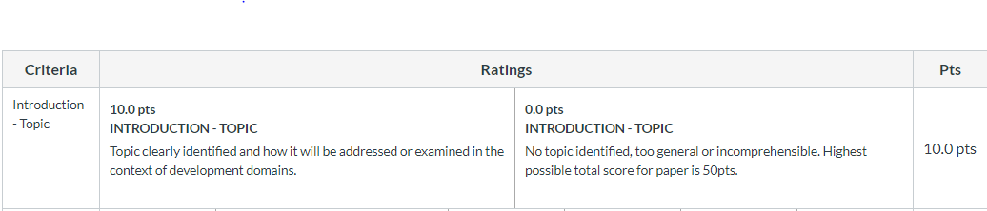
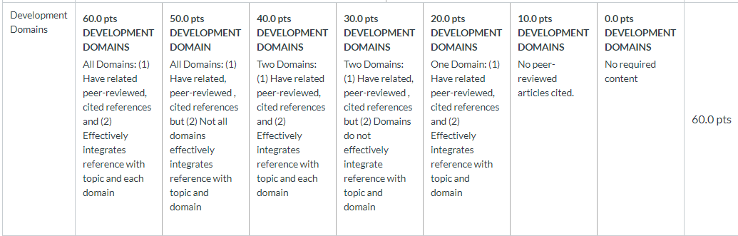
Rubric

Slide 65
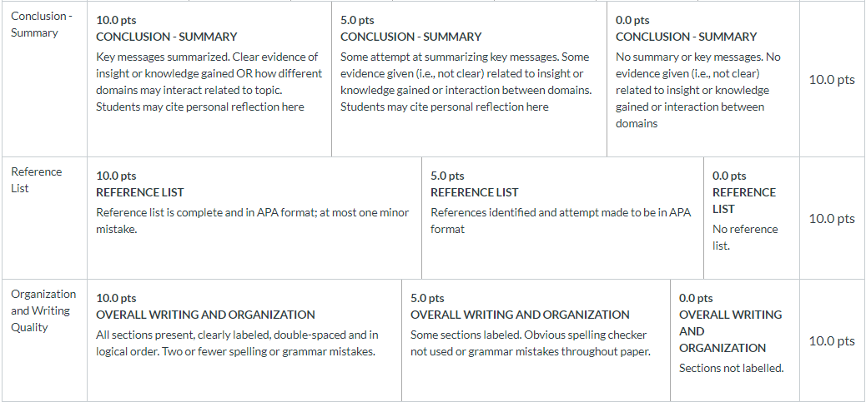
Rubric (cont)

