Slide 1
Sustainability in Engineering Design
ENGR 10
Introduction to Engineering

Slide 2
?
What is Sustainability in Engineering Design?
Some say, it is Engineering with a Conscience!

Slide 3
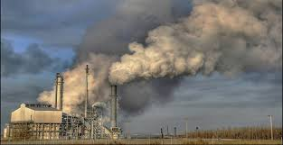
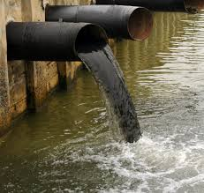
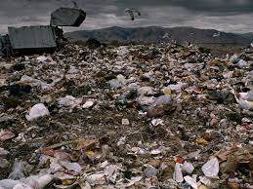
Engineering Without Conscience?
Notes:
Traditional engineering focused on solving problems, relatively short term solutions without much consideration to adverse or long term consequences

Slide 4
Sustainability – A Definition
"sustainable development is development that meets the needs of the present without compromising the ability of future generations to meet their own needs."
(Our Common Future, Brundtland Commission of the United Nations, 1987)
Notes:
In 1987, the World Commission on Environment and Development developed a definition of sustainability that was included in its findings, which became known as the Brundtland Report.
From Center for Engineering Sustainability

Slide 5
Or….
It’s sustainable development, if it is good for:
The environment
The economy
And it’s good for society

Slide 6
?
What are the current issues driving engineers (and others) to think about sustainability?

Slide 7
Issues Driving Sustainability
Depletion of non-renewable resources
Human exposure to toxics
Excessive demand for water
Damage to environment
Increase in number and size of landfills
Impact on global climate (?)

Slide 8
Other Issues…
First, consider this measure:
One Earth (or Earth Planet) is the amount of resources that the Earth regenerates in one year. Resources coming from fisheries, forests and soil that are primarily used for food, power and transportation.
Today, humanity is running at a rate of 1.5 Earths/yr!!
Notes:
Earth Planet = “the amount of biologically productive land and sea area necessary to supply the resources a human population consumes, and to assimilate associated waste.” http://en.wikipedia.org/wiki/Ecological_footprint

Slide 9
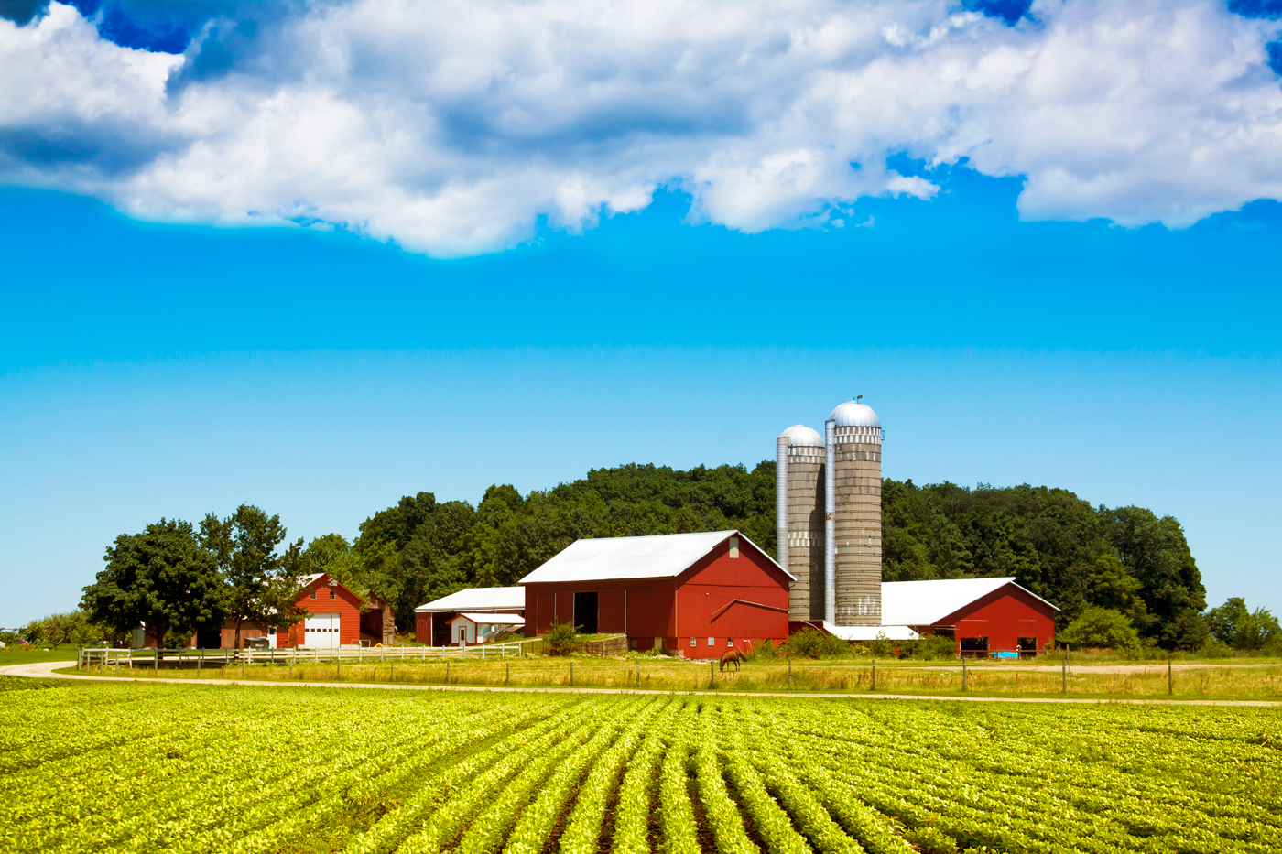
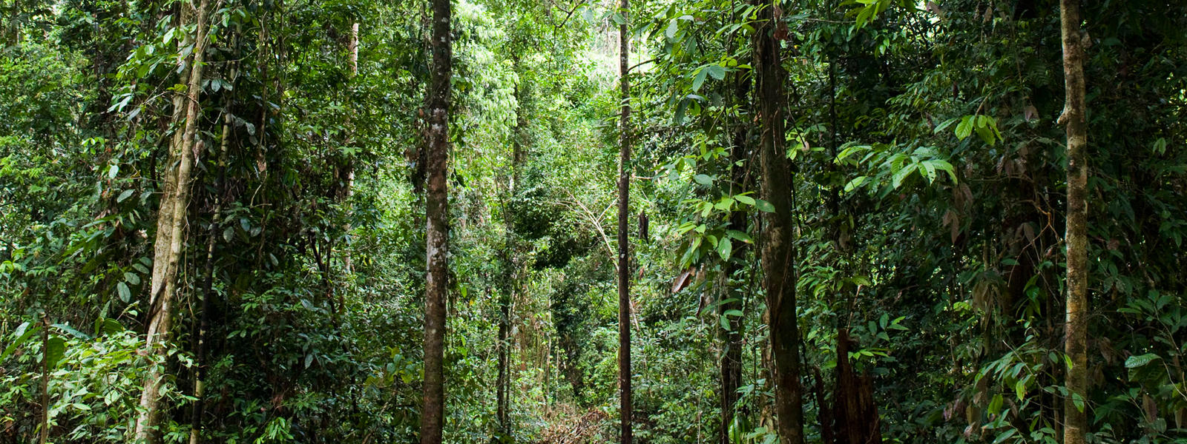
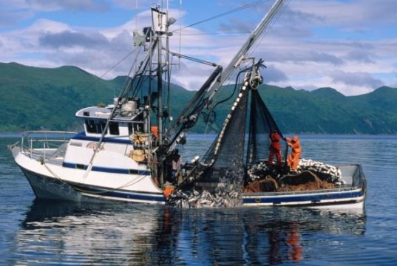
http://www.worldwildlife.org/habitats/forest-habitat
http://www.smallcapnetwork.com/Whats-the-Best-Farmland-Stock-FPI-LAND-ALCO-LMNR/s/via/3414/article/view/p/mid/1/id/1776/
https://www.sciencedaily.com/releases/2010/09/100914115246.htmCredit: iStockphoto/Tom Tietz

Slide 10
Earth Resources Consumption
Regeneration of Resources
1 Earth/yr
Earth Resources
- Fisheries
- Forests
- Land
“Overshoot Day” – Aug 8, 2016
Consumption/Waste
1.5 Earths/yr
We are consuming/wasting faster than the earth can regenerate.
Notes:
Given the current population of 7.1B people.

Slide 11
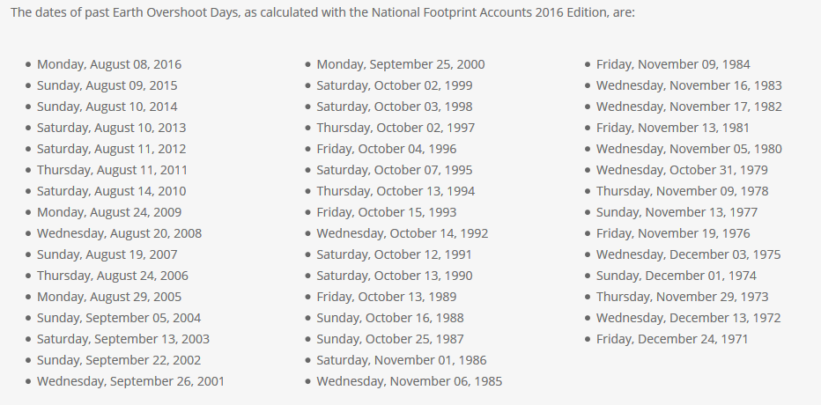
Past Overshoot Days
http://www.overshootday.org/newsroom/past-earth-overshoot-days/

Slide 12
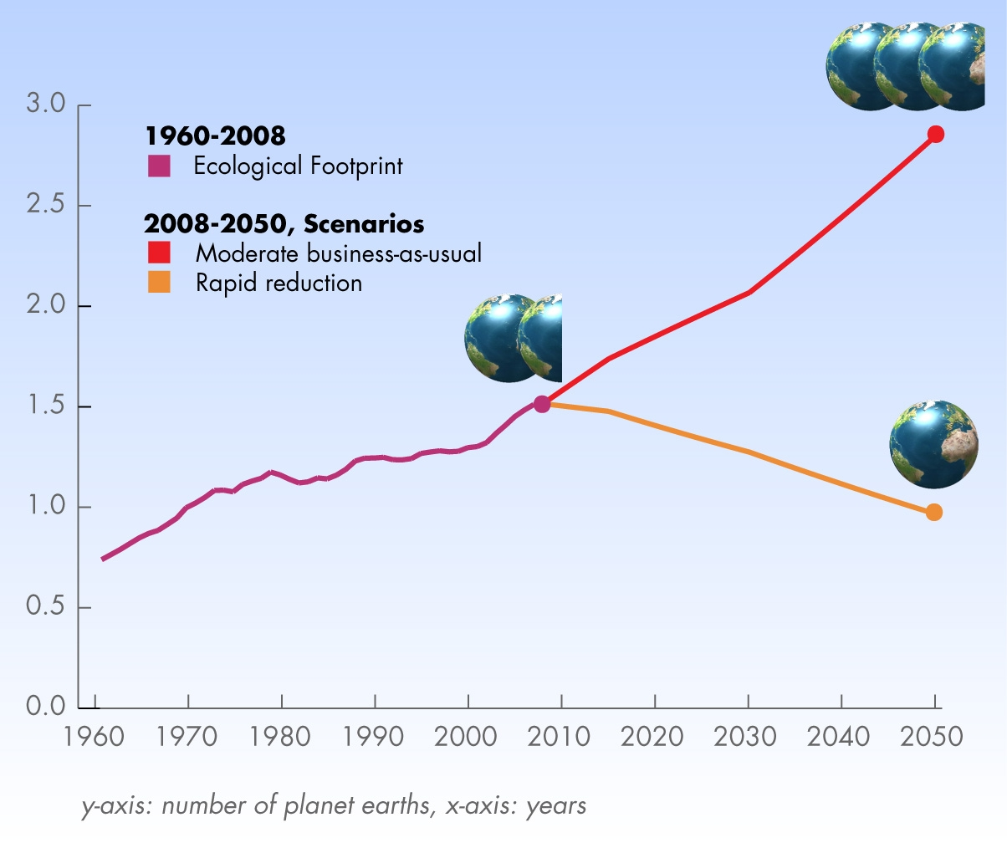
http://www.footprintnetwork.org/en/index.php/GFN/page/world_footprint/

Slide 13
What do you think?
If all people on Earth had the same consumption habits as Americans do, how many Earths would be needed to provide what the world’s population would consume?
      1 Earth
      2 Earths
      6 Earths
      20 Earths

Slide 14
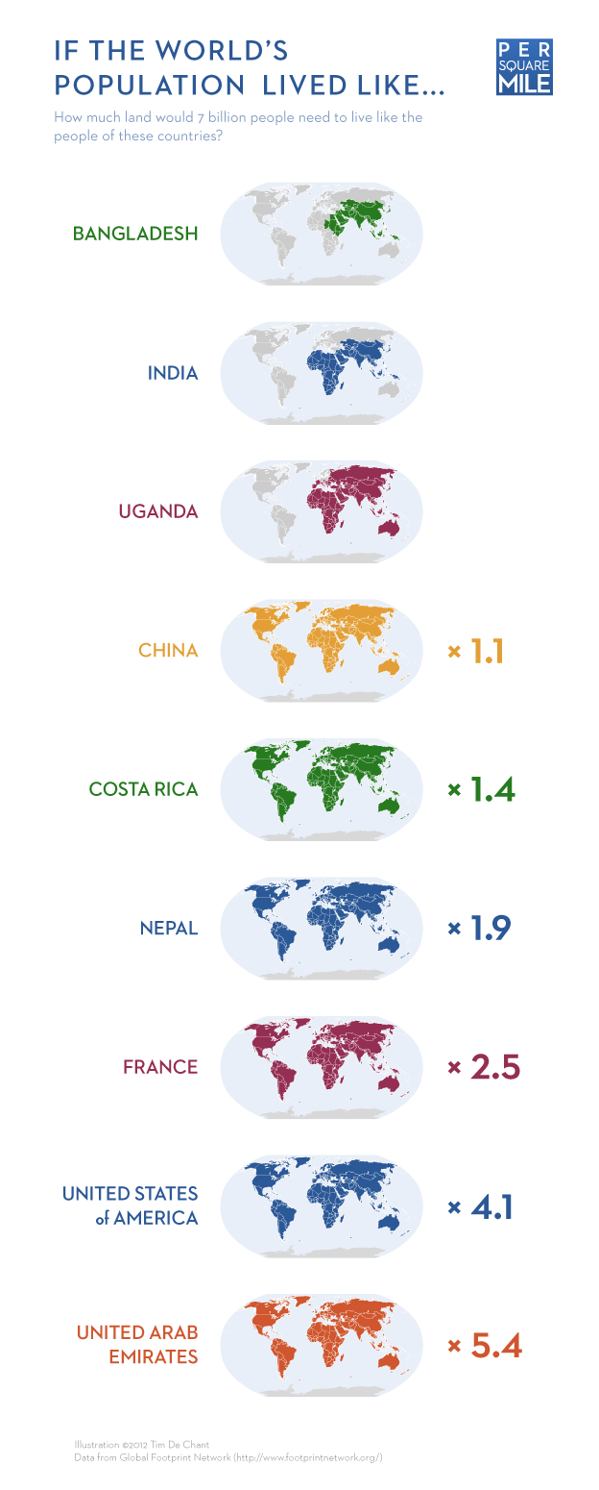
How many Earths do we need?
By Charlotte McDonald BBC News
16 June 2015

Slide 15
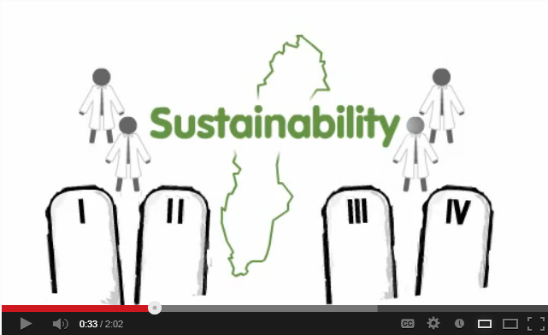
Watch the video
Sustainability explained through animation http://www.youtube.com/watch?v=B5NiTN0chj0
What are the four “Care Instructions” discussed in the video?
Notes:
Care instructions
Reduce dependence on fossil fuels and heavy metals
Reduce dependence on synthetic chemicals that persist in nature
Reduce destruction of nature
Ensure we are not stopping people globally from meeting their needs

Slide 16
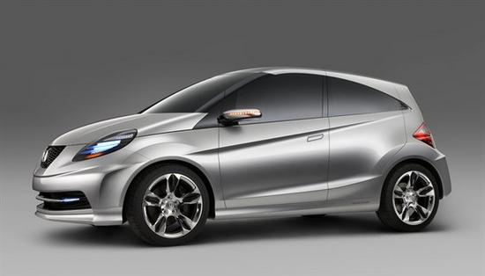
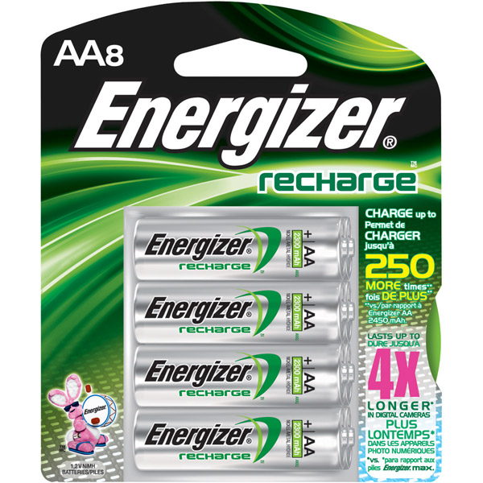
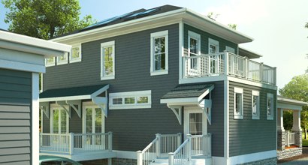
What sustainability principles might affect something you design.
www.greendiary.com/honda-promises-to-stay-competitive-in-green-car-market.html
http://www.greenstoreandmore.com
http://jeffdayllc.com/green-construction/

Slide 17
Sustainability is not a new concept
U.S. National Environmental Policy Act of 1969 → its goal a national policy to
"create and maintain conditions under which [humans] and nature can exist in productive harmony, and fulfill the social, economic and other requirements of present and future generations of Americans."

Slide 18
Three models of the three dimensions of sustainability
Notes:
Or the pillars are: People, Planet and Profit. Fair practices for ALL people. Manage planets renewable and non-renewable resources while reducing waste. Financially beneficial for most people.

Slide 19
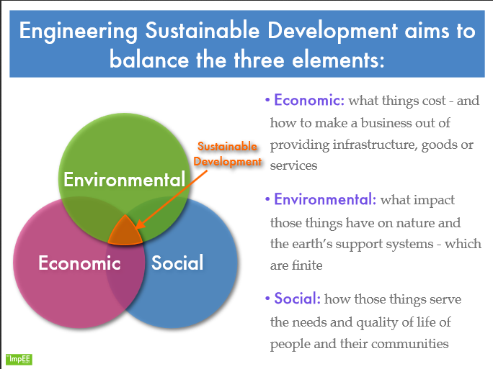

Slide 20
Elements of Sustainability
Economic – example: develop a process to use industrial waste rather than have to pay to get rid of it
Social – develop products that don’t disproportionally affect one population
Environmental – example: develop processes and products that minimize pollution

Slide 21
Show of hands
When you put your plastics on the curb for recycling, what happens to them?
1. They all get recycled
2. Many of them get thrown away

Slide 22
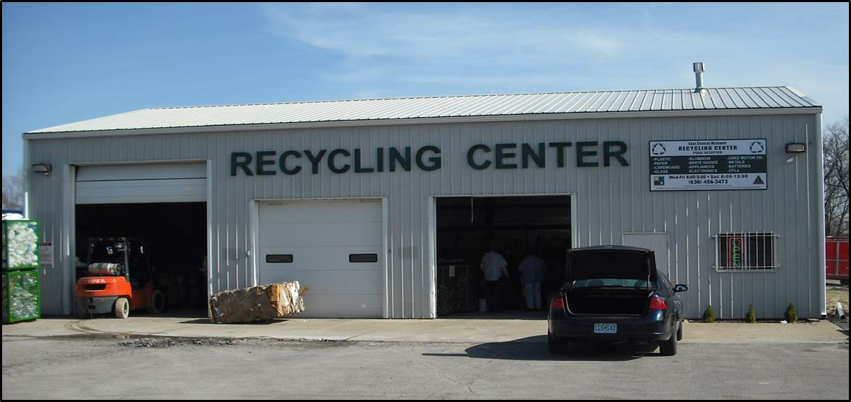
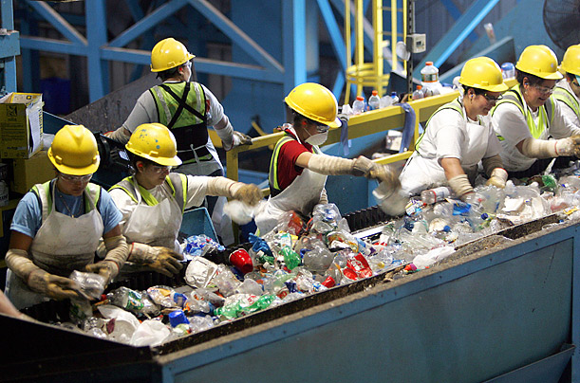

Slide 23
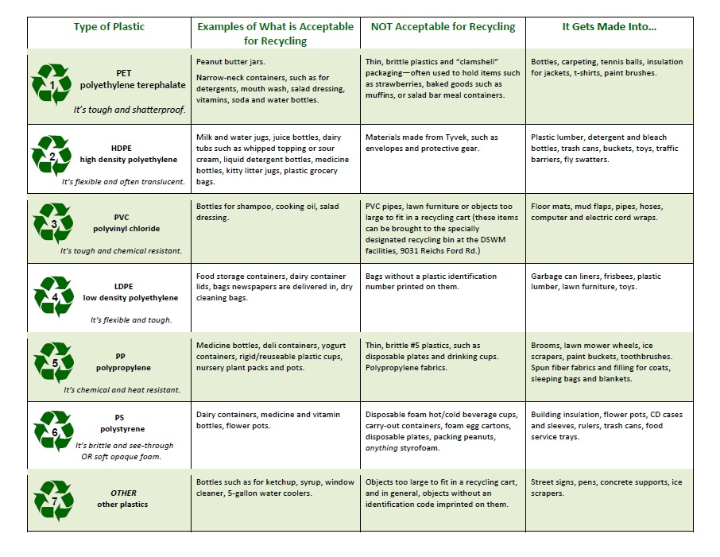
http://secondhandtips.com/plastic-recycling-codes/

Slide 24
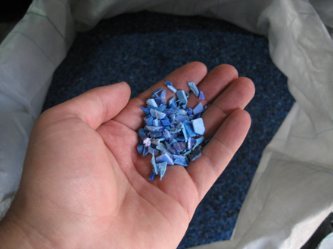

What happened to my soda bottle?
Patagonia developed fleece in 1993
http://www.patagonia.com/us/patagonia.go?assetid=2791
Notes:
Five 2-liter recycled PET bottles produce enough fiberfill to make a ski jacket (source: http://www.epa.gov/osw/education/pdfs/toolkit/tools-m.pdf)

Slide 25
Recycling Facts
Aluminum Cans:
A used aluminum can is recycled and back on grocery shelf in 60 days.
It requires 95% less energy and water to recycle a can than it does to create a can from raw resources
Recycling a single aluminum can save enough energy to power a TV for three hours.
Two-thirds of the aluminum ever produced is in use today.
There is no limit on how many times an aluminum can be recycled.
National Recycling Coalition, EPA, Earth91.org

Slide 26
Recycling Facts
Glass:
Glass can be recycled and re-manufactured an infinite amount of times and never wear out.
Making glass from recycled material cuts related water pollution by 50%.
Recycling just one glass jar saves enough electricity to light an 11 watt CFL bulb for 20 hours.
More than 28 billion glass bottles and jars end up in landfills every year -- that is the equivalent of filling up two Empire State Buildings every three weeks.
http://recycleacrossamerica.org/recycling-facts

Slide 27
Recycling Facts
Papers:
Americans throw away enough office paper each year to build a 12 foot high wall from Seattle to NY (a new wall every year).
Making paper from recycled paper reduces the related contribution to air pollution 95%.
Recycling a stack of newspaper just 3 feet high saves one tree.
More than 37% of the fiber used to make new paper products in the U.S. comes from recycled sources.
http://recycleacrossamerica.org/recycling-facts

Slide 28
Watch YouTube Video:
Going Green with Robotics & Automation http://www.youtube.com/watch?v=LatqW98SMXU
As you watch, think about how this applies to design and manufacturing
Another take on sustainability: The Story of Solutions http://storyofstuff.org/blog/movies/the-story-of-solutions/

Slide 29
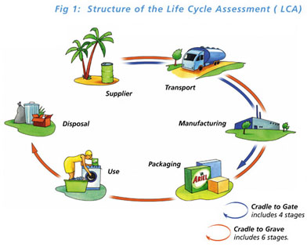
How do we judge if a product or service is sustainable?
Life Cycle Assessment (LCA)
Audit the total impact of the product’s or service’s
    Materials
    Manufacturing
    Packaging
    Use
    Disposal
    Transportation
Cradle to Cradle
(“Life Cycle Assessment,” n.d.)
Notes:
Process of comparing sustainability indicators for various engineering designs. Just one way to judge, there are others – LEEDS.

Slide 30
How do we judge if a product or service is sustainable?
Life Cycle Assessment
Audit in Terms of Energy and Resources
Air Emissions
Raw Material/ Processing
Manufacturing/Assembly
Energy
Use
Disposal
Transportation
Packaging
Water Pollution
Resources
Waste

Slide 31
Life Cycle Assessment
Categories of assessed damages
  Greenhouse gases (CO₂, CH₄, N₂O, H₂O, etc.)
  Ozone layer depletion
  Smog
  Habitat destruction
  Eutrophication (excessive nutrients)
  Pollutants
  Desertification
  Mineral & fossil fuel depletion

Slide 32
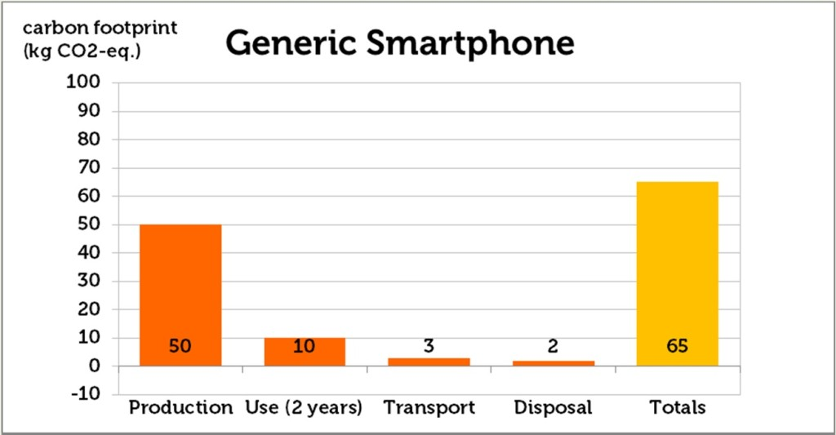
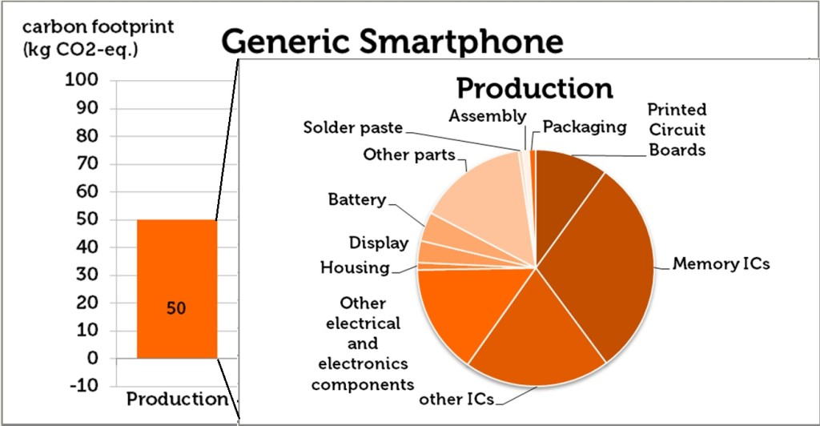
Life Cycle Assessment - Smartphone
https://www.fairphone.com/2013/08/01/whats-in-a-life-cycle-assessment/

Slide 33
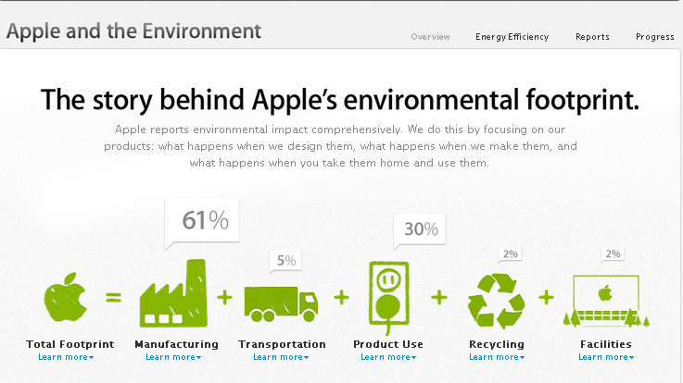
2013
Total Footprint 2013
Apple responsible for 33.8 million metric tons GHG emissions
http://www.apple.com/environment/reports/ /
Notes:
From Apple http://www.apple.com/environment/reports/ /
:
How our carbon footprint informs our thinking.
We’re always trying to improve the way we conduct our greenhouse gas life cycle
analysis. And when our assessments reveal a material, process, or system that’s making
a significant negative impact on our carbon footprint, we reexamine how we design
that product, process, or facility. For example, we were using industry
-
standard methods
to account for our emissions from aluminum, but because we use aluminum in so
many of our products, we decided to undertake an extensive survey of our aluminum
suppliers. Our study revealed that emissions associated with manufacturing our
aluminum housings were nearly four times higher than we believed, so we’ve updated
our 2013 life cycle analysis data to be more accurate. As a result, the carbon emissions
we reported for 2013 are 9 percent higher than the carbon emissions we reported for
2012. However, this increase is due to previously underestimating our emissions, not
because our emissions increased. In fact, when we recalculated the 2012 data using
the new methodology, our carbon emissions actually dropped by 3 percent year over
year. We’re committed to continuing to reduce our greenhouse gas emissions and
using our life cycle analysis to drive that change.

Slide 34
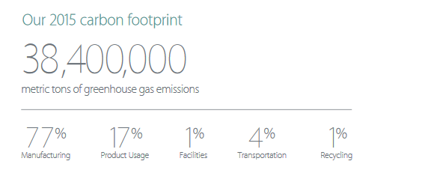
Apple’s Carbon Footprint 2015
http://images.apple.com/environment/pdf/Apple_Environmental_Responsibility_Report_2016.pdf

Slide 35
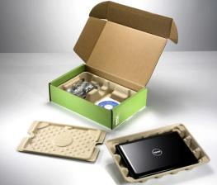
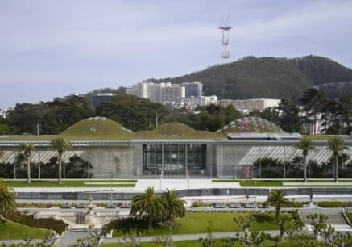
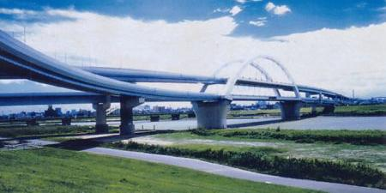
Sustainability Examples
Dell netbooks shipped in bamboo packaging
  Bamboo - highly renewable material as alternative to molded paper pulp, foams and corrugated cardboard
CA Academy of Sciences
  Green roof – natural insulation
  Insulation from recycled jeans
  Photovoltaics
Shuto Expressway- Japan
  Bridge lights powered using electricity
  generated from vibration caused by autos
Notes:
Ten vibration-power generators have been installed on the Goshiki-zakura Ohashi Bridge on the Tokyo Metropolitan Expressway, each containing a piezoelectric device fitted with a pendulum. Vibrations from passing vehicles cause the pendulums to swing, creating electricity that helps power the bridge's lights after dark. http://web-japan.org/trends/09_sci-tech/sci100107.html

Slide 36
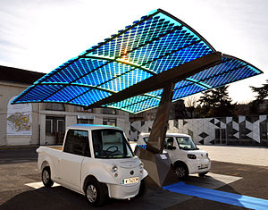
Sustainability Examples
Energy efficient parking garages
http://en.wikipedia.org/wiki/Sustainable_engineering

Slide 37

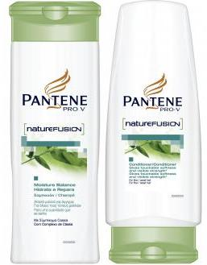

Bio-Based Bottles
Corn husks
Pine bark
Switch grass
100% Sugar cane
70% less fossil fuels & 170% less greenhouse gases per ton
Released March 2011
Notes:
Coca-Cola is partnering with JBF to build the world’s largest facility to produce bio-glycol—the key ingredient used to make PlantBottle packaging. The facility, which will be located in Araraquara, Sao Paulo, Brazil, will produce the ingredient using locally sourced sugarcane and sugarcane processing waste. The Brazil plant is part of Coke's plan to have plant-based resin in all of its plastic bottles by 2020

Slide 38
What is SJSU Doing?
Reduce consumption by 15% by the end of FY 2009/10, as compared to 2003/04. (EO 987)
Extensive recycling: SJSU 2009 waste diversion rate was 91% (compared to 59% in 2006)
Facilities Development & Operations has “green fleet” of 68 electric maintenance carts
Remodeled and new buildings - LEED* Certification
Artificial turf at stadium (1 million gallons water annually)
Other projects: see www.sjsu.edu/sustainability
*Leadership in Energy and Environmental Design

Slide 39
Actions on Campus - Examples
Spartan Shops
  100% of used cooking oil recycled to create biodiesel for vehicles like school buses and trucks
  Compostable/biodegradable cups, lids, and straws
  Tableware composed of 100% post-industrial recycled fiber products
  Use locally grown produce when available
AS Computer Service Center in Student Union Computer Lab has e-waste drop off site
Converting landscaping to low water plants
Recycled water for toilets and landscaping

Slide 40
(http://www.sjsu.edu/fdo/docs/sustainability_at_fdo_presentation_102109.pdf)

Slide 41
(http://www.sjsu.edu/fdo/docs/sustainability_at_fdo_presentation_102109.pdf)

Slide 42
Engineering for the future….
Traditional Engineer Focus:
  Technical solution
  Solve the problem now
  Minimal concern for environment
Today’s Engineer will need to:
  Evaluate technical and non-technical solutions
  Solve problems for today and the future
  Interact with other disciplines to solve problems

Slide 43
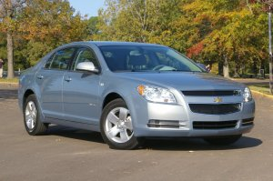
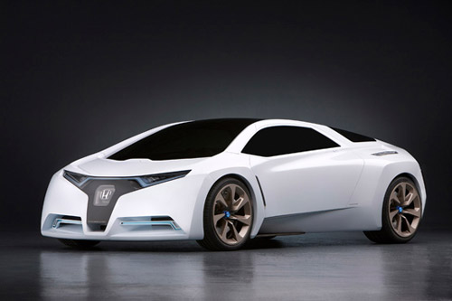
Tradition vs Future Engineering
Gas Combustion
Hydrogen Fuel Cell

Slide 44
Sustainability in our future
Phil Angelides (former CA State Treasurer): “between now and 2030, 75% of the buildings in the U.S. will either be new or substantially rehabilitated” (“What is,” 2008).
Read more: http://www.time.com/time/health/article/0,8599,1809506,00.html#ixzz0WiKqMFHL

Slide 45
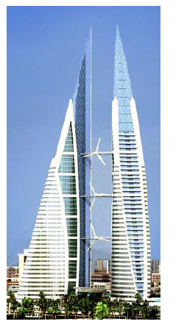
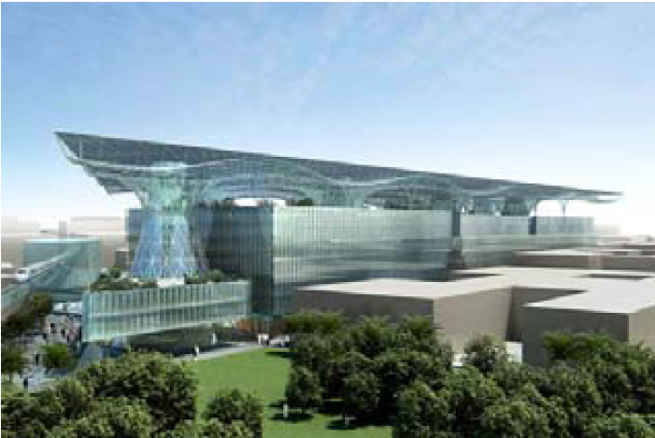
Zero-emissions city: Madar, Abu Dhabi
Bahrain World Trade Center: Manama, Bahrain

Slide 46
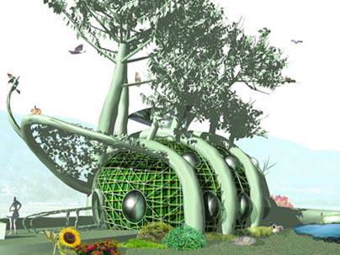
Home “Grown”
http://newsoffice.mit.edu/2006/house
Notes:
Tracy Staedter, Technology Review
August 1, 2006
Comment
In the future, homeowners may grow their houses instead of building them.
That's the vision of MIT architect Mitchell Joachim of the Media Lab's Smart Cities group. He and his colleagues -- environmental engineer Lara Greden (S.M. 2001, Ph.D. 2005) and architect Javier Arbona-Homar (S.M. 2004) -- have conceived a home that doesn't just use "green" design but is itself a living ecosystem. They call it the Fab Tree Hab.
The basic framework of the house would be created using a gardening method known as pleaching, in which young trees are woven together into a shape such as an archway, lattice, or screen and then encouraged to maintain that form over the years.

Slide 47
Green Collar Jobs
Solar energy
Wind energy
Public transit
Green Building design and construction
Design/manufacturing of sustainable products
Recycling and material reuse
Energy efficient automobiles
Environmental compliance specialist
Many more . . .

Slide 48
Green in Your Education
SJSU College of Engineering has a Green Engineering Minor
12 units total
Program goals
  Apply principles of green and sustainable engineering to engineering problems.
  Analyze economic and environmental impact of biofuels, photovoltaics, rechargeable batteries, and fuel cells.
  Use life cycle thinking in engineering activities.
  Participate in student research projects that apply new, sustainable and environmentally sound technologies and methods to real world problems.
More info: www.engr.sjsu.edu/gen/greenengr

Slide 49
Center of Sustainable Engineering
“…it is recognized that engineers of the future must be trained to make decisions in such a way that our environment is preserved, social justice is promoted, and the needs of all people are provided through the global economy.”
Center for Sustainable Engineering: http://www.csengin.org/csengine/

Slide 50
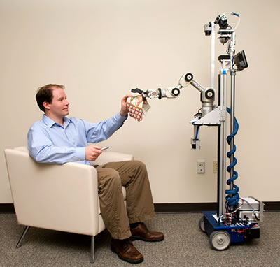
Designing Across Lifespan Paper
Lab Assignment
  See Guidelines
  Check with Lab Instructor for submitting
Discuss some ways you might modify an assistive robot for the two audiences
Source: http://www.robaid.com/

Slide 51
References
Dashboard of Sustainability. (2009, January 2). In Wikipedia, The Free Encyclopedia. Retrieved 14:55, November 24, 2009, from http://en.wikipedia.org/w/index.php?title=Dashboard_of_Sustainability&oldid=261419740
EPA. 2009. Sustainability: Basic Information. Retrieved Nov 1, 2009 from http://www.epa.gov/sustainability/basicinfo.htm
Life Cycle Assessment. (n.d.) Retrieved Nov 11, 2009 from http://www.scienceinthebox.com/en_UK/sustainability/lifecycleassessment_en.html
What is a Green Collar Job, Exactly? May 26, 2008. Time. Retrieved Nov 10, 2009 from http://www.time.com/time/health/article/0,8599,1809506,00.html

Slide 52
Back Up

Slide 53
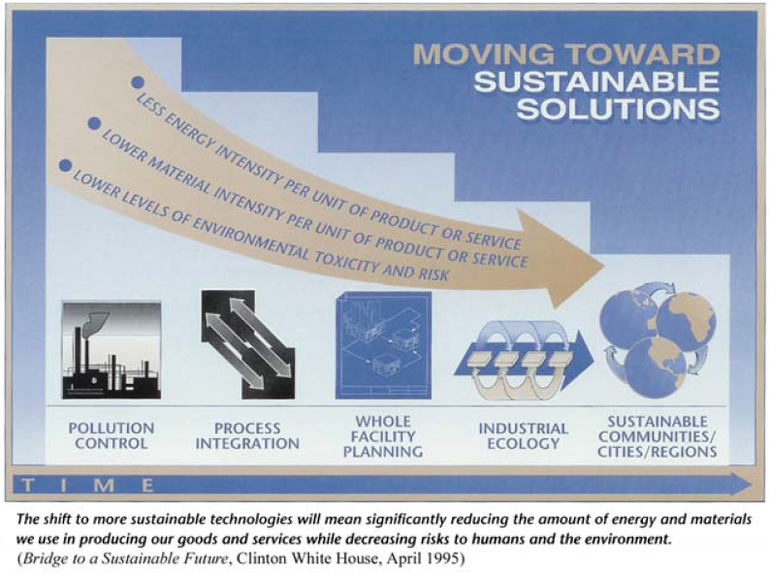

Slide 54
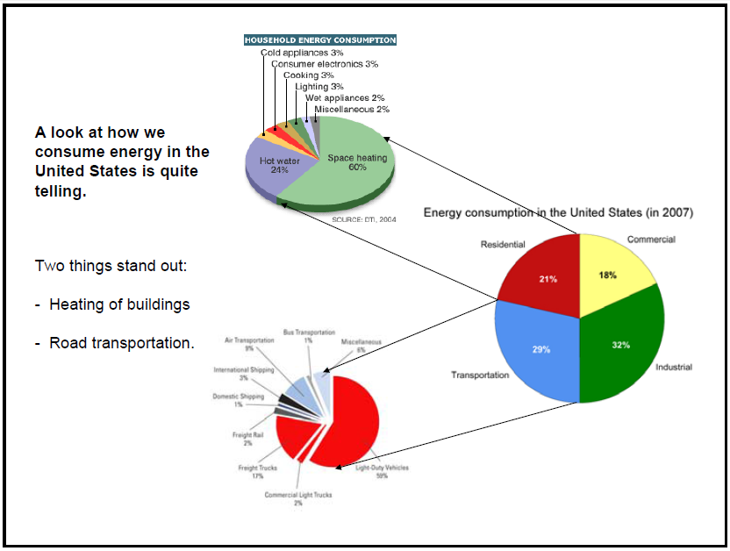

Slide 55
The Twelve Principles of Green Engineering
Inherent Rather Than Circumstantial. Designers need to strive to ensure that all materials and energy inputs and outputs are as inherently nonhazardous as possible.
Prevention Instead of Treatment. It is better to prevent waste than to treat or clean up waste after it is formed.
Design for Separation. Separation and purification operations should be designed to minimize energy consumption and materials use.
Maximize Efficiency. Products, processes, and systems should be designed to maximize mass, energy, space, and time efficiency.
Output-Pulled Versus Input-Pushed. Products, processes, and systems should be "output pulled" rather than "input pushed" through the use of energy and materials.
Conserve Complexity. Embedded entropy and complexity must be viewed as an investment when making design choices on recycle, reuse, or beneficial disposition.
Durability Rather Than Immortality. Targeted durability, not immortality, should be a design goal.
Meet Need, Minimize Excess. Design for unnecessary capacity or capability (e.g., "one size fits all") solutions should be considered a design flaw.
Minimize Material Diversity. Material diversity in multicomponent products should be minimized to promote disassembly and value retention.
Integrate Material and Energy Flows. Design of products, processes, and systems must include integration and interconnectivity with available energy and materials flows.
Design for Commercial "Afterlife". Products, processes, and systems should be designed for performance in a commercial "afterlife."
Renewable Rather Than Depleting. Material and energy inputs should be renewable rather than depleting.
* Anastas, P.T., and Zimmerman, J.B., "Design through the Twelve Principles of Green Engineering", Env. Sci. and Tech., 37, 5, 95 ? 101, 2003.

Slide 56


LEED MISSION:
Leadership in Energy and Environmental Design
Promote and accelerate adaptation of green awareness
To create better buildings and communities: healthy places to live, work and play

Slide 57
LEED Certification Process
Certification Level | Points Required
LEED Certified | 26 to 32
LEED Silver Certified | 33 to 38
LEED Gold Certified | 39 to 51
LEED Platinum Certified | 52 or more
Possible 70 points total

Slide 58
LEED MISSION:
Credits are divided in 6 categories:
Sustainable Sites
Water Efficiency
Energy and Atmosphere
Materials and Resources
Indoor Environmental Qualities
Innovation and Design Process

