Slide 1
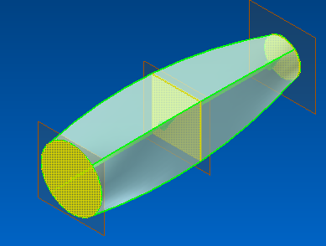
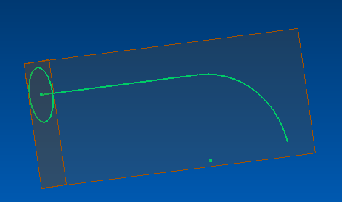
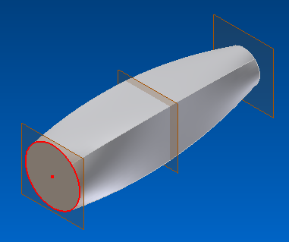
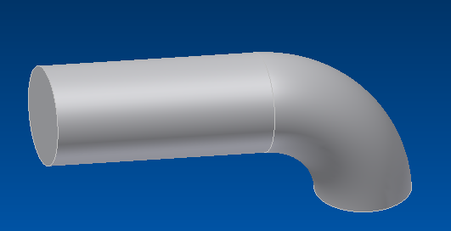
Sweep
Loft (sweep and blend combined
Creates a solid with different cross sections, multiple paths could be used
Creates a solid with uniform cross section
Profile
Path

Slide 2
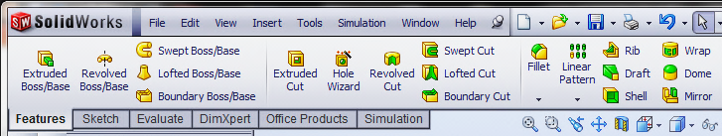
Sweep Command
Creates a swept solid
Removes material as it sweeps

Slide 3
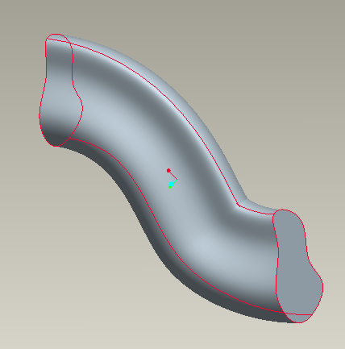
Sweep
Sweep command creates a solid by sweeping a profile along a specified path.
A sweep feature requires two sketches; a profile and a path. These two sketches cannot lie on the same plane or be parallel.
Path
The path can be either open or closed profile. It could lie on one plane or lie on multiple planes (3D sketch)
Profile (2D sketch)

Slide 4
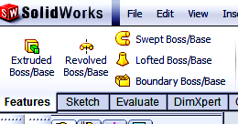
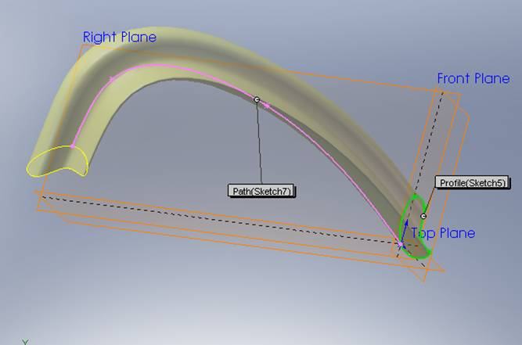
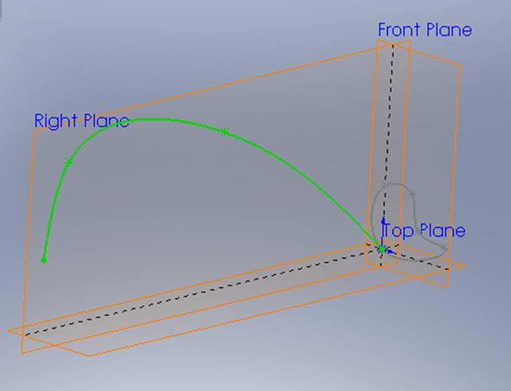
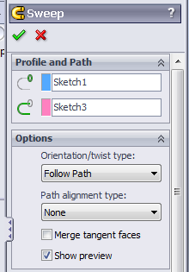
Sweep Command in SW
Sweep using a profile, path and Follow Path option
Path
Profile

Slide 5
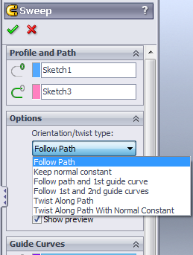
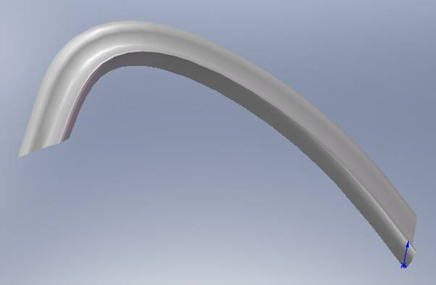
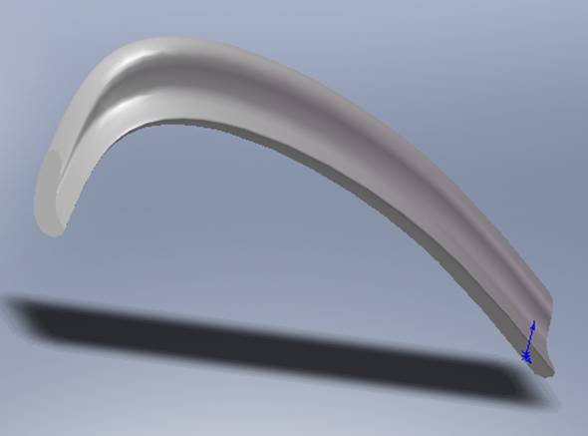
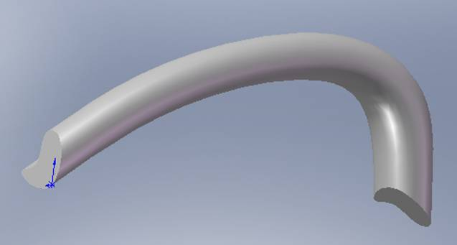
Sweep Command in SW
Sweeps using different Options
Follow Path
Twisted
Keep normal constant

Slide 6
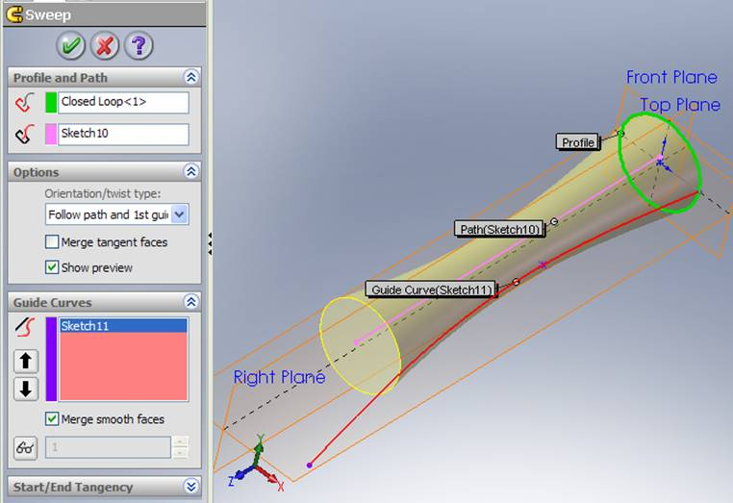
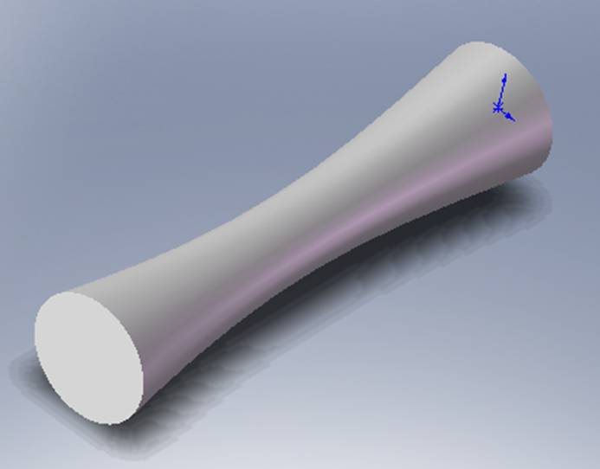
Sweep Command in SW
Sweep using a profile, path and one guide
Profile
Path
Guide curve 1

Slide 7
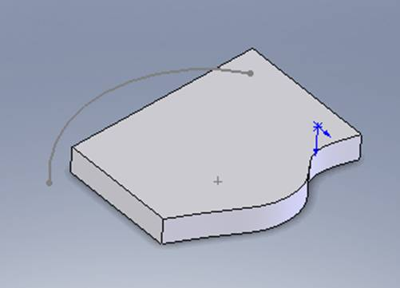
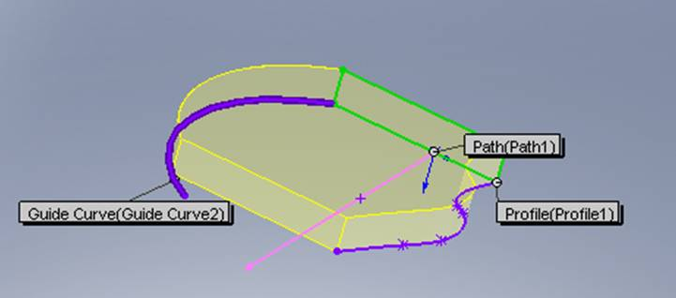
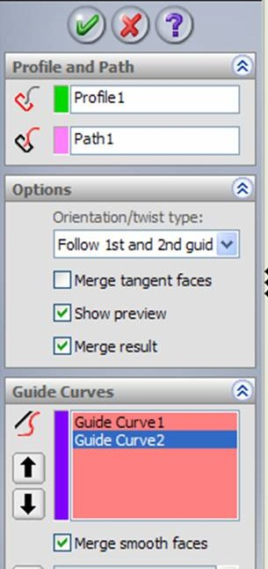
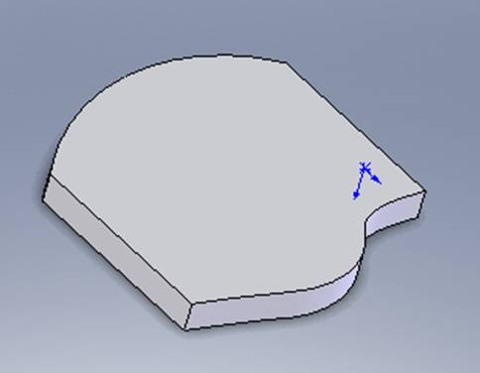
Sweep Command in SW
Sweep using a profile, path and two guides

Slide 8
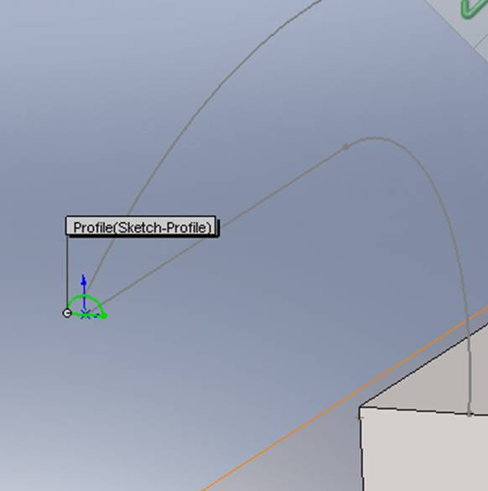
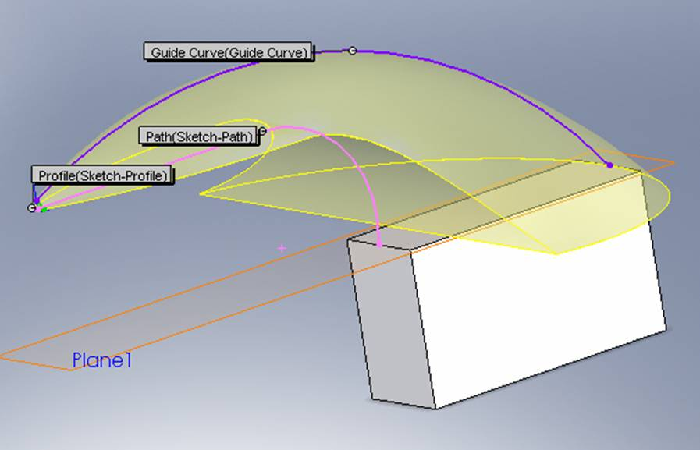
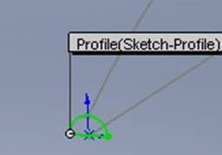
Sweep Command in SW
Sweep using Merge Smooth Faces option
Guide curve
Path

Slide 9
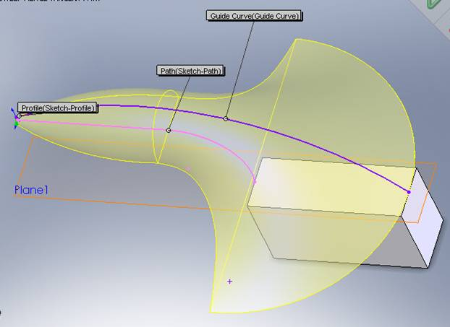
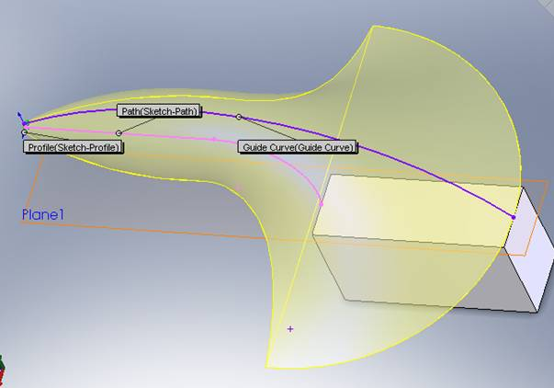
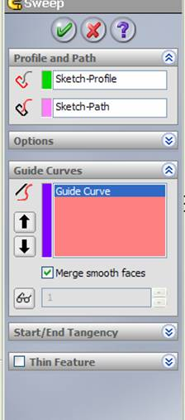
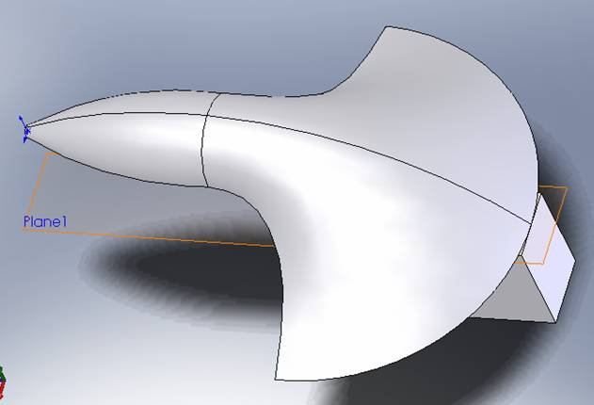
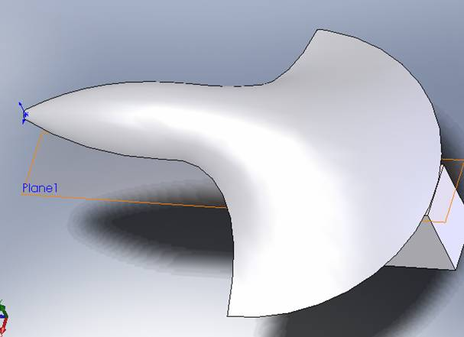
Sweep Command in SW

Slide 10
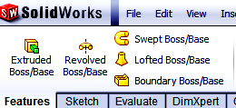
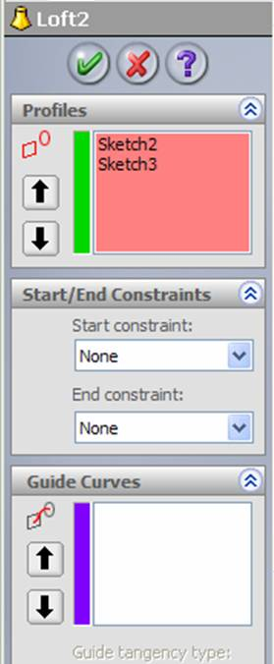
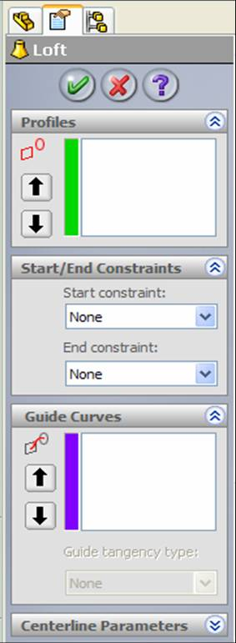
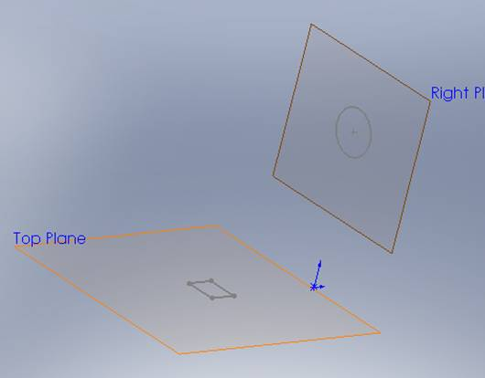
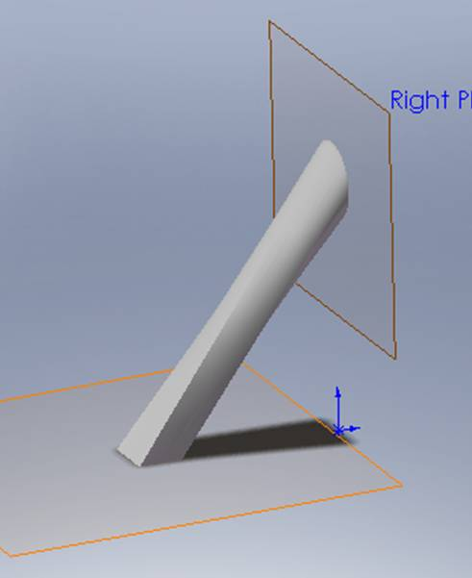
Loft Command in SW
Loft command creates a surface or a solid by sweeping and blending using two or more different profiles.
List of profiles
List of Guides

Slide 11
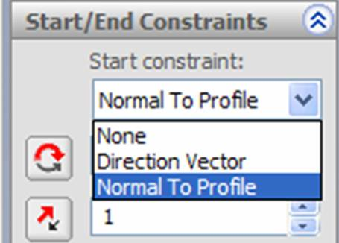
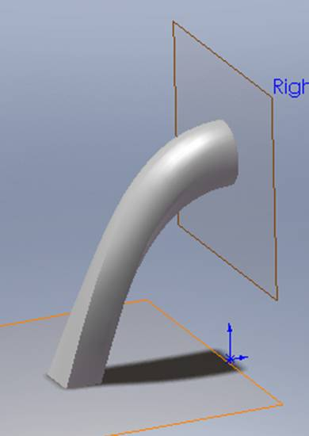
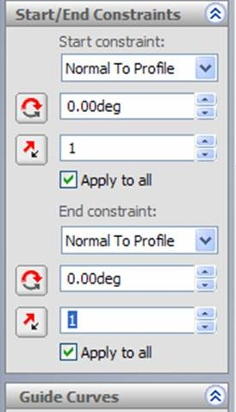
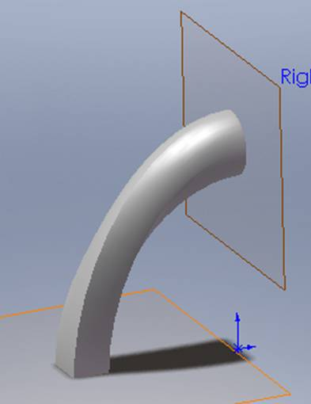
Loft Command in SW
Start and End Constraints options
Profile normal to the plane at the start
Profile normal to the plane at the end

Slide 12
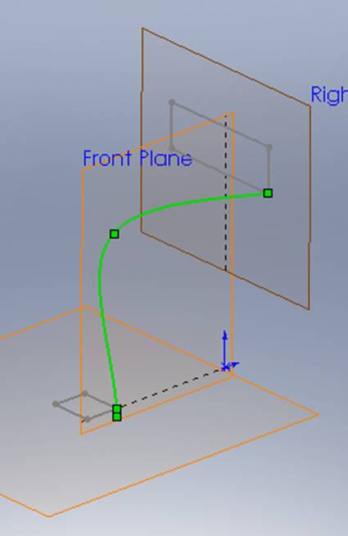
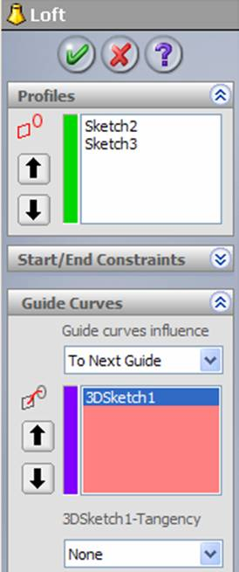
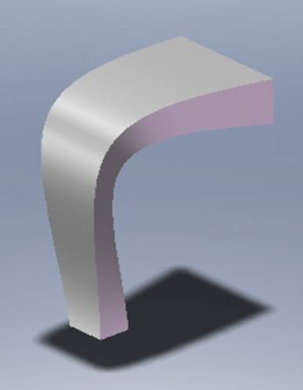
Loft Command in SW
Loft using a single Guide Curve.
Profile
Guide, 3D sketch
Profile

Slide 13
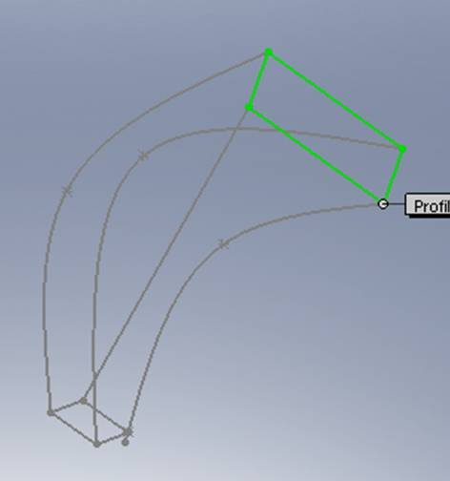
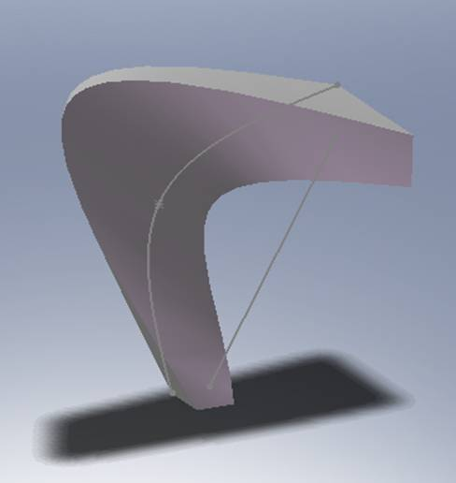
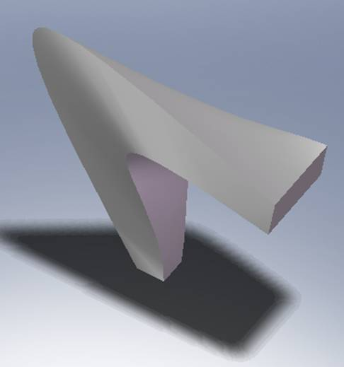
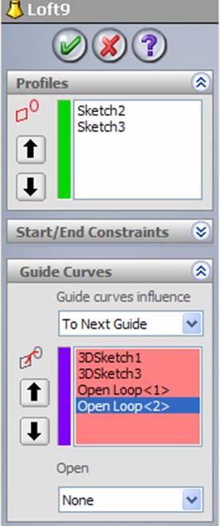
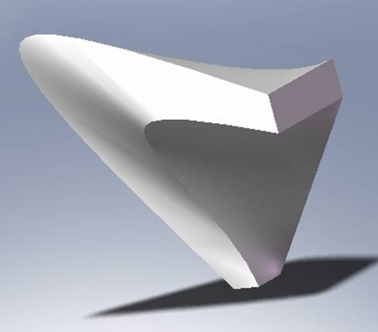
Loft Command in SW
Loft using many Guide Curves.
Guide 3
Guide 4
Guides 1,2
Guides 1,2,3
Guide 2
Guide 1
Guides 1,2,3,4

Slide 14
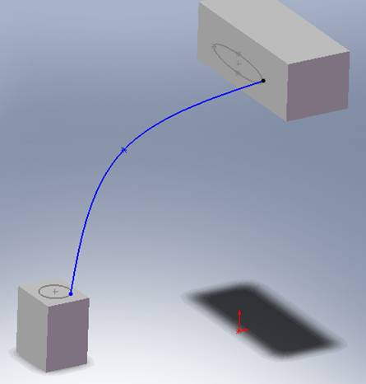
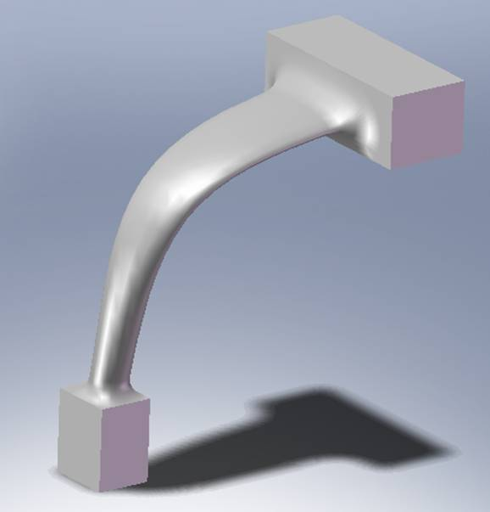
Loft Command in SW
Merging a Loft with a feature

Slide 15
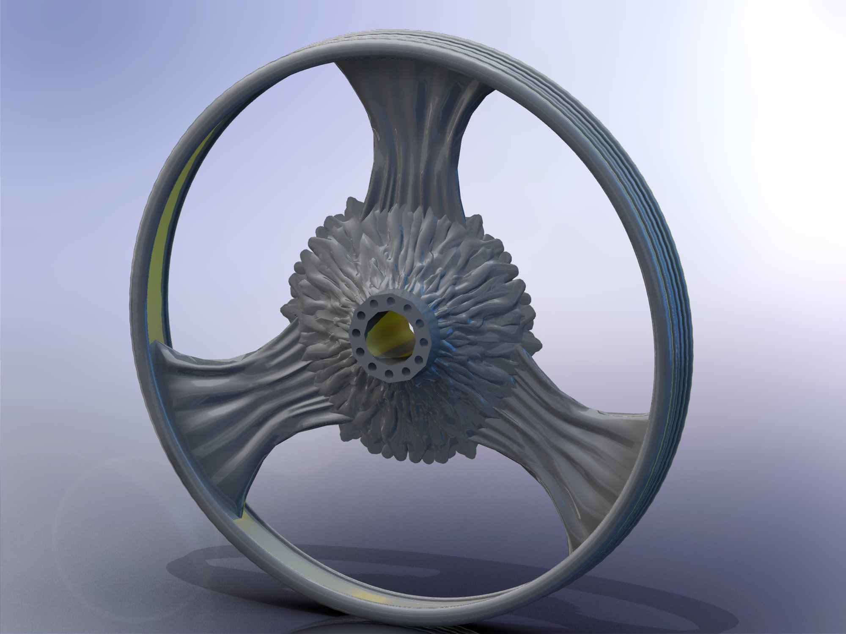

Slide 16
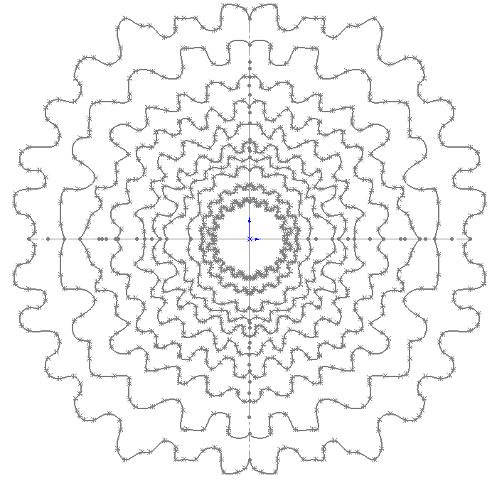
10 spline sketches on planes .3 inches apart

Slide 17
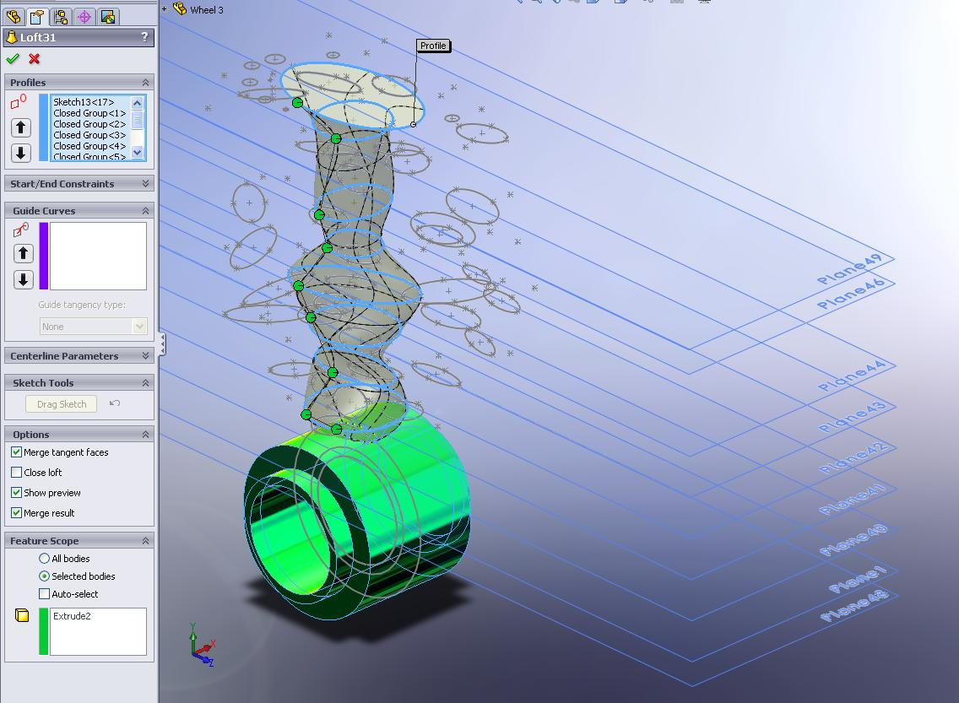
Example

Slide 18



Slide 19




Slide 20


Knife handle

Slide 21


Knife blade
Hand and wrist

