Slide 1
What is the CSU Early Assessment Program?
Jessica Shillings
Academic Preparation
San José State University
Notes:
Script: High school students, are you ready for college? The CSU’s Early Assessment Program can help you answer this important question. After all, getting into college is not the same thing as being prepared for college-level courses.

Slide 2
Multiple Measures
First Year Course Placement
The CSU Early Assessment Program evaluates academic preparation (and placement in first year math and writing courses) though Multiple Measures criteria, which take into account...
Overall HS GPA
HS Math GPA
Accumulated coursework
Some senior year coursework
Community college coursework
Standardized tests…
SAT and ACT
CAASPP/EAP
AP Exams
Notes:
Script: Like all colleges and universities, the CSU wants to make sure that our admitted students are successful during their first year of college - especially in their first year math and writing classes which are some of the most important foundational skills for all other college courses. The Early Assessment Program places students in the most appropriate math and writing courses during their first year at the CSU by evaluating multiple measures. This means that the CSU will look at the score you earned on the CAASPP exam, (the standardized test you took at the end of your junior year), as well as a number of other factors on your high school transcript, including: overall high school GPA, math GPA, how many math and english courses you took in high school, senior year math and english courses taken, as well as test scores from the SAT, ACT, AP or IB exams. We also consider community college coursework.

Slide 3
Early Assessment Program
All 23 CSU campuses use the Early Assessment Program to decide which students will need to take support and Early Start classes
Students are given three opportunities to demonstrate academic preparation.
First Opportunity
CAASPP Results
Second Opportunity
Choices you make during senior year
(Approved course work, high GPA as well as high AP/SAT/ACT/IB exam scores)
Third Opportunity
Supported coursework at the CSU
Academic Success
Notes:
Script: All 23 CSU campuses use the Early Assessment Program’s multiple measure transcript review process to decide which students will need to take support classes along with their regular math and writing general education courses during their first year of college. Students who do not demonstrate academic preparation through multiple measures during high school will be asked to take support courses, participate in the CSU’s Early Start summer program, or both. Students have three opportunities to demonstrate academic preparation: First by earning Level 4 on the CAASPP exam; Second by taking approved coursework, earning a high GPA or appropriate test scores on the SAT or ACT, AP or IB exams; and third by taking supported coursework at the CSU.

Slide 4
Senior Year Courses
Mathematics
Students who earn a 3 on the CAASPP can meet the CSU academic preparation mathematics standard by completing (with a C- or better in both semesters):
A yearlong math course that has Algebra II or Integrated Mathematics III as a prerequisite
Repeating Algebra II or Integrated Math III is not acceptable as a senior year experience.
English
Students who earn a 3 on the CAASPP can meet the CSU academic preparation writing standard by completing (with a C- or better in both semesters):
AP English (either course)
IB English (HL and SL)
Honors English – GPA-weighted in UC CMP
The CSU Expository Reading & Writing Course
Notes:
Script: Students who earn a Level 3 on the CAASPP should complete qualifying senior year math and English courses to demonstrate academic preparation while in high school. Any year long course at your high school that has a prerequisite of Algebra II or Integrated Math III is considered a qualifying senior year math course. (Repeating Algebra II or IM III is not acceptable.) For English, qualifying courses include: AP English (either course), IB English (HL and SL), the CSU’s Expository Reading and Writing Course (known as ERWC or any honors English courses recognized by the UC Course Management Portal. Students must earn a grade of C- or better in both semesters of any qualifying math or English course.

Slide 5
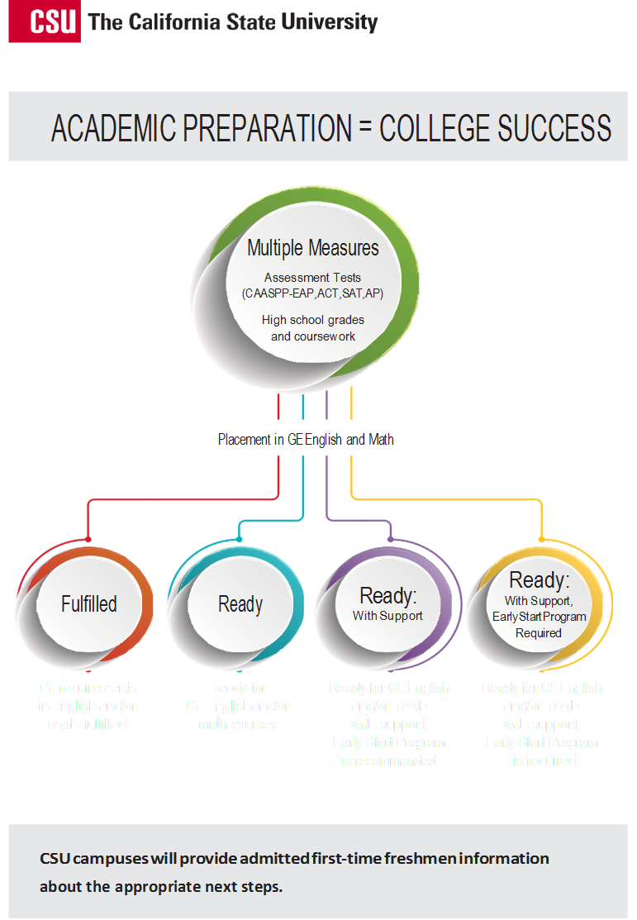
Category III: Academic Support
Stretch classes
Co-requisite classes
Optional Early Start
Category IV: Academic Support
Stretch classes
Co-requisite classes
Mandatory Early Start
Notes:
Script: In May of their senior year, admitted CSU students will receive notification of their final enrollment category for both math and English. There are four possible categories; Category 1 (Fulfilled) which means that the student already completed the general education math or English requirement with AP, IB or community college work; Category 2 (Ready) which means that the student is academically prepared to enroll in general education math or English courses without support; Category 3 (Ready with support) which means the student will be required to enroll in support courses along with their general education math or English courses; and Category 4 (Ready with support, Early Start Program Required) which means the student will be required to enroll in support courses along with their general education math or English courses and will also be required to attend the CSU’s summer Early Start program. Students in Category 3 have the option to attend the Early Start Program while Category 4 students are required to attend. Academic support classes come in several forms, including stretch courses which break a one-semester up into a year long course and co-requisite tutorial courses which are taken at the same time as the main math or English course.

Slide 6
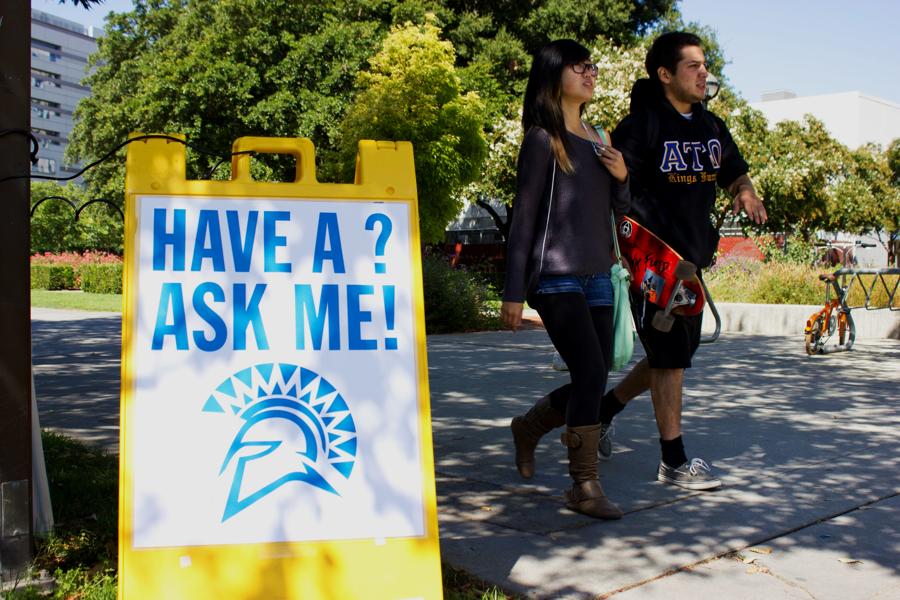
Jessica Shillings
Academic Preparation
jessica.shillings@sjsu.edu
Early Assessment Program:
http://www.sjsu.edu/eap/
Early Start: earlystart@sjsu.edu
http://www.sjsu.edu/earlystart/
Supported Instruction:
http://www.sjsu.edu/supportedinstruction/
Notes:
Thank you for learning more about the CSU’s Early Assessment Program! If you have questions about this important process, please feel free to contact SJSU staff member Jessica Shillings. You may also visit our SJSU Early Assessment Program website at www.sjsu.edu/eap/

