Slide 1

Lurie College of Education
Spring Forum
Themes: Safety & Communication

Slide 2

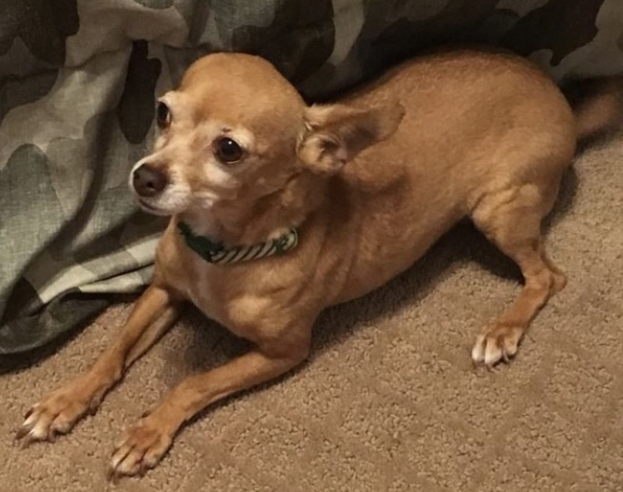


Slide 3
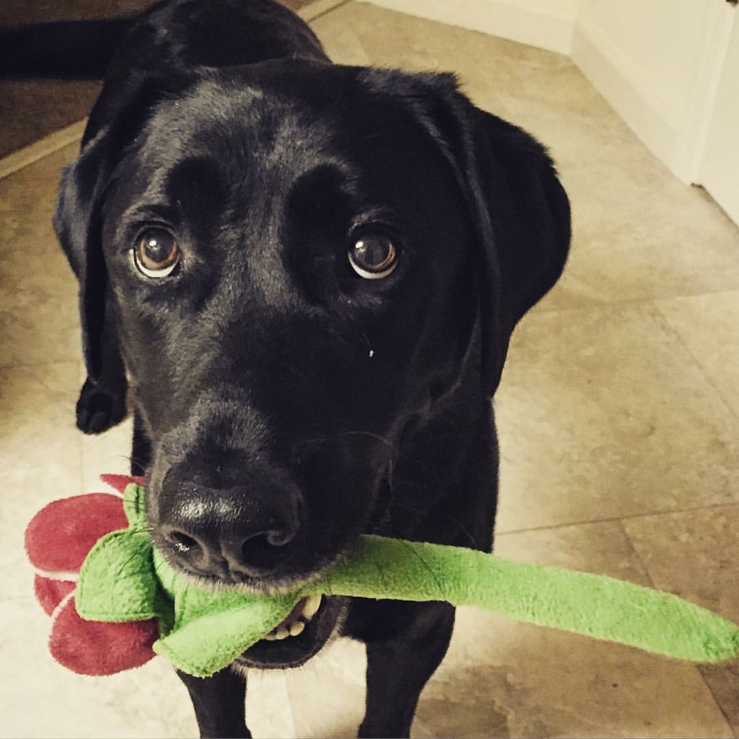
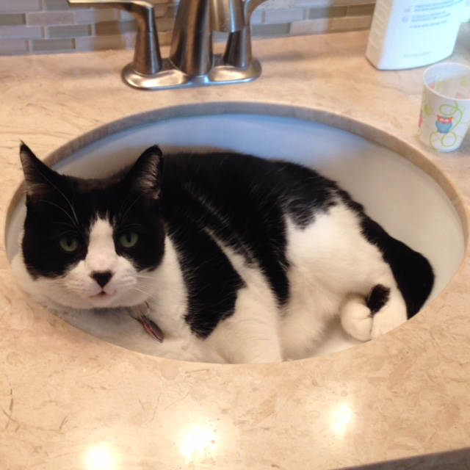

Slide 4
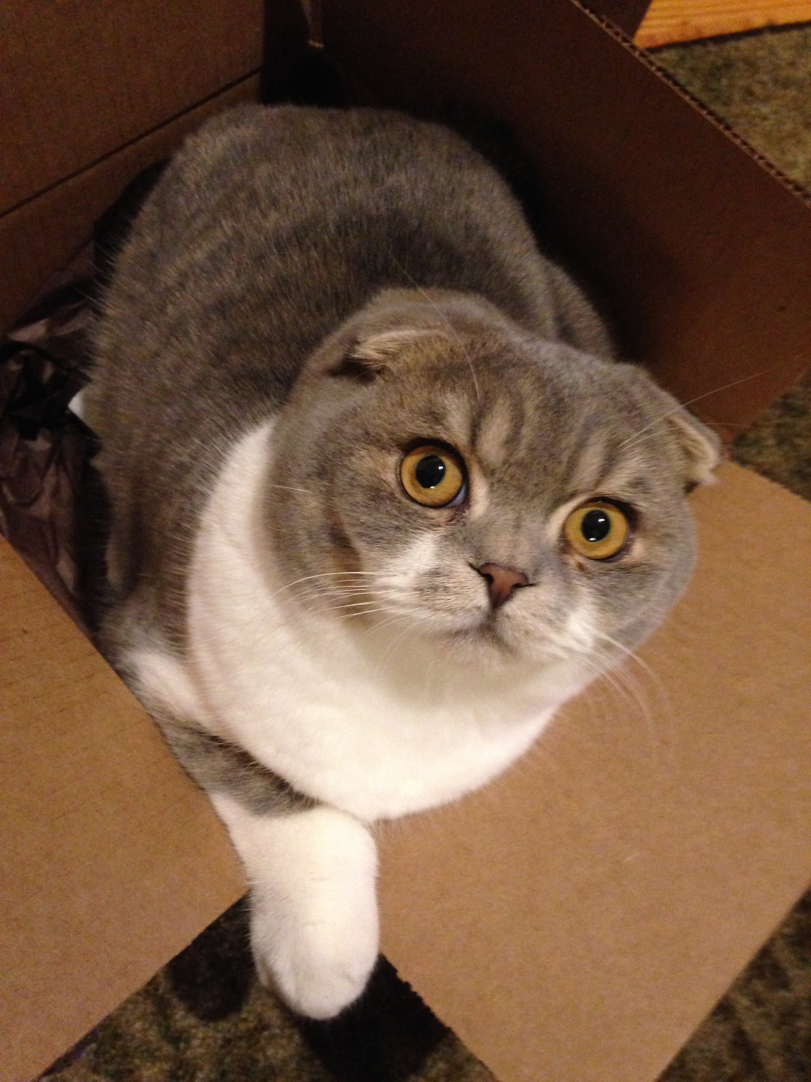
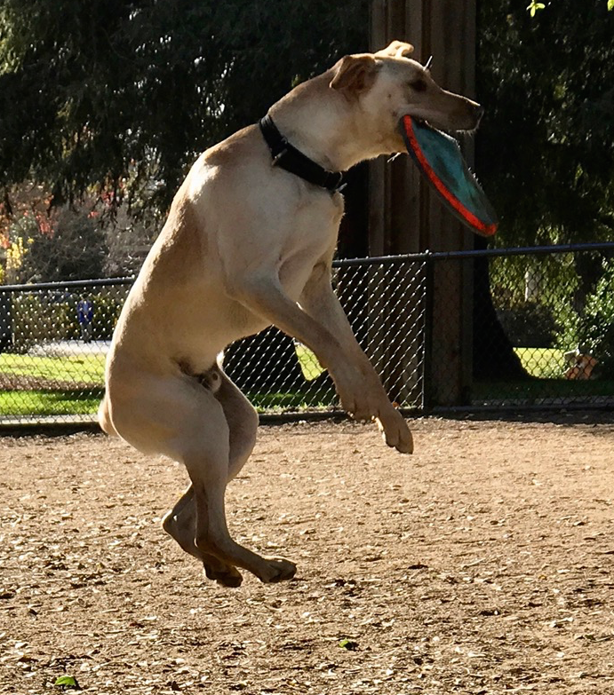

Slide 5

Agenda
Campus Safety
College Communications
Behavioral Intervention Team (9:15am)
Campus Police (10:30am)
Provost Feinstein (9:30am)
College Updates (9:45am)
Welty Report Follow-up (11:30am)

Slide 6
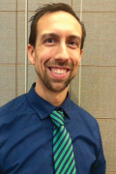
Behavioral Intervention Team
408-924-6339
http://www.sjsu.edu/bit/
Ben Falter

Slide 7
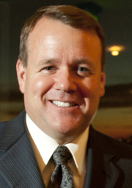
Andy Feinstein, Provost

Slide 8
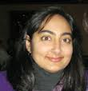
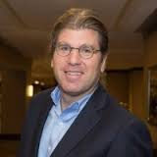
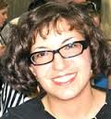
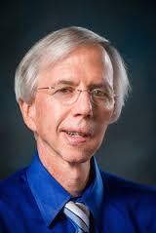
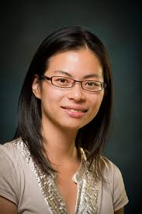
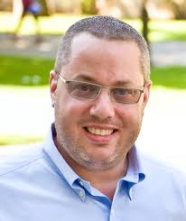

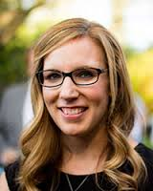
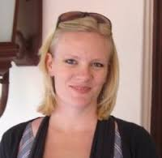
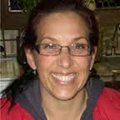
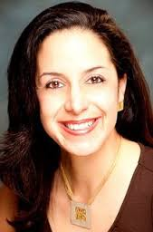
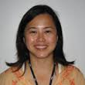
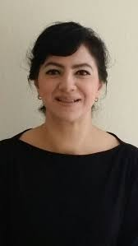
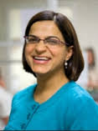
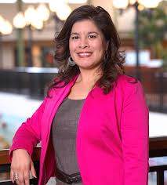
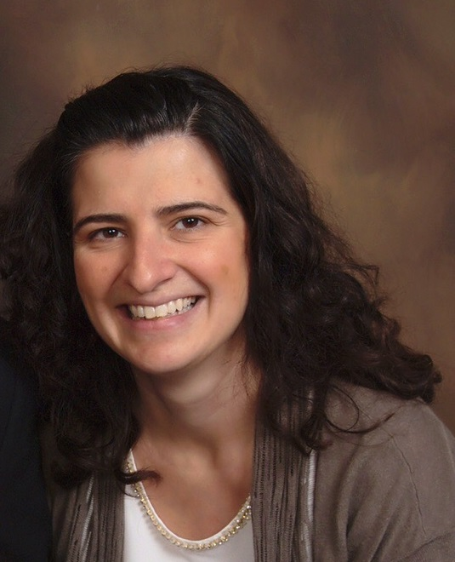
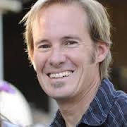
Senate Report

Slide 9
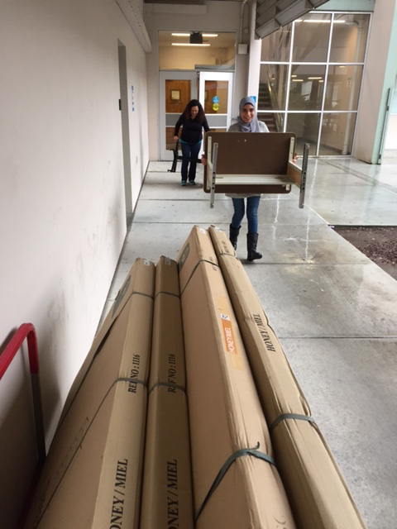
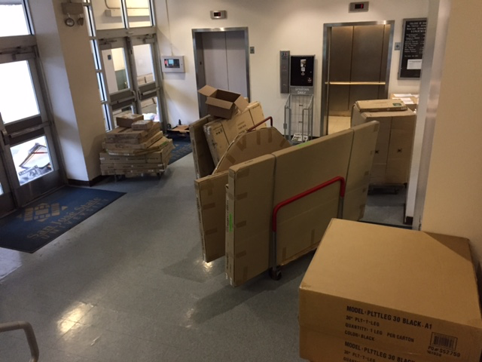
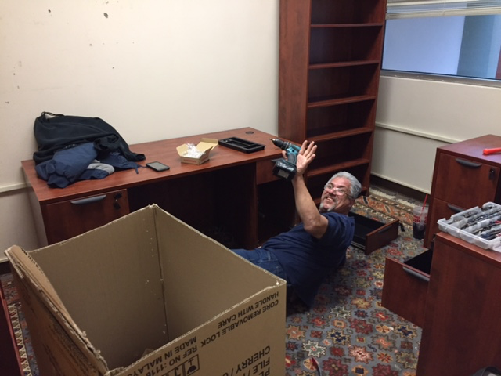
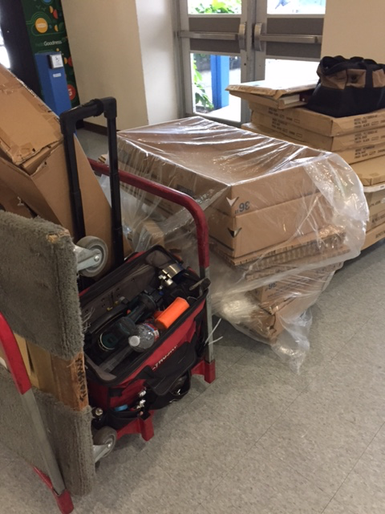
Thank
you
Sarah Arreola

Slide 10
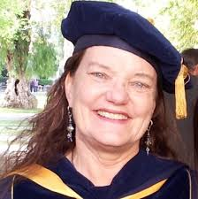
Thank
you
Chris Hagie

Slide 11
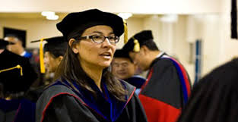
Thank
You
Cami Johnson

Slide 12
Spring, 2017 Chairpersons
Toni Campbell (CHAD)
Peg Hughes (EDSE)
Arnie Danzig (Ed.D.)
Welcome
Lynda Haliburton (CDS)
June McCullough (CDS)
Patty Swanson (TED)
Beverly Grindstaff (EDCO)
Mei-Yan Lu (EDAD)

Slide 13

Campus Safety
Capt. Frank BelCastro
Active Shooter Training
Managing Sexual Assaults

Slide 14
Lurie College Initiatives

Slide 15

Lurie College
Student Success Center

Slide 16
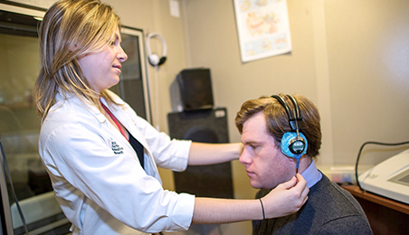

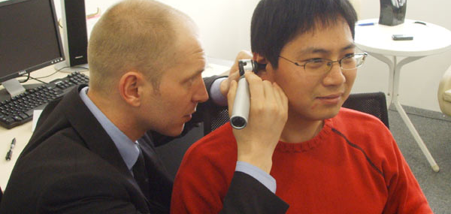
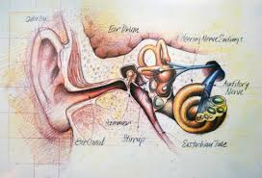
Doctor of Audiology (Au.D.)

Slide 17
Lurie College
Grants Academy Program
http://rfdr26.wixsite.com/lcoegap

Slide 18
Council for the Accreditation of Educator Preparation
Should Lurie College Recommend CAEP Re-accreditation?

Slide 19
CAEP Coordinator
Demonstrate current and accurate knowledge of CAEP processes and requirements
Work with Faculty, Chairpersons and Deans Office to embed CAEP elements into curricula, PLO’s, resource allocation
Liaison with SJSU initiatives: Student Success & WASC
Prepare CAEP documents
Facilitate CAEP site visit
Liaison with LEAP
Attend CAEP professional development conferences
Liaison with CCTC

Slide 20

Lurie College Co-Sponsor
Film Screening; Critical Race Studies Panel; Meet the Director (Enrique Aleman)
2/28/17; 4:00-7:00pm
Inclusiveness Day
Faculty Affairs
Accessible Education Center
3/21/17
Ability Redefined

Slide 21
Updates
Digital Display Monitor (Lesley)
Lurie College Communications Group (Lesley)
Alumni Board (Lesley)
Room 214 Renovation (Sue)
Travel Advisory Policy (Robin)
Permission for Final Exam Waivers (Robin)
President’s Town Hall, Friday 2/17/17, 3:30-4:30pm (Robin)

Slide 22
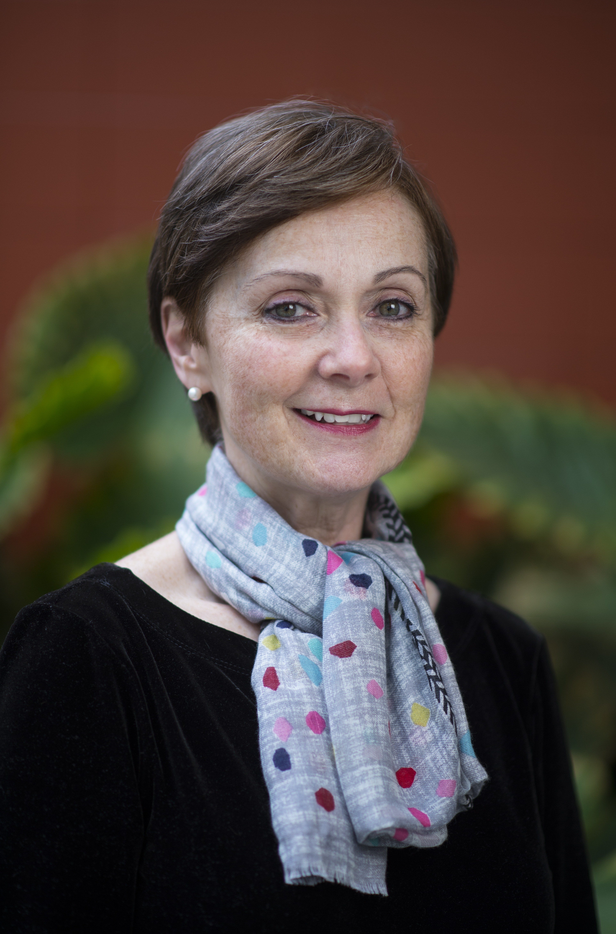
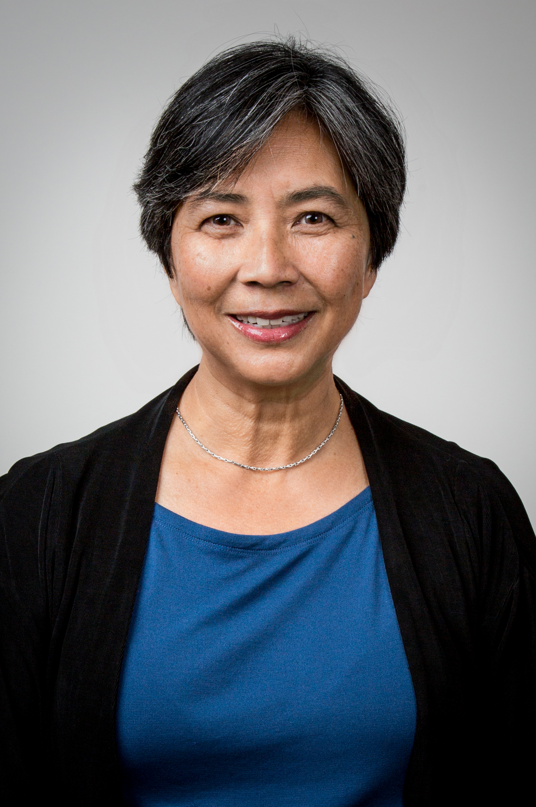
Mary McVey
Elaine Chin

Slide 23
Follow-up
Welty Report and Fall Retreat Working Groups

Slide 24


