Slide 1
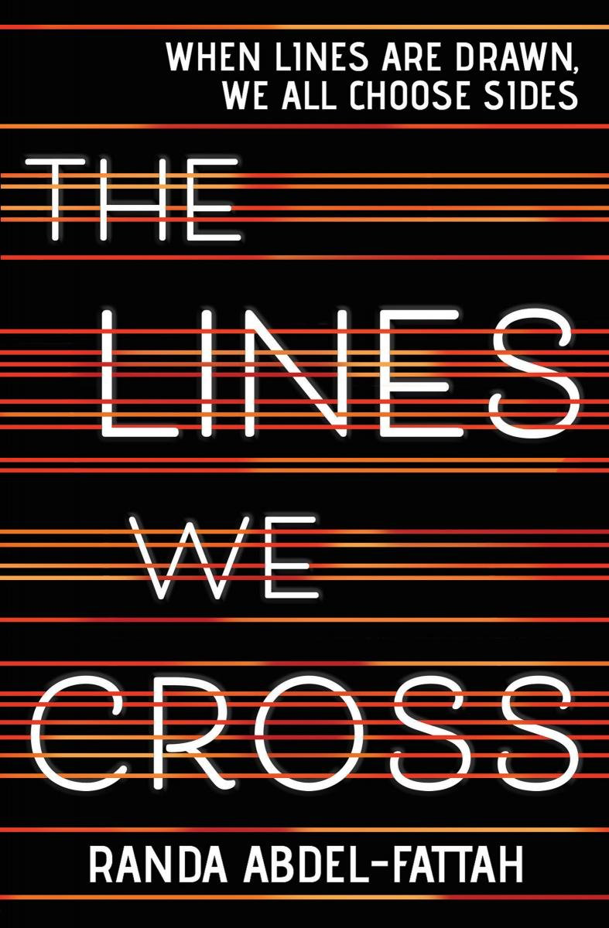
The Lines We Cross
by Randa Abdel-Fattah
Kendall Story

Slide 2
Politics, moral & ethical values, family, relationships, individual development

Slide 3
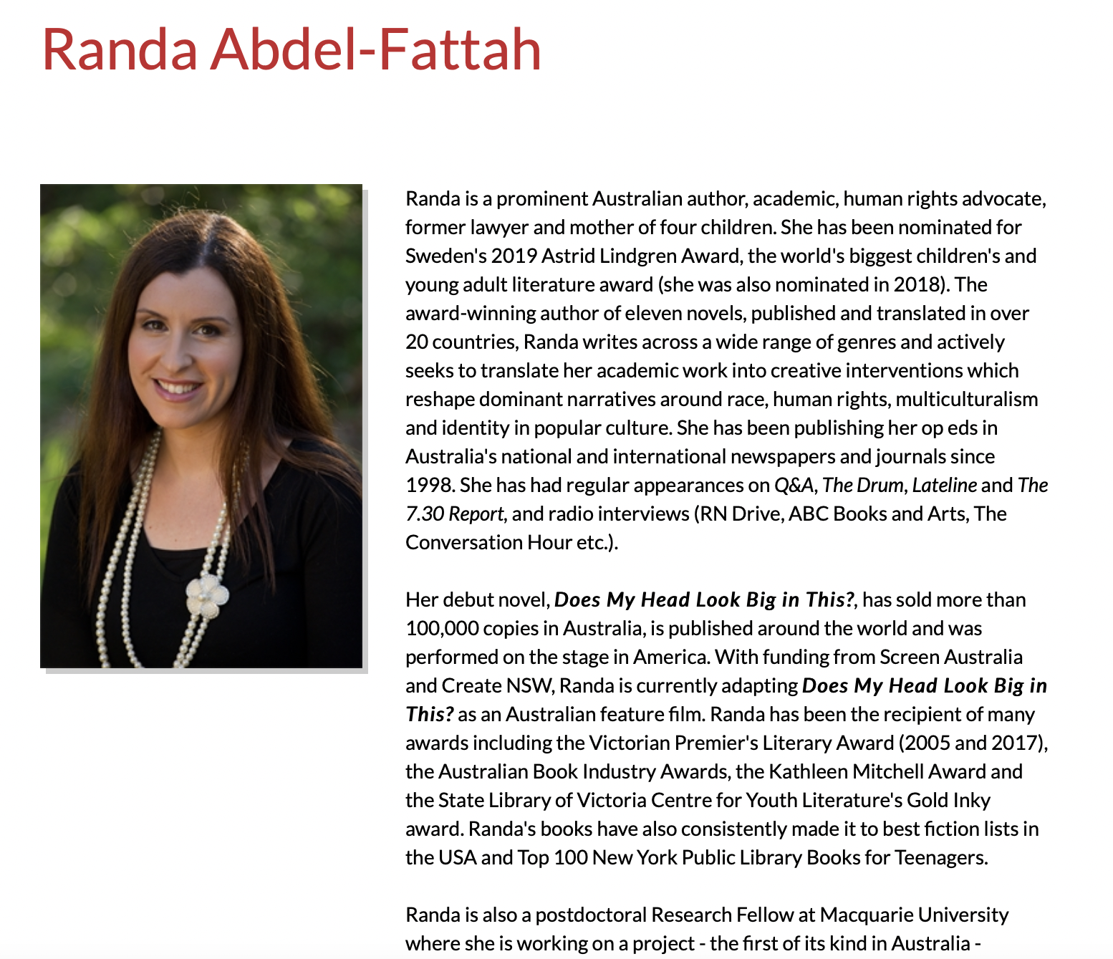
A bit about Randa Abdel-Fattah…
Postdoctoral Research Fellow in the Department of Sociology at Macquarie University where she is undertaking an ARC (Discovery Early Career Researcher Award)
Author, human rights advocate, lawyer, and a mother of four.
Literary style generally follows themes involving race, gender, identity, belonging, and political consciousness among young Australians.
Website (www.randaabdelfattah.com) is currently disabled.

Slide 4
Randa Abdel-Fattah
11 novels published in over 17 countries:
Does My Head Look Big In This?
The Lines We Cross
Where the Streets Have a Name
The Book That Made Me
Ten Things I Hate About Me
No Sex in the City
The Friendship Matchmaker Goes
Islamophobia and Everyday Multiculturalism in Australia
Coming of Age in the War on Terror
The Friendship Matchmaker
When Mina Met Michael

Slide 5
Summary:
The Lines We Cross by Randa Abdel-Fattah explains the colliding views of an Afghani-Australian teenager named Mina after earning a scholarship to a prestigious private school in Sydney, Australia and an opinionated young boy following his parent’s stance named Michael. Mina attends a back-to-school rally where she first meets Michael and quickly learns of his differentiating political views. Michael’s father is the leader of a small political party named “Aussie Values” which actively opposes allowing Muslim refugees and immigrants settle within Australia.
This story explains the points of view written in both Mina and Michael’s perspectives. Both students are in eleventh grade throughout the duration of the novel. Mina expresses her struggles adapting to this new cultural change and being surrounded by an amplified amount of privilege. Mina’s biological father was killed before the rest of her family decided to travel by boat to Australia for a safer life and are now being publicly viewed as “boat people” that “jumped the queue.”
Mina and Michael grow closer throughout the novel as they learn more about each other’s personal experiences. Michael is able to open his mind and see life in ways other than the how he was raised.

Slide 6
Chapter 3 p.g 22 - Michael
“They’re good students. First years. Always so eager at the start. So many young girls in hijabs though… How are people going to treat me? Am I inviting trouble?”
Chapter 4: Books about Real-Life Experiences
Chapter 6: Books about Identity, Discrimination, and Struggles with Decisions

Slide 7
Chapter 45 p.g 231 - Michael
“I feel as though a chasm has opened between my parents and me and that things between us can never be the same again… as if the only choice in front of me is keeping silent or breaking their hearts.”
Chapter 4: Books about Real-Life Experiences
Chapter 6: Books about Identity, Discrimination, and Struggles with Decisions
Chapter 7: Books about Courage and Survival

Slide 8
Chapter 45 p.g. 234 - Michael
“I can’t explain. It’s more than that. It’s like all these nameless, faceless people getting killed all around the world every day and nobody gives a shit because they’re not Aussie or American or French… He becomes real and he matters.”
Chapter 1: Young Adults Sharing Their Perspective
Chapter 4: Books about Real-Life Experiences
Chapter 5: Books about Facing Death and Loss
Chapter 7: Books about Courage and Survival

Slide 9
Text Complexity
Quantitative vs Qualitative
400 pages, realistic fiction, strong language
Lexile:
HL690L (ages 12-17)
ATOS:
Reading level 4.8
11.0 AR points
Readability:
Dale-Chall: 8
Flesch-Kincaid: 3.21/84
(very easy to read)
I agree with the text complexity statistics given for this novel. While some concepts throughout the novel may be more difficult to grasp for younger readers, this novel provides language that is easy to understand and an overall quick read. This novel offers opposing perspectives and the possibility of separating from your original roots. Invokes individualism and finding/standing up for your own true beliefs.

Slide 10
Work Cited
“Contributor.” Pan Macmillan Australia, 1 Sept. 2016, https://www.panmacmillan.com.au/author/randa-abdel-fattah/.
“Randa Abdel Fattah.” Macquarie University, https://researchers.mq.edu.au/en/persons/randa-abdel-fattah.

