Slide 1
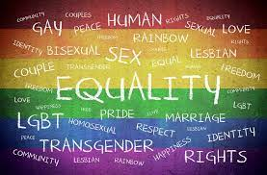
Representation in Literature

Slide 2
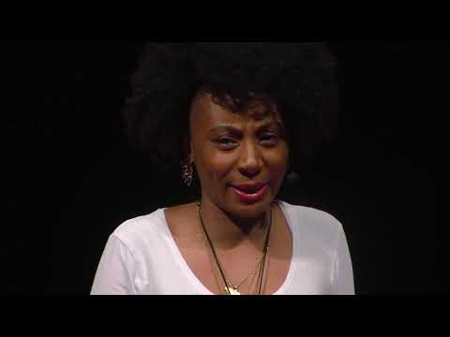
Aisha Thomas: Why Representation Really Matters
Until society represents everyone, the question will always be 'where do I belong?
Imagine growing up in the world where you are overlooked. What if you do not see yourself anywhere? The questions will always be where do I belong? Now I believe representation is vital because it provides the opportunity for your existence to be.

Slide 3
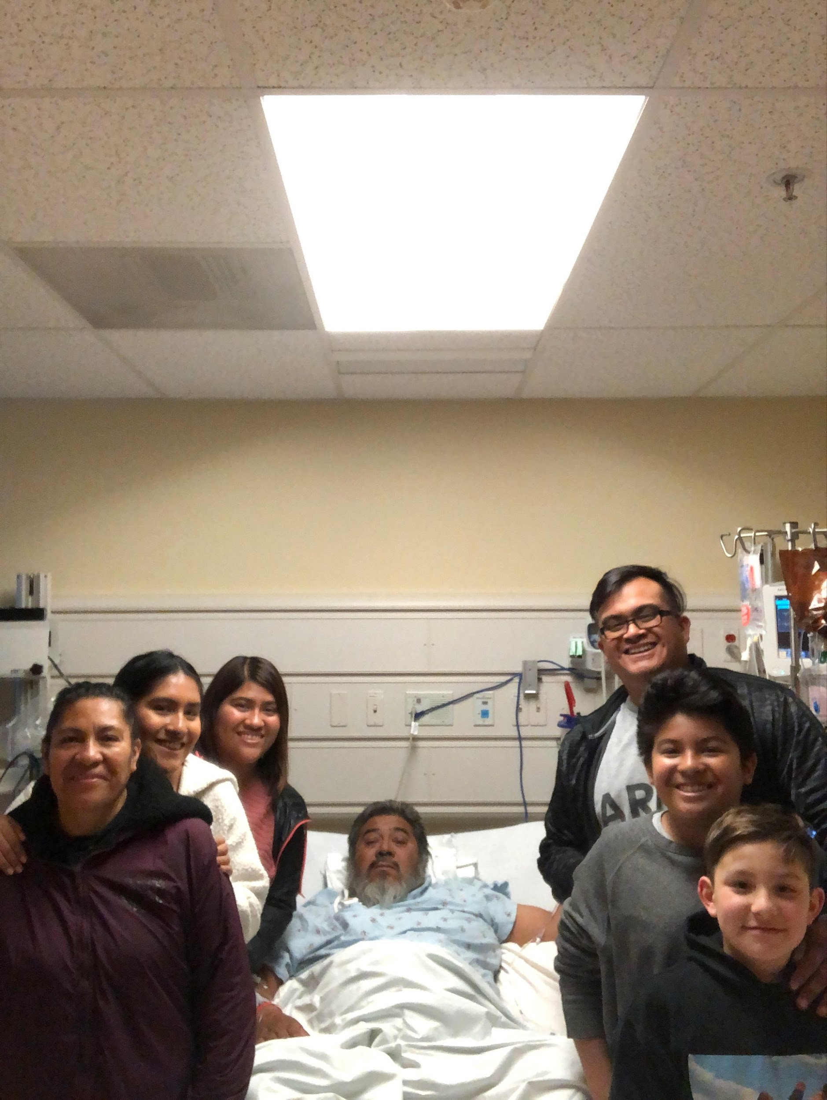
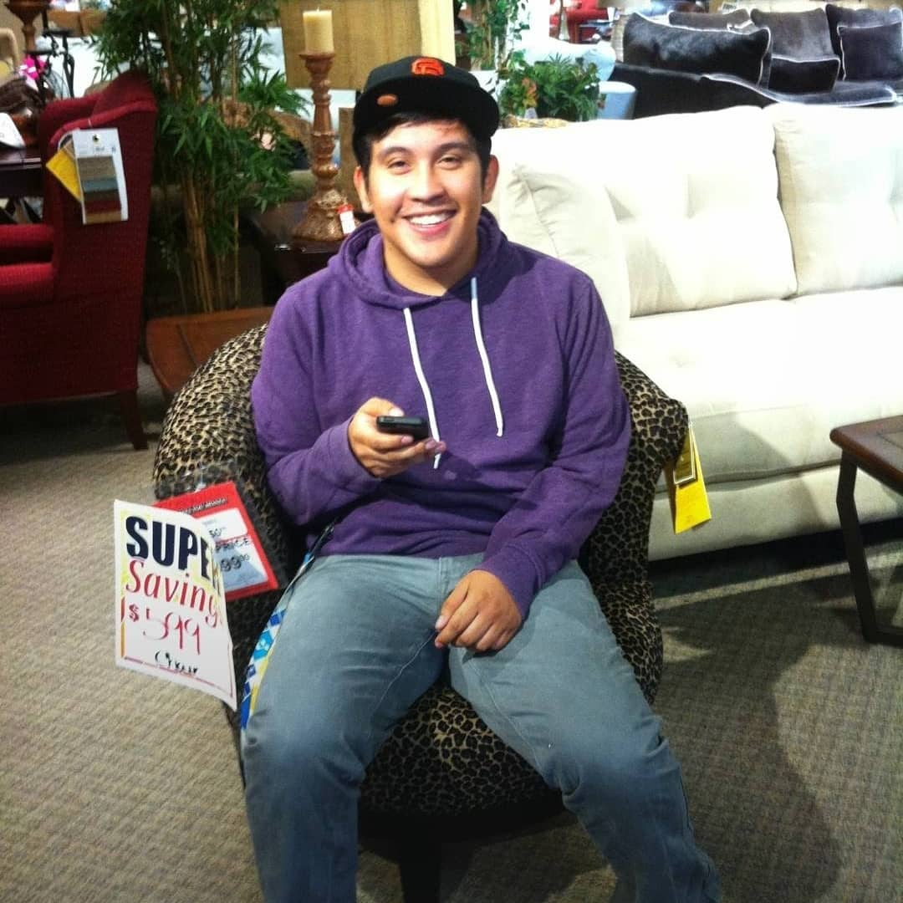
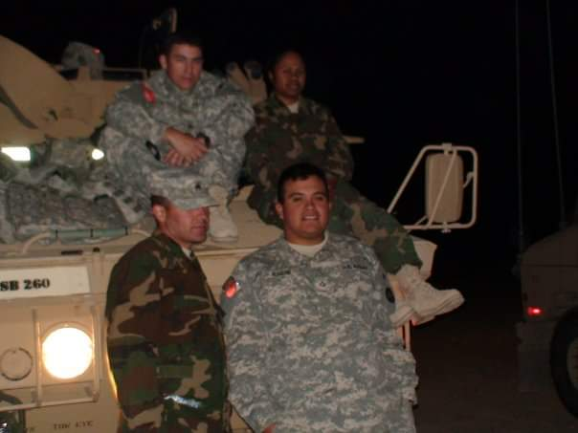
My Representation

Slide 4
1st Activity and Intro to book
After watching the YouTube video students will free write on a piece of paper:
What does representation mean to me?
The writing will be anonymous and at the end of 7-8 minutes of writing we will crumple of the papers and add them to a bin.
Once all papers collected, I would start by pulling out the first one reading out loud.
We would begin the book Like A Love Story using audio books and physical copies.

Slide 5
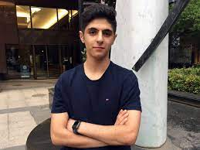
Characteristics of Reza
Iranian- from another country
Mother remarries after father being killed in Iran
Youngest child, has an older sister and an older step brother
Questioning his sexuality
Braces
New school

Slide 6
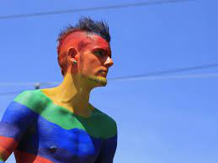
Characteristics of Art
Only openly gay teen at his high school.
Best friends with Judy.
Activist
Bold
Conservitive parents
Uses photography to document the AIDS epidemic

Slide 7
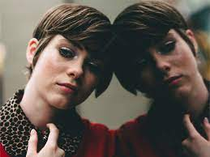
Characteristics of Judy
Best friends with Art
Aspiring fashion designer
Has an uncle that is battling AIDS
Activist
Parents are very accepting

Slide 8
Reflection of Intro to book
Students will start a Google doc and label it “Like my story”
The intro to the book has given a look at three different dynamics in a family with different teen outcomes.
Do you see your family reflected among the characters?
Which family do you connect with more and why?
You can mix up the families to fit your dynamic as well. Ex you have an uncle battling an illness and a conservative family, that would be similar to combining part of Judy’s family and Art’s.

Slide 9
Assignments
We are introduced to the main characters and immediately faced with a dilemma between Art and Reza. A Google doc will be started as a journal.
First entry in the journal will be to respond to what occurs between the teens?
Would you have handled the situation differently?
What would you tell Art in this situation if he asked you for advice?

Slide 10
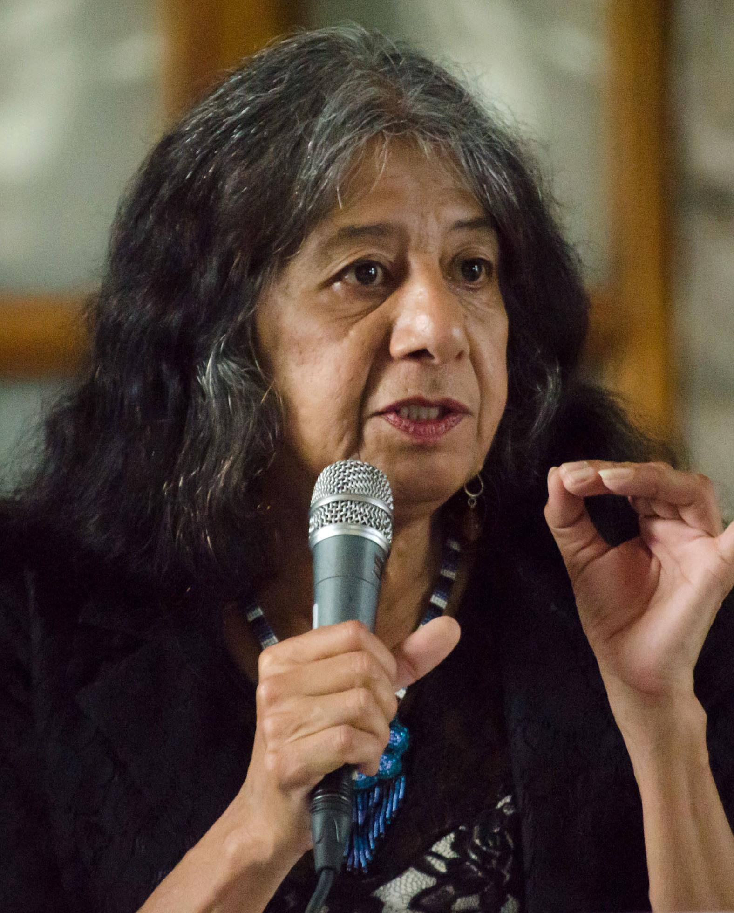
Representation in Poetry
One of the feelings Reza battles with is feeling at home or the sense of belonging. We will look at the poem Freeway 280 by Lorna Dee Cervantes. We will have an open discussion of the images described in the poem and if they recognize any. For those that are unsure of the imagery we would use Google Maps to check out pictures along the interstate.

Slide 11
Representation in Poetry cont.
The next assignment would be for the students to free write a poem on something that give that feeling of “home”.
Where do you feel most at peace?

Slide 12
Ending
In the novel, we see the AIDS epidemic and how it affected the LGTBQ+ community.
Do you see any similarities in the way we read how the church was spreading hate speech and today’s society?
Do you see any similarities in the way the AIDS epidemic is handled versus the COVID-19 pandemic?

Slide 13
Works Cited
Cervantes, Lorna Dee. “Freeway 280 by Lorna Dee Cervantes - Poems | Academy of American Poets.” Poets.org, Academy of American Poets, 10 Feb. 2010, https://poets.org/poem/freeway-280.
Nadal, Kevin Leo Yabut. “Why Representation Matters and Why It's Still Not Enough.” Psychology Today, Sussex Publishers, 27 Dec. 2021, https://www.psychologytoday.com/us/blog/psychology-the-people/202112/why-representation-matters-and-why-it-s-still-not-enough.
Nazemian, Abdi. Like A Love Story. HarpersCollins Publishers, 2019.
Wilson, Willow G. Ms. Marvel. Marvel WorldWide INC., 2014.

