Slide 1
The Struggles of First Born/First Generation Immigrant Daughters
Fatima Bello

Slide 2
Rationale
First Hand experience
TikTok
#firstgen,
#firstgenlatina,
#firstborn, #firstgencollegestudent
The Joy Luck Club, Like Water For Chocolate
Notes:
*Amy Tan studied at SJSU

Slide 3
Activities
Week 1
Week 2
Introduction
Family Tree
Show students YT video to familiarize them with novel.
Introduce students to terminology related to first generation, generational gap, etc
Show students multiple TikToks that are related to struggles of being
first gen.
Read 4 chapters to class + ask them to read and discuss similarities/differences between novel and Tiktoks
Share my own family tree with students to familiarize them with concept
Give students questions + form that will help them make their family tree
Let students know they can be as creative as they want
Read four chapters to students + ask students to read. After we read, I will give them some discussion questions.

Slide 4
Terminology
First generation | Children whose parents were born outside the U.S*., child is usually first person in family to become a citizen
Second generation | Children whose parents are born in the U.S.
Generational trauma | Refers to a traumatic event that began decades prior to the current generation and has impacted the way that individuals understand, cope with, and heal from trauma.
Generational Gap | differences of outlook or opinion between people of different generations.
Notes:
*Child themselves might be an immigrant
Generational Trauma: Encanto

Slide 5
TikTok
Here are some of the videos I would use:
https://www.tiktok.com/@moth120320/video/7111511854886702382?_r=1&_t=8Xr2mW1dPC6&is_from_webapp=v1&item_id=7111511854886702382
https://www.tiktok.com/@jenniferchunchi/video/7141531194780339502?_r=1&_t=8XsdkXvwlic&is_from_webapp=v1&item_id=7141531194780339502
https://www.tiktok.com/@rhea.shetty/video/7038826711827401990?_r=1&_t=8Xsdvcb1eY7&is_from_webapp=v1&item_id=7038826711827401990

Slide 6
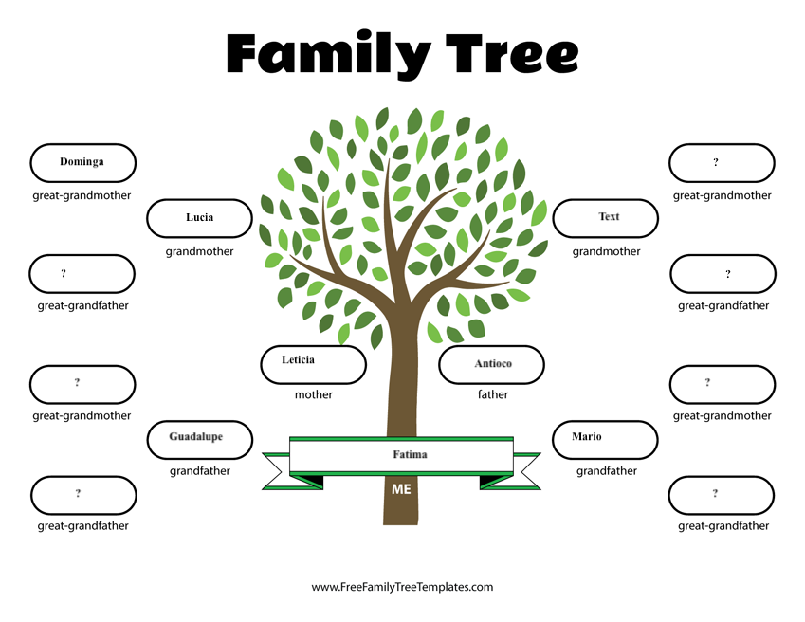
Family Tree
My example:

Slide 7
Activities
Week 3
Week 4
Finishing novel
Reading groups
We will finish the novel as a class.
Students will be given 3 options for the final project:
Create a TikTok that talks about one of the mother/daughter relationships. Or write an essay comparing the book and film. Or write a personal essay about a daughter/mother you relate to.
I will show students 5 YA novels. They will be asked to list which 3 novels interest them the most, this is how groups will be made. There will be 4 groups in total.
They will read as a group and after reading some chapters, we will come back as a class and discuss.
For discussion, students will share what their book is about (character, setting, plot)

Slide 8
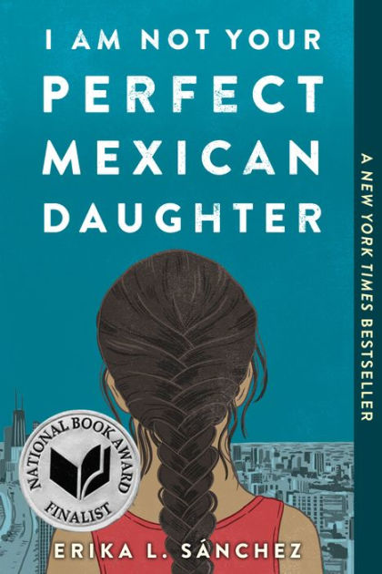
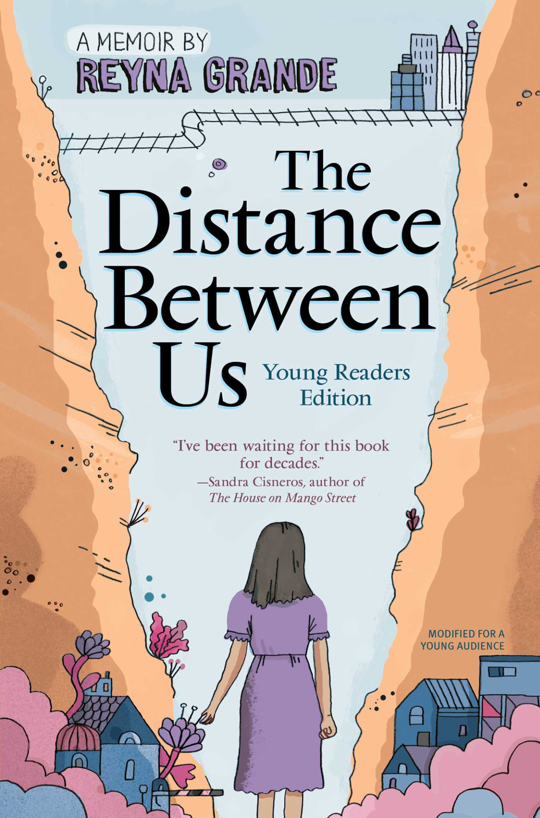
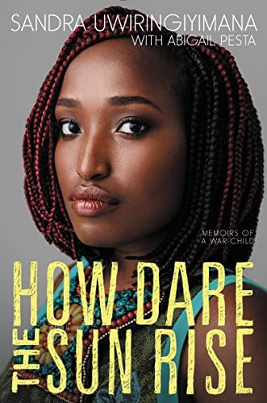
Week 4 Reading Groups /companion texts

Slide 9
Take away
As future teachers, it is our responsibility to make sure students feel safe and comfortable in our classrooms. Oftentimes, undocumented students feel like their experience is not talked about enough. I highly encourage you guys to include at least one of the books that I shared with you, in your curriculum. I promise, whether you know it or not, there will be at least one student who will be able to identify with the novel.

