Slide 1
Growth for All: Realism in YA Literature
Annotated Bibliography by Alexa Moreno

Slide 2
Growth for All
Books are a part of life that can help any young or older person grow, as long as they are open-minded and can discern between the useful information to them and the things that maybe don’t apply.
While YA literature can sometimes get a bad rep for being immature or only catering to a younger audience, people of any age group can find ways to relate to some real issue presented in these pieces.

Slide 3
The Power of Realism
This method, through either fiction or nonfiction, can connect to the audience through experiences many of them may recognize and go through. Situations that maybe aren’t so common but still possible allow the audience to grow from a situation that isn’t their own. They can learn things like:
Working through physical and mental challenges
Coping with death and survival
Family and relationship struggles and ties
Relating across cultures
And more!

Slide 4
List of works:
Thirteen Reasons Why by Jay Asher
The Perks of Being a Wallflower by Stephen Chbosky
We Were Here by Matt De La Pena
The Fault in Our Stars by John Green
Speak by Laurie Halse Anderson
Witness by Karen Hesse
The Outsiders by S.E. Hinton
We Were Liars by E. Lockhart
The Giver by Lois Lowry
How Dare the Sun Rise: Memoirs of a War Child by Sandra Uwiringiyimana

Slide 5
Real Life Experiences
Most of the stories reflect things that can happen in real life. One of the books that fits maybe the least into this category would be The Giver by Lois Lowry because it is set in a sort of utopian society. While that is the case, there are still many realistic struggles such as relationships and identity.

Slide 6
Facing Death and Loss
Many of the books in the list in someway have the characters facing death and loss:
Thirteen Reasons Why
The Perks of Being a Wallflower
We Were Here
The Fault in Our Stars
We Were Liars
How Dare the Sun Rise

Slide 7
Identity, Discrimination, Struggles with Decisions
Once again, most of the books touch on these topics as good stories should all include at least one of these:
Good Identity Selections: We Were Here, Witness, The Outsiders
Good Discrimination Selections: We Were Here, Witness, How Dare the Sun Rise
Good Decision Struggles: Thirteen Reasons Why, The Perks of Being a Wallflower, The Fault in Our Stars, Speak

Slide 8
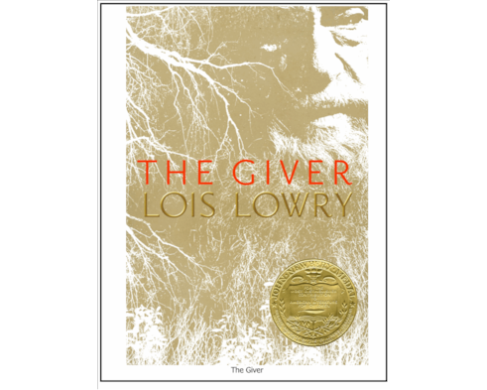
Fantasy (with realism?)
As mentioned previously, The Giver is centered around a utopian society and includes fantastical elements such as the passage of memories. That being said, Jonas goes through many realistic struggles in his life, such as finding who his true identity is, and struggling with decisions- especially when it goes against his community/society. Even though it is represented in a different way, the things he works through are realistic problems for people of all ages.

Slide 9
Historical
There is only one work that is more “historical” and that is Witness by Karen Hesse. It is also the only poetry book included within the mix. Witness, while set in 1924, talks about racism and discrimination, as well as people struggling with decisions about how they want to act and who they want to identify with. The scenarios may not be exactly the same as the ones going on today, but it does represent some foundational issues we have in today’s society with young and old folk alike.

Slide 10
Works Cited
Asher, Jay. Thirteen Reasons Why. Razor Bill, 2007.
Chbosky, Stephen. The Perks of Being a Wallflower. Pocket Books, 1999.
De La Pena, Matt. We Were Here. Random House Inc., 2009.
Green, John. The Fault in Our Stars. Penguin Books, 2012.
Halse Anderson, Laurie. Speak. Farrar Straus Giroux, 1999.
Hesse, Karen. Witness. Scholastic Press, 2001.
Hinton, S. E. The Outsiders. Penguin Random House, 1967.
Lockhart, E. We Were Liars. Delacorte Press, 2014.
Lowry, Lois. The Giver. Houghton Mifflin, 1993.
Uwiringiyimana, Sandra. How Dare the Sun Rise: Memoirs of a War Child. Harper Collins
Publishers, 2018.

