Slide 1
Minority Adolescents in Search for Identity

Slide 2
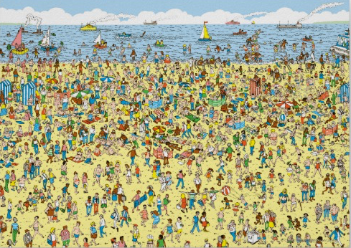
Where Am I?

Slide 4
Junot Diaz
“The monsters in the story often don’t see a reflection of themselves in the mirror…
The quickest way to create monsters in our inner cities is to never show those kids a reflection of themselves in literature because it doesn’t validate their lives.”

Slide 5
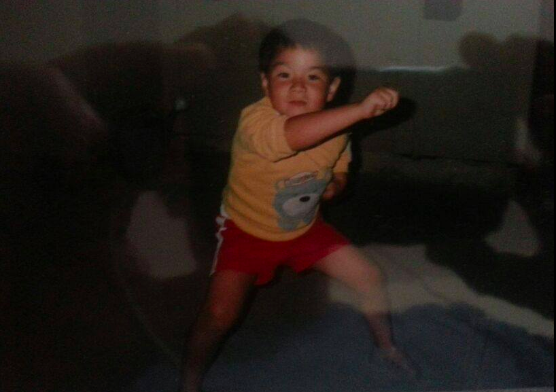

Slide 6
It ain’t easy…
Play video

Slide 7
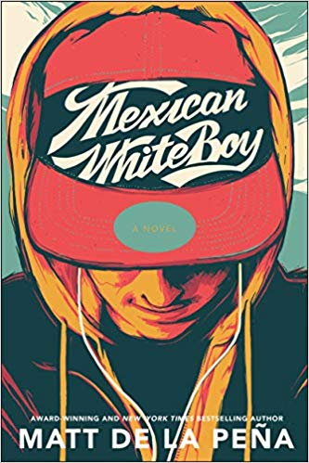
Mexican WhiteBoy Matt de la Pena
“Nobody paid him any attention anyway because he was Mexican. He roamed the school halls with his head down like a ghost. Drifted in and out of classrooms without a peep. Nobody even saw him as a real person.”
"D-man, Li'l D, D-money, roll it up right, man. Fold it up at the end. Here do like this, homey, with your fingers. Don't hold it like no white boys now or else the butter's gonna drip out the bottom, get all over your hand."

Slide 8
Intro: I’m Not Racist

Slide 9
And I work my ass off and I pay my taxes for what? So you can keep livin' off free government assistance? But you lazy and you'd rather sell drugs Than get a job and be straight, and then you turn around and complain About the poverty rate?
Put your pants up, nigga! Put that suit back on! Take that du-rag off! Take that gold out your mouth! Quit the pitiful stuff And then maybe police would stop killin' you
Nigga, that word was originated for you to keep us under And when we use it, we know that's just how we greet each other And when you use it, we know there's a double meaning under
It's hard to elevate when this country's ran by whites Judging me by my skin color and my blackness Tryna find a job but ain't nobody call me back yet Now I gotta sell drugs to put food in my cabinet Don't talk about no taxes, when I ain't making no dough

Slide 10
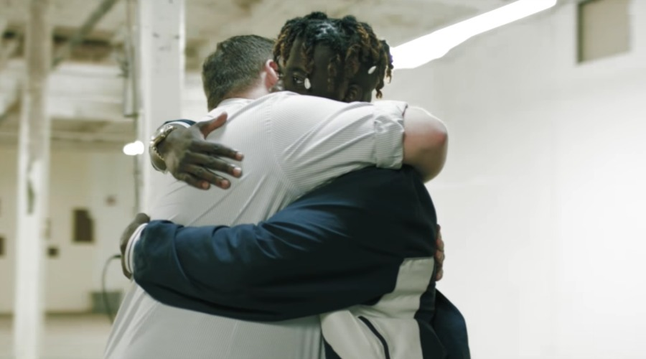
It's like we livin' in the same buildin' but split into two floors But there's two sides to every story, I wish that I knew yours
I wish we could trade shoes or we could change lives So we could understand each other more but that'd take time It's like we livin' in the same buildin' but splittin' the both sides
But there's two sides to every story and now you know mine

Slide 11
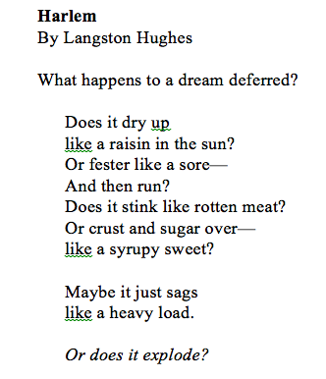
During the Unit

Slide 12
Continuing the Unit
“That's the problem. We let people say stuff, and they say it so much that it becomes okay to them and normal for us. What's the point of having a voice if you're gonna be silent in those moments you shouldn't be?”
“I can't change where I come from or what I've been through, so why should I be ashamed of what makes me, me?”
“To every kid in Georgetown and in all “the Gardens” of the world: your voices matter, your dreams matter, your lives matter. Be roses that grow in the concrete.”

Slide 13
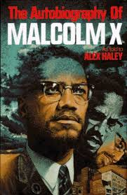
Continuation (una mas)

Slide 14
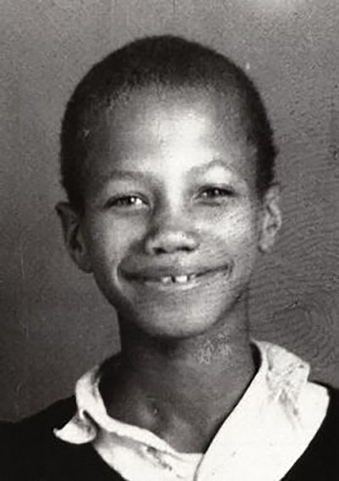
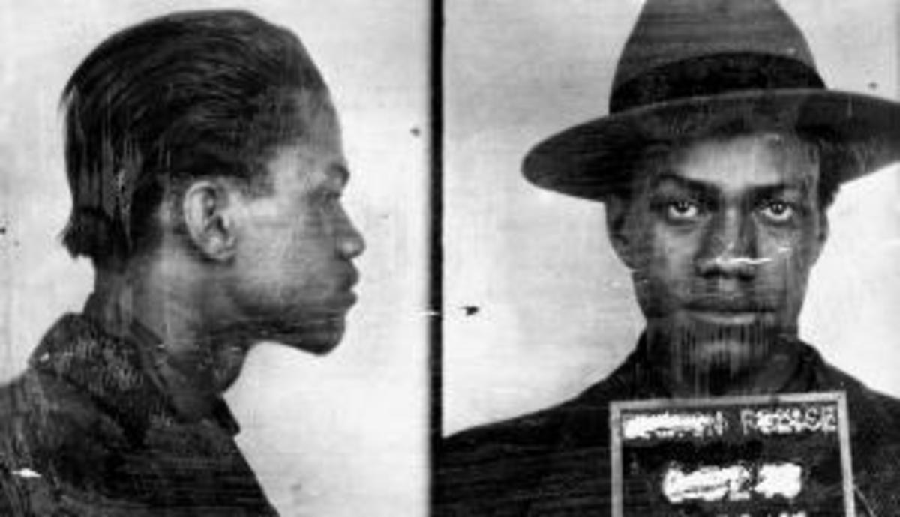
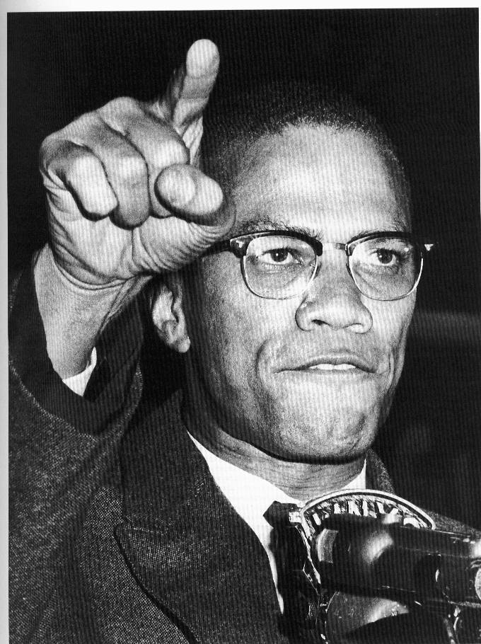
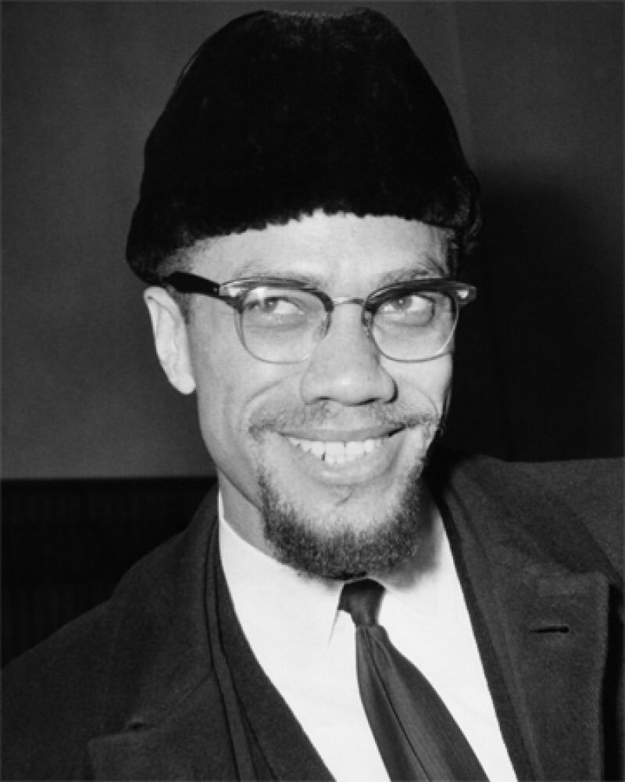
The 4 Identities

Slide 15
Basically we all need love…

