Slide 1
Dolly Parton’s “Turn, Turn, TUrn (To Everything there is a season)” and the Ecclesiastes
Avery Tubach

Slide 2
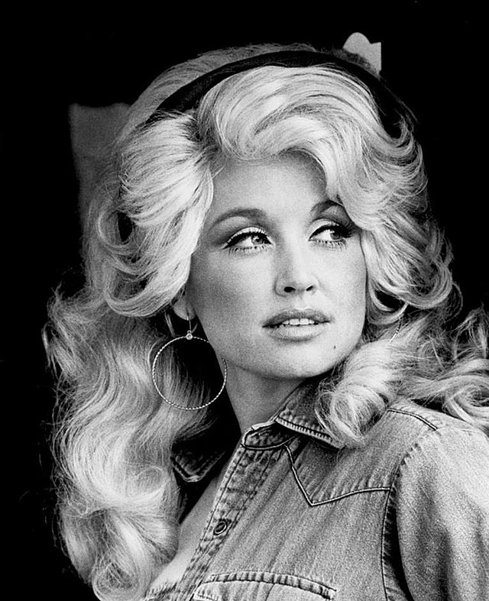
“Turn, turn, Turn (To everything there is a season)”
Released by Dolly Parton in 1984 as the third track of the album The Great Pretender
Originally written and performed by the Byrds in 1965
Lyrics come directly from chapter 3 of Ecclesiastes
Ecclesiastes attributed to King Solomon
https://www.youtube.com/watch?v=VmYcWkkOMgc

Slide 3
Lyric Comparison- Chorus
Chorus “Turn, turn, turn”
Ecclesiastes 3:1
“To everything
Turn, turn, turn
There is a season
Turn, turn, turn
And a time to every purpose under Heaven”
“For everything there is a season, and a time for every matter under heaven”

Slide 4
Lyric Comparison- Verses
Verse 1 “Turn, turn, turn”
Ecclesiastes 3:2-4
“A time to be born, a time to die;
A time to plant, and a time to plant what is planted;
A time to kill, and a time to heal;
A time to break down, and a time to build up;
A time to weep, and a time to laugh”
“A time to be born, a time to die
A time to plant, a time to reap
A time to kill, a time to heal
A time to laugh, a time to weep”

Slide 5
Significance
The Ecclesiastes is widely considered one of the most modern feeling books of the Bible
continued recreation of chapter three through song is evidence of its wide appeal across the ages
Contemporary audiences are able to resonate with the message of the song, even removed from the context of the Bible
It touches on universal themes and images that are accessible to most audiences

Slide 6
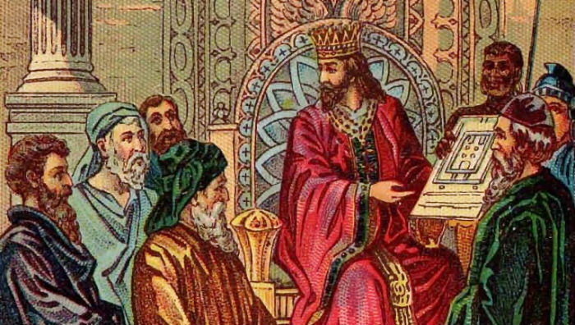
Thank you!
Works Cited
Parton, Dolly. “Turn, Turn, Turn (To Everything There Is a Season).” The Great Pretender. RCA Records, 1984. https://www.youtube.com/watch?v=VmYcWkkOMgc

