Slide 1
Chapter 16:
Women of Valor
Kyra Kennedy and Natalie Martinez Chavira

Slide 2
Intro
Biblical women tend to fall into two categories:
1.) Wily matriarchs (Sarah, Rebekah, Rachel, Hannah).
2.) Evil temptresses (Delilah, Jezebel).
A woman who transcends these generalizations is a rarity!
The books of Ruth and Esther have women that do this: the titular Ruth and Esther.

Slide 3
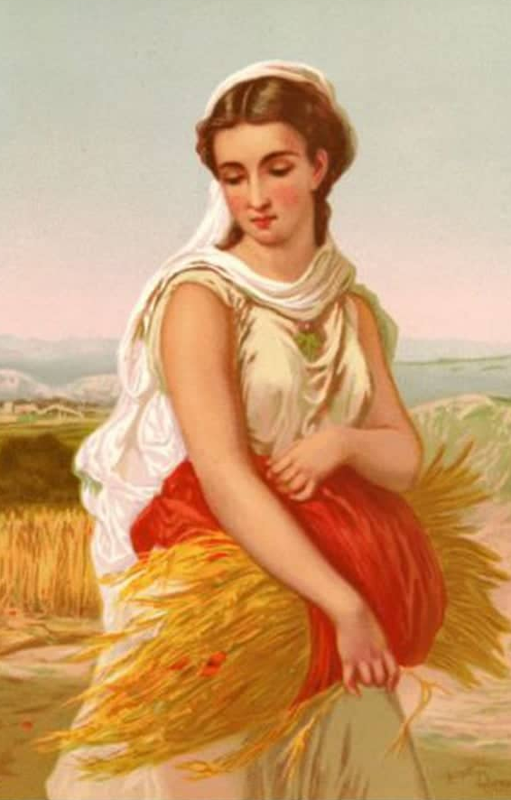
Ruth
Not originally Jewish, Ruth was a Moabite. She is considered to be the model convert to Judaism.
Ruth marries a Jewish man, Mahlon, who immigrated to Moab with his father, mother, and brother to escape the famine in Israel.
After the men in the family all die from disease, Naomi is devastated and decides to leave for Israel to see if there is anyone who will be willing to take her in.
Ruth refuses to let her leave alone, deciding that she will go with her.

Slide 4
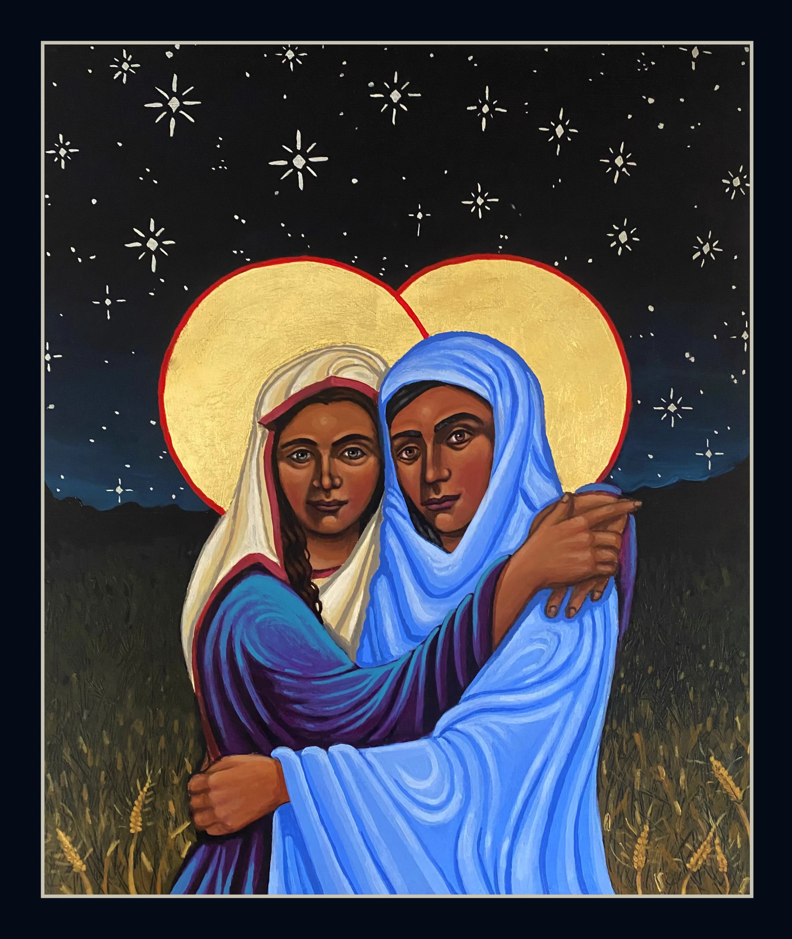
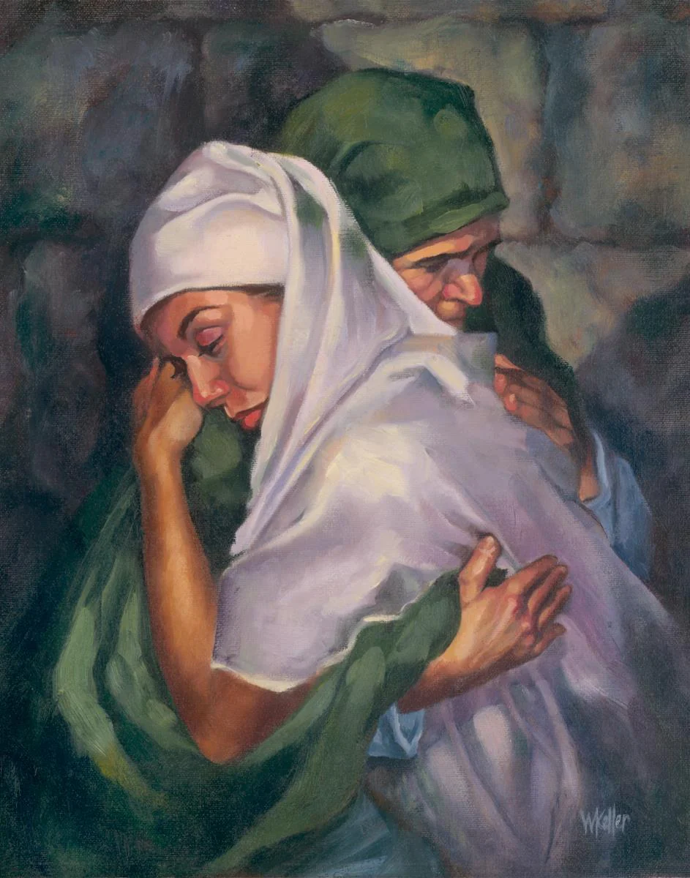
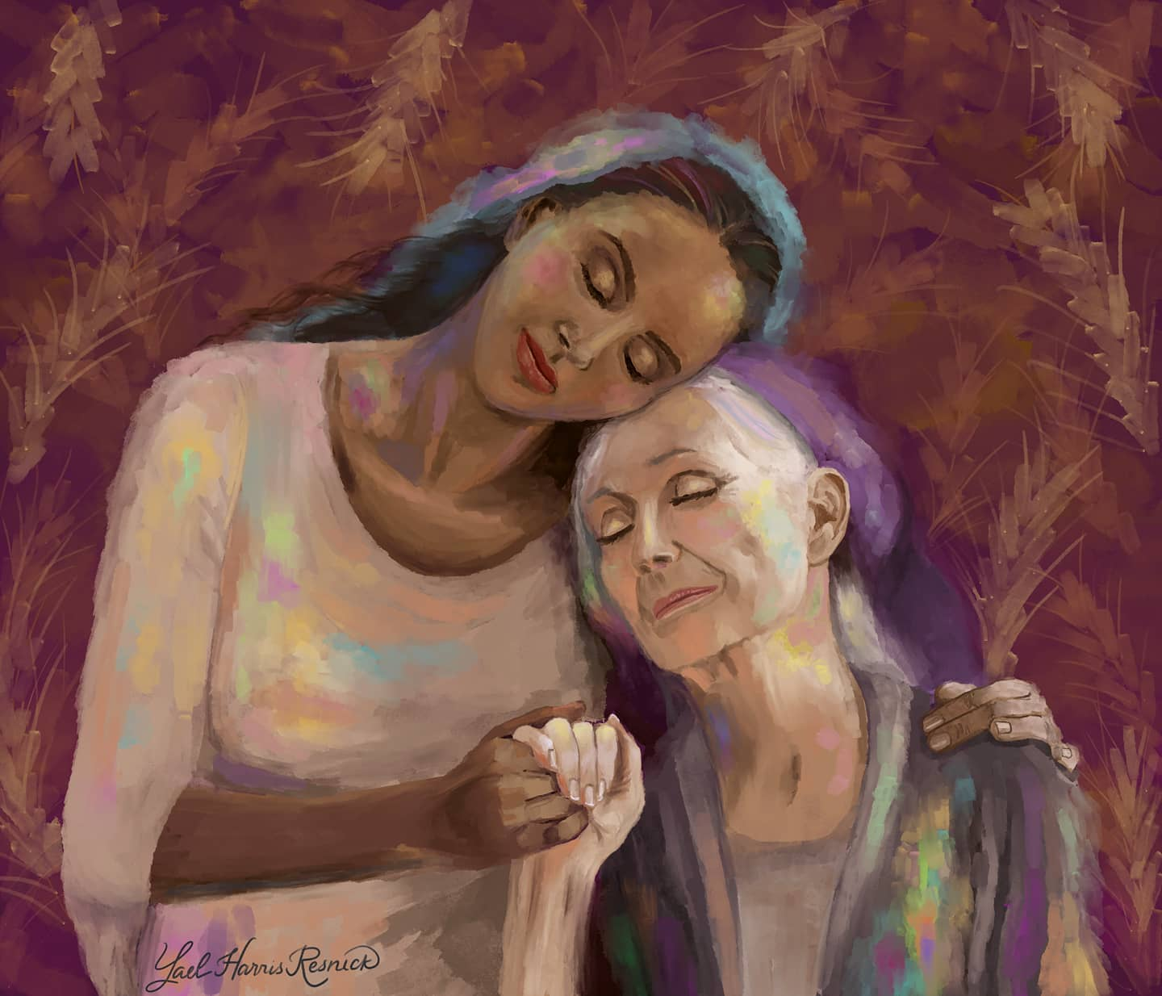
Ruth (cont.)
Ruth’s story, more specifically, her relationship with her mother-in-law Naomi, is a popular subject depicted in art.
“Do not press me to leave you
or to turn back from following you!
Where you go, I will go;
where you lodge, I will lodge;
Your people shall be my people,
And your God my God.
Where you will die I will die.
there will I be buried.
May the Lord do thus and so to me,
and more as well.” (Ruth 1: 16-17)

Slide 5
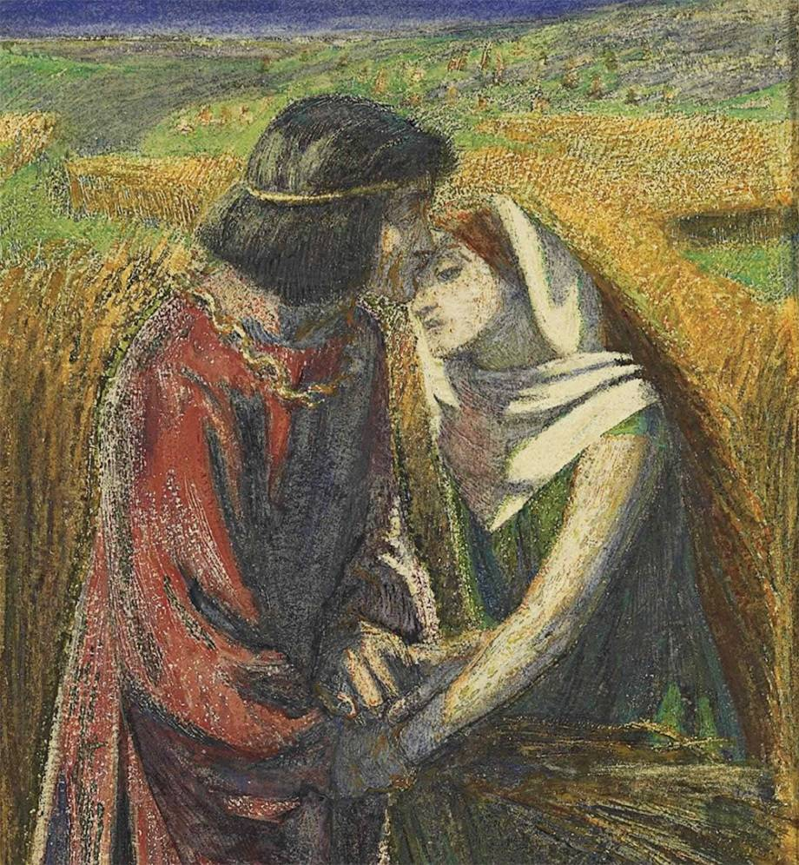
The Redeeming Kinsman
Boaz, a wealthy, unmarried man, takes pity on Ruth when she visits his field, giving her grain, water, and allowing her to rest under a shady place.
Naomi is excited to hear this news, encouraging Ruth to become engaged and marry Boaz.
She instructs her to dress her best, lie at his feet when he is sleeping, and ask for him to throw his cloak over her.
This is the ritual for the tradition levirate marriage. In an instance where a married man dies without kids, the closest male relative is to marry the widow and have a child who is the legal and religious heir of the dead husband.

Slide 6
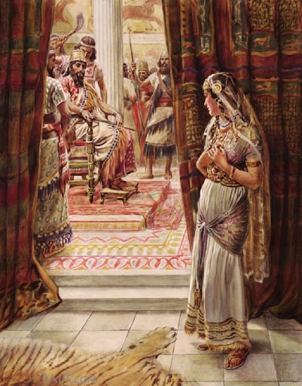
Esther
The book of Esther, much like the Song of Songs, is a unique book due to it having no mention of God.
It is also unique for it’s focus on women.
This book goes against the stereotype of the vapid beauty queen, by showing her to be a complicated and nuanced character, willing to take risks for the good of the people.

Slide 7
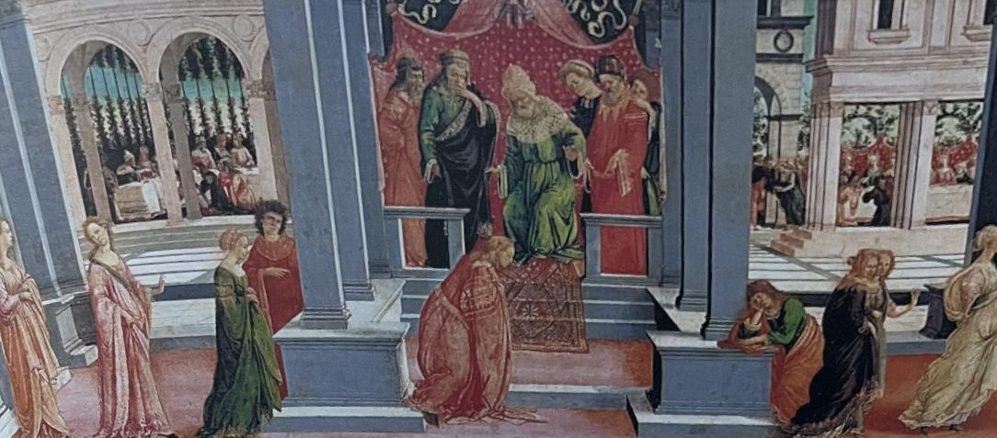
The Beauty Queen
Esther’s beauty & hidden brains
The beauty pageant
Beauty treatments
One night
John Keats
Thou wast not born for death, immortal Bird! /No hungry generations tread thee down; / The voice I hear this passing night was heard / In ancient days by emperor and clown: / Perhaps the self-same song that found a path / Through the sad heart of Ruth, when, sick for home, / She stood in tears amid the alien corn.
From Bible and Its Influence

Slide 8
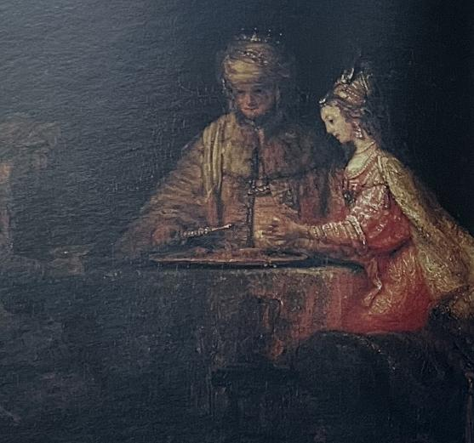
Haman the Wicked
No redeeming qualities (literal villain)
Hates all Jewish people
Convinced the tipsy king to sign edict which doomed all the Jets of Persia
From Bible and Its Influence

Slide 9
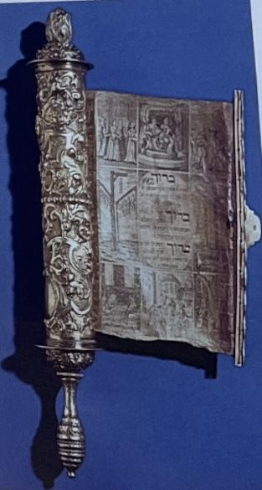
The Plan
"I will go to the king ,though it is against the law; and if I perish, I perish" (Esther 4:16)
One more night
A long play to carefully remove Haman
From Bible and Its Influence

Slide 10
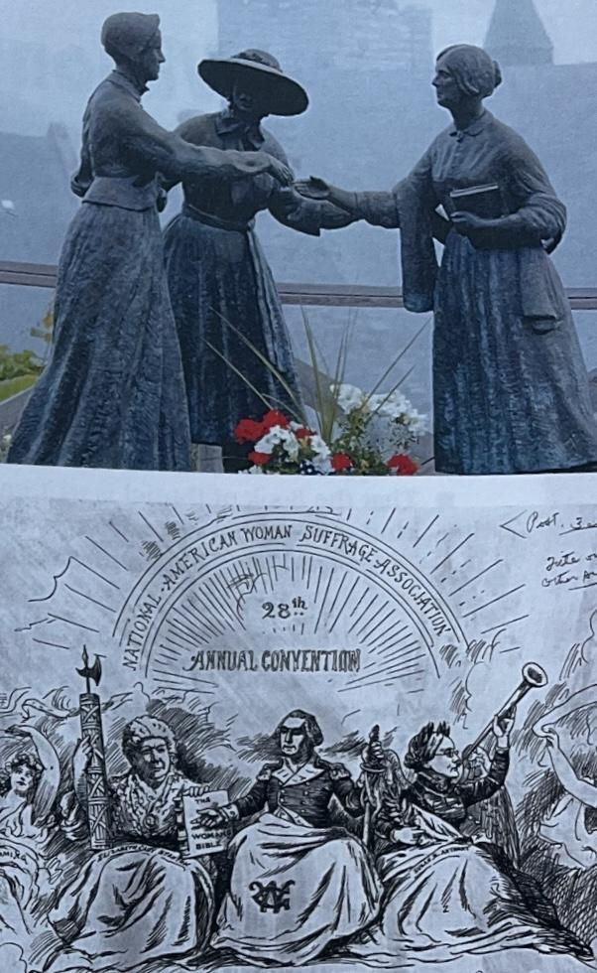
The Bible and Women
“Other women in the suffragist, abolitionist, and temperance movements drew inspiration, not frustration, from the biblical tradition”
Women’s stories in the Bible shouldn’t be reduced simply
Elizabeth Cady Stanton
Anna Howard Shaw
Susan B. Anthony

