Slide 1
Genesis: A Living Conversation
“Apocalypse”
By: Sophia Vera and Maricela Padilla

Slide 2
Noah’s Ark
God is full of wrath because of humankind’s wickedness
He saves Noah’s family because he was righteous
Tells him to build an ark in which he will put one female and one male of every kind of creature
The flood kills the rest of the living & when it is over, Noah plants seeds

Slide 3
Is God Evil?
God is destructive in Noah’s Ark & it contradicts his benevolent image
He created the world out of the primal waters, and uses these very waters to get rid of those he deemed unredeemable, except for Noah and his family
He encloses Noah in the ark & leaves everyone else out
Why would God have to destroy everything to start over?
Some dislike the idea that the destruction was a good turn of events for humanity just because Noah and his family were chosen to survive the disaster
Others thought it was necessary for a second chance as humanity’s freedom of choice had corrupted what God wanted them to be. A new beginning was needed.
How far gone were the others that God decided to kill them?
This baffles many people of religion because it complicates their relationship with God
Leaves the unanswered question of why God doesn’t intervene when something, like the Holocaust, occurs since he is supposed to be omniscient (all-knowing) and omnipotent (all-powerful)
Those in danger need saving, just like he saves Noah and his family
Who gets to be saved and who is left to suffer?

Slide 4
A Maturing God
A parable on regret
Angered that humanity was not the way he had hoped them to be, God wipes humanity out
This is an underdeveloped God, an inchoate being that is just beginning to form in Genesis
Noah’s ark teaches us that regret leads to destruction
God’s regret for his creation makes him want to wipe everything and start over
God is working out his relationship with humanity
God cannot see humanity for what they are, he wanted them to be just like him
Analogies for God and humanity:
Parent/Child: God expects humanity to be a certain way & it leads to feelings of anger and regret. When a child is created, another being is being created, not a replica.
Marriage: A person who doesn’t see their partner for who they are doesn’t have a relationship, and so the marriage fails. God has a failed partnership with humanity.
God learns to accept that he needs to put in the work in order to have a relationship with humanity, and he begins to relate and understand humanity.
God realizes that there needs to be room for failure and change

Slide 5
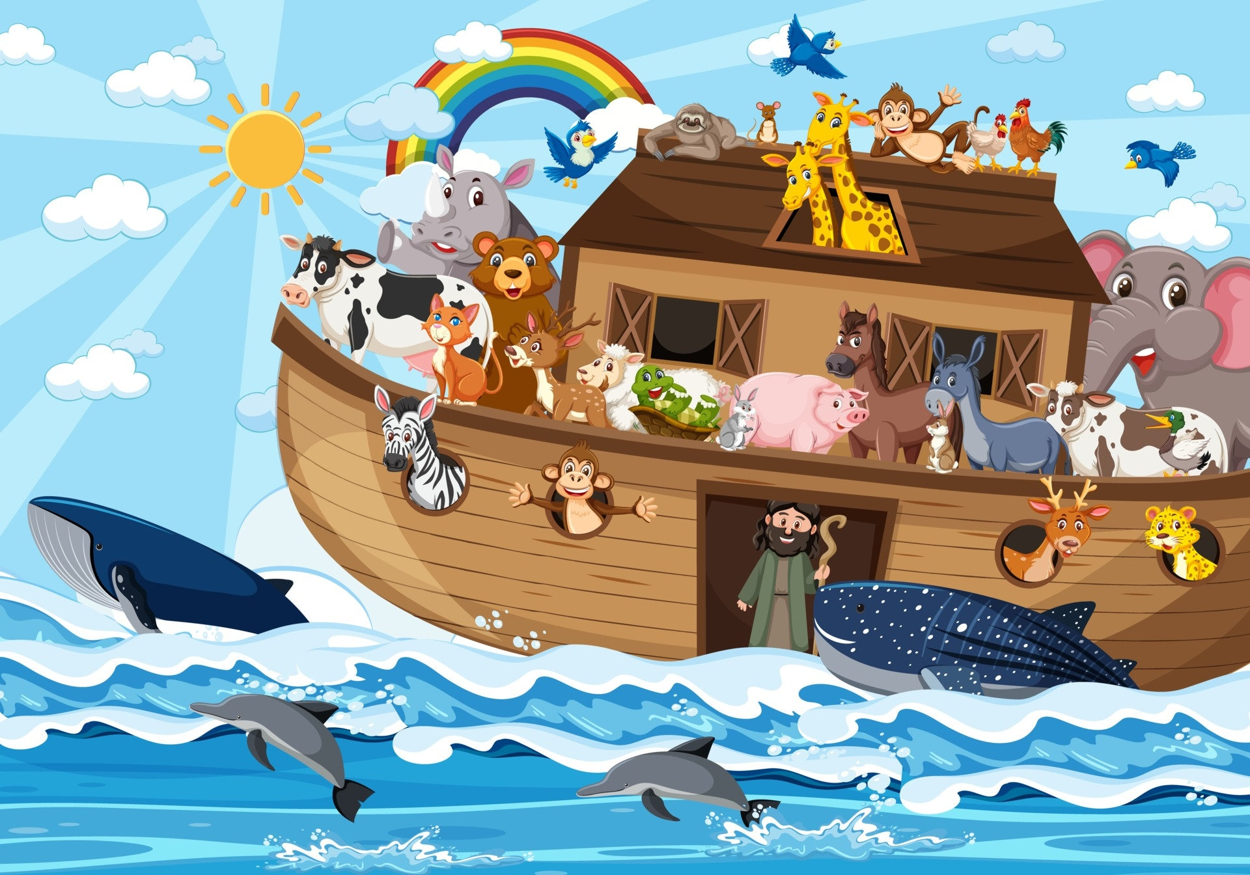
Inside the Ark
“To think concentrating on us in the Ark — us cozy outside — and forget about the people outside. Very often, we’ve demonized people on the outside of our faith, of our society.” (Karen Armstrong)
Does the parable inspire comfort for the faithful, and/or fear of the power of God?
Is Noah really an exception to the rules that govern the rest of humanity? Or is he more of a “token”? (Byron Calame)
https://www.etsy.com/listing/1210132681/noahs-ark-and-animals-clipart-digital

Slide 6
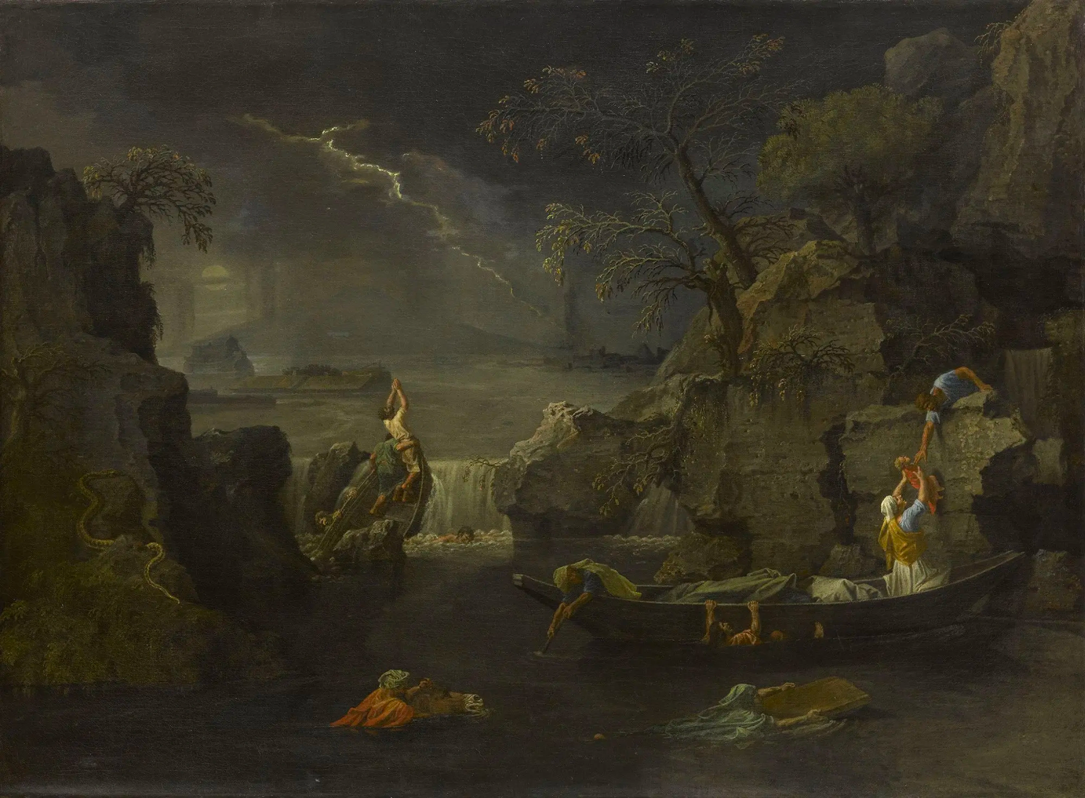
The Human Cost
“There isn’t in this whole record, one peep of the victims. There is not so much as a cry of mercy left in the Biblical record.” (Moyers)
Was all of humanity truly irredeemably evil?
Is wickedness the culmination of free will, the “freedom to reject what God wanted them to be”? (Samuel Proctor)
Nicolas Poussin, Le Deluge, 1660-1664, https://collections.louvre.fr/en/ark:/53355/cl010066113

Slide 7
Landfall
After departing from the Ark, Noah builds an altar and offers burnt offerings.
“I think we [may be] in error, if we think that the sacrifice was offered in love and praise. Noah just witnessed, in the most awesome of ways, how terrifying God can be. And I think as soon as he got off that boat, the first thing he was gonna do was propitiate God in the best way possible. There’s real terror.” (Burton Visotzky)
Noah plants a vineyard and gets drunk off of the wine. His son Ham looks upon his nakedness, thereby not correctly honoring his father. Noah then curses Ham’s son Canaan.
Is there a symmetry between Noah’s action’s and God’s?

