Slide 1
Software is eating the world*
Mandy Mock
General Manager for Product Engineering Systems IT
Intel Corporation
Interdisciplinary Computing Summer Institute (ICSI)
August, 2017
Source: MarcAndreessen - https://www.wsj.com/articles/SB10001424053111903480904576512250915629460

Slide 2

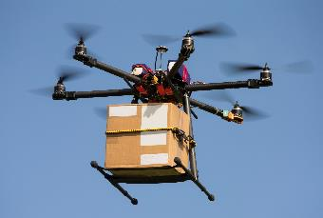
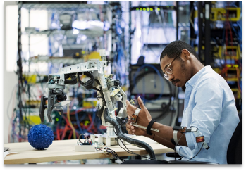
Two types of jobs in the future…
Those that are creating the automation
Those that will be automated

Slide 3
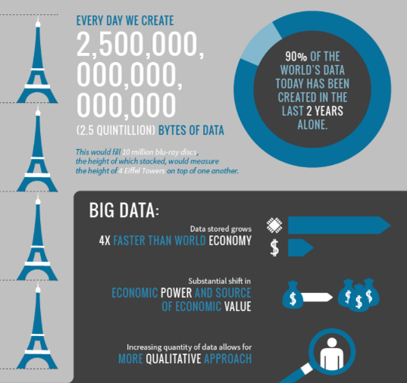
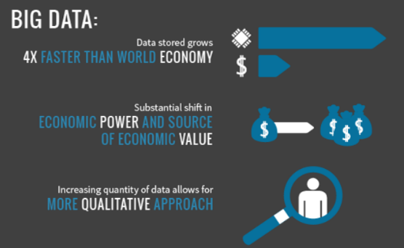
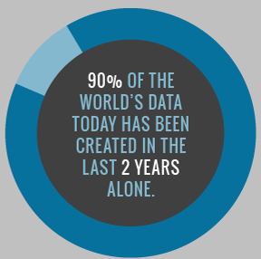
Source: http://www.vcloudnews.com/every-day-big-data-statistics-2-5-quintillion-bytes-of-data-created-daily/
Notes:
Mobile/social/cloud drove most recent wave of applications
Technology is getting faster -> approaching free. Means chips will be embedded in everything, and all connected to the internet.

Slide 4
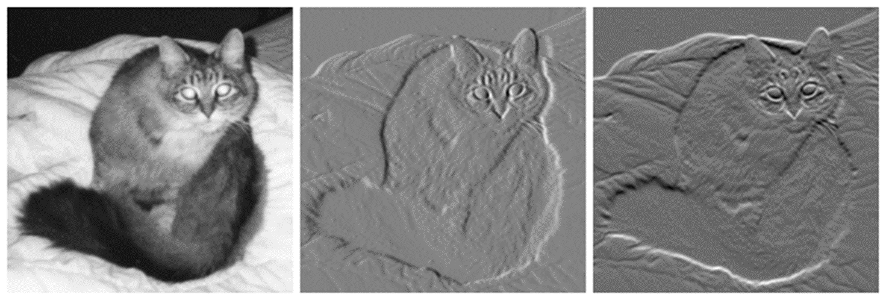
Usefulness of data for pattern recognition
Notes:
So what’s all this data good for? Well, we can use it to identify patterns. One example is photo recognition. Digital photos are essentially millions of individual pixels. By analyzing those, we can start to recognize things like edges and lines, and eventually map that to actual shapes. For example, with this cat.
So that might be great for helping you classify photos, but what’s the use in the real world? Let me give you an example.
Example of ‘Watson Diagnoses Lukemia’

Slide 5



Artificial Intelligence: The Future of Growth
Sense - Computer vision and audio processing can actively perceive the world around them by acquiring and processing images, sounds and speech. Using facial recognition at border control kiosks is an example of how it can improve productivity.
Comprehend - Natural language processing and inference engines can enable AI systems to analyze and understand the information collected. This technology is used to power the language translation feature of search engine results.
Act - An AI system can take action through technologies such as expert systems and inference engines, or undertake actions in the physical world. Auto-pilot features and assisted braking capabilities in cars are examples of this.
Source: https://www.accenture.com/lv-en/_acnmedia/PDF-33/Accenture-Why-AI-is-the-Future-of-Growth.pdf
Notes:
If everything has a chip, you can program the world.
Platforms today are distributed systems – built across many systems. AWS is an example
AI/ML/deep learning are emerging as a new platform. Inherently parallelizable
AI technologies going to open source and cloud – means that everyone can do ML. Ex google’s tensor flow
If you can simulate the real world and insert change into it, you have no real consequences. You try new technologies, social policies, etc. Or run many possible simulations and choose based on results. For example, government policy, economic decisions, social programs, health decisions, science experiments, etc. for example, predicting diseases people will get.

Slide 6


WE ARE LIVING IN A WORLD OF CHANGE…
70%
of Global 2000 CEOs will center their strategies around Digital Transformation by 2017¹
40%
of businesses in the top 20 of
every industry, will be disrupted by 2018²
50%
of the workforce will be Millennials by 2020³
…AND THIS IS THE LEAST AMOUNT OF CHANGE WE WILL EVER SEE
1. IDC – Digital Transformation Predictions (source)
2. PNC – Digital Disruption Challenges (source)
3. PWC - Millennial at Work, Reshaping the workplace (source);
Notes:
In Marc Andreeson’s classic article, “Software is Eating the World”, he describes how software is disrupting every industry. There are many great examples, but let’s start with books. In 2001, Borders handed over their online sales to Amazon, deeming it to be unstrategic and unimportant. Today, Amazon is essentially a software company – an extremely sophisticated engine for selling and distributing anything you could imagine. At the same time, Amazon has been leading the shift to digital content by pushing the Amazon Kindle. Now even the content of the books is software.
Other examples involve using software to change the game – Uber for example. Uber didn’t try to directly compete with incumbent taxi companies. Instead they came in sideways by completely changing the way people get transportation, through an easy to use software application. Same thing with Airbnb.
Looking forward, autonomous driving has the potential to change many industries. Not only the obvious ones of taxis and truck deliveries and insurance, but also things like what will people do with all that new found spare time if they don’t have to drive? Companies that want to help you optimize your drive experience will be sprouting like weeds. Or the data that is generated – it could completely change how cities develop infrastructure. Imagine city streets with no parking. Or imagine the airport with no parking lot. But, it turns out that airports get around 25% of their revenue from parking fees. So you can see how the disruption spreads radically.
Change will continue to accelerate, increasingly driven by the ability to harness the data.
Do you want to be ahead of the curve or behind it? This is happening everywhere

Slide 7
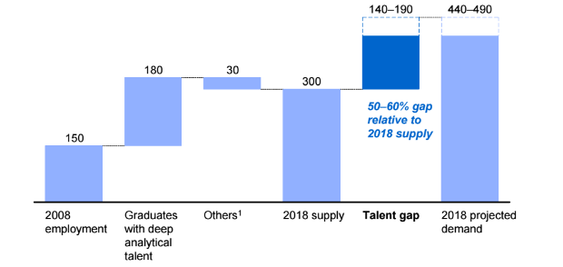
Demand for deep analytical talent could be 50 – 60% greater than projected supply by 2018
Thousand People
Source: McKinsey Global Institute analysis

Slide 8

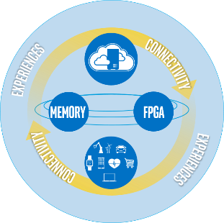
AS OUR CUSTOMERS ARE EVOLVING…
“
We expand the boundaries of technology to make the most amazing experiences of the future possible through our customers.
We’re moving toward a world where the boundary between digital and physical is eroding, computing is truly mobile and ubiquitous, and everything is smart and connected.
”
…SO IS INTEL
Notes:
We’ve talked about how businesses around the world need to evolve and transform, and of course Intel is no exception to this. As our customers are evolving, so are we.
We are in a time when technology is valued not just for the devices it produces, but for the experiences it makes possible. Intel will lead in this new era by remaining true to our history as inventors and makers, as a global leader in manufacturing, as world-class innovators. But Intel is evolving. We have a clear strategy for this, which we call the Virtuous Cycle of Growth:
We call it a virtuous cycle—the cloud and the data center, the Internet of Things, memory and FPGAs—all bound together by connectivity and enhanced by the economics of Moore’s Law.
Our strategy builds upon itself. These assets are all connected, and together, they fuel our business. With each new device that comes online and connects to the cloud—we have the tremendous opportunity to reinforce our company’s growth.
Putting it all together, Intel is uniquely positioned to power the cloud and drive the increasingly smart, connected world. We see tremendous opportunity in the growth of this virtuous cycle—the cloud and data center, the Internet of Things, memory and FPGAs all bound together by connectivity and enhanced by the economics of Moore’s Law—which will provide a strong and dynamic future for Intel, and create lasting value for our customers, partners, shareholders, and you, our employees.
And as our products, and the experiences we make possible evolve, we as a company are evolving too. We are unleashing the power of diversity and inclusion to transform our workforce, be a driving force for our continued relevancy and growth, and pave the path for the technology industry. We are taking on some of society’s most complex issues, and showing the world that with creativity, ingenuity, and possibility thinking, there is nothing that can’t be solved or changed for the better.
Intel is truly unique—from the technologies we invent to the amazing experiences we deliver.
CLOUD / DATA CENTER
The cloud is the most important trend shaping the future of the smart, connected world—and thus Intel’s future.
Intel architecture defines the infrastructure of the cloud, and we will continue to drive more and more of the footprint of the data center globally. There is much more value to unlock from the cloud and data center, and analytics is the key to that.
To put things in perspective, in 2020 the average internet user will generate about 1.5GB of traffic per day, up from 650MB in 2015. Certainly, a huge amount of data until you consider the machines. A Smart Hospital will generate 3,000 GB/day, a self-driving car will generate 4,000GB/day, a connected plane will generate 40,000 GB/day, and a connected factory will generate 1million GB/day.
The cloud and analytics from the data center are the greatest value drivers in technology today. The impact of everything becoming digitized is not only real-time exchanges of information between multiple connected devices and the cloud, but also an ability to analyze critical data in ways that will eliminate inefficiency, solve problems, and transform our experiences. This digitization of everything will disrupt entire industries and open up new cycles of growth.
At Intel, we’ll accelerate the power and value of this data and its analytics by continuing to innovate in high-performance computing, big data and machine learning capabilities.
IOT
The Internet of Things encompasses all smart devices—every PC, device, sensor, console and any other edge device—that are connected to the cloud.
The PC is foundational to our compute strategy and to our business. It’s an engine that creates critical shared IP that drives innovation across our entire product portfolio. Intel will continue to deliver an annual cadence of leadership performance and innovation in our PC and broader computing roadmap, with a focus on key growth opportunities in 2 in 1s, gaming and home gateways.
Intel will also lead our industry to move beyond the device we know today to completely new kinds of “PCs.” We are imaging and inventing a PC that is truly immersive, assistive, with an incredibly natural interface tailored for your individual needs.
Intel is also inventing a future that is more informed, collaborative, and meaningful given the widespread interconnectedness of everyday objects. Common objects (refrigerators, shoes, cars, etc.) are evolving into intelligent devices—equipped with sensors and connected through the Internet of Things. From wedding rings monitoring blood sugar, to coffee pots automatically ordering refill grounds, to work stations eliminating distractions to keep employees productive—soon everything will seamlessly improve and support day-to-day tasks, both simple and complex.
As the Internet of Things evolves, we see three distinct phases emerging. The first is to make everyday objects smart—this is well underway with everything from smart toothbrushes to smart car seats now available. The second is to connect the unconnected, with new devices connecting to the cloud and enabling new revenue, services and savings. New devices like cars and watches are being designed with connectivity and intelligence built into the device. The third is just emerging when devices will require constant connectivity and will need the intelligence to make real-time decisions based on their surroundings. This is the “autonomous era” and machine learning and computer vision will become critical for all kinds of connected devices.
At Intel, we will focus on autonomous vehicles, industrial and retail as our primary growth drivers of the Internet of Things.
MEMORY & PROGRAMMABLE SOLUTIONS
Memory and programmable solutions such as FPGAs will deliver entirely new classes of products for the data center and the Internet of Things.
Intel is driving innovations—using our deep understanding of materials science as well as computer architecture—to grow memory and storage at a much faster rate to virtually eliminate latency for data from storage. We believe two recent technological inventions—3D XPoint™ technology and 3D NAND—are key to keeping pace with the combination of growing data and increased computing capability.
Bigger memory and faster storage benefits many new devices by enabling more immersive experiences with natural interaction and also provides significant value to the cloud by allowing businesses to run more efficiently.
The availability of faster storage and bigger memory also unlocks more value in the cloud as we learn to automate and efficiently analyze increasing quantities of data. The need for innovation is clear and the opportunity is big, whether it is for customer service, supply chain optimization, financial fraud detection, or precision healthcare research that is processing and analyzing larger genetic data sets in real time.
FPGAs are now at the heart of a diverse compute model that spans the Internet of Things (IoT), communications infrastructure, to the cloud and data center, and automotive markets. Only FPGAs can efficiently manage the changing workload demands of next-generation data centers and offer the flexibility for users to change their workloads on the fly. Intel FPGAs are used by over 10,000 customers in applications ranging from machine learning, to Advanced Driver Assist Systems (ADAS), from the core to edge, and in factory automation and smart energy systems among many others. More than 80% of Altera’s top customers are also Intel customers—which points to the synergy (and opportunities)—we have across Intel with FPGAs.
Rack Scale Design, 3D XPoint™ memory, FPGAs and silicon photonics are technologies that have been in development for several years at Intel and that we will bring to production soon.
Over the next few years, we will bring many more breakthrough innovations and products to the cloud and data center infrastructure—revolutionizing the performance and architecture of the data center. Even more exciting, each of these technologies has a long roadmap that will allow for growth for years to come.
CONNECTIVITY
Threading this virtuous cycle together is connectivity—the fact that providing computing power to a device and connecting it to the cloud makes it more valuable.
Today, connectivity is defined by people connecting to other people and to the cloud primarily through mobile devices—smartphones, PCs, and tablets. In the future, we will add more than 50 billion smart and connected devices, machines, autonomous vehicles, buildings and cities.
These devices will be always on and connected—with a demand for lower-latency where dynamic, split-second analytics, decisions and action on the data is required. At Intel, we recognize that 5G is more than an evolutionary step forward for our industry. It’s an inflection point, a place in time where we will see and experience everything being smart and connected. The ability to connect to each other, to our devices, and to the cloud, and to derive actionable insights from the massive amount of data will bring new experiences to our daily lives and transform businesses.
Intel will continue to develop technologies such as Mobile Edge Computing, millimeter wave and NarrowBand IOT (NB-IOT). These are all important steps to bring connectivity to a variety of new IoT devices globally. We’ll also continue to forge industry partnerships to develop and transform network infrastructure technologies.
As the world moves to 5G, Intel will lead because of our technological strength to deliver end-to-end 5G systems. This is why Intel is focusing on three key areas: industry partnerships, end-to-end 5G-related hardware and software development, and supporting 5G standards-setting.
MOORE’S LAW
Moore’s Law will continue to progress and Intel will confidently continue to harness its value. Moore’s Law has fueled the technology revolution all of us have lived through. Intel’s leadership in Moore’s Law has driven the products delivering massive computing power growth and increasingly better economics and pricing.
As we progress from 14 nanometer technology to 10 nanometer and plan for 7 nanometer and 5 nanometer and even beyond, our plans are proof that Moore’s Law is alive and well.

Slide 9
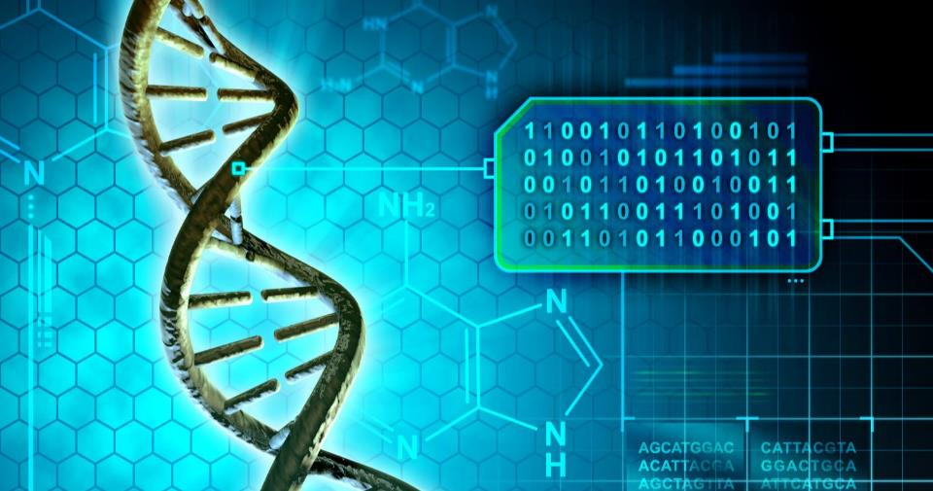
Barriers to genomics are disappearing and changing
USD 100 million
per genome
in 2001 to
USD 1,000
per genome
in 2014¹
Dramatic performance gains in computing technology²
Cost of genome sequencing no longer the bottleneck,
storing and managing the data is the next hurdle
1. http://www.bloomberg.com/bw/articles/2014-01-14/illuminas-dna-supercomputer-ushers-in-the-1-000-human-genome
2. https://www.youtube.com/watch?v=PzvOBI-Vt3Y
Notes:
The shift from population-based to precision medicine:
In the past, it was commonplace to treat a large cohort of patients that might have a similar condition the same way. This is true even today to an extent. So, all breast cancer patients get the following treatment regimen, same for diabetes patients.
In fact, with many medical conditions, it’s not quite that simple. There are different kinds of diabetes, different kinds of cancers. Even with breast cancer, there are many, many variations.
Beyond that, it’s rarely the case that someone with a chronic condition has just that single condition, so you have what are called comorbidities – multiple conditions. You’ve got a diabetic who’s also hypertensive and depressed. That person would respond to a much different kind of treatment than someone who is just diabetic alone.
In addition to traditional data that is available to healthcare organizations through the electronic health record, such as vital signs information, diagnosis, symptoms, these kinds of things, there is an increasing and accelerating desire to include genetic information. So, this slide is focused on genome sequencing.
From 2001 to 2014, the cost dropped dramatically. In fact, just this year, the magical barrier of $1,000 USD genome sequence was reached by our partner Illumina. The cost of sequencing is one of the barriers that has now been knocked down. While I think most believe this is really kind of limited to R&D, academia and research, this is accelerating into the clinical environment much faster than anyone anticipated.
Examples of this can be found in pharmacogenomics. Dosing of doctor-prescribed drugs, such as Coumadin, is tied to how well a person will metabolize the drug based on their genomic information. Non-invasive prenatal testing is another example. Now, with a simple blood test, you can uncover risks of developing conditions such as Down’s Syndrome or Cystic Fibrosis.
So, this is coming. With it comes a significant volume of information that will need to be fused with the more traditional healthcare information like electronic health record and claims data.

Slide 10
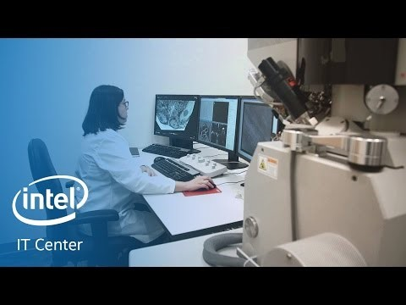
The new possible:
Collaborative analytics for personalized cancer care
https://www.intel.com/content/www/us/en/big-data/xeon-e7-collaborative-analytics-ohsu-cancer-institute-video.html
Notes:
The custom-built computing system is for cancer researchers to exchange healthcare information.
Currently, healthcare groups and institutes that study cancer typically avoid sharing data for fear of security breaches as well as legal reasons, said Eric Dishman, an Intel (INTC, +0.97%) fellow and general manager of the company’s health and life sciences group. Genomic information contains so much detail about patients' health that it could violate their privacy if it leaked, Dishman explained.
Additionally, technological limitations have made it difficult for many researchers to share their data, which is often stored in old databases and systems. To speed up research, these disparate collections of genomic data must be combined in a single system so it can be processed using advanced data crunching.
“What is remarkable about cancers is how heterogeneous they are,” said Joe Gray, a cancer researcher for the Oregon Health & Science University. “What we are really looking for are patterns for success in a maze of chaos.”
Although Intel's cancer cloud is still early in development, both Gray and Dishman, himself a cancer survivor, are hopeful that more groups will join the initiative to add more data. By 2020, they hope that the cloud system will help doctors give patients accurate cancer diagnosis and treatment plans within 24 hours.
“We worked together to solve what has been an intractable problem. OHSU and Intel took the opportunity to say, “‘We are not going to do business as we usually do. We are going to remove barriers to collaboration,'” said Stenzel-Poore. “We are not going to worry about who owns what, we are going to take on the most difficult problem, cancer, and provide a solution. And that is what we’ve done.”
Collaborative Cancer Cloud
While OHSU Intel have been working together on some level for decades, it was only in the past two years that the two began to utilize Intel’s compute resources to create a computer architecture that any cancer researcher can join, known as the Collaborative Cancer Cloud.
The CCC allows cancer researchers to share patient data that is relevant to their research, without compromising the patient’s private information. This system will allow enormous amounts of sequenced genome data from individual patients to be stored centrally so that other researchers can use the data bank to craft individual treatment plans for existing patients.
“I believe that we have a solution that will allow institutions across the world to share data securely, maintain patient privacy and control the data at the institution site, which will really allow us to come up with the most important treatments for patients with cancer,” said Stenzel-Poore. “Because you know, cancer is a completely unique disease in each person, and if we really can compare the data from one patient to millions of patients’ samples, we can come up with what’s the best treatment for that patient.”

Slide 11
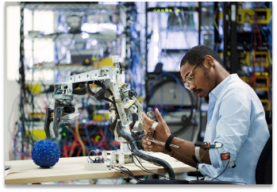
Two types of jobs in the future…
Those that are creating the automation
Those that will be automated
Which one do you want?

