Slide 1
New Graduate Students Orientation January 20, 2023
Agenda
Welcome
MSME Program
Q & A
Advising

Slide 2
Faculty and Staff Introduction
https://www.sjsu.edu/me/about-us/faculty/full-time.php

Slide 3
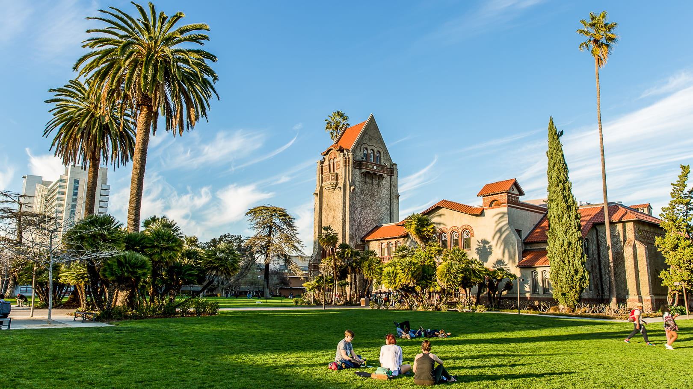
MSME Program
Evening classes

Slide 4
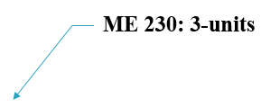
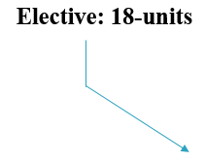
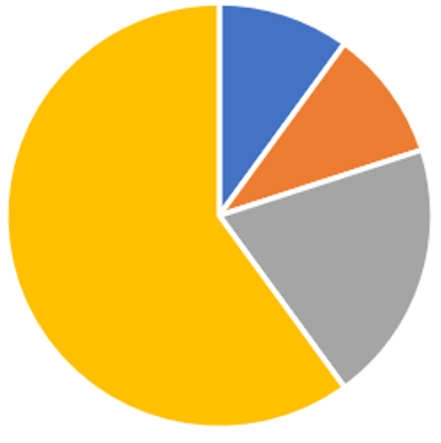


MSME Program
30-units Total

Slide 5
Overall minimum GPA of 3.0 or better
Grade in each of the 30 units for MS degree must be C or better (C- is an F)

Slide 6
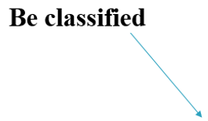
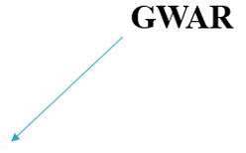
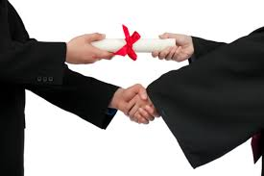


Program Requirements (30-units)

Slide 7
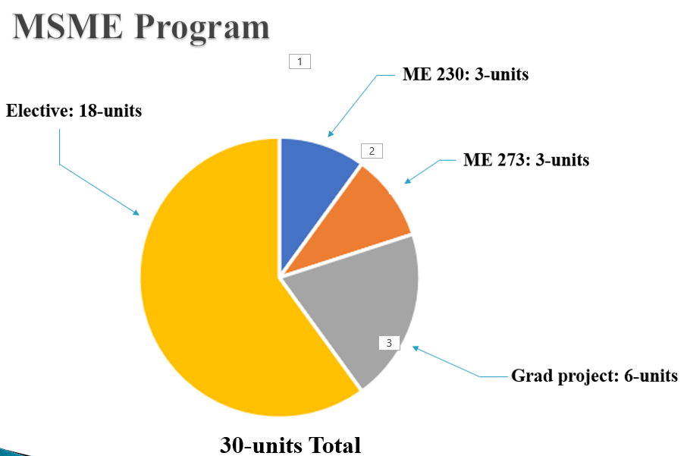



Approved Electives: 18-units
Which Courses Qualify as Electives
Any Graduate ME Course
Any ME Under grad Elective Course
Any Non-ME Course
Any Required ME Under grad Course
Any Non-ME Engineering Course

Slide 8






Approved Electives: 18-units

Slide 9
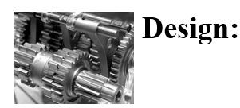
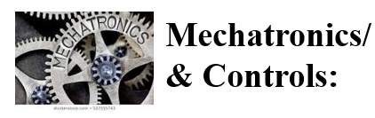
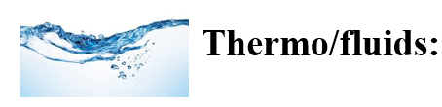
About the Program
Three Areas of emphasis:
  ME 240 ME 243, ME 250, ME 256, ME 260,
  ME 265
  ME 280, ME 281, ME 282, ME 283,
  ME 284, ME 285
  ME 200, ME 210, ME 211, ME
  221, ME 271

Slide 10
Program Notes
No rigid requirement for electives
You can pick and choose any ME Graduate courses
Generally, two courses/semester are offered in each area of emphasis
Up to 6 units can be below 200 level with the approval of the Graduate Advisor
Up to 9 units of graduate level coursework can be transferred

Slide 11




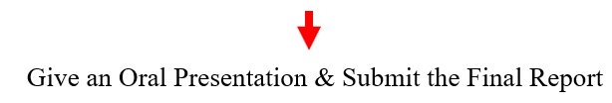

Steps for Graduation

Slide 12
Graduate Writing Assessment Requirement (GWAR)
The Graduate Writing Assessment Requirement (GWAR) is a university requirement
You must satisfy the GWAR before submitting the Candidacy form
GWAR can be satisfied by:
  Passing ME 201
  Passing 200W

Slide 13



Steps for Completing Project/Thesis (6-units)

Slide 14
About the Oral Presentation (Project/Thesis)
Given at the end of a semester
½ hour Oral Exam at the end of the first term of Project/Thesis
One-hour Oral Exam at the end of the second term of Project/Thesis
A draft copy of the final report is due before the oral Defense and a bound copy is due after the Oral Defense

Slide 15
Advising
  There is no mandatory advising for removing academic hold.
  Contact the ME office if you can’t register for classes
  For any questions related to your MSME program, contact the Graduate Program Advisor
  Advising is required if you are on Probation
  There is no advising available during the semester breaks and holidays
  Advising Rsource: https://www.sjsu.edu/me/msme/current_students/advising/

Slide 16
Registering for Classes
When eligible, you can register most of the courses online
You can add a class by getting an add code from the instructor (after the classes have started)
Graduate ME classes usually accommodate all
If you are Conditionally Classified and fulfilling a Conditional undergraduate class:
  Get an add code from the instructor (after the semester starts)
  Let the instructor know you are a graduate student and the Graduate Advisor has waived the pre-requisites
  Get written permission from the Graduate Advisor if needed

Slide 17
Probation and Disqualification
Probation: Overall GPA < 3.0
Disqualification: GPA < 3.0 two consecutive semesters
Reinstatement

Slide 18
Transfer Credits
Courses taken at other than SJSU Institutions
  Must be equivalent to the current SJSU courses
  Fill out an Equivalency Form and see the corresponding course instructor for evaluation
  Only a maximum of 9-units can be transferred
Courses taken at SJSU
  You can transfer up to 9-units of graduate ME courses completed as an SJSU undergraduate or taken on Open University. No pre-approval is required.

Slide 19
Resources
ME Web site:
https://www.sjsu.edu/me/

Slide 20
QUESTIONS
?

