Slide 1
Welcome to
ME 130 Applied Engineering Analysis Class
Fall 2018
Instructor:
Tai-Ran Hsu
Professor
Department of Mechanical Engineering
San Jose State University
San Jose, California, USA
Available @ links:
www.engr.sjsu.edu/mae/faculty/hsu/index,htm
www.engr.sjsu.edu/mae/greensheets/htm
ME 130 Greensheet F18/Green sheets

Slide 2
San Jose State University
Department of Mechanical and Aerospace Engineering
ME 130 Applied Engineering Analysis-1
Semester: Fall 2018
Course Number: 46683
Prerequisites**: Math 133A with grad C- or better
Co-requisites: ME 101 and ME 113
Class Hours: TR 09:00 – 10:15 AM
Class Room: E341, Engineering Building
Instructor: Dr. Tai-Ran Hsu, E117B, Tel: 924-3905,
E-mail: tai-ran.hsu@sjsu.edu
Office Hours: Thursdays 1:00 – 3:00 PM, or by appointment
** Students are expected to have learned the math subjects listed
in the Table in the next slide.
You are strongly encouraged to become familiar with those
underlined topics.

Slide 3
**Prerequisite Math Courses for the Course on Applied Engineering Analysis
SJSU Course No. and Title | Principal Course Syllabi
Math 19 Pre-Calculus | Functions and graphics; Polynomial and rational functions; Exponential,
 | logarithm and trigonometric functions; Analytic trigonometry; Applications of
 | trigonometric functions; Polar coordinates and vectors; Analytic geometry;
 | Systems of equations and inequalities
Math 30 Calculus I | Functions and continuity; Derivatives of polynomials, exponential,
 | trigonometric, logarithm and hyperbolic functions; Maximum and minimum
 | values; The mean value theorem; L'Hopital's rule; Newton's method-an
 | introduction to anti differentiation
Math 31 Calculus II | Areas and distances; The definite integral; Areas between curves; Volumes;
 | Volumes by washers and cylindrical shells; Work; Integration by parts;
 | Arc length; Area of a surface of revolution; Sequences and Series; Power series;
 | Complex numbers
Math 32 Calculus III | Curve defined by parametric equations; Areas and lengths in polar coordinates;
 | 3-D coordinate systems; Vector algebra; Equations of lines and planes;
 | Cylinders and quadric surfaces; Cylindrical and spherical coordinates; Vector
 | functions and space curves; Derivatives and integrals of vector functions;
 | Arc length; Motion in space; Functions of several variables; Partial derivatives.
 | The chain rule; Lagrange multipliers; Double integrals over general regions;
 | Applications of double integrals; surface area; Triple integrals in cylindrical
 | and spherical coordinates
Math 133A Differential Equations | Solution of first order differential equations with application to falling body,
 | terminal velocity; Solution to linear second order differential equations -
 | homogeneous and non-homogeneous equations with applications to vibration
 | of mass-spring systems; Laplace transforms; Series solutions of differential
 | equations-Taylor series method, power series, analytic functions

Slide 4
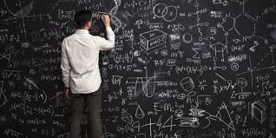
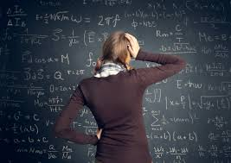
Mathematics indeed will be the principal TOOL that we will be using in this course.
But NOT this types of math that confuse everybody:!
We will use the math that you have already learned in your 4 previous math courses in the Lower Division to do the following in this course:
To enhance your learning of the following major sub-disciplines of mechanical engineering in:
fluid mechanics (ME 111),
heat transfer (ME 114),
rigid body dynamics (ME 101), and
machine design (CE 112, ME 147, 154,
ME 157, 160, 165) with Analytic models for the engineering processes and systems for these sub-disciplines.
Problems in these sub-disciplines will be the problems that you will be dealing with after you “walk-out” from this university and join the work force to be a valuable and versatile MECHANICAL ENGINEEERS!!

Slide 5
Course Description
To pick up the right math and solve the math for your problems is NOT enough,
you will also need to develop the knowledge and skill to get the: Practical
interpretations of analytical and approximate solutions for steady and
non-steady state mechanical engineering.
In addition to the course syllabi that you learned from your Lower
Division math courses (as in the Table in slide 3 shows), we will also
need to learn the linear algebra and statistics and their applications
in quality assurance in mass productions- to make you a more
contemporary mechanical engineer.
SO, THIS IS AN ENGINEERING COURSE –
NOT ANOTHER MATH COURSE
A side note: I Am aware of one criticism by my class in the 2017 SOTE report:
“I spent too much time in presenting “principles” than I should have
in offering more “examples” in the class.”
While I share this feeling by the student(s) who offered this criticism, and I wish we had
enough time to do both, my reason for spending more time on principles over examples
was solely because I want to educate you to be ENGINEERS but not TECHNICIANS.

Slide 6
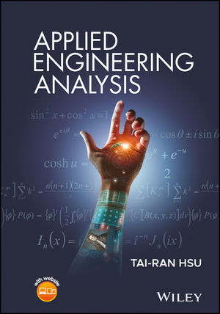
Textbook: 1) Bonded printed lecture notes on “Applied Engineering Analysis,”
by Tai-Ran Hsu, San Jose State University, Spring 2018
(printed and sold at the Spartan Book Store)
2) Slides for class instructions (copies available in
instructor’s SJSU web page)
References: 1) “Applied Engineering Analysis” by Tai-Ran Hsu, John Wiley & Sons,
Feb 2018 (ISBN 978-1-119-07119-8). Prices: $104.99 (e-version),
$130 hardcover. (see the cover picture below)
2) Avallone, Eugene A., Theodore Baumeister III and Alvan Sandegh,
“Marks’ Standard Handbook for Mechanical Engineers,” 11th edition
or newer, McGraw-Hill, 2006, ISBN 0071428674
3) CRC Standard Mathematical Tables, CRC Press, Inc., or
similar mathematical and mechanical engineering handbooks.
My latest book publication
By John Wiley & Sons:
Intended for both
ME 130 and ME 230

Slide 7
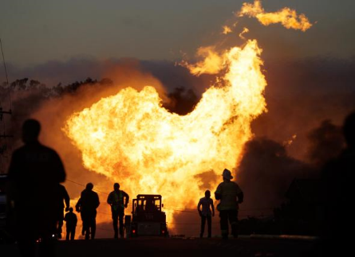
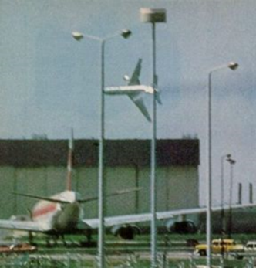
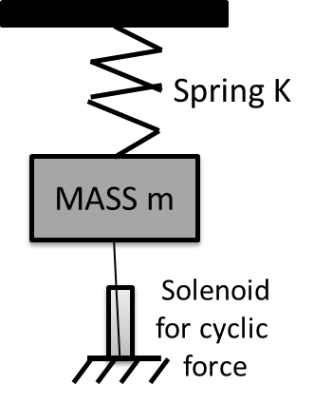
Grading Scheme:
Homework: 25% (account for the Best of 5 from 6 assigned sets)
Mid-term exam*: 30% (Thursday, November 8, 2018)*
Final examination: 45% (Thursday, December 13, 2018, 07:15-9:30 AM
Room E341)
Bonus quizzes: 6% on TWO (2) take-home assignments on specific
(see examples below) topics (may include building class demonstration
units) by teams of 2 or 3 students on VOLUNTARY
BASIS (marks will be based on satisfaction to the
specific requirements of the assignments).
* This date for the mid-term exam will be finalized on August 31, 2018
by the class - the last class date before voluntary withdrawal of this course.
• Answers (but not solutions) to homework problems are posted in the
instructor’s webpage.
4 Examples of Bonus quizzes related to engineering analysis:
on “Gas Pipeline burst in San Bruno, CA in September 2010?”
2) Crash of a DC 10 jumbo jet passenger plane over the Chicago O’Hare airport on
May 25th, 1979 as shown in the picture:
Experiment with the cooling of a small solid of known surface area (A) at an initial
temperature (T₀) to the desired lower temperature T in a cooling chamber at T_{f}.
4) Design and construct an experimental set-up for class
demonstrations of resonant and near-resonant vibration
of a solid mass supported by an elastic spring,

Slide 8
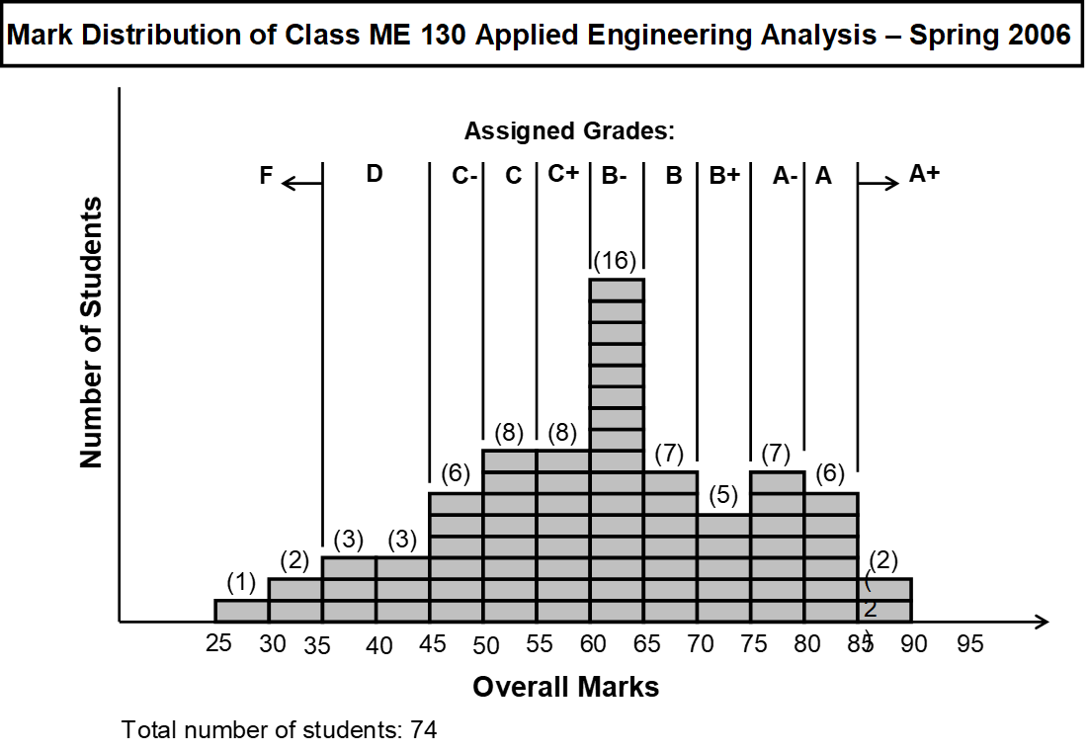
GRADING SYSTEM
Letter grades will be assigned based on overall class performance,
with Grade C+ or B- to be the median of the overall mark distribution of the class.

Slide 9
Important NOTE to the class:
There will be NO make-up mid-term and final examinations, except for students with serious medical reasons. A medical doctor’s certificate is required to support
such request. Request for make-up exams under this circumstance must be sent
to the Instructor for approval within three days after the event.
REASON for this stipulation is to be fair to the rest of the class.
(2) In all open-book exams, only calculators, reference books and bonded printed
notes are allowed but NOT notebook computers and any wireless phones or device.
(3) Late submission of homework past the due dates and time will not be accepted. This stipulation is necessary in order to be fair to the rest of the
class, which respects and abides by the assigned deadlines for submission.
Students are encouraged to use on-line solution methods in their home works. However, they must indicate the precise website address from which they obtained these solution methods. The Grader will not give credits for homework solutions without such disclosures.
(4) Students are encouraged to ask questions at all times in the classroom and
during the assigned office hours.

Slide 10
It will be your responsibility to let the Instructor know if he did not
answer your questions to your satisfaction.
(5) In preparing for future professional practices, students are expected to be
concise in answers to problems in home works and examinations.
• Some partial marks will be given to the examinations based on Examiner’s
judgment on student’s comprehensions of the problems in the exams with
incorrect answers
● In the spirit of fairness, the instructor will do his best in imposing uniform criteria
in assigning partial marks to quizzes and exams with incorrect answers.
Please refrain yourself from arguing for more generous allowance on the
marks from the instructor for incorrect answers to problems in exams.
(6) Class instructions will be handled exclusively by slide projections. Copies of the
slides are posted in the instructor’s webpage
(7) Materials for quizzes and exams will include: (a) printed lecture notes
(b) slide projections in class teaching, and (c) verbal presentations by the instructor.

Slide 11
Academic Integrity –
with Absolute ZERO TOLERANCE
Students are expected to have read the University Policy, which is available at:
http://www2.sjsu.edu/senate/S04-12.pdf
Course Goals
● To learn the relationships between engineering (the “master”) and
mathematics (the “servant”) and how they work together in solving
engineering problems
● To learn how to derive mathematical (analytical) models for the solution
of engineering problems
● To learn how to formulate mathematical models, e.g. calculus and
differential equations for mechanical engineering problems involving
various sub-disciplines
● To learn how to interpret mathematical solutions into engineering terms
and senses

Slide 12
Student Learning Objectives
● To fully understand the physical (engineering) interpretations of fundamentals
of mathematical terms such as variables, functions, differentiation and derivatives,
integration, differential equations
● To acquire experience and skill in basic methodologies in differentiation, integration
and solving ordinary and partial linear differential equations
● To be able to relate special tools such as Laplace transform and Fourier series
for modeling engineering phenomena and facilitate the mathematical solutions
● To be able to establish mathematical models, such as differential equations
and appropriate boundary and initial conditions for fundamental mechanical
engineering problems in fluid mechanics, vibration and heat conduction of solids
and find ways to solve these equations
● To be proficient in finding solutions of integrals and related information from
“tools” such as mathematical handbooks, spreadsheets and computer software
such as Mathcad and Matlab
● To learn the basic principles of linear algebra and statistics and their applications
in engineering design analysis and productions

Slide 13
Instruction Schedule
Focus: Math and physics (engineering):
Week 1: Chapter 1: The basic principles of engineering analysis and its applications
Week 2: Chapter 2: The principles and terms in mathematical modeling
Focus: Application of 1st order DEs in fluid dynamics and heat transfer:
Week 3: Chapter 3: Derivation and solutions of first order ordinary differential equations
Week 4: Chapter 3: Application of first order ordinary differential equations in
fluid mechanics, heat conduction in solids and kinematics of rigid body
Focus: Application of 2nd order DEs in mechanical vibration analyses:
Week 5: Chapter 4: Solution of homogeneous, second-order linear differential equations
Week 6, 7: Chapter 4: Application of ordinary differential equations in mechanical vibration
Focus: Useful tools for engineering analysis:
Week 7, 8: Chapter 5: Laplace transform and its physical meaning, and applications
Week 9: Chapter 6: Fourier series and its engineering applications
Week 10: Chapter 7: Introduction to partial differential equations
Week 11: Chapter 8: Linear algebra and its application in engineering analysis
Week 12: Chapter 9: Introduction to finite difference method
Focus: Application of statistics in quality control in mass productions:
Week 13-15: Chapter 10: Introduction to statistics and applications to manufacturing
process and quality control
NOTE: The above schedule may be modified as needed

Slide 14
“It is my passion to educate you the best I can,
but it is your responsibility to try hard to learn from me”
If you:
● Attend all classes, and listen attentively to what the Instructor says
in the lectures,
● Do not hesitate to ask questions in the classes, or after the classes. and
never pretend that you understand what is being said in the lectures
but the matter of fact is that you did not.
● Do all homework problems if possible, and understand how they are done
● Make sure to let the Instructor know your problems in learning the various subjects
of this class whenever they occur
● Make use of Instructor’s office hours for questions and advice
● Form a study group with 2 or 3 favored fellow students in the same class
to work on: exchange class notes, doing home works, review returned
and exam papers, and exchange speculations on possible exam problems.
● Above all; take a proactive attitude of ENJOYING what you are
learning from this course
♦ You will do well and be successful if you do all the above!

