Slide 1
Introduction to Data Conversion
EE174 – SJSU
Tan Nguyen

Slide 2
Introduction to Data Conversion
Introduction to ADC and DAC
  DAC specifications
  ADC specifications
  ADC/DAC Performances
Types ADC/DAC

Slide 3
Vocabulary
ADC (Analog-to-Digital Converter): converts an analog signal (voltage/current) to a digital value.
DAC (Digital-to-Analog Converter): converts a digital value to an analog value (voltage/current).
ADC sampling time: A sampling capacitor must be charged for a duration of T_{sample} before conversion taking place.
Full Scale output (V_{FS}) and Reference voltage (V_{ref}): Analog signal varies between 0 and V_{ref}, or between +/-V_{ref} . Note: V_{FS} = V_{ref} – 1LSB.
Resolution: Number of bits (N-bits) used for conversion. The higher bits, the more precise is the digital output.
Conversion Time: Time taken to convert the voltage on the sampling capacitor to a digital output.
Quantization is the process of converting a continuous range of values into a finite range of discreet values. This is a function of ADC, which create a series of digital values to represent the original analog signal.
The quantization error of an ideal ADC is half of the step size (1 LSB).
Differential Nonlinearity (DNL) error is the difference between an actual step width (for an ADC) or step height (for a DAC) and the ideal value of 1 LSB.
Integral Nonlinearity (INL) error is the deviation of the values on the actual transfer function from a straight line.
Effective Number Of Bits (ENOB) is a measure of the dynamic performance of an ADC.

Slide 4
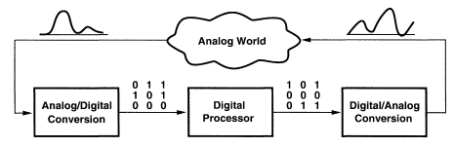
Data Conversion System
Data Conversion is the process of changing or converting one form of data in to another form. In processing and communication there are only two types of data forms i.e analog and digital data.
Real world signals are analog signals continuous time & amplitude (temp, pressure, position, sound, light, speed, etc.).
Digital processors can only process digital signals which are discrete time and discrete amplitude.
In order to interface digital processors with the analog world, data acquisition and reconstruction circuits must be used: analog-to-digital converters (ADCs) to acquire and digitize the analog signal at the front end, and digital-to-analog converters (DACs) to reproduce the analog signal at the back end.
➔ Digital data conversion system requires ADC and DAC.

Slide 5
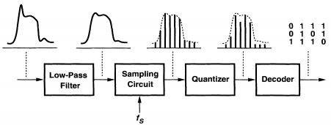
Analog-to-Digital Converter (ADC)
The analog-to-digital converter (ADC) converts a continuous-amplitude, continuous-time input to a discrete-amplitude, discrete-time signal.
An analog low-pass (anti-alias) filter limits the input signal bandwidth so that subsequent sampling does not alias any unwanted noise or signal components into the actual signal band.
The filter output signal is sampled at a rate of f_{S} samples per second to produce a discrete-time signal.
The amplitude of this discrete-time signal is "quantized," i.e., approximated with a level from a set of fixed references, thus generating a discrete-amplitude signal.
The discrete-amplitude signal is decoded to a digital representation of that level is established at the output.
Note: ADCs usually require the input be held constant during the conversion process, indicating that the ADC must be preceded by an Sample-and-Hold Amplifier (SHA) to freeze the band-limited signal just prior to each conversion.

Slide 6
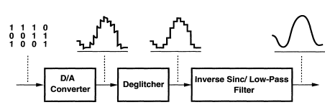
Digital-to-Analog Converter (DAC)
The digital data is processed by a digital processor and output to the digital-to analog converter (DAC). The DAC reverses the ADC process, it converts a discrete time, discrete amplitude into continuous time, continuous amplitude. The DAC is usually operated at same frequency as the ADC.
A DAC selects and produces an analog level from a set of fixed references according to the digital input.
If the DAC generates large glitches during switching from one code to another, a "deglitching" circuit (usually a sample-and-hold amplifier) follows to mask the glitches.
The reconstruction function performed by the DAC introduces sharp edges in the waveform as well as a sine envelope in the frequency domain, an inverse-sine filter and a low-pass filter are required to suppress these effects. The resulting staircase-like signal is finally passed through a smoothing filter to ease the effects of quantization noise.
Note: The deglitcher may be removed if the DAC is designed to have small glitches. Also, the inverse sine filtering may be performed before DAC conversion in the digital domain.

Slide 7
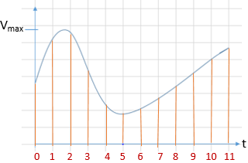
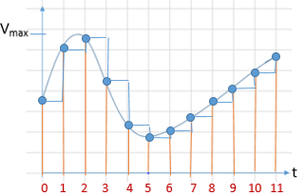
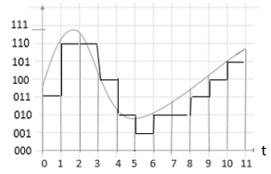
Illustration of ADC Process
There are two related steps in A-to-D conversion:
Sampling and holding
Analog signal is sampled at discrete points in time, usually at periodic interval
Taking samples from each location, reflects sampled and hold signal.
Analog voltage sampled at discrete time t is rounded off to nearest discrete voltage value.
Analog signal: continuous in time and voltage
Quantization and Encoding
The samples are quantized to discrete levels. Each sample is represented as a digital value.
Each level is assigned a digital code, and the signal is represented as a sequence of digital codes which can be stored the in memory for future processing.
Sequence of digital codes.
011, 110, 110, 100, 010, 001, 010, 010, 011, 100, 101.

Slide 8
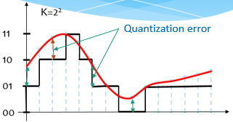
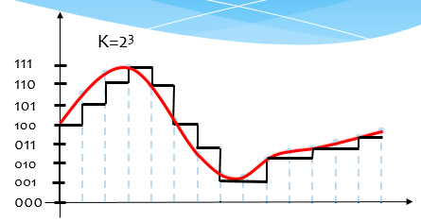
ADC Process: Quantization and Coding
The analog input is an infinite valued quantity and the output is a discrete value, an error will be produced as a result of the quantization. This error, known as quantization error, Q_{e}, is defined as the difference between the actual analog input V_{in} and the value of the output (staircase) V_{staircase} given in voltage. It is calculated as:
Q_{e} = V_{in}– V_{staircase}
The greater is the number of bits, the greater is the precision of the ADC
Round-off error (a.k.a. Quantization error) cannot be recovered and the amount of round-off error decreases with increasing number of bits used in the ADC.
The quantization error of an ideal ADC is half of the step size.
Encoding: Assigning a unique digital code to each quantum, then allocating the digital code to the input signal.
analog input
staircase
Example of 2-bit and 3-bit ADC

Slide 9
ADC Process: Sampling Theorem
The fundamental consideration in sampling is how fast to sample a signal to be able to reconstruct it.
Suppose a signal’s highest frequency is f_{max}. Then a proper sampling requires a sampling frequency f_{s} at least satisfying
As sampling rate increases, sampled waveform looks more and more like the original.
Sampling rate less than Nyquist rate results in original signal is not recovered known as aliasing phenomenon.
f_{s} > 2f_{max} Nyquist rate = 2 f_{max}
Nyquist frequency = f_{s}/2
Aliasing
Example 1: Given the signal v(t) = 7 + 5cos(2π440t) + 3sin(2π880t) , what is the proper sampling rate?
Solution: The proper sampling rate f_{s} > f_{Nyquist}= 2(880)=1760 Hz.
Analog sinusoid
x(t) = A cos(2πf₀t + φ)
Sample at T_{s} = 1/f_{s}
x[n] = x(T_{s} n) = A cos(2π f₀ T_{s} n + φ)
Keeping the sampling period same, sample
y(t) = A cos(2π(f₀ + lf_{s})t + φ) where l is an integer
y[n] = y(T_{s} n) = A cos(2π(f₀ + lf_{s})T_{s}n + φ) = A cos(2πf₀T_{s}n + 2π lf_{s}T_{s}n + φ)
= A cos(2πf₀T_{s}n + 2π l n + φ) = A cos(2πf₀T_{s}n + φ)
= x[n] ➔ y[n] indistinguishable from x[n]

Slide 10
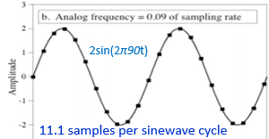
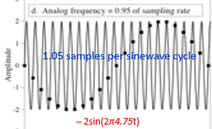
ADC Process: Sampling Theorem
For a sinusoid signal v(t) = 2sin(180πt) = 2sin(2π90t) is sampled at f_{s} = 1000 Hz > 2 f_{max} ➔ a proper sampling to recover signal. Equivalently, there are 1000/90 = 11.1 samples per sinewave cycle.
Now, if sampling f_{s} = 95 Hz or equivalently there are 1.05 samples per sinewave cycle ➔ an improper sampling of the signal because another sine wave can produce the same samples.
The original sine misrepresents itself as another sinewave. This phenomenon is called aliasing.
For v(t) = 2sin(180πt) = 2sin(2π90t).
Analysis:
For f_{s1} = 1000 Hz ➔ v₁[n] = 2sin(2πn 90/1000) = 2sin(2πn(0.09)) = 2sin(0.18πn)
Recovering signal: v_{r1}(t) = 2sin(0.18π tx1000) = 2sin(180πt) = 2sin(2π 90t)
Signal recovered
For f_{s2} = 95 Hz ➔ v_{r2}[n] = 2sin(2πn 90/95) = 2sin(πn(1.9)) = 2sin(πn(2 – 0.1))
= 2sin(πn( – 0.1)) = – 2sin(0.1πn)
Recovering signal: v_{r2}(t) = – 2sin(0.1πtx95) = – 2sin(9.5πt) = – 2sin(2π4.75t) ➔ Signal is not recovered

Slide 11
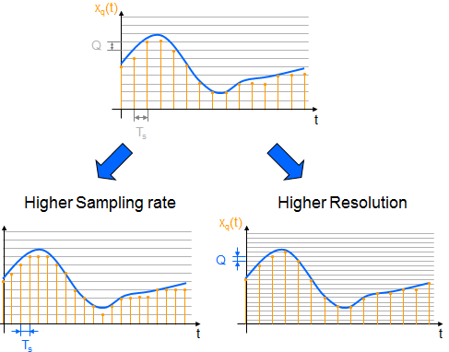
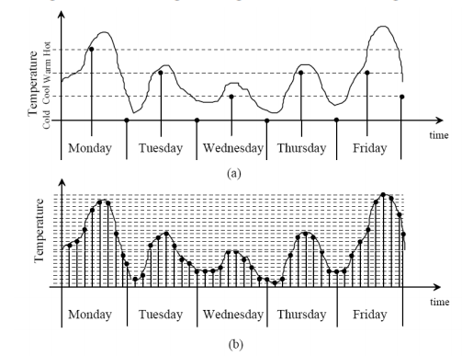
Improve the accuracy in ADC
Increase the sampling rate which increases the maximum frequency that can be measured.
Increase the resolution which improves the accuracy in measuring the amplitude of the analog signal.
Increasing both sampling time and resolution, the difference between the analog and the digital signals would become negligible
Example of daily temperatures:
(a) Two samples per day with four quantization levels (b) Nine samples per day with 25 quantization levels.

Slide 12
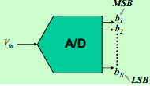

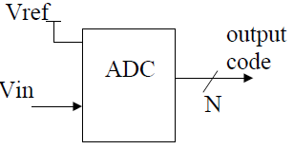
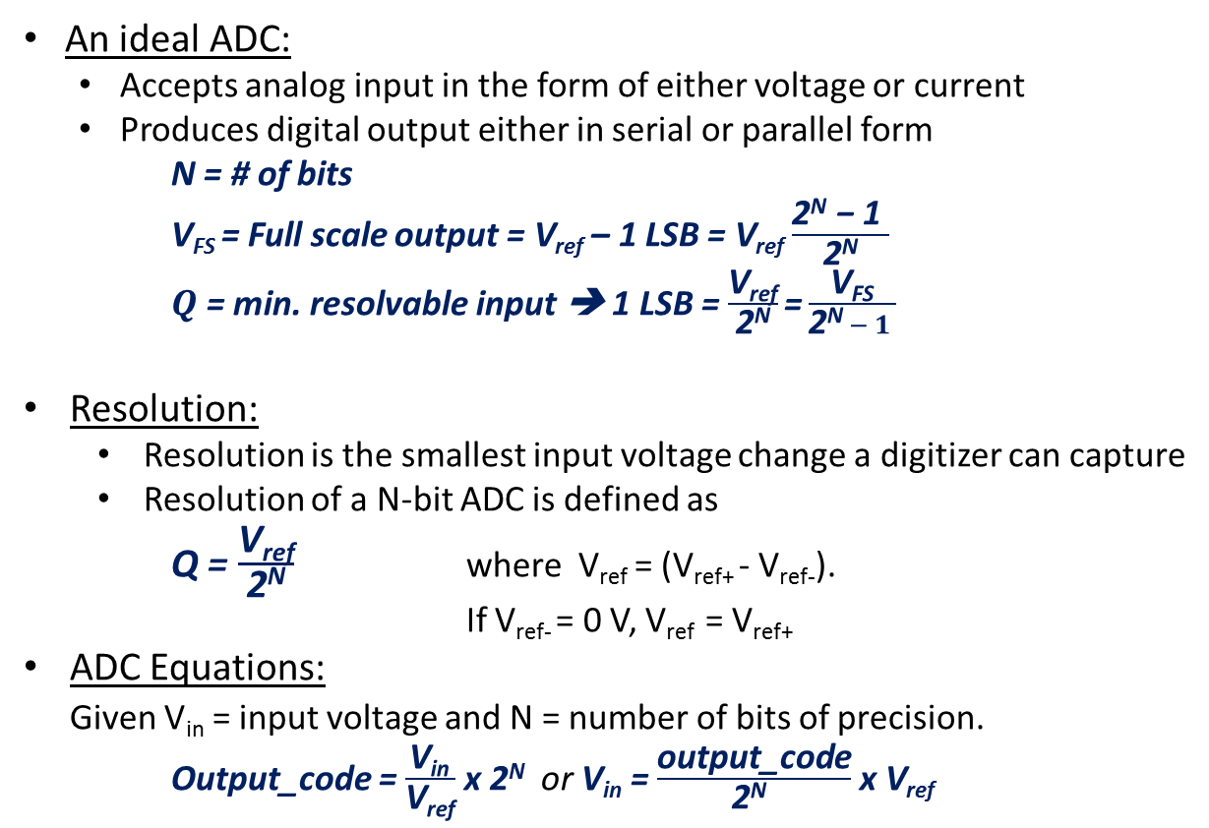
ADC Characteristics
An ideal ADC:
  Accepts analog input in the form of either voltage or current
  Produces digital output either in serial or parallel form
N = # of bits
V_{FS} = Full scale output = V_{ref} – 1 LSB = V_{ref} $\frac{\text{2}\text{N}\text{ − 1 }}{\text{2}\text{N}}$
$Q$ = min. resolvable input ➔ 1 LSB = $\frac{\text{V}\text{ref}}{\text{2}\text{N}}\text{=}\frac{\text{V}\text{FS}}{\text{2}\text{N} − 1 }$
Resolution:
  Resolution is the smallest input voltage change a digitizer can capture
  Resolution of a N-bit ADC is defined as
Q = $\frac{\text{V}\text{ref}}{\text{2}\text{N}}$ where V_{ref} = (V_{ref+} - V_{ref-}).
If V_{ref-} = 0 V, V_{ref} = V_{ref+}
ADC Equations:
Given V_{in} = input voltage and N = number of bits of precision.
Output_code = $\frac{\text{V}\text{in}}{\text{V}\text{ref}}$ x 2^{N} or V_{in} = $\frac{\text{output}\text{_}\text{code}}{\text{2}\text{N} }$ x V_{ref}
Out-put code
For V_{ref} = 5V, step size (1LSB) = 5V/256 = 0.0195V

Slide 13
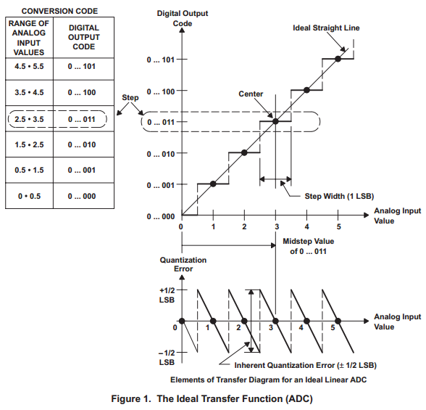

ADC: Ideal Transfer Function and Quantization Noise Model
When an ADC converts a continuous signal into a discrete digital representation, there is a range of input values that produces the same output. That range is called quantum (Q) and is equivalent to the Least Significant Bit (LSB). The difference between input and output is called the quantization error.
Therefore, the quantization error can be between ±Q/2.
Any value of the error is equally likely, so it has a uniform distribution ranging from −Q/2 to +Q/2. Then, this error can be considered a quantization noise with RMS:
For an ideal ADC:
Quantization error is bounded by –Q/2 … +Q/2 for inputs within full-scale range

Slide 14

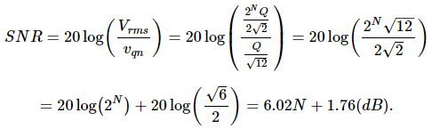

Signal-Noise Ratio (SNR) relates to N-bits in digital presentation
Assuming an input sinusoidal with peak-to-peak amplitude V_{ref}, where V_{ref} is the reference voltage of an N-bit ADC (therefore, occupying the full-scale of the ADC), its RMS value is
To calculate the Signal-Noise Ratio, we divide the RMS of the input signal by the RMS of the quantization noise:
SNR = 6.02 x N + 1.76 (dB)
This SNR equation generalizes to any system using a digital representation. Accurate for N > 3.

Slide 15

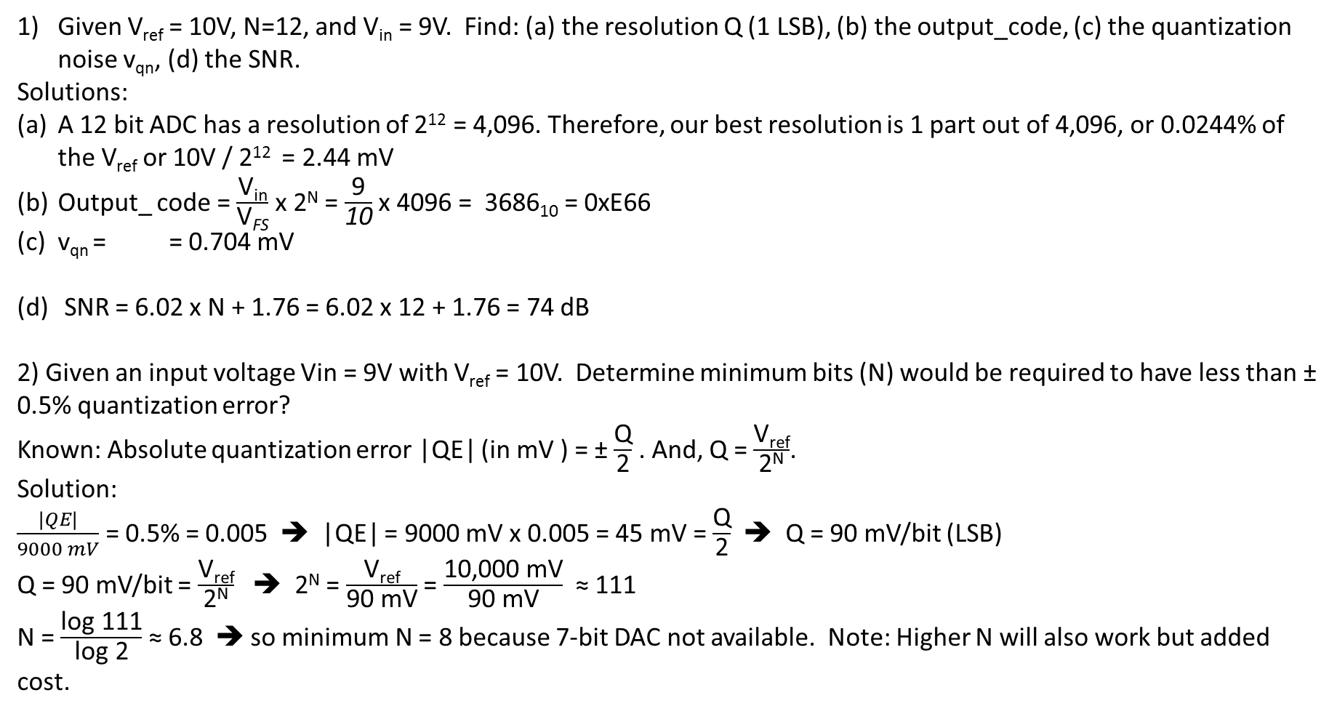
Examples
Given V_{ref} = 10V, N=12, and V_{in} = 9V. Find: (a) the resolution Q (1 LSB), (b) the output_code, (c) the quantization noise v_{qn}, (d) the SNR.
Solutions:
A 12 bit ADC has a resolution of 2¹² = 4,096. Therefore, our best resolution is 1 part out of 4,096, or 0.0244% of the V_{ref} or 10V / 2¹² = 2.44 mV
Output_ code = $\frac{\text{V}\text{in}}{\text{V}\text{FS}}$ x 2^{N} = $\frac{\text{9}}{\text{10}}$ x 4096 = 3686₁₀ = 0xE66
v_{qn} = = 0.704 mV
SNR = 6.02 x N + 1.76 = 6.02 x 12 + 1.76 = 74 dB
2) Given an input voltage Vin = 9V with V_{ref} = 10V. Determine minimum bits (N) would be required to have less than ± 0.5% quantization error?
Known: Absolute quantization error |QE| (in mV ) = ± $\frac{\text{Q}}{\text{2}}$ . And, Q = $\frac{\text{V}\text{ref}}{\text{2}\text{N}}$.
Solution:
$\frac{|QE|}{9000 mV}$ = 0.5% = 0.005 ➔ |QE| = 9000 mV x 0.005 = 45 mV = $\frac{\text{Q}}{\text{2}}$ ➔ Q = 90 mV/bit (LSB)
Q = 90 mV/bit = $\frac{\text{V}\text{ref}}{\text{2}\text{N}}$ ➔ 2^{N} = $\frac{\text{V}\text{ref}}{\text{90 }\text{mV}}$ = $\frac{\text{10,000 }\text{mV}}{\text{90 }\text{mV}}$ ≈ 111
N = $\frac{\text{log}\text{ 111}}{\text{log}\text{ 2}}$ ≈ 6.8 ➔ so minimum N = 8 because 7-bit DAC not available. Note: Higher N will also work but added cost.

Slide 16
Examples
3) Given V_{ref} = 10V, and a 10-bit A/D output code is 0x12A.
a) What is the ADC input voltage?
b) If the input voltage is V_{in} = 2.915 V, what is the output code?
c) What is the input voltage range that yield an output code of 0x005?
Solution:
1 LSB = Q = 10V / 2¹⁰ = 0.00976 V = 9.76 mV ➔ Q/2 = 4.88 mV
a) V_{in} = output_code / 2^{N} * V_{ref} = (0x12A) / 2¹⁰ x 5 V = 298/1024 x 10 V
= 2.91015 V = 2910.15 mV (ADC Vin)
b) For the output code 0x12A, the input voltage range is 2910.15 ± Q/2 or
2905.27 mV < V_{0x12A} < 2915.03 mV
So for V_{in} = 2.915 V the out put code is also 0x12A
c) The ideal input voltage to produce output code 5 is
V_{0x005} = 5 x 9.76 mV = 48.8 mV
The range for output code 0x005 is 48.8 ± 4.88 mV or
43.92 mV < V_{0x005} < 53.68 mV

Slide 17
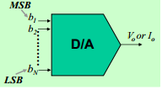
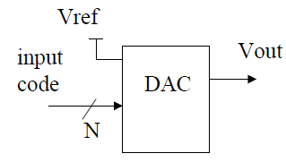
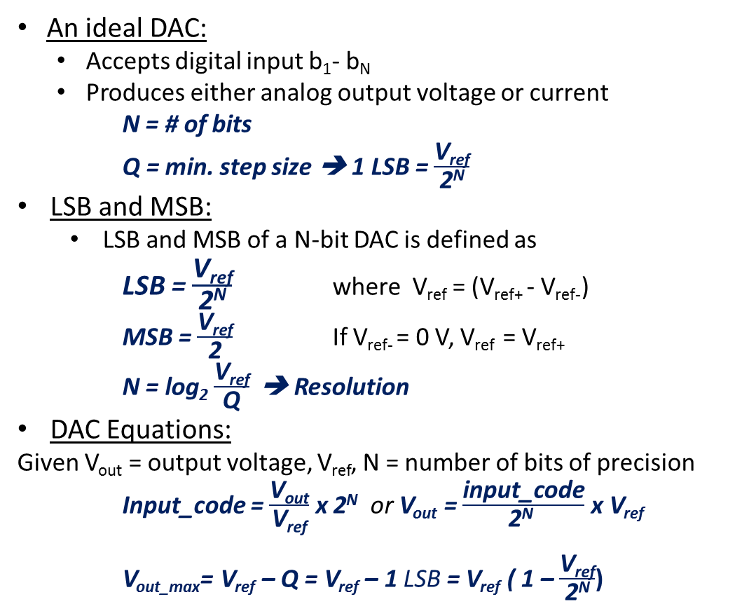
DAC Characteristics
An ideal DAC:
  Accepts digital input b₁- b_{N}
  Produces either analog output voltage or current
N = # of bits
Q = min. step size ➔ 1 LSB = $\frac{\text{V}\text{ref}}{\text{2}\text{N}}$
LSB and MSB:
  LSB and MSB of a N-bit DAC is defined as
LSB = $\frac{\text{V}\text{ref}}{\text{2}\text{N}}$ where V_{ref} = (V_{ref+} - V_{ref-})
MSB = $\frac{\text{V}\text{ref}}{\text{2}}$ If V_{ref-} = 0 V, V_{ref} = V_{ref+}
N = log₂ $\frac{\text{V}\text{ref}}{\text{Q}}$ ➔ Resolution
DAC Equations:
Given V_{out} = output voltage, V_{ref}, N = number of bits of precision
Input_code = $\frac{\text{V}\text{out}}{\text{V}\text{ref}}$ x 2^{N} or V_{out} = $\frac{\text{input}\text{_}\text{code}}{\text{2}\text{N} }$ x V_{ref}
V_{out_max}= V_{ref} – Q = V_{ref} – 1 LSB = V_{ref} ( 1 – $\frac{\text{V}\text{ref}}{\text{2}\text{N}}$)

Slide 18
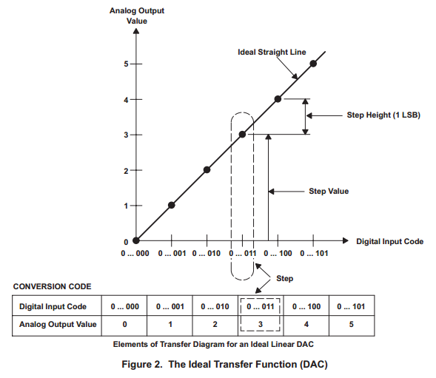
Ideal Transfer Function DAC
DAC: Ideal Transfer Function
• Ideal DAC introduces no error!
• One-to-one mapping from input to output

Slide 19
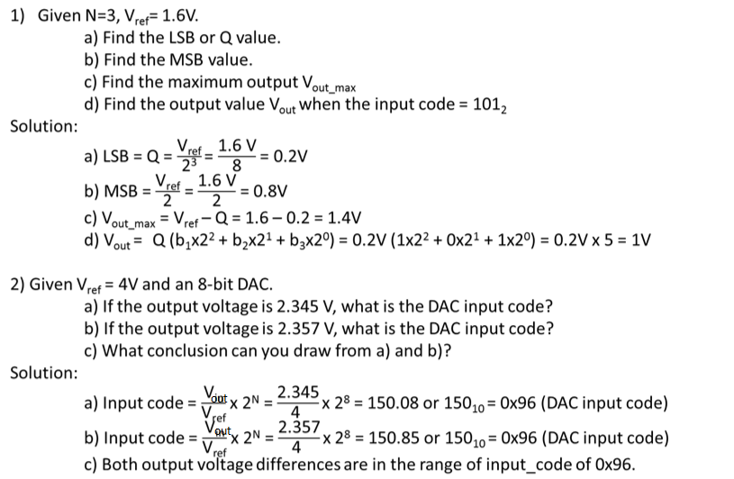
Example DAC Computations

Slide 20
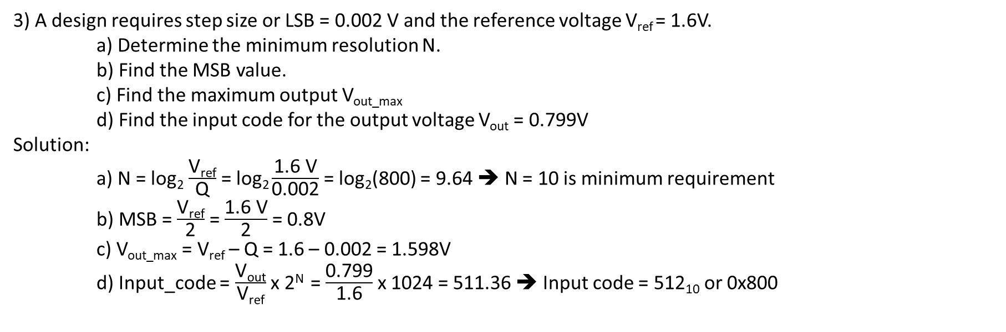
Example DAC Computations
3) A design requires step size or LSB = 0.002 V and the reference voltage V_{ref} = 1.6V.
a) Determine the minimum resolution N.
b) Find the MSB value.
c) Find the maximum output V_{out_max}
d) Find the input code for the output voltage V_{out} = 0.799V
Solution:
a) N = log₂ $\frac{\text{V}\text{ref}}{\text{Q}}$ = log₂ $\frac{\text{1.6 }\text{V}}{\text{0.002}}$ = log₂(800) = 9.64 ➔ N = 10 is minimum requirement
b) MSB = $\frac{\text{V}\text{ref}}{\text{2}}$ = $\frac{\text{1.6 }\text{V}}{\text{2}}$ = 0.8V
c) V_{out_max} = V_{ref} – Q = 1.6 – 0.002 = 1.598V
d) Input_code = $\frac{\text{V}\text{out}}{\text{V}\text{ref}}$ x 2^{N} = $\frac{\text{0.799}}{\text{1.6}}$ x 1024 = 511.36 ➔ Input code = 512₁₀ or 0x800

Slide 21
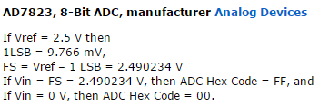
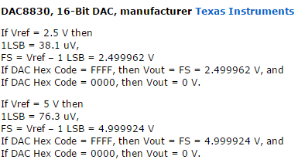
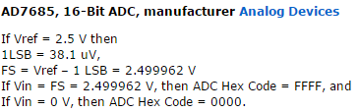
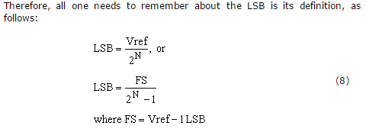
Some Data Sheet Examples

Slide 22
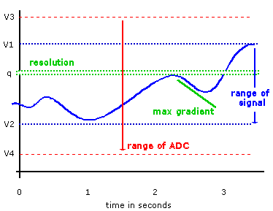
Selecting ADC/DAC
In converting between analog and digital domains errors are introduced. The conversion system must be carefully designed to suit the nature of the signals to prevent these errors affecting the validity of the data. For the more difficult case, of converting from analog to digital data. We need to decide:
The range of the allowed input signal: signal has a range of (v1 - v2) volts. To be certain that the signal will never exceed our ability to convert it we choose a converter with a greater range, say (v3 -v4) volts.
The resolution is the smallest change that we need to measure.
The sampling frequency: How often the signal must be measured to suit the fastest changing part of the signal.
The choice of a DAC is usually limited to the number of bits
required, as all DACs are quite fast.
Having identified the range we require and the resolution to
which we must measure tells us the number of bits required.

Slide 23
Data Converter Performance Metric
EE174 – SJSU
Tan Nguyen

Slide 24
Data Converter Performance Metrics
Data Converters are typically characterized by static, time-domain, & frequency domain performance metrics :
  Static
    Offset
    Gain error
    Full-scale error
    Differential nonlinearity (DNL)
    Integral nonlinearity (INL)
    Monotonicity
  Dynamic
    Delay & settling time
    Aperture uncertainty
    Distortion-harmonic content
    Signal-to-noise ratio (SNR), Signal-to-(noise+distortion) ratio (SNDR)
    Idle channel noise
    Dynamic range & spurious-free dynamic range (SFDR)

Slide 25
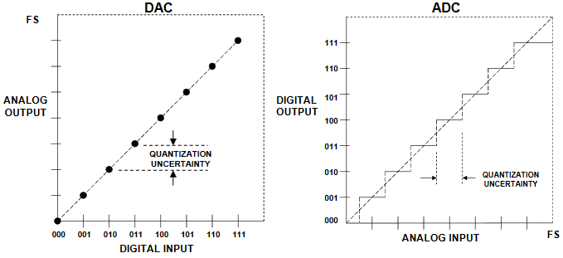
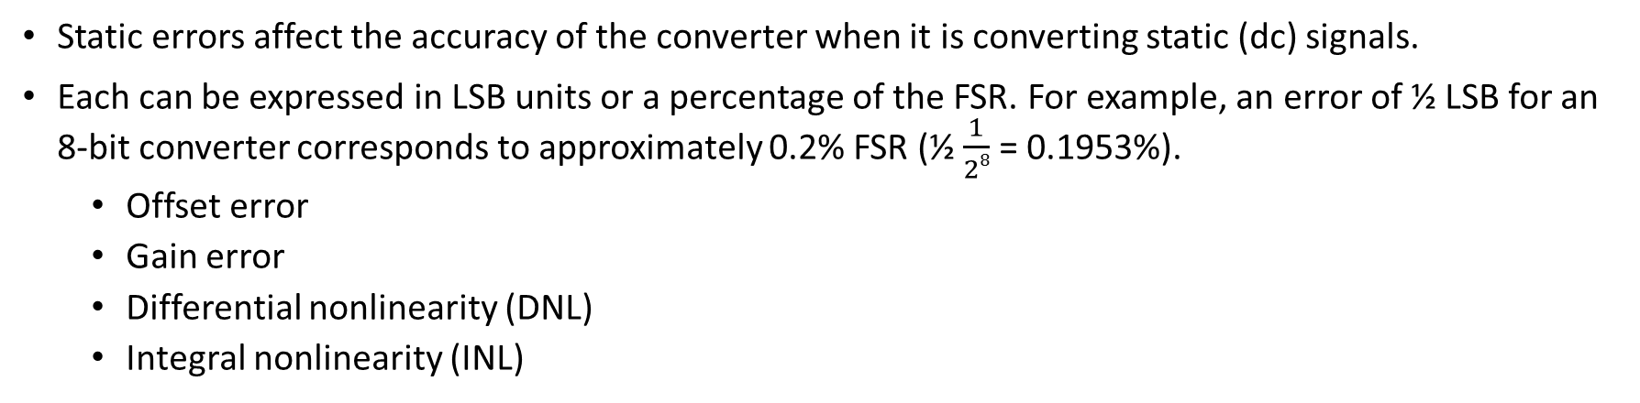
Static Errors on Converters
Static errors affect the accuracy of the converter when it is converting static (dc) signals.
Each can be expressed in LSB units or a percentage of the FSR. For example, an error of ½ LSB for an 8-bit converter corresponds to approximately 0.2% FSR (½ $\frac{1}{28}$ = 0.1953%).
  Offset error
  Gain error
  Differential nonlinearity (DNL)
  Integral nonlinearity (INL)
Ideal 3-bit ADC and DAC Transfer Function

Slide 26
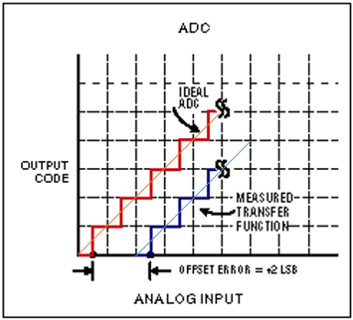
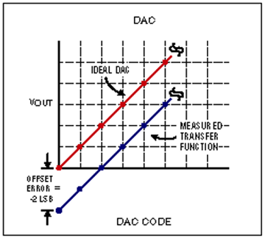
Offset Errors: ADC and DAC
Offset Error (Zao scale er)
The offset (or zero-scale) error is defined as the difference between the nominal and actual offset points and measured in LSBs.
For an ideal ADC, the first transition occurs at 0.5LSB above zero. For an ADC, the offset voltage is applied to the analog input and is increased until the first transition occurs.
ADC offset error can be removed be measuring a reference point and subtracting that value from future samples.
For a DAC, offset error is the analog output response to an input code of all zeros.
0.5
2.5LSB

Slide 27
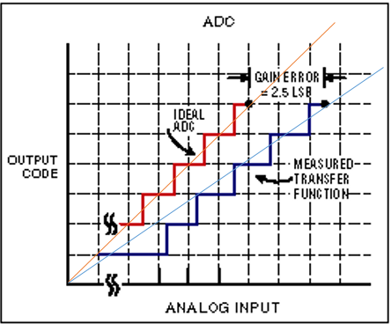
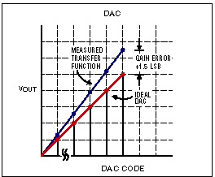
Gain Errors: ADC and DAC
Gain Error
The gain error of an ADC or DAC indicates how well the slope of an actual transfer function matches the slope of the ideal transfer function after the offset error has been calibrated out.
Gain error is usually expressed in LSB or as a percent of full-scale range (%FSR), and it can be calibrated out with hardware or in software.

Slide 28
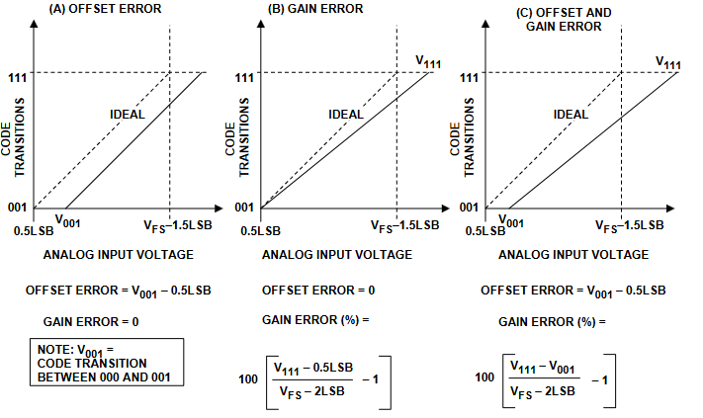
Measuring 3-bit ADC Offset and Gain Error

Slide 29
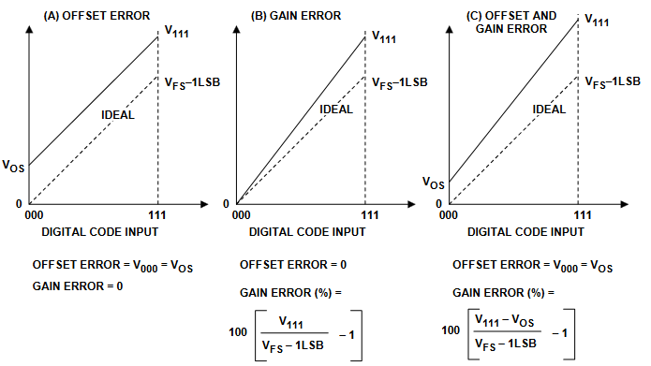
Measuring 3-bit DAC Offset and Gain Error

Slide 30
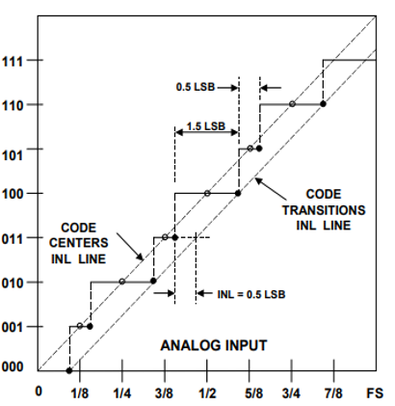
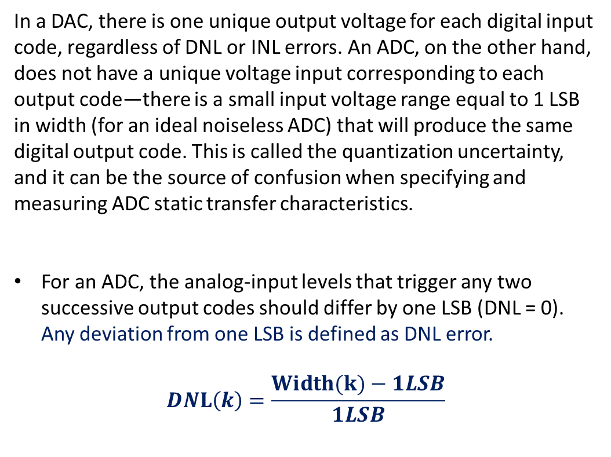
DNL and INL of ADC
In a DAC, there is one unique output voltage for each digital input code, regardless of DNL or INL errors. An ADC, on the other hand, does not have a unique voltage input corresponding to each output code—there is a small input voltage range equal to 1 LSB in width (for an ideal noiseless ADC) that will produce the same digital output code. This is called the quantization uncertainty, and it can be the source of confusion when specifying and measuring ADC static transfer characteristics.
For an ADC, the analog-input levels that trigger any two successive output codes should differ by one LSB (DNL = 0). Any deviation from one LSB is defined as DNL error.
$$DNL\left(k\right)=\frac{Width(k)−1LSB}{1LSB}$$
k
INL (k) = ∑ DNL[i]
i = 1

Slide 31
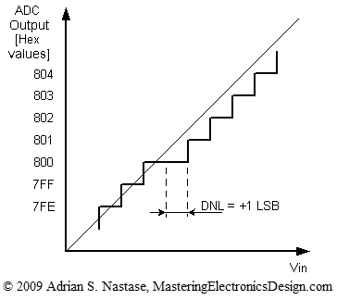
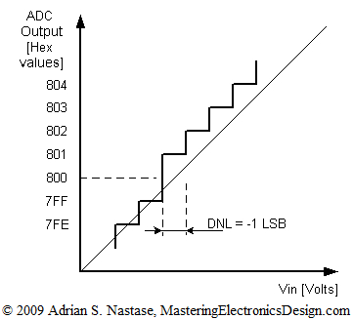
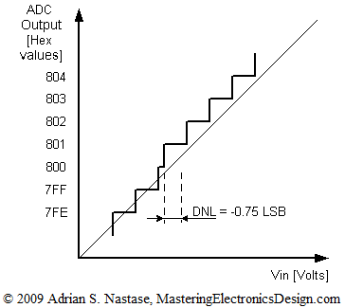
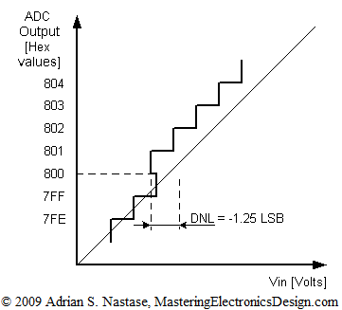

ADC DNL Error
$$DNL\left(k\right)=\frac{Width(k)−1LSB}{1LSB}$$
Fig. 2: 0x800 code width is 0 LSB (Missing code).
DNL = – 1 LSB.
Since 0x800 is missing, the ADC cannot be used for high precision applications.
Fig. 1: Wide code width
Fig. 2: Missing code
Fig. 1: The 0x800 code width is 2 LSB (Wide code width).
➔ DNL = +1 LSB.
Fig. 3: The 0x800 code width is 0.25 LSB (Narrow code width).
DNL = – 0.75 LSB ,
Since the 0x800 is still there, the ADC can be used in precision applications.
In Fig. 4: The 0x800 code width is – 0.25 LSB (undefined/non- monotonic).
DNL = – 1.25 LSB.
It is clear that the ADC is highly nonlinear.
Fig. 4: Non-monotonic
Fig. 3: Narrow code width

Slide 32
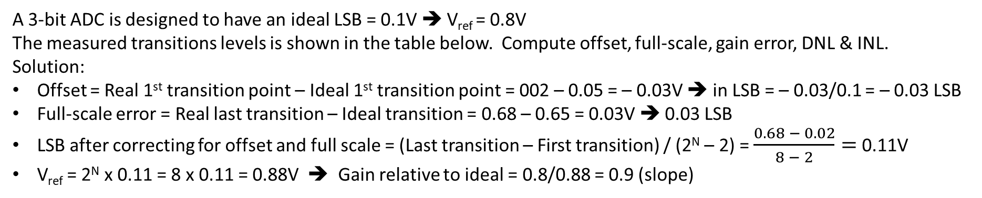
ADC Offset, Gain, DNL and INL Example
A 3-bit ADC is designed to have an ideal LSB = 0.1V ➔ V_{ref} = 0.8V
The measured transitions levels is shown in the table below. Compute offset, full-scale, gain error, DNL & INL.
Solution:
Offset = Real 1st transition point – Ideal 1st transition point = 002 – 0.05 = – 0.03V ➔ in LSB = – 0.03/0.1 = – 0.03 LSB
Full-scale error = Real last transition – Ideal transition = 0.68 – 0.65 = 0.03V ➔ 0.03 LSB
LSB after correcting for offset and full scale = (Last transition – First transition) / (2^{N} – 2) = $\frac{0.68 − 0.02}{8 − 2}=$ 0.11V
V_{ref} = 2^{N} x 0.11 = 8 x 0.11 = 0.88V ➔ Gain relative to ideal = 0.8/0.88 = 0.9 (slope)
Transition # | Ideal transition point | Real transition point | Code width [V] | Width [LSB] = 0.11V | DNL=W - 1 | INL = ∑ DNL
1 | 0.05 | 0.02 | 0.15 – 0.02 = 0.13 | 1.18 | 0.18 | 0
2 | 0.15 | 0.15 | 0.2 – 0.15 = 0.05 | 0.45 | -0.55 | 0.18
3 | 0.25 | 0.2 | 0.37 – 0.2 = 0.17 | 1.55 | 0.55 | -0.37
4 | 0.35 | 0.37 | 0.42 – 0.37 = 0.05 | 0.45 | -0.55 | 0.18
5 | 0.45 | 0.42 | 0.5 – 0.42 = 0.08 | 0.73 | -0.27 | -0.37
6 | 0.55 | 0.5 | 0.68 – 0.5 = 0.18 | 1.64 | 0.64 | -0.64
7 | 0.65 | 0.68 | * | * | * | 0

Slide 33
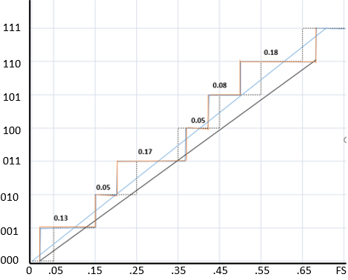
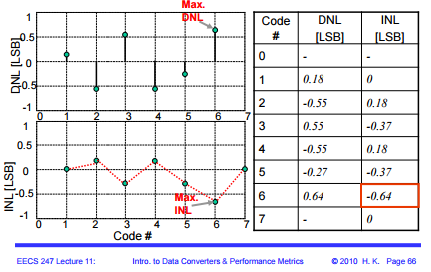
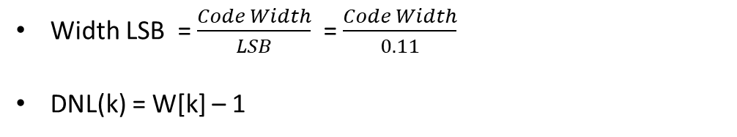
ADC Differential & Integral Nonlinearity Example
Width LSB = $\frac{Code Width}{LSB}$ = $\frac{Code Width}{0.11}$
DNL(k) = W[k] – 1
k
INL (k) = ∑ DNL[i]
i = 1
Notice: For end-point corrected measurement
INL[0] ➔ undefined
INL[1]=0
INL[2^{N}-1]=0

Slide 34
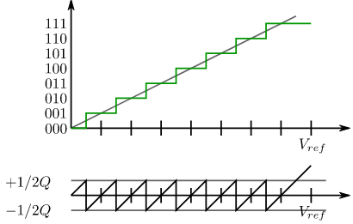

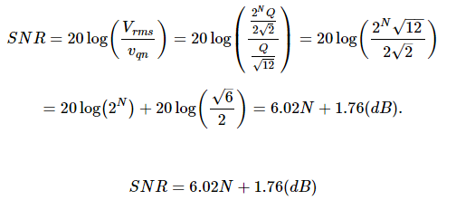
Effect Number Of Bit (ENOB) in DAC
Quantization noise with RMS
Assuming an input sinusoidal with peak-to-peak amplitude Vref, where Vref is the reference voltage of an N-bit ADC, its RMS value is
http://www.onmyphd.com/?p=quantization.noise.snr

Slide 35
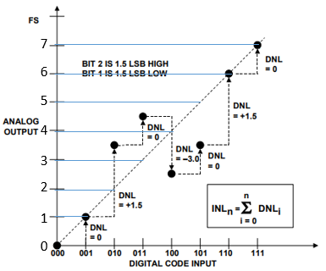


DNL and INL of DAC
In a DAC, we are concerned with two measures of the linearity of its transfer function: integral nonlinearity, INL (or relative accuracy), and differential nonlinearity, DNL.
Differential nonlinearity (DNL) error is the difference between the ideal and the measured output responses for successive DAC codes. An ideal DAC response would have analog output values exactly 1LSB apart (DNL = 0).
  DNL specs ≥ 1LSB guarantees monotonicity in DAC
  If the differential nonlinearity is more negative than –1 LSB, the DACs transfer function is non-monotonic.
Integral nonlinearity (INL) is the maximum deviation, at any point in the transfer function, of the output voltage level from its ideal value—which is a straight line drawn through the actual zero and full-scale of the DAC.
$$DNL\left(m\right)=\frac{Vout\left(m\right)−Vout\left(m −1\right)−1LSB}{1LSB}$$
  INL at the 101 code: DNL001 + DNL010 + DLN011 + DNL100 + DNL101 = 0 + 1.5 + 0 – 3 + 0 = –1.5 LSBs.

Slide 36



DNL and INL for Non-monotonic 3-Bit DAC
$$DNL\left(m\right)=\frac{Vout\left(m\right)−Vout\left(m −1\right)−1LSB}{1LSB}$$
$DNL\left(1\right)=\frac{Vout\left(1\right)−Vout\left(0\right)−1LSB}{1LSB}$ = $\frac{1 −0 −1}{1}$ = 0
$DNL\left(2\right)=\frac{Vout\left(2\right)−Vout\left(1\right)−1LSB}{1LSB}$ = $\frac{3.5 −1 −1}{1}$ = 1.5
$DNL\left(3\right)=\frac{Vout\left(3\right)−Vout\left(2\right)−1LSB}{1LSB}$ = $\frac{4.5 −3.5 −1}{1}$ = 0
$DNL\left(4\right)=\frac{Vout\left(4\right)−Vout\left(3\right)−1LSB}{1LSB}$ = $\frac{2.5 −4.5 −1}{1}$ = - 3.0
$DNL\left(5\right)=\frac{Vout\left(5\right)−Vout\left(4\right)−1LSB}{1LSB}$ = $\frac{3.5 −2.5 −1}{1}$ = 0
$DNL\left(6\right)=\frac{Vout\left(6\right)−Vout\left(5\right)−1LSB}{1LSB}$ = $\frac{6 −3.5 −1}{1}$ = 1.5
$DNL\left(7\right)=\frac{Vout\left(7\right)−Vout\left(6\right)−1LSB}{1LSB}$ = $\frac{7 −6 −1}{1}$ = 0
DNL < -1 LSB for for a DAC ➔ Non-monotonicity

Slide 37
Total Unadjusted Error (TUE)
The Total Unadjusted Error (TUE) specification is an indication of the ADC’s worst rms error without applying any Offset or Gain Error correction. The TUE number is not calculated as a summation of Offset, Gain, DNL and INL errors. Since it is an RMS number, the TUE is calculated as
TUE = sqrt (sq(Offset Error) + sq(Gain Error) + sq(DNL) + sq(INL))
It is important to convert all the errors to same units.
For example, ADC with Offset Error = 3 LSB, Gain Error = 4 LSB, DNL = 1 LSB and INL = 2 LSB, will have
TUE = sqrt (9 + 16 + 1 + 4) and TUE = 5.48 LSB
Since the offset and gain error can be calibrated out from the ADC transfer curve, the actual error in the application will be dominated by INL and DNL errors.

Slide 38
Offset Error Example
Offset Error value is usually specified using one of the following units: Volts, Least Significant Bits (LSB), %Full Scale Value (%FSV), and parts per million (ppm).
For the above example, you can convert between different units as shown in the following example.
Calculate a 3 LSB offset error conversion to Volts:
Offset Error (V) = Error in LSB × Maximum Input / (2^{N})
Offset Error (V) = 3 × 5 V / (2¹⁶) ➔ FSV = 5V, N=16
Offset Error (V) = 0.000229, that is, 229 μV
spacer
Offset Error (%FSV) = Offset Error (V) × 100 / Full scale value
Offset Error (%FSV) = 0.00458%
in term of ppm, with regard to full scale voltage, is Offset Error (ppm FSV) = 46 ppm
Though the offset error is usually specified at 25°C in the data sheets, the offset does vary with temperature. The variation in offset is specified as Offset Drift and denoted as ppm/°C. The actual offset at any temperature can be calculated by adding the drift to offset value calculated for room temperature. For the above example if the drift is specified as 1 ppm/°C of REF V.
Offset at 85°C = 229 μV + [(85 – 25) × 5 μV] = 529 μV.

Slide 39
Gain Error Example
For an ADC, if the gain error is 4 LSB, then it can be converted to Volts as follows:
  • Gain Error (Volts) = Error in LSB × Maximum Input / (2^{N})
  • Gain Error (Volts) = 4 × 5 / (2¹⁶) = 0.000305 V, that is, 305 μV
This means the ADC will reach 0xFFFF code for input voltage of 4.999656 V.
If the gain error is –4 LSB, then the device will reach 0xFFFF code for input voltage 5.000267 V.
  • Gain Error (%FSV) = Gain Error (V) × 100 / Full scale value
  • Gain Error (%FSV) = 0.0061%
Similar to offset error, the gain error is usually specified at 25°C in the data sheets and the gain also varies with temperature. The variation in gain is specified as Gain Drift and denoted as ppm/°C. The actual gain error at any temperature can be calculated by adding the drift to gain error value calculated for room temperature.
For the above example, if the drift is specified as 1 ppm/°C of REF V.
Gain Error at 85°C = 305 μV + [(85 – 25) × 5 μV] = 605 μV.

Slide 40
Types of ADC
Flash ADC
Successive approximation converter
Counter Ramp Converter
Integrating ADC

Slide 41


Flash ADC
3-bit flash ADC
Also known as Parallel ADC
A n-bit flash ADC uses 2^{n}-1 comparators , 2^{n} resistors and a priority encoder logic.
Advantage: the fastest type of ADC.
Disadvantages: limited resolution, expensive, large power consumption and low accuracy.
Applications: Data acquisition, satellite communication, radar processing, sampling oscilloscope and high density disk drives.
7
6
5
4
3
2
1
7
6
5
4
3
2
1

Slide 42


Flash ADC Example
Determine the binary number sequence of the 3-bit ADC for the input signal and the sampling pulses (encoder enable) shown below. Draw the resulting digital output waveforms.
The resulting binary output sequence in relation to the sampling pulses is: 011, 101, 110, 110, 100, 001, 000, 001, 010, 101, 110, 111

Slide 43

Successive-approximation ADC
Start Conversion (SC)
A DAC is used to generate approximations of the input voltage.
A comparator is used to compare V_{in} and V_{appr}.
In each cycle, SAR finds one output bit using comparator.
To start conversion, set SC = 1. When conversion ends, EOC = 1.
Quite fast, expensive, high accuracy and one of the most widely used design for ADCs.
It starts making large amplitude guesses, then takes progressively smaller steps, one will always be too high or too low, but will iterate to "very close to just right."

Slide 44

Successive Approximation ADC Example
Given: 8-bit ADC, V_{in} = 5.65V and V_{full scale} = 8V. Find digital value V_{in}
Start approximation with MSB (Bit 7) ➔ LSB (Bit 0):
Let
Bit 7 = 1 ➔ V_{DAC} = 4V < 5.65 ➔ Bit 7 = 1
Bit 6 = 1 ➔ V_{DAC} = (4 + 2)V = 6V > 5.65 ➔ Bit 6 = 0
Bit 5 = 1 ➔ V_{DAC} = (4 + 1)V = 5V < 5.65 ➔ Bit 5 = 1
Bit 4 = 1 ➔ V_{DAC} = (5 + 0.5)V = 5.5V < 5.65 ➔ Bit 4 = 1
Bit 3 = 1 ➔ V_{DAC} = (5.5 + 0.25)V = 5.75V > 5.65 ➔ Bit 3 = 0
Bit 2 = 1 ➔ V_{DAC} = (5.5 + 0.125)V = 5.625V < 5.65 ➔ Bit 2 = 1
Bit 1 = 1 ➔ V_{DAC} = (5.625 + 0.0625)V = 5.6875V > 5.65 ➔ Bit 1= 0
Bit 0 = 1 ➔ V_{DAC} = (5.625 + 0.03125)V = 5.65625V > 5.65 ➔ Bit 0 = 0
Bit 7 Bit 6 Bit 5 Bit 4 Bit 3 Bit 2 Bit 1 Bit 0
V_{DAC}
= 5.65V
1 | 0 | 1 | 1 | 0 | 1 | 0 | 0

Slide 45


Counter Ramp Converter
0
1
0
1
Counter-ramp converters comprise a D-A converter, a single comparator, a counter, a clock and control logic
Counter is initially reset to zero.
The sample-and-hold amplifier is use to freeze the analogue voltage available for an extended period.
A clock signal increments the counter that feeds to ADC to generate the reference voltage to compare with the analogue input.
When DAC reference voltage > analog input ➔ comparator output = 1, which notifies the control logic the conversion has finished encoder input signal digital output
The value of the counter is output as the digital value.
A drawback of the counter-ramp converter is the length of time required to convert large voltages. A 10 bit ADC will require 1024 iterations to resolve the maximum input voltage.
The worst case must be assumed when calculating conversion times

Slide 46

Counter Ramp Converter
Given V_{in} = 5.6V, 4-bit DAC with V_{ref} = 8V. Determine the digital output .
Solution:
1 LSB = $\frac{8V}{2N}$ = $\frac{8V}{16}$ = 0.5V
Counter = 1 ➔ 1 x 0.5 V = 0.5 V < 5.6 V
Counter = 2 ➔ 2 x 0.5 V = 1.0 V < 5.6 V
. . .
. . .
. . .
Counter = 11 ➔ 11 x 0.5 = 5.5 V < 5.6 V
Counter = 12 ➔ 12 x 0.5 = 6.0 V > 5.6 V ➔ Counter stop with digital output = 11₁₀ or 1011₂
V_{in} =5.6V
V_{ref} = 8 V
1
0
1
1

Slide 47





Dual-Slope ADC Architecture
The name Dual Slope comes from its basic behavior of creating a waveform with a negative slope, followed by a positive slope. The entire conversion occurs in three phases.
1. RAMP DOWN - Integrate a variable input V_{A} (charging) for a fixed time t_{1.}
2. RAMP UP - Integrate a fixed voltage V_{ref} (discharging at same slope) for a variable time t₂ until output returns to 0V.
Where is the conversion? The time interval t₂ is proportional to the input voltage ➔ Simply measure t₂ with a clock and a counter. At the end-of-conversion, the DVM's display is updated with the new count value.
3. RESET - Short C for V_{A} = 0V
Dual-Slope ADC is independent of component R,C and t₂ is proportional to V_{A}

Slide 48

Dual-Slope ADC Architecture
1) Design a ± 10V dual-slope ADC with t₁ = t₂ = 10 ms.
  Let C = 0.1 µF, calculate R for a max V_{S} = 10V for V_{A} =10V during T1 = 10 ms.
  What is the total conversion time?
  For clock rate of 10 µs, what is the total count for input V_{A} = 10V?
  If input voltage V_{A} = 5V, what is t₂ and total count with same clock rate of 10 µs?
Solution:
a)
  Total conversion time: t₁ + t₂ = 10 ms + 10 ms = 20 ms
  Total count = t₂ / clock rate = 10 ms / 10 µs = 1000 counts or digital output = 0x3E8
  For V_{A} = 5V ➔ t₂ = 5 ms and Total count = t₂ / clock rate = 5 ms / 10 µs = 500 counts or digital output = 0x1F4
2) Given input voltage V_{A} = 5V and V_{ref} = – 10V and t₁ = 5 ms. Find the digital output in hex when the clock rate is 1 µs.
Solution:
t₂ = (V_{A} /V_{ref}) t₁ = (5/10) 5 = 2.5 ms ➔ total counts = 2.5ms / 1 µs = 2500 counts ➔ digital output = 0x9C4

Slide 49
ADC Summary
TYPE | SPEED (RELATIVE) | COST (RELATIVE)
Flash | Very Fast | High
Successive Approximate | Medium Fast | Low
Counter Ramp | Slow | Low
Dual Slope | Slow | Medium

Slide 50
Types of DAC
Binary Weighted Resistor
R-2R (Non-inverting and Inverting) Ladder

Slide 51




Binary Weighted Resistor DAC
Binary Weighed Resistor DAC utilizes summing Op-Amp circuit. Weighted resistors are used to distinguish each bit from MSB to LSB. Transistors are used to switch between V_{ref} and ground (bit high or low).
Assume binary inputs B₀ (LSB) to B_{n-1} (MSB). Each B_{i} = 1 or 0 and is multiplied by V_{ref} to get input voltage
Advantages: Simple and fast.
Disadvantages: Require large range of resistor values with
high precision in low resistor values and very small switch
resistances. Op-amp may have trouble producing low currents
at the low range of a high precision DAC. Can be expensive and
Typical limitted to 8-bit resolution.
Resolution: V_{out} max:

Slide 52

Binary Weighted Resistor DAC
Example: Given a 4-bit Binary Weighted Resistor DAC with R_{f} = R = 2kΩ, Vref = 5V. Determine:
Circuit
Resolution of the DAC
Maximum output voltage Vout(max)
Vout when binary input is 1010.
Solution:
a) b)
= 2kΩ(5V)/ 2kΩ(2³) = 0.625V
c) = 5V(1 – 1/16) = 4.6875V
d)
Vout = – 2kΩ(5V) (1/2kΩ + 0/4kΩ + 1/8kΩ + 0/16kΩ)
= – 10V(1/2 + 1/8) = – 6.25V

Slide 53


R/2R Non-inverting Ladder DAC
R/2R Non-inverting Ladder DAC uses non-inverting type of Op-Amplifier.
Each bit corresponds to a switch:
If the bit is high, the corresponding switch is connected to Vref.
If the bit is low, the corresponding switch is connected to ground.
Output voltage:
Example: For 3-bit Non-inverting DAC with V_{ref} = 5V, R₁ = R_{F}.
Determine V_{O} when input b₂ b₁ b₀ = 011.
Solution:
V_{O} = 5V/8 (1 + 2 + 0) (1 + 1) = 3.75V

Slide 54




R/2R Non-inverting Ladder DAC
Each bit corresponds to a switch:
If the bit is high, the corresponding switch is connected to the inverting input of the op-amp.
If the bit is low, the corresponding switch is connected to ground.
Resolution: V_{out} max:
Advantages
  Only two resistor values (R and 2R)
  Does not require high precision resistors
Disadvantage
  Lower conversion speed than binary weighted DAC

Slide 55
Sampling and Reconstruction of Signal

Slide 56

x(t)
x~(t)

Slide 57


Oversampling
An ADC is used to capture discrete samples of a continuous analog voltage and provide a discrete binary representation of the signal. ADC converters are generally characterized in three ways: input voltage range VREF, resolution (# bits), and bandwidth (conversion rate) is an indication of the maximum number of conversions the ADC can perform each second.
Oversampling improves the results of ADC. Oversampling simply refers to sampling the signal at a rate significantly higher than the Nyquist Frequency. Doubling the sampling frequency yields an improved first-order representation of the input signal
Sampling rate (T) must be high enough to provide enough samples to adequately represent the input signal (Nyquist-Shannon Sampling Theorem).
Note that the increased sampling rate does not directly improve ADC resolution, but by providing more samples, this technique more accurately tracks the input signal by better utilizing the existing ADC dynamic range.

Slide 58
Oversampling the ADC for Higher Resolution
The Nyquist-Shannon Sampling Theorem states that a signal must be sampled at least twice the maximum frequency of the signal to accurately reconstruct the waveform; otherwise, the high-frequency content will alias at a frequency inside the spectrum of interest (passband). The Nyquist rate: f_{N} = 2f_{max}
The theory behind ‘Oversampling and decimation’ is rather complex, but using the method is fairly easy. The technique requires a higher amount of samples. These extra samples can be achieved by oversampling the signal. For each additional bit of resolution, n, the signal must be oversampled four times.
Oversampling is a popular method used for improving ADC resolution.
Oversampling frequency: f_{OS} = 4^{n} f_{N} = k f_{N}
Over Sampling Factor , k | SNR Improvement, dB | Extra Bit of Resolution
4 | 6 | 1
16 | 12 | 2
64 | 18 | 3
256 | 24 | 4
1204 | 30 | 5

Slide 59


Oversampling the ADC for Higher Resolution
The following is a chart of DC input voltage, incremented in steps of 1 LSB. 1-LSB steps are provided by a precision 16-bit DAC. The Ideal values for a 16-bit converter and a 12-bit converter are compared with the measured oversampled values. Analog input voltage is incremented in steps of 1 LSB. Figure 2 data is taken over the entire range of 216 voltage values. Figure 3 is a zoomed-in snapshot of the data, which simplifies looking at the chart. An Excel spreadsheet is available in the zip file with this application report and contains the entire data set.

Slide 60
Oversampling the ADC for Higher Resolution
Choosing the resolution for the integrated ADC in an MCU application involves a balance between cost and performance. The higher the ADC resolution required, the higher the cost. Utilize oversampling method can achieve extra bits of resolution for the ADC.
Example:
The MSP430 is used in an application requires to detect a change of less than 40 µV over a range of 0 to 2500 mV. MSP430 contains a 12-bit ADC with conversion speeds in excess of 200,000 samples per second. The highest signal frequency f_{max} = 100 Hz.
Solution:
For MSP430: 1 LSB = V_{FS} / (2^{n} – 1) = (2500 – 0)mV / (4096 – 1) = 610 µV >> 40 µV
DAC requires: (2^{n} – 1) = 2500 mV / 40 µV = 62500 or 2^{n} = 62499 ➔ n = 15.93 or 16
For 16-bit ADC: 1 LSB = (2.5 V – 0 V) ÷ 65535 = 38 40 µV , 40 µV.
Oversampling frequency: f_{OS} = 4^{n} x f_{N} where: f_{OS} is oversampling frequency
f_{N} = 2f_{max} is Nyquist frequency
n = extra bit of resolution
(For each additional bit of resolution, n, the signal must be oversampled four times)
For additional 4-bits ➔ n = 4 or f_{os} = 4⁴ x f_{N} = 256 x 200 Hz = 51200 Hz < 200,000 Hz
SNR (dB) = (6.02 × N) + 1.76 + 10 × log (4^{n}) = (6.02 x 12) + 1.76 + 10 x log(256) = 98.08 dB
Check SNR (dB) = (6.02 x 16) + 1.76 = 98.08 dB
Note: Assume the application requires 5 additional bit (n =5) then the oversampling frequency f_{os} = 4⁵ x f_{N} = 1024 x 200 Hz = 204,800 Hz > 200,000 Hz ➔ Not OK with MSP430

Slide 61


Oversampling the ADC for Higher Resolution
Overall system for discrete-time sampling and reconstruction with sampling period N.
Discrete-time sampling and reconstruction with the reconstruction interpreted in the time domain as a process of interpolation.

Slide 62




Sampling and Reconstruction of Signal
Overall system for discrete-time sampling and reconstruction with sampling period N
Spectrum of the original signal
Fourier transform of the sampling function
Fourier transform of the sampled signal with
Ω_{S} > 2Ω_{M} to avoid aliasing
Fourier transform of the sampled signal with
Ω_{S} < 2Ω_{M} is too low to avoid aliasing.
Illustration of the recovery of the original discrete-time spectrum from the spectrum of the sampled signal using an ideal lowpass filter.

Slide 63


Oversampling the ADC for Higher Resolution
Fourier transform of cos (ω₀t): F{cos (ω₀t)} = πδ(ω – ω₀) + πδ(ω + ω₀)

Slide 64

Sampling and Reconstruction of Signal
Example:
Given a cosine signal of the form: x_{C}(t) = cos Ω₀t
Fourier Transform: X_{C}(jΩ) = πδ(Ω − Ω₀) + πδ(Ω + Ω₀)
Figure (a) shows X_{C}(jΩ).
Figure (b) shows the Fourier transform of x_{S}(t) with Ω₀ < Ω_{S} /2.
Figure (c) shows the Fourier transform of xs(t) with Ω_{S} /2 < Ω₀ < Ω_{S}.
Figures (d) and (e) correspond to the Fourier transform of the lowpass filter output for
Ω₀ < Ω_{S} /2 = π/T and Ω_{S} /2 < Ω₀ < Ω_{S}, respectively, with Ω_{C} = Ω_{S} /2.
Figures (b) and (d) with no aliasing, the reconstructed output is
x_{C}(t) = cos Ω₀t.
Figures (c) and (e) correspond to the case of aliasing, the reconstructed output is
x_{C}(t) = cos (Ω_{S} - Ω₀)t ≠ cos Ω₀t.

Slide 65
References:
Electronic Devices 9th Edition by Thomas Floyd
file:///C:/Users/test1/Downloads/slaa323.pdf
http://www.atmel.com/images/doc8003.pdf
http://www.analog.com/media/en/training-seminars/design-handbooks/Data-Conversion-Handbook/Chapter8.pdf
https://www.physik.uni-kl.de/fileadmin/beigang/Vorlesungen/WS_07_08/Fourier_Transforms_Rick_Trebino.pdf
web.engr.oregonstate.edu/~thinhq/teaching/ece352/spring07/ch4b.ppt
ume.gatech.edu/mechatronics_course/DAC_S05.ppt
http://www.analog.com/media/en/training-seminars/design-handbooks/Data-Conversion-Handbook/Chapter5.pdf
http://www.analog.com/static/imported-files/tutorials/MT-003.pdf
http://www.hit.bme.hu/~papay/edu/Acrobat/DataConv.pdf
Evaluating High Speed DAC Performance by Walt Kester – Analog Devices MT-013 Tutorial
http://www.ni.com/white-paper/4806/en/
Home > Products and Services > White Papers > Understanding Resolution in High-Speed Digitizers/Oscilloscopes
http://inst.eecs.berkeley.edu/~ee247/fa10/files07/lectures/L11_2_f10.pdf
http://194.81.104.27/~brian/DSP/ADC_notes.pdf
ume.gatech.edu/mechatronics_course/ADC_F10.pptx
https://inst.eecs.berkeley.edu/~ee247/fa07/lectures.html
http://control.ucsd.edu/mauricio/courses/mae143a/lectures/8sampling.pdf
http://www.maximintegrated.com/en/app-notes/index.mvp/id/1041
http://users.ece.utexas.edu/~bevans/courses/ee313/lectures/16_Sampling_Theorem/lecture16.ppt
http://nptel.ac.in/courses/112103174/module2/lec8/2.html
http://www.electronics-tutorial.net/analog-integrated-circuits/data-converters/dual-slope-type-adc/
http://www.asdlib.org/onlineArticles/elabware/Scheeline_ADC/ADC_ADC_V2F.html

Slide 66
References:
www.ti.com/lit/an/slaa587/slaa587.pdf
1. Understanding Data Converters – SLAA013
2. ADS8318 data sheet – SLAS568A
http://citeseerx.ist.psu.edu/viewdoc/download;jsessionid=98D88A3076BBB49FAD450352ABDA637E?doi=10.1.1.130.7043&rep=rep1&type=pdf
www.skillbank.co.uk/SignalConversion/index.htm
http://164.100.133.129:81/eCONTENT/Uploads/session_06_Introduction%20to%20Data%20Converter.pdf
http://masteringelectronicsdesign.com/an-adc-and-dac-least-significant-bit-lsb/
http://www.analog.com/static/imported-files/tutorials/MT-003.pdf
https://inst.eecs.berkeley.edu/~ee247/fa07/files07/lectures/L12_f07.pdf
http://www.ecircuitcenter.com/Circuits/DVM/dual_slope_int1.htm
http://www.hit.bme.hu/~papay/edu/Acrobat/DataConv.pdf
http://masteringelectronicsdesign.com/an-adc-and-dac-integral-non-linearity-inl/
Evaluating High Speed DAC Performance by Walt Kester – Analog Devices MT-013 Tutorial
https://inst.eecs.berkeley.edu/~ee247/fa07/lectures.html
http://www.dspguide.com/ch3/1.htm
http://www.cse.psu.edu/~chip/course/analog/lecture/SFDR1.pdf
http://www.cypress.com/file/144536/download
http://www.atx7006.com/articles/static_analysis/dac#gain_error
https://www.maximintegrated.com/en/app-notes/index.mvp/id/641
http://blog.prosig.com/2008/04/14/what-is-db-noise-floor-dynamic-range/

Slide 67
References:
http://194.81.104.27/~brian/DSP/ADC_notes.pdf
http://ume.gatech.edu/mechatronics_course/ADC_F08.pdf
http://astro.temple.edu/~silage/Chapter8MS.pdf
http://www.embedded.com/design/configurable-systems/4025078/Understanding-analog-to-digital-converter-specifications
ume.gatech.edu/mechatronics_course/ADC_F12.pptx
http://www.elin.ttu.ee/~olev/lect2.pdf
http://my.ece.msstate.edu/faculty/reese/ece3724_pic16/lectures/adcdac.pdf
http://www.mediacollege.com/glossary/q/quantization.html
http://www.ti.com/lit/an/slaa013/slaa013.pdf
http://www.ti.com/europe/downloads/Key%20Parameters.pdf
https://courses.engr.illinois.edu/ece110/content/courseNotes/files/?samplingAndQuantization
http://www.onmyphd.com/?p=quantization.noise.snr
http://ecetutorials.com/digital-electronics/data-converters-dac-or-adc/

Slide 68

https://classes.engineering.wustl.edu/ese488/Lectures/Lecture5a_QNoise.pdf
https://en.wikipedia.org/wiki/Quantization_(signal_processing)

