Slide 1
Chapter 3: The Foundations of the American Urban System
Frontier Urbanization: European Colonization to Independence
Mercantile Period (1790-1840) Local Markets and Central Place
Early Industrial Expansion and Realignment (1840-1875)
Industrialization (1875-1920) Uneven and Unstable
Fordism (1920s-1945) Mass production and severe economic depression

Slide 2
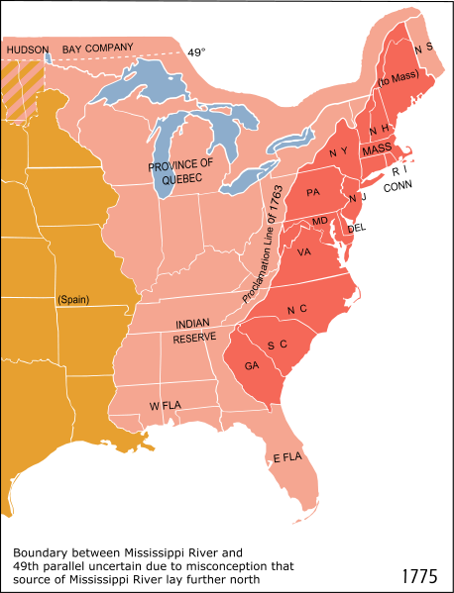
Frontier Urbanization
Late 1500s, Spain had established towns in Florida and New Mexico. By 1700s, established pueblos, missions, and presidios in U.S. southwest and California.
Dutch established New Amsterdam in the Hudson Estuary (1615ish)
French establish trading posts throughout Canada, Great Lakes, and along Mississippi river system
British Establish a colony in Jamestown, Virginia (1607)

Slide 3
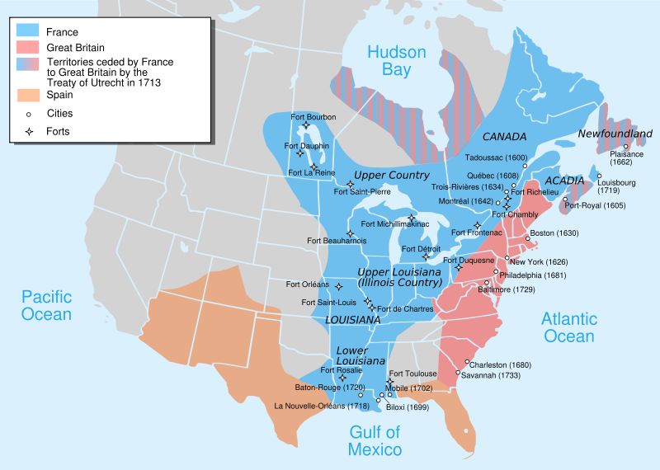

Slide 4
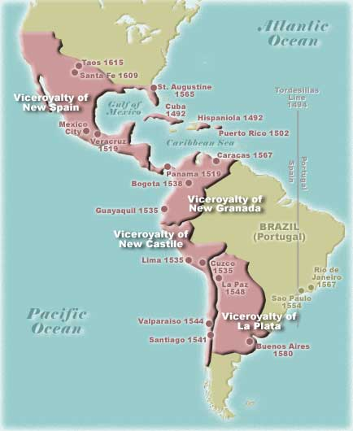

Slide 5
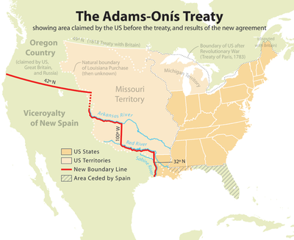

Slide 6
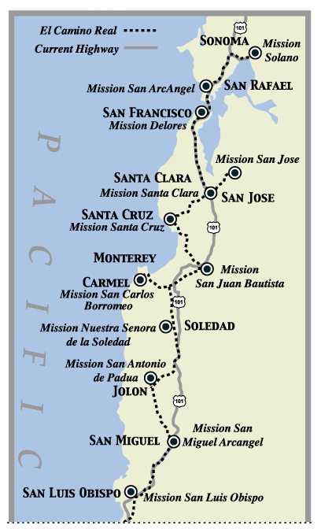
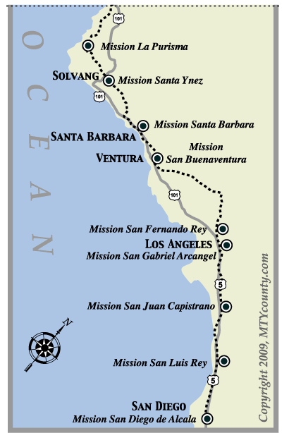

Slide 7
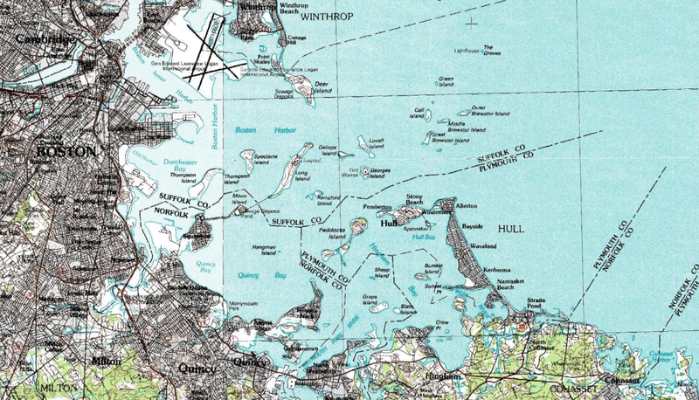
Frontier Urbanization Continued
This embryonic Urban System operated as a string of Gateway cities
  Assembly of Staple Products for export
  Distribution of imported manufactured goods
  Civil Admin. Of New territories
  Entrepots began to emerge. Places with better natural port/trade advantages, and could better coordinate shipping schedules with other ports (ex. New York, Boston, Charleston, Philadelphia, and Newport)

Slide 8
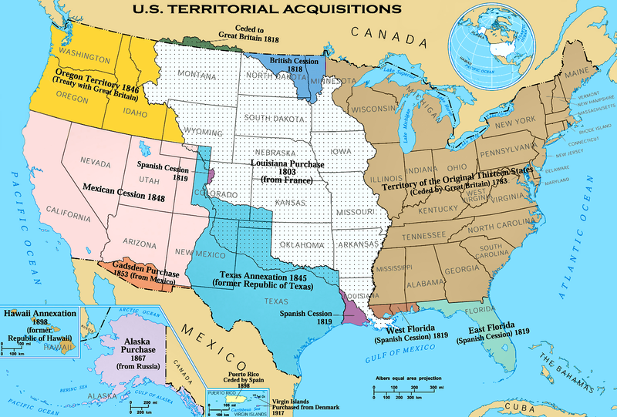

Slide 9
Mercantile Epoch (1790-1840)
1776 American Independence from Britain
US Constitution was written by City dwellers – Placed strong influence on City based manufacturing and trade (Federalist system in terms of money and trade)
Forced cities and regions within U.S. to trade with each other rather than Europe
Investments were financed by American capital rather than European capital. Profits remained in US
Proliferation of local and regional administrative functions – led to small towns, state capitals, and federal capital (Washington D.C.)
Westward expansion led to the development of Frontier towns (ex. Santa Fe, N.M.-local service centers)

Slide 10
Mercantile Epoch (1790-1840)
Led to a growth in Gateway Cities situated along rivers and waterways that connected Atlantic Seaboard with western territories (e.g. New Orleans and St. Louis)
Creation of canals that connected east coast merchants to these waterways via Erie Canal along Hudson to the Great Lakes – birth of Buffalo, Cleveland, Detroit, Chicago and Milwaukee became wholesale centers. Also, Cincinnati and Louisville became important Inland Gateways.
Led to Comparative Advantage- Local Conditions allow a city or region to undertake an economic activity more efficiently compared to other possible activities (Cincinnati began to specialized in hog processing, for example).
As well, increased agricultural and farming productivity in addition to rising numbers of immigrants continued to fuel the “urbanization process” in the U.S.

Slide 11
Vance’s Mercantile Model
Depicts the early development of the American Urban System based on the Mercantile model.
He argues that external influences and long-distance trade were most important in the creation of this urban hierarchy via five stages.

Slide 12
Five Stages of Vance’s Mercantile Model
Exploration – Search for Knowledge and economic opportunities for the old world
Harvesting of natural resources – Establishment of colonies for procurement and trade of natural resources (timber, beaver pelts)-
Emergence of farm-based staple production-Colonization of land for grain, salted meat, cotton, tobacco – Gateway Cities emerge “Points of Attachment” become focus of emerging system.
Establishment of Interior Depot Center- Towns emerged that served as inland gateway cities/”Deposits of Staples Collection” for the continued demand for staples and interior colonization (Frontier Urbanization)
Economic Maturity and Central Place Infill- Depends on a domestic market economy large enough and affluent enough to sustain the growth of Industry. Gives rise to central place systems with Market towns.
Key: Settlements associated with long-distance trade are seen as leading central places of the urban system rather than settlements associated with local markets. Long distance trade, “fixes” the spatial pattern of the cities that come to function as leading central places of the urban system rather than local markets.
***Vance synthesizes elements of staples theory, economic base theory, innovation diffusion theory and central place theory dynamics to account for the history of settlement in North America.

Slide 13
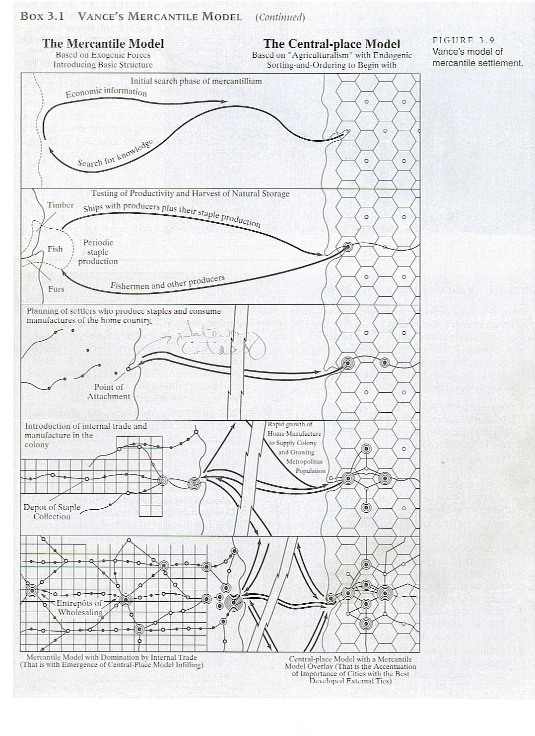
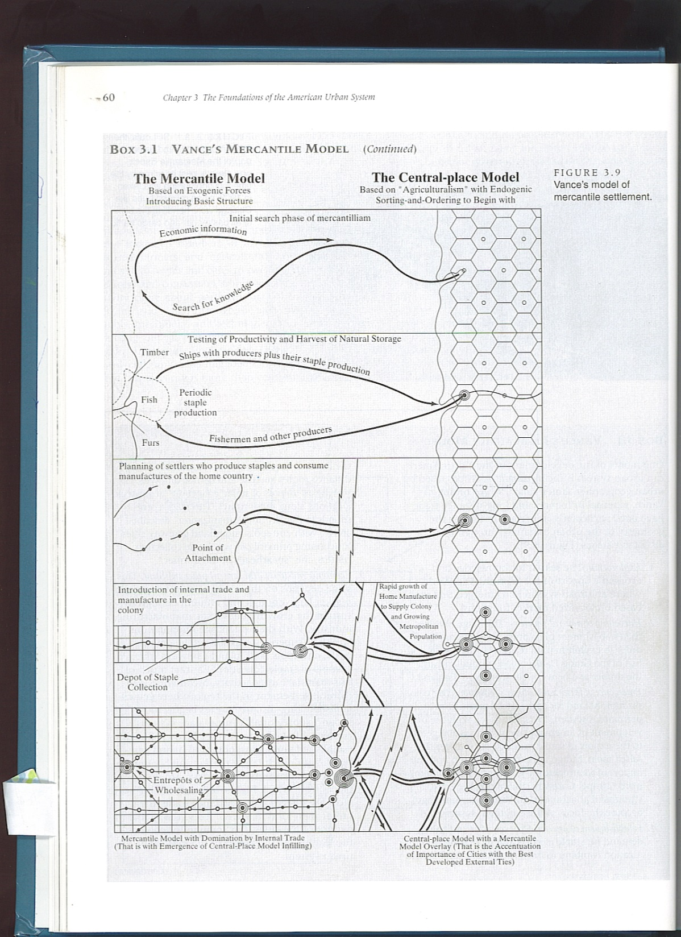

Slide 14
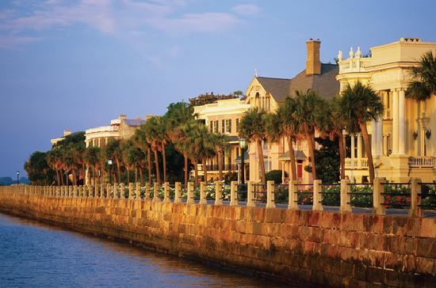
The Mercantile City – The Pedestrian City, Charleston, South Carolina

Slide 15
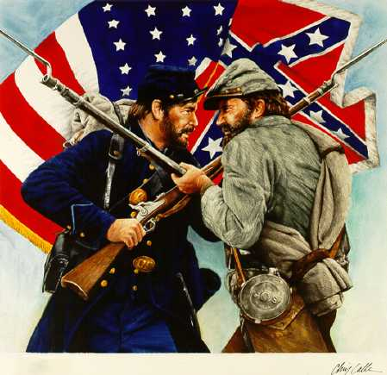
American Civil War 1861-65

Slide 16
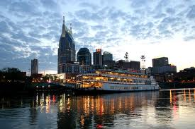
Early Industrial Expansion and Realignment
1840s- Transitions from a trading economy to a growing agricultural and Industrial Economy
These new Industrial Economies had specific location requirement
1. Power Sites – Water with fall line
2. Mining Towns
3. Transportation Center
4. Heavy Manufacturing Towns

Slide 17
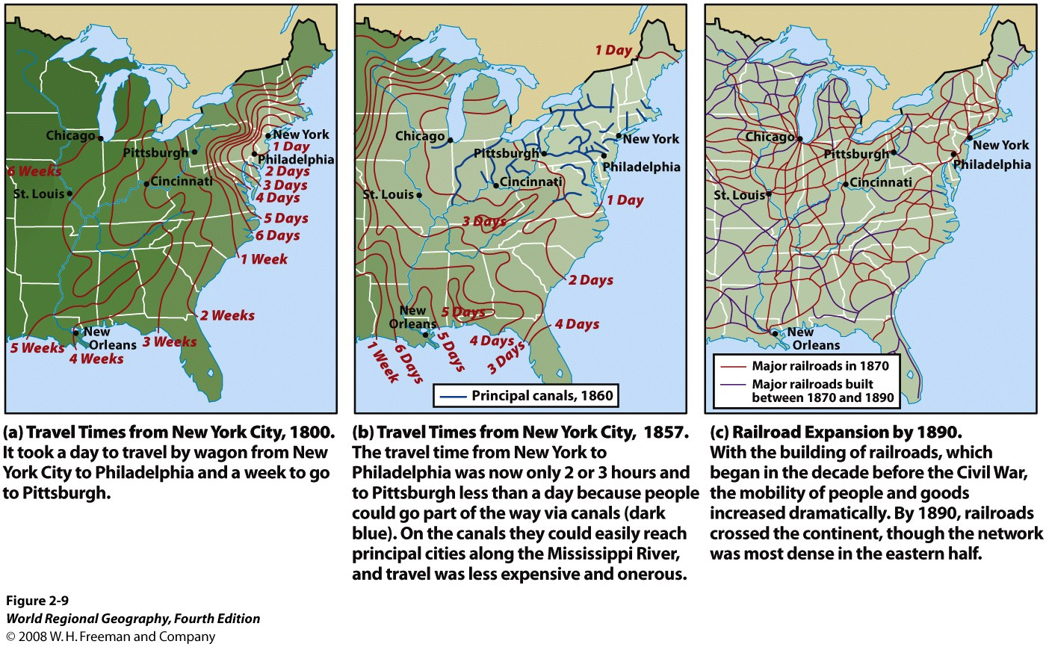

Slide 18
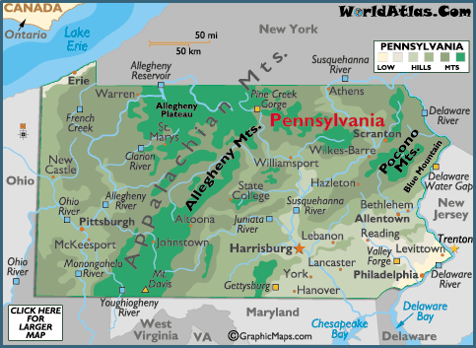

Slide 19
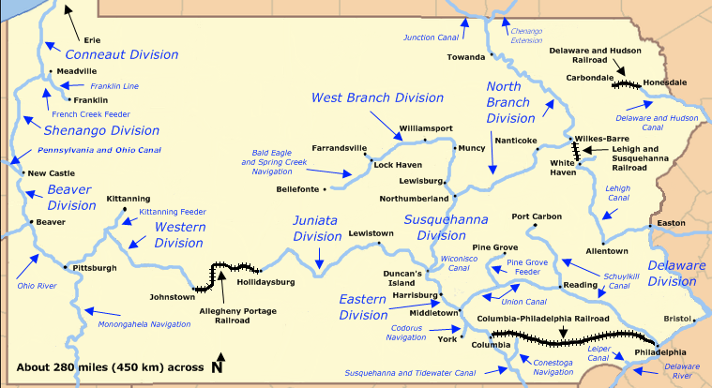

Slide 20
Early Industrial Expansion and Realignment (1840-1875)
Railroad network (1886) enabled CONTINENTAL Economies of Scale
NY, Buffalo, Detroit, Chicago, Milwaukee, Philadelphia, Pittsburgh, Cincinnati grew (wholesale economies that took advantage of competition between waterborne and RR transportation).
Most early industrial growth occurred in largest existing towns and cities.
1875 – Urban system had expanded to more than 15 cities over 100,000 people (New York-1.3 million; Baltimore, Chicago, Philadelphia, Pittsburgh & St. Louis – 350,000-450,000 people; Athens, Boston, Buffalo, Cincinnati, Cleveland, Detroit, Manchester (NH) New Orleans, Providence, Rochester, and Syracuse - 100,000-150,000 people

Slide 21
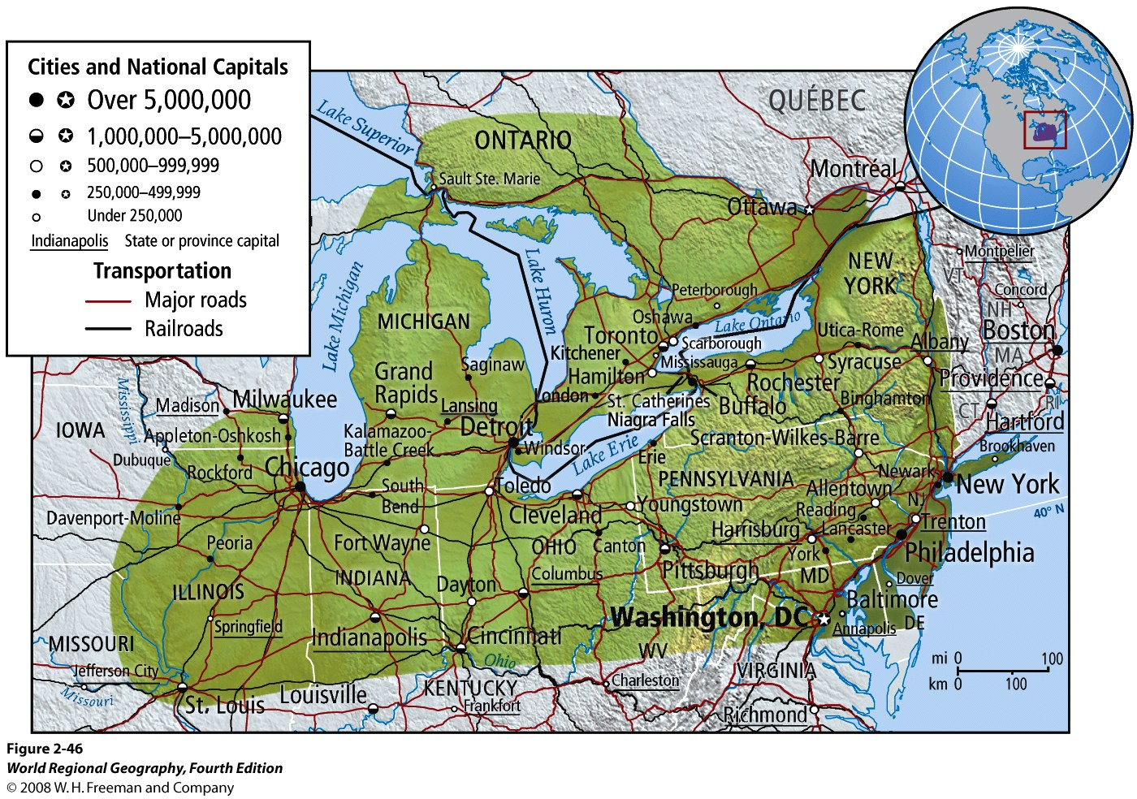

Slide 22
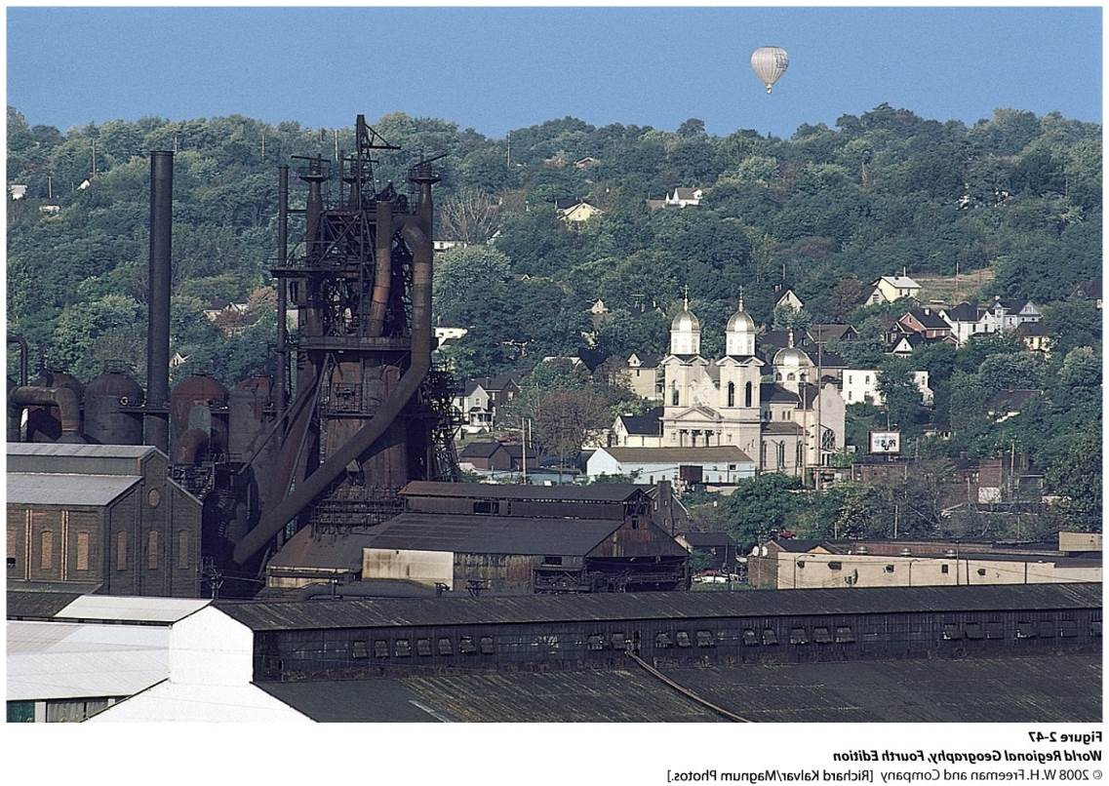
Some Principles of Urban Growth
Reason for growth in these cities included the idea of Initial Advantage:
Capital and Profits from craft and Wholesaling were reinvested into factories and machineries
Knowledge and Tradition of entrepreneurship, investment & lending supported industrial development
Largest Pools of Labor
Largest and Most Affluent local and regional Markets

Slide 23
Initial Advantage special case of an External Economies – Cost advantage that accrue to firms because of their locational setting
  Local specialized labor, pools of capital, accessibility to specialized business services
  More traditional factors include physical infrastructure such as roads, harbors, RR, and utilities.
External Economies derives from any advantage that stems from the COLLECTIVE, rather than the EXCLUSIVE use of any of the elements necessary for profitable activity. Often referred to as Agglomeration Economies or Urban Economies
Localization Economies include only certain types of firms being able to benefit from external economies (ex. Shipwrights, research institutes, legal services, entertainment production)
Explains Economic Specialization in Cities ( Akron-rubber, Dayton –metal and machinery, Pittsburgh-iron and steel)
Ex. Seattle-Airplanes, LA - Film

Slide 24
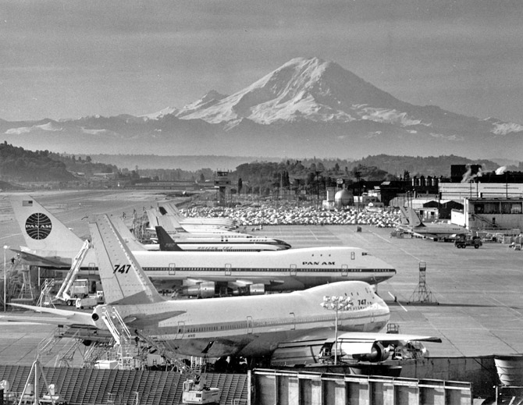

Slide 25
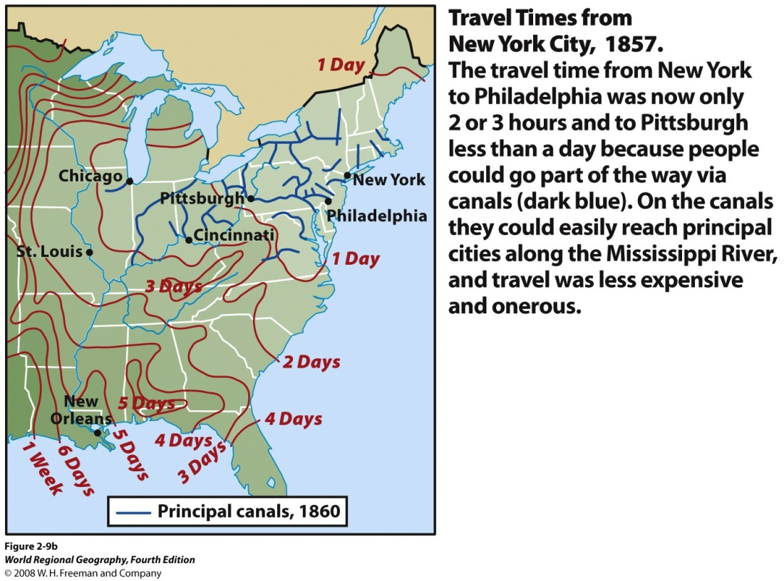
Beginnings of Central Place Theory
Trade and marketing in 1800s allowed for development of regularities in spacing and patterns of towns and cities
Settlements evolved to match distance that could be covered by river, canal or turnpike within a day’s travel
Gave rise to Cities and Towns serving as Local Service Centers, or Central Places
Brought a logic or order to the spatial distancing of towns and cities based on the variety of services they provide

Slide 26
Central Place Theory
Range of a particular product is the max. distance a customer will travel for a product
High Order Goods-Might have a range of several hundred miles (Medical care, specialized equipment, professional sports teams) infrequent need/travel
Low Order Goods-Perishable or required at large amounts frequently (saloons, bakeries, hair salons, post offices)
Threshold – Minimum market size required to keep product on offer (minimum distance necessary to secure a hinterland with enough potential customers to keep an enterprise profitable - Hospitals needs thousands of people whereas a grocery store needs a few hundred)
1930s, Walter Christaller observed striking regularities in size and spacing of settlements in S. Germany
Accessibility of settlements is based on Distance.
Foundations of Central Place is a dependent on the principles of “range” and “threshold” of goods and services.

Slide 27
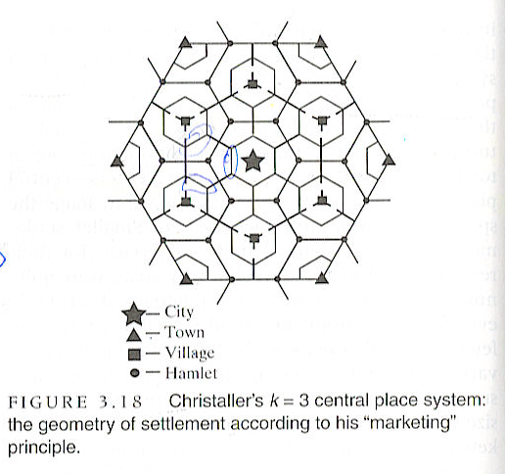
Central Place Theory (Continued)
Christaller developed a hinterland hexagonal pattern (competitive zone at margin of each hinterland)
Led to a Nested Hierarchy of City-Town-Village-Hamlet
Using a market principle, all service providers profits would be kept to a max if central places were kept to a minimum (k=3)
So, 1 City = 3 Towns = 9 Villages = 27 Hamlets

Slide 28
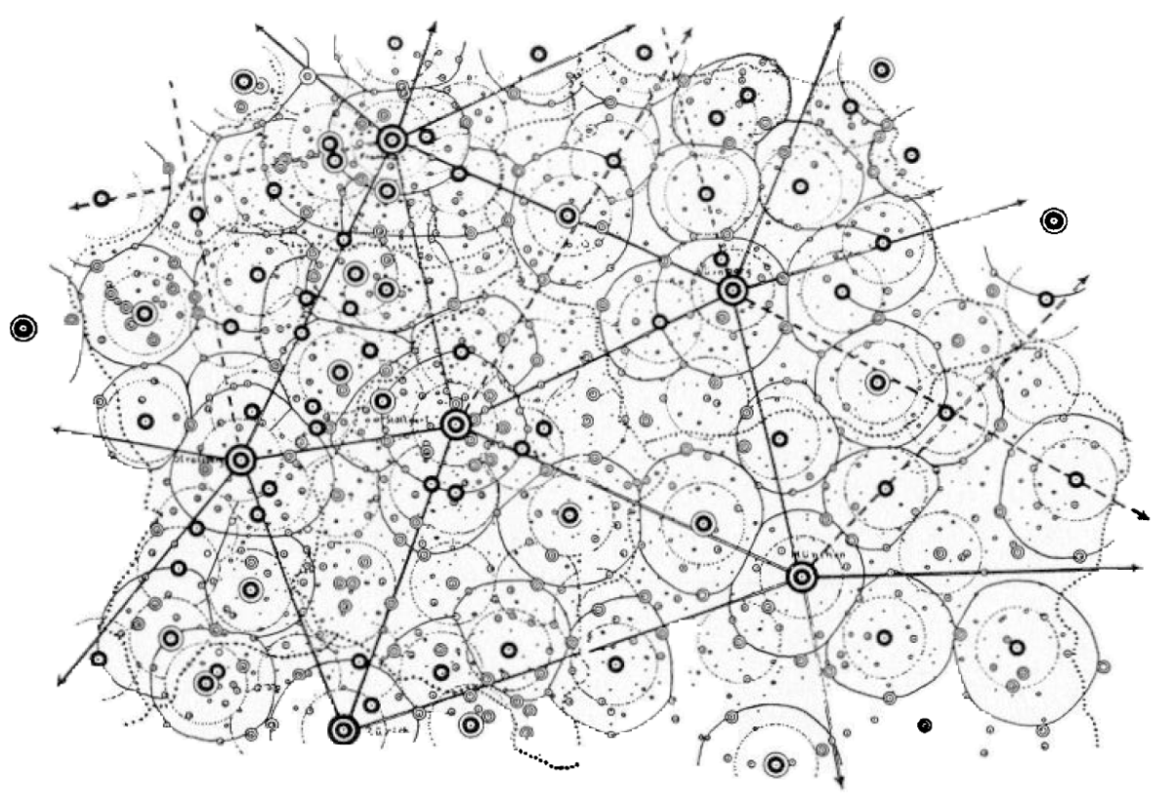

Slide 29
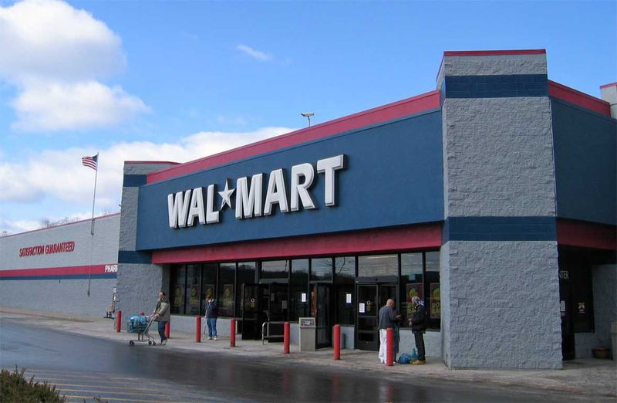

Slide 30
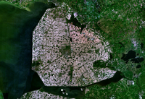
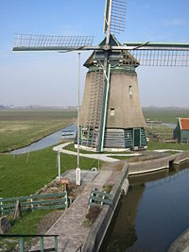
The Polders in the Netherlands
Used still in consumer behavior and distance travel for site selection of stores, used to plan new settlements in the Dutch polderlands and new settlements in Israel.
Drawbacks- Does not focus on manufacturing and long distance trading functions, also a static model that is not responsive to pop. densities, spending power, transportation technologies or communication

Slide 31
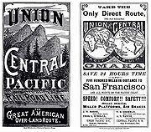
The Organization of Industry (1875-1920
Industrial Capitalism in full swing; RR allows urban places to serve as regional center (e.g. Birmingham, Jacksonville, Memphis and Houston to emerge as central places and with regional status); pop. Expanded – natural increase and immigration (12 million immigrants arrived in US between 1890-1910) (Saw Economies of Scale actualized – Ag. In California and west, minerals in central west, coal in Southeastern US)
Fueled urban growth – NY-4.75 million; Boston. Chicago, Philadelphia, & Pittsburgh - ~1.5 million; LA, San Francisco, Seattle, Dallas, Kansas City, Milwaukee, St. Louis, Baltimore, Providence – 500,000 people

Slide 32

The Organization of Industry (1875-1920)
Logic of Industrial Location influenced patterns of urban growth
Manufacturing belt was consolidated due to Initial Advantage @ a Regional Scale.
  Had large markets (growing consumer base), advanced transportation networks, & coal reserves
  Efficiency of telegraph services, postal service, rationalization of banking, reduced energy costs

Slide 33



The Organization of Industry (1875-1920)
Led to:
(1) Local Specialization directed to National rather than local markets – Brewers in Milwaukee and St. Louis took advantage of refrigerated rail cars and mechanized production techniques; Chicago took advantage of meat packing, printing and furniture making; Boston took advantage of musical instruments and men’s clothing. Smaller cities became even more specialized (signature boutique production)

Slide 34
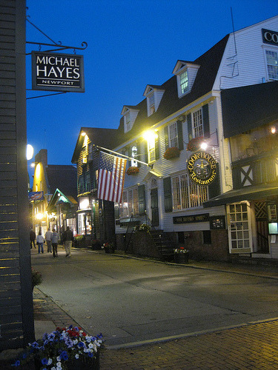
The Organization of Industry (1875-1920)
(2) Specialization provided the foundation for Increased Commodity Flows between towns and cities of the Manufacturing Belt
  Bound the region even more tightly together. With a combination of $, commercial linkages, and technical expertise – region was attractive to new industrial activity with large or national markets. Thus, other cities could not compete @ this scale or intensity. Other cities and regions could not attract manufacturers of mass-produced goods for the national market.

Slide 35
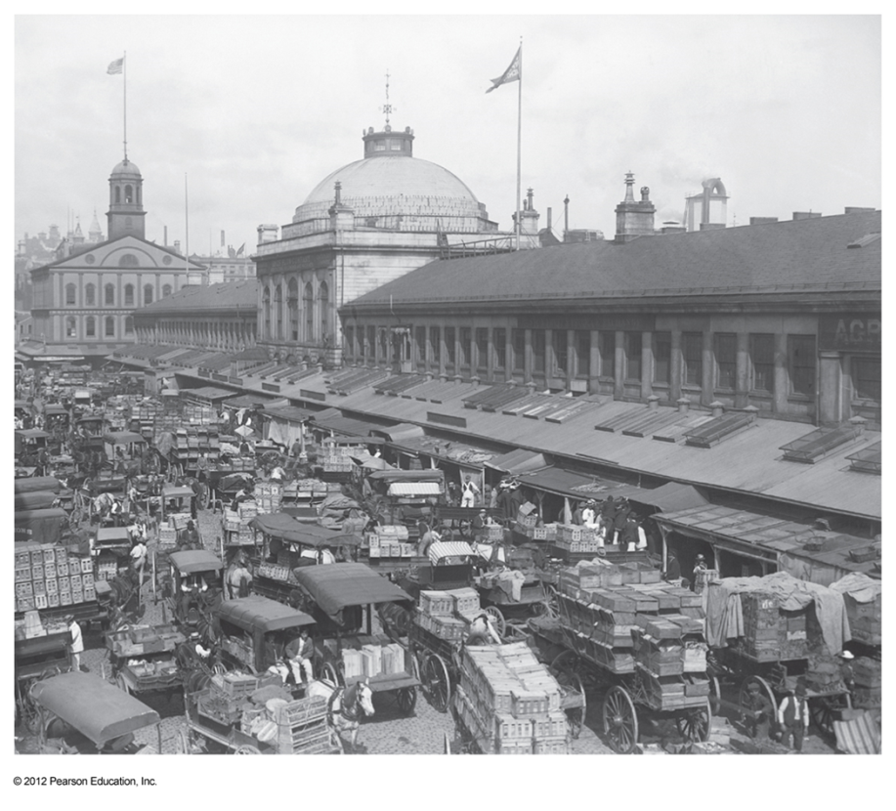
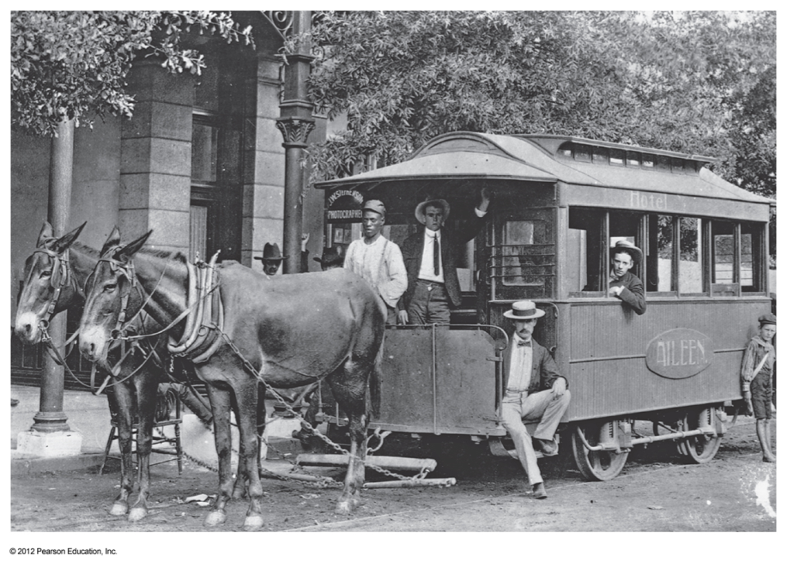
Extreme Congestion in Leading East Coast Cities
Wealthy got out of town!
Boston, Massachusetts

Slide 36
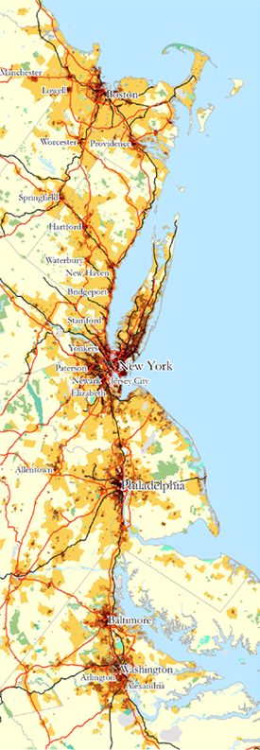
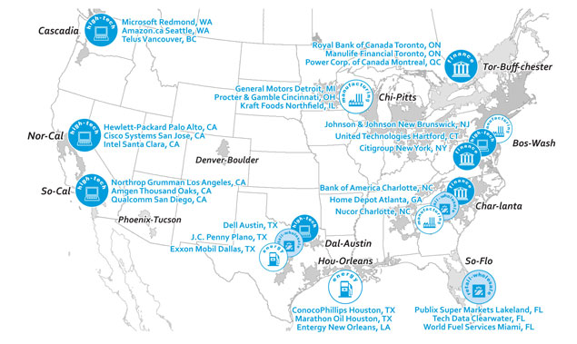
Uneven Development

Slide 37
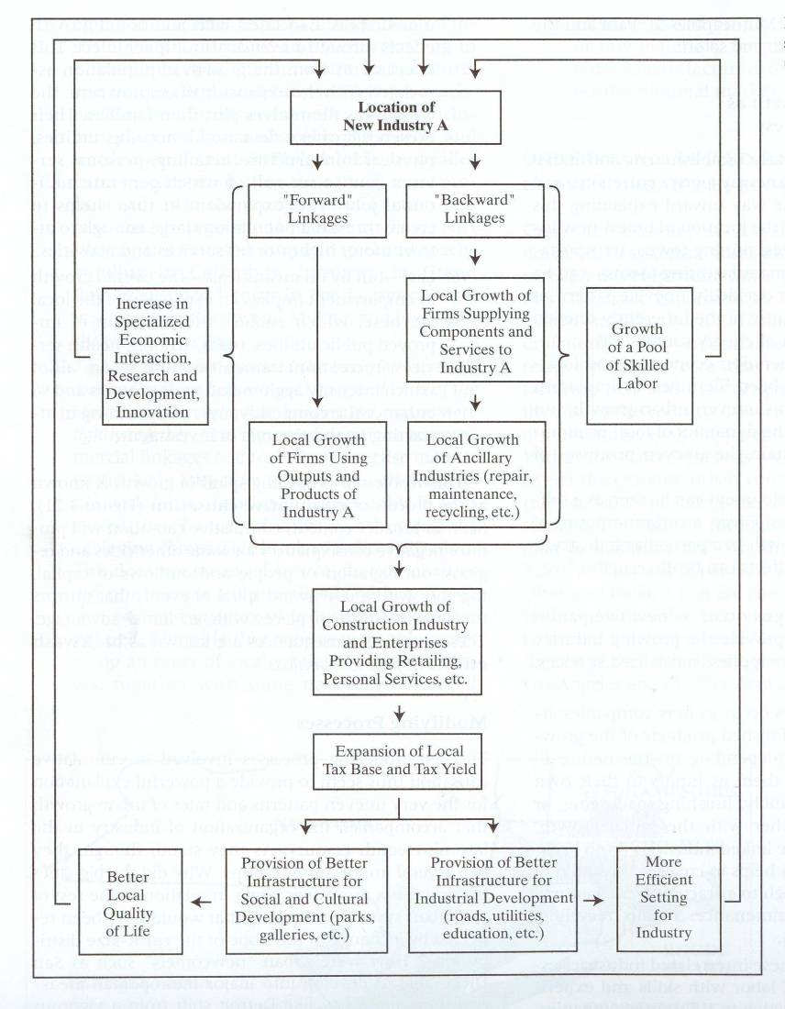

Slide 38
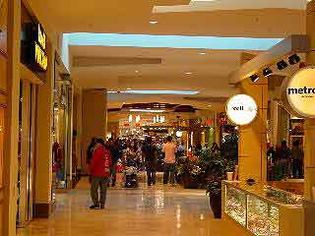

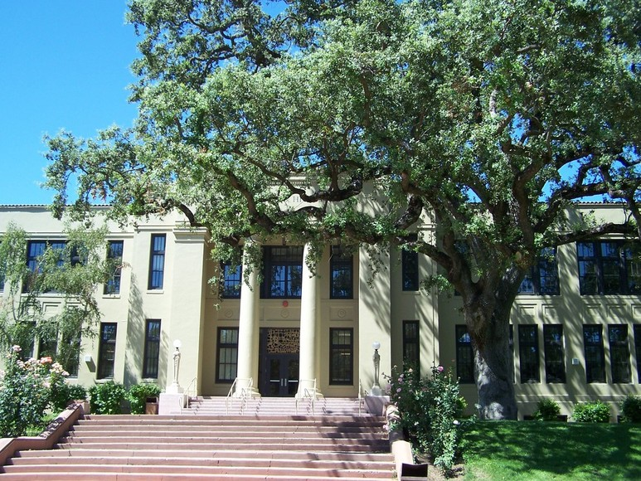

Slide 39

Modifying Processes to UI Growth
Spread or “Trickle-Down” effects – Peripheral regions provide agriculture and support to core (e.g. California in early 1900s). A. O. Hirchman as opposed to Backwash effects (G. Myrdal)
Import Substitution – Local markets in periphery provide their own goods – depends on local entrepreneurs to adopt (and further develop) appropriate innovation.

Slide 40
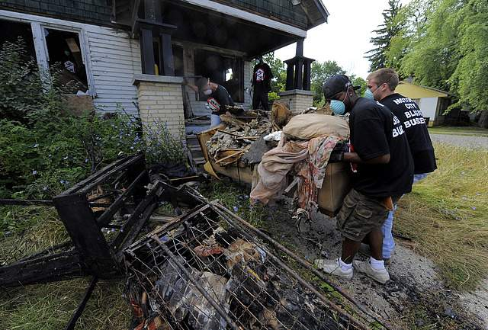
Modifying Processes to UI Growth
Agglomeration Diseconomies – Over saturation point of a mature urban region. Cost to companies of inflated land prices, traffic congestion, crowded ports and RR facilities, high cost of waste disposal, higher taxes. Costs go to consumers eventually.
Kondratiev Upswing –Lead to new industry not tied down to existing industrial complexes. Using innovations in transportation and communication creates Windows of Locational Opportunity. Results in new industrial complexes being formed.
Tilts balance of existing comparative advantage. Eventual shift of periphery becoming new core. Old Core becomes deindustrialized. New $ is reinvested into new ventures in other regions. Called Creative Destruction. (Inherent to the dynamics of Capitalism)

Slide 41
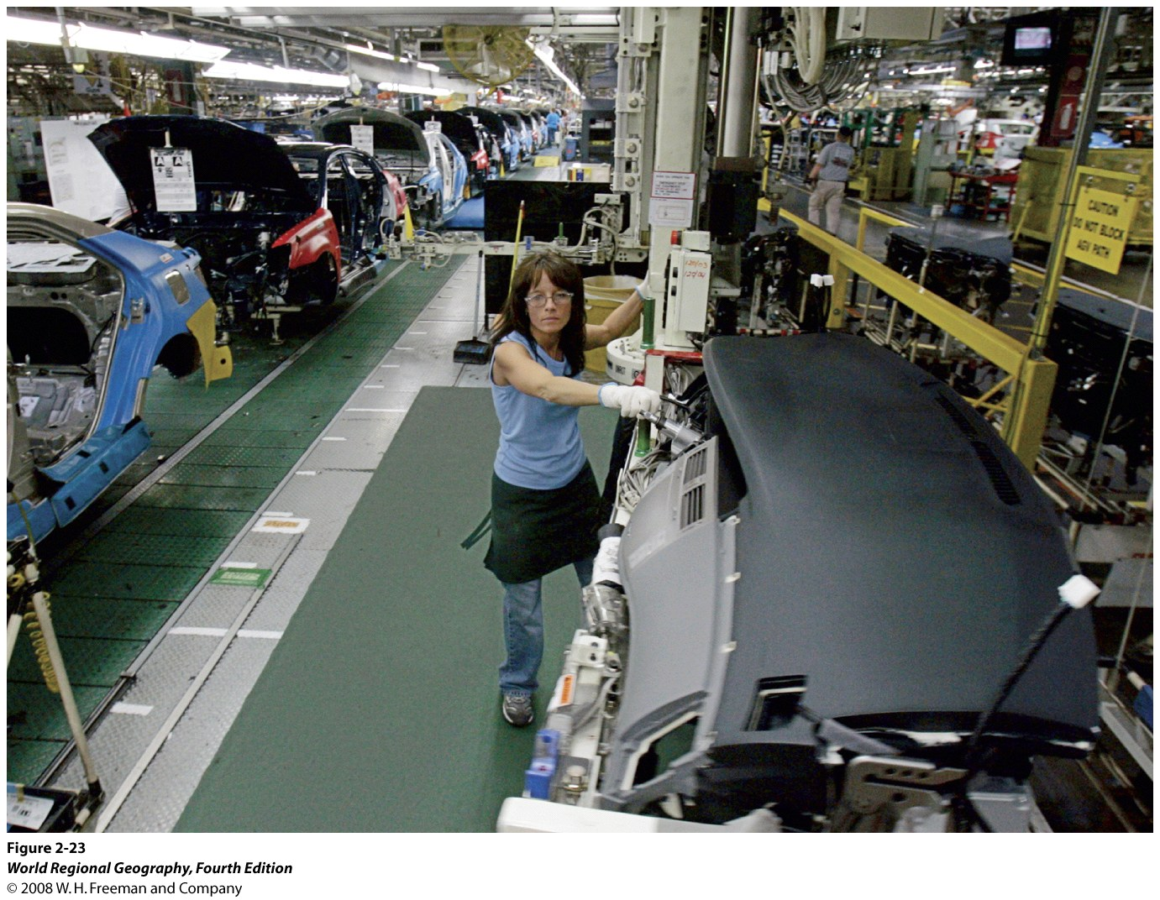

Slide 42
