Slide 1
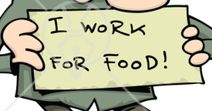
San Jose Mercury News:
“Report says wage hike could cost 500k jobs, puts Dems on defensive”
By: Alan Fram
February 19, 2014

Slide 2
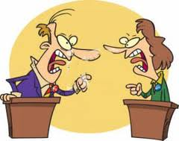
Summary
Reports show that raising the minimum wage to $10.10 per hour would increase pay for more than 16.5 million people, mostly those earning low wages. It also would lift 900,000 people over the federal poverty threshold, the study said
However, there are others contest that statement saying that raising the minimum wage will reduce job by .3% or 500,000 by 2016

Slide 3
Benefit of raising the minimum wage
Pay increase for more than 16.5 million people, mostly those earning low wages.
Increase business transaction activities.
It lifts 900,000 people over the federal poverty threshold
The government spends less tax money on unemployment and poverty .

Slide 4
The argument
Jack Furman referred to a statement made by 600 economists saying that increasing the minimum wage has little to no effect on employment
This claim is strong because he quotes from a large number of credible economists.
This statement fully answers to the opposition’s claim

Slide 5
Stake holder
 | Raise |  | No raise
 | Benefit | Harm | Benefit | Harm
Worker | Earn more money | A decrease in job | No change in salary | No change in employment
Employer | Customers have more money to spend on purchasing | Have to pay more money to employees | Spend less money on salary | People don’t have enough money to spend, business slow down
Customer | Has more money to spend of daily need and activities | Has to spend more money because of an increase in price | Prices stay the same | Have not enough money to spend on daily activities
Government | Spend less money on poverty programs | Spend more money on unemployment | Spend less money on unemployment | Spend more money on poverty programs

Slide 6
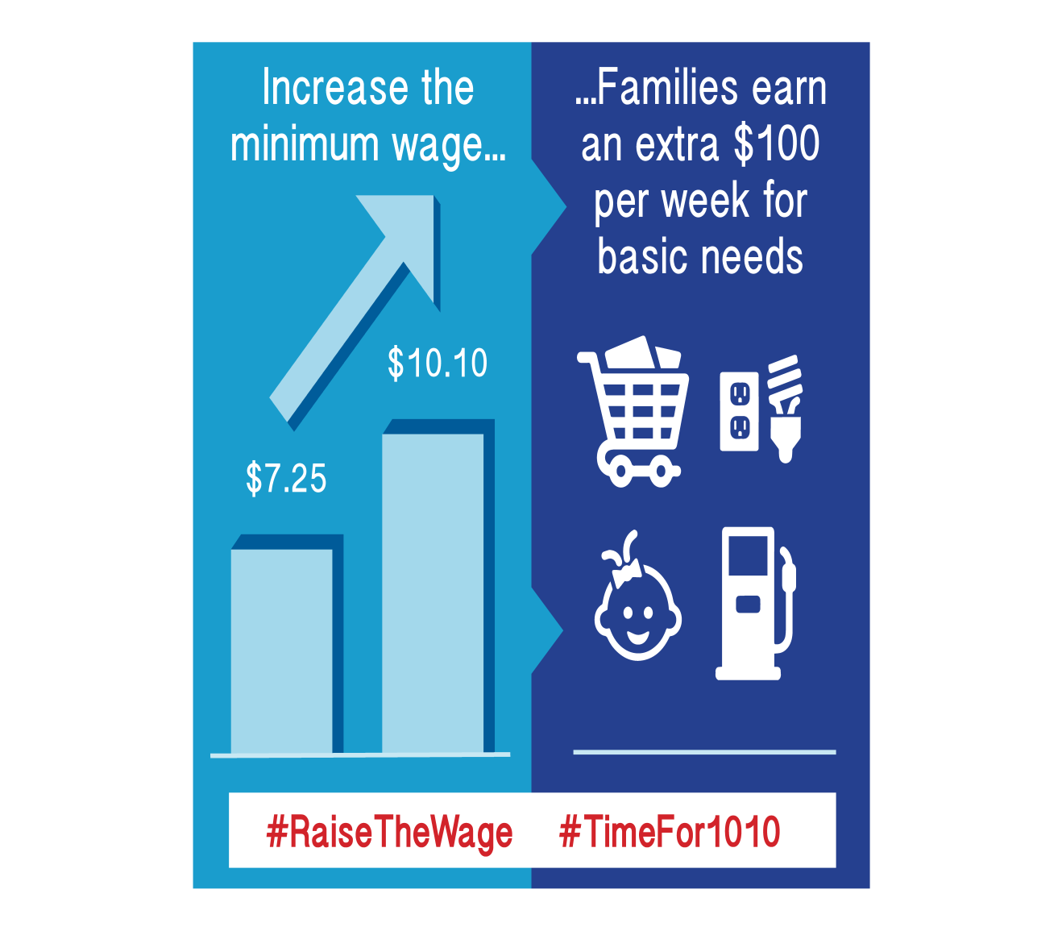
Raising the minimum wage to $10.10 is the right decision
From an Utilitarian point of view, it would maximize pleasure over pain.
In 2016, it will create about 100,000 fewer jobs, higher wages for 7.6 million workers and 300,000 people lifted out of poverty.

Slide 7
The opposition
“Today's CBO report shows that raising the minimum wage could destroy as many as 1 million jobs, a devastating blow to the very people that need help most in this economy,” Senate Minority Leader Mitch McConnell, R-Ky., said
However, he didn’t mention about how raising the minimum wage will increase the spending power of the people. Thus, driving the US economy upward.

Slide 8
The raise in minimum wage will have little to none effect on the federal budget deficit
It decreases the amount the government must spend on poverty programs
It increases the amount the government must spend on unemployment.

Slide 9
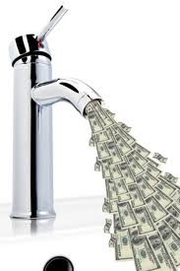
Raising the minimum wage is the right decision according to Utilitarian principles
It gives people a bigger money pool to spend on necessities.
It speed up the flow of capital
In time, it will creates more jobs

Slide 10
Consequences of not raising the minimum wage

Slide 11
Alcoholism

Slide 12
Poor people who can’t afford to pay their bill will become beggars
Or robbers/ thieves

