Slide 1
Buyer Behaviors
Chapter 3

Slide 2
Chapter Overview
Chapter Overview
Consumer purchase process
Consumer buying environment
Trends in consumer behavior
Business buying center
B-to-B purchasing process

Slide 3
Common Purchase Reasons
Products/services provide utility
To satisfy physical needs
To satisfy psychological needs
To satisfy social needs
To satisfy emotional needs

Slide 4
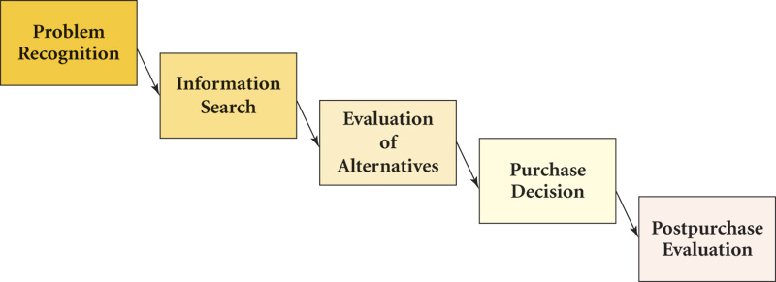
Consumer Decision-Making Process
Fig. 3-1
3-4

Slide 5
Information Search
Internal search
  Known sources
  Low-risk, low involvement
External search
  Less-frequent purchase
  Greater social/financial importance

Slide 6
External Search
Ability to search
  Education, pre-existing knowledge
Motivation
  Level of involvement
  Need for understanding (cognition)
  Shopping enthusiasm
Perceived cost vs. Perceived benefit

Slide 7
Consumer Values
Attitudes shaped by personal values.
Values are strongly held beliefs.
Values contribute to attitudes.
Personal values
Comfortable life
Equality, Freedom
Happiness
Personal accomplishment

Slide 8

Consumer Attitudes
Affective
Cognitive
Conative
Attitudes drive purchase decisions.
Marketing communications attempts to influence attitudes.
Notes:
Consumer attitude can be impacted by effective marketing communications. Attitude is the mental position a person takes towards a topic, person, or an event that influences an individual’s feelings, perceptions, learning processes, and behaviors. Attitude consists of three components.
Affective is the feeling and emotional part of attitude.
Cognitive is the individual’s knowledge, understanding, and interpretation of a topic, person, or thing.
Conative is an individual's intentions, actions, or behavior.
This ad for St. Francis North Hospital is designed to impact the cognitive component of attitude by providing information and knowledge about imaging technology.

Slide 9
Attitude
3 Components:
Affective
  Feelings or emotions about the object, topic, or idea.
Cognitive
  Mental images, understanding, interpretations
Conative
  Intentions, actions, behavior

Slide 10
Attitude Sequence
Cognitive → Affective → Conative
(Think, feel, do )
Affective → Conative → Cognitive
(Feel, do, think )
Conative → Cognitive → Affective
(Do, think, feel )

Slide 11
Cognitive Mapping (CM)
Simulations of knowledge structures and memories
Assumptions, beliefs, interpretations
Marketing messages aim to:
  Strengthen current linkage
  Modify current linkage
  Create a new linkage

Slide 12
Principles concerning processing of information and cognitive mapping:
CM enhances movement from short-term to long-term memory.
Repetition is necessary to establish new linkages.
Once linkage exists, difficult to modify or create new linkages.

Slide 13
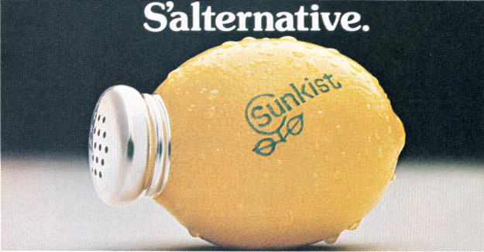
Role of Marketing Messages in Cognitive Mapping
Strengthen linkage
“Establish a new linkage as alternative to salt”
Modify linkage
Create new linkage
Marketing
Message
Fig. 3-5
Notes:
Marketing messages have three roles when it comes to cognitive mapping. First, the message may be designed to strengthen current linkages. Second, it may be designed to modify current linkages. Third, it may create new linkages. If consumers did not know that lemons could be used as a salt substitute, then this ad would create a new linkage. Perhaps consumers knew there were some natural salt substitutes but weren’t sure if they really were good or not, this ad may modify that linkage to say lemons would be a good option to try. Adding new linkages or modifying current linkages is more difficult than strengthening current linkages.

Slide 14
Information Processing
Elaboration Likelihood Model (ELM)
Hedonic, Experiential Model (HEM)

Slide 15
Information Processing
Occurs along two routes:
Central Route
  Cognitively processes a message with a high degree of attention to core elements of the message (uses cognitive skills)
Peripheral Route
  Attention paid to marginal cues imbedded in the message (repetition important)
  Music, actors, background of an ad

Slide 16
ELM
Consumers pay attention to
Prices
Product quality
Company/brand attributes
HEM
Consumers pay attention to
Emotions
Feelings
Fun
New or unusual experiences

Slide 17
Evaluation of Alternatives
Problem
Recognition
Information
Search
Evoked set
Multiattribute
Affect referral
Evaluation of
Alternatives
F ig 3 . 6
3-17

Slide 18
Evaluation of Alternatives
Evoked set method
  Evoked set
  Inept set
  Inert set
Multiattribute method
  Based on beliefs about a brand’s performance on product attributes and the importance of each attribute. (High involvement)
Affect referral
  Chooses brand liked, without evaluation of other brands or attributes

Slide 19
Evoked Set
The set of brands and purchase locations that meet both the objective and subjective requirements of the consumer.
Development of the evoked set begins during the internal search.
Inclusion in the evoked set is a major goal of marketers.

Slide 20
Factors Affecting Consumer Purchasing Behaviors
Demographics (age, gender, income, etc.)
Heredity and home environment
Family life cycle
Life changing events
Social/Cultural environment
Situational environment
  Unplanned/impulse/variety alternatives

Slide 21
Consumer Trends
Age complexity
Gender complexity
Individualism
Active, busy lifestyles
Cocooning
Pleasure binges
Health Emphasis

Slide 22
Postpurchase Evaluation
Evaluation of product performance.
Cognitive dissonance.
Impacts future purchases.
Impacts word-of-mouth communications.

Slide 23
Business-to-Business
Buyer Behavior
A simplistic view of the
Buying Center
Users
Buyers
Influencers
Deciders
Gatekeepers

Slide 24
Traditional BtB Buyer Behavior Process
1. Problem recognition
2. General need description
3. Product specification
4. Supplier/Source search
5. Proposal Solicitation
6. Selection
7. Make the transaction routine
8. Evaluate performance
Notes:
24

Slide 25
Creation and Perception of Value
Buying Center
PERCEIVES
Support Activities
Total
Offering
ADDED VALUE
Direct Activities
CREATES

Slide 26
Individual Factors
Business-to-Business Buying Center
Personality
Roles and perceived roles
Motivation
Levels of power
Attitude towards risk
Levels of cognitive involvement
Personal objectives
Can be summed up as……

Slide 27
3 Primary Roles of Buying Center Members
Needs of the job function
Needs of the organization
Personal needs

Slide 28
Types of B-to-B Sales
Straight rebuy
Modified rebuy
New task

Slide 29
Dual/Multiple Channels
Based on Customer needs related to economic utility
  Multi-distribution
    Multiples of same channel design to reach intended intensity of distribution
  Dual distribution
    Unique channel designs for different target markets

Slide 30
Dual Distribution
Manufacturer
Distributor
Large end user
Small user/ Retailer
Unique channel designs for different target markets

Slide 31
Multi-Distribution
Manufacturer
Retailer
Retailer
Retailer
Retailer
Retailer
Multiples of same channel design to reach intended intensity of distribution

