Slide 1
MIGRATIONS of African Americans
The Great Migration (1916-1930)
The Second Great Migration (1940-1970)
The Third Great Migration (1970-today)

Slide 2
The Great Migration (1916-1930)

Slide 7
The Second Great Migration (1940-1970)

Slide 14
The Civil Rights Movement 1950’s-70’s
The Children

Slide 15
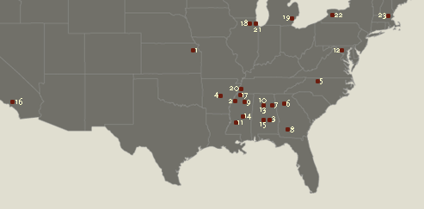
Civil Rights “Hot Spots”
Birmingham (#10 & 13) Wallace elected governor
16th Street Baptist Church Bombed

Slide 16
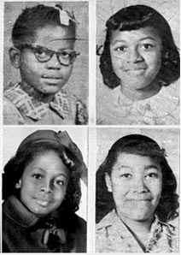
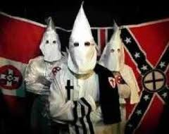
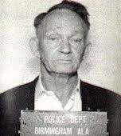
“Four Angels of Change”
16th Street Baptist Church Bombing
Sept. 15th, 1963

Slide 17
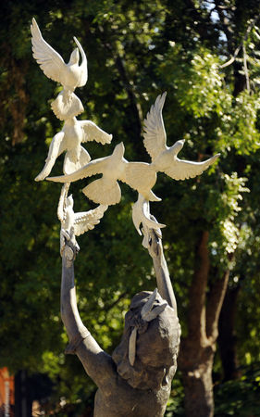
50 Year Anniversary

Slide 18
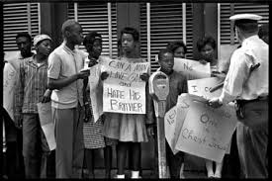
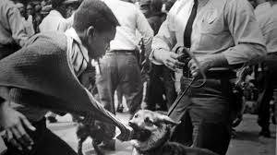
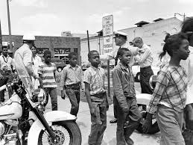
The Children’s March

Slide 19
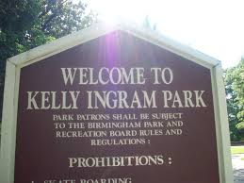
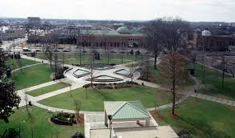
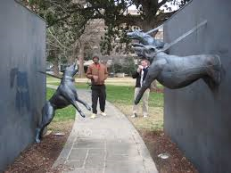
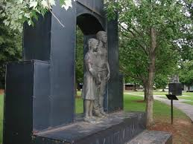

Slide 20
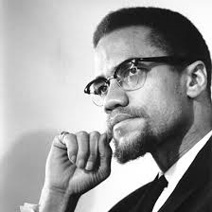
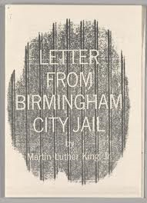
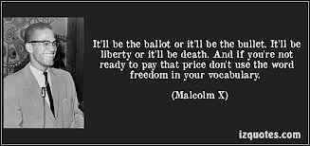
MLK & Malcolm X

Slide 21
AFFIRMATIVE ACTION
A policy in which an individual's color, race, sex, religion or national origin are taken into account by a business or the government in order to increase the opportunities provided to an underrepresented part of society.
It is often considered a means of countering historical discrimination against a particular group.

Slide 22
Regents of the University of CA v. Allen Bakke (1978)
Const. Issue Details (about 5)
Supreme Court’s Decision
Impact Upon Society

Slide 23
JIGSAW: Count off to “3”
Draw a “T-Chart” in your notebooks
Group 1: “The Case for Affirmative Action”
Group 2: “The Case Against Affirmative Action”
Group 3: “Academic Merit is Most Important”
If you finish early, split up & join another group

Slide 24
Socratic Seminar
Essential Question: Should Affirmative Action
programs be legal today?
We will be looking for:
1. Pro/Con Arguments using the “T-Chart”
2. Use of the Four Cornerstones of Geography:
Location, Conditions/Place, Connections, & Region
3. Socratic Seminar etiquette

