Slide 1
Imperialism Political Cartoons
19th-early 20th centuries

Slide 2
Gallery (Carousel) Walk
Directions: Divide into 5 groups
Using the following Tier 3 words, write a 1 sentence message about U.S. Imperialism at the turn of the 20th century on each set of cartoons. Use info from the Spanish & Phillipine-Americans wars.
Insurgency
Imperialism/Anti-Imperialism
Social Darwinism
Nationalists
Yellow Journalism
Roosevelt Corollary/Monroe Doctrine
Platt Amendment
Tariff

Slide 3
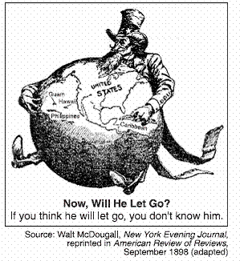
#1 #2

Slide 4
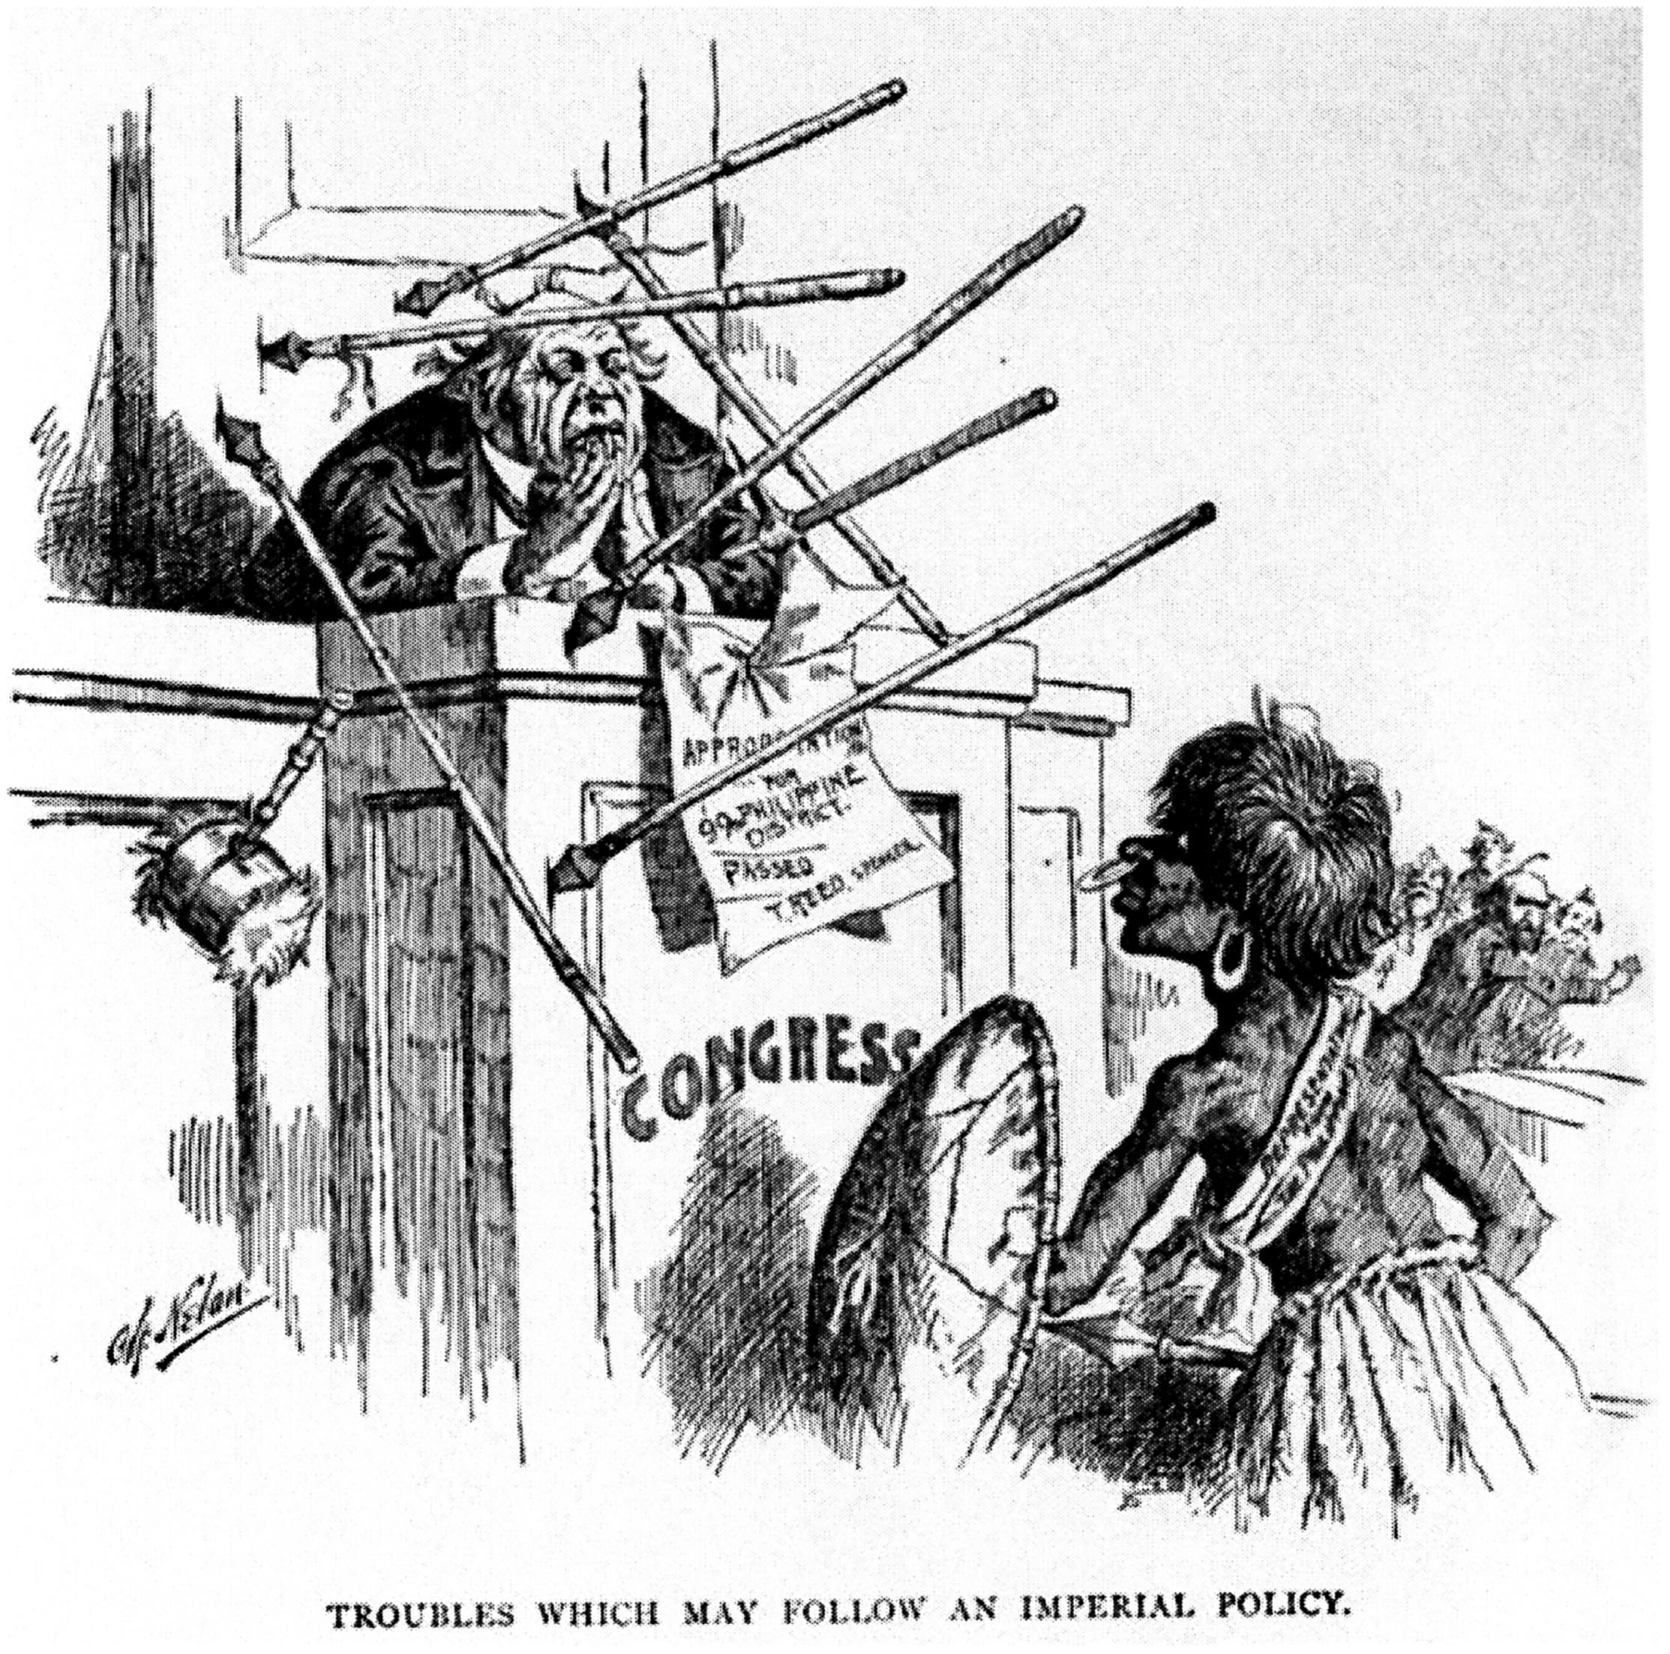
#3 #4

Slide 5
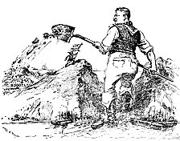
#6
#5

Slide 6
#7

Slide 7
#8

Slide 8
#9

