Slide 1

San José State Police Department
Active Shooter Awareness

Slide 2
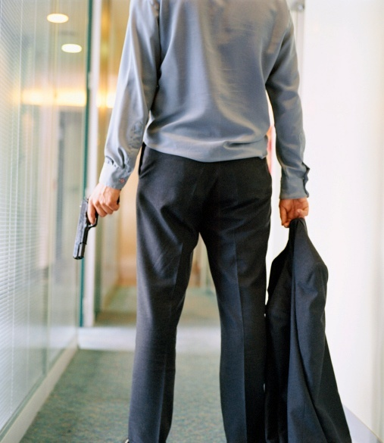
Active Shooter Response Training
Santa Clara County
Police Chief’s Association
Notes:
This presentation is oriented towards the community (businesses, neighborhood groups, etc.)

Slide 3
TRAINING OBJECTIVES
Offer strategies to prevent and prepare for a potential Active Shooter incident
Provide options to enhance survival when confronted with an Active Shooter
Describe actions needed to safely interact with the responding police officers

Slide 4
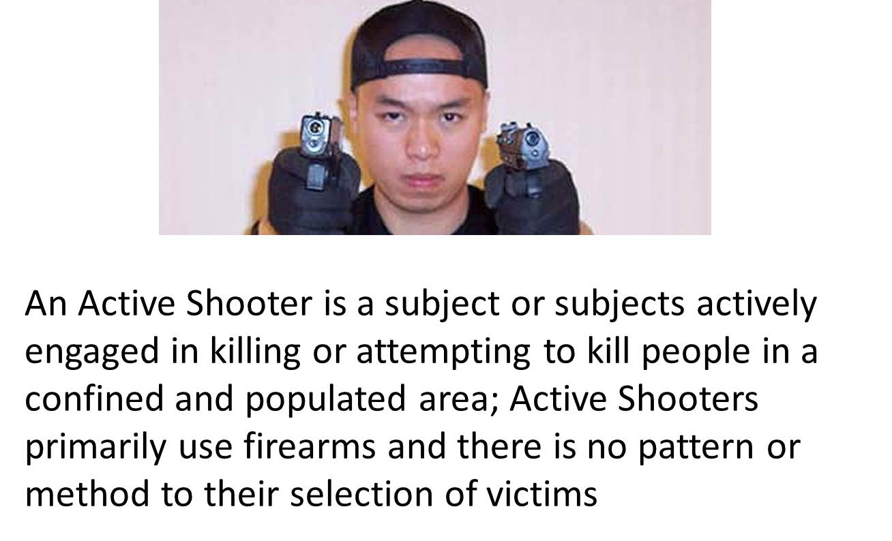
Definition of an Active Shooter

Slide 5
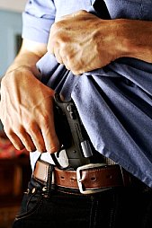
Active Shooter Events
Unpredictable
Evolve quickly
Continue until stopped by law enforcement, suicide or other intervention

Slide 6
The Tragic Reality
Las Vegas
Virginia Tech University
UC Santa Barbara
San Bernardino

Slide 7
It happens frequently
(and continues to happen…)
Columbine High School, Colorado
Virginia Tech University
Fort Hood, Texas
Oikos University, Oakland, CA
UC Santa Barbara
Newtown, Connecticut
Inland Regional Center, San Bernardino, CA
Route 91 Harvest Music Festival, Las Vegas, NV
Stoneman Douglas High School in Parkland, FL

Slide 8
Lessons Learned
Taking action makes a difference
NEUTRALIZING THE THREAT IS NECESSARY TO SAVE LIVES
Active Shooter Events are often over within 10-15 minutes (before the police arrive in half the cases)
Actions YOU need to take to minimize or eliminate the threat

Slide 9
Prevention & Detection
Harden the target (security upgrades)
  Video surveillance of open areas
  Peep holes on doors
Report suspicious activity to police and your supervisory personnel
  Implement an anonymous reporting system
  Consider a multi-disciplinary team to assess potential threats
Train and prepare!
  A survivor mindset is critical

Slide 10
Red Flag Indicators
Although no single set of warning signs are reliable predictors of an Active Shooter, there can be “red flags”.
A “red flag” indicator is a questionable, suspicious or inappropriate behavior that may be presented through someone’s appearance, spoken or written words, or specific actions.

Slide 11
Examples of Red Flag indicators
Behaviors which regularly interfere with the work environment
Overly aggressive behavior or threats toward others
Poor decision-making and coping skills
Low frustration tolerance; overreaction to circumstances; anger management problems
Notable change in behavior or appearance
Writings, comments or social network postings endorsing violence; an unusual interest in violence

Slide 12
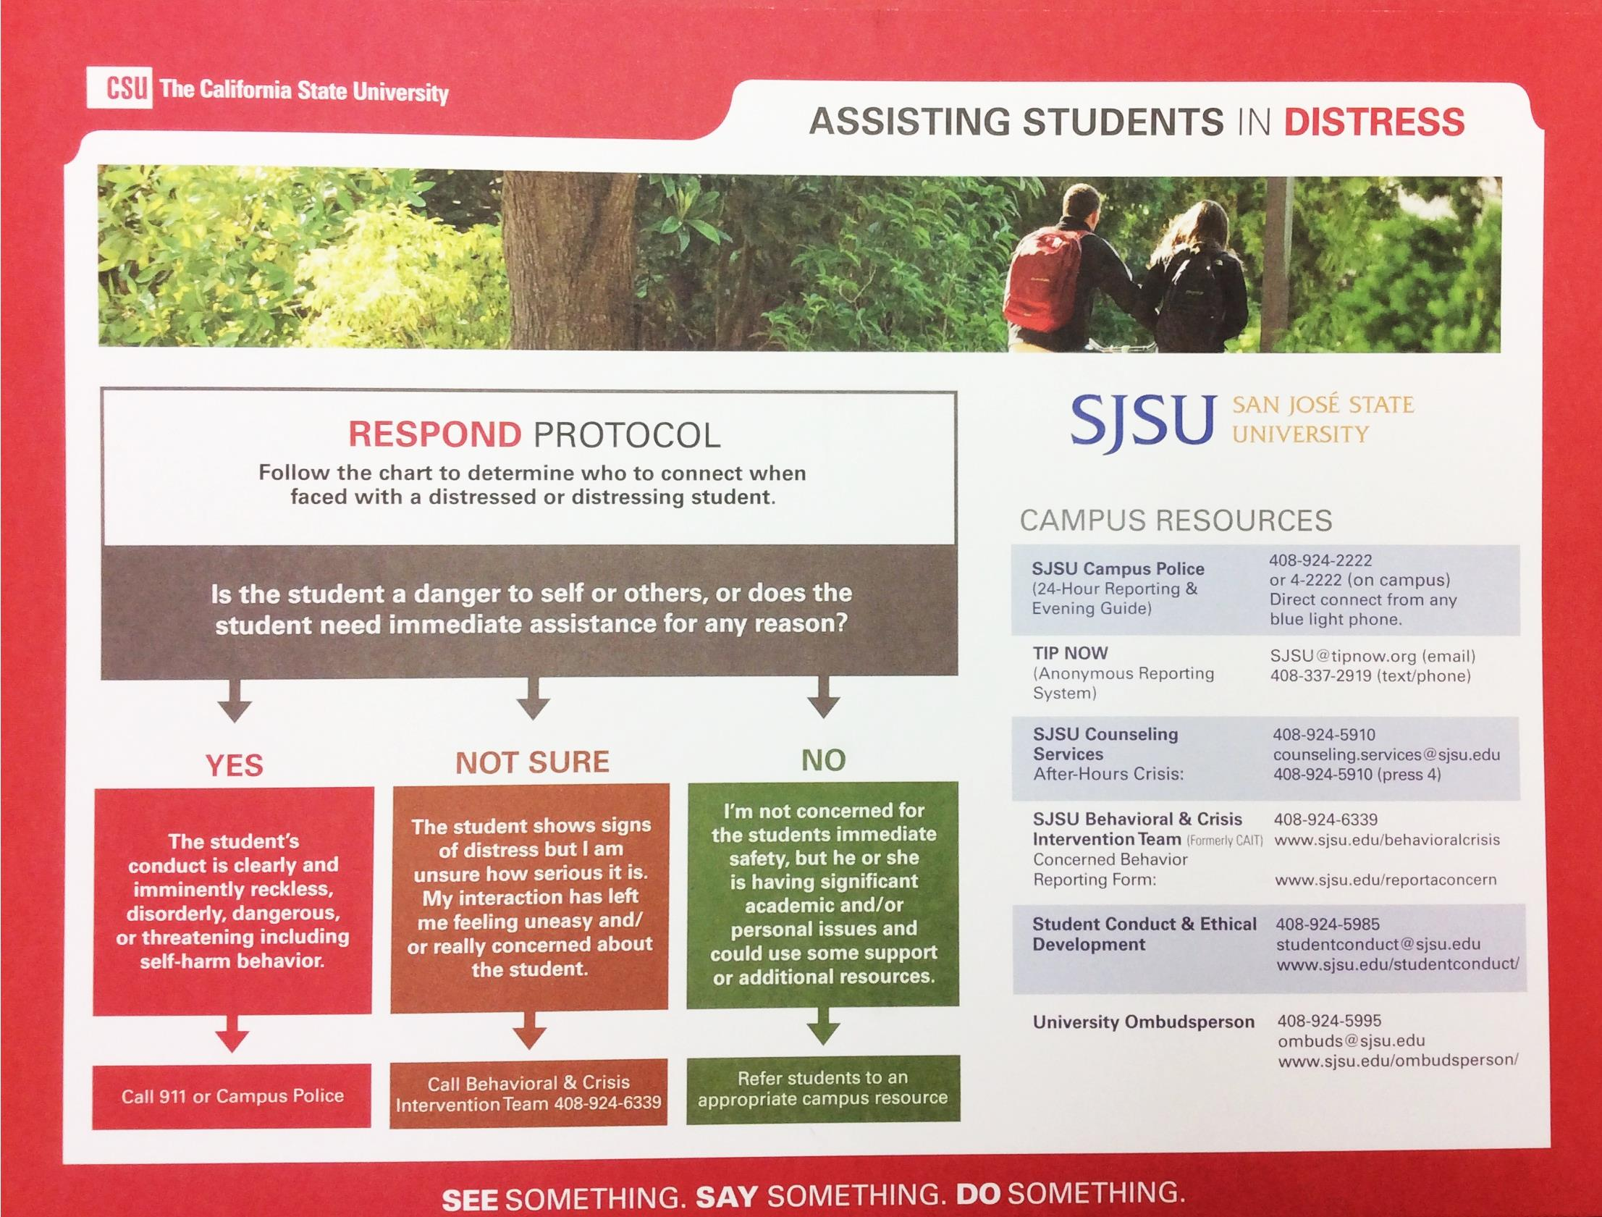




SJSU Red Folder
RED FOLDER
ASSISTING SPARTANS IN DISTRESS

Slide 13
RUN, HIDE, FIGHT: Options for surviving an Active Shooter Event
The following video produced by the City of Houston provides options for surviving an Active Shooter in its most elemental format
Notes:
Other options: Avoid, Deny, Defend

Slide 14

Run, Hide, Fight!

Slide 15
RUN = Evacuate
Decide if you can escape safely
If it is safe, run as fast as you can away from the direction of the gunshots
DO NOT stop running until you are far away from the area
Leave your belongings behind
Help others escape, if possible
Prevent individuals from entering the area, but not at the risk of your own safety

Slide 16
RUN (other considerations)
Get away from the threat and identify a safe place
When fleeing from danger, keep buildings, cars or other objects between you and the threat
Do not attempt to move wounded people
Call 911 when safe
DO NOT pull the fire alarm

Slide 17
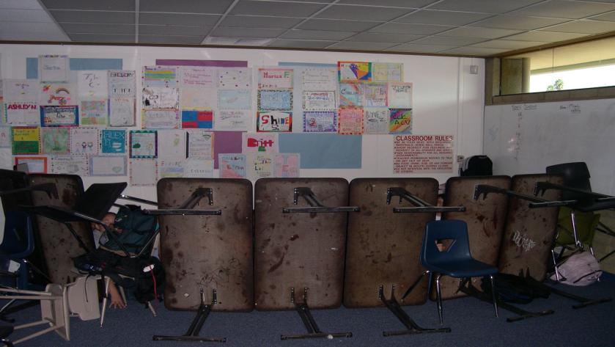
HIDE = Lockdown
If escape is not feasible; hide and create a stronghold
Lock the door if possible, turn off the lights and close the blinds
Barricade the door
Take cover behind large items
Silence your cell phones and turn off vibrate mode
Remain quiet
Move away from doors and windows

Slide 18
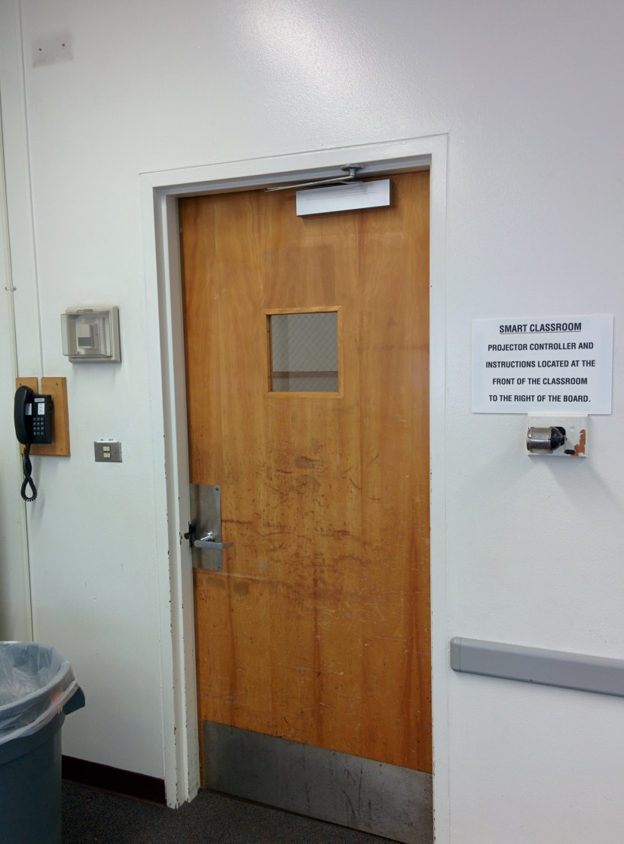
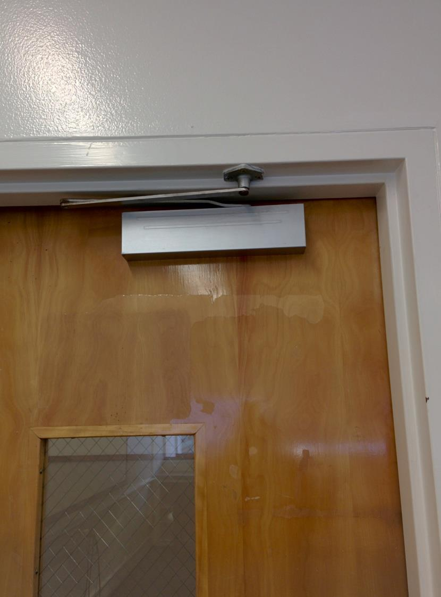
Sweeney Hall

Slide 19
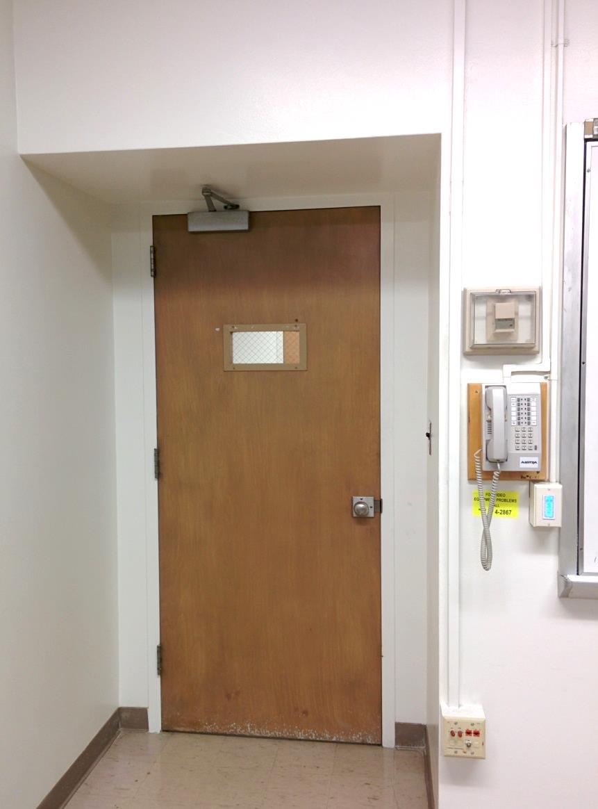
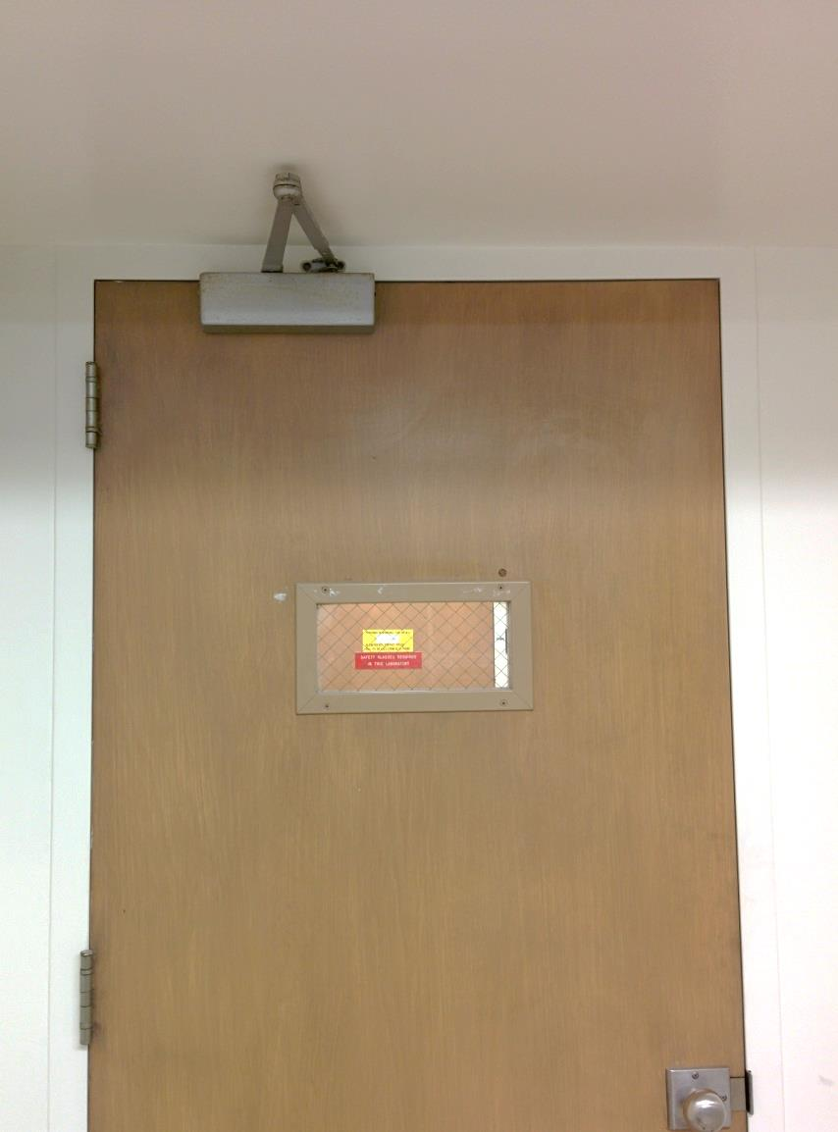
Duncan Hall

Slide 20
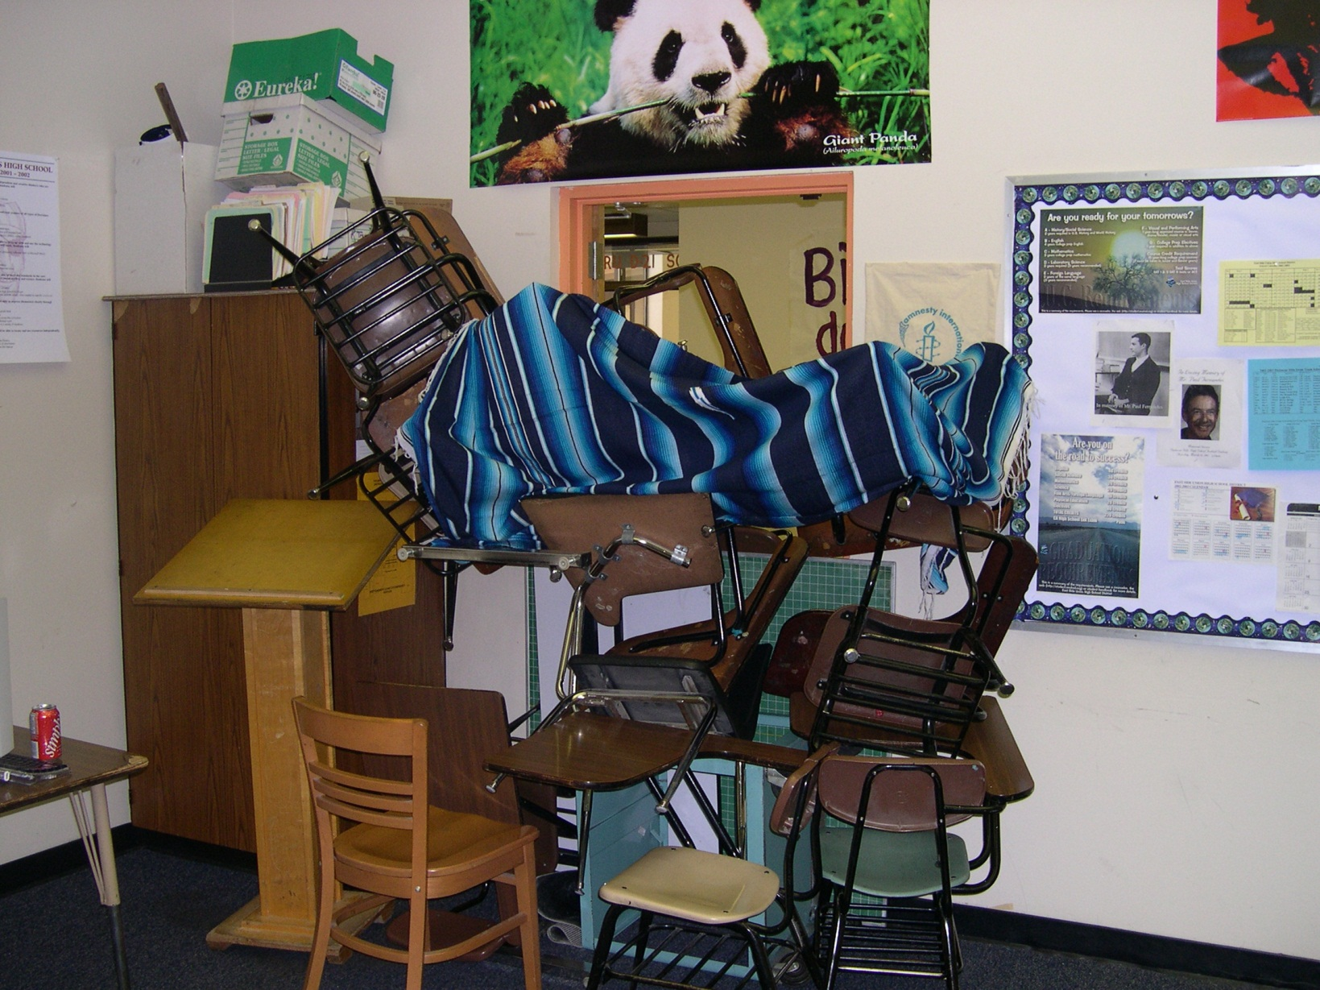
Erect barricades on ALL of the doors
Fill in the voids
Suspect will take the Path of Least Resistance

Slide 21
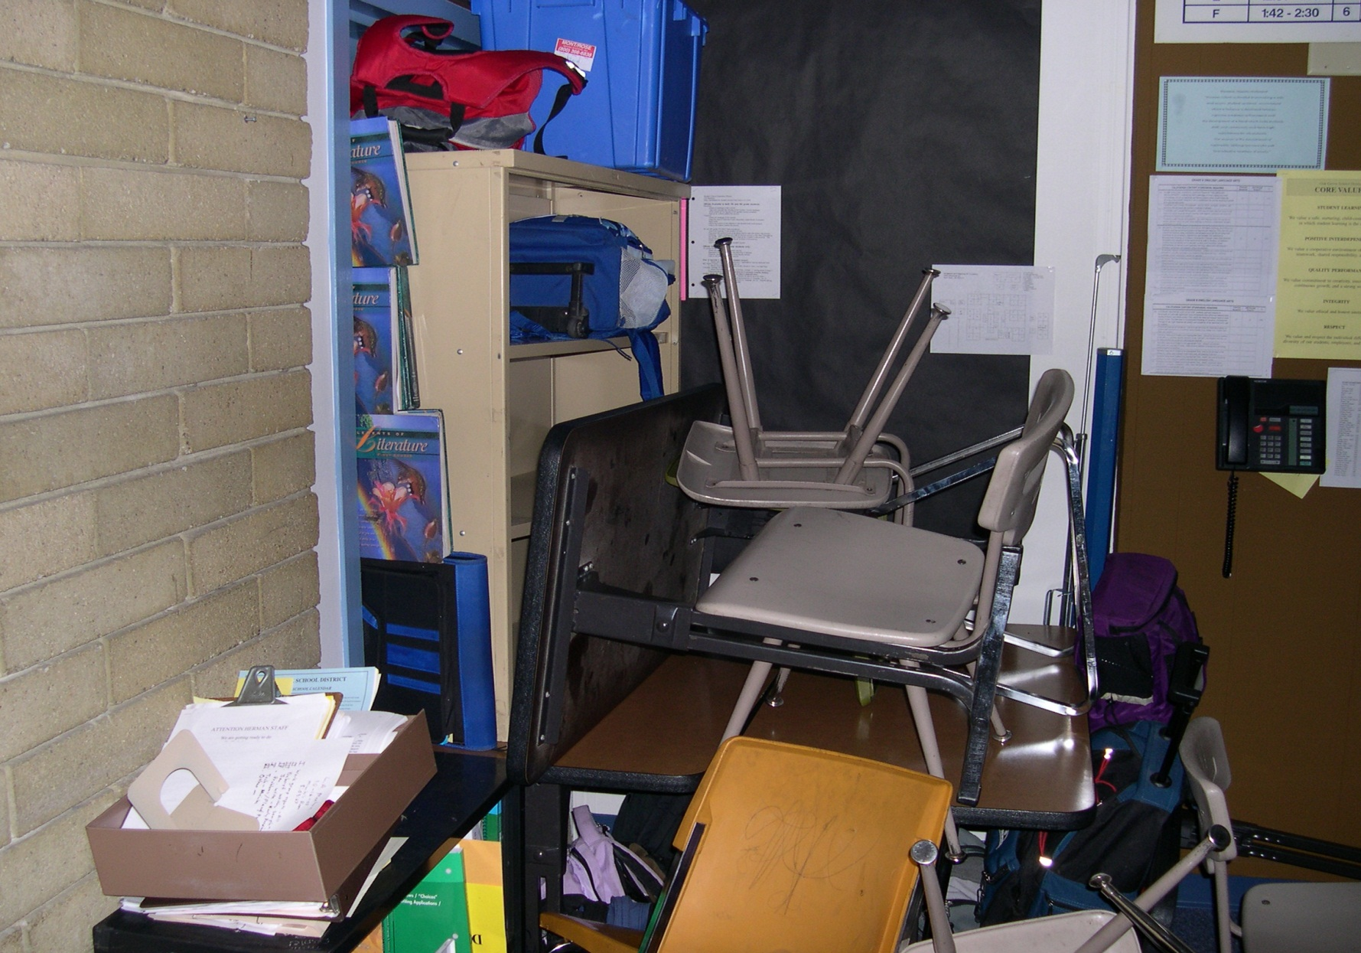
Good example of a barricade
Reinforce the primary barricade

Slide 22
HIDE (other considerations)
Call 911 when it is safe to do so
Once you have secured the door do not open it for anyone. Police will enter the room when the situation is over.
Prepare yourself mentally and physically for the possibility of engaging the Active Shooter
  Put yourself in a position to surprise the suspect(s) if they enter the room.

Slide 23
FIGHT = Fight for your Life
This is a last resort
Commit to your actions!
Act as aggressively as possible
Improvise weapons
Attack in a group
Yell and and make loud noises to disorient the shooter
If possible, grab the shooter’s limbs and head, take them to the ground and hold them there.

Slide 24
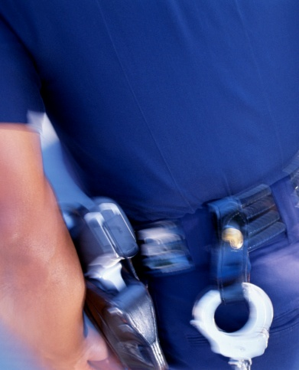
When police officers arrive on scene
Their first priority is to eliminate the threat
Officers will advance to the area where the last shots were heard
Initial officers will not tend to injured victims nor stop to speak with you

Slide 25
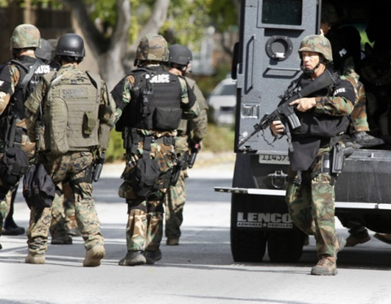
Additional Officers & Rescue Teams
Officers may not be wearing traditional police uniforms
Instead they may be in “tactical” gear with rifles, helmets and ballistic vests
To minimize risk, everyone must be treated as a suspect until the suspect is identified
Officers will issue loud commands and may get physical

Slide 26
Reacting to Law Enforcement
Remain calm
DO NOT approach officers
Follow all instructions by officers
Put down any items and DO NOT pick up any weapons
Raise hands and spread fingers
Avoid quick movements
Avoiding pointing, screaming or yelling at officers
If you are barricaded in a room, DO NOT open the door

Slide 27
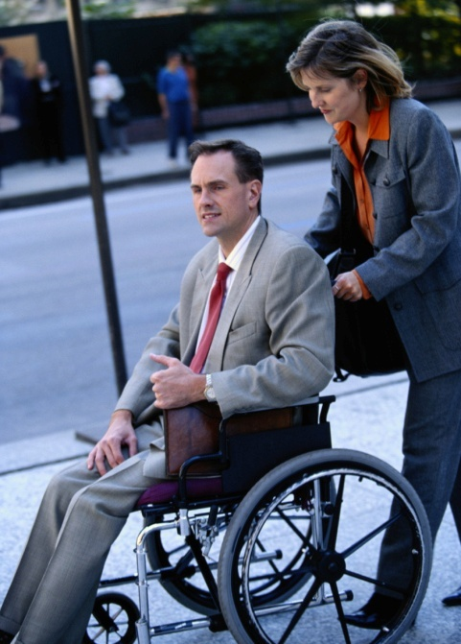
Other Considerations
Be aware there may be situations where people:
May have limited or no English proficiency
May be hearing or sight impaired
May be mobility impaired
Do the best you can to help without putting yourself at risk

Slide 28
Shelter in Place
Situations where there is no immediate threat to your location
  Dangerous incident in the surrounding neighborhood
  Dangerous incident at a nearby school
  Any situation where you feel keeping your staff inside is the safest alternative
Notes:
Also referred to as “Code Blue”

Slide 29
Shelter in Place Considerations
Close all doors and windows (no barricades)
Remain inside; engage in normal indoor activities
Keep movement outdoors to a minimum
Use buddy system when leaving your location
Communicate with your co-workers if you plan to leave

Slide 30
Training Summary
Plan & prepare
Be aware of your environment
  Always know your escape route
  Identify possible dangers
In the event of an Active Shooter: RUN, HIDE, FIGHT!
Call 911 when it is safe to do so
Never approach an officer during an active shooter situation

