Slide 1

Project Succeed
Funded by the U.S. Department of Education

Slide 2

SJSU Washington Square
Project Succeed is a five-year graduation and retention improvement plan beginning in October 2014.
Project Succeed intends to strengthen SJSU’s culture for undergraduate student success by increasing our retention and graduation rates as well as closing the achievement gap for Under-Represented Minorities (URMs).

Slide 3
Project Team
SJSU Washington Square
Dr. Patricia Backer, Project Director
Project Team
Dr. Maria Luisa Alaniz, Professor and Coordinator, Social Science Teacher Preparation.
Dr. Maureen Smith, Professor of Child and Adolescent Development
Ms. Stephanie Hubbard, Associate Director of Residential Life
Ms. Cynthia Kato, Director of Academic Advising and Retention Services.

Slide 4
Goals
SJSU Washington Square
Strengthen SJSU’s core academic performance in two key areas: retention and graduation.
Provide an improved supportive environment for URM students
Enhance the delivery and integration of academic and co-curricular support services for students

Slide 5
Advisory Board Agenda
SJSU Washington Square
Introduction of new members
Block Scheduling Update (Cynthia Kato)
Peer Mentors and Educators Update (Deanna Peck)
Faculty Mentor Program Update (Maria Alaniz & Marlene Stern)
First Year Experience Update (Maureen Smith & Stephanie Hubbard)
Student Learning Communities Update (Stephanie Hubbard)
Evaluator Update (Daniel Brenner, WestEd)
Discussion and Feedback
  FYE Project Groups
  Continuation of Peer Educator Pilot in Spring 2017
  Question and answers
Adjournment

Slide 6
Block Scheduling Update
SJSU Washington Square
For Fall 2015 newly matriculated freshmen in the College of Business, the College of Engineering, and Child and Adolescent Development (CHAD) were assigned schedules that included at least 2 shared classes with other students in their declared majors.
 | Blocked | Unblocked |  | probability
Total enrolled Fall 2015 | 1272 | 2198 | 37%
Retention after 1 year | 1136 | 1877
% Retention | 89.3% | 85.4% |  | p<.001
SJSU units earned | 24.8 | 23.1 |  | p<.001
SJSU GPA | 2.872 | 2.899 |  | p<.149
Probation | 95 | 160
% Probation | 7.5% | 7.3% |  | p<.421
Disqualified | 31 | 48
% Disqualified | 2.4% | 2.2% |  | p<.317

Slide 7
Block Scheduling Update
SJSU Washington Square
Comparison of retention after the first year for Fall 2015 freshmen in Business and Engineering to that of the prior two years is shown in the table. Data for the Fall 2013 and Fall 2014 cohorts can be found in the Student Success Milestones on the Institutional Effectiveness & Analytics website.
Retention after 1st year
Business |  | Engineering
2013 | 89.9% | 2013 | 86.8%
2014 | 87.4% | 2014 | 87.5%
2015 | 88.0% | 2015 | 90.0%

Slide 8
Block Scheduling Update
SJSU Washington Square
Fall 2016
Block scheduled only 2 classes, preregistered students for those classes, and increased proactive communication with instructors regarding block scheduling, peer mentors, etc. We added Music to Business, Engineering, and CHAD majors.
We collaborated with departments and scheduling to hide sections held for the blocking to reduce confusion on the part of students and with the Registrar to batch enroll students.
Fall 2017
we plan to add 2-3 majors each in the Colleges of Applied Sciences and Arts and Social Science and to add all majors in the College of Science.
We have also already planned with scheduling to use specific section numbering to identify blocked classes.

Slide 9
Peer Mentors & Educators
SJSU Washington Square
30 Faculty working with Peer Educators
  The faculty are either being paid through the Project Succeed Grant or they are working with Peer Connections. This number does not include the 3 faculty working with Peer Connections to have Supplemental Instruction Leaders that are not being paid through the grant.
50 Peer Educators (All being paid through the grant)
How are the Peer Educators being utilized by the various instructors?
  12 being used as Tutors
  20 being used as Mentors/Hybrids
  18 being used as Supplemental Instruction Leaders

Slide 10

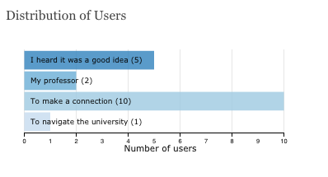
Discussion Session 9/9/11
  30 attendees
Hired interns
Project Succeed Collaborative Support
  Space – Peer Mentors
  Block classes - 5 orientations
    COMM 20
    MAS 10A
  Residence Hall Presentations
  COSS Admin Orientation
Fall Pilot
  48 mentors 17 mentees registered Fall ‘16 Pilot
Why Students Participate
Notes:
Put the details for the bullet points in the report
48 mentors (6 w/incomplete profiles)
17 mentees registered Fall ‘16 Pilot
4 matches
14 have not yet searched for a mentor

Slide 11
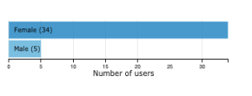
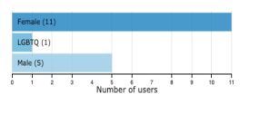
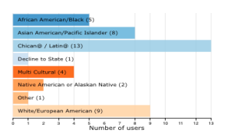
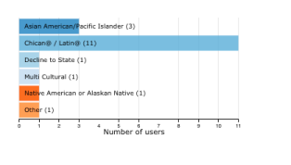
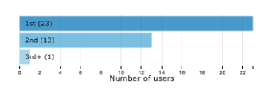
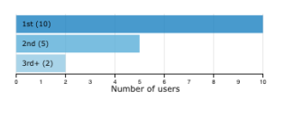
Gender
Mentors
Mentees
Ethnicities
Generation

Slide 12
Challenges & Future Plans
Infrastructure/Integration
  Block class requirement
  FYE class requirement
  others
Spring Launch 2017
Capacity
SJSU Commitment to Sustainable Program
Notes:
Infrastructure/integration
- Mandate for students (ie block class extra credit)
Spring Launch 2017
Capacity
SJSU Commitment to Sustainable Program
-resources

Slide 13
FYE Program
SJSU Washington Square
Hosted a 3-hour FYE Forum
  Staff
  Faculty/MPP/Library
  Students
Established FYE Working Groups
  Muse/Area E (n=3)
  1 Unit FYE (n=2)
  Housing/1st 6 weeks FYE (n=3)
  On-line Orientation Plus (n=4)

Slide 14
FYE Program
SJSU Washington Square
Established an FYE Steering Committee
  Fall 2016
    Will establish FYE standards
    Will review FYE proposals
Pilot and Assess FYE proposals in Fall 2017
Propose New FYE Policy and Guidelines Spring 2018

Slide 15
Student Learning Communities
SJSU Washington Square
There are currently six Living Learning Communities (LLCs): located within our first year residential areas:
Arts Village Global Village
Black Scholars Community Rainbow Village
BUILD CELL
Block Scheduling in BUILD, CELL, and Arts Village
Community Councils in Black Scholars Community, Rainbow Village and possibly BUILD
Nine Faculty In Residence (FIR) hired
Three new academic positions

Slide 16
WestEd Evaluation Update
SJSU Washington Square
Impact on Academic Outcomes
Compare the Project Succeed group to the rest of the cohort to see if they differ on academic outcomes (e.g., retention, probation, GPA, units taken)
Create a matched group that is matched on characteristics we thing might be correlated with outcomes
Run the comparison of outcomes between the treatment group and the matched group
Conduct exploratory analyses to determine whether the intervention impact is larger for certain traditionally lower performing subgroups

Slide 17
WestEd Evaluation Update
SJSU Washington Square
Findings from Analysis of Student Survey Results, Spring 2016
Block scheduling, the Peer Mentor program and Themed Housing were positively reviewed by student respondents
Both Academic Advising experiences and Meeting with Faculty
Formative Evaluation of Other Program Aspects in Progess
Peer Educator Program
Faculty Mentor Program
FYE Program

Slide 18
Discussion and Feedback
SJSU Washington Square
  FYE Project Groups
  Continuation of Peer Educator Pilot in Spring 2017
  Question and answers

