Slide 1
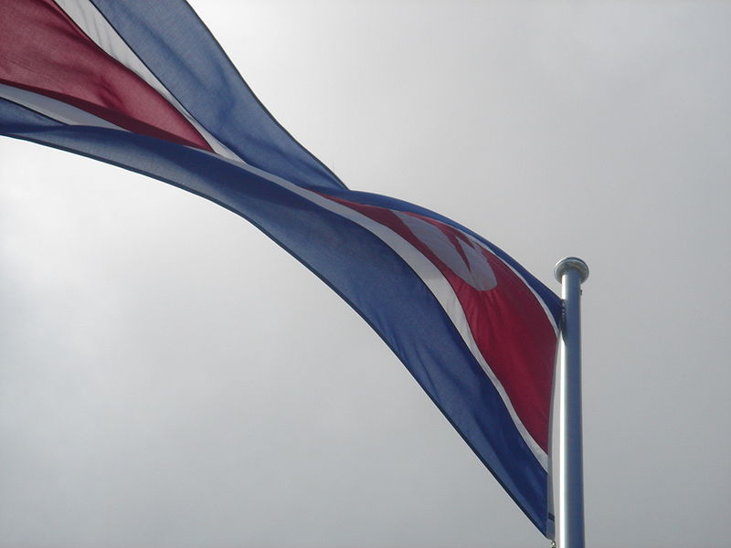
Vexillology and Vexillidolatry in the Democratic People’s Republic of Korea.
조선 민주주의 인민 공화국의 국기 국기와 사랑의 역사.
A research paper by Dean Thomas
Notes:
Vexillidolatry – the reverence of flags – is not uncommon around the world. People in all countries gravitate around their national flag to some degree. However, there is one country that stands out in its reverence of its national and internal flags and emblems. Known popularly in the media as North Korea, this country’s formal name is the Democratic People’s Republic of Korea, and it is there that love of the flag is taken VERY seriously.
To those interested in Vexillology, the DPRK demonstrates a reverence for its flags and symbols in a way that not even the United States does. Indeed, to its citizens, the DPRK flag is far more than a symbol of their nation, it represents to them their ideals and rationale taken to a level seldom seen in history. It may seem incredible to outsiders that the love that the citizenry have to their flags have been taken to such an extent, but given the turbulent history of Korea and the political evolution of the Korean peninsula since the end of the Second World War, such a reverence – and its underlying reasons – is quite logical, once people understand the forces of the past that acted on the Korean Peninsula.

Slide 2
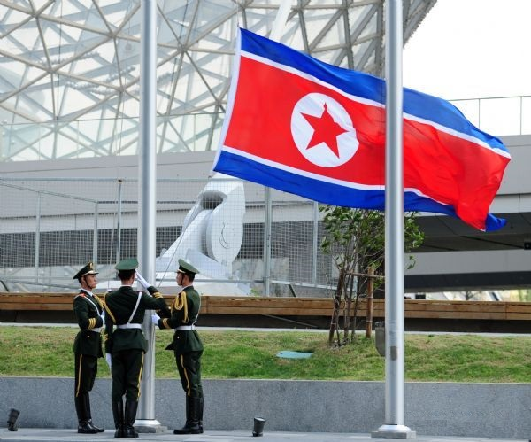
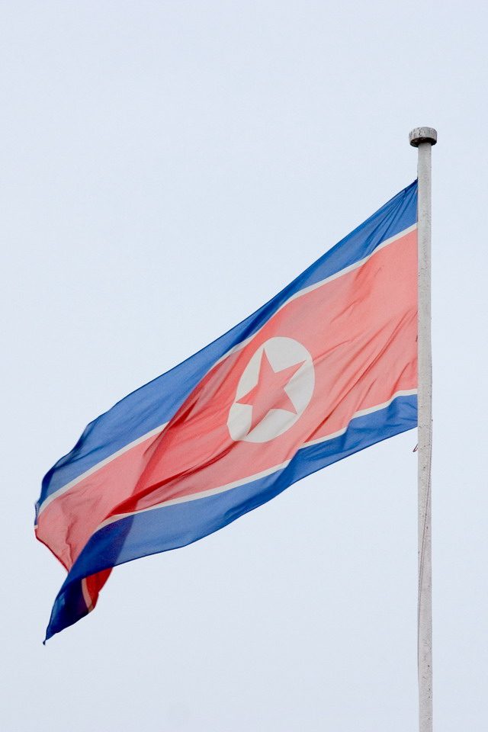
(Or) What flags mean to the DPRK
그 깃발을 북한에게 주는 의미
Notes:
Korea is a country that has had the geographic misfortune to be lodged between other – more powerful - nations who have used it through the centuries as a strategically placed springboard to attack their neighbors throughout history. Japan, China, and Russia have had Korea under their sphere of influence at one time or another over the last millennium, with the United States adding their influence over the last half-century. As a result, Korea had been ruled by outsiders for a considerable period – either as a vassal state, or simply as a province of another country. For a time, ancient Korea had tried a policy of seclusion, but that proved ineffectual over the long term, given the political and military aspirations of her neighbors.
This history of conquest and forced subservience to foreign powers has scarred itself in the Korean psyche, making the Korean people intensely nationalistic. This sense of nationalism manifested itself in the Korean people’s resistance to foreign rule and influences, reinforced Korean traditions, values, and its language, and manifested itself in a determination to stay independent and free of outside control.
So, while the political system – and its trappings – of the DPRK can be said to have been heavily influenced by the Stalinist Soviet Union, it would be unwise to say that the DPRK is a direct copy. It’s evolution along socialist principles along with a firm grasp of Korean nationalism has resulted in a unique political system known as ‘Juche’ (loosely translated as ‘Self Reliance’) that is reflected in the symbolism of their flags and emblems, and the attitude of the DPRK populace to them.
This paper will attempt to explain the symbolism of the DPRK’s flags and emblems, and to show just how revered they are in the eyes of the people and government.

Slide 3
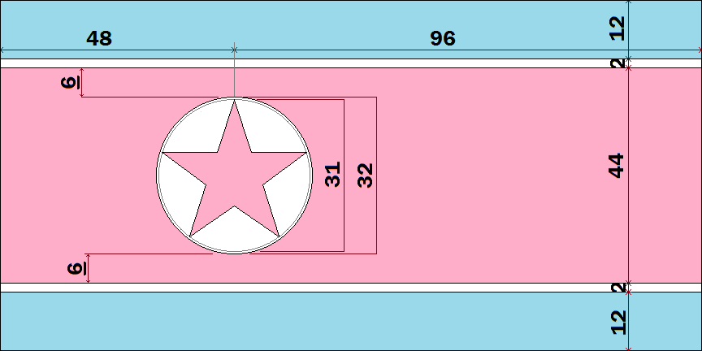
Chapter VII, Article 170 of the Socialist Constitution of the Democratic People’s Republic of Korea:
The national flag of the Democratic People’s Republic of Korea consists of a central red panel, bordered both above and below by a narrow white stripe and a broad blue stripe. The central red panel bears a five-pointed red star within a white circle near the hoist. The ratio of the width to the length is 1:2.
Notes:
CHAPTER ONE: THE NATIONAL FLAG
The Socialist Constitution of the Democratic People’s Republic of Korea refers to the national flag in Chapter VII, Article 170:
The national flag of the Democratic People’s Republic of Korea consists of a central red panel, bordered both above and below by a narrow white stripe and a broad blue stripe. The central red panel bears a five-pointed red star within a white circle near the hoist. The ratio of the width to the length is 1:2.
The description is simple, and thus the National Flag meets two of the positive criteria of flag design: easy to construct and easy to identify. But understanding the construction and description only goes part of the way. Understanding the symbolism of the flag itself goes a long way to understanding the nation and its people.
Red, White, and Blue are classic flag colors, used by a large number of countries. In the case of the DPRK, those colors have always been used in some form by Koreans, which is symbolic of the national character, plus red, white, and blue are regarded internationally as classic republican colors.
The color Red predominates because – like the flags of the majority of socialist states – it represents sacrifice and socialism. The DPRK is first and foremost a socialist republic, plus the DPRK had formed in the aftermath of a recent period of suffering: the Japanese annexation and colonization of the Korean Peninsula from 1910 to 1945. Recalling the blood sacrifice of those resisting the Japanese (and other invaders) connects the past with the socialist ideals of the present, thus making this particular color in the flag the honored color: representative of the patriotic and fighting spirit of the nation.
The narrow white stripes bordering the top and bottom of the red panel represents the homogeneous Korean nation with its long history and resplendent culture. White is regarded as a sacred color to Koreans and its inclusion reflects this aspect of the Korean people.
The broader blue stripes (in relation to the white) at the top and bottom symbolizes the desire to fight for the victory of the ideals of independence, peace and friendship in unity with the progressive peoples of the world, thus reflecting the republican ideals of the DPRK and its connection of those ideals to other countries.

Slide 4
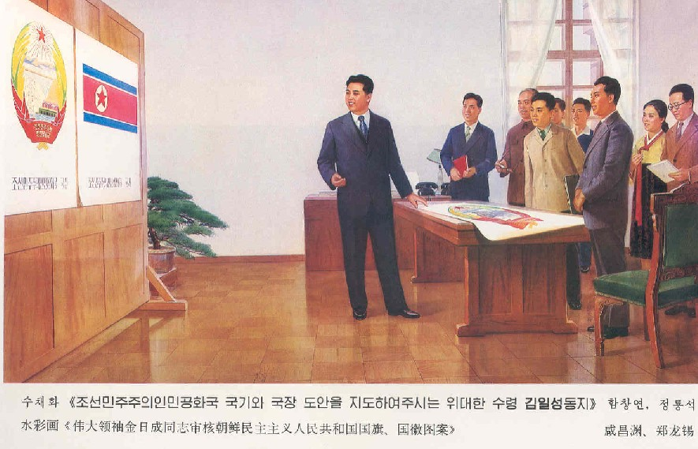
THE NATIONAL FLAG’S BEGINNING: 8 SEPTEMBER 1948
그 깃발의 시작: 8 1948년 9월
Translation: "The Great Leader Kim Il-Sung directing design of Democratic People’s Republic of Korea flag and emblem"
Notes:
A big part of understanding the importance of the flag is to understand under whose ‘guidance’ the flag came to be. The founder of the DPRK: Kim Il Sung has had a massive personality cult built up around him (which of course was extended to his son and successor Kim Jong Il, and now on his successor Kim Jong Un). The people of the DPRK are brought up to understand that the Great Leader (the title that he was addressed as when we was alive) is either personally responsible for – or at least in having a major role in – the chief decisions of the country. So judging from the picture depicted here, the National Flag and State Arms were brought about primarily because of him. This alone gives the DPRK flag it’s ‘endorsed sacred’ status amongst the people.

Slide 5
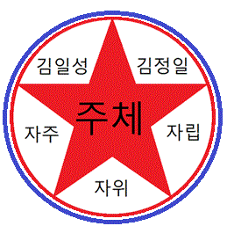
The Juche (주체) Star and Disc
Political Independence (자주)
Economic Independence (자립)
Military Self-Sustainability (자위)
Kimilsungism (김일성)
Kimjongilism (김정일)
Notes:
The emblem that dominates all of these colors is the red five-pointed star on a white disc. Originally representative of communism and internationalism, since the 2009 and 2012 rewritings of the DPRK constitution eliminated all references to Marxism-Leninism; this emblem has progressed – along with the constitution - in its meaning.
Originally, the emblem was said to merge the tae-guk (yin-yang) emblem of Korea with the red star of communism, but with the evolving of the constitution, so had the meaning of the star and disc. The white disc with the red star taken together now represents the political ‘bedrock’ of the DPRK: The white segments that form the star’s outline can be taken to represent the three primary tenants of the Juche philosophy of self reliance: political independence ( 자주) , economic self-sustenance (자립), and self-reliance in defense (자위) .
Added to this are the two tenants of political social awareness espoused by the philosophies of the founding President of the DPRK, Kim Il-Sung (김일성) and his successor after his death in 1984 - Kim Jong-Il (김정일), who himself passed away in 2011. The significance of this was enounced in 2012 by the current Supreme Leader of the DPRK, Kim Jong-un at the 4th Congress of the ruling Workers Party of Korea, who keyed the term: ‘Kimilsungism-Kimjongilism’. He said:
“Kimilsungism-Kimjongilism is an integral system of the idea, theory and method of Juche, and a great revolutionary ideology representative of the Juche era. Guided by Kimilsungism-Kimjongilism, we should conduct Party building and Party activities, so as to sustain the revolutionary character of our Party and advance the revolution and construction in line with the ideas and intentions of the President (Kim Il-Sung) and the General (Kim Jong-Il)”.
Note: The references to ‘President’ and ‘General’ is because Kim Il-Sung has the posthumous title ‘Eternal President of the DPRK’, and Kim Jong-Il has the posthumous title ‘Eternal General Secretary of the Workers' Party of Korea’.
It can then be said that each of the other two white segments represents Kim Il-Sung and Kim Jong-Il, thus with the other white segments representing the tenants of independence, self-sustenance, and self-defense, thus forms and defines the red star and white disc of Juche socialism as illustrated:

Slide 6
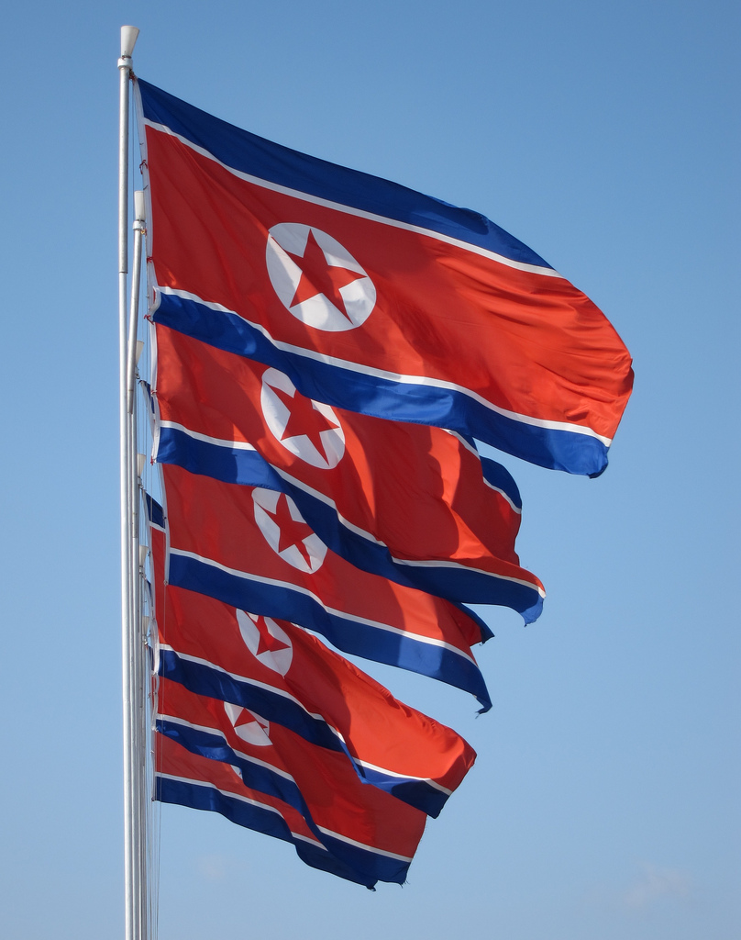
The end result: symbolic simplicity
최종 결과: 상징적인 단순성
Notes:
Taken together, the flag of the DPRK represents Korean history, sacrifice, idealism, and independence in a simple, yet aesthetically pleasing form. The 1:2 ratio gives the flag a ‘streaming’ look when flying in a breeze. Whether this ratio was chosen either for aesthetics or because it was influenced by the flag of the USSR isn’t known with absolute certainty, but regardless, the end result is pleasing when seen, and that makes for a good national flag.
The flag was adopted officially as the National Flag of the DPRK on 8 September 1948; both as the National Flag and Civil Ensign.

Slide 7
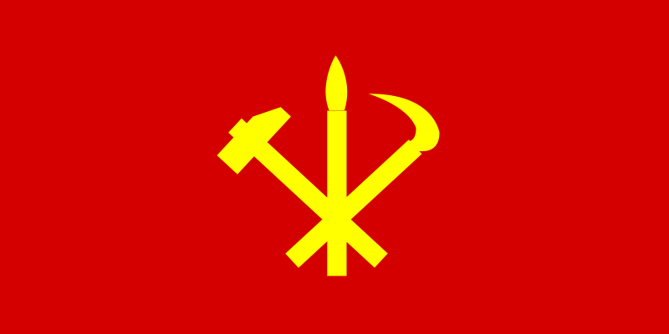
The Flag of the Workers Party of Korea
한국의 노동당의 국기
Chapter 1, Article 11 of the Socialist Constitution of the Democratic People’s Republic of Korea: The Democratic People’s Republic of Korea shall conduct all activities under the leadership of the Workers’ Party of Korea.
Notes:
CHAPTER TWO: The Flag of the Workers’ Party of Korea
Chapter 1, Article 11 of the Socialist Constitution of the Democratic People’s Republic of Korea states:
The Democratic People’s Republic of Korea shall conduct all activities under the leadership of the Workers’ Party of Korea.
This article underpins the leading role of the Workers Party of Korea in governing the country and its people. As a result, the images of the Party’s leaders, and also the emblem of the party itself are prominently displayed, and are treated with the same reverence as the National Flag. Indeed, this flag can be regarded as de facto the co-National Flag of the DPRK.

Slide 8
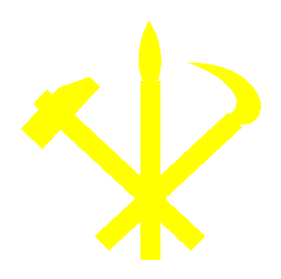
Symbolism of the WPK emblem
한국의 노동당의 상징에 대한 무엇
Calligraphy brush for the nation’s Intellectuals 이 나라의 지식인들의 서예 브러시
Hammer for the nation’s workers 이 나라의 노동자들을 위한 해머
Sickle for the nation’s farmers 이 나라의 농민들에게 낫
Notes:
The flag itself is a red banner with a ratio of 1:2 (like the National Flag), and bears in the center of the flag a yellow emblem which is a combination of three tools: a hammer, a long-handled sickle, and a calligraphy brush: representing the country’s workers, the country’s farmers, and the country’s intellectuals. Merged together, the emblem and colors represents the united front of all social classes in one party.
Vexillologically speaking, the flag’s design has clearly been influenced by traditional communist symbols of other socialist countries, but with the addition of the brush, and trading out of the ‘traditional’ sickle with the type used by Korean farmers, this flag clearly represents an indigenous version of communism. Like the National Flag, this design is simple to construct and easy to identify.

Slide 9
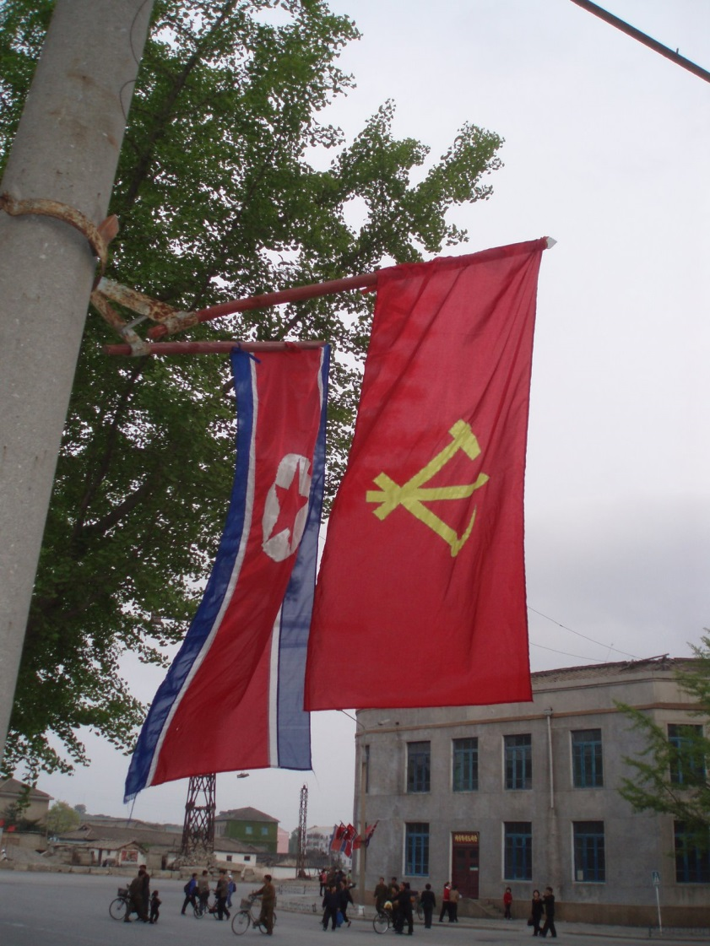
The De-Facto DPRK Co-National Flag
두 번째 비공식 북한 국기
Notes:
Within the DPRK, both the national and party flags can be seen displayed together. Given the official history of the DPRK crediting Kim Il Sung with the design of both flags, such displays not only infuse patriotism amongst the populace, but reinforces the cult of personality.

Slide 10
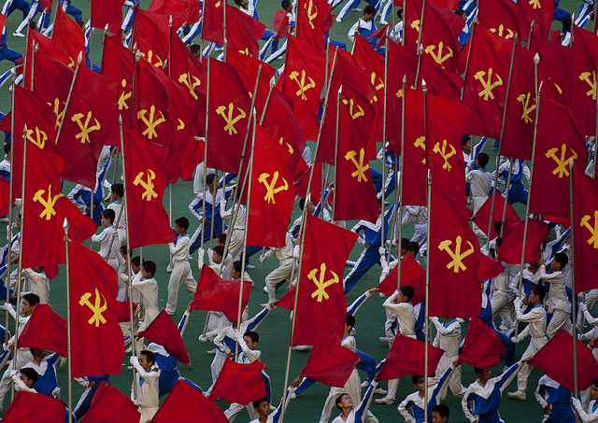
The party emblem is everywhere…
당 엠블럼 어디에서나 사용되고 있...
Notes:
One can seldom go anywhere in the DPRK without seeing the WPK flag in some form…

Slide 11
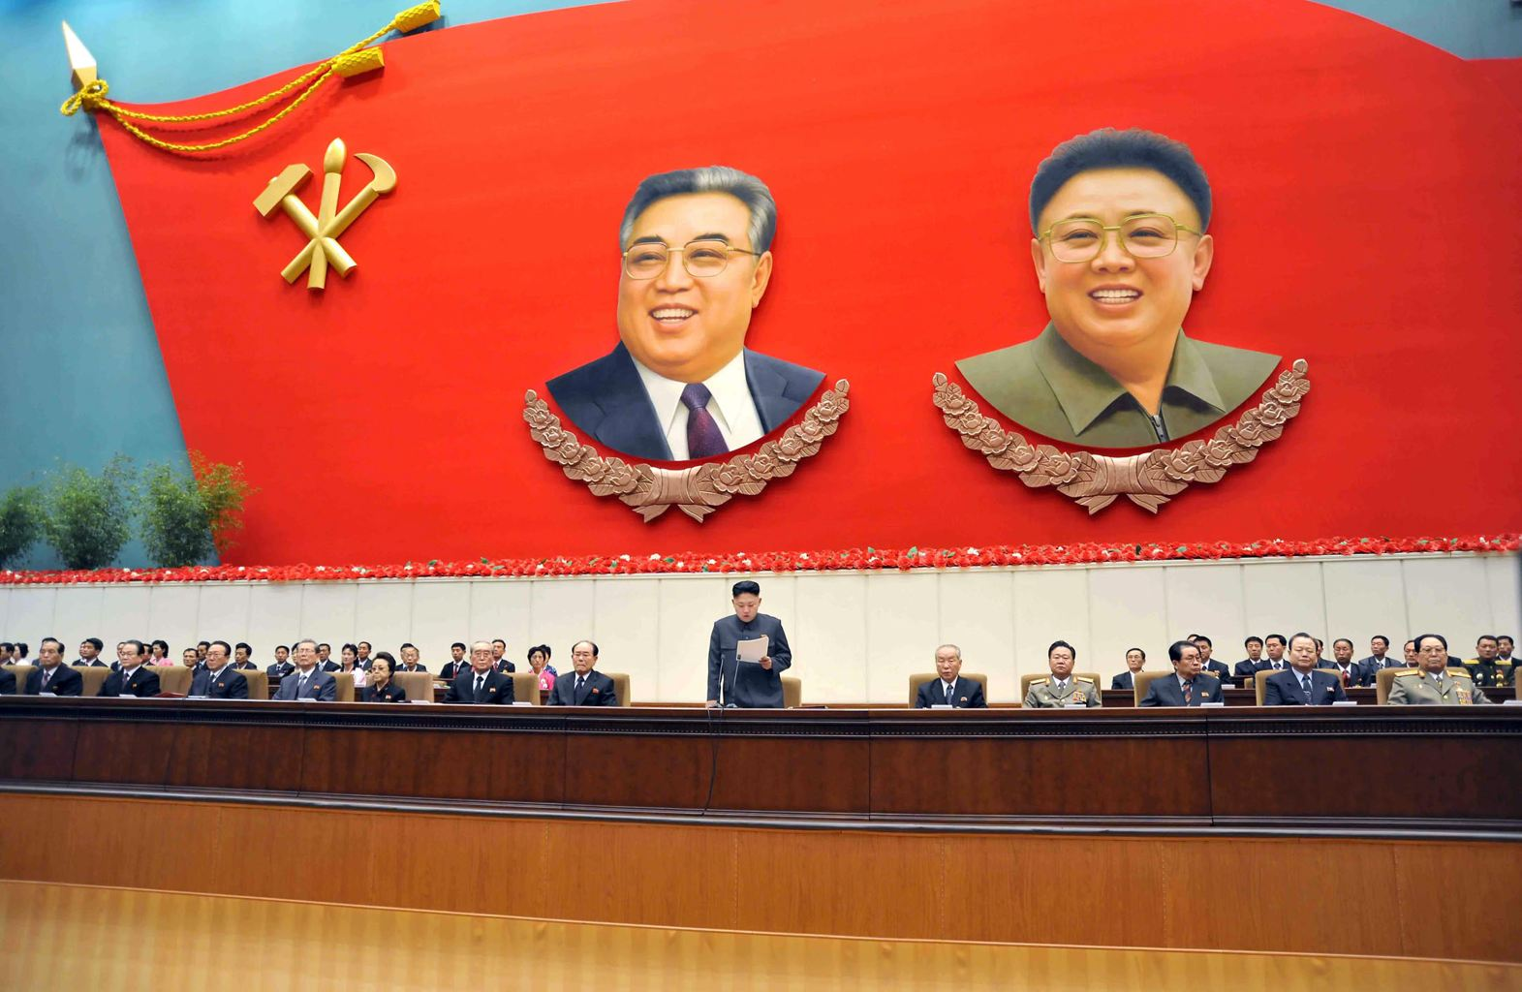
With depictions of their leaders – large…
- 대형 그들의 지도자로 묘사...
Notes:
However, there are some variances of the design. A prime example of this involved reducing the size of the central emblem and placing it in the upper left corner of the flag, and the resulting larger red space used to place images of the leaders of the Party. Until 1994, it was the image of Kim Il-Sung. After Kim Jong-Il ascended to the Supreme Leadership of the WPK - and the DPRK – his image was added to the flag:

Slide 12
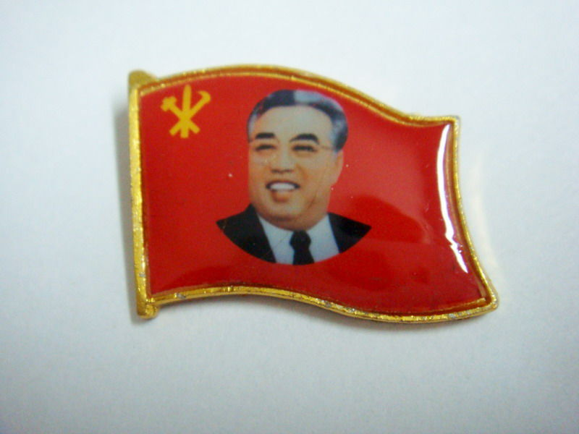
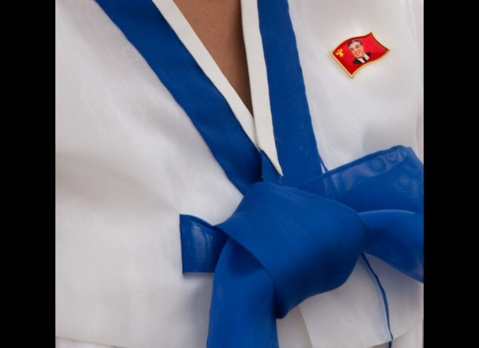
…and small
... 작은
Notes:
Smaller versions of this flag are in lapel pin form and are worn by all DPRK citizens – military and civilian - on the left breast of their outer garment, symbolizing their loyalty and fidelity to the party and its leaders.

Slide 13
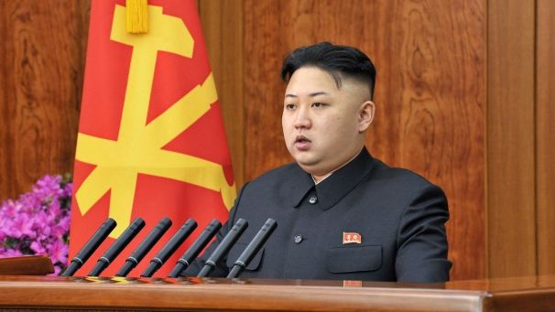
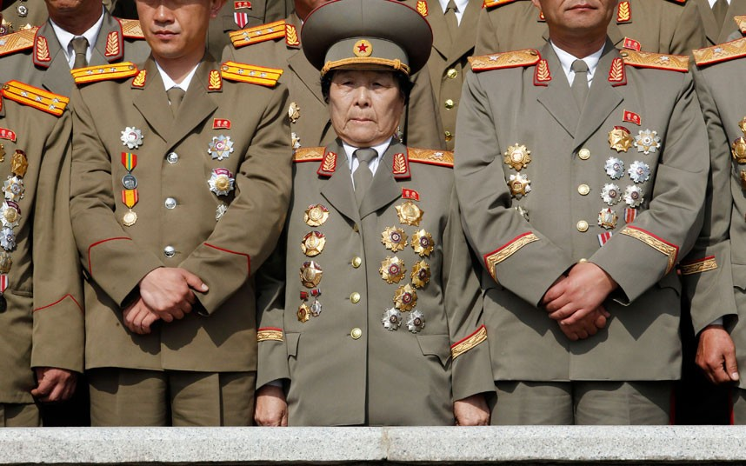
From their leaders, to the military…
그들의 지도자는 군사시설...
Notes:
Note the flag-shaped lapel pins worn on the civilian garb of incumbent leader Kim Jong-un and on military uniforms. (Note: The female centered in the picture is that of a People’s Army Major General).

Slide 14
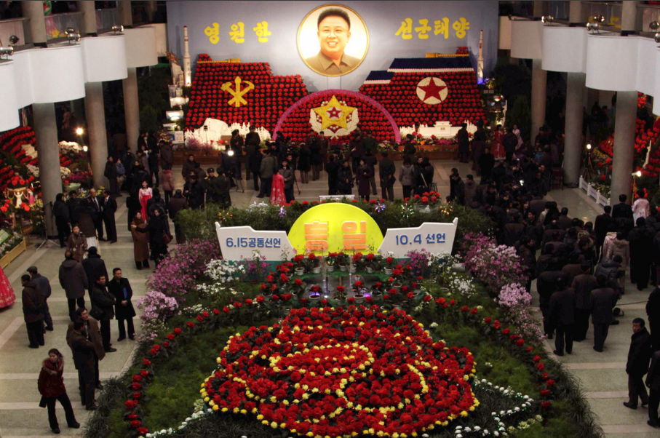
In flower shows…
꽃에...
Notes:
The origin of the emblem was as a direct result of Kim Il-Sung’s input. This happened when the work to institute the emblem of the WPK was under way after Korea’s liberation from the 40-odd-year-long military occupation and colonization of the peninsula by the Japanese. Kim Il Sung had instructed the officials concerned that the Party’s emblem should represent the working class, the farmers, and the intelligentsia so as to symbolize it as “a united party of the working people that admits progressive elements of workers, farmers and intellectuals and that the working class should be represented by a hammer, the farmers by a sickle and the intellectuals by a writing brush instead of a pen”. Following this directive, the officials drew a design as he instructed, and presented it to him. This initial design showed a hammer standing vertically, and a sickle and a brush fanwise to the right of the hammer.

Slide 15
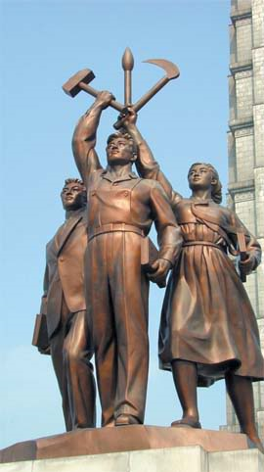
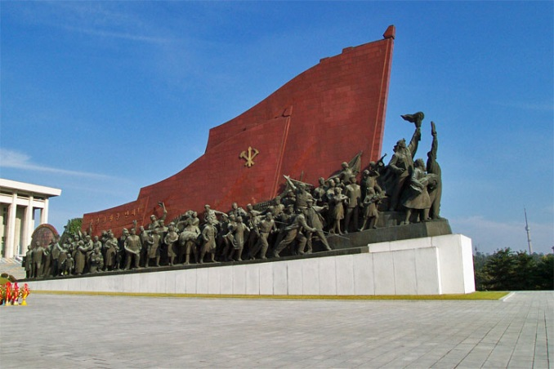
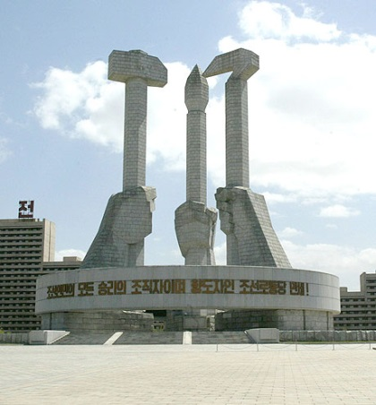
And on monuments…
및...기념비에
Notes:
After carefully examining the design, Kim Il-Sung said that the hammer and sickle in the design were alien things, not the Korean ones, and that the hammer used by the Korean workers and the sickle used by the Korean farmers should be drawn instead. He then suggested that the hammer, the sickle and the writing brush should be crossed in the middle of their handles not only from the viewpoint of the design’s composition but for the purpose of symbolizing the close unity of the working masses of Korea. And he further proposed placing the hammer on the left and the sickle on the right with the brush at the center. He went on to stress that the brush should be surely placed at the center and placed a little higher than the hammer and the sickle so as to “make the design proportionate and to give the meaning that all the workers and farmers should possess profound knowledge and raise their cultural standard so as to contribute to the building of a prosperous, civilized, independent, sovereign country”. This is how the WPK’s current emblem came to be.
A large number of the monuments in the city also utilize the National Flag and the WPK symbol as an integral part of their façade, reinforcing the equating of the love of the flag to the love of the country, and by extension the WPK.
.

Slide 16
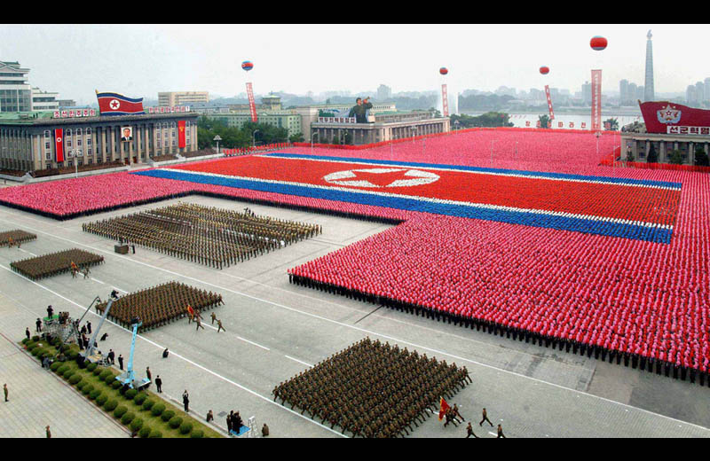
Use of the DPRK and WPK Flags
사용 북한과 노동당의 플래그
Notes:
CHAPTER 3: Usage of the DPRK National and WPK Political Flags
While the flags of the DPRK and the WPK are ubiquitous throughout the country, There are two locations in particular in the DPRK that symbolizes the pride and importance of the flags in DPRK society: The capital city of Pyongyang and the Demilitarized Zone that marks the southern boundary of the nation.

Slide 17
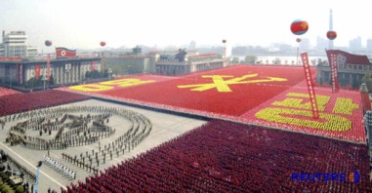
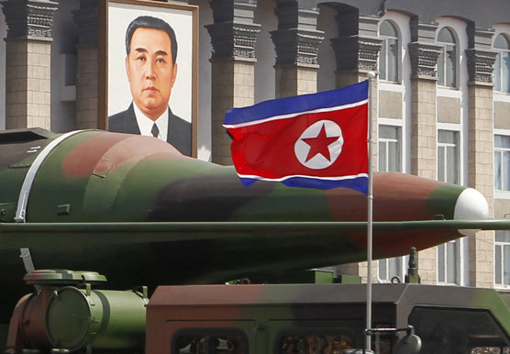
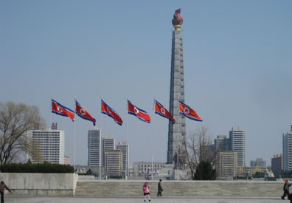
In Pyongyang…
평양에서 ...
Notes:
Pyongyang.
As the political, economic, and cultural capital of the DPRK, the city represents the aspirations and ideals of its builders and inhabitants. As such, the city is endowed with magnificent monuments, ‘assertionist’ architecture, and impressive public facilities such as sports stadiums and their impressive subway system. Adorning these structures are the symbols of the nation and ruling party. A visitor to the city would be overwhelmed by these structures, and the flags that prominently fly and/or hang everywhere. Indeed, it is thanks to the mixture of Vexillology and architecture that clearly demonstrate the power of the State, and the respect shown to it by the citizens.

Slide 18
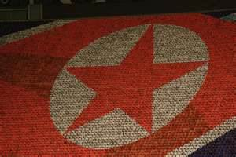
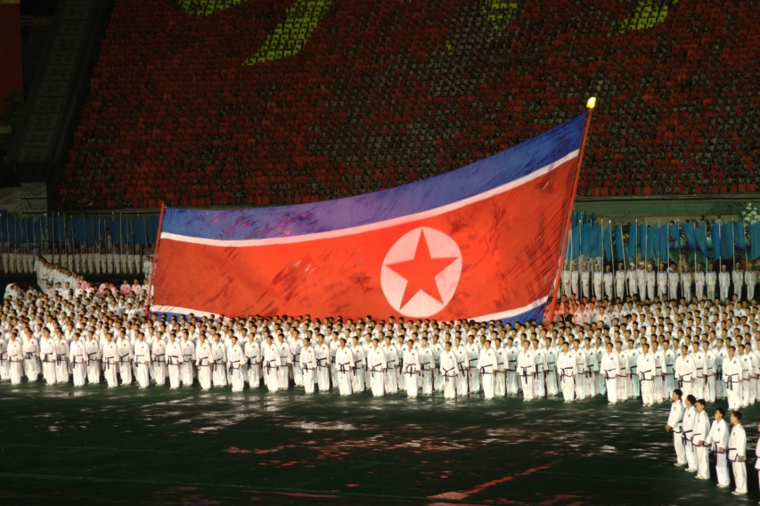
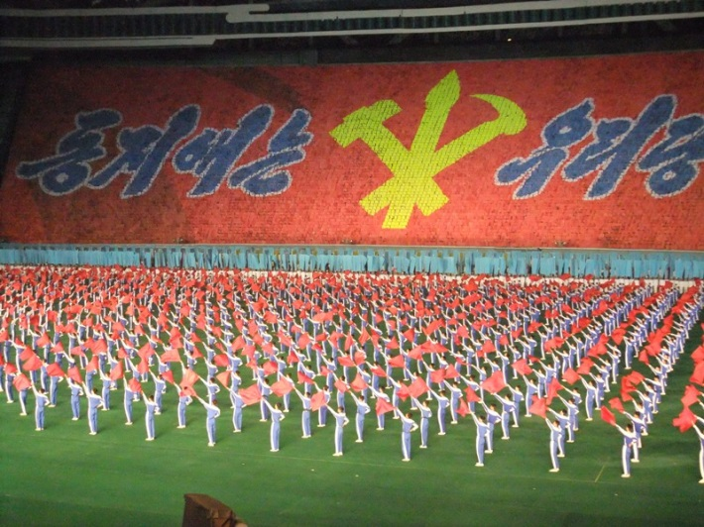
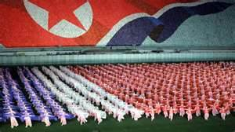
At the Arirang Mass Games…
아리랑 축제…
Notes:
This can be best emphasized by two major events that the DPRK is famous for: the military parades in Kim Il-Sung Square, and the Arirang Festival held at the Immense May Day Stadium. Not only military discipline and loyalty to both the country and the party is impressively demonstrated by such displays, but the reverence shown to the symbols of the country as well. The National Flag, Party Flag, the plain Red Banner of revolution, and images of Kim Il-Sung and Kim Jong-Il dominate throughout, along with patriotic slogan banners.

Slide 19
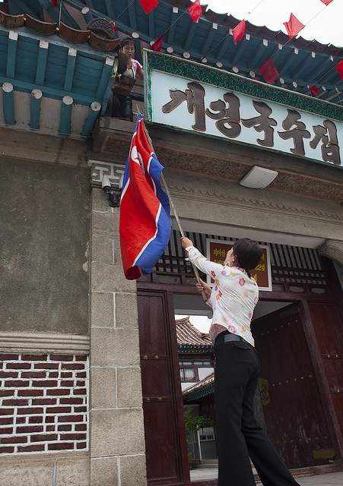
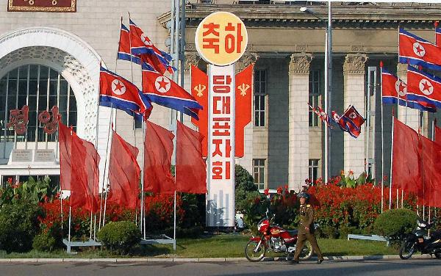
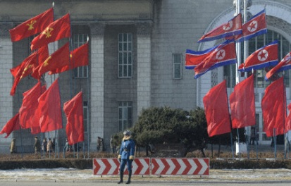
and by the city’s citizens…
또는 도시의 시민들이...
Notes:
For displays of flags outside those of large parades, they are usually grouped together to create flag montages. It is not uncommon to see displays of the National Flag, the WPK emblem, and the plain red flag of revolution, which also appears on monuments and more overt patriotic displays.

Slide 20
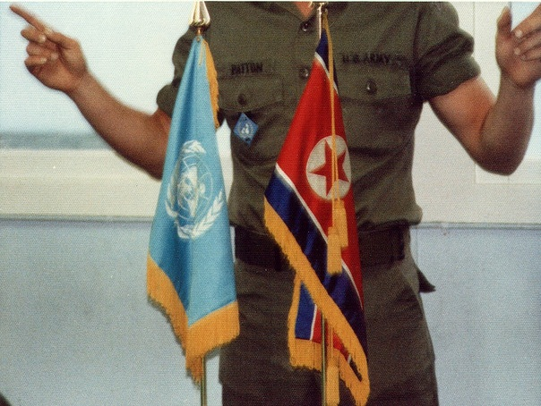
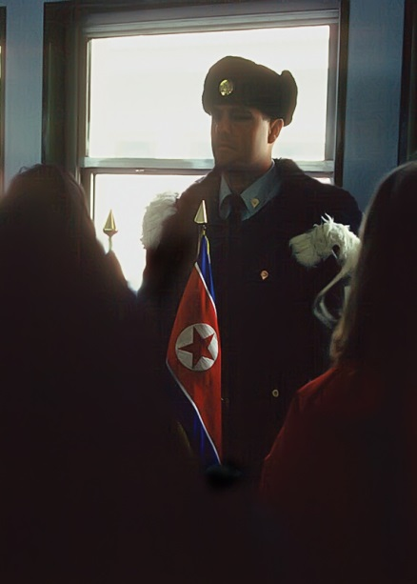
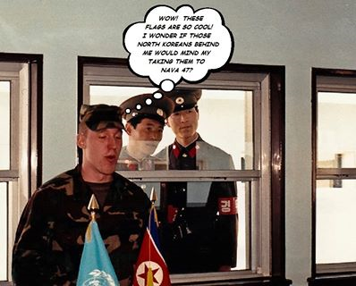
In the Demilitarized Zone…
... 이에 비무장지대(dmz)
At Panmunjom (판문점)
One of the smallest - but also one of the most-negotiated – flags in the DMZ
그러나 DMZ에서 가장 많은 사람들이 협상 - 플래그의 또한 그것이 가장 작은 - 중 하나
Notes:
The Demilitarized Zone.
In the Armistice Agreement of July 27, 1953, which ended the Korean Conflict (known in the DPRK as the Fatherland Liberation War) the DMZ was created as each side agreed to move their troops back 2,000 m (2,200 yards) from the front line, creating a buffer zone 4 km (2.5 mi) wide. The Military Demarcation Line goes down the center of the DMZ and indicates exactly where the front was when the agreement was signed.
It is at the Joint Security Area at a place named Panmunjom – in a blue prefabricated building straddling the MDL – that one of the smallest, yet one of the most important DPRK flags are located. It is a desk flag sitting beside a similarly-sized desk flag of the United Nations. Because south Korea did not sign the armistice agreement, that is why the UN flag rests there in its place. Both of these flags were as the result of intense negotiations over the size and disposition of the flags at the one place where both sides meet: the Joint Security Area. Every aspect of the two flags – the height of the poles, the design of the flag’s bases, the finials, and the fringes – were as the result of lengthy negotiations and visitors from both sides of the MDL are strictly warned not to touch either flag.

Slide 21
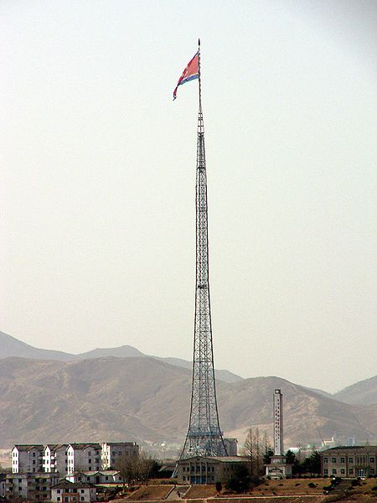
Kijongdong (평화리)
World’s Third Largest Flagpole
세계에서 세 번째로 큰 깃대
This DPRK flag weighs 500 pounds, cannot fly in wet weather as the added weight would bend the pole, and there is a bounty on this flag from the south Korean government.
이 북한 국기, 500파운드의 무게를 젖은 날씨에 추가 무게 폴 굽히며 날아다닙이 한국정부로 부터 이 플래그의 가격입니다.
Notes:
Not far away, in a village within the DMZ named Kijongdong, there is another DPRK flag whose size is huge. It flies from the world’s third-highest flagpole and it weighs in at over five hundred pounds. This flagpole and flag were as the result of a ‘competition’ between the DPRK and south Korea.
The south Koreans have a village within the DMZ named Daesong-dong. When a large flagpole flying the south Korean flag was set up there, a taller flagpole with a larger flag was set up in Kijongdong in response. When the Daesong-dong flagpole was extended in size to ‘top out’ the Kijongdong flagpole, the DPRK authorities lengthened theirs in a tit-for-tat one-upmanship flagpole game (called ‘the Flagpole War’) that the south Koreans eventually gave up on. For a long time, the flagpole at Kijongdong was the world’s tallest, until recently when two giant sized flagpoles were set up in Dushanbe, Tajikistan, and in Baku, Azerbaijan. Still, the impressive height and lattice-work construction of the flagpole at Kijongdong dominates the area.
An illustration of how this particular DPRK flag is regarded by south Korea is revealed in the fact that that the Seoul government had put a bounty on the flag some years ago. Any person who removed that flag from Kijongdong and delivered it to the Blue House in Seoul would receive US $500,000.00. However, given that any potential bounty hunter would have to (a) get through one of the most heavily-guarded regions on the planet, remove a flag over 500 pounds in weight, then get it back through the DMZ, the likelihood of such an expedition succeeding would be close to non-existent.

Slide 22
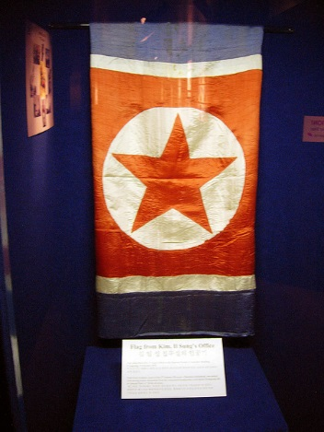
A DPRK flag that the DPRK wants back…
북한은 원하는 플래그...
Notes:
This DPRK flag is one of the most-prized DPRK flags, though it is actually located in south Korea! This flag had hung in Kim Il-Sung’s office at WPK headquarters in Pyongyang up to September 1950, when Pyongyang was briefly occupied by UN forces during the Korean Conflict. Taken as war booty by an American soldier, it is now on display in a military museum at Camp Red Cloud, Uijongbu, south Korea.
The DPRK has sworn to recover this flag by any means necessary, and it is presumed that Camp Red Cloud would be a priority target in the event of renewed hostilities taking place on the Korean peninsula.

Slide 23
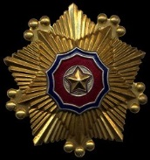
Order of the National Flag
태극기 주문
One of the highest awards in the DPRK.
북한의 최고의 시상식 중 하나.
Awarded in three classes. 세 클래스에서 수여
Notes:
CHAPTER 4: Other references to – and uses of – the national flag in the DPRK
The flag is held in high esteem in both military and civil terms. Not just in overt displays of military might and patriotism such as Ariang and the massive military parades – both designed to impress visitors as well as the local populace, but in other manners – as in awards, artwork and product-branding, and more modest displays.
One of the most prestigious awards in the DPRK’s systems of honors and decorations is the Order of the National Flag. Named after the DPRK national flag, it is a decoration awarded in three classes.
The order is a pentagonal-shaped pin-on badge bearing the national colors and Juche star. The level of the award is denoted by the metal color of the badge: Gold for First Class, Silver-Gold for Second Class, and Silver for Third Class. Until the Order of Kim-Il-Sung was created, this was the DPRK’s highest honor. Still, this award is highly regarded and the recipients are recognized by the populace as heroes of the Republic.

Slide 24
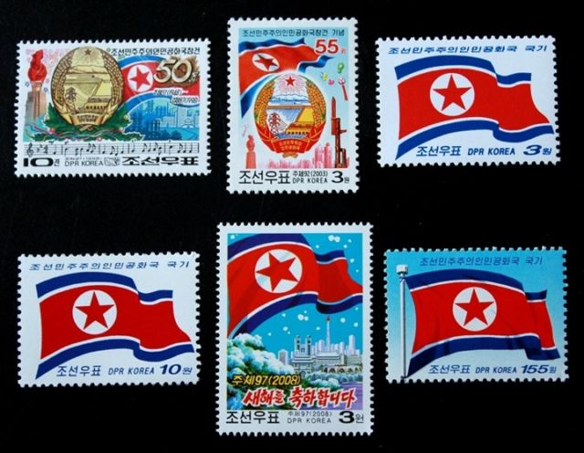
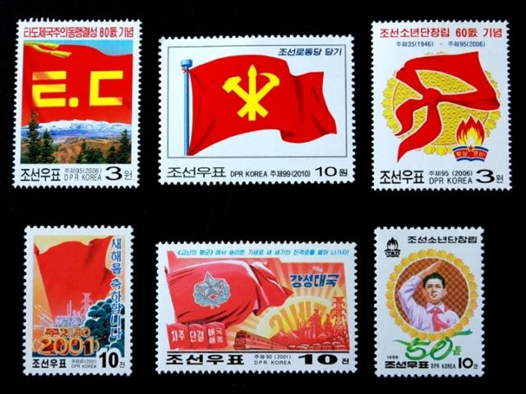
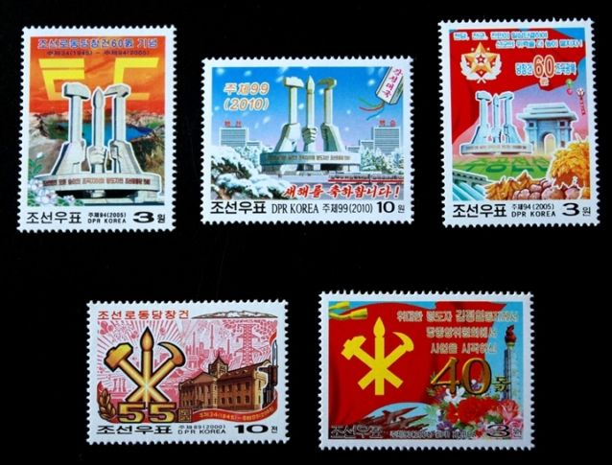
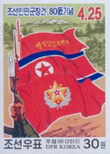
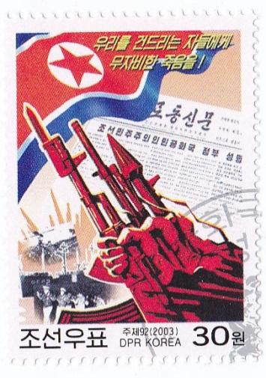
DPRK flags in stamps
북한우표
Notes:
For more ‘mundane’ displays of the DPRK flag, the flag is a feature often used in stamps, logos of state-owned enterprises, and in patriotic art.
Stamps of the DPRK are typically either simple depictions of the flag, or scaled-down pictures of patriotic artwork involving the flag.

Slide 25
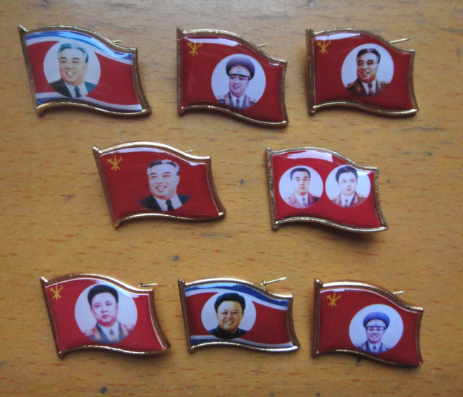
Flag lapel pins (the wearing of is obligatory) 플래그(의 착용 의무) 옷깃 핀
Notes:
As mentioned earlier, the flag lapel pins bearing images of Great Leader Kim Il Sung and Dear Leader Kim Jong Il are ubiquitous.

Slide 26
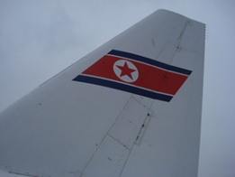
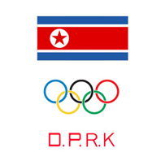
“Corporate” Branding
"기업용" 브랜딩
Notes:
Examples of national flag ‘corporate branding’: The National Airline of the DPRK – Air Koryo – uses as its company logo and fin-flash identifier the flag of the DPRK. It’s simple- yet striking – design contrasts with the more garish designs of other civil airlines and clearly shows its country of origin. Likewise with the emblem of the DPRK’s Olympic Committee.

Slide 27
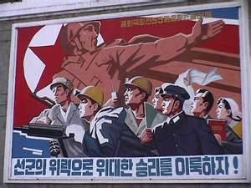
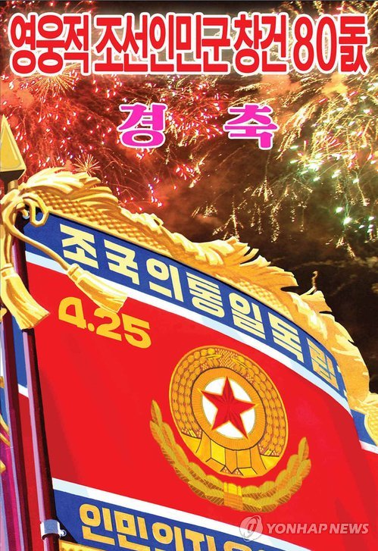
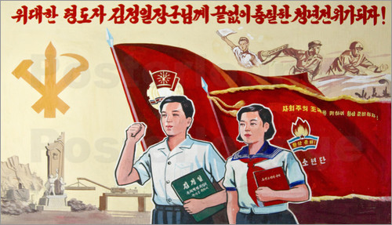
Patriotic Artwork
애국적인 아트워크
Notes:
Patriotic artwork showing the DPRK flag (and other flags) are displayed everywhere.

Slide 28
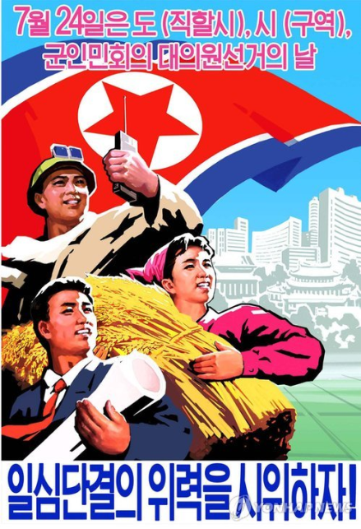
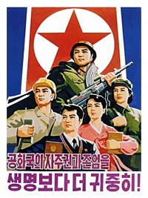



More Patriotic Artwork
더 많은 애국적 아트워크
Notes:
Mostly encapsulating a common theme: entwining the flags with patriotic slogans and images of citizenry (and their leaders) striving for a common goal.

Slide 29



And not so-nice artwork against Old Glory…
및 미국 플래그에 대한지 않도록- 멋진 예술품
Notes:
Those pieces of patriotic artwork that involve other flags usually show those flags not getting accorded the same respect. It is not surprising that the U.S. Flag is always depicted being dishonored in some way. (Note the US flag getting trodden on in the lower picture).

Slide 30

This type of thing is not liked in DPRK…
일의 이 유형 조선민주주의인민공화국에서 좋아하지 않...
Notes:
Needless to say, while the DPRK smiles upon patriotic displays of their national flag, acts of disrespect towards the flag are taken very negatively. When protests against the DPRK in south Korea involve defacing, burning, or tearing up a DPRK flag, the news media of the DPRK makes it very clear as to what the country thinks of such antics…
The Korean Central News Agency (KCNA) is known for making very blunt statements in its press releases that include a lot of socialist jargon and threatening rhetoric, so when displays of DPRK flag desecration are remarked on by the KCNA, with comments such as “Despicable elements of the ruling clique in Seoul allowing monstrous and shameful desecrations of our Sacred flag”, while sounding like a typical report, in such cases this really cannot be dismissed as ‘standard party jargon’. Their definition of the DPRK flag as ‘sacred’ is really no exaggeration, and displays like this repeated on DPRK television easily brings a DPR Korean’s blood to boil.

Slide 31




Viewpoints
보기의 포인트
Notes:
Speaking to members of the Korean Friendship Association who have visited the DPRK, they commented that the flag displays they have seen stand out for two major reasons: First, they have never seen any flags that were faded or tattered – even outside Pyongyang the flags are pristine (which means that there certainly isn’t any shortage of flags or cloth in the DPRK), and that they are certainly not displayed in a frivolous manner. Comparing this with the use of the United States flag at home, the DPRK flag is (a) not displayed outside businesses or used in non-flag products as clothing or items such as shopping bags or displays advertising domestically sold produce. Despite this, the respect shown to the national flag by its citizenry is ubiquitous.
I had the opportunity to talk with a former DPRK citizen (who asked not to have his name mentioned), and when I asked him about how he and his fellow citizens regarded the DPRK and WPK flags, he had this to say:
“The National Flag – like our anthem - was taught to us from the very beginning to be something to be respected and honored. As I grew up, this respect was something that grew. It was a source of pride to see the flag as it represented our country. While the authorities were constantly looking out for any unpatriotic – meaning disloyal - behavior, I can say that the respect we showed for the National Flag was far more out of pride than fear, particularly when seen in newscasts about victories at the Olympics and our football (soccer) team. The flag was thus treated in a manner designed to be accorded the utmost respect. This was the case with the WPK flag as well, though for a somewhat different reason. That emblem represented the authority of the Party over everybody, and as we learned from a very early age, the Party was always right and never to be questioned – let alone criticized. So we quickly learned to respect the WPK flag for the power that the Party had over our lives. In every village, town, city, the WPK emblem was there and you knew that behind that emblem were those who mercilessly enforced the authority of what it represented. Our having to wear the WPK pins with the images of the Great and Dear Leaders on our shirts only reinforced this realization. Still, tempering this fear of the state was a respect for the party being able to keep the DPRK free of control or excessive influence from other nations – including our allies China and Russia, by the way. The Nuclear and space programs are prime examples of that”.
When I asked if this sentiment was a universal one, I was answered thus:
“We have been taught to keep our feelings to ourselves as displays of emotion outside sanctioned activities are regarded as unproductive and politically suspect. Close friends can very easily become bitter rivals ready to show loyalty to the Party by denouncing anything you say and do, so asking people if they think the WPK flag and emblem is something to be feared rather than loved could be interpreted as disloyalty to the State. But I can say that the people living in the DPRK think of themselves first and foremost as Korean, and that given our history of foreign domination by Japan, China, Mongolia, and Russia, we are truly proud to be an independent nation once again, hence the love for the primary symbol of our independence: the national flag.

Slide 32

Flag of Supreme Commander
최고사령관의 국기
Notes:
CHAPTER FIVE: Other Flags and Emblems of the DPRK
This paper would not be complete without mentioning the State Arms and the other official flags of the country: That of the Korean People’s Armed Forces, and the Flags representing high political office.
The Supreme Commander’s Flag.
This flag denotes the Supreme Commander of the Nation, and of the Korean People’s Armed Forces. An amalgamation of the Juche Star and a silver wreath upon a red flag, this flag represents the current Supreme Commander, Kim Jong-Un. This flag has been seen in ratios of both 2:3 and 1:2.

Slide 33





Flags of Korean People’s Armed Forces
Obverse of Army, Navy, Air Force, and Red Guard Flags 육군의 다른 면이다 ., 해군, 공군,과 홍위병 플래그
Translation: “The Unification and Independence of the Motherland” (top)
“For the Freedom and Liberation of the People” (bottom)
Notes:
The Flag of the Korean People’s Armed Forces
This flag is a variation of the National Flag, with the State Arms of the DPRK replacing the Juche Star and Disc. The Hangul inscription reads: For the independence of the Homeland and the people!
Korean People’s Army
This flag – again a variant of the National Flag of the DPRK – has a different design on the reverse of the flag. The obverse bears the KPA’s emblem, the numbers 4.25, which is in reference to the date of the founding of the KPAF (4/25/1932), and the mottoes: “The Unification and Independence of the Motherland” (top) and “For the Freedom and Liberation of the People” (bottom).
The Reverse bears the emblem of the Workers Party of Korea, thus representing the political loyalty of the Army to the ruling Party. While this particular illustration does not show any mottoes, pictures of military parades have shown mottoes depicted on the Reverse.
Korean People’s Navy
Following a similar layout to the flag of the Korean People’s Army, this flag is nonetheless unusual in that the predominant color is not Red. Still, the mottoes on the obverse are the same as that on the KPA flag, and the reverse of the flag bears the emblem of the Workers Party of Korea, symbolizing the Navy’s political allegiance. The small amount of red is shown in the date of the founding of the Korean People’s Armed Forces, and in the Juche Star, that is in the center of the Navy’s emblem, similar to the Army’s, though with a larger outer wreath and an anchor surmounting the inner wreath.
Korean People’s Army Air Force
The KPAAF flag – like the Naval Flag – is a flag in which the red color does not predominate. Instead, light blue (representing the sky) shows clearly what branch of the Armed Forces this flag represents. A wreathed Juche Star (though without a supporting lower wreath), and stylized wings makes up the emblem of the Air Force. Otherwise, the KPAF date, mottoes, and the WPK emblem layout follow the same pattern as that of the Army and Navy Flags. Red is only shown in the central Juche star.

Slide 34




Reverse of Military Flags
군 플래그의 역
Notes:
DPRK Worker-Peasant Red Guards Militia
The Worker-Peasant Red Guards is a paramilitary force in North Korea. It is the largest civilian defense force in the DPRK with an estimated 2007 strength of approximately 3.5 million. It was established on January 14, 1959 by Kim Il-Sung and is not only under National Defense Commission and Ministry of People's Armed Forces control, but is also attached to the Worker's Party of Korea under its Department of Civil Defense. The militia is organized on a provincial/town/city/ village level, and structured on a brigade, battalion, company, and platoon basis. The militia maintains infantry small arms, with some mortars and anti-aircraft guns and even modernized older equipment such as multiple rocket launchers like the BM-14 and older Ural D-62 motorcycles, although some units are unarmed indicating status as logistics and medical units
The obverse of the Red Guards flag consists of a plain red background with the WPRG emblem – a wreathed gold-outlined red star –placed in the center, and with the mottos: “The Unification and Independence of the Motherland” (top) and “For the Freedom and Liberation of the People” (bottom). Like the other service flags, the reverse of the flag shows the emblem of the WPK.

Slide 35

The four Service Flags together
함께 네 가지 서비스 플래그
Notes:
Whenever there is a press conference held at the Ministry of People’s Defense, the backdrop to the briefer shows the Service Flags – including that of the Red Guards – grouped together.

Slide 36

Anti-Japanese People’s Guerilla Army Flag.
AJPGA founded 25 April 1932
Notes:
The First Flag of the Korean People’s Army. This flag can be seen in a number of artistic depictions, and on DPRK postage stamps.
This flag is held in high reverence by the Korean People’s Armed Forces. Displayed in a military museum in Pyongyang, It is the flag first shown by Kim Il-Sung when he proclaimed the founding of the Anti-Japanese People's Guerilla Army on 25 April 1932. The flag is a red rectangular banner (nowadays slightly worn-out), inscribed with the golden-yellow Hangul inscription: “Anti-Japanese People’s Guerilla Army”. The AJPGA was formed on 25 April 1932, as “the first Juche-oriented revolutionary armed force of the Korean people”, and was in March 1934 reorganized into the Korean People's Revolutionary Army (KPRA). It is for this reason that 4. 25 ( for April 25) is emblazoned on the Army, Navy, and Air Force flags as the Korean People’s Armed Forces trace their lineage to the AJPGA..

Slide 37

DPRK Young Pioneers
북한 젊은 개척자들
“Let's get ready for Socialist Homeland at any time!”
Songdown International
Boys Camp Flag
Notes:
Youth movements – patterned on the scouting movement though with heavy political education – such as the Young pioneers have their own flags as well. Learning loyalty to the state starts very early in a DPRK citizen’s life.

Slide 38

State Arms of the Democratic People’s Republic of Korea
조선 민주주의 인민 공화국의 상징
Ch. VII, Article 168 of the Socialist Constitution of the DPRK: The national emblem of the Democratic People's Republic of Korea bears the design of a grand hydroelectric power plant under Mount Paektu, the sacred mountain of the revolution, and bearing the beaming light of a five-pointed red star, with ears of rice forming an oval frame, bound with a red ribbon bearing the inscription "The Democratic People's Republic of Korea."
Notes:
State Arms
Ch. VII, Article 168 of the Socialist Constitution of the DPRK states:
The national emblem of the Democratic People's Republic of Korea bears the design of a grand hydroelectric power plant under Mount Paektu, the sacred mountain of the revolution, and bearing the beaming light of a five-pointed red star, with ears of rice forming an oval frame, bound with a red ribbon bearing the inscription "The Democratic People's Republic of Korea."
The State Arms – clearly influenced by the Arms of the USSR and its constituent Republics – shows the history of the country by the representation of Mt. Paektu, the works of both the country’s workers, intellectuals, and farmers by the hydroelectric dam and ears of rice, and the guiding principle of the state by the red star of Juche Socialism. The State Arms predominates on official documents, on the facades of DPRK diplomatic missions, and on various flags.

Slide 39

Notes:
CONCLUSION
The flags of the DPRK can be seen to represent two things: Love of the country, and the Authority of the WPK. The overwhelming presence of the National flag and political flags reinforce not only the sovereignty of the DPRK as an independent nation to the people, but also the authority and ideology of the State. Vexillidolatry in the DPRK is therefore not a small thing. Both patriotism and demonstrating loyalty to the State play a role in this. Also the fact that the DPRK defines itself to its people as a nation under siege from ‘unwanted foreign influences’ helps gravitate the people to rally around the flag.
Some people would argue that these trappings really show nothing more than totalitarian control, and people who oppose such a system of government would see logic in such an argument: particularly with those flags and symbols of the WPK prominently displayed around the country. Still, despite the means that both the WPK and KPA use to assert their control and claim legitimacy in the eyes of the people, the love of the National Flag as a national symbol of independence, and love of the National Anthem (which interestingly enough is devoid of political terminology) demonstrates that the people of the DPRK – while indoctrinated with the politics of the WPK – are still first and foremost Koreans, and that is what defines their love and respect for their national flag. Patriotism – rather than politics – thus guides the people, and this – with the history of Korea – guides the people in their desire to see a reunified strong Korea without any foreign presence.
To be sure, a lot of outside observers look at these displays with a degree of disdain, particularly as it overlaps with the Cult of Personality built up around the founding leader Kim Il Sung, his son Kim Jong Il, and now passing on to Kim Jong Un. Drawing parallels to similar displays that had been used in Nazi Germany, the Soviet Union and its satellite states, and other countries that have similar styles of government reinforces the conclusion that the similar usage of flags in the DPRK is simply symbolizing a “prime directive” of totalitarian rule: Love your country, but also know from where and from whom your country is ruled. Stories from DPRK defectors would reinforce such a conclusion. But given that the response of the people in the DPRK rests more with patriotism (Korean-style, with the emphasis on freedom from centuries of foreign control) than terror, and one can see that Korean Vexillidolatry steers a subtly different path than with the other aforementioned nations. Their love of their flags is a sincere one and regardless of how we may gauge the government of the DPRK, the people are proud of being Korean, and being independent.

Slide 40
Acknowledgements
다음 분들께 감사드립니다
Korean Friendship Association 한국친선협회
Korean Central News Agency 조선중앙통신
Korean Central Television 조선중앙방송
Flags of the World Website 웹 사이트는 세계의 국기
North Korea Leadership Watch 북한 지도부 시계
Notes:
This is the end of this presentation.

