Slide 1

Office of the Provost
Division of Academic Affairs
2016-17 Budget Presentation
to the Academic Senate
October 10, 2016

Slide 2
2016-17 Budget Planning Priorities
Advance Student Success
Improve Tenure Density
Continue support for RSCA and Professional Development

Slide 3
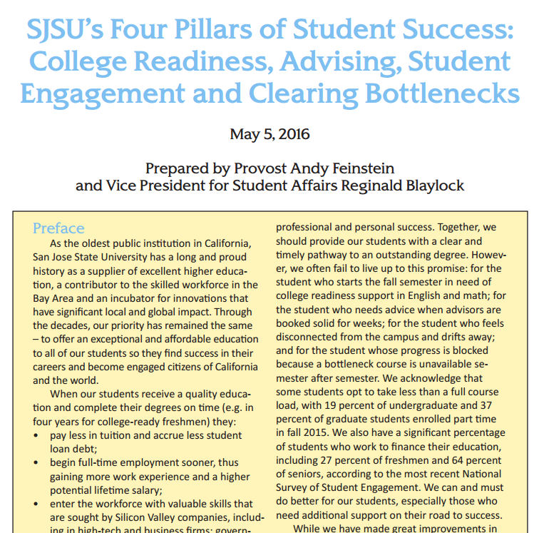

Four Pillars of Student Success
Academic Affairs and Student Affairs are partners in student success
Notes:
PROVOST FEINSTEIN SETS THE CONTEXT FOR THE AAD BUDGET PLAN: STUDENT SUCCESS
SJSU’s guiding document – have you heard of it?

Slide 4
SJSU Graduation 2025 Initiative Goals
Group | Original Goals | Projection for Current Cohorts | Revised Goals
Frosh 4-yr | 17% | 12% | 35%
Frosh 6-yr | 57% | 61% | 71%
Transfer 2-yr | 27% | 21% | 36%
Transfer 4-yr | 73% | 72% | 80%
Pell Gap | 5 points | 1 point | 0 points
URM Gap | 6 points | 11 points | 0 points
Notes:
The CSU Graduation 2025 Initiative guides resource discussions at the system and state level
Focus is now on four-year graduation rates: see California Promise

Slide 5
California Promise (SB 412)
“A more concerted, statewide effort to create pathways to four-year graduation is needed at the California State University”
8 campuses for Frosh, 20 campuses for Transfers
Students must complete at least 30 units per year and maintain GPA standard
Campus provides: priority registration, academic advisement and progress monitoring
Notes:
By 2017-18, CSU will identify 8 campuses to participate in the California Promise at the Frosh level, and 15 at the transfer level. Another 5 will be added for transfers by 2018-19. The CA Promise sunsets in 2026.

Slide 6
Four Pillars Support: $5.3M
Clearing Bottlenecks (enrollment $$) $2,795K
20 new staff advisors $1,153K
  Advisor/student ratio from 1:1,848 to 1:860
Student Data Warehouse (Koret Grant) $600K
Admission to Graduation Initiative $356K
Writing Support $217K
  Writing Fellows and additional sections for international students
Dream Center Establishment ($300K total) $150K
  Support Center for undocumented students
Notes:
Support for the Four Pillars totals $5.3M in 2016-17 through a combination of enrollment funds, university allocations, and the Koret grant.
Funds for course bottlenecks would support up to 500 additional sections. About 350 identified so far.
A-G Initiative seeks to streamline processes around student success. 2016-17 funding supports admissions evaluators, graduation application evaluator, streamlining the transfer credit posting process, and SmartPlanner (multi-year course planning tool with integrated degree audit).
Dream Center is a joint effort with Student Affairs – very successful example at CSU Northridge

Slide 7
Distribution of Bottleneck Funds
College | Funded Sections | Allocation
Applied Sciences & Arts | 29 | $ 145,216
Lucas College of Business | 33 | 188,660
Lurie College of Education | - | -
Davidson College of Engineering | 71 | 276,341
Humanities & the Arts | 68 | 364,181
Science | 61 | 308,256
Social Sciences | 91 | 500,429
Total Allocated to Colleges | 353 | $1,783,083

Slide 8
Tenure Density
More than 125 new tenure-track faculty hired in past two years; 64 more recruitments underway
Reaching 60% requires hiring 75 faculty per year for the next 7 years
Notes:
Seven years isn’t fast enough to support student success. We need to prioritize resources for this area.

Slide 9
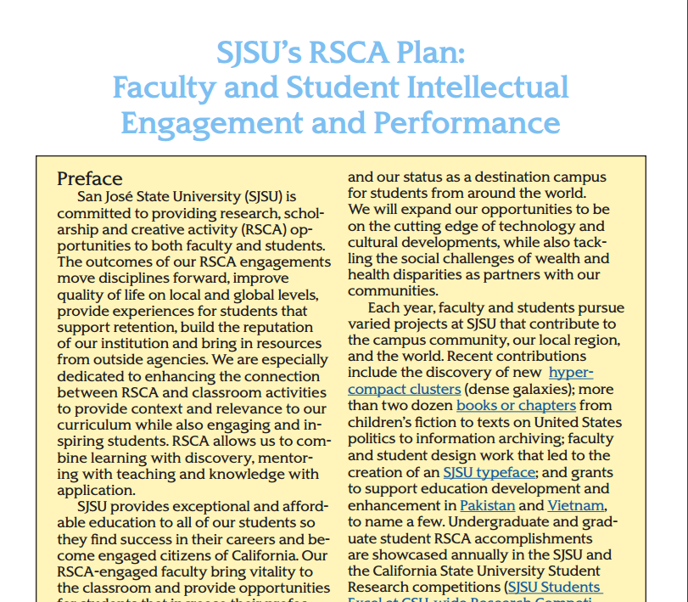
RSCA and Professional Development
Goal is to maintain steady funding
$584K from division carry forward added to other RSCA funds to make a $1M pool
$100K pool for staff professional development

Slide 10
Other Division Priorities: $609K
Classroom Improvements $400K
Workflow Automation (“paperless”) $134K
  Faculty Onboarding
  Academic Scheduling
SOTES System Replacement $75K

Slide 11
Campus IT Projects: $600K
Imaging System Replacement $350K
Web Portal $250K

Slide 12
Summary of Fund Sources
(All one-time funds)
Enrollment Funding (bottlenecks) $2,795K
University Allocations 2,092K
Academic Affairs Carry Forward 1,677K
Koret Foundation Gift 600K
Total $7,164K

Slide 13
Enrollment Funding - $7.6M
 | Resident | Non-resident | Total | New Funding
2015-16 Target (Base) | 22,001 | 2,400 | 24,401 | --
Target Increase (Base) | 410 | 250 | 660 | $3,366,000
Goal FTES (One-time)* | 1,075 | 275 | 1,350 | $4,197,500
2016-17 Enrollment Goals & New Funding | 23,486 | 2,925 | 26,411 | $7,563,500
*Includes the $2.795M for clearing course bottlenecks
Notes:
The budget model continues, and the division received $7.6M for enrollment. Note that the $4.2M for Goal (surplus) FTES includes the funds for bottlenecks

Slide 14
Enrollment Funding Distribution
College FTES Allocations per Budget Model | $4.1M
Clearing Bottlenecks (353 additional sections) | $1.8M
Reserve for Bottlenecks/Enrollment | $1.0M
College Staffing/OE&E/Course Support | $0.5M
Academic Support Units Staffing/OE&E | $0.2M
Total | $7.6M
Notes:
All but $200k went to the colleges, or is earmarked for the colleges

Slide 15
Headcount Majors by College
College | 2016-17 | 2015-16 | Change
Applied Sciences & Arts | 5,093 | 4,877 | 216
Lucas College of Business | 4,860 | 4,917 | -57
Lurie College of Education | 1,833 | 1,686 | 147
Davidson College of Engineering | 7,167 | 7,096 | 71
Humanities & the Arts | 3,634 | 3,599 | 35
Science | 2,652 | 2,551 | 101
Social Sciences | 4,650 | 4,355 | 295
Undeclared | 1,794 | 2,107 | -314
Total | 31,680 | 31,186 | 495
Notes:
The enrollment plan keeps headcount majors essentially constant. The distribution of majors is guided by college capacities, which are coordinated with the deans.

Slide 16
College FTES Distribution
College Resource Allocations memo, page 5, and ICLM Explained
Notes:
ICLM was again used to predict FTES enrollment across the colleges.

Slide 17
Budget Model
College Enrollment Funding is Based on FTES Type & Residency
Marginal Cost of Instruction (MCI) Rates
Applied Sciences & Arts | $3,657
Lucas College of Business | $3,366
Lurie College of Education | $3,489
Davidson College of Engineering | $3,527
Humanities & the Arts | $3,157
Science | $3,325
Social Sciences | $2,710
Residency | Target FTES Rate | Surplus FTES Rate
Resident | MCI | $2,600
Non-resident | MCI | MCI
College Resource Allocations, Appendix
Notes:
The budget model funds FTES based on residency and whether they are Target or Surplus FTES. There is an appendix in the College Resource Allocations memo that explains the AAD budget model.

Slide 18
Net Budget Impact of FTES Changes
Notes:
The budget impacts don’t necessarily make sense on the surface. For example, Science had a net decrease of 2 FTES, but they lost more in surplus FTES, which are funded at a lower rate. The breakdown of Target and Surplus FTES and associated budget adjustments is detailed in Attachment 2 to the College Resource Allocation Memo.

Slide 19
No Limits Enrollment Plan
In effect for two years (2016-17 and 2017-18)
No change in headcount students
No college FTES caps
Clear bottlenecks (more sections)
Undergraduate average unit load (AUL) should increase
  Goal: move AUL from 12.4 to 13.1
Notes:
We have an innovative enrollment plan this year. The enrollment plan is key to meeting our student success goals, especially the AUL increase.

Slide 20
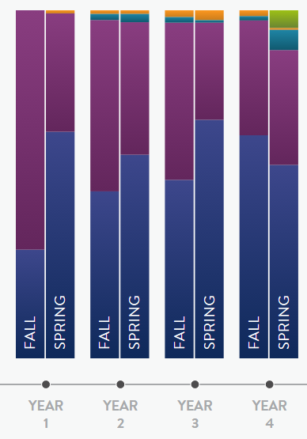
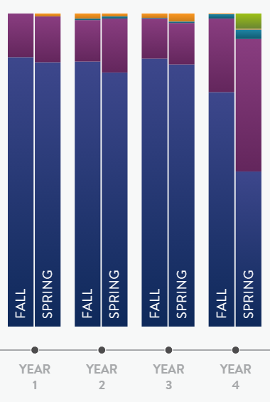
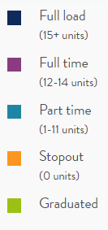
4-Yr Graduation Rates & Unit Loads
SJSU – 9.1%
Monterey Bay – 21.4%
2009 cohorts
Notes:
AUL is a major area of focus and is the strongest indicator of changes in 4-year graduation rates

Slide 21
AUL Results at Fall Census
Notes:
Improved, but we did not meet 13.1 goal in fall

Slide 22
AUL by Class Level
Group | Fall 2015 | Fall 2016
New Frosh | 13.1 | 13.6
New Transfers | 11.3 | 11.8
Continuing Undergrads | 12.6 | 12.8
All Undergrads | 12.4 | 12.7
The greatest opportunity for change is with entering students. Undergraduate AUL should rise steadily over the next four years as a result of our efforts.

Slide 23


Base Operating Fund Budget Changes
SJSU Washington Square
15% Increase over 2015-16 ($18.6M)
Other Adjustments includes organizational changes (addition of ITS, removal of EOP) and funding for the Educational Doctorate program. See the 2016-17 AAD Budget Plan for details.
Notes:
Snapshot of budget changes. Compensation adjustments and organizational changes account for 13% of the year-over-year increase. Enrollment growth was just over 2%.

Slide 24
For more information:
Marna Genes, AVP-Academic Budgets & Planning
www.sjsu.edu/provost/budget
Links:
Annual Budget Plans
Annual College Resource Allocations memos
ICLM Explained

Slide 25


