Slide 1
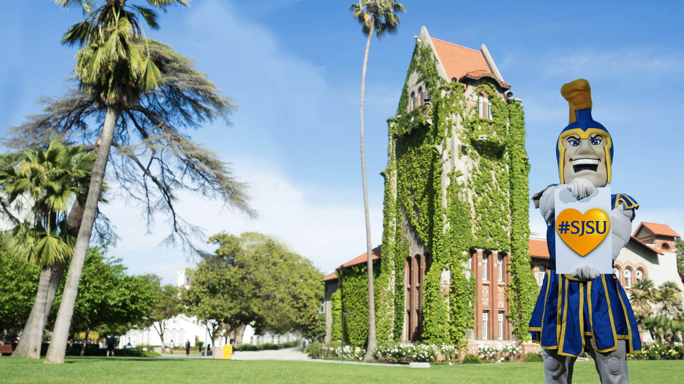


Accreditation Review Committee
September 30, 2024
Accreditation @ SJSU

Slide 2

Towards WSCUC Special Visit 2025: Updates and Planned Series of Actions
September 30, 2024
An Institutional Accreditation Update
presented to Members and Guests of the Academic Senate
Accreditation @ SJSU

Slide 3

Discussion Agenda
Accreditation
ARC
WSCUC Timelines and Calendar
Recommendations
Discussion, Q&A
Close

Slide 4

WSCUC &
Institutional Accreditation

Slide 5
Accreditation: A Typical Cycle
Periodic (every 6-10 years) evaluation, reflection, and goal-setting process
Institutional Self-Study Report: Self-assessment of our performance on standards (criteria) submitted
Onsite visit by an external peer review team. Review team provides a report with commendations and recommendations
Commission letter stating WSCUC’s decision on duration of reaffirmation of accreditation, commendations and recommendation
Interim Special Visit may be required if WSCUC wants to track progress in specific areas

Slide 6
How does this benefit SJSU?
Opportunity for university-wide assessment and reflection: How are we doing in our mission to enrich the lives of our students, to transmit knowledge to our students along with the necessary skills for applying it in the service of our society, and to expand the base of knowledge through research and scholarship?
Provides a structured peer review—external peer assessment
Benchmarks our work against external standards and best practices
Identifies and recognizes areas where we excel
Identifies areas where we need to continue to develop and creates recommendations for future action

Slide 7
Accreditation Review Committee
Accreditation @ SJSU

Slide 8

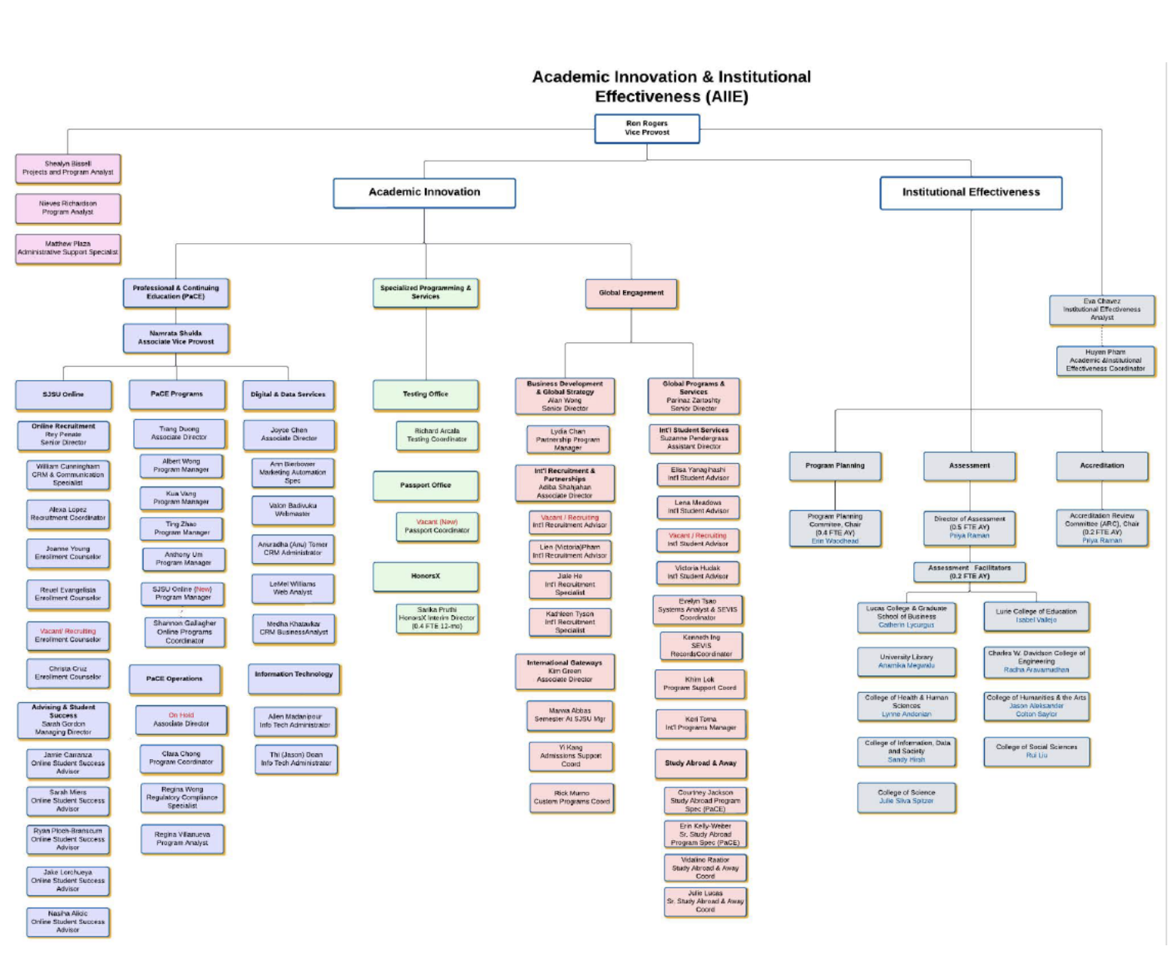
Academic Innovation and Institutional Effectiveness - Meet the Team!

Slide 9
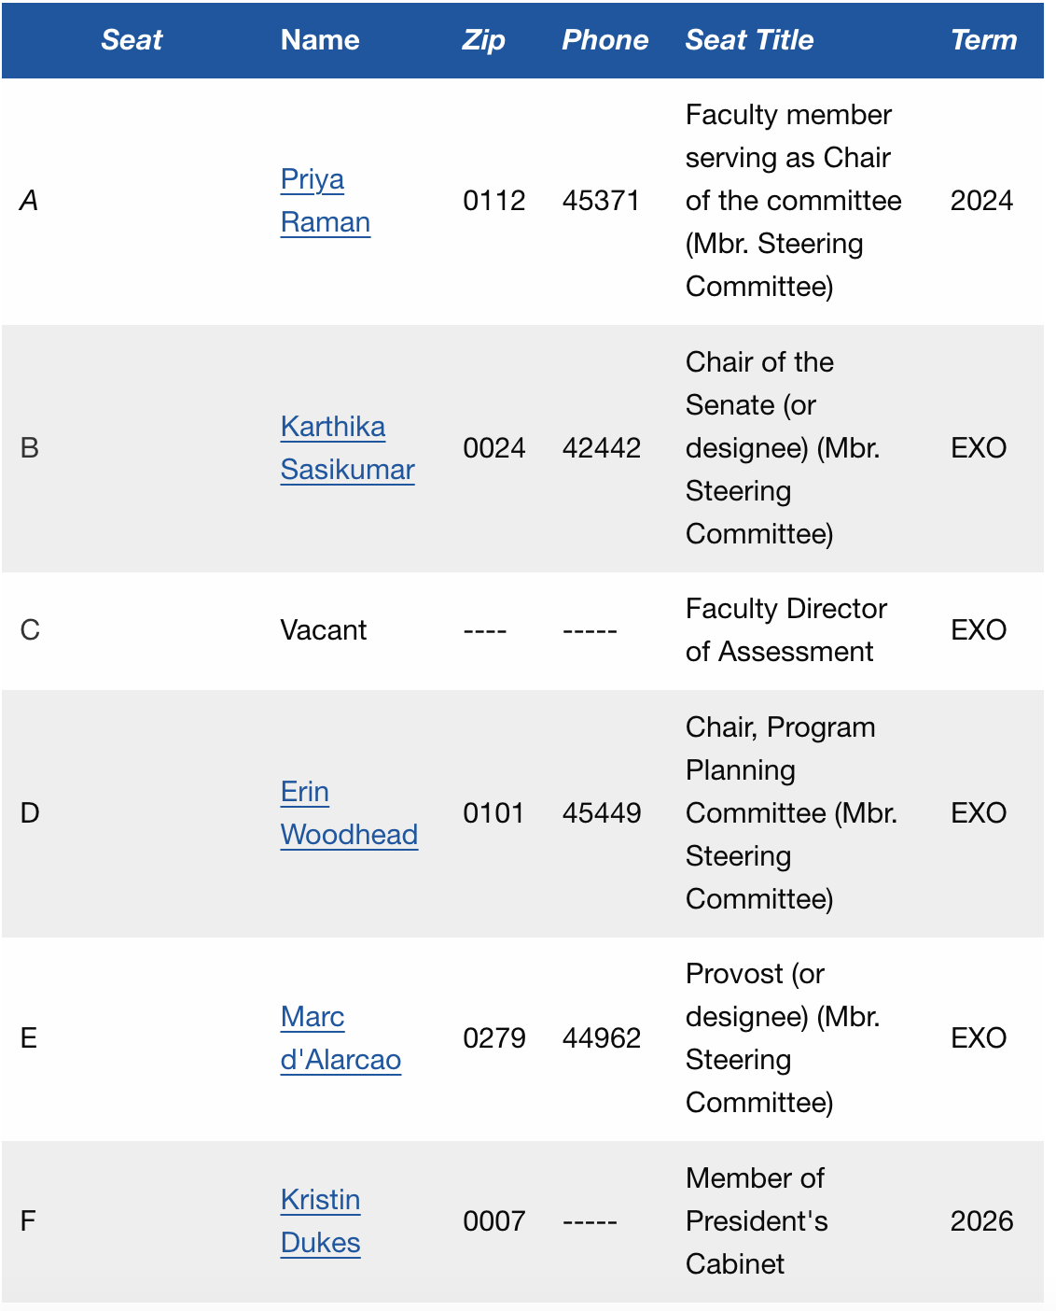
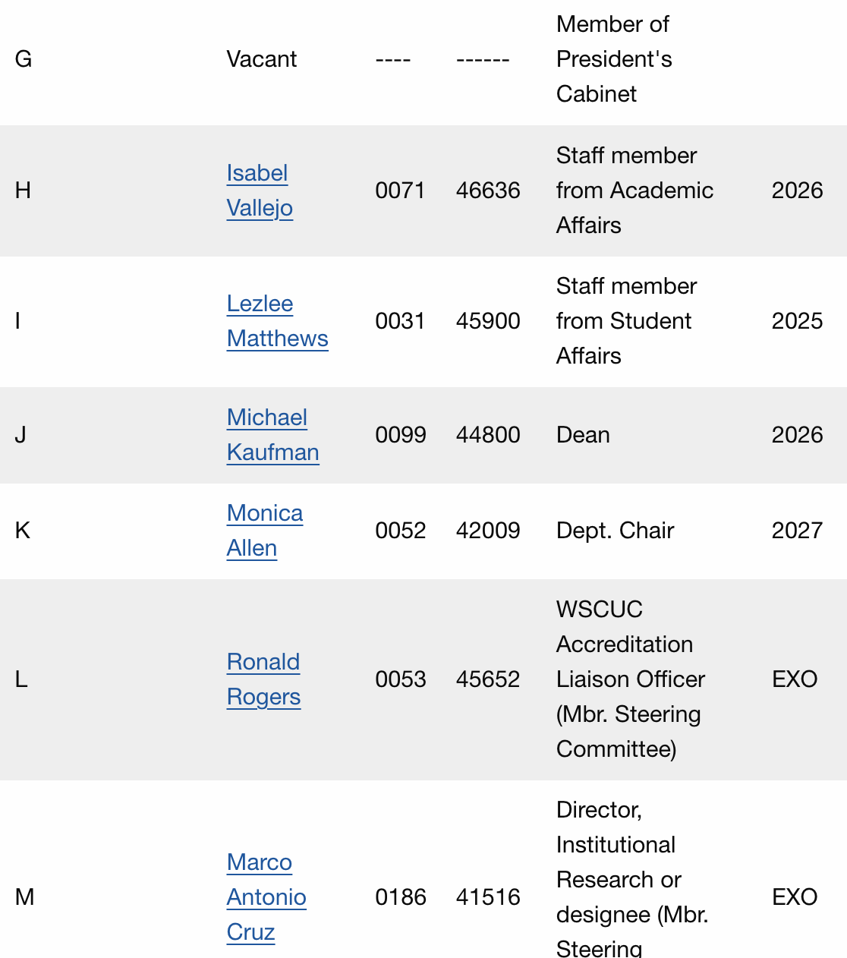
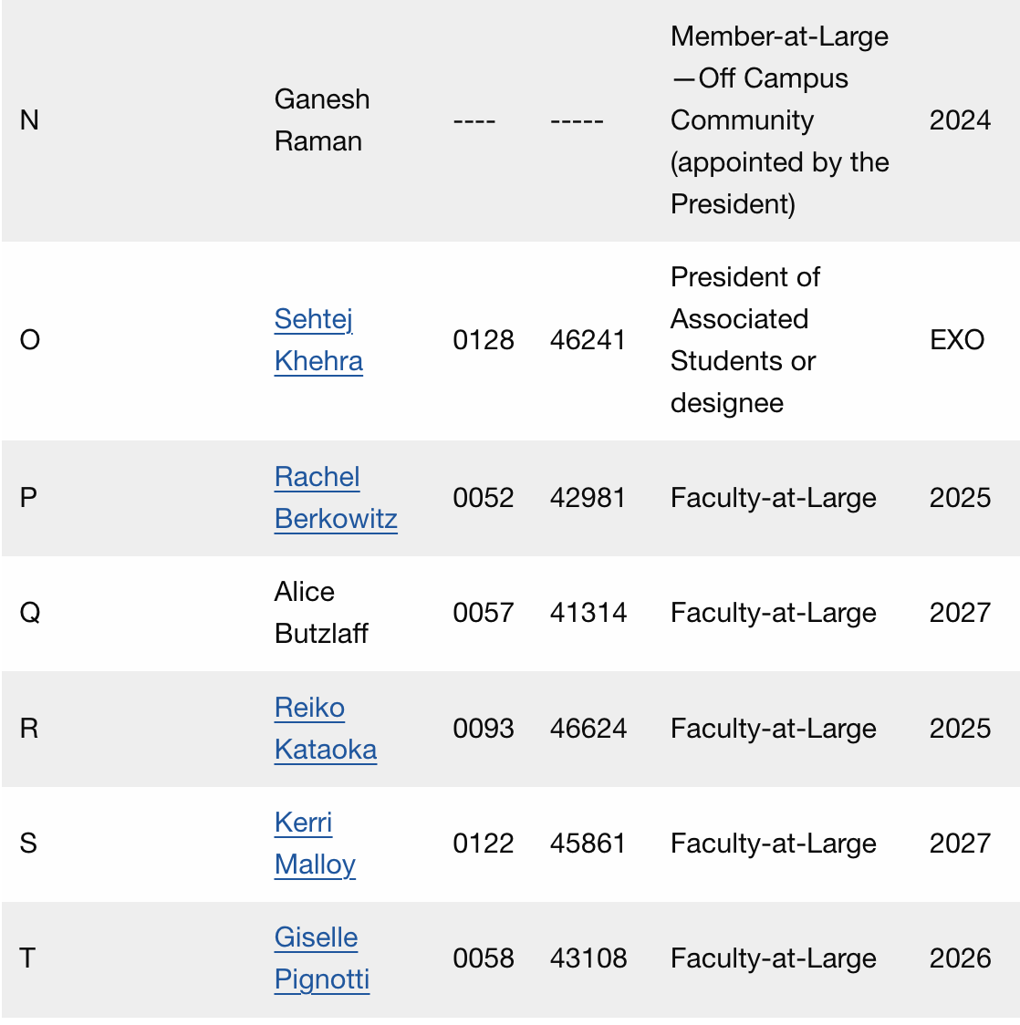
Accreditation Review Committee - Roster

Slide 10
ARC Charge
Summarize the feedback received from WSCUC and make it widely available.
Engaging diverse voices in the reflection and analysis of information collected and reported to the Western Senior College and University Commission (WSCUC).
Developing a campus preparation and implementation plan that responds to the directions given to the campus in the previous WSCUC Commission letters and WSCUC accreditation review reports.

Slide 11
ARC Charge
Communicating to all campus constituents’ information regarding accreditation activities and priorities.
Generating institutional reports and materials needed to meet WSCUC requirements.
Overseeing campus preparations to meet the requirements of WSCUC Special Visit.

Slide 12

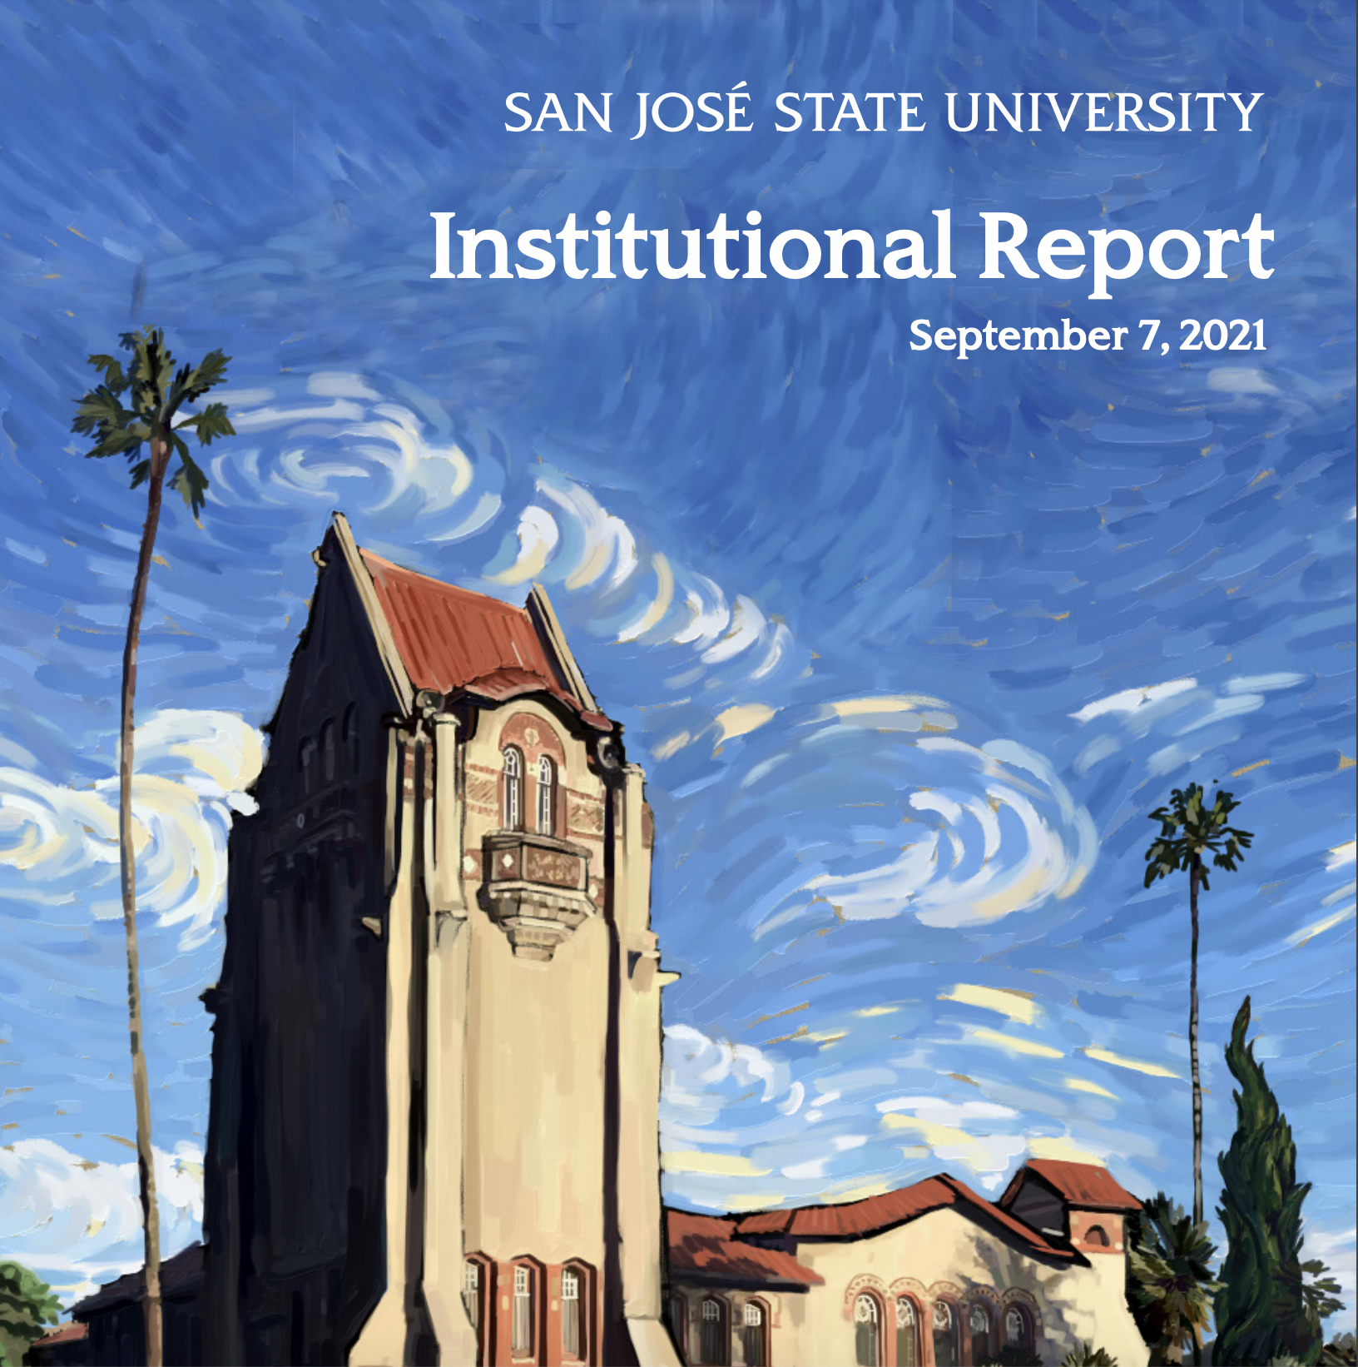
Preparing for Special Visit 2025
For more background information, please review the Institutional Accreditation site.

Slide 13
WSCUC @SJSU Timeline
WSCUC Onsite Visit
Five member review team meets with various campus representatives and completes a report based on their findings.
Interim Report Due to WSCUC
Report details how the university has responded to the 9 issues identified by the Commission.
July 2022
Spring 2025
April 2022
Fall 2024
WSCUC Action Letter
WSCUC reaffirms accreditation and requires a special visit in 2025 to respond to 9 issues identified in the letter.
Onsite Special Visit
A sub-committee of the members of the 2022 review team return to campus to assess our progress.

Slide 14
WSCUC @SJSU Dates
Interim Report Due to WSCUC - Jan 29
Report details how the university has responded to the 9 issues identified by the Commission.
Evidence + Drafting + Setting paths + Draft Report
Spring 2024
Spring 2025
Fall 2023
Fall 2024
Onsite Special Visit - April 9, 10, 11
A sub-committee of the members of the 2022 review team return to campus to assess our progress.
Sharing + Consensus Building + Feedback

Slide 15
Recommendations #1 & #2
Engage in a comprehensive assessment of campus climate and develop measurable goals for positive change.
Improve shared governance to ensure consultation is inclusive of all stakeholders including faculty, staff, administration, and students.

Slide 16
Recommendations #3 & #4
Recruit and retain a chief executive officer to provide effective leadership and promote and ensure stability.
The CSU Board of Trustees must exercise appropriate engagement with San Jose State University over institutional integrity, policies, stability of leadership, and accreditation.

Slide 17
Recommendations #5 & #6
Integrate DEI and underrepresented student success initiatives across the campus to promote equitable student outcomes.
Narrow equity gaps in achievement between URM/non-URM and Pell eligible/non-Pell eligible students.

Slide 18
Recommendation #7
Integrate learning outcomes into a more strategic and inclusive planning process with leadership at all levels, faculty, staff, administration, curriculum committees, and assessment coordinators.

Slide 19
Recommendation #8
Assess the ability of institutional research to effect positive change across the institution and focus institutional research efforts to sustainably support student academic success throughout the institution.

Slide 20
Recommendation #9
San Jose State in partnership with CSU System leadership shall conduct a critical review of the Moss Landing Consortium to include:
  developing and implementing long-range strategic plans outlining the support strategy for the Consortium and clarifying the role and expected outcomes of SJSU’s participation
  developing and implementing improvements in the meaning, quality, and integrity of degrees and in student support services

Slide 21
How can you contribute to the Special Visit?

Slide 22


Slide 23
Thank you for your time!
Any follow-up questions?
Please contact me at priya.raman@sjsu.edu if you have any follow up questions or topics that were not answered, or covered today.

Slide 24
Additional Material

Slide 25
Accreditation Resources
SJSU Institutional Report 2021-2022 (September 7, 2021)
WSCUC Accreditation Visit (AV) Team Report (April 5-8, 2022)
SJSU Letter to WSCUC Commission (June 8, 2022)
WSCUC Accreditation Visit (AV) Commision Action Letter (July 7, 2022)
SJSU President’s Blog RE the Decision Letter from the WSCUC Accreditation Reaffirmation of Accreditation (June 13, 2022)
Assessment Excerpts from the 2021-2022 Reaffirmation of Accreditation Process

Slide 26
Equity, Evidence, Effectiveness
Huddle Questions and Checklists - can be modified to include diverse audiences, stakeholders, contexts, and actions.

Slide 27
New Standards
For the Spring 2025 Special Visit, WSCUC will be using the new 2023 Standards; a crosswalk has been provided to us
Updated Team Report and Template, and the updated Institutional Report Guide
2013 to 2023 Standards Crosswalk/Comparison

Slide 28
Special Visit Report Structure

Slide 29
Response to issues identified by the commission and the last visiting team
A full description of the issue
The action(s) taken by the institution
A self-reflective analysis of the effectiveness of the action(s), and
The next step(s). It is important that this section of the report include not only a description of the responses undertaken by the institution, but equally important, an assessment of the impact of these changes.
    Have they been successful in resolving the issue? What is the evidence supporting progress? What further concerns or issues remain? How will such issues be addressed, by whom, and under what timetable?

Slide 30
Identification of other changes or
issues the institution is facing
Any other significant issues or changes that are likely to occur at the institution e.g., changes in
  key personnel
  major new programs
  modifications in the governance structure
  or significant financial results that are not described or identified in the preceding section.
This information will help the team gain a clearer picture of the current status of the institution and understand the context in which the responses discussed earlier have taken place

Slide 31
Review Team Report Structure (part)

Slide 32
From the Review Team Report Checklist:
Was the report well organized and clearly written and presented?
Did the report accurately portray the condition of the institution?
What was the extent of institutional involvement in the review and report preparation?
If issues of teaching and learning were addressed, how were faculty included in the discussion and in the action steps taken?
Did the institution address each of the identified issues as a rigorous inquiry with searching questions, appropriate methodology, and effective use of evidence?
How effective was the institution’s analysis of the evidence?
How well did the institution’s conclusions align with the evidence?
How did the institution evaluate its own action steps and how effective did they prove to be?

