Slide 1

2016/17 Annual Budget Report
Charlie Faas
VP Administration & Finance/CFO

Slide 2
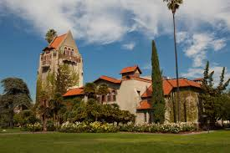
Leadership Priorities
Collaborative
Transparent Process
Four Pillars of Student Success
Looking ahead:
Multi-Year Budgeting

Slide 3
Multi-Year Budgeting
Projecting permanent & temporary funds
Impacts of One-Time v. Ongoing Expenses
Forecasting Assumptions:
Uncertainty over permanent state funding
Tuition Fees (Board of Trustees)
Enrollment growth
CSU/Campus Programs & Priorities

Slide 4
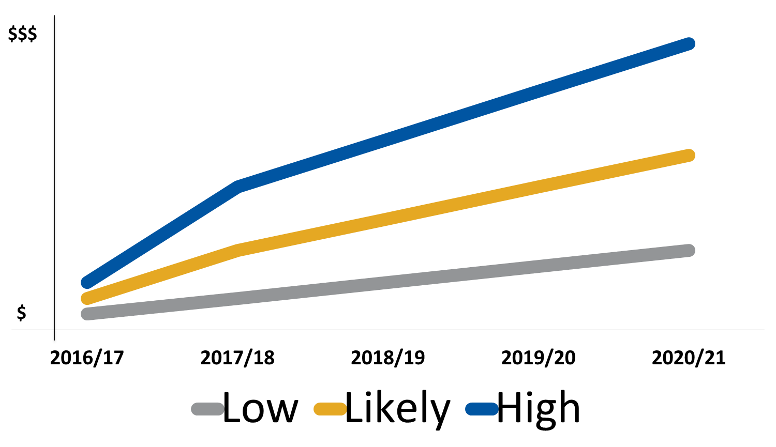
Multi-Year Budgeting

Slide 5
2016/17 Funding Highlights
Four Pillars of Student Success - $3.4M
Facilities & Deferred Maintenance - $2.1 M
Campus Security Improvements - $2.3M
Notes:
Four Pillars of Student Success Includes:
Student Success Advising & Writing
A-G Project Support
Dream Center
International Student Support
Eastside Promise
Peer Mentoring
Student Resource Center Buildout
Facilities & DM Includes:
South Campus Stadium Turf
Engineering Building DM
DMH HVAC
Morris Dailey Ceiling & Seating
Business Tower Roof
Campus-wide Elevator Maintenance & Modernization
Campus Security Includes:
Campus Emergency Broadcast System
External Video Surveilance
Police Retention
Up to 6 New Officers

Slide 6
Operating Fund
$334M
Athletics
$28M
Housing
$45M
Parking
$6M
Extended Ed.
$34M
Associated Students
$8M
Spartan Shops
$25M
Research Foundation
$59M
Tower Foundation
$32M
Student Union
$11M
Student Health
$13M
SSETF
$19M
Revenue Budgets
Notes:
Re-order bubbles (auxiliaries grouped)

Slide 7
Not All Money is Green
Appropriated Sources
General Fund
Enrollment $ per FTE
Compensation
Employer Benefits Costs
Retirement Adjustments
Health Rate Changes
Campus Deferred Maintenance
CSU Capital/Deferred Maintenance
Lottery
Special Initiatives
Collected Sources
Student Fees
Tuition
Mandatory Fees
Self-Support Program Fees
Fees-For-Service
Federal Financial Aid
Reimbursements
Revenue Generating Activities
Auxiliary Organizations
Green: Operating Budget
Purple: Generally Restricted
Red: Restricted Funding

Slide 8

Operating Fund - $334 Million
FY 16/17 Budget
Revenue Sources
State General Fund Appropriation
Student Fees
Functions
Primary Support for Instructional Mission
Highlights / Accomplishments
Student Success Initiatives
Compensation Programs

Slide 9
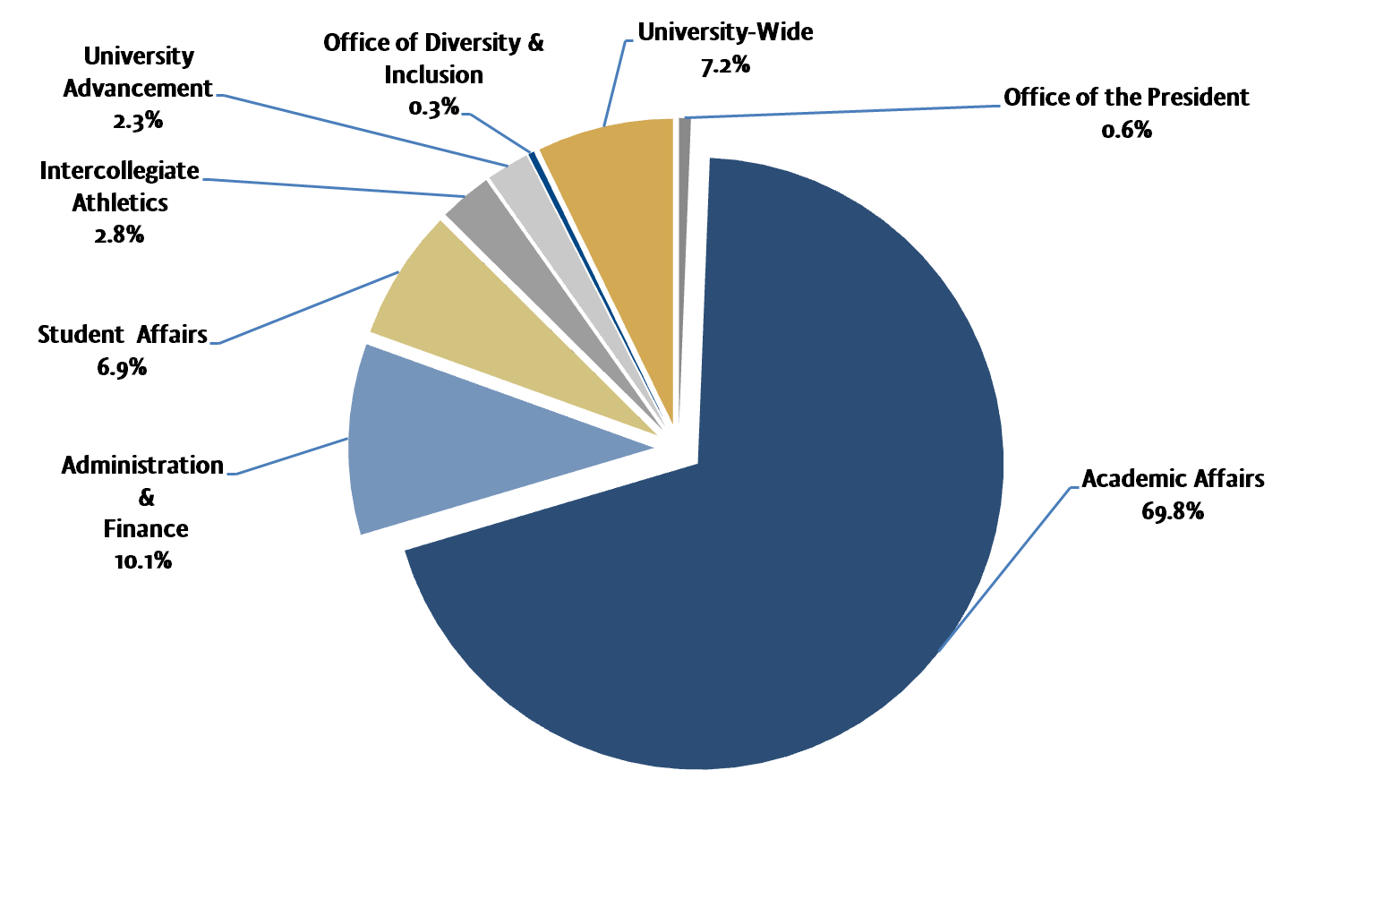
Operating Fund Expenditures
FY16/17 Budget
Notes:
Budget variance primarily reflects three changes:
ITS move from A&F to AAD
7% Faculty Compensation Increase
More allocations have gone out at this time from Uwide than last year.
ADD FY15/16 % Amounts Below:
President: 0.6
Diversity: 0.4
Athletics: 2.8
DSA: 6%
AAD: 64%
A&F
Uwide

Slide 10
Breakdown of Op. Fund Expenses
FY16/17 Budget
Notes:
Re-Color OE+E & or extract sliver

Slide 11
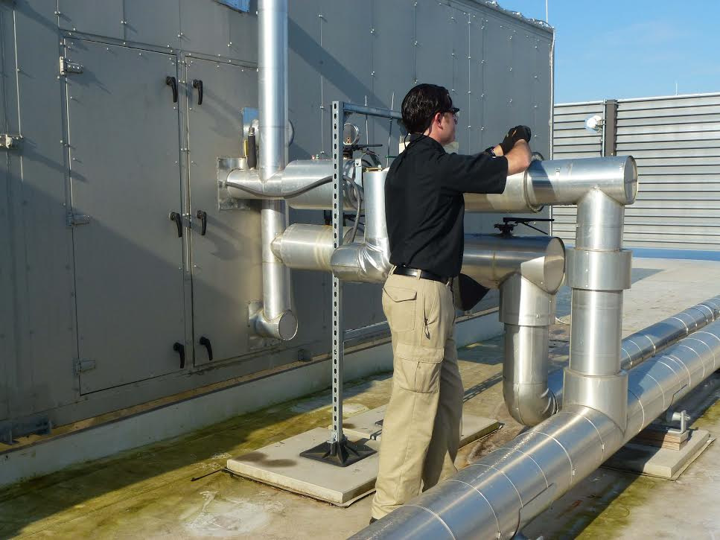
Capital Projects & Deferred Maintenance
CSU Funded Infrastructure - $1.6M
Utilities Infrastructure
State Funded Deferred Maintenance - $2.1M
Campus-wide Elevator Modernization
Campus Deferred Maintenance - $2.1M
Engineering Bldg, Biz Tower Roof, South Campus, etc.
Major Capital Projects
Student Recreation & Aquatic Center -$130M
Interdisciplinary Science Building - $85M
DMH

Slide 12
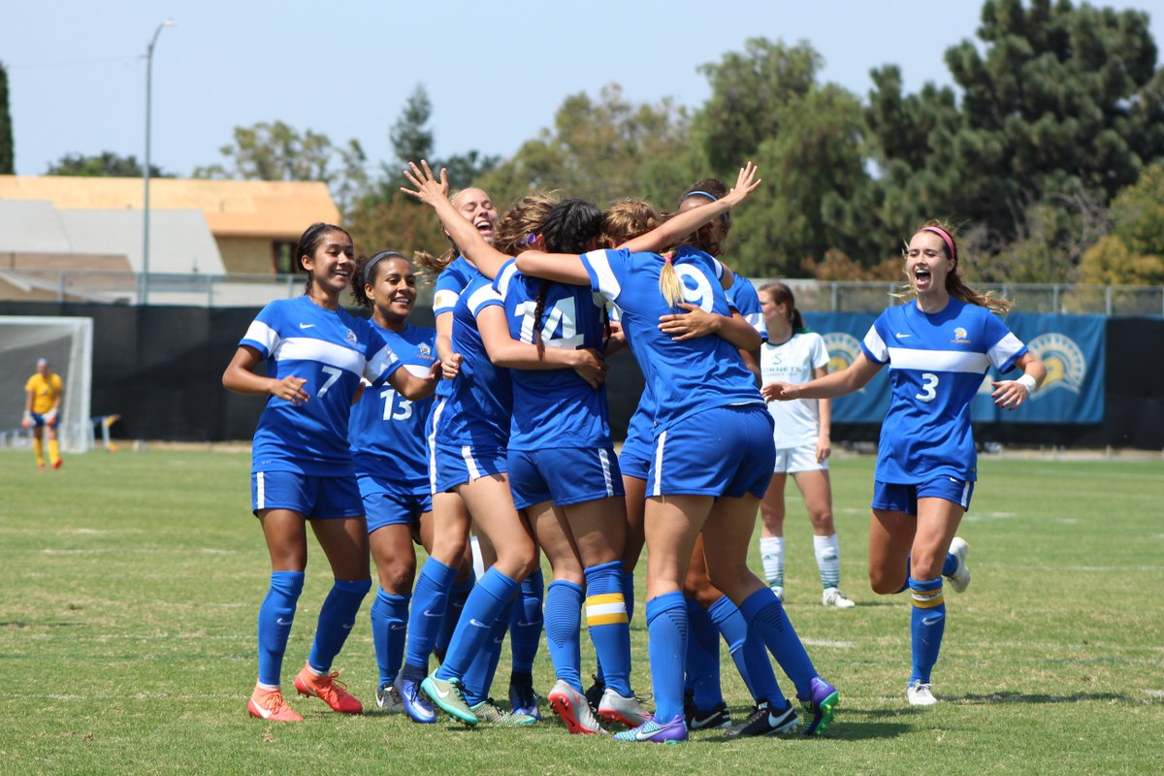
Athletics Operations
$28 million FY16/17 Budget
Revenue Sources
Operating Funds, SSETF-IRA, Ticket sales, conference distribution, game guarantees, NCAA distribution and development
Functions
Supports operating and travel costs for all sports
Grants in Aid for student-athletes
Highlights / accomplishments
Build Golf practice facility on South Campus
Establish on the University’s tradition of academic & Athletic excellence
Recruit and retain top athletes by providing financial incentives through scholarship
Notes:
28 M and highlight all 3 funds for total operations.

Slide 13
Athletics Budget Overview
 | 2014/15 |  |  | 2015/16
 | Budget | Actual | Variance | Budget | Actual | Variance
Operating Fund | $ 7,001 | $ 7,375 | $ (374) | $ 8,093 | $ 8,091 | $ 2
SSETF - IRA | 7,673 | 7,673 | - | 8,325 | 8,322 | 3
Self Suppt. | 7,607 | 7,607 | - | 8,903 | 8,903 | -
TOTAL | $ 22,281 | $ 22,655 | $ (374) | $ 25,321 | $ 25,316 | $ 5

Slide 14
SJSU Athletics Spending
 | San Jose State | San Diego State | Fresno State | Colorado State | Nevada-Las Vegas
FY 2014/15 Total Expenses/FTE | $ 1,127 | $ 1,794 | $ 2,103 | $ 1,009 | $ 1,948
FY 2014/15 Total Expenses | $28,479,255 | $53,607,909 | $41,535,096 | $38,781,340 | $44,935,234
FY 2014/15 full time equivalent (FTE) enrollment | 25,270 | 29,877 | 19,746 | 38,440 | 23,064
Footnote:
The above data is from -
http://sports.usatoday.com/ncaa/finances/
https://nces.ed.gov/ipeds/datacenter/login.aspx
Notes:
Move to back of front

Slide 15

For more information, visit:
http://www.sjsu.edu/finance/about_us/budget/budget_reports/
http://www.sjsu.edu/adminfinance/about/budget_central/
http://www.sjsu.opengov.com

Slide 16
BACKUP & SUPPORTING DOCUMENTATION

Slide 17
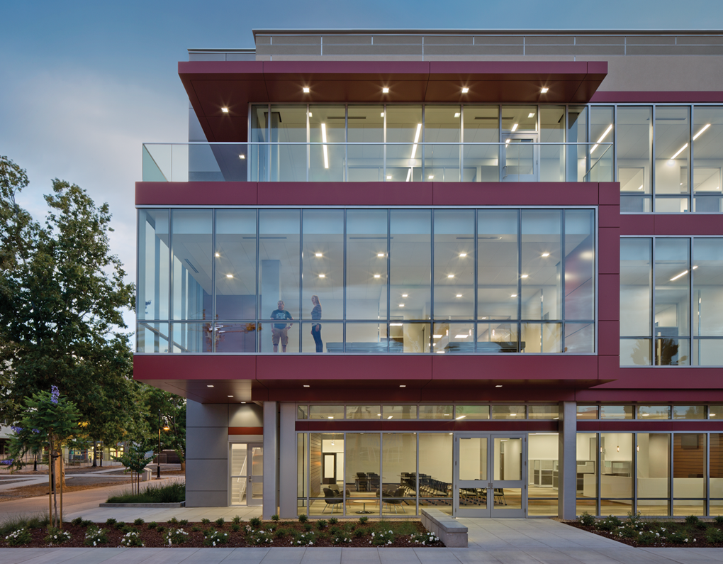
Student Health $13.5 million FY16/17 Budget
Revenue Sources
Student Health & Health Facility Fees
Functions
Used to support student health & mental health services
Health Facility development/debt service
Highlights / Accomplishments
Student Health & Wellness Center
Increased Counseling & Preventative Health support

Slide 18
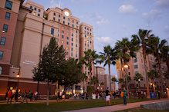
University Housing Services $45 million FY16/17 Budget
Revenue Sources
Housing Rent and Fees
Other Lodging and Conference Fees
Functions
Used to support housing operations & programs
Highlights / Accomplishments
4,000 residents
Campus Village II
Living Learning Communities w/Faculty-in-Residence

Slide 19
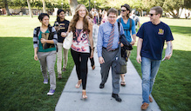
Continuing and Extended Ed
$34 million FY16/17 Budget
Revenue Sources:
Tuition and fees from for-credit & noncredit programs
Functions
Extended ed. operations and program/curriculum development
Highlights / Accomplishments
New Programs: Master of Social Work, Masters in Speech Pathology, Advanced Certificate in Big Data Analytics, among others.
New CIES space in the Student Union - Summer, 2017
Partnership with College of Science to build out part of new Interdisciplinary Science Building

Slide 20
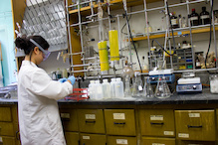
Research Foundation $59 million FY16/17 Budget
Revenue Source – federal and state grants and contracts, fees, investment income, and other revenues
Functions
Most funding tied to grants or specific programs
Highlights / Accomplishments
The Research Foundation also provides employment support to more than 1,800 individuals, including faculty, students, research affiliates, and staff.

Slide 21
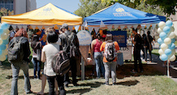
Associated Students $8 million FY16/17 Budget
Revenue Source – Fees, program revenues, grants and contracts
Fee changes must be approved by student referendum
Functions
Student fees support AS programs
Student Leadership
Child Care Center
Campus Life
Transportation
Highlights / Accomplishments
A.S. has moved into the new Student Union
Print & Technology Center now in Student Union

Slide 22
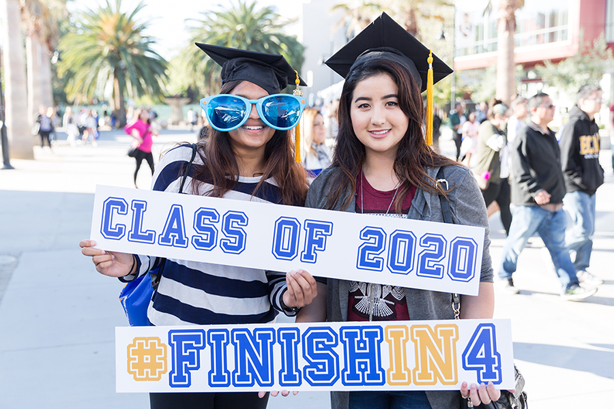
SSETF $19 million FY16/17 Budget
Revenue Source – SSETF Fees
Expenditures reviewed by CFAC & Approved by President
Functions
Instructionally Related Activities
Course Support
Student Success
Highlights / Accomplishments
Spartan Scholars Program
SASS Programs (Task Forces)
Academic Technology Improvements

Slide 23
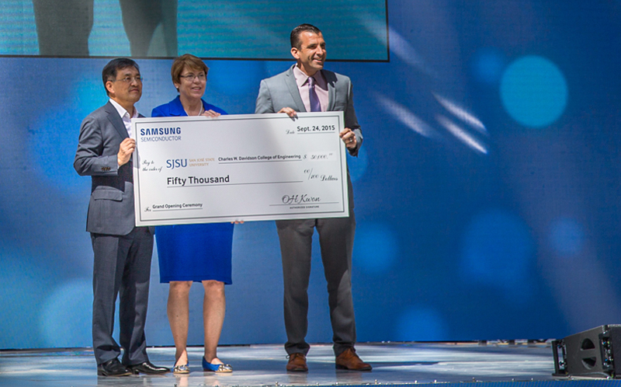
Tower Foundation
$32 million FY16/17 Budget
Revenue Source – Gifts, pledges, investment income
Functions
As a 501(c)(3) auxiliary organization, Tower Foundation directly manages all financial aspects of funds donated to San Jose State University
Tower Foundation Board approves the annual endowment distribution rate (3% for FY16/17)
Highlights / Accomplishments
$125 million endowment (620+ individual funds)
In 2015-16, $7+ million in new principal added to endowment
$45 million raised in 2015/16

Slide 24
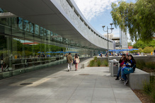
Student Union
$11 million FY16/17 Budget
Revenue Source – Mandatory Student Union Fee
Functions
Supports Student Union Operations
Capital Construction (SU Expansion & New SRAC)
Highlights / Accomplishments
Student Union Renovation & Expansion Grand Opening
Ground Breaking on Student Recreation & Aquatic Center
Student Union Spaces booked for entire year

Slide 25
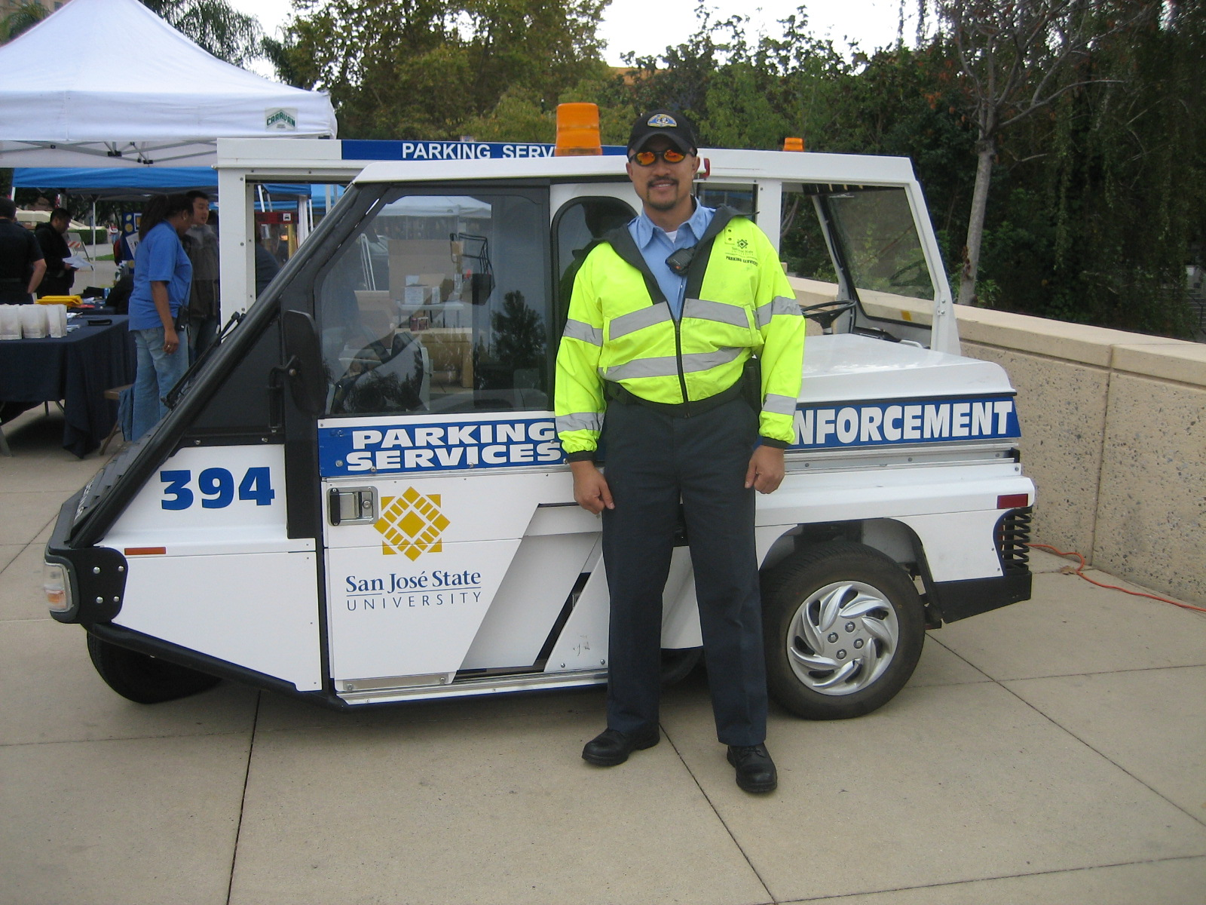
Parking Funds
$6 million FY16/17 Budget
Revenue sources
Parking permit sales and parking citation fines
Functions
Parking operations and enforcement costs
Maintenance and repair to existing facilities
Alternative transportation program
Highlights / Accomplishments
Parking permits available online
Provide Park & ride courtesy shuttle
Plans to update bus fleet

Slide 26
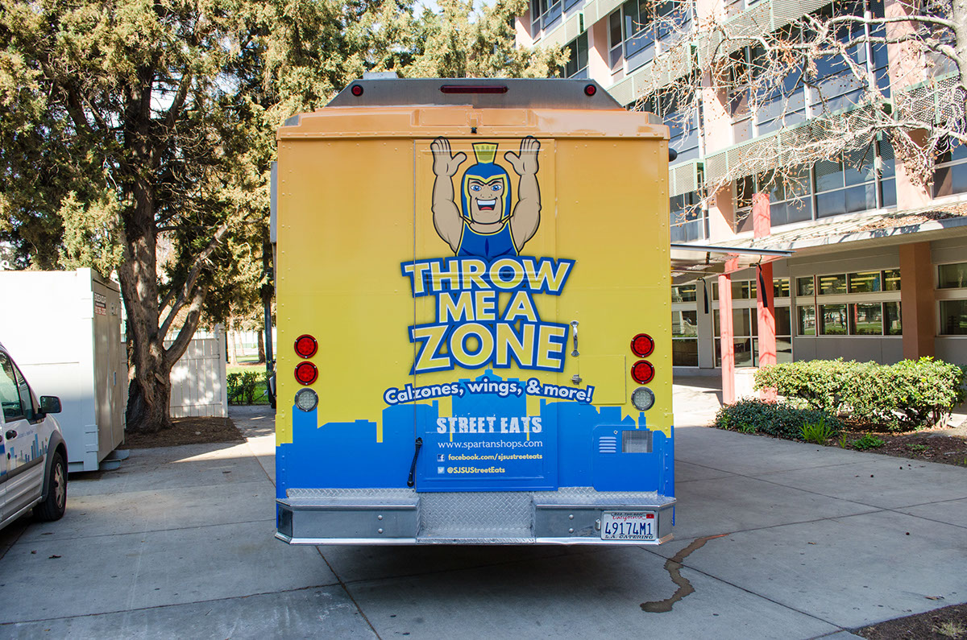
Spartan Shops
$25 million FY16/17 Budget
Revenue Sources
Food & Retail Services
Highlights / accomplishments
Barnes & Noble Bookstore opening November 1
Service agreement with Spartan Athletics
Real Estate Services to SJSU faculty and staff

