Slide 1
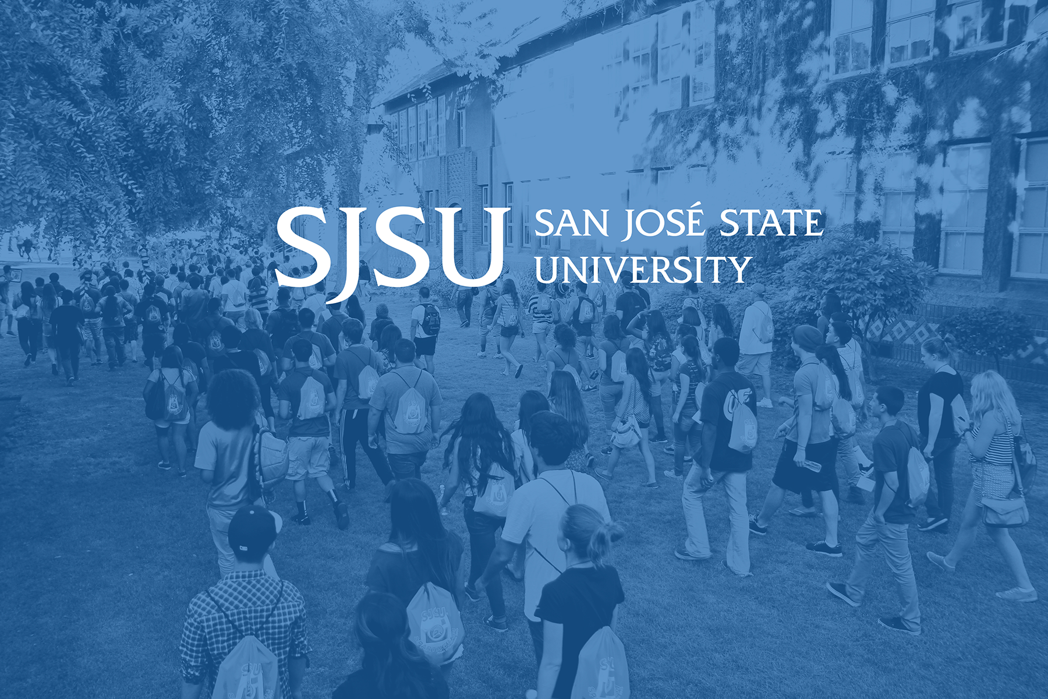
Campus Climate Survey Results
Academic Senate – April 4, 2016
Institutional Effectiveness and Analytics

Slide 2
Survey Background
The 2015 questionnaires were developed by the President’s Commission on Diversity (PCD)
Some revisions over the 2010 version
Attempted to balance between having comparable data points over time and responding to current campus needs

Slide 3
Campus Climate Survey Contents
 | Students | Faculty | Staff | MPP
General climate at SJSU
Immediate work climate
Success of diversity initiatives
Harassment/discrimination
Classroom/out-of-classroom experience
Perceptions of open communication
Participation in diversity activities
Diversity sensitivity
Job satisfaction & career issues
Governance issues
Demographics

Slide 4
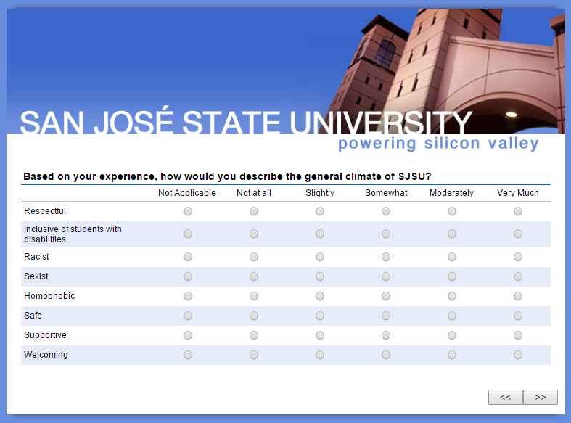
SJSU Washington Square
Campus Climate Methods
  All current students, faculty, staff, and administrators were invited via e-mail to complete the survey online in March and April 2015. Responses were anonymous, but those who provided their contact information were eligible to win a gift card for their participation. Results are unweighted.
 | Estimated Population Size | Unique E-mail Addresses | Usable Responses Received | Estimated Participation Rate
Students | 32,532 | 33,659 | 5,586 | 17%
Faculty (incl. temporary) | 2,016 | 2,320 | 493 | 24%
Staff & administrators (incl. student asst.) | 3,449 | 5,329 | 783 | 23%

Slide 5
Respondent Profile: Students
Gender
55% Female, 44% Male, 1% Genderqueer, Transman/Transwoman, Intersex, Other
Age
Average age was 24. About 25% were younger than 20 years of age
Disability
6% indicated having a disability
Ethnicity
Asians (41%) were the predominant ethnic group, followed by White (24%), Latino (19%), Two or more races (7%), African American (3%), Middle Eastern (2%), Pacific Islander (1%) and others (4%). The predominant Asian nationalities were Asian Indian (27%), Chinese (25%), Vietnamese (19%), and Filipina/o (12%)
Notes:
Gender: 4,666 students responded Female 2,527 (55%), Male 2,036 (44%)
>1%: Genderqueer 24, Other 17, Transman 8, Transwoman 6, Intersex 3
Age: 4,669 students responded Minimum <20 (1143, 25%); Maximum >50 (113, 2%); Average (Wghtd) 24 years of age
Ethnicity: 4,690 students responded
Disabled: 4,717 students responded Not disabled 4,438 (94%), Disabled 279 (6%)

Slide 6
Respondent Profile: Employees
Gender
63% Female, 35% Male, 2% were Genderqueer, Transman, Intersex and Other
Age
Average age was 47. 20% were over the age of 60
Disability
9% indicated having a disability
Ethnicity
Most were White (44%), followed by Asians (18%) , and Hispanic/Latino (16%), Two or more races (7%), African American (5%), Pacific Islander (1%), and Other (5%)
Notes:
Race: Total Employees responded 1,063
Gender: Total responses (1,086); Male 381 (35%), Female 684 (63%
<1%: Other (11), Genderqueer (8), Transman (1), Intersex (1)
Disabled: Total Responses (1,096); Disabled (96, 9%), Not-disabled (1,000, 91%)
Age: Total respondents 1,025; Minimum 23 or younger (36, 4%), Maximum 60 or older (205, 20%), Wgnted Average 47 years
Sexual Orientation: Total responses (556); Heterosexual (457, 82%), Gay (23, 4%), Bisexual (21, 4%), Lesbian (19, 3%), Queer (11, 2%), Pansexual (3, <1%), Other (22, 4%)

Slide 7
General Climate: Many Stakeholders Upbeat,
But Room to Improve
SJSU Washington Square
A majority of respondents in each constituent group—students, faculty, staff, and administrators—view the overall campus climate favorably
Most perceived the climate as ‘moderately’ or ‘very much’ respectful (71% of students and 67% of faculty, staff, and administrators)
Only 45% of students and 33% of employees rated the campus as ‘not at all’ racist. The shares believing the campus was not at all sexist were slightly higher (52% of students and 33% of employees).
African Americans were more likely to perceive the climate as more racist.
LGBT students were more likely than their heterosexual peers to view the university climate as homophobic
Among those who identified as disabled 23% of disabled students and almost a third of disabled employees rated the SJSU climate as ‘not at all’ or only ‘slightly’ inclusive of the disabled

Slide 8
Student ratings of the general campus climate

Slide 9
SJSU Washington Square
Employee ratings of the general campus climate

Slide 10
SJSU Washington Square
Student reports of discrimination or harassment by type and source
Who committed the act of discrimination or harassment?
Type of
discrimination
reported

Slide 11
SJSU Washington Square
Many Students Experience Discrimination
Just over half of student respondents indicated one or more episodes of discrimination or harassment on campus (unchanged from 2010)
Race, gender, and political views were the most commonly cited forms
African Americans experienced more race-based harassment than other groups and women were much more likely to report gender discrimination
Most often, other students are the source of discrimination
Students in 2015 were less likely to feel that SJSU staff were sensitive to issues of sexism, racism, and homophobism than in 2010

Slide 12
SJSU Washington Square
Faculty and Staff Report Many Instances, Too
Gender, age, and ethnic discrimination are the most commonly cited forms of discrimination or harassment among employees
In-group discrimination was the most prevalent for faculty, staff, and administrators
The most prevalent discrimination instances by type of discrimination and source include:
    Faculty: Gender (by other faculty and by administrators)
    Administrators: Gender & Age* (both by fellow administrators)
    Staff: Race (by other staff) & Age* (by administrators)
* Age discrimination was prevalent in both younger and older employees

Slide 13
Both Students and Employees Worry About Open Communication, Voicing Unpopular Opinions
Part of the university community feels marginalized due to few venues for free, civil discussions and even overtly hostile encounters that discourage open exchange of ideas
This can include sensitive issues like past hate crimes, race, and the airing of other problems on campus
In general, as compared to students, employees are much more critical of the university not being successful at facilitating differences of opinions
Since 2010, the perception has grown that there is racial tension on campus

Slide 14
SJSU Washington Square
Students and Employees Seek Deeper Interaction, More Events
Students living both on and off campus expressed interest in having more activities—including many ideas about clubs—as well as better notifications about upcoming events, including via e-mail and Canvas
Faculty and staff described similar concerns about lack of community and a wish for more social events
African Americans were less likely to believe that SJSU was building a sense of community, but black employees reported higher job satisfaction

Slide 15
SJSU Washington Square
Students Increasingly Concerned About Safety
More than 300 written comments referred to matters of physical safety on campus, with women and minorities more likely to have fears
The percentage expressing fear rose substantially from 2010 to 2015
Females and nontraditional gender students were more likely than men to express concerns about safety
Asian students were also significantly more likely than either whites or Latina/os to express concerns about safety

Slide 16
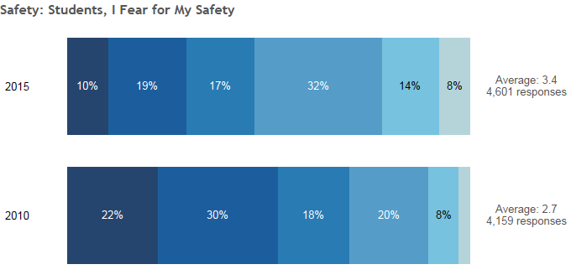
SJSU Washington Square
Student ratings on whether
they fear for their safety on campus

Slide 17
SJSU Washington Square
Faculty Morale Low, Staff Seek Recognition
Faculty had concerns about decision-making, sharing of information, and opportunities for research and professional development, while staff and administrators sought more mentoring and recognition
Both faculty and administrator overall job satisfaction declined from 2010 to 2015, and compensation was cited often by faculty and staff
African American employees reported having greater satisfaction with their level of autonomy and overall job satisfaction, and rated their professional relationship with coworkers higher.

Slide 18
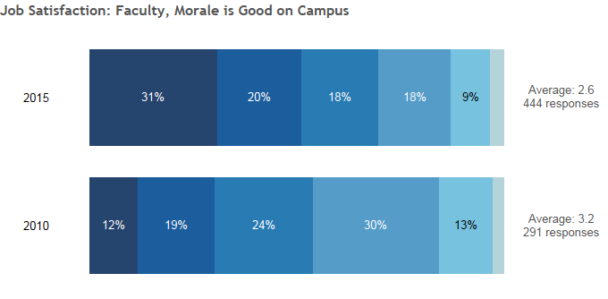
SJSU Washington Square
Faculty ratings on whether
they believe faculty morale is good

Slide 19
SJSU Washington Square
Dissatisfaction with Campus Leadership
Satisfaction with campus leadership dropped precipitously from 2010 to 2015 among faculty, staff, and administrators
The largest decrease among administrators and the smallest among staff.
Many respondents perceived a lack of transparency, disconnected decision-making, and a decline of shared governance

Slide 20
Overview of Qualitative Responses
SJSU Washington Square

Slide 21
SJSU Washington Square
Further Steps
Continued presentations and custom data releases to campus constituencies (e.g. Student Affairs, Academic Affairs)
Partial release of summary data in online interactive format for open access to the campus community

Slide 22

Discussion

