Slide 1
Faculty Recruitment
Annual Report to the Senate
from the Office of Faculty Affairs
April 2016

Slide 2
Challenges we face
Number 1 reason offers are declined: cost of housing in the Bay Area
Our salaries are competitive, but not in the context of cost of living
Facilities
Prop 209 restrictions

Slide 3
Proposition 209
“The state shall not discriminate against, or grant preferential treatment to, any individual or group on the basis of race, sex, color, ethnicity, or national origin in the operation of public employment, public education, or public contracting.”

Slide 4
Diversity Master Plan
http://www.sjsu.edu/diversity/research/
Broaden applicant pools by advertising and outreach
Faculty in Residence for Diversifying the Faculty
Travel funds for recruitment activity
Training for search committees

Slide 5
Where we advertised this year
Blacks in Higher Education
CalJobs/Employment Development Dept
Chronicle of Higher Education
Diverse Education
Higher Ed Jobs
Hispanics in Higher Education
Insight into Diversity
LGBT in Higher Education
Northern California Higher Education Recruitment Consortium (HERC)
SJSU Faculty Affairs website
Veterans in Higher Education
Women in Higher Education

Slide 6
Faculty in Residence
2014-2016: Carlos Garcia (Sociology)
2016-2017: Magdalena Barrera (Mexican American Studies)
Rebeca Burciaga (Educational Leadership)

Slide 7
Most recent recruitment cycles includes librarians
 | # of searches | # of TT hires | # of Tenured hires | Total hires
2012-2013 (start fall 2013) | 26 | 28 | 2 | 30
2013-2014 (start fall 2014) | 39 | 26 | 5 | 31
2014-2015 (start fall 2015) | 66 | 58 | 0 | 58
2015-2016 (start fall 2016) | 72 | 46 to date | 0 to date | tbd

Slide 8
Offset by losses (resignations)
 | Assistants | Associates | Fulls | Total
2012-2013 | 7 | 1 | 2 | 10
2013-2014 | 3 | 4 | 3 | 10
2014-2015 | 9 | 3 | 3 | 15

Slide 9
Resignations against hires
 | Total gains | Total losses
2012-2013 (start fall 2013) | 30 | 10
2013-2014 (start fall 2014) | 31 | 10
2014-2015 (start fall 2015) | 58 | 15

Slide 10
2014-15 Resignations by demographic categories
Category | Number
Male | 7
Female | 8
African American | 1
Asian | 4
Hispanic | 0
White | 8
Not specified | 2

Slide 11
Focus on Recent Hires (Tenured/Tenure Track)
FA data
 | Male | Female
New Hires Fall 2015 (n=58) | 41.4% (24) | 58.6% (34)
White | Minority | UNK
62.1% (36) | 22.4% (13) | 15.5% (9)

Slide 12
Focus on 3 Years Recent Hires
(Tenured/Tenure Track)FA data
 | Male | Female
New Hires Fall 2013, Fall 2014, Fall 2015 (n=115) | 47% (54) | 53% (61)
White | Minority | UNK
52.2% (60) | 30.4% (35) | 17.4% (20)

Slide 13
Internationalizing the Faculty:
14 out of the 58 new hires
Country of birth | Number
Canada | 3
China | 4
Iran | 1
Russia | 2
Serbia | 1
South Korea | 2
Turkey | 1

Slide 14
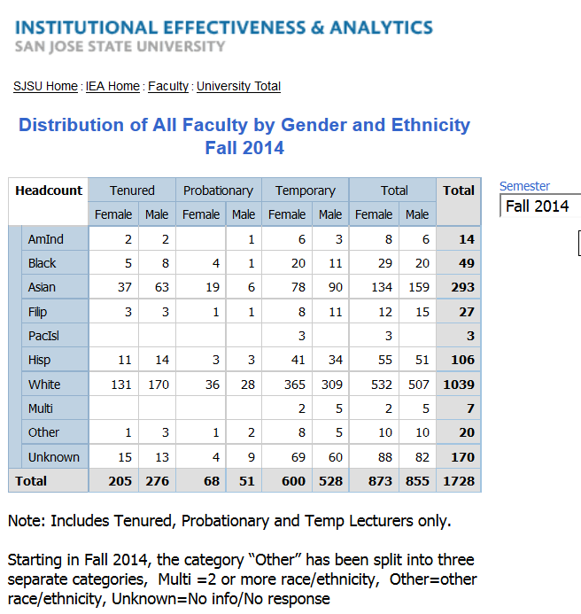
Difficulties with reporting data

Slide 15
Difficulties with reporting data
Not included:
Librarians
Counselors
Sabbaticals/DIPs
Leaves of absence
1.0 Chairs

Slide 16
Difficulties with reporting data
Not included: | Fall 2014
Librarians | 18
Counselors | 12
Sabbaticals/DIPs | 41
Leaves of absence | 7
1.0 Chairs | 7
 | 85

Slide 17
Current statistics using FA data
[All tenure-line faculty including librarians & counselors, Fall 2015]
 | Tenured | Probationary | Total | As % of all TT
AmInd | 4 | 1 | 5 | 0.8
Asian | 118 | 36 | 154 | 24.2
Black | 12 | 6 | 18 | 2.8
Hisp | 26 | 9 | 35 | 5.5
Other/ Unknown | 37 | 24 | 61 | 9.6
White | 280 | 83 | 363 | 57.1
totals | 477 | 159 | 636

Slide 18
Overall Faculty by Gender, Fall 2015
IEA data, tenure/tenure-track
female | 304 | 47.6%
male | 335 | 52.4%

Slide 19
Prepared by OFA using data from IEA

Slide 20
Prepared by OFA using data from IEA

Slide 21
Questions?

