Slide 1
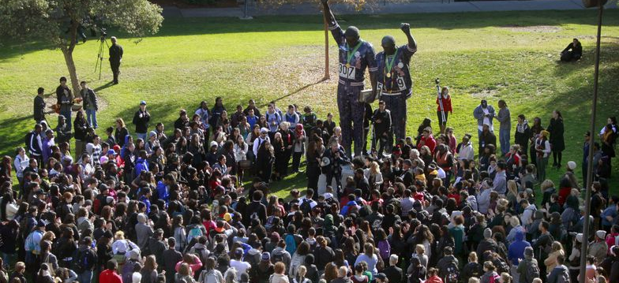
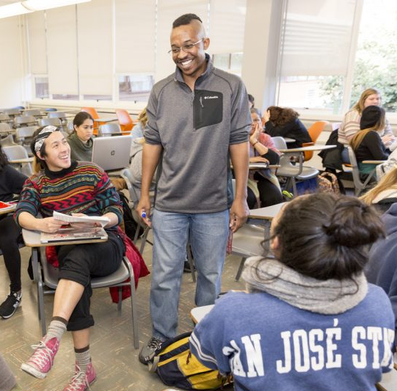
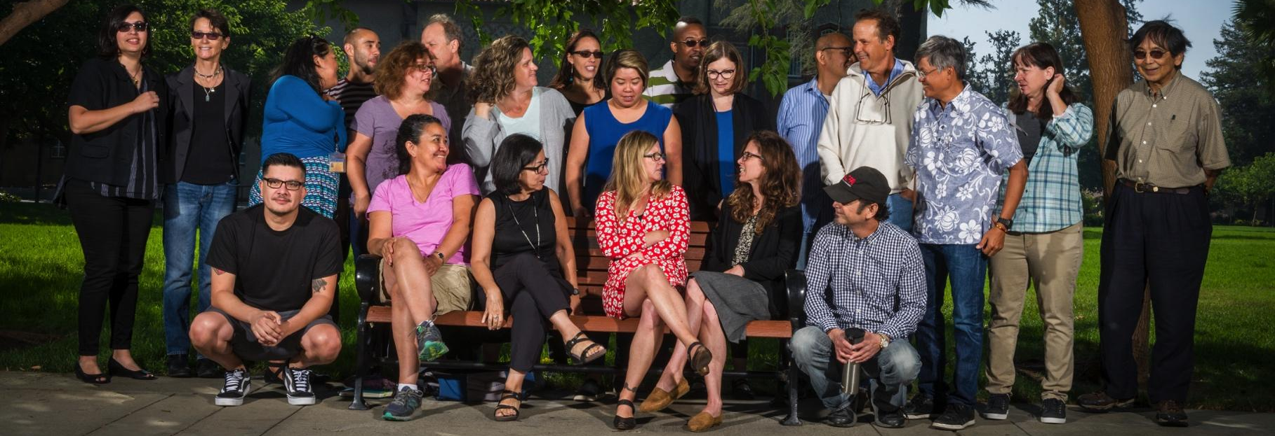
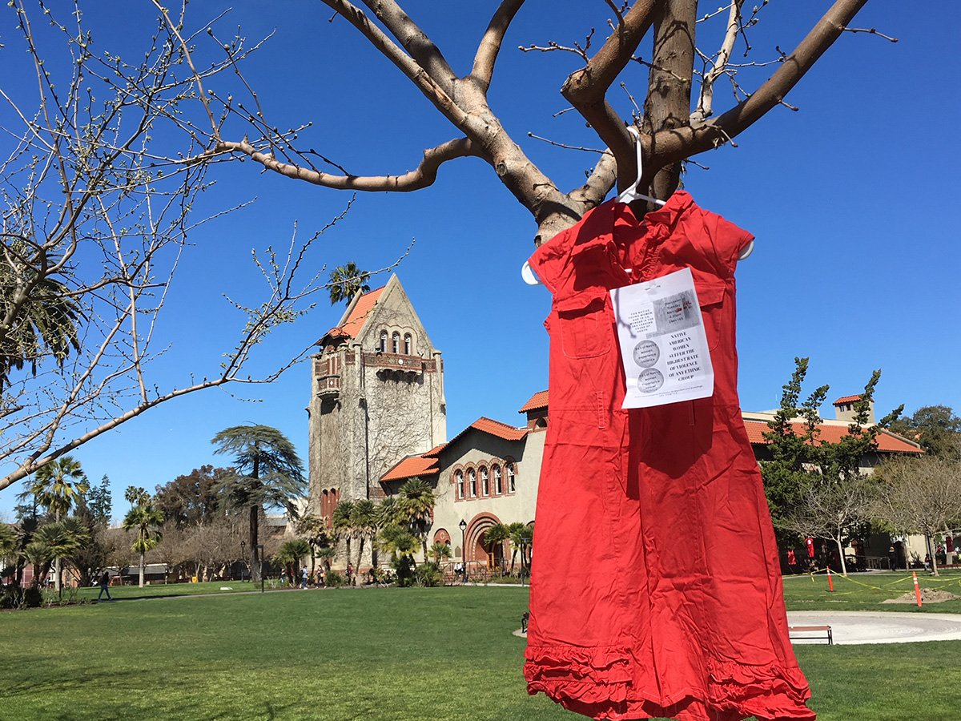
Department of Sociology and Interdisciplinary Social Sciences
Dudley Moorhead Hall
DMH 241
✆ (408) 924-5320
🖂 sociology@sjsu.edu
🖳 sjsu.edu/siss

Slide 2
General Overview of the Major
Sociology Concentrations:
BA, Sociology
BA, Sociology, concentration in Community Change
BA, Sociology, concentration in Social Interaction
BA, Sociology, concentration in Women, Gender and Sexuality Studies
BA, Sociology, concentration in Race and Ethnic Studies
The following Minor Programs are offered by the department:
Asian American Studies
Sociology
Sociology of Education
Women, Gender, and Sexuality Studies

Slide 3
Sociology Graduation Requirements
To graduate with a degree in Sociology, you will need to:
Earn 120 Units
Up to 70 units may be transferred from a community college
40 units must be from upper division classes (numbered 100 or higher)
Complete all University requirements
GE core classes
SJSU Studies (Areas R, S, V, and Z) classes
American Institutions classes
PE classes
Complete all Sociology Major requirements (42 units)
Core Sociology classes (27 units)
Major elective classes (15 units)
Complete all Minor requirements (if applicable)

Slide 4
Sociology Core Sequence
Core Sociology classes: (27 Units)
SOCI 1: Intro (GE: D1)
SOCI 80: Social Problems (GE: D3)
SOCI 15: (GE: B4) or equivalent statistics class
SOCI 116: Global Society
SOCI 100W: Writing Workshop (GE:Z)
Requires completion of the WST or WST Directed self-placement
SOCI 101: Social Theory
Pre- or co-requisite: SOCI 100W
SOCI 104: Quantitative Research Methods
Prerequisites: SOCI 15 or equivalent; SOCI 101
SOCI 105: Qualitative Research Methods
Prerequisite: SOCI 101
SOCI 181B: Senior Capstone, or SOCI 104B: Advanced Quantitative Methods or SOCI 105B: Advanced Qualitative Methods
Prerequisite: Completion of at least one methods class (SOCI 104 or SOCI 105)
Note: You only need to take one of these classes

Slide 5
Sociology Major Electives
All Sociology students must complete 15 units (5 classes) of major electives
The choice of elective classes varies by concentration
General Sociology: Most flexible choices in classes, broad categories.
Concentration in Social Interaction: Focus on micro-sociology (social interaction, socialization, personality and behavior)
Concentration in Community Change: Focus on macro-sociology (communities, organizations, public and community service, changing society)
Concentration in Race and Ethnic Studies: Interdisciplinary course sequence covering Asian American Studies, African American Studies, Chicana/Chicano Studies, and Native American Studies.
Concentration in Women, Gender, and Sexuality Studies: Focuses on how gender and gender identity, race, class, sexuality, and nation shape lives.

Slide 6
Academic Advising
Major Advising: See the SISS Advising Faculty
Minor Advising: See the Intended Department Advisor
GE Advising: See the Academic Counseling Center for Excellence in the Social Sciences (ACCESS Center) located in Clark Hall 240
General Education advising
Help with decisions about changing majors
Academic policy related questions
Peer advising
Academic advice and tips about how to navigate your way around SJSU
Probation and Disqualification
Socsci-access@sjsu.edu (408) 924-5363

Slide 7
SISS Advising Faculty
Designated Undergraduate Sociology Advisors
Dr. Elizabeth Sweet
Dr. Faustina DuCros
Dr. Natalie Boero (on leave Fall 2021)
Other Sociology Advisors
Dr. William Armaline
Dr. Peter Chua
Dr. Carlos E. Garcia
Dr. Scott Myers-Lipton
Dr. Preston Rudy
Dr. Megan Thiele
Asian American Studies Minor Advisors
Dr. Hien Do
Dr. Yvonne Kwan
Dr. Joanne Rondilla
Sociology of Education Minor Advisors
Dr. Peter Chua
Dr. Megan Thiele
Women, Gender, and Sexuality Studies Advisors
Dr. Tanya Bakhru
Dr. Jack Caraves
Notes:
Come early and often!

Slide 8
What Classes Do I Register For?
Four Questions:
What classes did you take at the community college?
Have you taken the Writing Skills Test (WST) Directed Self Placement and placed into SOCI 100W?
What is your concentration?
What classes are available?
Try to take the core courses as soon as possible
If you can’t take core classes take major electives
Classes for minor
University electives

Slide 9
Mode of Instruction: Fall 2021
In Person
Meets on at a set day and time
Note a specific day, time, location are indicated
No online component
Hybrid
Meets on campus on certain days at a set time with an online instruction as well
Note a day and time are indicated but also “TBA” which indicates online component

Slide 10
Mode of Instruction: Fall 2021
ONLINE
Synchronous
Meets online at a set day and time
Notice a day and time are indicated but room is “On Line”
Asynchronous
Completely online
Notice no set meeting day or time
Bichronous
Meets online on some days at a specific time
Note a set day and time for meeting but also “TBA”
“TBA” indicates online component

Slide 11
How to:
Find the classes for your concentration
Search for classes
Change concentrations
Managing waiting lists
Sign up for WST-DSP
Applying for graduation

Slide 12
Questions?
Notes:
People that are okay can leave
People that need registration help can meet with advisor in breakout room for one-on-one
People interested in general registration can info can stick around

Slide 13
Case Study #1
Background Information
Took Introduction to Sociology, Social Problems, and Statistics at Community College
Placed into 100W in the WST Directed Self-Placement
In the WGSS Concentration
Minor in Biology
Wants to take 15 units
What Should/Could the Student Take?
SOCI 100W
SOCI 101
SOCI 116 or Major Elective
Area R,S, or V
Minor Elective (Consult Minor Department)

Slide 14
Case Study #2
Background Information
Took Introduction to Sociology and Statistics at Community College but did not Take Social Problems
Placed into 100W in the WST Directed Self-Placement
In the Social Interaction Concentration
No Minor
Wants to take 12 units
What Should/Could the Student Take?
SOCI 080 (Social Problems)
SOCI 100W
SOCI 101
SOCI 116 or Major Elective or Area R,S, or V

Slide 15
Case Study #3
Background Information
Took Introduction to Sociology, Social Problems, and Statistics at Community College
Did not self place into SOCI 100W OR SOCI 100W classes are full
In the General Concentration
No Minor
Wants to take 15 units
What Should/Could the Student Take?
If self placed into 100A, register for ENGL 100A or LLD 100A
SOCI 116
Major Elective
Major Elective
Major Elective or University Elective

Slide 16
Case Study #4
Background Information
No classes in Major available
What Should/Could the Student Take/Do?
Get on wait lists for Core classes and Major electives
WST Directed Self-Placement – Area R,S,V
Minor classes?
How many University elective units do you need?
Register for University electives
Monitor enrollments

Slide 17
Tips for Being Successful at SJSU
Become familiar with the department website.
The SISS Department office can be reached at sociology@sjsu.edu
Use your sjsu.edu email.
Include your SJSU ID number in your emails.
Become familiar with your MyProgress report.
Don’t know how to address your teacher? Use “Professor.”
Complete the Writing Skills Test (WST) Directed Self Placement as soon as possible.
Complete SOCI 100W and SOCI 101 before the start of your third semester at SJSU.
Complete either SOCI 104 or 105 (ideally both) before the start of your fourth semester at SJSU.
When you create your schedule, take into account that in addition to being at a new university, you will be transitioning from lower division to primarily upper division classes.
The University encourages students to take 15 units per semester to complete their degrees in two years.
If you are disqualified in Sociology, you will have one opportunity for reinstatement. After a second disqualification, you will have to find another major.
It is possible to receive a “D-” in a course in the major and graduate, but your major GPA and your overall SJSU GPA must be 2.0 for graduation.
If your transfer units have not posted by the first day of class email: eval@sjsu.edu.
If you have a question ask a Designated Undergraduate Sociology Advisor.

Slide 18
Department of Sociology and Interdisciplinary Social Sciences
Dudley Moorhead Hall
DMH 241
✆ (408) 924-5320
🖂 sociology@sjsu.edu
🖳 sjsu.edu/siss

