Slide 1
Department of Sociology and Interdisciplinary Social Sciences
Dudley Moorhead Hall
DMH 240B
(408) 924-5320
sociology@sjsu.edu
sjsu.edu/siss

Slide 2
General Overview of the Major
Sociology Concentrations:
  BA, Sociology
  BA, Sociology, concentration in Community Change
  BA, Sociology, concentration in Social Interaction
  BA, Sociology, concentration in Women, Gender and Sexuality Studies
  BA, Sociology, concentration in Race and Ethnic Studies
The following Minor Programs are offered by the department:
  Asian American Studies
  Sociology
  Sociology of Education
  Women, Gender, and Sexuality Studies

Slide 3
Sociology Graduation Requirements
To graduate with a degree in Sociology, you will need to:
  Earn 120 Units
    Up to 70 units may be transferred from a community college
    40 units must be from upper division classes (numbered 100 or higher)
  Complete all University requirements
    GE core classes
    SJSU Studies (Areas R, S, V, and Z) classes
    American Institutions classes
    PE classes
  Complete all Sociology Major requirements (42 units)
    Core Sociology classes (27 units)
    Major elective classes (15 units)
  Complete all Minor requirements (if applicable)

Slide 4
Sociology Core Sequence
Core Sociology classes: (27 Units)
  SOCI 1: Intro (GE: D1)
  SOCI 80: Social Problems (GE: D3)
  SOCI 15: (GE: B4) or equivalent statistics class
  SOCI 116: Global Society
  SOCI 100W: Writing Workshop (GE:Z)
    Requires completion of the Upper-Division Writing Directed Self Placement (formerly know as WST or WST Directed self-placement)
  SOCI 101: Social Theory
    Pre- or co-requisite: SOCI 100W
  SOCI 104: Quantitative Research Methods
    Prerequisites: SOCI 15 or equivalent; SOCI 101
  SOCI 105: Qualitative Research Methods
    Prerequisite: SOCI 101
  SOCI 181B: Senior Capstone, or SOCI 104B: Advanced Quantitative Methods or SOCI 105B: Advanced Qualitative Methods
    Prerequisite: Completion of at least one methods class (SOCI 104 or SOCI 105)
    Note: You only need to take one of these classes

Slide 5
Sociology Major Electives
All Sociology students must complete 15 units (5 classes) of major electives
The choice of elective classes varies by concentration
  General Sociology: Most flexible choices in classes, broad categories.
  Concentration in Social Interaction: Focus on micro-sociology (social interaction, socialization, personality and behavior)
  Concentration in Community Change: Focus on macro-sociology (communities, organizations, public and community service, changing society)
  Concentration in Race and Ethnic Studies: Interdisciplinary course sequence covering Asian American Studies, African American Studies, Chicana/Chicano Studies, and Native American Studies.
  Concentration in Women, Gender, and Sexuality Studies: Focuses on how gender and gender identity, race, class, sexuality, and nation shape lives.

Slide 6
Academic Advising
Major Advising: See the SISS Advising Faculty
Minor Advising: See the Intended Department Advisor
GE Advising: See the Academic Counseling Center for Excellence in the Social Sciences (ACCESS Center) located in Clark Hall 240
  General Education advising
  Help with decisions about changing majors
  Academic policy related questions
  Peer advising
  Academic advice and tips about how to navigate your way around SJSU
  Probation and Disqualification
  Socsci-success@sjsu.edu (408) 924-5363

Slide 7
SISS Advising Faculty
Designated Undergraduate Sociology Advisors
  Dr. Elizabeth Sweet (Summer 2022; Fall 2022)
  Dr. Faustina DuCros (Fall 2022)
Other Sociology Advisors
  Dr. William Armaline
  Dr. Amy August
  Dr. Natalie Boero
  Dr. Soma de Bourbon
  Dr. Scott Myers-Lipton
  Dr. Megan Thiele
  Dr. Yolanda Wiggins
Dr. Carlos E. Garcia
  Email (carlos.e.garcia@sjsu.edu), include several days and times when you are free and student ID number
Asian American Studies Minor Advisors
  Dr. Hien Do
  Dr. Yvonne Kwan
  Dr. Joanne Rondilla
Sociology of Education Minor Advisors
  Dr. Peter Chua
  Dr. Megan Thiele
Women, Gender, and Sexuality Studies Advisors
  Dr. Tanya Bakhru
  Dr. Jack Caraves
Notes:
Come early and often!

Slide 8
What Classes Do I Register For?
Four Questions:
  What classes did you take at the community college?
  Have you completed the Upper-Division Writing Directed Self Placement (formerly known as Writing Skills Test (WST) Directed Self Placement and placed into SOCI 100W)?
  What is your concentration?
  What classes are available?
Try to take the core courses as soon as possible
If you can’t take core classes take major electives
Classes for minor
University electives

Slide 9
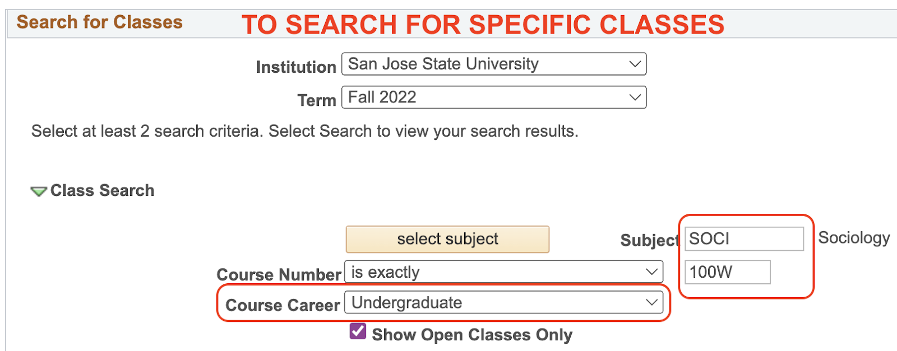

Slide 10
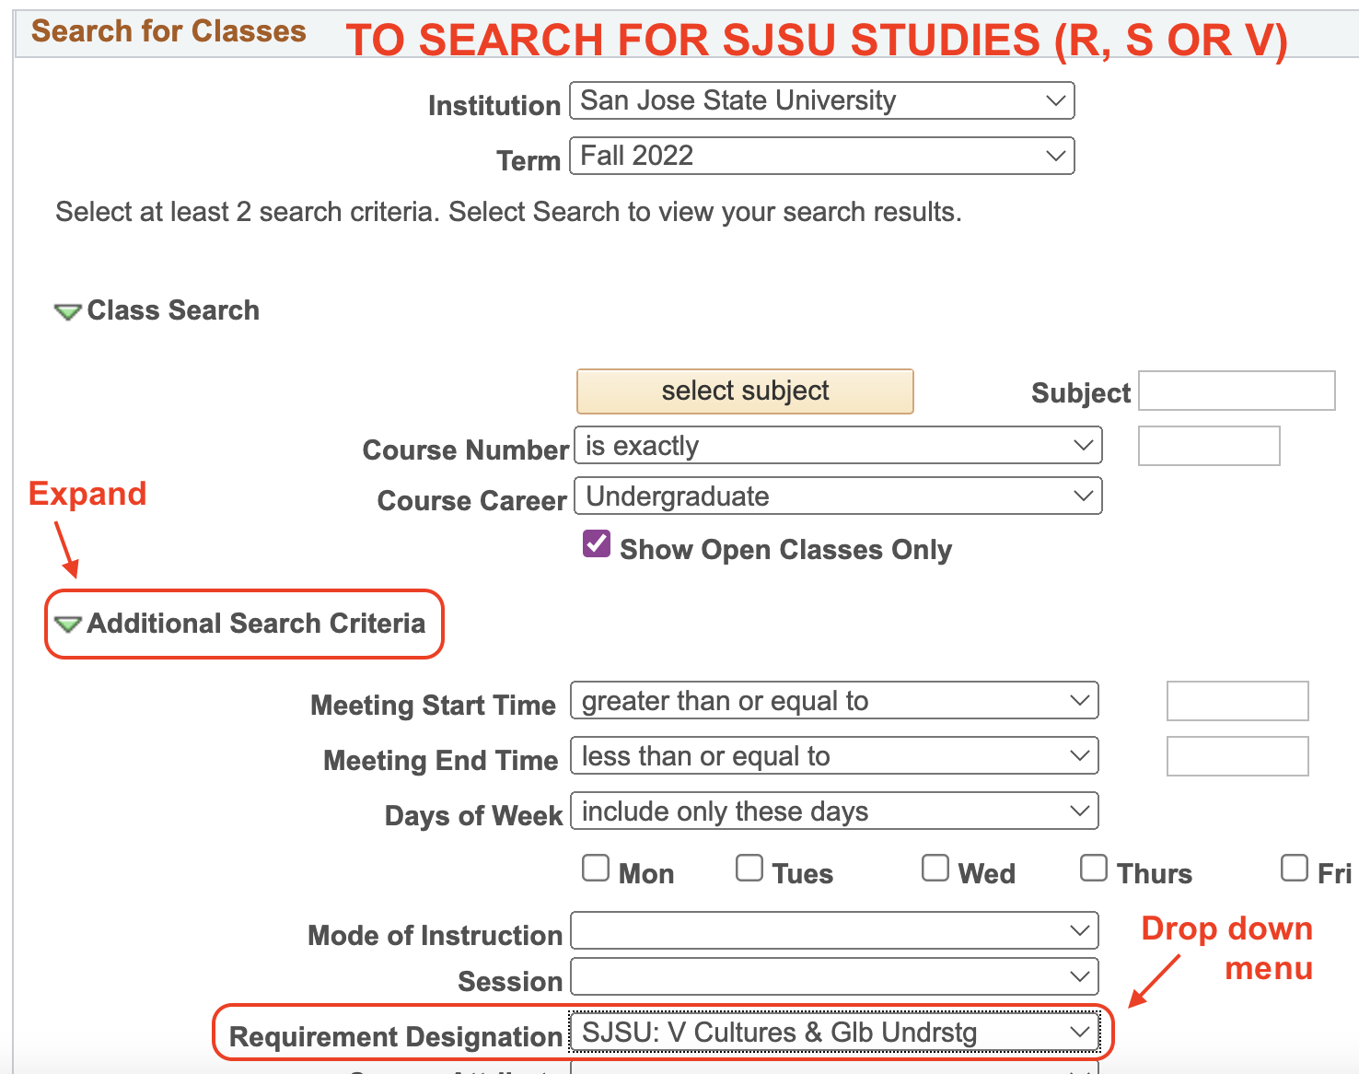

Slide 11

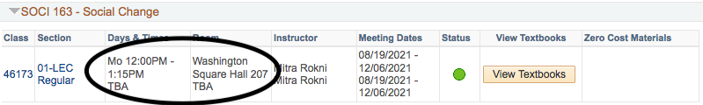
Mode of Instruction:
In Person
Meets on at a set day and time
Note a specific day, time, location are indicated
No online component
Hybrid
Meets on campus on certain days at a set time with an online instruction as well
Note a day and time are indicated but also “TBA” which indicates online component

Slide 12

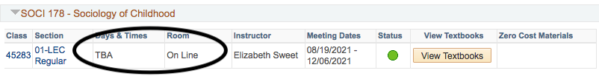
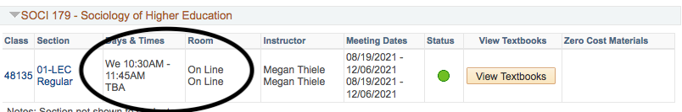
Mode of Instruction:
ONLINE
Synchronous
Meets online at a set day and time
Notice a day and time are indicated but room is “On Line”
Asynchronous
Completely online
Notice no set meeting day or time
Bichronous
Meets online on some days at a specific time
Note a set day and time for meeting but also “TBA”
“TBA” indicates online component

Slide 13
How to:
Find the classes for your concentration
Search for classes
Change concentrations
Managing waiting lists
Sign up for WST-DSP
Applying for graduation

Slide 14
Questions?
Notes:
People that are okay can leave
People that need registration help can meet with advisor in breakout room for one-on-one
People interested in general registration can info can stick around

Slide 15
Case Study #1
Background Information
  Took Introduction to Sociology, Social Problems, and Statistics at Community College
  Placed into 100W in the WST Directed Self-Placement
  In the WGSS Concentration
  Minor in Biology
  Wants to take 15 units
What Should/Could the Student Take?
  SOCI 100W
  SOCI 101
  SOCI 116 or Major Elective
  Area R,S, or V
  Minor Elective (Consult Minor Department)

Slide 16
Case Study #2
Background Information
  Took Introduction to Sociology and Statistics at Community College but did not Take Social Problems
  Placed into 100W in the WST Directed Self-Placement
  In the Social Interaction Concentration
  No Minor
  Wants to take 12 units
What Should/Could the Student Take?
  SOCI 080 (Social Problems)
  SOCI 100W
  SOCI 101
  SOCI 116 or Major Elective or Area R,S, or V

Slide 17
Case Study #3
Background Information
  Took Introduction to Sociology, Social Problems, and Statistics at Community College
  Did not self place into SOCI 100W OR SOCI 100W classes are full
  In the General Concentration
  No Minor
  Wants to take 15 units
What Should/Could the Student Take?
  If self placed into 100A, register for ENGL 100A or LLD 100A
  SOCI 116
  Major Elective
  Major Elective
  Major Elective or University Elective

Slide 18
Case Study #4
Background Information
  No classes in Major available
What Should/Could the Student Take/Do?
  Get on wait lists for Core classes and Major electives
  WST Directed Self-Placement – Area R,S,V
  Minor classes?
  How many University elective units do you need?
  Register for University electives
  Monitor enrollments

Slide 19
Tips for Being Successful at SJSU
Become familiar with the department website.
The SISS Department office can be reached at sociology@sjsu.edu
Use your sjsu.edu email.
Include your SJSU ID number in your emails.
Become familiar with your MyProgress report.
Don’t know how to address your teacher? Use “Professor.”
Complete the Writing Skills Test (WST) Directed Self Placement as soon as possible.
Complete SOCI 100W and SOCI 101 before the start of your third semester at SJSU.
Complete either SOCI 104 or 105 (ideally both) before the start of your fourth semester at SJSU.
When you create your schedule, take into account that in addition to being at a new university, you will be transitioning from lower division to primarily upper division classes.
The University encourages students to take 15 units per semester to complete their degrees in two years.
If you are disqualified in Sociology, you will have one opportunity for reinstatement. After a second disqualification, you will have to find another major.
It is possible to receive a “D-” in a course in the major and graduate, but your major GPA and your overall SJSU GPA must be 2.0 for graduation.
If your transfer units have not posted by the first day of class email: eval@sjsu.edu.
If you have a question ask a Designated Undergraduate Sociology Advisor.

Slide 20
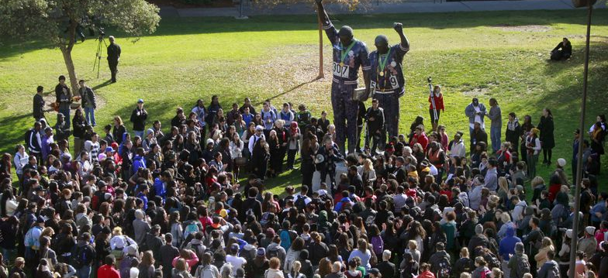
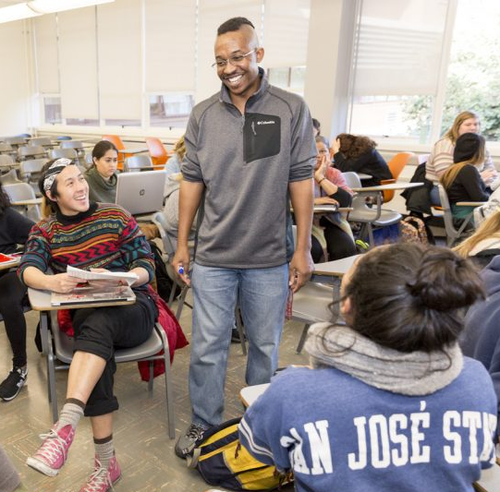




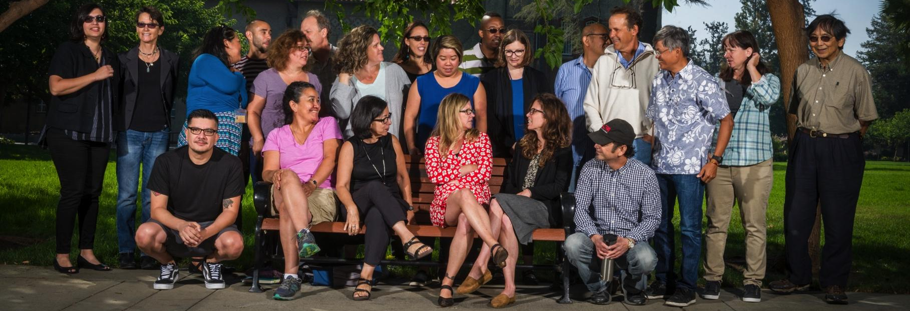
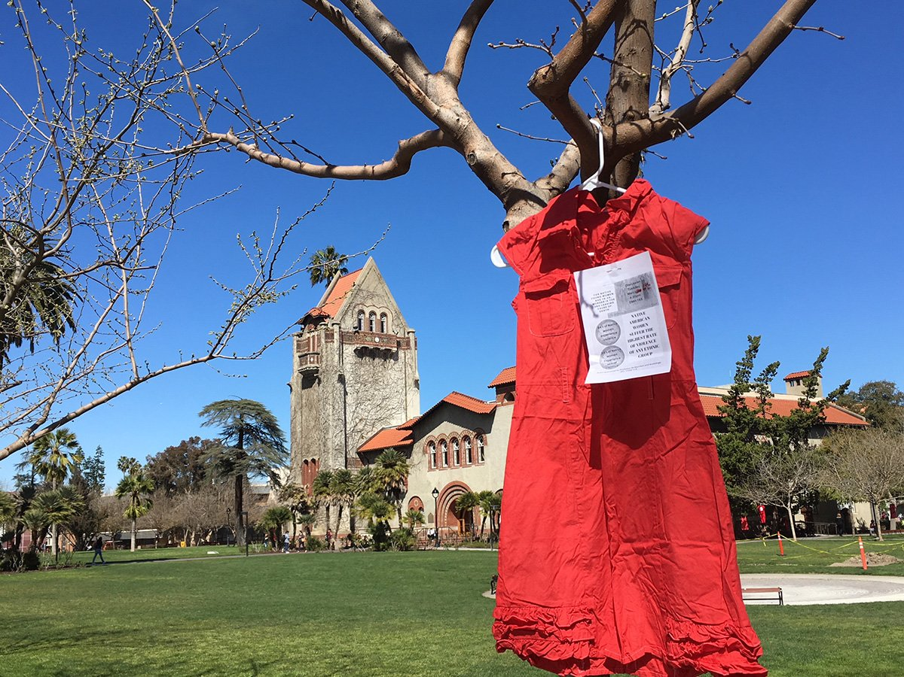

Department of Sociology and Interdisciplinary Social Sciences
Dudley Moorhead Hall
DMH 241
✆ (408) 924-5320
🖂 sociology@sjsu.edu
🖳 sjsu.edu/siss

