Slide 1
SAS Recoding for Quintile Process
Chenchen Shen – Report for Summer Internship at Travelers, June 3rd – Aug 18th, 2013

Slide 2
Prologue
ASA Website -> Education -> Graduate -> Internships
Various industries: Pharmaceutical, Biotech, Banking, Insurance, Academic…
60% for PhD
Average deadline: Mid. January
Phone interview within the same week after application
Questions were based on resume
70% technical, 20% general, 10% critical thinking

Slide 3
Insurance Industry
Risk Type
Life & Health
Property & Casualty
Auto
Pension
Home
Functional Department
Personal
Business
Claims
Profit = premium + investment income – loss – expenses
Actuaries: ratemaking & reserving
Statisticians: predictive modeling

Slide 4
The Company
2nd U.S. commercial property casualty (P&C) insurance writer
Rank 116 of Fortune 500 (2013)
Revenue: $25.7 billion (2012)
Employees: 30500 (2012)
-- data from Wikipedia
In summer 2013:
About 30 Actuarial interns, all American undergrads
About 20 Analytic interns, all PhD’s & Masters, 14 Chinese, only 1 American
I was working in Commercial Analytic Strategic Development (CASD) for small businesses
40-50 actuaries & statisticians, 6-7 in 1 market group, 2-3 on 1 project

Slide 5

The Models
# of claims $Y\sim Poisson(λ)$:
$Y=e^{β^{T}X}$, where $β^{T}X=β_{0}+β_{1}x_{1}+⋯+β_{n}x_{n}$
SAS: PROC GENMOD;
$Pure Premium=\frac{Incurred Loss}{Exposure}\sim Tweedie Distribution$
SAS Macro developed by Travelers

Slide 6
Quintile Process
Model implementation for renewal strategy
Strategic Model
Prediction of loss
e.g. $2000
Comparison to premium actually charged
e.g. $500
Data from customer
Mmmm… Well…

Slide 7
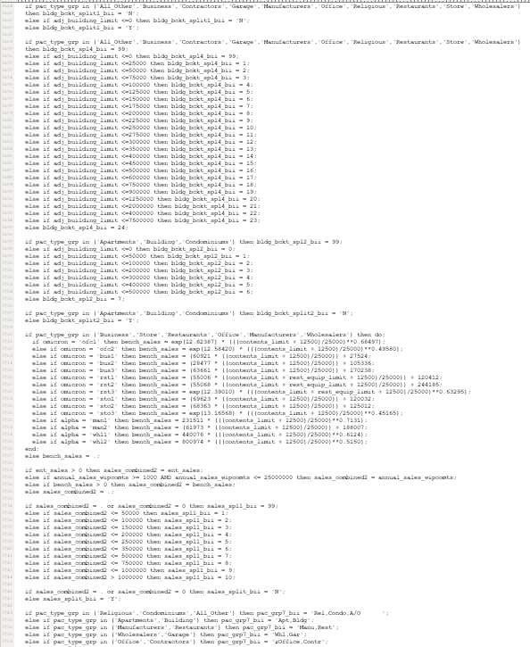
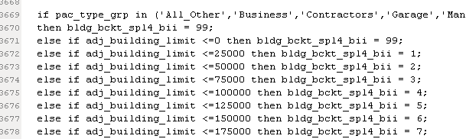
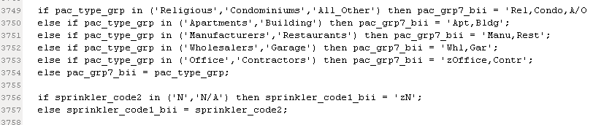
Problems on Implementation
10163 lines! And separated!!
Tons of groupings
Vague names
Difficult to update
Big challenge to SAS beginners

Slide 8
Recode by Excel and PROC SQL
Step 1
Input parameter estimates into spreadsheets by individual factors
Step 2
Code in SAS
Match factors and parameter estimates for each record by SQL
Step 3
Calculate fitted responses
Verify results by comparing with values from original code
Set boundaries for groups in spreadsheets

Slide 9
Advantages
Excel + SQL is easy to understand & use
Easily obtain & update factors
Macro coding enabled
Accessible to everybody (e.g. actuaries & IT programmers)

Slide 10
Improvements
Working knowledge of SAS & Microsoft Office
Skills in predictive modeling, ratemaking and reserving
Business knowledge of insurance industry
Professional etiquette
Networking with peers & senior professionals

Slide 11
Challenges
Reading SAS code from various authors
Verifying results with values from original code
Reporting to supervisor
Multi-task & time management

