Slide 1
Stat Forecasting summer 2013 internship
NOTE: See additional Title slide photos in Image Library section of this file.
Zizi Zhuang

Slide 2
Agenda
Ways to Find an Internship
Intro to Brocade
My Job at Brocade
Statistical Forecast Process
MAPE and Forecast Accuracy
Software Used in Intern
Highlights

Slide 3
How to Find an Internship?
Job Fair on campus
Indeed.com
Company websites

Slide 4
How do I find my internship?
Job Fair
Create a personal profile on Brocade careers website
Phone interview from HR
Onsite interview with my supervisor and the manager from Revenue Planning Department

Slide 5
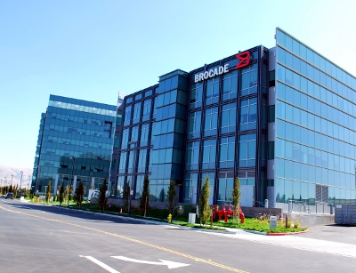
Brocade Communications Systems, Inc.
Industry: Software Networking
Headquarters: San Jose, California, USA
CEO: Lloyd Carney
Revenue: $2.24 billion (FY12)
Approximately 4,000 employees worldwide
A wide range of industries and customers in more than 160 countries

Slide 6
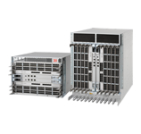
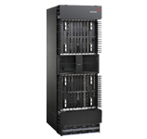
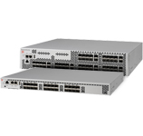
What does Brocade sell?
Main products: SAN (storage area network) directors and switches, network-attached storage, data center switches, and etc.
DCX 8510 Backbones VDX 6720 Switch FCOE 10-24 Blade (director) MLX Series (router)

Slide 7
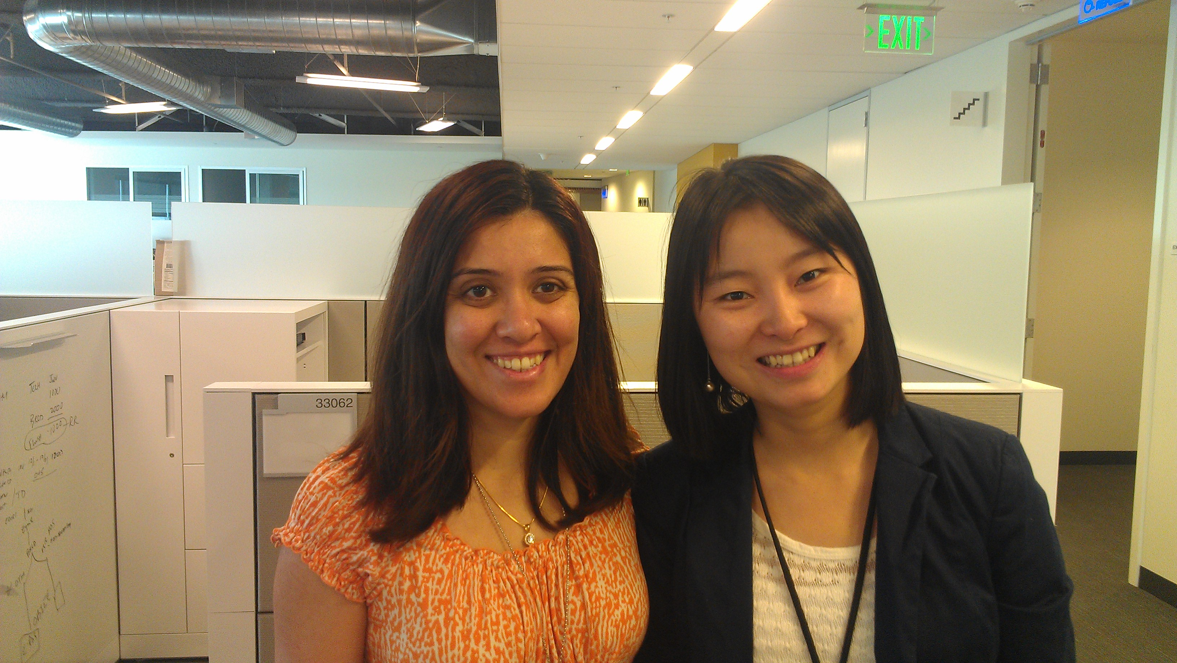
A little about my team
Revenue Planning Department
Manager: Subha Muthukrishnan

Slide 8
What am I doing at Brocade?
Build data sets at the product line, forecast class level for all SAN (Storage Area Network) and LAN (Local Area Network) products
Generate stat forecasts for all SAN and LAN products
Compare MAPEs (Mean Absolute Percentage Error) to improve forecast accuracy
Develop a new statistical model for revenue and units forecasting

Slide 9
Stat Forecast Process
Current Quarter
Use historical data and graph
Current Quarter
1) Determine if it is new product or end of life product
2) Analyze trends and seasonal effects
Choose the best statistical model
Next Quarter
1) Calculate forecast accuracy for prior stat forecasts
2) Choose a new model if forecast accuracy is less than 70%

Slide 10
MAPE and Forecast Accuracy
MAPE (Mean Absolute Percentage Error) $=\frac{|Actual −Stat Forecast|}{Actual}$%
Smaller MAPE, better forecast
Forecast accuracy = 100% - MAPE

Slide 11
Which software do I use?
Excel
Power Point
Eviews
R
Python

Slide 12
Highlights
2013 Intern Tech-lympics
Compete with SanDisk and Amazon Lab 126

Slide 13
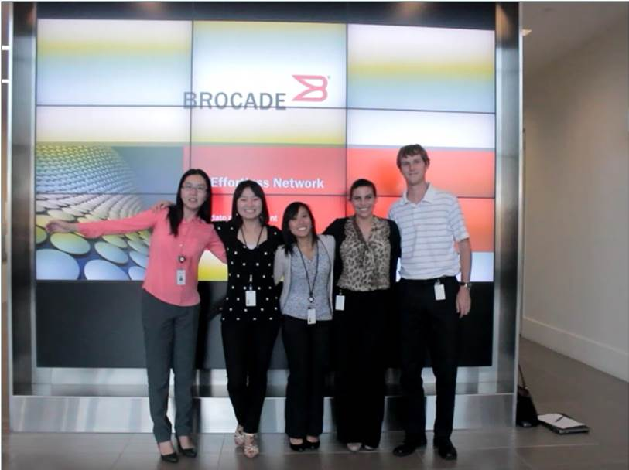
Highlights
Group Video
http://www.youtube.com/watch?v=f0cAuDbGFek
Intern workshops
Secrets to a successful internship
Networking & Brocade Products
LinkedIn

Slide 14
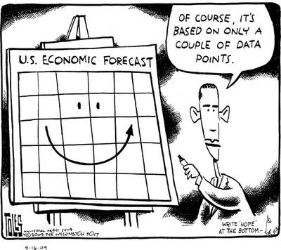
Thank you!

