Slide 1
System Overview
Presented by
CHRS Recruiting Project Team
University Personnel

Slide 2
About today’s session:
High level overview
We are still in testing; some elements may change
Details will be covered in individual training sessions
Time for questions at the end of each section
Session will be recorded and posted
Back to Home

Slide 3
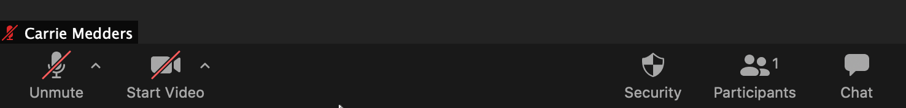
About Zoom:
Please stay muted throughout the presentation unless asked to unmute for questions; video is optional
Post questions in chat at any time
Back to Home

Slide 4
The Basics of CHRS Recruiting | Post a Job for Recruitment | Screen, Evaluate, and More | Offer the Job and Hire a Candidate | Wrap Up
What | Process Flow | Process Flows | Process Flows | Training
Why | Who | Who | Who | Webpage
Who | How | How | How | Support
When | Key Points | Key Points | Key Points | Q & A
General Info | Q & A | Q & A | Q & A | Thanks!

Slide 5
What is CHRS Recruiting?
CHRS – Common Human Resources System
  Combined HR system for the CSU
CHRS Recruiting
  First combined system for CSU HR functions
  Used for all faculty and staff recruitments
PageUp – The software used for CHRS Recruiting
  It is not PeopleSoft (SJSU @ Work); It is not Interfolio
  It integrates with PeopleSoft
Back to Home

Slide 6
Why are we implementing it?
Systemwide project – all CSUs will implement
More consistent processes
Better systemwide reporting
Additional benefits for SJSU
  3 recruitment systems into 1
  Ability to apply for jobs via mobile devices
  Better visibility for applicants on recruitment status
  Online screening of applications and evaluation
  Workflow to move applicants through process
Back to Home

Slide 7
Who is impacted?
Hiring Managers
Department Chairs
College and Department Resource Managers/Analysts
Administrative Staff in Departments
Search Committee Chairs & Members
University Personnel Staff
Applicants
Back to Home

Slide 8
When is this happening?
July 8, 2020
What’s happened so far?
System Configuration and Process Design
Testing
  Round 1: Complete
  Round 2: In-Progress (ends June 15)
  Round 3: Begins June 17
Back to Home

Slide 9
General Information
Shared system
  At times you will see data from other campuses
  SJSU data will always be prefaced with SJ
Team
  PageUp’s term for a department/department ID
Card
  PageUp’s term for a process: Job Card, Approval Card, etc.
Not everything is in the system
  Certain pieces of the recruitment process are managed outside of the system
It’s new for everyone – we are here to help!
Back to Home

Slide 10
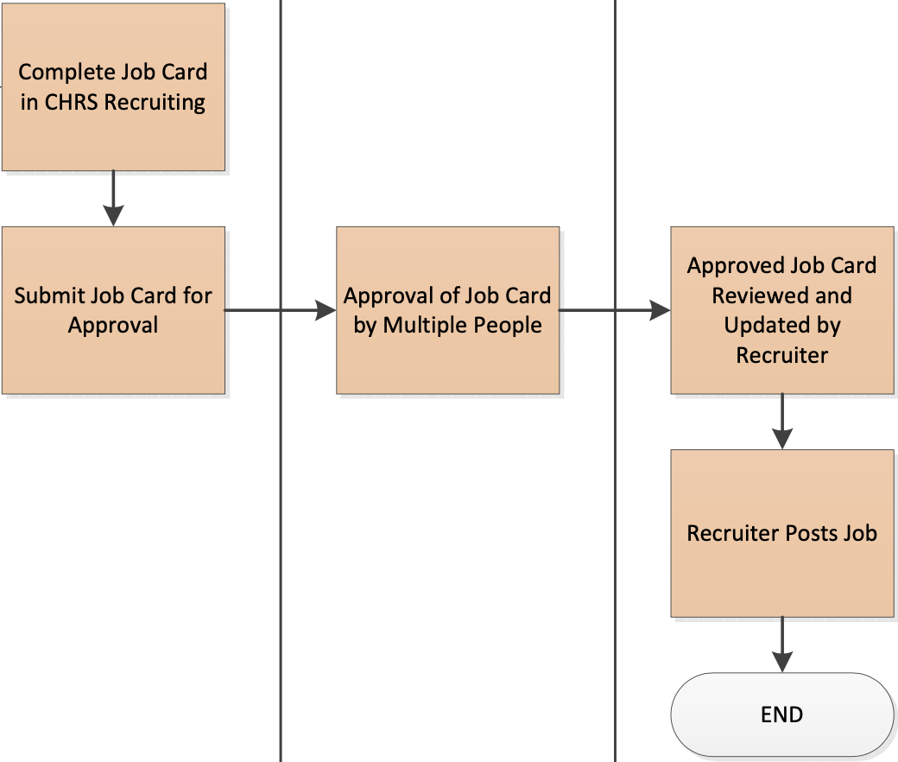
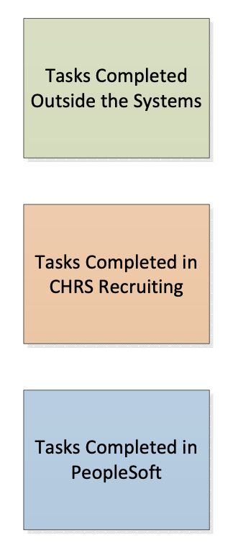
DEPARTMENT
VARIOUS
RECRUITER
Back to Home

Slide 11
Who Creates the Job Card?
Department
  Department Admin, College or HR Contact, Hiring Manager
Who Approves the Job Card?
Faculty
  Chair
  Dean
  Division/Student Affairs only
  Senior Director, Faculty Affairs
Staff/MPP
  Position data reporting structure – Levels 1 and 2/standard
  Division/varies by division
  VP/varies by division
  Budget Office/standard
  President/new MPPs only
Back to Home

Slide 12
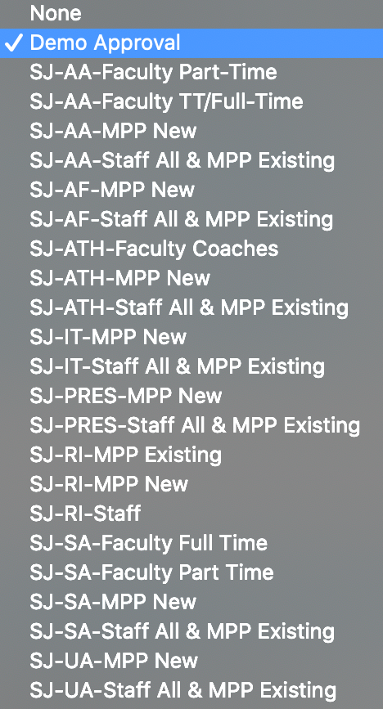
Approvals
Multiple approval structures, based on division
Division with faculty positions have more choices
  Academic Affairs
  Athletics
  Student Affairs
Back to Home

Slide 13
Let’s see how it’s done!
Back to Home

Slide 14
Key Points
Have all information ready before starting process
Team is like Department/Department ID
SJSU information will be prefaced with SJ
System required fields have an * but other fields are also required for SJSU processing
Be mindful when selecting Recruitment and Approval Processes
Think about who is going to manage the recruitment
Process differs slightly between Staff/MPP and Faculty recruitments
Back to Home

Slide 15
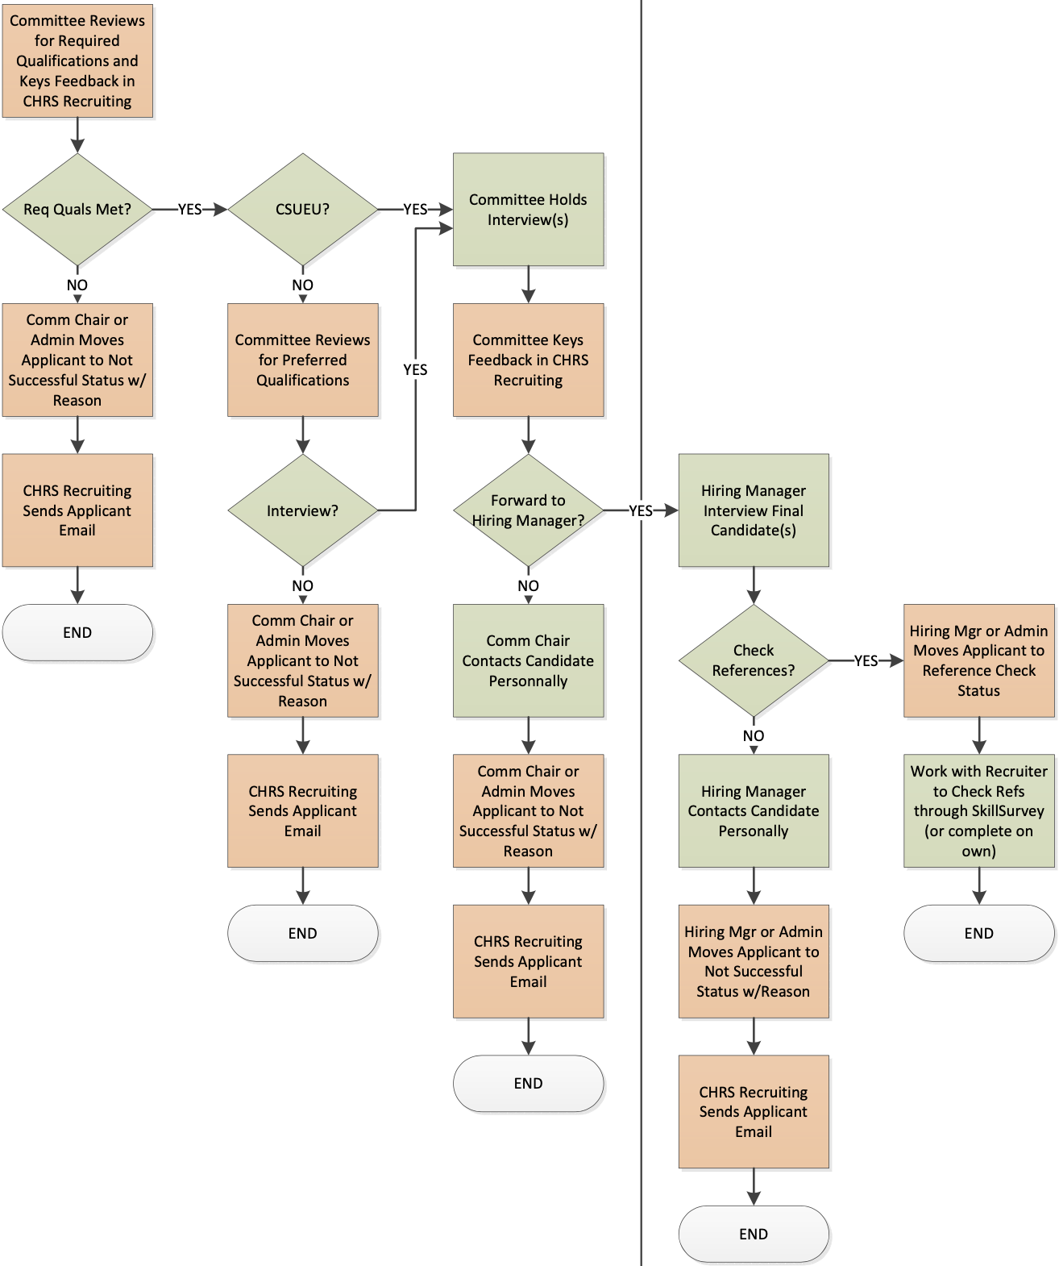
RECRUITMENT COMMITTEE
HIRING MANAGER
Staff & MPP Recruitments
Process begins after Recruiter routes applications
Back to Home

Slide 16
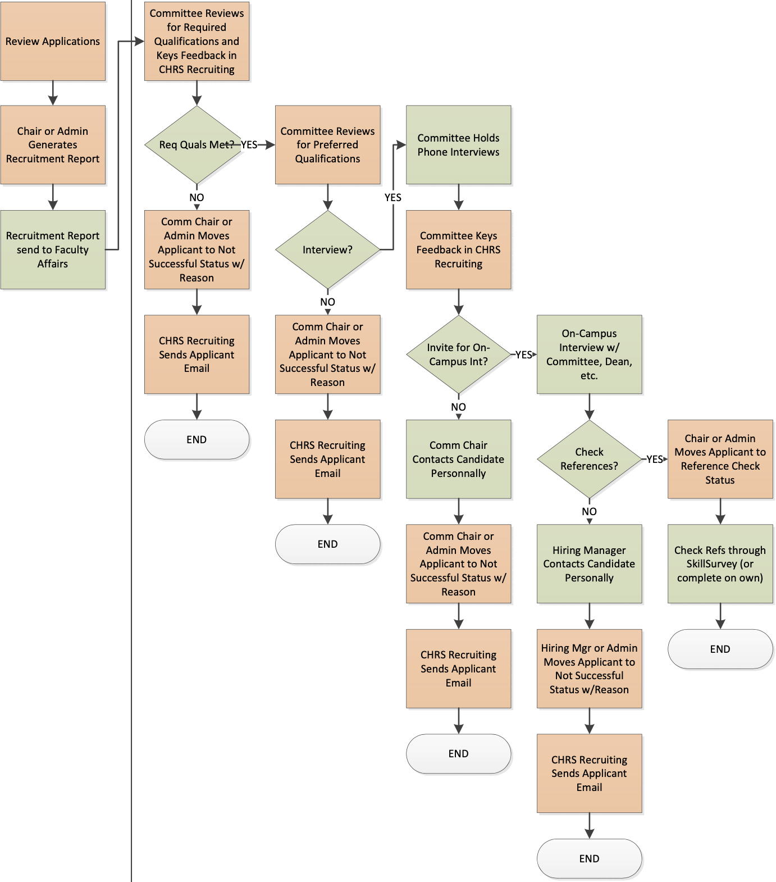
CHAIR
RECRUITMENT COMMITTEE
Tenured/Tenure-Track and Full-Time Temporary Faculty Recruitments
Process begins when Department Chair receives applications
Back to Home

Slide 17
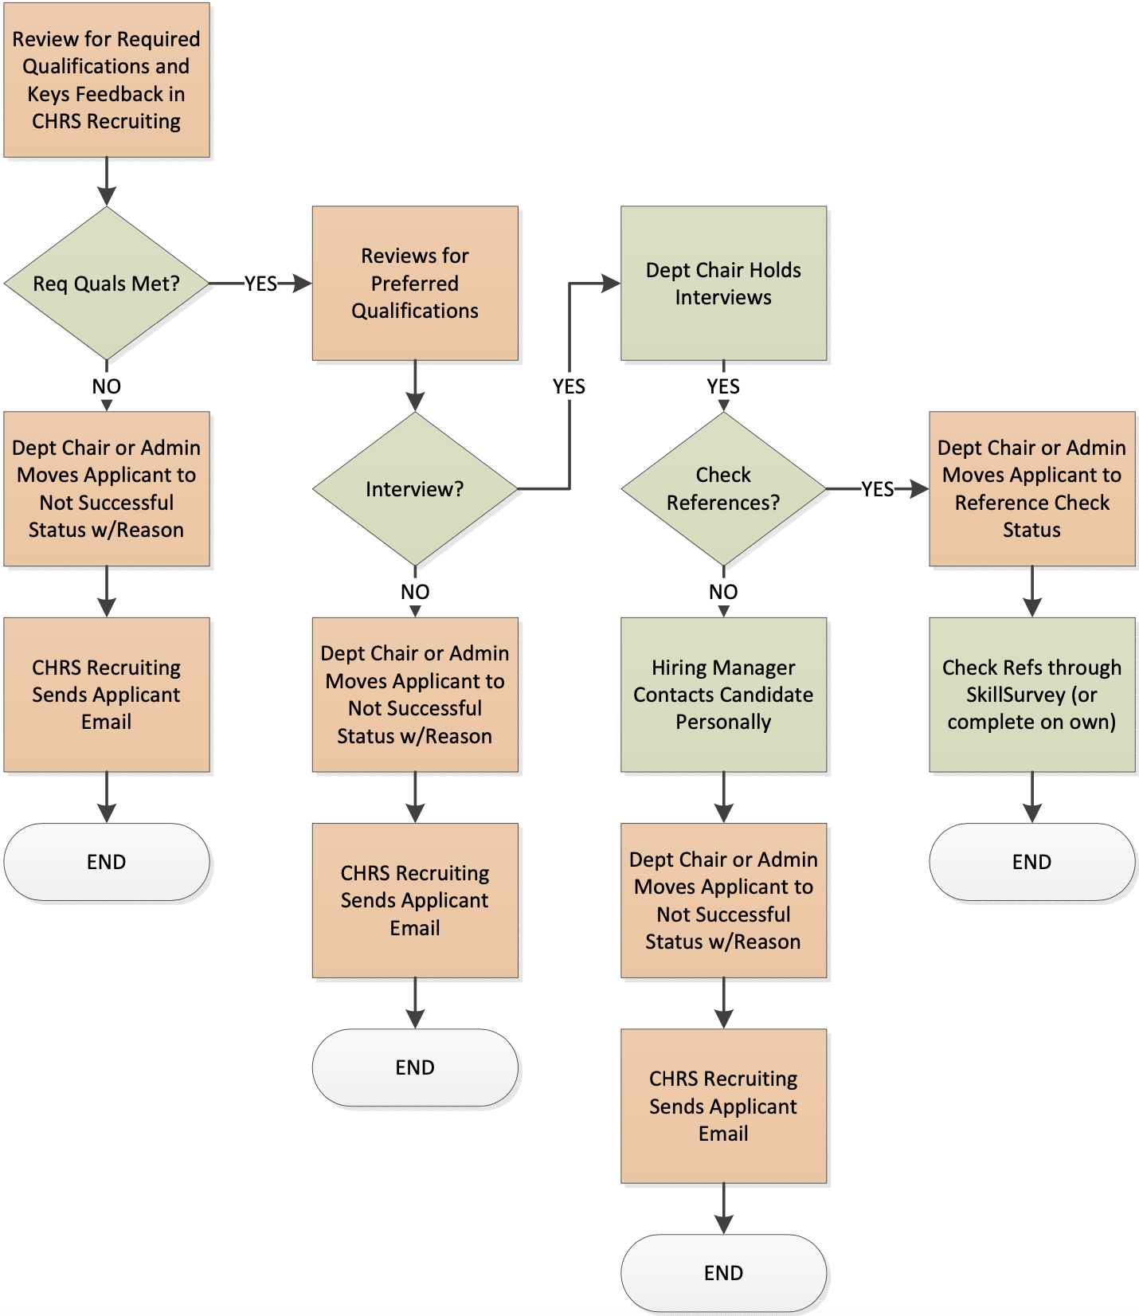
CHAIR
Part-Time Temporary Faculty Recruitments
Process begins when Department Chair receives applications
Back to Home

Slide 18
Who Routes Applications?
Staff/MPP
  Recruiter
Faculty
  Department Chair or Recruitment Administrator
Who Screens Applications, Evaluates Interviews?
Staff/MPP
  Search Committee Chair & Members, Hiring Manager
Faculty
  Department Chair, Search Committee Chair & Members, Hiring Manager
Back to Home

Slide 19
Who Manages the Recruitment?
Who Moves Applicants through the Process?
These will vary by recruitment and are important to determine up front.
Back to Home

Slide 20
Let’s see how it’s done!
Back to Home

Slide 21
Key Points
Know who will manage the recruitment and move applicants through the process up front
Steps in the process can be skipped if they are not needed
Feedback at every step is important; be thoughtful
Back to Home

Slide 22
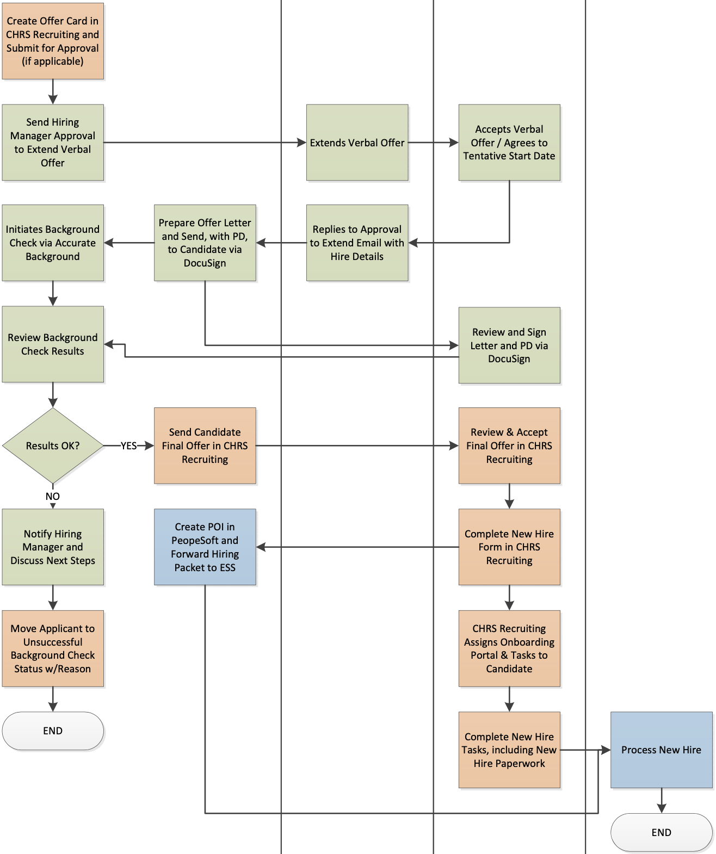
RECRUITER
MANAGER
CANDIDATE
ESS
Staff & MPP Recruitments
Process begins once finalist has been selected and recruitment has been reviewed by Recruiter
Back to Home

Slide 23
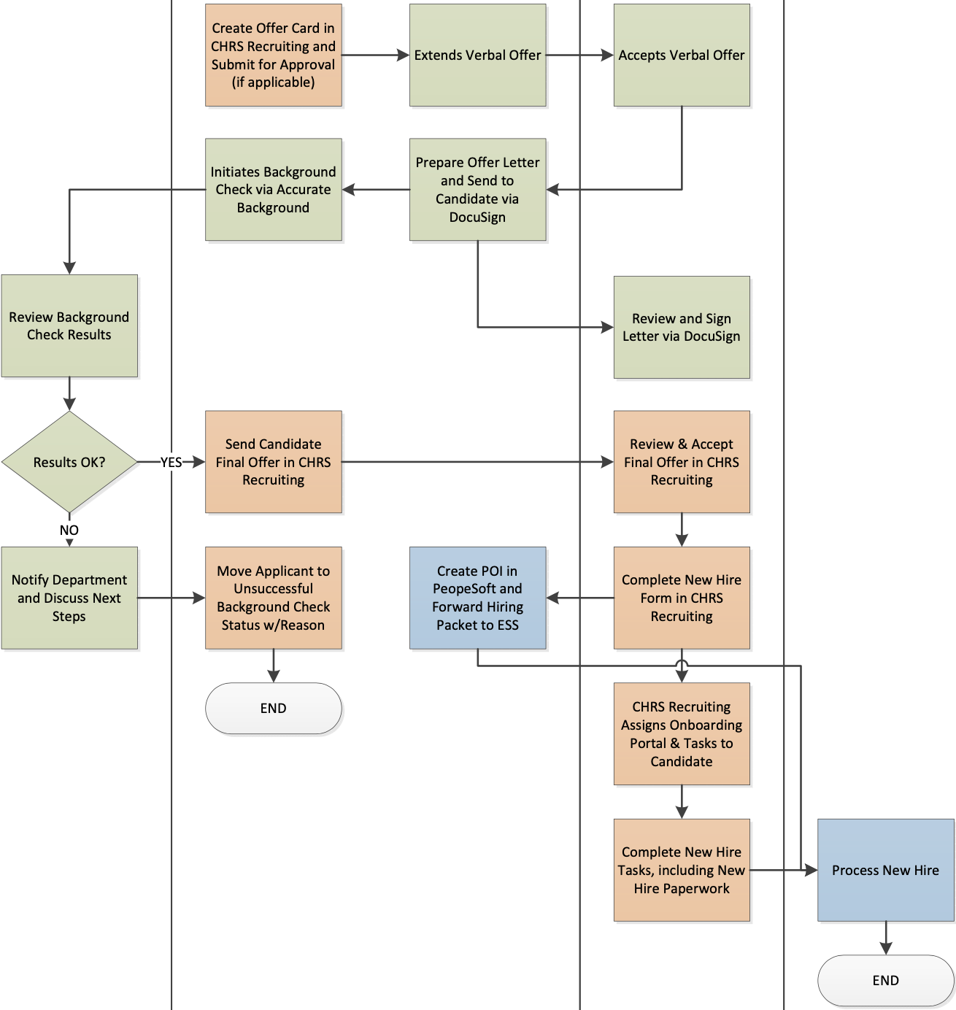
RECRUITER
DEPARTMENT
CANDIDATE
ESS
Tenured/Tenure-Track Recruitments
Process begins once finalist has been selected
Back to Home

Slide 24
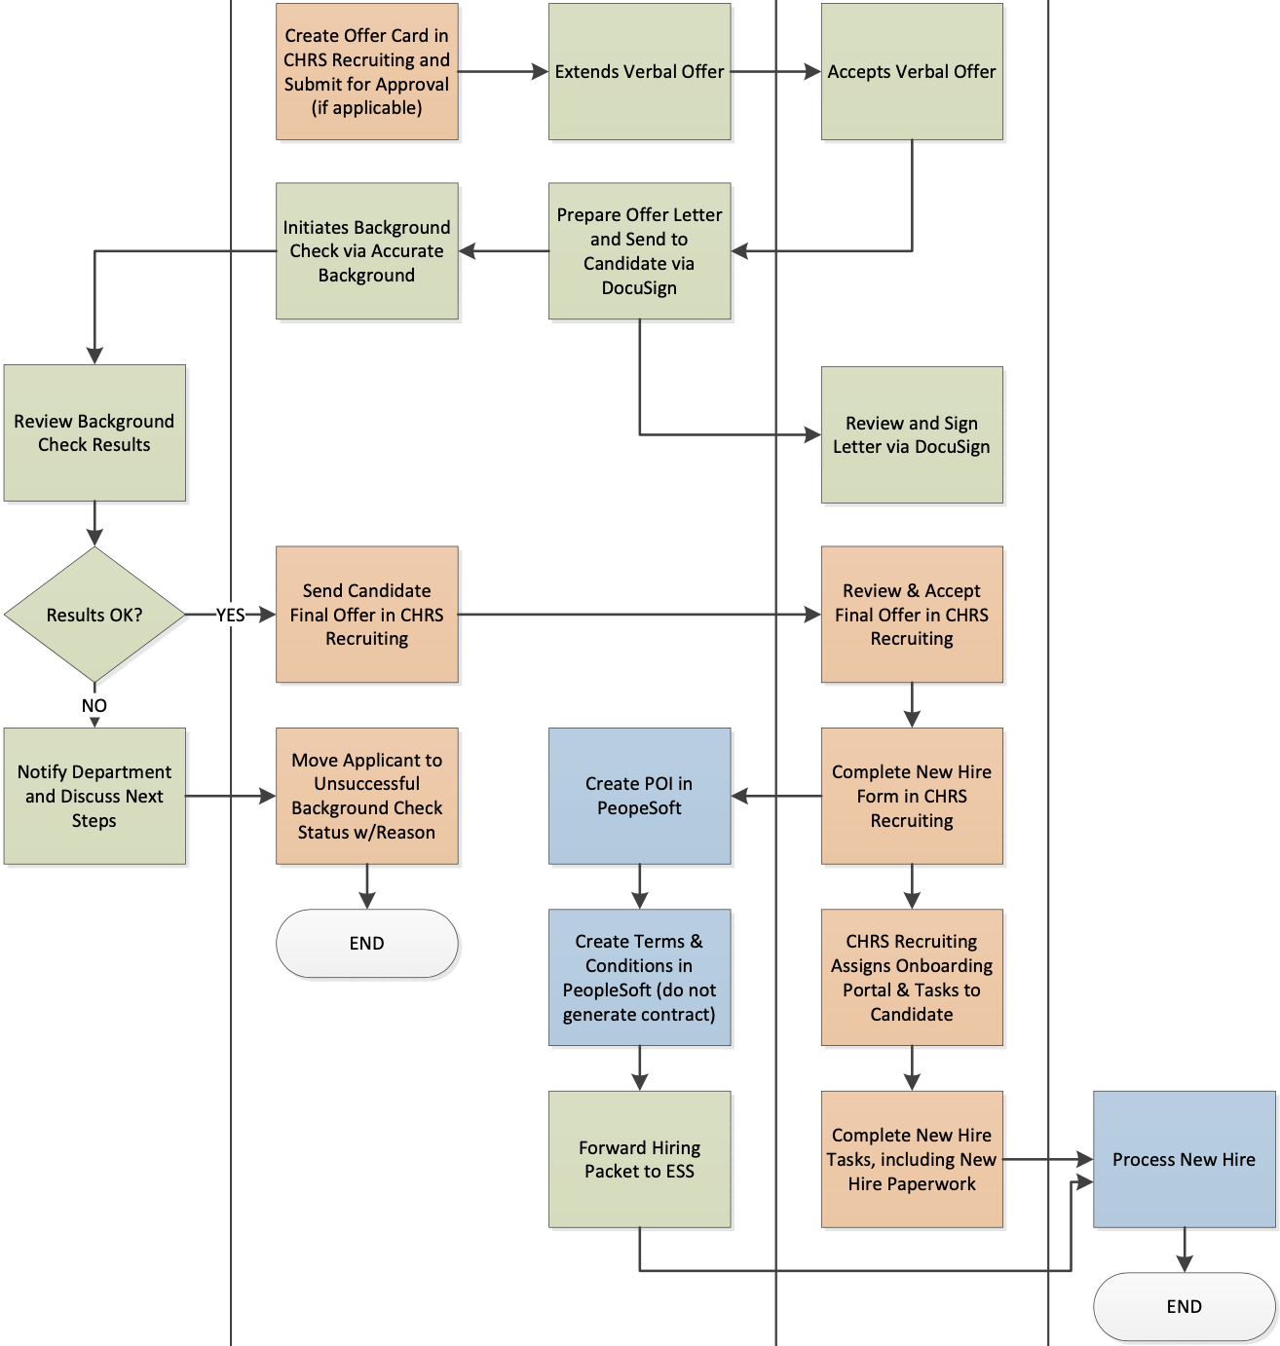
RECRUITER
DEPARTMENT
CANDIDATE
ESS
Part- and Full-time Temporary Faculty Recruitments
Process begins once finalist has been selected
Back to Home

Slide 25
Who Completes the Offer Card?
Staff/MPP
  Recruiter
Faculty
  Department Chair or Recruitment Administrator
Who Manages the Background Check?
Staff/MPP
  Recruiter
Faculty
  Department initiates; Faculty Affairs Reviews
Back to Home

Slide 26
Who Manages the Integration with PeopleSoft?
Staff/MPP
  Recruiter
Faculty
  Colleges: Dean’s Office Staff
  Counseling, Athletics, Library: Designated HR Contacts
Who Finalizes the Recruitment?
Staff/MPP
  Recruiter
Faculty
  Department Chair or Recruitment Administrator
Back to Home

Slide 27
Let’s see how it’s done!
Back to Home

Slide 28
Key Points
Approval for offer takes place outside of the system
Candidates will sign offer letters (and position descriptions when applicable) via DocuSign
  New part- and full-time temporary faculty only need to sign the offer letter; they do not need to sign the PeopleSoft Terms & Conditions
Accurate Background will be integrated with the system later this year
Back to Home

Slide 29
Training
All training will be handled via Zoom for the foreseeable future
Classes are limited in size to ensure effective learning
Learning will be hands-on for most courses
Documentation will be made available for download
Some portions of the training will be recorded for those who are unable to attend
This overview session will be posted
Back to Home

Slide 30
Training
Initiate Recruitments - CHRS02
  This course will teach you how to open a recruitment in the new system
  Most colleges and departments are limiting this access to 1-3 people so before selecting a course session, please confirm with your College or HR Contact how they plan to manage this
  REQUIRED to obtain this access
  Course Sessions: June 2, 9, 16; July 20, 27
Back to Home

Slide 31
Training
Approving Recruitments - CHRS03
  This course will show you how to approve recruitment
  If you are a work lead, department chair, or hiring manager; or if you have a role at a division level that requires you to approve recruitments; or if you are in the budget office; you will automatically gain access to this function when a recruitment is initiated
  This is not a required course
  Course Sessions: June 10, 18, 19, 23; July 13, 14, 17, 30
Back to Home

Slide 32
Training
Screening Applications & Evaluating Interviews - CHRS04
  This course will show you how to review and provide feedback online for applications and interviews
  This course is especially important for search committee members, search committee chairs, and hiring managers
    You will automatically gain access to these functions if you are in one of these roles
  This is not a required course
  Course Sessions: June 23, 29; July 13, 16, 20, 23, 28
Back to Home

Slide 33
Training
Managing Recruitments - CHRS05
  This course will teach you how to manage a recruitment once it’s been opened
  This work will typically be done by administrative staff in departments, those who typically manage recruitments even if they are not part of the search committee
  This will teach you how to move an applicant through various steps in the recruitment process
  This course is REQUIRED for those who will be in these types of roles
  Course Sessions: June 3, 11, 22, 25, 26; July 14, 15, 24, 29, 31
Back to Home

Slide 34
CHRS Recruiting Webpage
Two ways to find the page on the UP Website (sjsu.edu/up)
  Quick Links: found on the home page and under Resources
  Process Toolkit: found in the Recruit section
Find
  Training information
  System demos
  FAQs
  Project updates
  Project team information
  Help information
Back to Home

Slide 35
Support
Find information and documentation on the CHRS Recruiting webpage
Dedicated support staff in University Personnel
  Email chrs@sjsu.edu or hr-info-systems@sjsu.edu
Open Labs at go-live and regularly during the rollout
Back to Home

Slide 36
Q & A
Back to Home

Slide 37
Thank you for attending today’s overview!
Back to Home

