Slide 1
CHRS Recruiting
System Overview
Presented by
CHRS Recruiting Project Team
University Personnel

Slide 2
Today’s Agenda:
Welcome and Introductions
Zoom Instructions
Project Overview
Timeline and Transition
CHRS Recruiting Webpage
Support
General Software Information
Integration with PeopleSoft
High Level Process Flow
Dashboards
Step-by-step System Review
Q & A

Slide 3
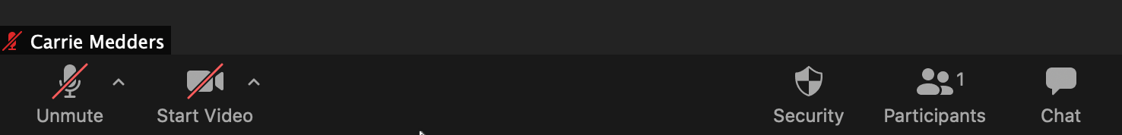
About Zoom:
Please stay muted throughout the session; video is optional
Post questions in chat at any time

Slide 4
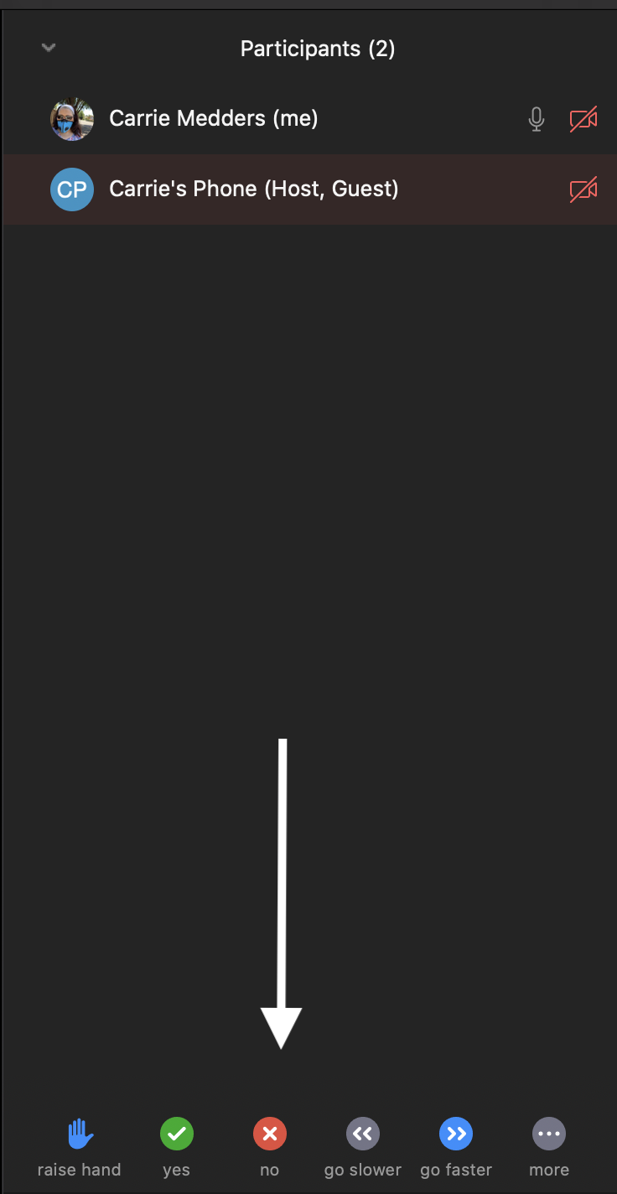
About Zoom:
Please raise your hand to request to be unmuted to ask a question
  Open the Participants List

Slide 5

About Zoom:
Use the icons at the bottom of the Participants List

Slide 6
A word from our sponsor…
Joanne Wright
  Senior Associate Vice President, University Personnel
Back to Home

Slide 7
What is CHRS Recruiting?
CHRS – Common Human Resources System
  Combined HR system for the CSU
CHRS Recruiting
  First combined system for CSU HR functions
  Used for all Staff/MPP, Tenured/Tenure Track, and Full- and Part-Time Temp Faculty recruitments
CHRS Recruiting replaces the PeopleSoft eRecruit functionality as well as the Interfolio Faculty Search functionality
Back to Home

Slide 8
What is CHRS Recruiting?
PageUp – The software used for CHRS Recruiting
  It is not PeopleSoft (SJSU @ Work); It is not Interfolio
  It integrates with PeopleSoft
Not everything is in the system
  Certain pieces of the recruitment process are managed outside of the system
Back to Home

Slide 9
Why are we implementing it?
Systemwide project – all CSUs will implement
More consistent processes
Better systemwide reporting
Additional benefits for SJSU
  3 recruitment processes and 2 recruitment systems into 1
  Ability to apply for jobs via mobile devices
  Better visibility for applicants on recruitment status
  Online screening of applications and evaluation
  Workflow to move applicants through process
  Better reporting and analytics
Back to Home

Slide 10
Who is impacted?
Hiring Managers
Department Chairs
College and Department Resource Managers/Analysts
Administrative Staff in Departments
Search Committee Chairs & Members
University Personnel Staff
Applicants
Back to Home

Slide 11
Timeline and Transition
CHRS Recruiting, built in PageUp, goes live July 8, 2020
Between July 1 and July 8 no jobs will be posted in PeopleSoft or Interfolio
Access to the eRecruit functionality in PeopleSoft will be turned off on July 1; except to the UP Recruiters
  Recruiters will move open recruitments to CHRS Recruiting prior to July 8, 2020
Access to Interfolio’s Faculty Search functionality will be limited beginning July 1
Applicants in PeopleSoft and Interfolio will be contacted with information on the new system prior to June 30

Slide 12
CHRS Recruiting Webpage
Two ways to find the page on the UP Website (sjsu.edu/up)
  Quick Links: found on the home page and under Resources
  Process Toolkit: found in the Recruit section
Find
  Training information – classes scheduled through July 31; a regular schedule will be developed prior to August 1
  System demos
  FAQs
  Project updates
  Project team information
  Help information, including detailed and quick step documentation (coming soon)
Back to Home

Slide 13
Support
Dedicated support staff in University Personnel
  Email chrs@sjsu.edu or hr-info-systems@sjsu.edu
  Lisa Chen, Senior Business Analyst – Supporting Staff Recruitments
  Julia Chan, Business Analyst – Supporting Faculty Recruitments
  Ana Dean, Recruiter – Subject Matter Expert, Staff Recruitments
  Remie Bontrager, Coord, Faculty Recruitments – Subject Matter Expert, Faculty Recruitments
Open Labs in July
  July 9-31: 9:00am-11:00; 2:00pm-4:00pm
  Zoom information will be posted on the CHRS Recruiting webpage
Back to Home

Slide 14
System Access
Security assigned in PeopleSoft
Automatic assignments for some
  Hiring Managers and Department Chairs
  General role for most employees in the event they are on a search committee
Manual assignments based on completion of training
  Individuals assigned to initiate recruitments in their department
  Individuals assigned to manage recruitments in their department
Back to Home

Slide 15
General Software Information
Shared system
  At times you will see data from other campuses
  SJSU data will always be prefaced with SJ
Team
  PageUp’s term for a department/department ID
Card
  PageUp’s term for a process/information: Job Card, Offer Card, Applicant Card, etc.

Slide 16
Integration with PeopleSoft
PeopleSoft to CHRS Recruiting
  Employee Data, including security information
  Position Data
  Department Data
CHRS Recruiting to PeopleSoft
  New Hire Data
    Candidates will complete a new hire form to push data from one system to the other; current employees will not have to complete this form
  Identified individuals in colleges, the Library, Counseling and Athletics will finalize faculty hires in their areas
  Staff Recruiters in University Personnel will process staff hires

Slide 17
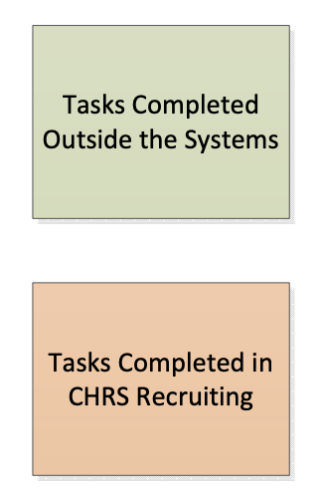
Initiate Recruitment/Complete Job Card
Approve Job Card
Application
Route Applications
Screen Applications
Interview
Select Finalist(s)
Reference/Background Check
Prepare Offer
Extend Offer

Slide 18
Dashboards have two styles
  Tiles – This style will be seen by:
    Hiring Managers, Department Chairs, Department Admins, Search Committee Chairs, Search Committee Members
  List – This style will be seen by:
    Recruiters, College Resources Managers/Analyst (also those in the Library, Counseling and Athletics)
You can use the dashboard or the menu on the left to navigate the system
You may also see links in the top blue bar that can be used to move to specific sections of the system

Slide 19
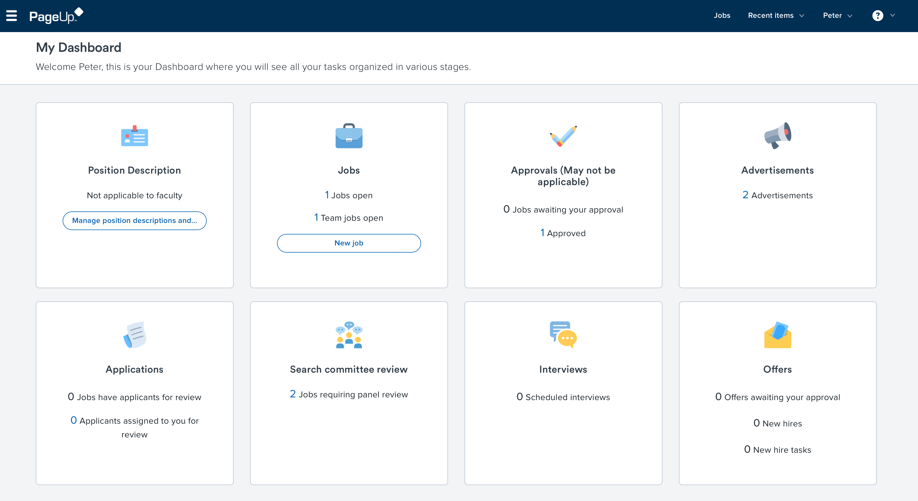

Slide 20
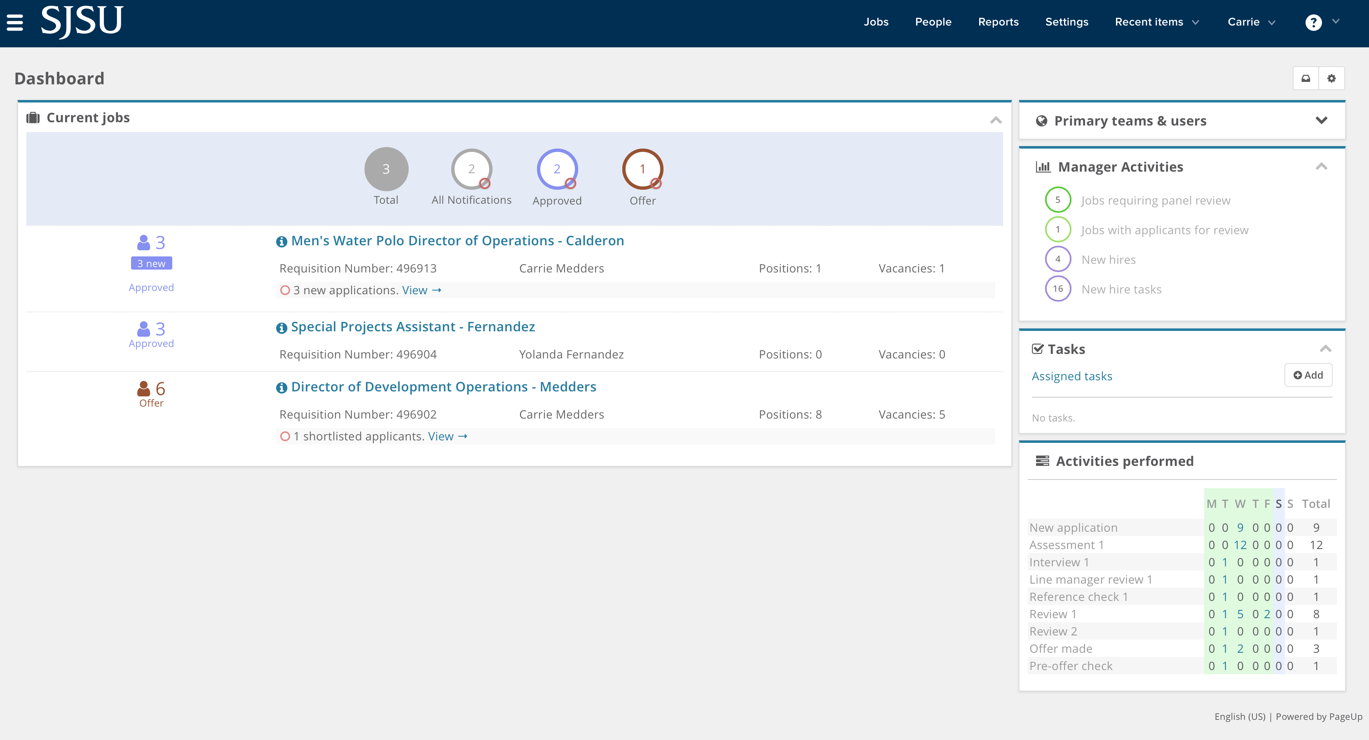

Slide 21
System Demonstration

Slide 22
Q & A

Slide 23
Thank you for attending today’s overview!

