Slide 1
Designing Effective Writing Assignments and Assignment Sequences
Funded by the WAC program
Sara Cook

Slide 2
“We liberate our students to write well by constructing for them appropriate and unambiguous tasks, with clear and understandable goals. Such assignments free students from the enervating, distracting, and often futile labor of guessing what we want, why we want it, and how we will respond.”
-- Edward White

Slide 3
Assigning Writing
The Fundamentals

Slide 4
Distributing the Assignment
    Remember to give students enough time to engage the writing process. Distribute prompts at least a week in advance of the due date for an assignment that is 2-3 pages. The larger the assignment, the more lead-time the student needs.

Slide 5
Distributing the Assignment
    Remember to give students enough time to engage the writing process. Distribute prompts at least a week in advance of the due date for an assignment that is 2-3 pages. The larger the assignment, the more lead-time the student needs.
    Distribute the rubric with the assignment sheet. The rubric can act as a generative tool, helping students measure their ongoing work against specific expectations.

Slide 6
Distributing the Assignment
    Remember to give students enough time to engage the writing process. Distribute prompts at least a week in advance of the due date for an assignment that is 2-3 pages. The larger the assignment, the more lead-time the student needs.
    Distribute the rubric with the assignment sheet. The rubric can act as a generative tool, helping students measure their ongoing work against specific expectations.
    Discuss the assignment with the students. Any questions that arise will help them produce a better product and help you see the task through their eyes.

Slide 7
The Writing Process
Scaffold the assignment
Require drafts
Provide feedback on drafts
Require a self-reflection on process and product
Initial Draft
Revise
Edit
Proofread
Final Draft

Slide 8
Designing Effective Writing Assignments
The Writing Context

Slide 9
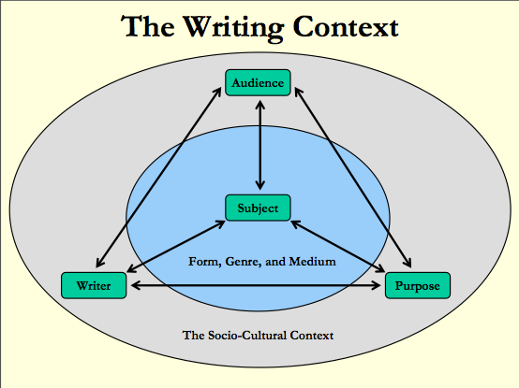
The Writing Context

Slide 10
The Writing Context
What is the field of study + subject matter of the course?
Design writing assignments that will account for
  1) the overall objectives of the class, and
  2) the immediate context of the course
  Students should be able to see the relationship of the assignment to both the class objectives and their “real world” future work.

Slide 11

The Writing Context
Who are the students?
Design writing assignments that will account for
  1) the level of the course
  2) students’ age, experience, and shared background knowledge

Slide 12
Designing Effective Writing Assignments
Rhetorical Specifications

Slide 13
Purpose
Define a clear purpose for the writing assignment.
Explain
Analyze
Argue
Prove
Evaluate
Compare
Describe
Persuade
Entertain
Some other purpose?

Slide 14
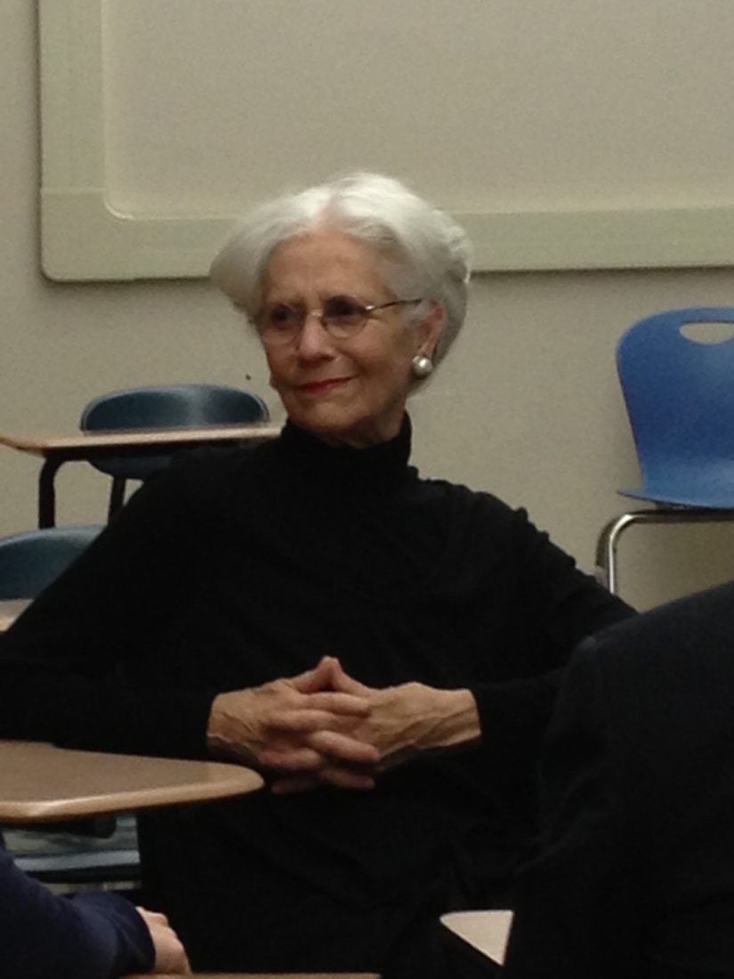
Audience
Define a clear audience for the writing assignment.
Who are they and what do they need?
“One of the characteristics of an effective communicator is the ability to write for a variety of audiences, using language, style and evidence appropriate to particular readers, listeners, or viewers.”
-- Andrea Lunsford

Slide 15
Genre/Medium
Define a clear genre for the writing assignment.
A report
A review
A journal article
An argument essay
A research project
A letter
A presentation
A blog posting
Instructions
Other multi-modal texts?

Slide 16
Rhetorical Specifications
Students need to practice writing with various purposes, to various audiences, in various genres.
Student can write with various Purposes
Student can write to various Audiences
An Effective Communicator
Student can write in various genres

Slide 17
Designing Effective Writing Assignments
The Prompt

Slide 18
Prompt
Accounts for class context: Relevant and reasonable

Slide 19
Prompt
Accounts for class context: Relevant and reasonable
Based on accessible content: Shared background and cultural knowledge

Slide 20
Prompt
Accounts for class context: Relevant and reasonable
Based on accessible content: Shared background and cultural knowledge
Solicits a scope of content proportional to the size of the assignment

Slide 21
Prompt
Accounts for class context: Relevant and reasonable
Based on accessible content: Shared background and cultural knowledge
Solicits a scope of content proportional to the size of the assignment
Measures student skills + knowledge

Slide 22
Prompt
Accounts for class context: Relevant and reasonable
Based on accessible content: Shared background and cultural knowledge
Solicits a scope of content proportional to the size of the assignment
Measures student skills + knowledge
Provides a learning opportunity for writers

Slide 23
Prompt
Accounts for class context: Relevant and reasonable
Based on accessible content: Shared background and cultural knowledge
Solicits a scope of content proportional to the size of the assignment
Measures student skills + knowledge
Provides a learning opportunity for writers
Uses transparent and easy to interpret language

Slide 24
Prompt
Accounts for class context: Relevant and reasonable
Based on accessible content: Shared background and cultural knowledge
Solicits a scope of content proportional to the size of the assignment
Measures student skills + knowledge
Provides a learning opportunity for writers
Uses transparent and easy to interpret language
Is Engaging, interesting, involving

Slide 25
Common Pitfalls
Content: the bigger the better
Freshman Political Science Course:
The purpose of this paper is to examine the origins and results of Soviet control and influence in the Soviet satellites of Bulgaria, Czechoslovakia, East Germany, Hungary, Romania, and Poland, as well as the current reforms and their implications. Your paper must be 6-10 double-spaced, typewritten pages.
Context: Absent
Freshman Astronomy Course:
Do a report on an astronomer who is currently living or has lived in the past 100 years. The report should consist of 4 0r 5 typed pages and should be well written and well researched.

Slide 26
Remember…
…to REVISE!
Keep notes for the next time you teach the course.

Slide 27
Designing Effective Writing Assignments
The Assignment Sheet

Slide 28
Visual Layout
Make rhetorical choices that aid in the understanding of the assignment, and make it as unambiguous as possible.
  Text boxes
  Bullet points
  Bold, Italicize, Underline
  Avoid large blocks of text and fonts smaller than size 12.

Slide 29
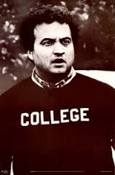
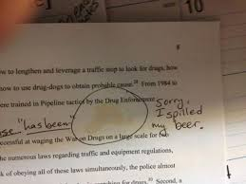
Graphics
“I am going to college. I don’t care if it ruins my career. I’d rather be smart than a movie star.” -- Natalie Portman
Critical Reading Essay (7)
Chapters 1-3 of The Other Wes Moore
Critical Essay(9)
Constructing an argument about an entire book: The Other Wes Moore
Data collecting Essay (8)
An annotated bibliography: The Other Wes Moore
A college student: Dahlia Cook (specific subject)
A college: SJSU (larger context)
THE INTRODUCTION—The Bread
Introduce the quote by making a statement about the point that the quote supports. The quote is supplementary to your own ideas.
THE QUOTE ITSELF—The Meat
Make sure the quote is relevant and necessary.
THE FOLLOW-UP—The Bread
Follow the quote with analysis that expresses the significance of the quote and why you chose to use it.

Slide 30
Other Considerations
Including a bulleted list of the learning goals
What the writing assignment is not
A reference to sources that might help students (e.g. examples of the genre, librarian info for the department, etc.)

Slide 31
Designing Effective Assignment Sequences

Slide 32
Assignment Sequences
An assignment sequence has a unifying component, linking the 2, or more, writing assignments together.
  For example, the subject matter
An assignment sequence also has variables that change as the sequence progresses.
  For example, the genre (and level of difficultly)
Critical Reading Essay (4)
"Becoming Members of Society" by Aaron Devor: gender as a social construct
Data Collection Essay (5)
Investigating and reporting on a single media source: what does it communicate about gender?
Profile Essay (6)
Using the data from the previous essay , write a profile on that media source and its contribution to the social construct of gender in the U.S.

Slide 33
Assignment Sequences
Sequenced writing assignments help students to…
  Build on prior skills
  Link old and new content knowledge
  Distinguish rhetorical situations
  Understand the immediate writing context

Slide 34
Works Cited
Lunsford, Andrea. The Everyday Writer, 5th edition. New York: Bedford/St. Martin’s, 2013. Print.
Reid, Joy, and Barbara Kroll. “Designing and Assessing Effective Writing Assignments for NES and ESL Students.” Journal of Second Language Writing 4.1 (1995): 17-41. Print.
Sasser, Tanya. The Writing Context. Diagram. Tes.org. Web. 21 Mar. 2016
White, Edward. Teaching and Assessing Writing. San Francisco: Jossey-Bass, 1985. Print.

Slide 35
Workshop
Discuss your assignment sheets. Help each other: brainstorm, troubleshoot, etc.
Anything missing?
  Context? Rhetorical specifications? Basic requirements?
Is the prompt unambiguous? Does it meet all criteria?
How does the visual layout and/or use of graphics contribute to the understanding of the assignment?

