Slide 1

Dissertation Resources
Tom Moriarty
Professor of Writing and Rhetoric
Director of the Writing Across the Curriculum Program
Thomas.moriarty@sjsu.edu

Slide 2
Welcome
Tell Us About Yourself
Year in the EdD program?
What is your dissertation about? (In 100 words or less.)
Where are you in your dissertation research and writing? (Again, in 100 words or less.)
How’s it going?

Slide 3
Tonight’s Agenda
Discussion, But No Dinner…
Reminder of the Dissertation Process
A Possible Process for Drafting and Formatting Your Dissertation
Overview of Dissertation Resources
Q&A

Slide 4
The Dissertation Process
Research Questions
And, eventually, will help us improve our
A Problem of Practice
Leads us to pose
Research Questions
Practice
A
Which answer our
Review of the Literature
Findings
Reveals that we have studied this and that, this and that way, but not this or that, this or that way
Which produced these
But good news! This study addresses this gap in the literature, using these
Methods

Slide 5
The Dissertation Process
Research Questions
And, eventually, will help us improve our
A Problem of Practice
Leads us to pose
Research Questions
Practice
Chapter 1
A
Which answer our
Chapter 5
Chapter 2
Review of the Literature
Chapter 4
Findings
Chapter 3
Reveals that we have studied this and that, this and that way, but not this or that, this or that way
Which produced these
But good news! This study addresses this gap in the literature, using these
Methods

Slide 6
Drafting and Formatting Your Dissertation
You Don’t Have to Do Everything At Once
Three elements in your dissertation:
Words (Content)
Figures and Tables (Content)
Formatting (Not Content)

Slide 7
Drafting and Formatting Your Dissertation
A Suggestion
Work on your Content and your Formatting separately.
Why?
They are separate processes.
It’s easy to get all caught up in formatting before you need to do it.
  Which slows you down.

Slide 8
A Possible Process
For Drafting and Formatting Your Dissertation
Draft your words in Word using a simple, plain format.
Copy and paste your content into Word documents.
Format your dissertation in Word
Develop and design figures and tables in Word, Excel, or Powerpoint using the correct format.

Slide 9
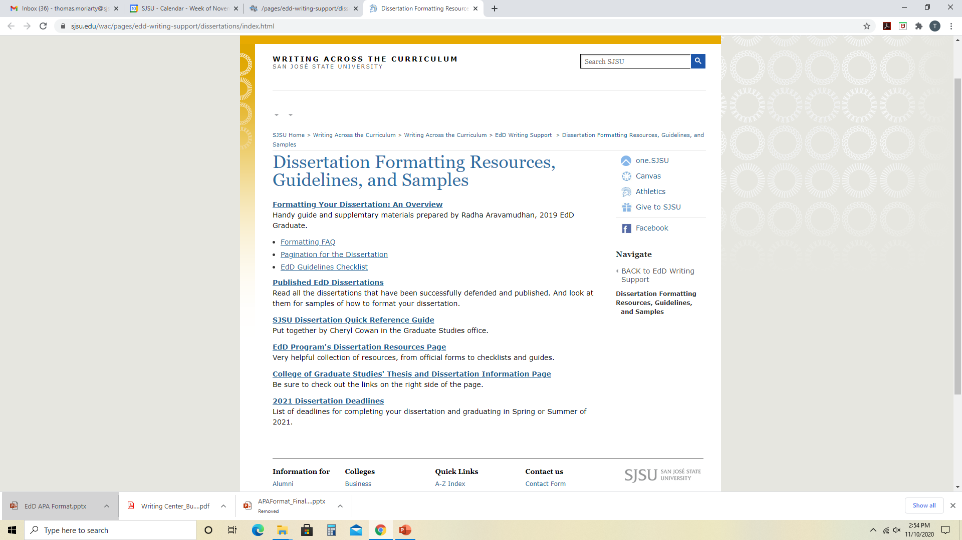
Resources

Slide 10
Resources
When you are ready to start formatting, start here first

Slide 11
Resources
Go here to see samples

Slide 12
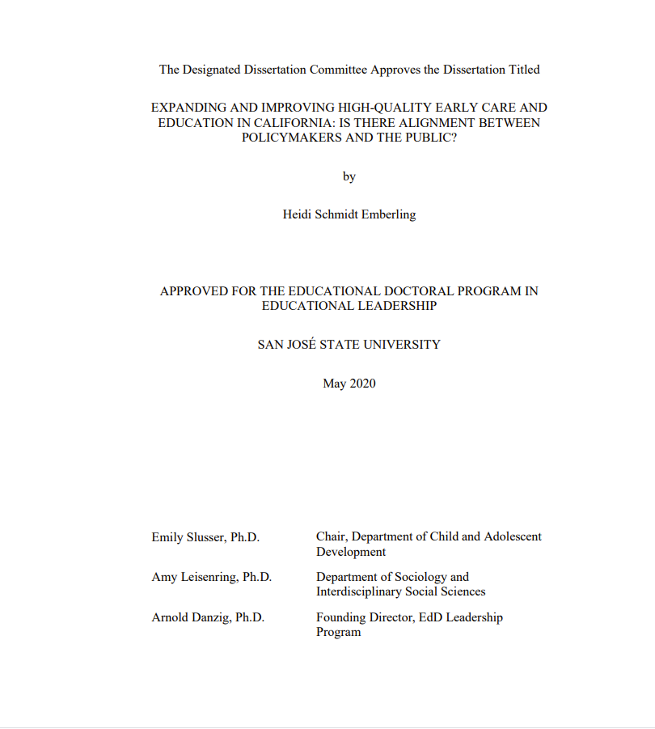
Resources

Slide 13
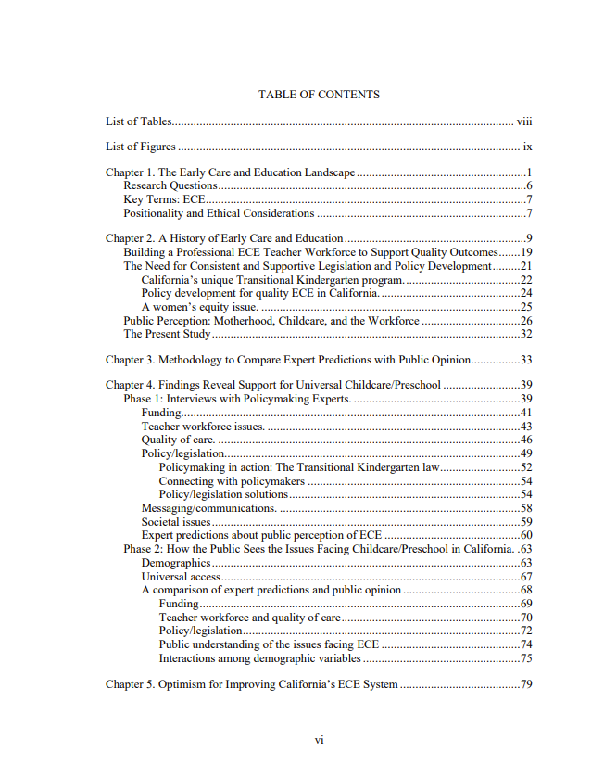
Resources

Slide 14
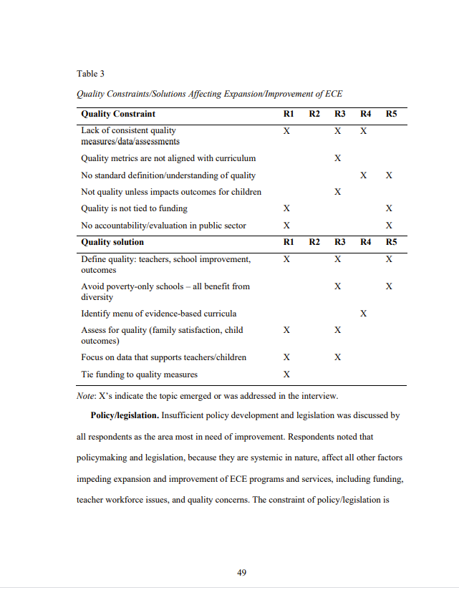
Resources

Slide 15
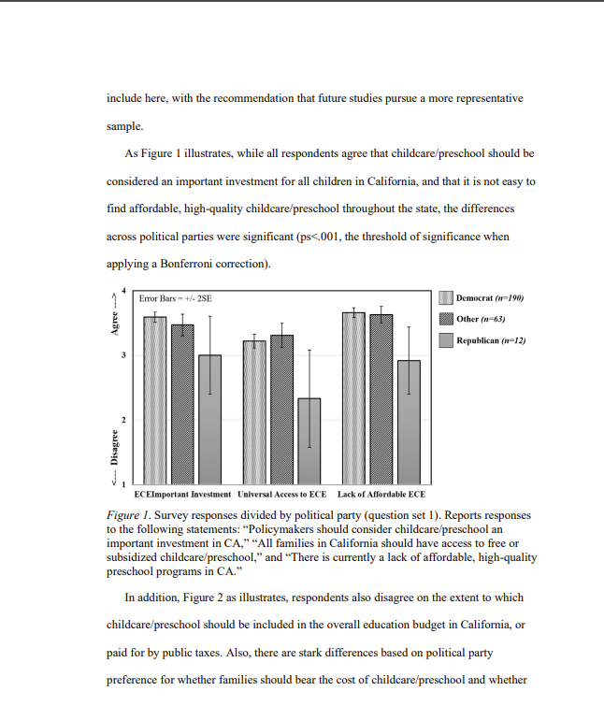
Resources

Slide 16
Resources
This is the full guide from Graduate Studies. It has been condensed into Radha’s Powerpoint.

Slide 17
Resources
Official information pages from the EdD Program and the College of Graduate Studies

Slide 18
Resources
When you need to get stuff done to graduate

Slide 19
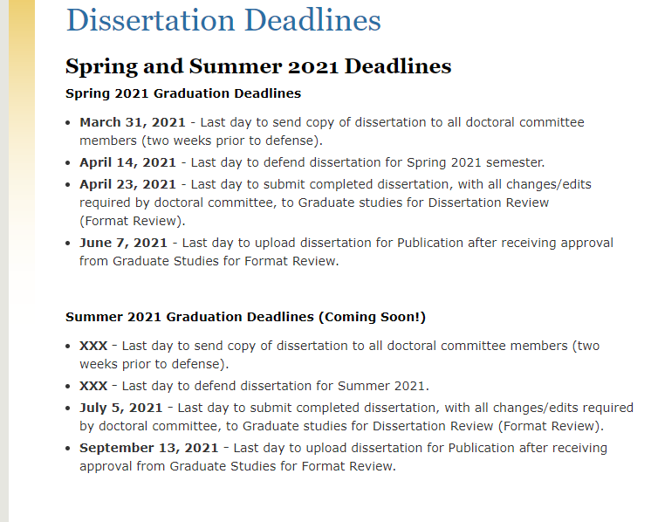
Resources

Slide 20
Q&A
Can I Go to Bed Now?

