Slide 1
APA Format Review
Radha Aravamudhan
Ed.D. Class of 2019

Slide 2
Graduate Studies Formatting requirements
Apply to all the front pages preceding the introductory section of the body of the text.
Justification must be left throughout.
Spacing should be double throughout except in stand alone quotations, footnotes, figure and table captions, and within entries in the Table of Contents, the figure and table lists, and the reference section.
Stand alone quotations should be indented (0.25”) from both margins inward.
Only one font to be used in the entire dissertation, except for appendices. GS recommends Times New Roman or Arial (Refer Page 10 of guidelines).
Abbreviations – Introduce upfront and use the same acronym throughout (Refer APA Manual p.106 for usage).

Slide 3
Graduate Studies Formatting requirements
Margins
  L: 1.5” R:1” Top and Bottom:1.25”
  Indentations, which must be approximately 0.25”
Pagination
  Front page material before Introduction are paginated as i,ii,iii,iv…
  Bottom center of the page- Page is counted but number is suppressed for front pages until Acknowledgments.
Headings – Typical to have 4
  Consistent naming of headings.
  Sub-headings must follow the heading format- Make sure you have > one sub-heading else remove sub-heading.

Slide 4
Graduate Studies Formatting requirements
Do not use Division of words at the end of lines with hyphens.
Double columns cannot be used except in a table.
Do not use headers and footers except for page numbers.
In general use italics sparingly for emphasis( Refer APA Manual p.104).
Single lines of a para at the top or bottom of a page and headers and titles at the very bottom of the page must not occur(Refer Page 19 of GS guidelines).
Boxes not required for figures but if you use them be consistent.
Citations – et al. is not to be italicized (p.177-APA Publication Manual).
Refer to Section 7 (p.193-216 APA Publication Manual) for online journal format. Make sure the link is locatable.

Slide 5

Demo on MS Word

Slide 6
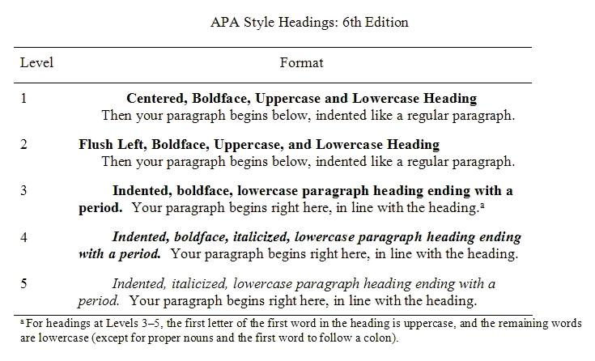
Format for Headings
Refer Page 62 Section 3.03 of APA Manual

Slide 7

1.5” from top
TITLE PAGE
CAPS, NO /b, single spaced, Centered, 1.5” from top of page
Page# Suppressed but Counted

Slide 8
Title page- Things to remember
Always print and check for format.
Title is 300 characters max and Single Space.
Check case.
Ensure date is graduation date and not defense date.

Slide 9

Copyright Page

Slide 10
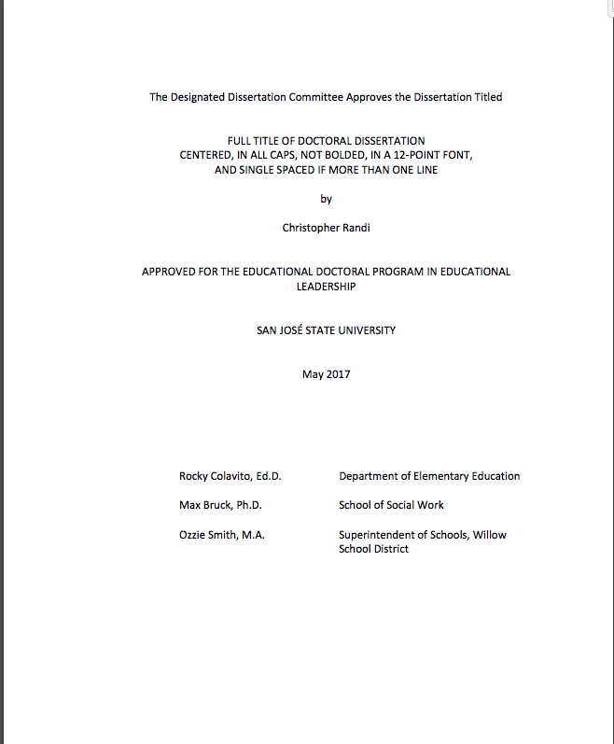
Start 4 lines from top
COMMITTEE APPROVAL FORM
Skip 2 lines
Skip 2 lines
Skip 1 line
DO NOT USE BORDERS
Skip 2 lines
Skip 2 lines
All Centered
Skip 2 lines
Skip 6 lines
Dr. ABC
Dr. CDA
Dr. XYZ
OR
ABC, Ph.D.
CDA, Ed.D.
XYZ, M.A
Create a Table ( Single spaced)
Align First initial with A
Highest degree

Slide 11
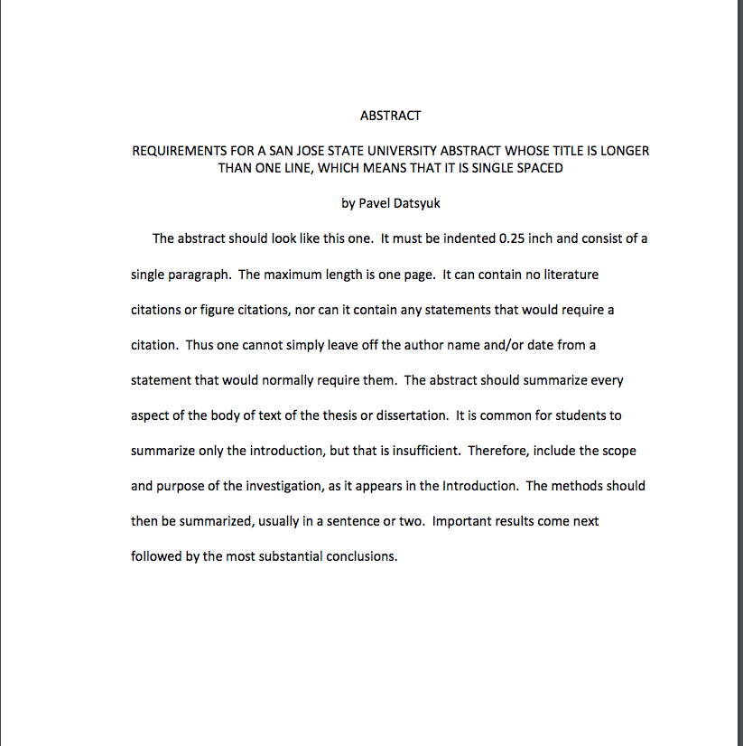
Start 4 lines from top
ABSTRACT
Skip 2 lines
CAPS, Single Space
0.25” indent
Skip 2 lines
Skip 1 line
APA states 150-250 words depending on the journal.
Graduate Studies thesis/dissertation guidelines supersede APA in a few areas and this is one of them. The abstract must be one page, one paragraph, no key words. See the abstract information in the thesis/dissertation guidelines (p.14) and make sure that all of the elements mentioned therein are covered in the abstract.
Skip 2 lines
All Centered
Skip 2 lines
Skip 2 lines
Skip 6 lines
Align First initial with A
Create a Table ( Single spaced)
Scope, Purpose, Methods,
Results, Conclusions

Slide 12
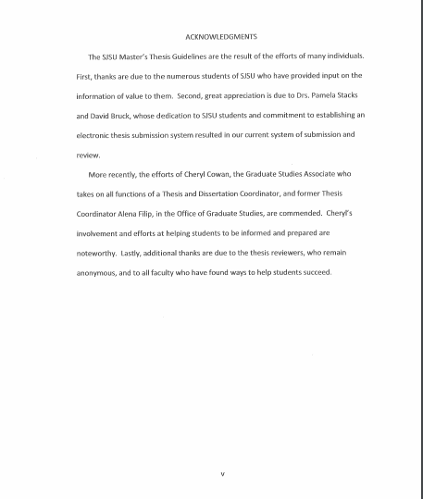
Centered and CAPS
This page is Optional
Page# to be shown

Slide 13
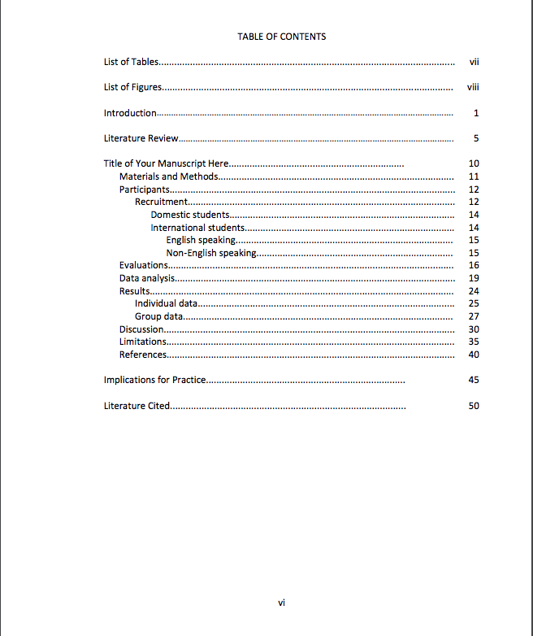
Skip 2 lines between Main Headings
Right Justify
On RH
Column
To align
Page#s
TABLE OF CONTENTS
Indent
0.25” Format/Paragraph/0.25” from Left
Skip 1 line
Within
Headings
Pagination continues
And shown
Same font as rest

Slide 14
Table of contents – things to remember
Set your titles to match APA format.
Double Space between headings and Single Space within.
Place References BEFORE Appendices.
Appendices............................................................................................... 100
A. Participant Consent ................................................................. 100
B. Individual Interview Protocol.................................................. 101
C. Group Interview Protocol...................................................... 103
D. Observation Protocol.............................................................. 105
E. Field Notes.................................................................................. 106
F. Final Coding................................................................................. 109

Slide 15
Tables & figures
Must appear directly after the initial reference to them.
Same data cannot be used for both Table & Figure - Choose 1 format.
Table title appears above table.
Figure description follows immediately after the figure number (APA Manual p.152).
Cite Table or Figure adapted from another source.
Mid-sentence break to place Table or Figure within text is NOT ALLOWED.
Color not recommended – Using shading, cross-hatching recommended.

Slide 16
Tables
Table 1
Example Short Table
Note. Adapted from….
Title Case
Short title
Italics
Heading Ex 1 | Heading Ex 2 | Heading Ex 3 | Heading Ex 4
Notes under the table. (Note italicized)

Slide 17
Table Title
Word has an option of generating table and figure captions which can then be used to generate the List of Tables/Figures automatically.
Tables
  Create the table and add the description above the table.
  Place cursor at the beginning of the description.
  Go to References/Insert Caption.
  Choose Label as Table and make sure the box above shows Table # in the caption field.
  APA format has the title in two lines, so place the cursor at the end of the label and hit Shift + Enter to start a new line.
  If you use just Enter, the List of Tables would only pick up the first line (Table #).

Slide 18
Figures
Sentence Case
Description length not a concern.
Figure 1. Sample picture taken from Ed.D website

Slide 19
Figure caption
Word has an option of generating table and figure captions which can then be used to generate the List of Tables/Figures automatically.
Figures
  Create the figure and add the description below the table.
  Place cursor at the beginning of the description.
  Go to References/Insert Caption.
  Choose Label as Figure and make sure the box above shows Figure # in the caption field.
  Insert a tab between the figure # and description and also italicize Figure #
  Select the caption and single space it.

Slide 20
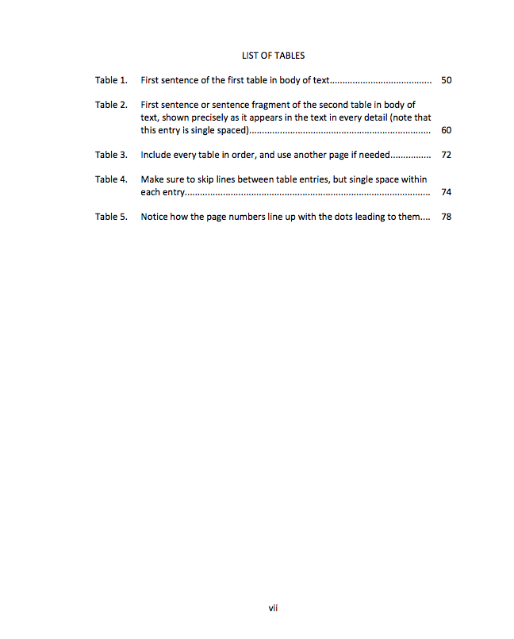
Double Space between
Sections
LIST OF TABLES
Right Justify
On RH
Column
To align
Page#s
TABLES MUST BE IN TITLE CASE. THESE ARE INCORRECT in the guidelines. EXAMPLE FOR TABLE 1: It should read First Sentence of the First Table in Body of Text
Single Space within Sections
Dots line up with Page#
Pagination continues
And shown
Same font as rest.

Slide 21
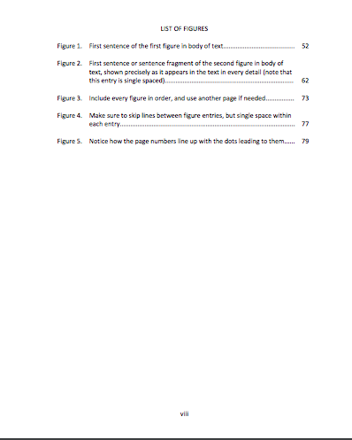
The words “LIST OF FIGURES” should be in all CAPS in the center of the page.
D/S between sections but S/S spaced within sections.
Make sure that the page numbers line up with the dots leading up to them. If there is more than one line of text, make sure the page number is lined up with the second line of text.
Pagination uses a lowercase Roman numeral centered at bottom of the page.
Continue counting from the List of Tables, if included.

Slide 22
List of tables/figures formatting
Click on References/ Insert Table of Figures.
Choose Caption Label: Table and Formats: From Template in the dropdown.
Check Show page numbers and right align page numbers.
Click on Modify and in the new window click on Modify again.
Set the spacing to Single spaced, choose your font type and size.
Click on Format and Paragraph.
Set indentation right to 0.5” and Special to Hanging 0.75”.
Click OK.
The Table titles are now formatted but italicized, click on the titles and unclick italics.
Repeat the same for List of Figures.

Slide 23
checklist
Left Justified.
0.25” Indent.
No Hyphenated words at end of line.
No double columns except in tables.
D/S except in offset quotations, footnotes, table & figure captions, with TOC and the references.
Offset quotations should be indented from both margins inward.
Only 1 font ( except appendices – can use another).
Margins : Left-:1.5”, Top & Bottom – 1.25” each; Right-1”

Slide 24
checklist
Crowding words and leaving excessive space not permitted.
No headers or footers(except for page#).
Title – CAPS, no /b, S/S, Centered, 1.5” from top, 300 characters.
Page # as Arabic numerals (1,2..) beginning from Introduction placed either bottom center or top right hand corner. Appendices also include page #.
Table & Figures must appear directly after the initial reference to them.
Same data cannot be used for both Table & Figure- Choose 1 format
Table captions above table; Figure description below figure.
Succinct captions in List of tables or figures.

Slide 25
checklist
Color not recommended.
Watch for overuse of possessives and lack of apostrophes. Whereas it is not erroneous to use participants’ responses, the meaning is unchanged and the awkwardness removed by changing the phrase to participant responses.
A numeral, such as 40 cannot start a sentence. A number, such as Forty can.
Check that References match citations and vice versa.

Slide 26
Pre-format review experiences…
Abstract - Do not define acronyms(LCAP, LCFF) here. Do that in your document upfront and then use the acronyms throughout.
Abbreviations – Check to make sure that they are defined before using them.
Appendix – Add Page numbers. Format for Appendix is given in Page 39 of the APA manual.
Page numbers need to be the same size and font as the rest of the document.
Please check the settings for your margins. It must be L-1.5", R-1" , Top and Bottom 1.25”.
All indents must be 0.25" and not 0.5".
Quotes Offset - Do not right justify. Indent 0.25" both sides.
Italics can be also be used when you are introducing a new key term or label, test scores and scales, statistical symbols etc. For examples, refer to the list of specific uses of italics in pages 104-106, 118, 176-77 of the APA manual.

Slide 27
Pre-format review experiences…
References -Hanging indent could be 0.5“.
All multiple in text citations must be in Alphabetical order and not by date – For example- the citation should be(Brewster & Railsback, 2003; Bryk & Schneider, 2002; Tschannen-Moran & Gareis, 2015).
‘References’ is centered and not bold. Double space all reference entries. Use the hanging indent format- first line of each reference is set flush left and subsequent lines are indented. Refer Chapter 6 of the APA manual (P.169-192).
Please check References -Check the format for references in Ch. 7 of the APA format manual. Google scholar does not give the correct format. Please look at the references examples in the manual or template.
Please double check that all your in text citations are in the references and vice versa.

Slide 28
Pre-format review experiences…
Please check your headings - The Table of Contents and the document must match.
In the Table of Contents, Page numbers need to be right aligned.
Table of Contents -
  The titles must match case - For ex: the sub headings must be sentence case.
  For long titles, split it into two lines(Single spaced) and then have the dots running up to the page number on the second line.
Table width must fit within margins, also refer APA Manual pages 127-129 for table formatting requirements (borders).
Tables/ List of Tables - Use shorter titles in the document and make sure the titles match those in the list(including title case). You can move larger part of the text in the table title to the Note under the table.
Check format for Figure captions (Page 160 of APA Manual).
Figures/ List of Figures - Make sure the caption is sentence case. And the captions in the document and the List of figures match word to word.

Slide 29
Some useful links
Graduate Studies dissertation reference guide:
  http://www.sjsu.edu/wac/pages/edd-writing support/SJSU%20Dissertation%20Quick%20Reference%20Guide.pdf
http://www.sjsu.edu/edd/resources/edddissertationguidelines/index.html
  Ed.D. Guidelines Checklist
  FAQ
  Dissertation pagination guide
Use of doi/url - https://blog.apastyle.org/files/doi-and-url-flowchart-8.pdf
http://www.sjsu.edu/gup/docs/dissertation_forms_packet.pdf

