Slide 1

Making Friends with Canvas and Writers Help
An Introduction to what’ is possible
Notes:
NOTE: Want a different image on this slide? Select the picture and delete it. Now click the Pictures icon in the placeholder to insert your own image.

Slide 2
Agenda
Introductions and issues
How I use Canvas
How I use Writer’s Help diagnostics and Learning Curve
Ways to integrate writers Help
A note about comparing versions in Word—and referring to Writers Help.

Slide 3

Five problems that using Canvas has solved for me:
No lost papers 
Saves paper: No printing of handouts (theoretically), really no need for a course book if all handouts and readings are in the file folders (easy to organize) 
No questions about grades (Students can always see in Canvas and I can download final tally into excel) 
My handwriting is an issue for anyone and students can not incorporate suggestions if they can’t read them!  Also:
Easy notation in papers—that we can all read later
Easy connection to learning objectives/rubrics
Easy notification for all when there is a change of plans/schedule

Slide 4
Writers Help good stuff
Diagnostic allows you to take the grammatical pulse of your students. Results can be tabulated so you know what needs attention.
Outcome of diagnostic goes right into gradebook (if set up to do so)
I ask students to do a workshop for every diagnostic section under 75%. Some really like the opportunity to find out what a modifier is.
You can point to activities and explanations in Writers help as you grade a paper.
You can assign special work for language learners—online, and go over questions with them during office hours. This is one way to help recent English language adopters work in the background while doing the same in class work (differentiation).
NOTE: No computer can take the place of a good tutor, teacher, mentor. Language learning is difficult.

Slide 5
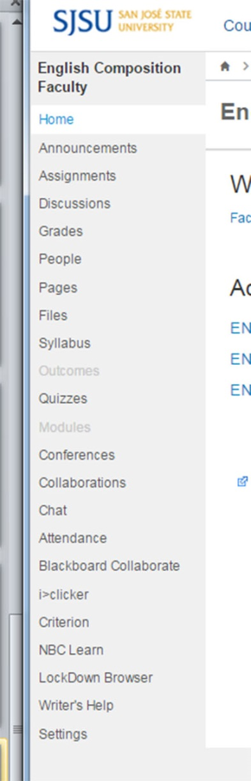
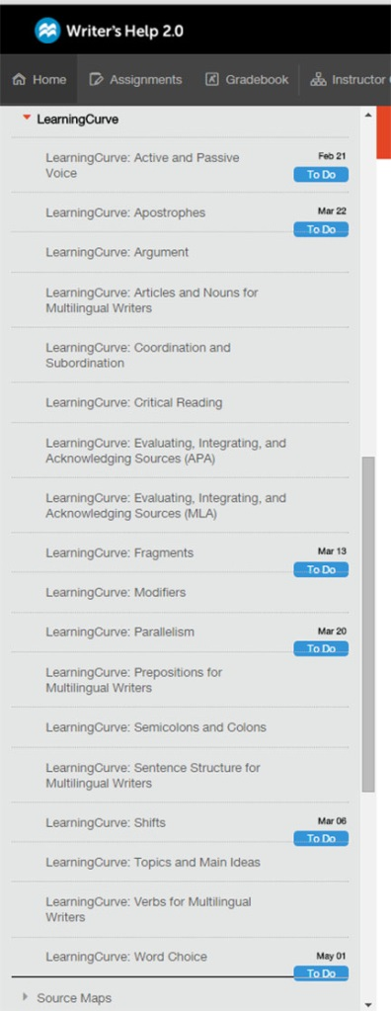
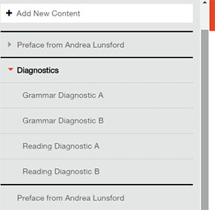
Where is Writers help (in Canvas) and what is in there
Where
What is in there?
Reading and grammar Diagnostics
Learning Curve activities
Scroll around and see for yourself
Near bottom

Slide 6
How to take diagnostics
Non integrated way:
Students open writers help in Canvas and click on diagnostic, chose the one you want them to take
Students answer the questions, get their results in a table
Students paste table into word doc (with header to indicate whose it is)
And either: print out and give to you, post in canvas (you’ve made a spot), or email it to you.
Then YOU see where they got less than what you want them to achieve (I set it at 70%)
Then YOU assign them activities in Learning curve (See previous page) and ask for proof (same as above) when they have done them.
For integrated way: Edith.Brady.contractor@macmillan.com

Slide 7
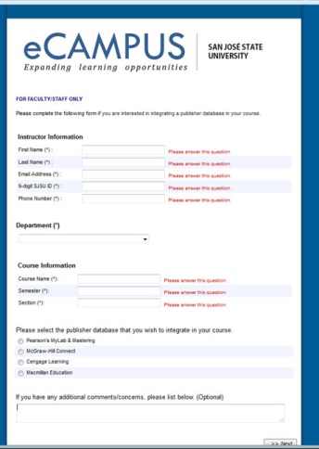
Writers Help integrations begins www.sjsu.edu/at/ec/integratingpublisherdatabase/index.html
Let Jennifer Redd’s group know you want to integrate
writers help with canvas by clicking on the link above
or pasting it into your browser.
Fill out form and click last radio button: Macmillan Education
In the comments box, list all other sections or courses
you want integrated
Click next and keep going. Submit.

Slide 8
Integration continued
After filling out the form and submitting…
Macmillan Higher Ed appears on our navigation bar on the left (in Canvas)
Click on link to Macmillan Higher Ed and a new screen appears with the phrase “Getting Started”
Click on that and answer questions, which takes you to a list of courses.
If your course is not in the “master list”—create a course at this point. This will refresh your list of courses. Choose the course you want to link.
Then email Edith.Brady.contractor@macmillan.com and let her know which sections you want to link.

Slide 9
Things to note
Preferred browsers: google chrome, Firefox.
Dispreffered: Safari (99% works), Internet Explorer (often problematic)
Must go into settings (in browser) to allow pop-ups or nothing will run.
For instructors:
Within canvas, default email must be your sjsu email.
Settings in Canvas/Apps tab: view App configurations, macmillan@highered app—edit: choose privacy, must be public, not anonymous. Submit

Slide 10
Writers Help
What I currently do:
In Canvas: highlight issues and good stuff
At the bottom of word doc, indicate what highlighting means
Type or paste in the link to the chapter describing the issue and how to correct it,
the Learning Curve activity you would like them to use,
and how they can let me know they did these things.
For what more is possible, contact Edith.Bradey.contractor@macmillan.com

Slide 11
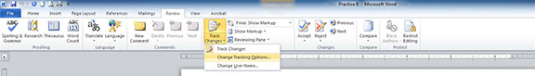

IN MS word--comparisons
Requirements: Papers are in Msword. I have my students submit them to canvas. If in any other format, you will have to take quite a few steps to create a word doc.
Download both versions (you may have already saved the first version) to separate folders identified as a and b versions (or however you identify for yourself)
Prepare your comparison settings in Review/track changes/change tracking options
More in word doc example
Then choose Compare—combine

Slide 12
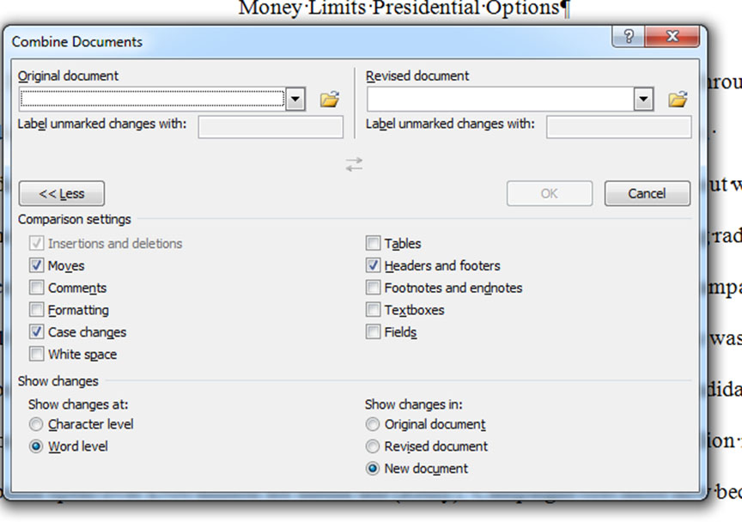
Comparing in MSword
And finally, select the two papers
And what you want to compare

Slide 13
If we run out of time, what else would you like to work on?
Email me with questions at linda.lappin@sjsu.edu
Also, Email me about proposed ways to use these technologies in math, science, history, art, etc.

Slide 14
References
About canvas (help online): https://community.canvaslms.com/community/answers/guides/
About Writer’s Help: Edith.Brady.contractor@macmillan.com
About evaluating with rubrics—come to workshop on that
Faculty Focus—lots of ideas for teaching and learning: http://www.facultyfocus.com/
Teaching Professor (Stanford blog): https://tomprof.stanford.edu/

