Slide 1
Providing feedback on student writing
Sponsored by the Writing Across the Curriculum Program
San Jose State University
Sara Cook

Slide 2

We’ve made it through the last 3 years!

Slide 3
Agenda
Feedforward: Designing Effective Materials
The Tenets of Effective Feedback
In-text Marks + Comments
Culminating Comments + Rubric

Slide 4
The goal of providing feedback
To communicate how the student can improve by detailing his/her/their strengths and weaknesses.
Consider the feedback process an opportunity to teach
(vs. substantiate a grade).

Slide 5
Before feedback, feedforward

Slide 6
Designing effective materials
Set them (and you) up for success with clear, well-developed materials and scaffolding.
Clear instructions
Rubric
Modeling Skills
Scaffolding*
  *Helps prevent AI use

Slide 7
Designing effective materials
Assignments
Basic Requirements: Due dates, length, etc.
Context: Learning goals, real life, etc.
Rhetorical Specifications: Purpose, Audience, Genre.
Prompt: Accounts for classroom context, appropriate scope, etc.

Slide 8
Designing effective materials
Assignments
rubrics
Basic Requirements: Due dates, length, etc.
Context: Learning goals, real life, etc.
Rhetorical Specifications: Purpose, Audience, Genre.
Prompt: Accounts for classroom context, appropriate scope, etc.
Specifying the assessment criteria – for them AND you.
Narrative, Numeric, Analytic, and Holistic
Criteria: Content and Prose
Diction: Employ the same diction in the rubric and the prompt: the student must see how these two documents take root in each other.

Slide 9
The tenets of effective feedback

Slide 10
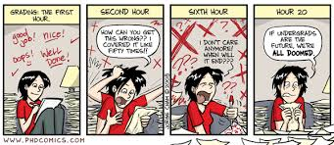
The tenets of effective feedback
1. Identify both strengths and weaknesses
Students need to know what to replicate, as well as what to repair.

Slide 11
The tenets of effective feedback
Content
Strengths
Weaknesses
Prose
Strengths
Weaknesses
2. Criticize both Content and Prose
GE Guidelines, Assessment:
“Writing shall be assessed for
grammar, clarity, conciseness and
coherence.”

Slide 12
The tenets of effective feedback
3. Quantity Matters
Too little feedback =
Makes it very difficult for students
to improve (and not make the
Same mistakes again.)

Slide 13

The tenets of effective feedback
3. Quantity Matters
Too little feedback =
Makes it very difficult for students
to improve (and not make the
Same mistakes again.)

Slide 14

The tenets of effective feedback
3. Quantity Matters
Too much feedback =
The volume of marks/comments can overwhelm students (especially now).

Slide 15
The tenets of effective feedback
3. Quantity Matters
Too much feedback =
The volume of marks/comments can overwhelm students (especially now).
Students are not given the opportunity to find and correct errors themselves.

Slide 16
The tenets of effective feedback
3. Quantity Matters
Too much feedback =
The volume of marks/comments can overwhelm students (especially now).
Students are not given the opportunity to find and correct errors themselves.
Instructors may burn-out, or sacrifice future assessments.

Slide 17
The tenets of effective feedback
4. Mark Patterns
Students often repeat; errors or weaknesses throughout an assignment.
  Whenever possible; identify these patterns for the student.
  Focus on the errors or weaknesses; that most undermine the clarity and readability of the piece.
  (What is the pattern of error in this slide?)

Slide 18
The tenets of effective feedback
5. Actionable + Specific
Consider these common feedback phrases:
“Good work!”
“This is a weak paper.”

Slide 19
The tenets of effective feedback
5. Actionable + Specific
Consider these common feedback phrases:
“Good work!”
“This is a weak paper.”
These are not actionable, or specific.
These are value judgements.
What, exactly, is “good”? What, exactly, is “weak”?

Slide 20
The tenets of effective feedback
5. Actionable + Specific
If you favor phrases like these, consider adding a colon after each statement of value.
    "Good work: Your sentence construction is more strategic in this paper than in the last one, which has yielded more meaningful prose.“

Slide 21
The tenets of effective feedback
5. Actionable + Specific
If you favor phrases like these, consider adding a colon after each statement of value.
    "Good work: Your sentence construction is more strategic in this paper than in the last one, which has yielded more meaningful prose.”
    "This is a weak paper: Your thesis only addresses the prompt superficially, and in the second paragraph you propose a different thesis; following this, you do not offer any evidence to support your claims, just beliefs."

Slide 22
The tenets of effective feedback
5. Actionable + Specific
Consider familiarizing yourself with the Top 20 Errors in Undergraduate Writing
This helps us avoid comments like “awkward” that are not actionable or specific, and usually just exist to substantiate a grade.

Slide 23
The tenets of effective feedback
5. Actionable + Specific
“The most ubiquitous form of evaluation, grading, is so much a part of the school landscape that we easily overlook its utter uselessness as actionable feedback. Grades are here to stay, no doubt—but that doesn't mean we should rely on them as a major source of feedback.” - Grant Wiggins

Slide 24
In a nutshell
Balance:
Strengths & Weaknesses
Content & Prose
Enough feedback, but not too much

Slide 25
In a nutshell
Balance:
Strengths & Weaknesses
Content & Prose
Enough feedback, but not too much
Identify:
Patterns of error, and/or what problem/s are doing the most damage.
Provide:
Specific, actionable feedback.

Slide 26
In-text feedback
What do we mark, and how do we mark it?

Slide 27
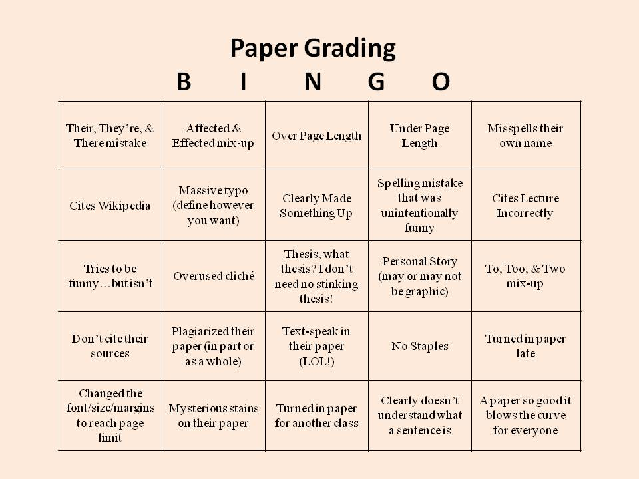
Get prepared
Review the prompt and rubric.
Think about what skills, knowledge, and learning goals students need to demonstrate in the assignment.
What is most important?

Slide 28
In-text feedback
1. Triage
Start by reading the entire assignment WITHOUT marking anything. Sit on your hands if you have to.
Or, preview 4-5 papers and see if any patterns emerge.

Slide 29

In-text feedback
1. Triage
Next
Given the rhetorical context and learning objectives of the assignment, what issues are most undermining the text? What issues most deserve your time and attention?

Slide 30
In-text feedback
1. Triage
A triage helps save time, and focus the feedback.
This allows instructors to find patterns, and decide which battles they are going to fight (ultimately saving time).
Battles can be local/sectional/global.

Slide 31
In-text feedback
1. Triage
A triage helps save time, and focus the feedback
This allows instructors to find patterns, and decide which battles they are going to fight (ultimately saving time).
Battles can be local/sectional/global.
This also enables instructors to find (if applicable) one paragraph, or one page, that comprehensively demonstrates the systemic issues in the text. Then, the instructor can thoroughly mark-up only that one paragraph, or page.

Slide 32
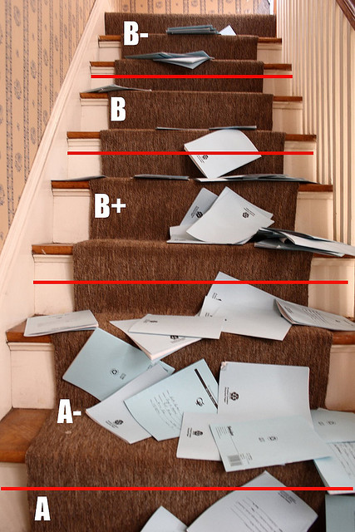
In-text feedback
2. WHAT to Mark
  Whenever possible, mark patterns of error or weakness.
  Content: Tackle the problem/s that are preventing the student from achieving the purpose of the assignment and/or learning goals, or whatever problem is doing the most damage.
  Prose: Tackle the problem/s that most interfere with meaning, and/or readability.

Slide 33
In-text feedback
3. HOW to Mark: the 4-Step Strategy
1. Indicate, name, and correct the first occurrence in the pattern.
Responsibility: Instructor
2. Indicate and name the second occurrence in the pattern.
Responsibility: Instructor & student
3. Indicate the third occurrence in the pattern. Responsibility: Instructor & student
4. Leave some errors completely unmarked. Responsibility: Student

Slide 34
In-text feedback
Why is it so important to name the error or weakness?
  This makes the feedback actionable and specific (and not a value judgement).
  It enables students to help themselves by giving them recourse to correct their errors.
  Makes the lesson transportable.
  Builds a common language between instructors.

Slide 35
In-text feedback
4. Comments: Initiate a Dialogue
By framing comments as questions, rather than statements, instructors are inviting students into the assessment dialogue, and encouraging them to reflect on the choices they’ve made.
How does this prove […]?
How can you […] more effectively?
How am I to understand the link between these two paragraphs?

Slide 36
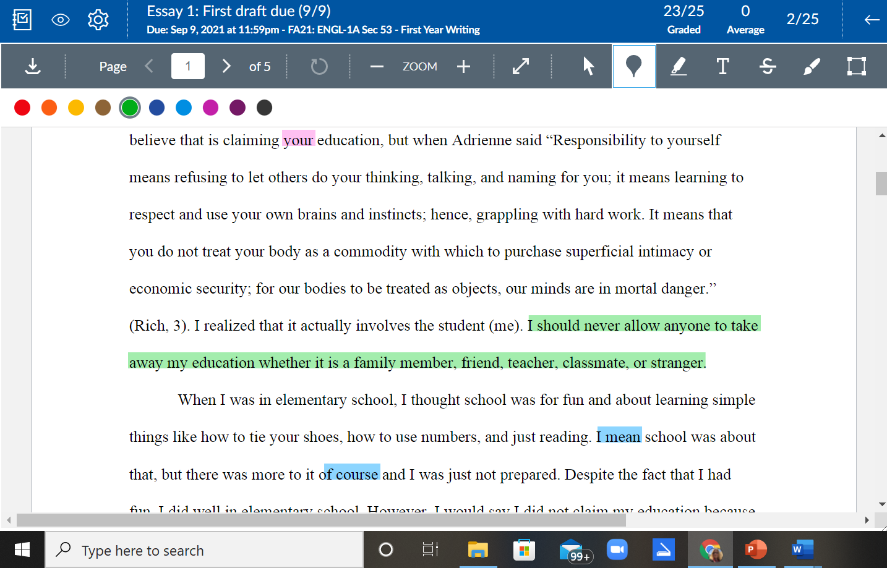
In-text feedback with speedgrader
Consider Color-Coding
Problems with purpose of assignment? (Those most important things you identified when you were getting prepared)
Patterns of error you found in the triage?

Slide 37
In-text feedback with speedgrader
Consider Providing Informational Links with In-Text Comments
Course text
Style Manual
Writing Center “Homegrown Handouts”
You are having trouble synthesizing your sources, which has resulted in unconvincing evidence for your thesis. Please review synthesizing sources for your future essays: https://www.simplypsychology.org/synthesising.html

Slide 38
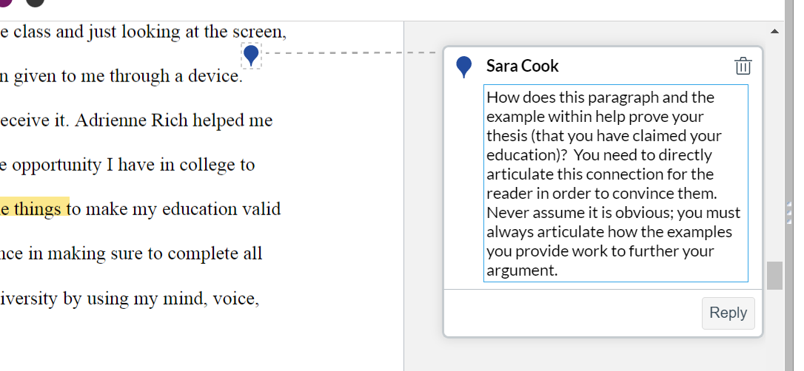
In-text feedback with speedgrader
Comments: Initiate a Dialogue

Slide 39
In-text feedback with speedgrader
Consider Creating a Comment Bank
Create a document with complete comments, or sentence frames, or links, to copy/paste into SpeedGrader annotations/highlighting.
When possible, borrow language from the rubric.

Slide 40
In-text feedback with speedgrader
Consider Creating a Comment Bank
Create a document with complete comments, or sentence frames, or links, to copy/paste into SpeedGrader annotations/highlighting.
When possible, borrow language from the rubric.
“Great thesis: it is critical and of the appropriate scope. Keep this up!”
“Pattern of error = sentence fragments. Please review this issue here, and proofread your next essay for this error. Let me know if you need help with this.”

Slide 41
culminating comments + rubric

Slide 42
Culminating comments
Remember the Balancing Act:
Strengths & Weaknesses
Content & Prose
Enough feedback, but not too much

Slide 43
Culminating comments
Dahlia,
In the first few pages here you do a good job using concrete info (i.e. specific players) to discuss this topic; however, this info, and your sources, simply proves that competitors use PEDs, not why this practice needs to be stopped (which is what your thesis promises to prove). That said, I see improvement in your sentence crafting here (see pg.2). In your next essay I’d like you to work on your imprecise and/or poor word choices (see pg. 1), as well as creating a more convincing concluding paragraph (pg. 2,3). See my other comments/corrections throughout and let me know if you have any questions.

Slide 44
Culminating comments
Dahlia,
In the first few pages here you do a good job using concrete info (i.e. specific players) to discuss this topic; however, this info, and your sources, simply proves that competitors use PEDs, not why this practice needs to be stopped (which is what your thesis promises to prove). That said, I see improvement in your sentence crafting here (see pg.2). In your next essay I’d like you to work on your imprecise and/or poor word choices (see pg. 1), as well as creating a more convincing concluding paragraph (pg. 2,3). See my other comments/corrections throughout and let me know if you have any questions.
  Begins with a strength.

Slide 45
Culminating comments
Dahlia,
In the first few pages here you do a good job using concrete info (i.e. specific players) to discuss this topic; however, this info, and your sources, simply proves that competitors use PEDs, not why this practice needs to be stopped (which is what your thesis promises to prove). That said, I see improvement in your sentence crafting here (see pg.2). In your next essay I’d like you to work on your imprecise and/or poor word choices (see pg. 1), as well as creating a more convincing concluding paragraph (pg. 2,3). See my other comments/corrections throughout and let me know if you have any questions.
  Begins with a strength.
  Organizational strategy: Critique of content, followed by critique of Prose.

Slide 46
Culminating comments
Dahlia,
In the first few pages here you do a good job using concrete info (i.e. specific players) to discuss this topic; however, this info, and your sources, simply proves that competitors use PEDs, not why this practice needs to be stopped (which is what your thesis promises to prove). That said, I see improvement in your sentence crafting here (see pg.2). In your next essay I’d like you to work on your imprecise and/or poor word choices (see pg. 1), as well as creating a more convincing concluding paragraph (pg. 2,3). See my other comments/corrections throughout and let me know if you have any questions.
  Begins with a strength.
  Organizational strategy: Critique of content, followed by critique of Prose.
  Looks to past writing and future writing: helps students understand writing as a process and a skill that needs cultivation.

Slide 47
Culminating comments
Dahlia,
In the first few pages here you do a good job using concrete info (i.e. specific players) to discuss this topic; however, this info, and your sources, simply proves that competitors use PEDs, not why this practice needs to be stopped (which is what your thesis promises to prove). That said, I see improvement in your sentence crafting here (see pg.2). In your next essay I’d like you to work on your imprecise and/or poor word choices (see pg. 1), as well as creating a more convincing concluding paragraph (pg. 2,3). See my other comments/corrections throughout and let me know if you have any questions.
  Begins with a strength.
  Organizational strategy: Critique of content, followed by critique of Prose.
  Looks to past writing and future writing: helps students understand writing as a process and a skill that needs cultivation.
Most importantly, comments are anchored by in-text feedback: Directing students to in-text examples (by referring to page numbers) helps them translate the broader final comments into specific textual choices.

Slide 48
Culminating comments
Consider Using Bullet Points
Strengths: Weaknesses:
- Critical analysis - Introductory paragraph (see pg.1)
(see pgs. 2 & 4) - Patterns of grammatical errors:
- Academic, reliable sources verb-tense shifts (pg. 3) and
(see References) comma errors (pgs. 1 & 2)
(Or sometimes “The Good, The Bad, and The Ugly”)

Slide 49
“Wise” feedback
“Breaking the Cycle of Mistrust: Wise Interventions to Provide Critical Feedback Across the Racial Divide” (Yaeger et al., 2014)
Wise Feedback:
Communicate high expectations.
  “I know it feels like this is a very challenging task I’m asking you to do - and it is.”
Explain that you believe the student can meet the expectations.
  “Your work to this point demonstrates that you already can do _____ and ___ well, so I know that you are capable of meeting the expectations for the final draft.”
Provide actionable feedback that demonstrates support.
  “The feedback I gave you on your draft is where you should start as you write the next version - I look forward to reading your final paper!”

Slide 50
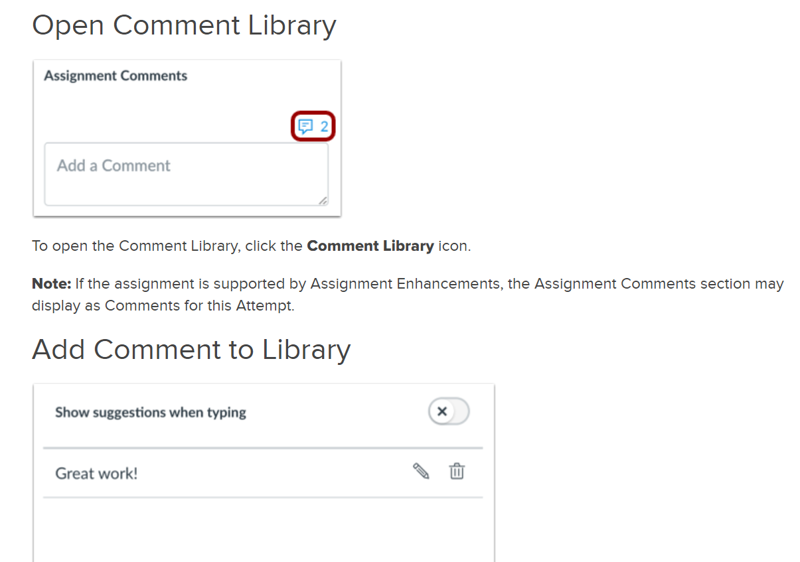
Culminating comments
Consider Using the Comment Library in SpeedGrader
Directions here

Slide 51
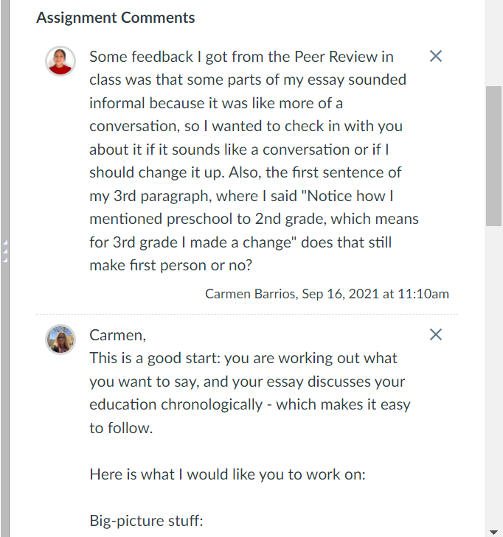
Culminating comments
Consider soliciting students to focus your feedback
Ask students to identify what they would like your feedback on. Maybe something they had trouble with? Or something they worked hard on and want their success validated?
Student reflection = good pedagogy!
This could be a requirement included on the assignment sheet.

Slide 52
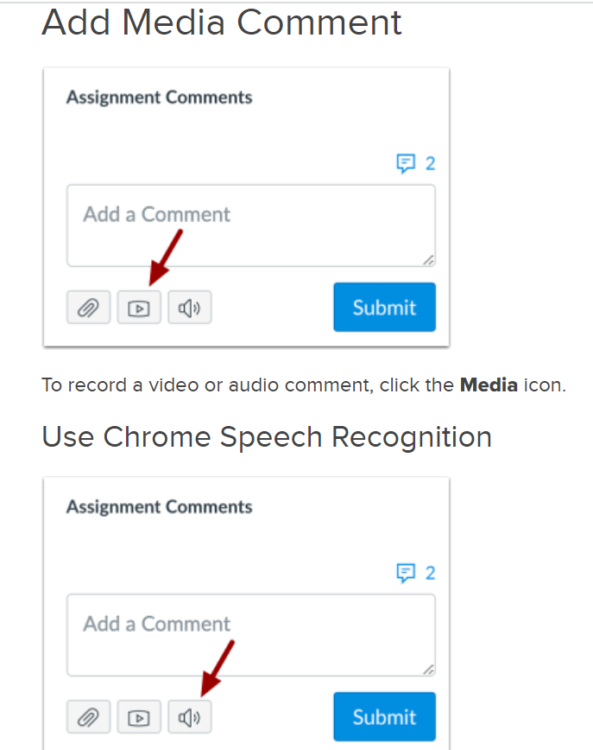
Culminating comments
Consider media comments in SpeedGrader
This can make feedback more personal.
This method is particularly effective for commenting on rough drafts, or for A-quality work.

Slide 53
Feedback: forms of delivery
“Evaluating Written, Audio and Video Feedback in Higher Education Summative Assessment Tasks” by Josh McCarthy
Research study: McCarthy examines the use of audio, video and written feedback, to establish the advantages and disadvantages of each technique, and to “determine which model provides students with more insight into their academic performance” (McCarthy 153).

Slide 54
Feedback: forms of delivery
“Evaluating Written, Audio and Video Feedback in Higher Education Summative Assessment Tasks” by Josh McCarthy
Research study: McCarthy examines the use of audio, video and written feedback, to establish the advantages and disadvantages of each technique, and to “determine which model provides students with more insight into their academic performance” (McCarthy 153).
Conclusions:
  There is no ‘one size fits all’ feedback model when it comes to assessment in higher education. However, when possible, educators should match the feedback model with the genre of the assignment.

Slide 55
Feedback: forms of delivery
“Evaluating Written, Audio and Video Feedback in Higher Education Summative Assessment Tasks” by Josh McCarthy
Research study: McCarthy examines the use of audio, video and written feedback, to establish the advantages and disadvantages of each technique, and to “determine which model provides students with more insight into their academic performance” (McCarthy 153).
Conclusions:
  There is no ‘one size fits all’ feedback model when it comes to assessment in higher education. However, when possible, educators should match the feedback model with the genre of the assignment.
  66% of students preferred video feedback because “it provided more in-depth analysis of their academic performance in assignments, which were largely visual-based” (McCarthy 166).
    22% preferred written feedback, and 12% preferred audio feedback.

Slide 56
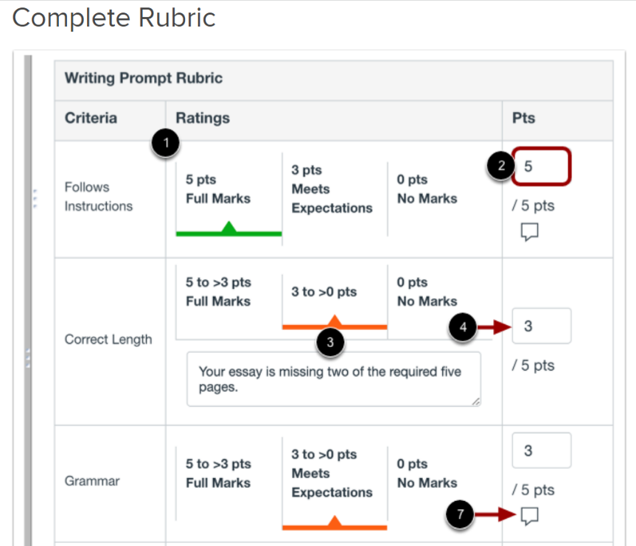
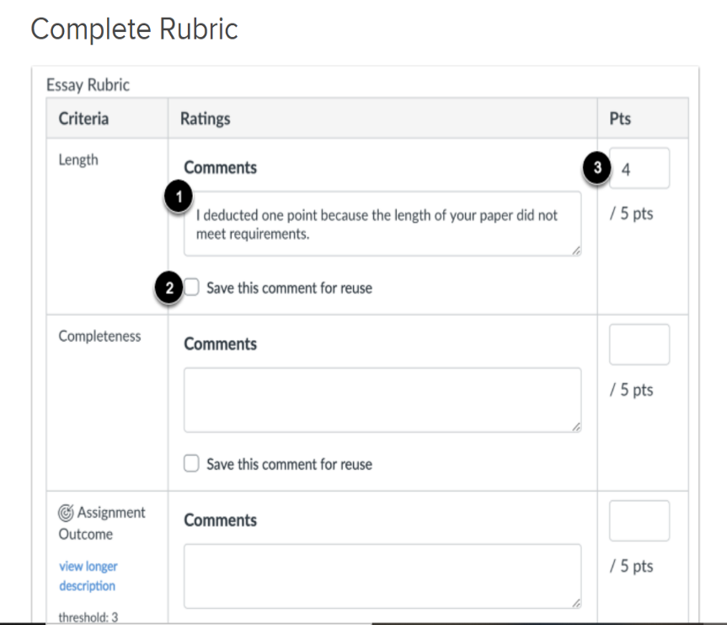
Completing the rubric
How do I use a rubric to grade submissions in Speedgrader?
How do I use free-form comments instead of ratings in a rubric on Speedgrader?

Slide 57

Completing the rubric
Whenever possible, link specific textual choices to the broader criteria in the rubric.
During the test-drive, you chose your battles; then, you marked those battles in-text. Now you can refer to the specific page numbers of those battles in the appropriate criteria in the rubric.

Slide 58
At the end…
Don’t overdo it
What feedback should go in the “Assignment Comments” and what should go in the rubric?
Make sure there is a clear
relationship between the
3 forms of feedback.
Rubric
Final Comments
In-Text Feedback

Slide 59
At the end…
Consider Creating Opportunities for Students to Engage the Feedback
Students must correct the indicated and/or unmarked errors in a pattern of error that the instructor has identified for them.
Students must type at the top of their assignment what they were asked to work on in their last assignment.

Slide 60
At the end…
Consider Creating Opportunities for Students to Engage the Feedback
Students must correct the indicated and/or unmarked errors in a pattern of error that the instructor has identified for them.
Students must type at the top of their assignment what they were asked to work on in their last assignment.
Students must submit a cover sheet reflecting on previous errors, successes, etc.
  How have you worked to improve your writing in this essay?
  What elements of your essay do you believe have been successful (i.e. good things that I should not overlook)?
  Are there any parts of this assignment that you had trouble with?
  Is there a specific part of your writing or part of this essay that you would like me to address in my feedback?

Slide 61

review
  Consider the feedback process an opportunity to teach the student how to improve.
  Remember that developing good materials up-front saves time in the long run.
  Triage and pick your battles.
  Create a clear relationship between the in-text marks, final comments, and rubric.

