Slide 1
Speedgrader
Sponsored by the Writing Across the Curriculum Program
San Jose State University
Sara Cook

Slide 2
agenda
SpeedGrader Settings
In-Text Feedback: The Annotation Tools
Culminating Feedback: Assignment Comments, Media Comments, and Rubric
Examples
Questions

Slide 3
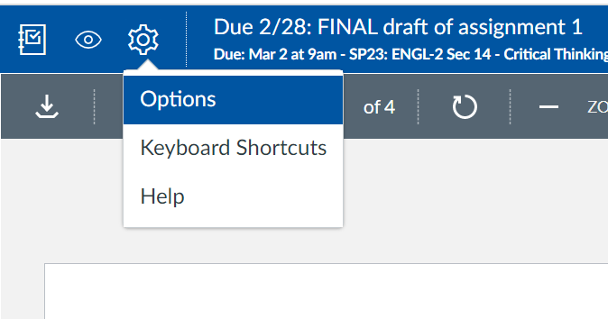
Settings
Settings icon

Slide 4
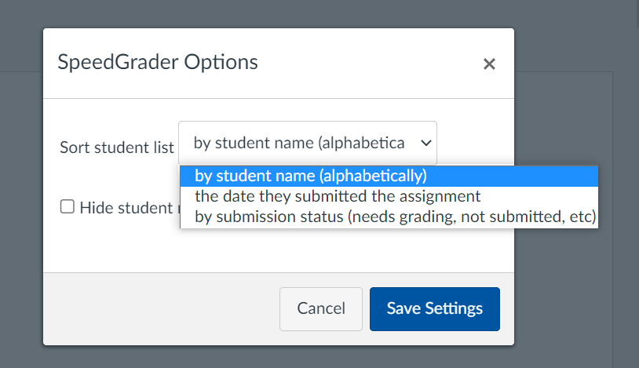
Settings
Settings icon
Setting options

Slide 5
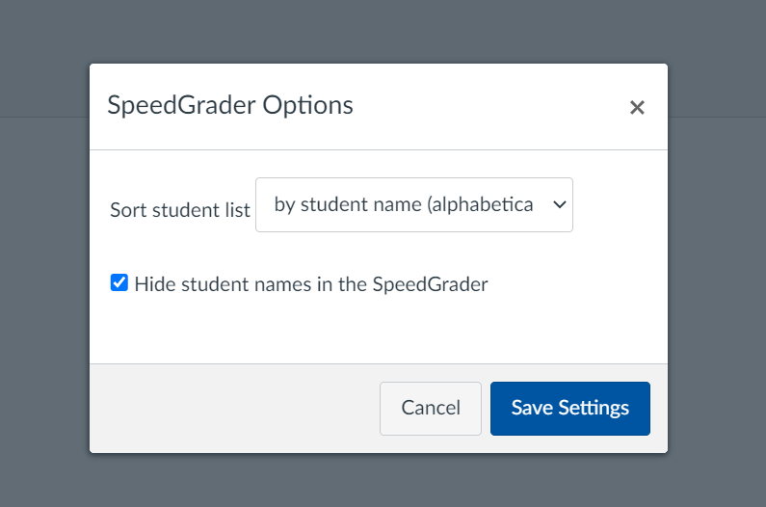
Settings
Setting to Hide student names

Slide 6
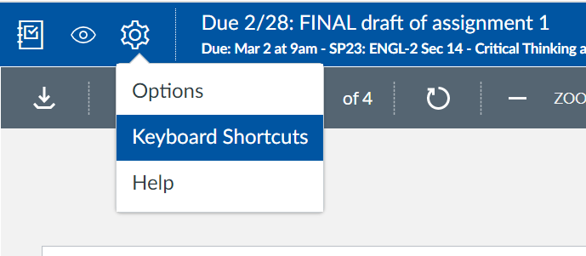
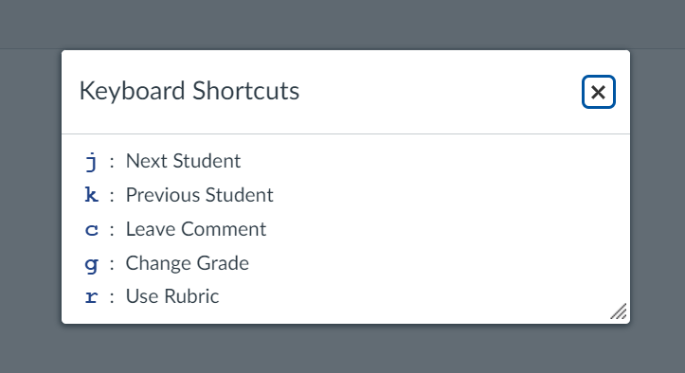
Settings
Setting to Hide student names
Setting to reveal keyboard shortcuts

Slide 7
In-text feedback: the annotation tools

Slide 8

In-text feedback: The annotation tools
Pindrop Highlight Write Text Strikethrough Free Draw Box

Slide 9
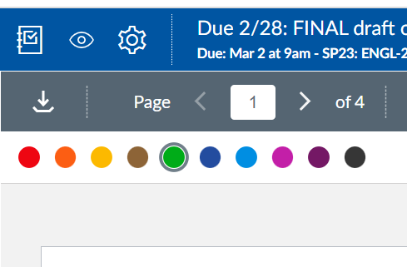
In-text feedback: The annotation tools
Color selection

Slide 10
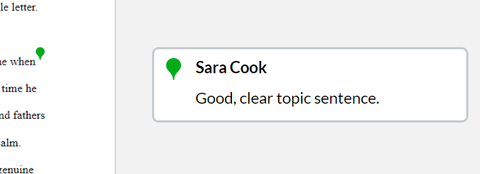
In-text feedback: The annotation tools
Color selection
Optional comments

Slide 11
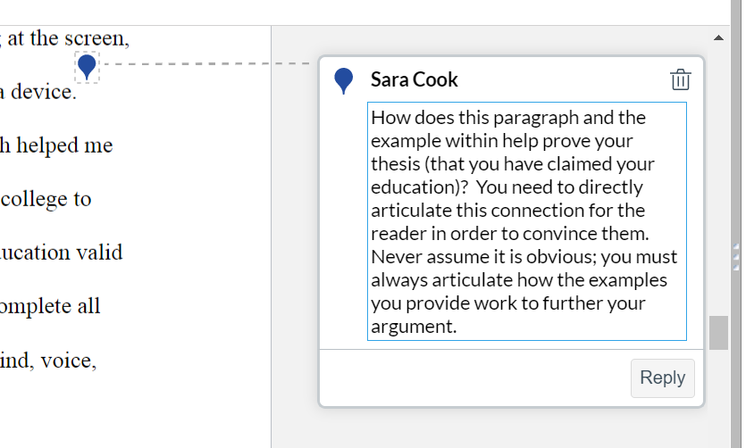
Pindrop tool
The Pindrop calls attention to a geographical area of the paper. It does not identify specific text.

Slide 12
Pindrop tool
The Pindrop calls attention to a geographical area of the paper. It does not identify specific text.
This tool is most useful for providing feedback on more global issues (e.g. organization or analysis) that do not require identifying specific text.

Slide 13
Pindrop tool
The Pindrop calls attention to a geographical area of the paper. It does not identify specific text.
This tool is most useful for providing feedback on more global issues (e.g. organization or analysis) that do not require identifying specific text.
Remember: Best practice is to frame your comments as questions, not statements, in order to encourage students to reflect on the choices they’ve made and participate in the assessment process.

Slide 14
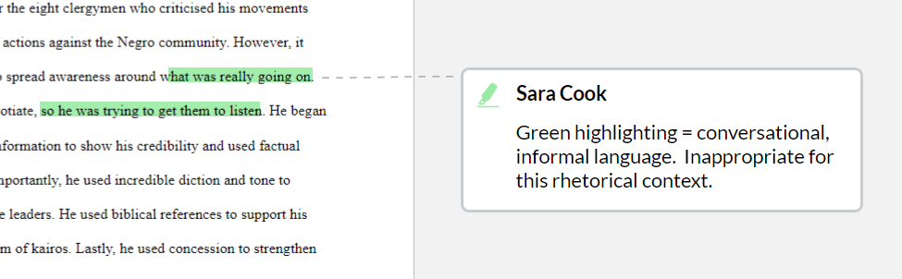
Highlighting tool
The highlighting tool identifies specific textual choices the student has made.
This makes it useful for providing feedback on more local issues like syntax and diction.

Slide 15
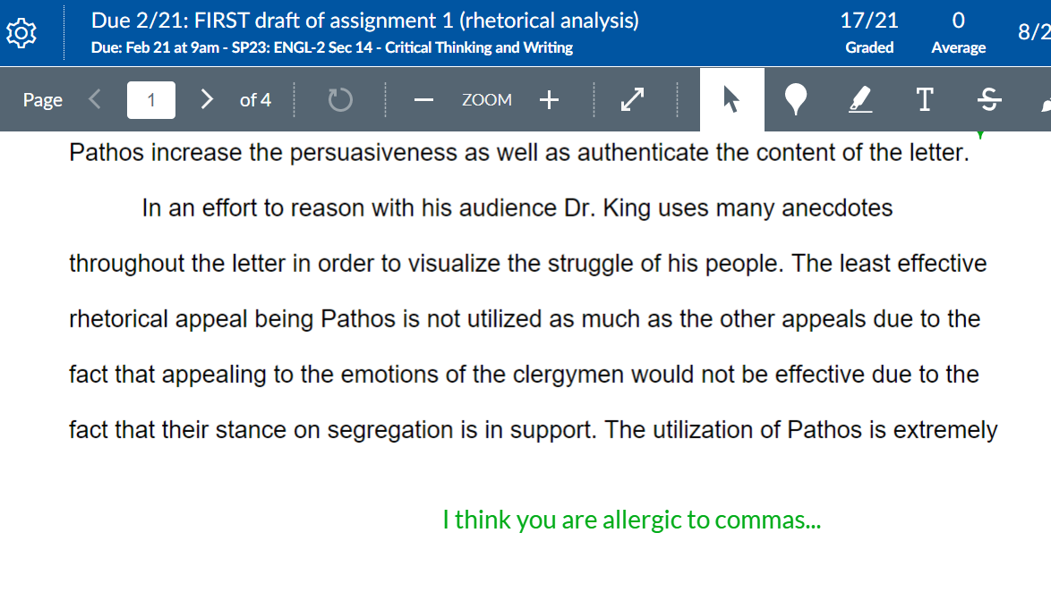
Writing tool
The Writing tool does not identify specific text in the paper, but has the benefit of being more immediately visible to the student.

Slide 16
Writing tool
The Writing tool does not identify specific text in the paper, but has the benefit of being more immediately visible to the student.
This tool is useful for making comments on chronic issues and matters pertaining to essay geography.
  “At this point in your essay I should understand what your governing argument is, but I don’t. Where is your thesis/roadmap?”

Slide 17
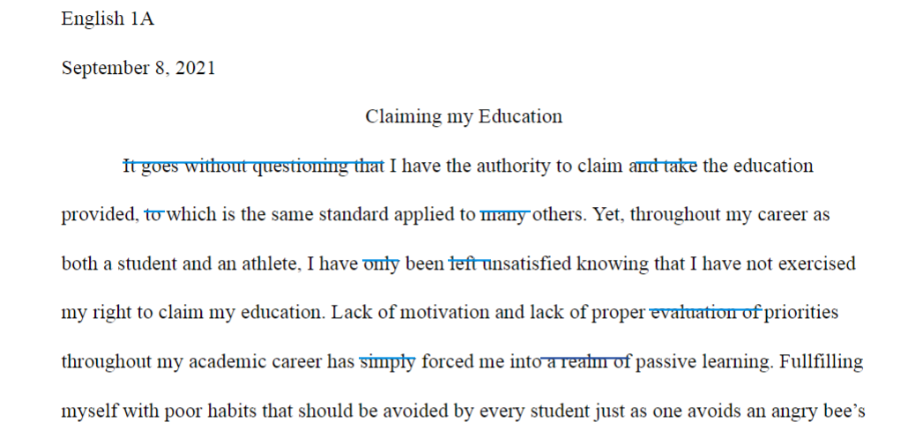
Strikethrough tool
Like the highlighting tool, the strikethrough tool identifies specific text. Therefore, it is useful in providing feedback on local issues like syntax and diction.

Slide 18
Strikethrough tool
Like the highlighting tool, the strikethrough tool identifies specific text. Therefore, it is useful in providing feedback on local issues like syntax and diction.
While in this screenshot the strikethrough tool identifies wordiness, it can also send a powerful message by striking through an entire paragraph.

Slide 19
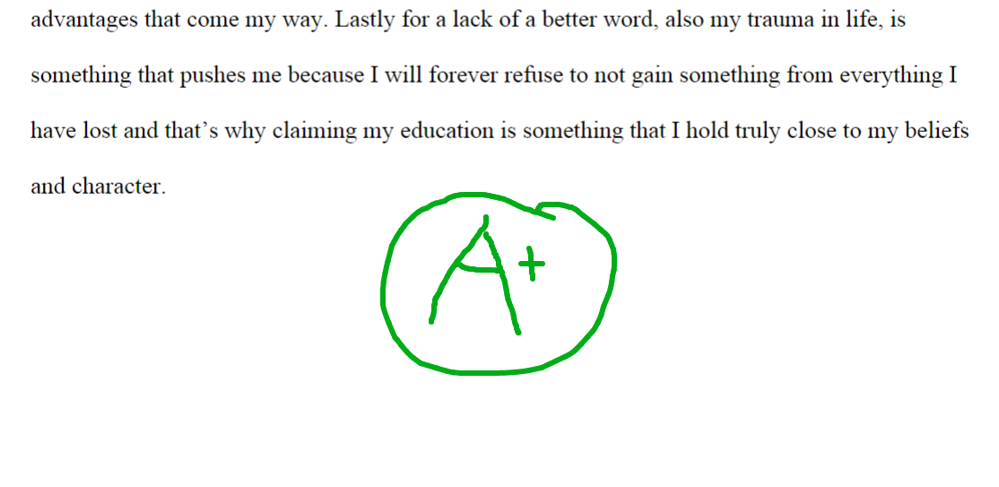
Free draw tool
The free drawing tool is mostly useful when providing feedback on math or sciences work (e.g. drawing and equation, carbon ring, etc.).
In student writing, it can be used to encourage or celebrate great work (think a big yellow smiley face, or stars).

Slide 20
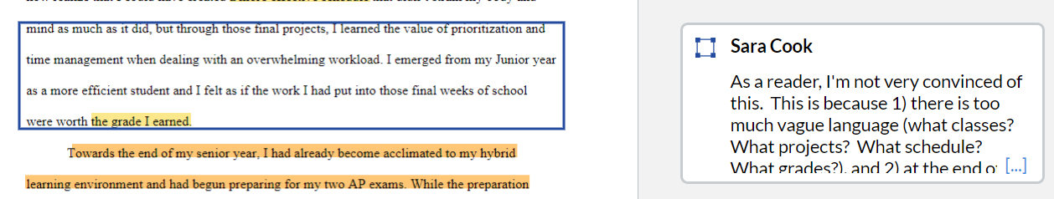
box tool
The box tool allows for identifying blocks of text in a way that is less visually stimulating than highlighting. This makes it useful for providing feedback on short passages of text (i.e. a few sentences or a paragraph).

Slide 21
box tool
The box tool allows for identifying blocks of text in a way that is less visually stimulating than highlighting. This makes it useful for providing feedback on short passages of text (i.e. a few sentences or a paragraph).
This tool is also helpful if there is one paragraph in the paper that is representative of the issues ubiquitous to the text. The paragraph could be boxed with a detailed comment, with no further annotations needed in the paper.

Slide 22
The tenets of effective feedback
Goal of feedback: to help the student improve, by detailing his/her/their strengths and weaknesses.
Identify both strengths and weaknesses.
Criticize both content and prose.
Provide some feedback, but not too much.
Mark patterns of error or weakness, when possible.
Provide feedback that is actionable and specific.

Slide 23
Color coding
Consider focusing your feedback, and helping the student improve, by creating a color-coding system using the annotation tools.

Slide 24
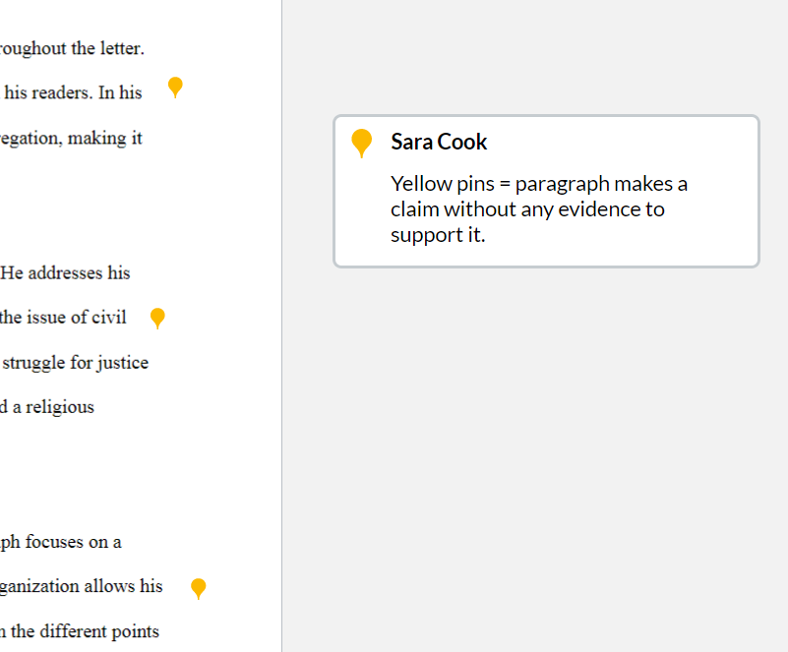
Color coding
Consider focusing your feedback, and helping the student improve, by creating a color-coding system using the annotation tools.

Slide 25
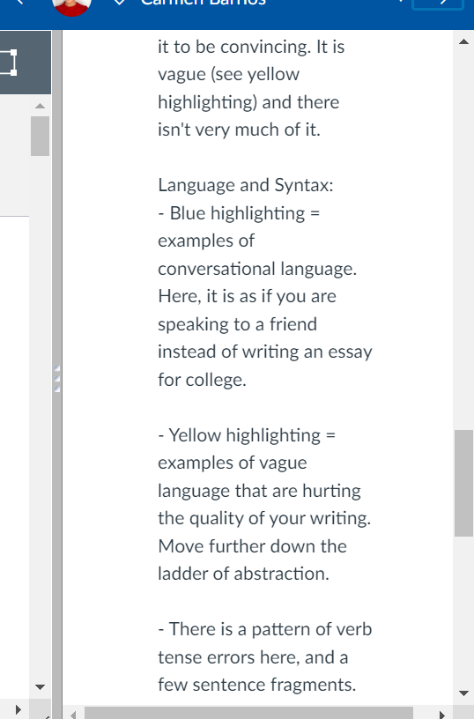
Color coding
The color-coding explanation can be written in
  1) the comment of the annotation (see previous slide), or
  2) can be written in the “Assignment Comments” for the paper, like the example here.

Slide 26
Color coding
The color-coding explanation can be written in
  1) the comment of the annotation (see previous slide), or
  2) can be written in the “Assignment Comments” for the paper, like the example here.
It is helpful to have a comment bank, or a comment frame, to copy and paste.

Slide 27
Annotation comments
If the annotation is identifying a pattern of error or weakness, write the feedback in the comment box of the first instance in the pattern.

Slide 28
Annotation comments
If the annotation is identifying a pattern of error or weakness, write the feedback in the comment box of the first instance in the pattern.
After this, mark the problem with the annotation tool, but no further comments are needed.

Slide 29
Annotation comments
If the annotation is identifying a pattern of error or weakness, write the feedback in the comment box of the first instance in the pattern.
After this, mark the problem with the annotation tool, but no further comments are needed.
Consider visual noise: in this example, the Pindrop is more effective than, for example, boxing each paragraph that lacks evidence.

Slide 30
annotation comments
Consider Providing Informational Links with In-Text Comments
You are having trouble synthesizing your sources, which has resulted in unconvincing evidence for your thesis. Please review synthesizing sources for your future essays: https://www.simplypsychology.org/synthesising.html

Slide 31
annotation comments
Consider Providing Informational Links with In-Text Comments
Course text
Style Manual
Writing Center “Homegrown Handouts”
You are having trouble synthesizing your sources, which has resulted in unconvincing evidence for your thesis. Please review synthesizing sources for your future essays: https://www.simplypsychology.org/synthesising.html

Slide 32
Create a Comment bank
Create a document with complete comments, or sentence frames, or links, to copy/paste into SpeedGrader annotation comments.

Slide 33
Create a Comment bank
Create a document with complete comments, or sentence frames, or links, to copy/paste into SpeedGrader annotation comments.
  Note: A comment bank can become unwieldy if you let it. Make sure your bank is focused on what is most important in the assignment.

Slide 34
Create a Comment bank
Create a document with complete comments, or sentence frames, or links, to copy/paste into SpeedGrader annotation comments.
  Note: A comment bank can become unwieldy if you let it. Make sure your bank is focused on what is most important in the assignment.
When possible, borrow language from the rubric.
“Pattern of error = sentence fragments. Please review this issue here, and proofread your next essay for this error. Let me know if you need help with this.”

Slide 35
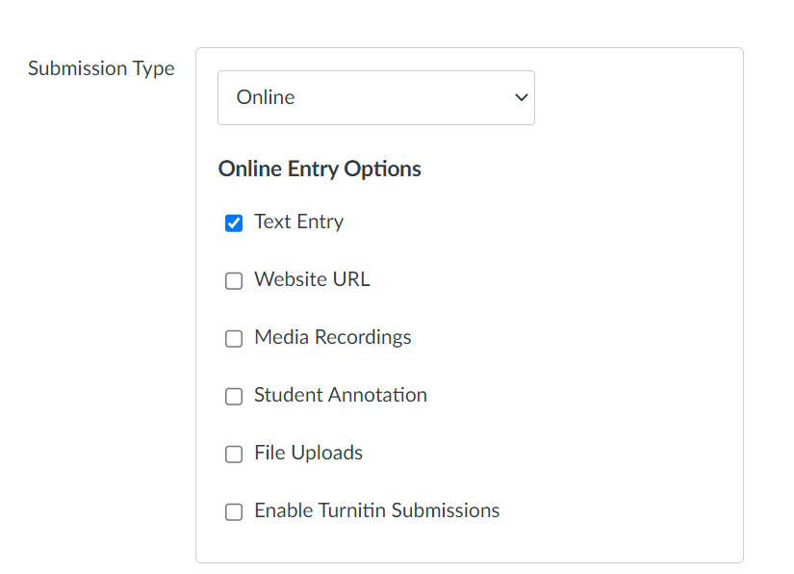
Important to note
1. The annotation tools are not available if the student submits the assignment as a “text” entry.

Slide 36

Important to note
1. The annotation tools are not available if the student submits the assignment as a “text” entry.
A comment bank is faster and easier with dual screens.

Slide 37
Culminating feedback: Assignment comments, media comments, and rubrics

Slide 38

Assignment comments
Best Practices
Begins with a strength
Has an organizational strategy
  For example, critique of content followed by critique of prose

Slide 39
Assignment comments
Best Practices
Begins with a strength
Has an organizational strategy
  For example, critique of content followed by critique of prose
MOST IMPORTANTLY:
Comments are anchored by in-text feedback: Directing students to in-text examples (by referring to page numbers or annotations) helps them translate the broader final comments into specific textual choices.
Weak analysis See Pindrop pg. 2

Slide 40
Assignment comments
Consider Using Bullet Points
Strengths: Weaknesses:
- Critical analysis - Introductory paragraph (see pg.1)
(see pgs. 2 & 4 Pindrops) - Patterns of grammatical errors:
- Academic, reliable sources verb-tense shifts (yellow, pg. 3) and
(see References) comma errors (green, pgs. 1 & 2)
(Or sometimes “The Good, The Bad, and The Ugly”)

Slide 41
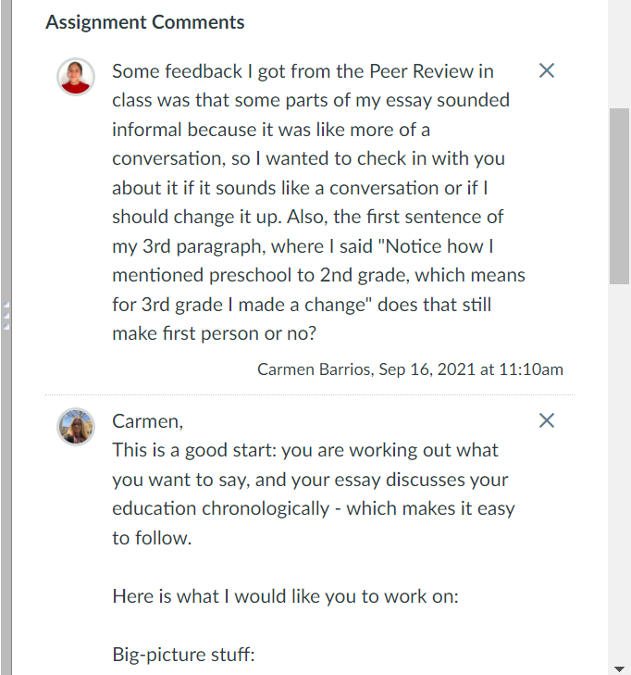
Assignment comments
Consider soliciting your students
Have your students use the assignment comments box to focus your feedback. What is something they had trouble with in the assignment? Or, what is something they worked hard on and want their success validated?

Slide 42
Assignment comments
Consider soliciting your students
Have your students use the assignment comments box to focus your feedback. What is something they had trouble with in the assignment? Or, what is something they worked hard on and want their success validated?
Student reflection = good pedagogy!
This could be a requirement included on the assignment sheet.

Slide 43
Assignment comments:
“Wise” feedback
“Breaking the Cycle of Mistrust: Wise Interventions to Provide Critical Feedback Across the Racial Divide” (Yaeger et al., 2014)
Wise Feedback:
Communicate high expectations.
  “I know it feels like this is a very challenging task I’m asking you to do - and it is.”
Explain that you believe the student can meet the expectations.
  “Your work to this point demonstrates that you already can do _____ and ___ well, so I know that you are capable of meeting the expectations for the final draft.”
Provide actionable feedback that demonstrates support.
  “The feedback I gave you on your draft is where you should start as you write the next version - I look forward to reading your final paper!”

Slide 44
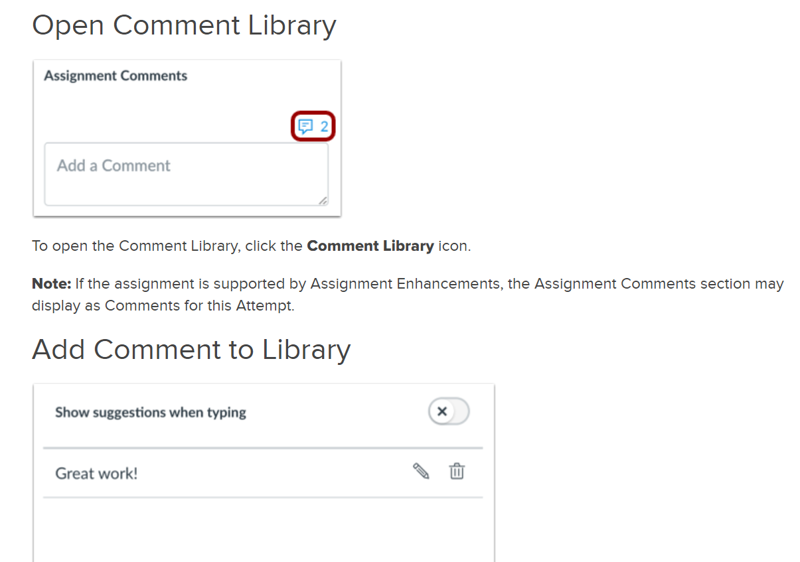
Assignment comments: comment library
Benefit: Fast and Easy.
Drawback: Only one comment from the library is allowed.
Useful to insert a comment frame, to help keep your feedback focused.
Directions here

Slide 45
Poetry break
An Error Message Just for You
You are not a Roomba
Or Rosey from The Jetsons
Or Pacman or Inspector Gadget or
A Tesla with a vanity plate
(they all have vanity plates)
You’re more Florence than Machine
More holy mother than motherboard
Here for much more than to be user friendly
So take this as a reminder – flashing on the screen in
Yellows and reds –
To power down
And let your systems process
Because even an Optimus in her prime
Such as you
Is not designed to constantly operate
At full capacity
@maryoliversdrunkcousin

Slide 46
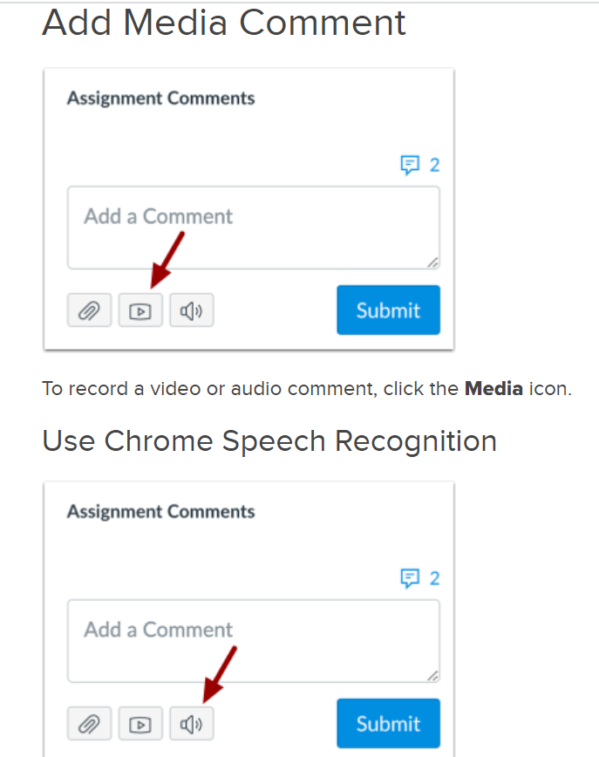
Media comments
Recording video feedback can make it more personal (which students like).

Slide 47
Media comments
Recording video feedback can make it more personal (which students like).
This method is particularly useful for commenting on really great and/or improved work (insert cute dog, dancing child, fun song…).

Slide 48
Media comments
Recording video feedback can make it more personal (which students like).
This method is particularly useful for commenting on really great and/or improved work (insert cute dog, dancing child, fun song…).
The speech-to-text function creates too much editing work.

Slide 49
Media comments
“Evaluating Written, Audio and Video Feedback in Higher Education Summative Assessment Tasks” by Josh McCarthy
Research study: McCarthy examines the use of audio, video and written feedback, to establish the advantages and disadvantages of each technique, and to “determine which model provides students with more insight into their academic performance” (McCarthy 153).
Conclusions:
  There is no ‘one size fits all’ feedback model when it comes to assessment in higher education. However, when possible, educators should match the feedback model with the genre of the assignment.
  66% of students preferred video feedback because “it provided more in-depth analysis of their academic performance in assignments, which were largely visual-based” (McCarthy 166).
    22% preferred written feedback, and 12% preferred audio feedback.

Slide 50
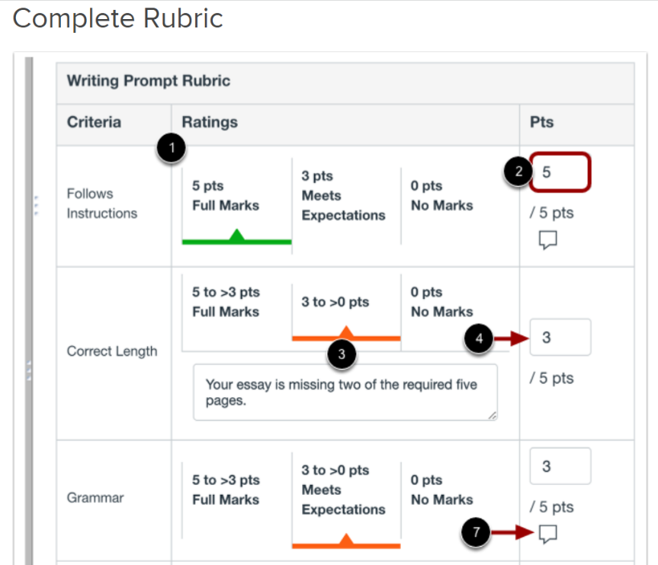
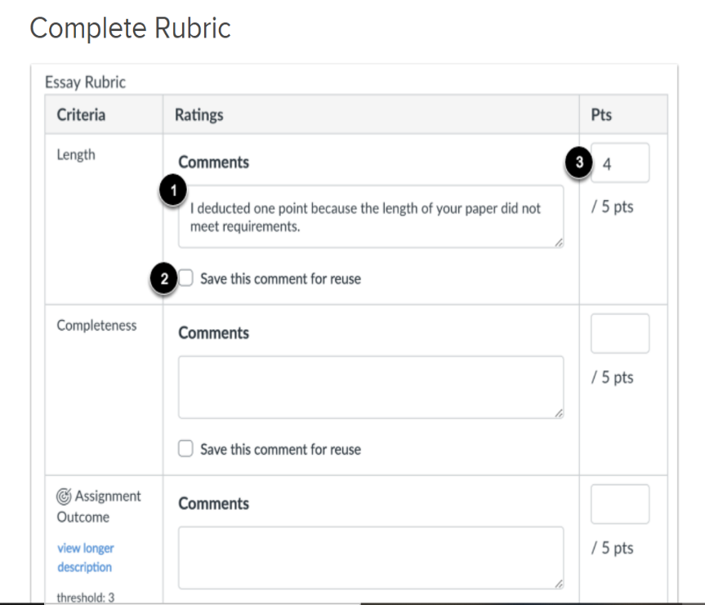
Completing the rubric
How do I use a rubric to grade submissions in Speedgrader?
How do I use free-form comments instead of ratings in a rubric on Speedgrader?

Slide 51
examples
Assignments have been submitted, you’ve reached your procrastination deadline, and you really want a margarita-reward for getting through these papers.

Slide 52
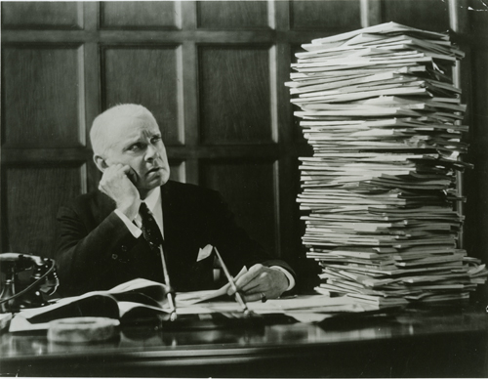
Get prepared
Review the prompt and rubric.
Think about what skills, knowledge, and learning goals students need to demonstrate in the assignment.
What is most important?

Slide 53
triage
1. The test drive
Start by reading the entire assignment WITHOUT marking anything. Sit on your hands if you have to.
Or, preview 4-5 papers and see if any patterns emerge.

Slide 54
triage
1. The test drive
Start by reading the entire assignment WITHOUT marking anything. Sit on your hands if you have to.
Or, preview 4-5 papers and see if any patterns emerge.
Giving feedback before reading the entire paper often takes more time. What happens if you’ve spent 5-10 minutes on the first 2 pages and then page 3 presents an issue that really needs your attention?

Slide 55
triage
1. The test drive
2. Pick your battles
Start by reading the entire assignment WITHOUT marking anything. Sit on your hands if you have to.
Or, preview 4-5 papers and see if any patterns emerge.
Giving feedback before reading the entire paper often takes more time. What happens if you’ve spent 5-10 minutes on the first 2 pages and then page 3 presents an issue that really needs your attention?
Given the rhetorical context and learning objectives of the assignment, what issues are most undermining the text? What issues most deserve your time and attention?

Slide 56
triage
1. The test drive
2. Pick your battles
Start by reading the entire assignment WITHOUT marking anything. Sit on your hands if you have to.
Or, preview 4-5 papers and see if any patterns emerge.
Giving feedback before reading the entire paper often takes more time. What happens if you’ve spent 5-10 minutes on the first 2 pages and then page 3 presents an issue that really needs your attention?
Given the rhetorical context and learning objectives of the assignment, what issues are most undermining the text? What issues most deserve your time and attention?
Are there patterns of error or weakness that you need to address?
Is there a paragraph or page that demonstrates the systemic issues in the paper?

Slide 57
The menu of feedback options
In-text feedback
Culminating feedback
Pindrop
Highlight
Write text
Strikethrough
Free draw
Box
All can be used with or without a comment attached.
Assignment Comments
Video
Rubric

Slide 58
The menu of feedback options
In-text feedback
Culminating feedback
Pindrop
Highlight
Write text
Strikethrough
Free draw
Box
All can be used with or without a comment attached.
Assignment Comments
Video
Rubric
Given the rhetorical context of the assignment you are providing feedback on, which menu items will work best?

Slide 59
Example 1
Rhetorical context
Essay is a first draft
The genre is a rhetorical analysis
The class is English 2 (“Critical Thinking and Writing”), which is mostly freshmen

Slide 60
Example 1
Rhetorical context
skills to demonstrate
Essay is a first draft
The genre is a rhetorical analysis
The class is English 2 (“Critical Thinking and Writing”), which is mostly freshmen
A comprehensive analysis of the rhetorical strategies in the text
Using evidence to support claims

Slide 61
Example 1
In-text feedback: what I’ve decided to use (loosely)
Green Pindrops to locate where the analysis is effective or not (if needed).
Yellow Pindrops to provide feedback on evidence (if needed).

Slide 62
Example 1
In-text feedback: what I’ve decided to use (loosely)
Green Pindrops to locate where the analysis is effective or not (if needed).
Yellow Pindrops to provide feedback on evidence (if needed).
I will use the highlighter to identify patterns of grammatical/mechanical/syntactical errors (if needed).
  One color per pattern of error
  Mark no more than 2 patterns of error

Slide 63
Example 1
In-text feedback: what I’ve decided to use (loosely)
Rationale
Green Pindrops to locate where the analysis is effective or not (if needed).
Yellow Pindrops to provide feedback on evidence (if needed).
I will use the highlighter to identify patterns of grammatical/mechanical/syntactical errors (if needed).
  One color per pattern of error
  Mark no more than 2 patterns of error
Because I am trying to help a student get to their next draft, I am going to primarily focus on global issues and the most important skills they need to demonstrate.
I am going to spend less time on local issues, as the student is not yet at the editing phase.

Slide 64
Example 1
culminating feedback: what I’ve decided to use (loosely)
A comment frame, stored in the Comment Library, that I will populate for each student.
  Example here
I will not use media comments.
I will not complete the rubric.

Slide 65
Example 1
culminating feedback: what I’ve decided to use (loosely)
Rationale
A comment frame, stored in the Comment Library, that I will populate for each student.
  Example here
I will not use media comments.
I will not complete the rubric.
I want to keep my feedback focused, because first drafts can be a time-suck due to all the problems.

Slide 66
Example 1
culminating feedback: what I’ve decided to use (loosely)
Rationale
A comment frame, stored in the Comment Library, that I will populate for each student.
  Example here
I will not use media comments.
I will not complete the rubric.
I want to keep my feedback focused, because first drafts can be a time-suck due to all the problems.
Also because these are first drafts, I want to be encouraging and remember to say positive things as well as suggestions for revision.

Slide 67
Example 1
culminating feedback: what I’ve decided to use (loosely)
Rationale
A comment frame, stored in the Comment Library, that I will populate for each student.
  Example here
I will not use media comments.
I will not complete the rubric.
I want to keep my feedback focused, because first drafts can be a time-suck due to all the problems.
Also because these are first drafts, I want to be encouraging and remember to say positive things as well as suggestions for revision.
The students are writing about writing, so my feedback will reflect that genre. Also, written feedback allows me to be more detailed, which these freshmen need.

Slide 68
Example 1
culminating feedback: what I’ve decided to use (loosely)
Rationale
A comment frame, stored in the Comment Library, that I will populate for each student.
  Example here
I will not use media comments.
I will not complete the rubric.
I want to keep my feedback focused, because first drafts can be a time-suck due to all the problems.
Also because these are first drafts, I want to be encouraging and remember to say positive things as well as suggestions for revision.
The students are writing about writing, so my feedback will reflect that genre. Also, written feedback allows me to be more detailed, which these freshmen need.
This is a formative, not summative assessment, so I don’t need to complete the rubric.

Slide 69
Example 2
Rhetorical context
skills to demonstrate
The genre is a final draft of a research paper. Students have received feedback during the drafting process.
The class is Psych 100W.
The students are upperclassmen, learning how to write in their discipline.
Find and evaluate sources
Organize information
Use information
Document information

Slide 70
Example 2
Feedback method
Video recording
  Have a brief script
No in-text feedback (generally)
Complete rubric

Slide 71
Example 2
Feedback method
Rationale
Video recording
  Have a brief script
No in-text feedback (generally)
Complete rubric
Because the students have received feedback on the iterations of their drafts, the final draft requires little but mapping it against the evaluation criteria.
The rubric is the only essential feedback method in this context, but a short video works because these are upperclassmen and this is likely their last writing course.

Slide 72
Overall…
The prep work is what saves time:
  Remind yourself what’s important in the assignment so you can focus.
  Create a comment frame and/or comment bank.
  Know which in-text tools and culminating feedback methods work for the context of the writing assignment.
Choose which methods work for you!
Don’t overdo it ☺
Have a margarita

Slide 73
Questions?

