Slide 1
How to Teach Your Students to Use Active Voice in Scholarly Research and Writing
Daniel Bohigian
Department of Kinesiology
San José State University

Slide 2
Introduction
For students enrolled in a 100w course at San José State University, the shift in emphasis and style is often a difficult adjustment to make within the constraints of a single-semester course.
For first-time authors of literature reviews, specifically, citing sources clearly and appropriately can be a challenge.

Slide 3
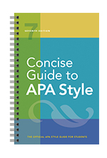
Trust in the Concise Guide (With Editorial Emphasis Applied)
Explaining the importance of understanding and adopting the active voice early in the semester can assist in a smooth and comfortable transition from casual, informal, and/or creative writing to clear, concise, and organized scholarly writing.
Using the Concise Guide to APA Style (7th Ed.) as a point of reference, the citations, examples, and commentary offered in this guide can serve students and instructors alike in facilitating clear, direct, and precise scholarly communication through a well-cited literature review.

Slide 4
General Note Prior to the 6 Rules: Beware of the “Phonebook”
As cited by Booth et al. (2016, p. 11), “Bem (1995) notes that authors of literature reviews are at risk for producing mind-numbing lists of citations and findings that resemble a phone book - impressive case, lots of numbers, but not much plot”.

Slide 5
The 6 Rules
1: Clarify the Difference Between Active and Passive Voice
2: Establish Tone
3: Apply the Active Voice Using Researcher-First Language
4: Repeatedly Citing Specific Last Names Does Not Equal Redundancy
5: Avoid Lumping Sources Together In Parenthetical Citations
6: Avoid the Terms “This”, “These”, and “Those”.

Slide 6
Rule 1: Clarify the Difference Between Active and Passive Voice
Concise Guide Chapter 2, Section 2.13, p. 41 – Active and Passive Voice
- One of the more important concepts to grasp in the Concise Guide, and an entire 100w course for that matter, is the understanding of the active voice. Adopting the active voice is essential for clear, direct, and informative scholarly writing. Rarely will the passive voice be appropriate for scholarly writing, as the subject is often confused or hidden in dense strings of data, commentary, and citation.
Active Voice: the subject of the sentence is presented first.
Example: Participants completed the survey.
Example: The patients took the medication orally.
Passive Voice: the object of the verb is presented first, followed by the subject.
Example: The survey was completed by the participants.
Example: The medication was taken orally by the patients.

Slide 7
Rule 2: Establish Tone
Concise Guide Chapter 2, Section 2.7, p. 38 – Tone
- “Although scholarly writing differs in form and content from creative or literary writing, it does not need to lack style or be dull. When writing a scholarly paper, keep in mind that scholarly prose and creative or literature writing serve different purposes.”
- A well-written, well-organized, and well-cited literature review can be aesthetically pleasing, even beautiful. An easy-to-read paper is generally a better paper. For 100w instructors teaching one or more sections of the course, reading, editing, and grading literature reviews can be a chore when citations are chaotically applied.
- Getting students on board with the style clashes presented by 100w courses can be a motivating force – a literature review does not have to be boring!

Slide 8
Rule 3: Apply the Active Voice Using Researcher-First Language
-Pair active verbs with human actors/subjects – eliminate anthropomorphic claims and avoid accident use of biased language while including specific and direct citations:
Jones (2017) concluded…
Smith and Lee’s (2014) experiment detailed…
Murray (2018) extrapolated the rate of change…
Bohigian’s (2021) findings resemble ideas previously established by Xue (2012)…
- Theories, literature reviews, experiments, books, etc. cannot “conclude” - human beings do. Attribute specific ideas and actions to specific authors and researchers throughout the semester, specifically in the literature review itself. Avoid assumptions of sex and/or gender in the process, too.

Slide 9
Rule 4: Repeatedly Citing Specific Last Names Does Not Equal Redundancy
- Avoid terms like “researchers”, “they”, “them”, and other assumed pronouns. Don’t be shy in repeating specific last names of researchers when citing sources.
- Building upon Rule 3 while borrowing from Chapter 3 of the Concise Guide detailing techniques in avoiding bias in writing, it is wise to instruct students to repeat last names of researchers instead of offering broad, vague, or simply incorrect labels for the sake of diversifying word choice. Altering paragraph structure can break up the monotony of repeated author names.
- The following slide is an example taken directly from Chapter 8 of the Concise Guide (p. 187, figure 8.3). NOTE: I am not outright seeking to undermine APA style suggestions, however, the selection can be altered to be more direct and precise. There are built in mechanisms in the Concise Guide to ensure editorial and instructor emphasis, as detailed in Chapter 1:

Slide 10
Concise Guide Figure 8.3, p. 187 Example of Repeated Narrative Citations with the Year Omitted
Koehler (2016) experimentally examined how journalistic coverage influences public perception of the level of agreement among experts. Koehler provided participants with quotations from real reviews for movies that critics either loved or loathed. He found that participants better appreciated the level of expert consensus for highly rated movies when only positive reviews were provided rather than when both positive and negative reviews were provided, even when the proportion of positive to negative reviews was indicated. These findings, in combination with similar research, demonstrate that providing evidence for both sides when most experts agree may lead to a false sense of balance (Koehler, 2016; Reginald, 2015).
*The selections in bold can (and will be) adjusted for clarity and conciseness.

Slide 11
Issues With Figure 8.3
1. Instead of “He”, simply provide the last name of the author (Koehler, in this case). Avoid assumptions.
2. Use of “these findings” can be broad and vague, as “Koehler's findings” is clear and direct. (More on the problems with “this”, “these”, and “those” will be detailed in discussing Rule 6).
3. The end-of-paragraph parenthetical citation can be clarified. The final sentence can be re-written as follows: When compared with similar research performed by Reginald (2015), Koehler’s (2016) findings demonstrate that providing evidence for both sides when most experts agree may lead to a false sense of balance.”
NOTE: Repeating last names of authors can be redundant and distracting if the selection reads like a “list” or in robotic fashion. A simple inclusion of a transitional device can break up the monotony of repeating author names via narrative citation.

Slide 12
Suggested Edit to Figure 8.3
Koehler (2016) experimentally examined how journalistic coverage influences public perception of the level of agreement among experts. Koehler provided participants with quotations from real reviews for movies that critics either loved or loathed. As a result, Koehler found that participants better appreciated the level of expert consensus for highly rated movies when only positive reviews were provided rather than when both positive and negative reviews were provided, even when the proportion of positive to negative reviews was indicated. When compared with similar research performed by Reginald (2015), Koehler’s (2016) findings demonstrate that providing evidence for both sides when most experts agree may lead to a false sense of balance.
* While subtle, including the transitional device “As a result”, along with introducing Reginald (2015) first in the comparison via a narrative citation, a “robotic” and list-like paragraph is avoided, as Koehler’s name does not appear as the first term in back-to-back sentences too often. The active voice is applied appropriately without the presence of redundant language. Also, when weaving sources, I suggest including the year of publication once again for clarity and focus.

Slide 13
Additional Student Example - Findings Section Draft (Fall 2020)
As indicated by the extensive commentary/annotations, the paragraph to the right include inconsistent and vague citations.
When weaving sources, specifically, opt to use active researcher-first language to avoid confusion. Don’t be shy in repeating last names of researchers.

Slide 14
Rule 5: Avoid Lumping Sources Together In Parenthetical Citations
- Including multiple sources in an end-of-sentence parenthetical citation can be clear, direct, and appropriate. The practice is readily observed when reading peer-reviewed published scientific literature and is a more advanced technique to be explored in future writing endeavors beyond 100w courses.
- While including dense parenthetical citations is a common practice and is encouraged for the abstract and introduction sections when summarizing dense material, for the beginning scholarly writer, amplified specificity in citation should be the goal for the findings (or results) section, where weaving of sources is essential.
- Emphasizing narrative citations utilizing the active researcher-first voice is suggested in order to allow the beginning scholarly writer to clearly lead the reader through the necessary comparisons required of a complete literature review.

Slide 15
Examples - Findings Section Draft (Fall 2020)
As previously noted, when summarizing larger portions of material for an abstract or an introduction section, end of sentence parenthetical citations can be an affective tool.
Unfortunately, the two examples offered to the right are present in the same findings section, where clear and detailed comparisons are required – the lumping of sources results in more questions than answers.

Slide 16
Rule 6: Beware of the Terms “this”, “these”, and “those”
-The active researcher-first voice is particularly important to utilize when weaving (comparing/contrasting) multiple sources in the same section of a paper. The terms “this”, “these”, and “those” are broad and can lead to confusion. The former terms indicated a space/time familiarity that is not possible to establish when reading a literature review.
-Instead, students are encouraged to offer narrative citations using the active researcher-first voice in order to facilitate clear communication. When referencing “this study” in a literature review, it is unclear if the “this” means the student’s literature review, or a citation within vicinity of the implied citation.
-The following slides detail samples and screenshots from assignments uploaded to Canvas during the Fall 2020 semester.

Slide 17
Example 1 – Single Source Citation (Annotated Bibliography)
Suggested Preliminary Edit:
Shams-Elden’s (2017) experiment detailed the effects of aquatic exercise in observation of 10 children diagnosed with autism spectrum disorder (ASD) chosen via the Al Amal Association. The children were assigned to practice the Halliwick method for ten weeks, attending the sessions three times per week and were further evaluated using the childhood autism rating scale (CARS).
Issue: Citation to Shams-Elden (2017) is delayed. Offering “This experiment” prior to specific citation is simply confusing and interrupts the flow and continuity of the paragraph immediately.

Slide 18
Example 2 – Single Source Citation (Annotated Bibliography)
Issues: Another vague inclusion of the term “this”. The term “they” shortly follows, resulting in a robotic and list-like reading for the remaineder of the paragraph.
Suggested Preliminary Edit:
Lewis et al. (2011) explored how obese individuals apply information from the internet in seeking information to improve their daily lives. Using in-depth telephone interviews, Lewis et al. surveyed 142 individuals from an Australian community with a BMI greater or equal to 30, finding individuals diagnosed with stigmatized health issues commonly resort to the internet for information to improve health and well-being. In addition, Lewis et al. found online communication physicians was a common occurrence.

Slide 19
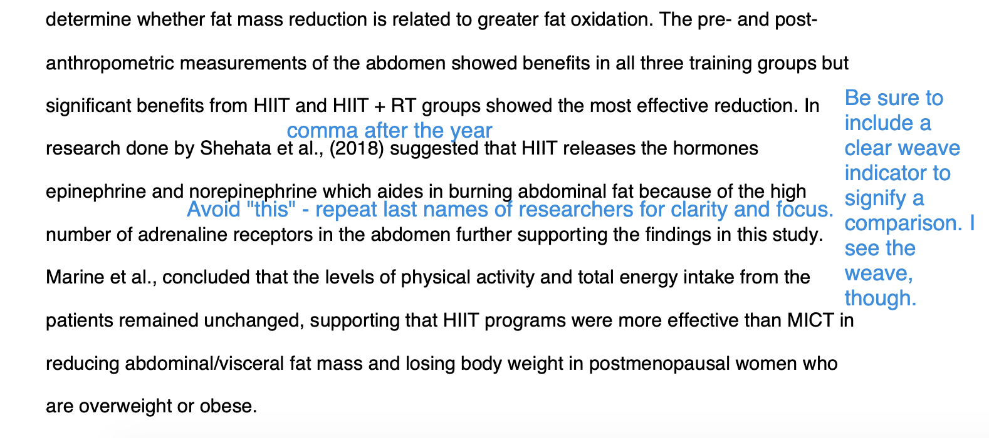
Example 3 – Two Source Citation (Annotated Bibliography)

Slide 20
Example 4 – Multiple Source Citation (Introduction Section Draft)

Slide 21
Example 5 – Multiple Source Citation (Findings Section Rough Draft)

Slide 22
Altering the Concise Guide Chapter Flow
With the 6 Rules detailed, presenting the active voice early in the semester will require altering the default chapter flow. Since citation-heavy assignments like the annotated bibliography are most likely due early in the semester, emphasizing the active voice sooner rather than later is suggested.
NOTE: Students will often struggle in comprehension of numbers and statistics (chapter 6) and tables and figures (chapter 7) while conducting research in preparation for major writing assignments. As 100w instructors, we must choose our battles due to the density of course material. Refer to APA style guideline handouts as supplements until able to detail in lecture.
https://apastyle.apa.org/instructional-aids

Slide 23
Start with Chapter 1 (Shocking Development, I know…)
Chapter 1, “Student Paper Types, Elements, and Format” offer essential descriptions what is involved writing in a literature review, what purpose a literature review serves, and why a literature review is important.
Specifically, detail section 1.2, Student Essays – explain the presence of elements from expository essays and persuasive essays. The annotated bibliography is outlined, as well. Setting purpose and expectations ASAP is essential.

Slide 24
Proceed With Chapters 2 and 3
Chapter 2, “Writing Style and Grammar” details important concepts such as continuity and flow, conciseness and clarity, tone, anthropomorphism, and verb tense – active voice vs. passive voice.
Chapter 3, ”Bias Free Language Guidelines” will further solidify the importance of the active voice and the subsequent avoiding of biased language.

Slide 25
Jump to Chapter 8
Chapter 8, “Works Credited in Text”, should follow. If following the Concise Guide in default order, key details regarding in-text citation will be delayed. Allow students the opportunity to conceptualize and gather experience with in-text citation sooner rather than later to enable successful comprehension of scholarly peer-reviewed literature.

Slide 26
Continue to Chapters 9 and 10
Chapter 9, “Reference List” and Chapter 10, “Reference Examples” should follow the discussion of Chapter 8. Assuming a detailed annotated bibliography is required prior to the final literature review assignment in your course, appropriately formatting references and offering well-cited, clear, and concise annotations enables smooth coursework and material flow.
NOTE: Due to time constraints, I suggest offering a forecasting statement regarding legal guidelines presented late in chapter 10.

Slide 27
Follow Up With Chapters 4, 5, 6, and 7
In jest, taking students ”back to 3rd grade” in reviewing punctuation (chapter 4) and spelling and grammar (chapter 5) should not be overlooked. Assume students can use some reminders – you may need some, too!
Per instructor discretion, you may opt to focus on newer information regarding numbers and statistics (chapter 6) and tables and figures (chapter 7).

Slide 28
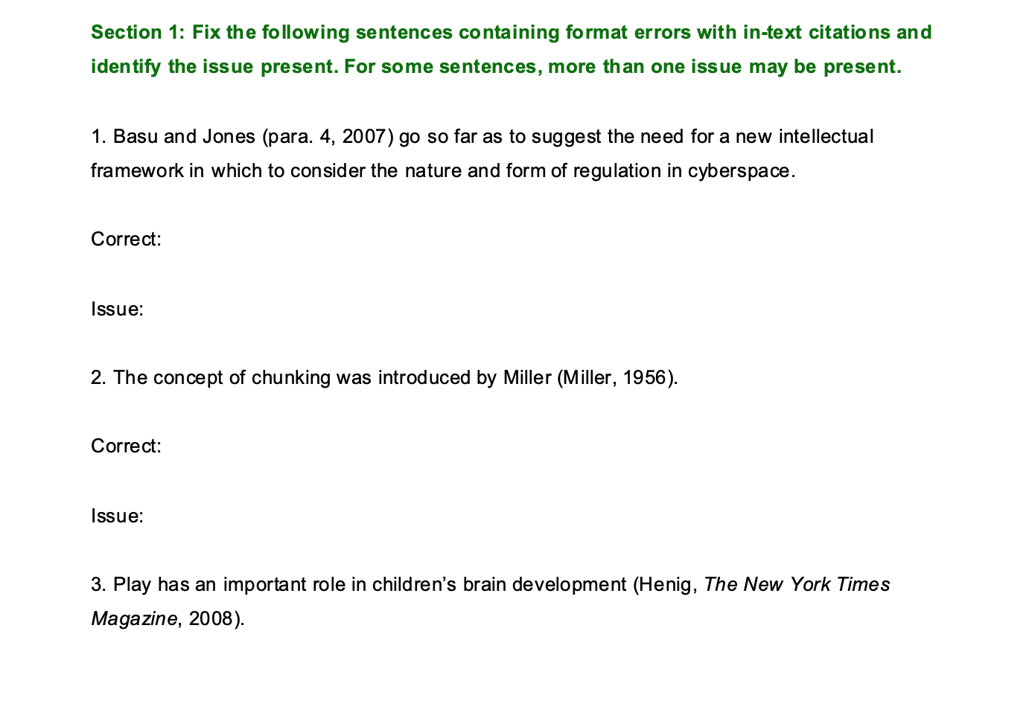
Further Suggestions
Establish in-class group exercises where students are encouraged to apply concepts and techniques outlined by the Concise Guide. The example screen left, while incomplete and lacking additional detail and context, is a quick view of a group exercise you may wish to offer.
If interested, feel free to contact me at Daniel.bohigian@sjsu.edu for further examples and assignment ideas. Thank you!

Slide 29
References
American Psychological Association. (2020). Concise guide to APA style (7th ed.). https://doi.org/10.1037/0000173-000
Booth, A., Sutton, A., & Papaioannou, D. (2016). Systematic approaches to a successful literature review.

